Slide 1
Neural Networks: Part 3
BIO 4990/6990
February 26, 2024
Dr. Megan Smith
Mississippi State University

Slide 2
Outline
Reviewing Intuition
Backpropagation
Examples

Slide 3
Outline
Reviewing Intuition
Backpropagation
Examples

Slide 4
Neural Networks: An Example
Neural Networks can fit complex non-linear models!
Imagine we tested a drug meant to treat an illness.
We gave the drug to three different groups in low, medium and high doses.
Goal: predict which dosages are effective.
Yes (1)
Efficacy
No (0)
Dosage

Slide 5
Drug Dosage Example
Imagine we have already fit this neural network (i.e., estimated the weights and biases.)

Slide 6







Drug Dosage Example
Imagine we have already fit this neural network (i.e., estimated the weights and biases.)
$$+2.14$$
$$×−34.4$$
$$×−1.30$$
Dosage
$$×−2.52$$
sum + -0.58
efficacy
$$×2.28$$
$$+1.29$$

Slide 7
Drug Dosage Example
Imagine we have already fit this neural network (i.e., estimated the weights and biases.)
$$+2.14$$
$$×−34.4$$
$$×−1.30$$
Dosage
$$×−2.52$$
sum + -0.58
efficacy
$$×2.28$$
$$+1.29$$

Slide 8
Drug Dosage Example
Imagine we have already fit this neural network (i.e., estimated the weights and biases.)
$$+2.14$$
$$×−34.4$$
$$×−1.30$$
Dosage
$$×−2.52$$
sum + -0.58
efficacy
$$×2.28$$
$$+1.29$$

Slide 9
Drug Dosage Example
Imagine we have already fit this neural network (i.e., estimated the weights and biases.)
$$+2.14$$
$$×−34.4$$
$$×−1.30$$
Dosage
$$×−2.52$$
sum + -0.58
efficacy
$$×2.28$$
$$+1.29$$

Slide 10
Drug Dosage Example
Imagine we have already fit this neural network (i.e., estimated the weights and biases.)
$$+2.14$$
$$×−34.4$$
$$×−1.30$$
Dosage
$$×−2.52$$
sum + -0.58
efficacy
$$×2.28$$
$$+1.29$$

Slide 11
Drug Dosage Example
Imagine we have already fit this neural network (i.e., estimated the weights and biases.)
$$+2.14$$
$$×−34.4$$
$$×−1.30$$
Dosage
$$×−2.52$$
sum + -0.58
efficacy
$$×2.28$$
$$+1.29$$

Slide 12
Drug Dosage Example
Imagine we have already fit this neural network (i.e., estimated the weights and biases.)
$$+2.14$$
$$×−34.4$$
$$×−1.30$$
Dosage
$$×−2.52$$
sum + -0.58
efficacy
$$×2.28$$
$$+1.29$$

Slide 13
Drug Dosage Example
Imagine we have already fit this neural network (i.e., estimated the weights and biases.)
$$+2.14$$
$$×−34.4$$
$$×−1.30$$
Dosage
$$×−2.52$$
sum + -0.58
efficacy
$$×2.28$$
$$+1.29$$

Slide 14
Drug Dosage Example
Imagine we have already fit this neural network (i.e., estimated the weights and biases.)
$$+2.14$$
$$×−34.4$$
$$×−1.30$$
Dosage
$$×−2.52$$
sum + -0.58
efficacy
$$×2.28$$
$$+1.29$$

Slide 15
Drug Dosage Example
Imagine we have already fit this neural network (i.e., estimated the weights and biases.)
$$+2.14$$
$$×−34.4$$
$$×−1.30$$
Dosage
$$×−2.52$$
sum + -0.58
efficacy
$$×2.28$$
$$+1.29$$

Slide 16
Drug Dosage Example
Imagine we have already fit this neural network (i.e., estimated the weights and biases.)
$$+2.14$$
$$×−34.4$$
$$×−1.30$$
Dosage
$$×−2.52$$
sum + -0.58
efficacy
$$×2.28$$
$$+1.29$$

Slide 17
Drug Dosage Example
Imagine we have already fit this neural network (i.e., estimated the weights and biases.)
b₁
w₁
$$+2.14$$
w₃
$$×−34.4$$
$$×−1.30$$
Dosage
w₂
b₃
$$×−2.52$$
w₄
sum + -0.58
efficacy
b₂
$$×2.28$$
$$+1.29$$

Slide 18
Outline
Reviewing Intuition
Backpropagation
Examples

Slide 19
Backpropagation
In reality, we do not know the values of the parameters.
We need to estimate them by fitting the network to our training data.
To do this, we use backpropogation.
Backpropagation is used to estimates the weights and biases of a neural network.
It does this by using gradient descent to optimize parameters.
Backpropagation starts with the last parameter and works its way backwards to estimate the other parameters.

Slide 20
Drug Dosage Example
Imagine we know all parameters except b₃.
b₁
w₁
$$+2.14$$
w₃
$$×−34.4$$
$$×−1.30$$
Dosage
w₂
b₃
$$×−2.52$$
w₄
sum + ???
efficacy
b₂
$$×2.28$$
$$+1.29$$

Slide 21
Drug Dosage Example
Imagine we know all parameters except b₃.
b₁
w₁
$$+2.14$$
w₃
$$×−34.4$$
$$×−1.30$$
Dosage
w₂
b₃
$$×−2.52$$
w₄
sum + ???
efficacy
b₂
$$×2.28$$
$$+1.29$$

Slide 22
Drug Dosage Example
Imagine we know all parameters except b₃.
b₁
w₁
$$+2.14$$
w₃
$$×−34.4$$
$$×−1.30$$
Dosage
w₂
b₃
$$×−2.52$$
w₄
sum + ???
efficacy
b₂
$$×2.28$$
$$+1.29$$

Slide 23
Drug Dosage Example
Imagine we know all parameters except b₃.
b₁
w₁
$$+2.14$$
w₃
$$×−34.4$$
$$×−1.30$$
Dosage
w₂
b₃
$$×−2.52$$
w₄
sum + ???
efficacy
b₂
$$×2.28$$
$$+1.29$$

Slide 24
Drug Dosage Example
Imagine we know all parameters except b₃.
b₁
w₁
$$+2.14$$
w₃
$$×−34.4$$
$$×−1.30$$
Dosage
w₂
b₃
$$×−2.52$$
w₄
sum + ???
efficacy
b₂
$$×2.28$$
$$+1.29$$

Slide 25
Drug Dosage Example
Imagine we know all parameters except b₃.
b₁
w₁
$$+2.14$$
w₃
$$×−34.4$$
$$×−1.30$$
Dosage
w₂
b₃
$$×−2.52$$
w₄
sum + ???
efficacy
b₂
$$×2.28$$
$$+1.29$$

Slide 26
Drug Dosage Example
Imagine we know all parameters except b₃.
b₁
w₁
$$+2.14$$
w₃
$$×−34.4$$
$$×−1.30$$
Dosage
w₂
b₃
$$×−2.52$$
w₄
sum + ???
efficacy
b₂
$$×2.28$$
$$+1.29$$

Slide 27
Drug Dosage Example
How do we find a good value for b₃?
b₁
w₁
$$+2.14$$
w₃
$$×−34.4$$
$$×−1.30$$
Dosage
w₂
b₃
$$×−2.52$$
w₄
sum + ???
efficacy
b₂
$$×2.28$$
$$+1.29$$

Slide 28
Drug Dosage Example
Initialize b₃ to some value (usually zero)
How do we find a good value for b₃?
b₁
w₁
$$+2.14$$
w₃
$$×−34.4$$
$$×−1.30$$
Dosage
w₂
b₃
$$×−2.52$$
w₄
sum + ???
efficacy
b₂
$$×2.28$$
$$+1.29$$

Slide 29

Drug Dosage Example
Initialize b₃ to some value (usually zero)
Calculate the cost function (SSE)
How do we find a good value for b₃?
b₁
w₁
$$+2.14$$
w₃
$$×−34.4$$
$$×−1.30$$
Dosage
w₂
b₃
$$×−2.52$$
w₄
sum + ???
efficacy
b₂
$$×2.28$$
$$+1.29$$
SSE
b₃

Slide 30


Drug Dosage Example
Initialize b₃ to some value (usually zero)
Calculate the cost function (SSE)
Propose new values of b₃ using gradient descent.
How do we find a good value for b₃?
$$b_{3}≔b_{3}−α\frac{d}{db_{3}}J(w,b)$$
b₁
w₁
$$+2.14$$
w₃
$$×−34.4$$
$$×−1.30$$
Dosage
w₂
b₃
$$×−2.52$$
w₄
sum + ???
efficacy
b₂
$$×2.28$$
$$+1.29$$
SSE
b₃

Slide 31
Drug Dosage Example
Initialize b₃ to some value (usually zero)
Calculate the cost function (SSE)
Propose new values of b₃ using gradient descent.
How do we find a good value for b₃?
$$b_{3}≔b_{3}−α\frac{d}{db_{3}}J(w,b)$$
b₁
w₁
$$+2.14$$
w₃
$$×−34.4$$
$$×−1.30$$
Dosage
w₂
b₃
$$×−2.52$$
w₄
sum + ???
efficacy
b₂
$$×2.28$$
$$+1.29$$
SSE
b₃

Slide 32






Drug Dosage Example
Initialize all parameters to random values.
Propose new values of all parameters using gradient descent!
Repeat until convergence!
We can estimate all parameters in this same way
b₁
w₁
$+$???
w₃
$$× \text{???}$$
$×$ ???
Dosage
w₂
b₃
$×$ ???
w₄
sum + ???
efficacy
b₂
$×$ ???
$+$ ???
SSE
b₃

Slide 33
Backpropagation
Backpropagation is used to estimates the weights and biases of a neural network.
It does this by using gradient descent to optimize parameters.
Backpropagation starts with the last parameter and works its way backwards to estimate the other parameters.

Slide 34
Outline
Reviewing Intuition
Backpropagation
Examples

Slide 35

Estimating population genetic parameters
Goal: detect selection and infer population sizes.
Training data: simulated with and without selection and with different population sizes.
Features: summary statistics calculated from genetic data (345)
Labels: selection (no selection, selective sweep, balancing selection) and population sizes.

Slide 36
Estimating population genetic parameters
Input: 345 statistics
Hidden layers: 3 (25, 25, and 10 neurons)
Hidden layer activation functions: sigmoid
Outputs: 3 continuous, plus categorical with 4 potential outcomes

Slide 37
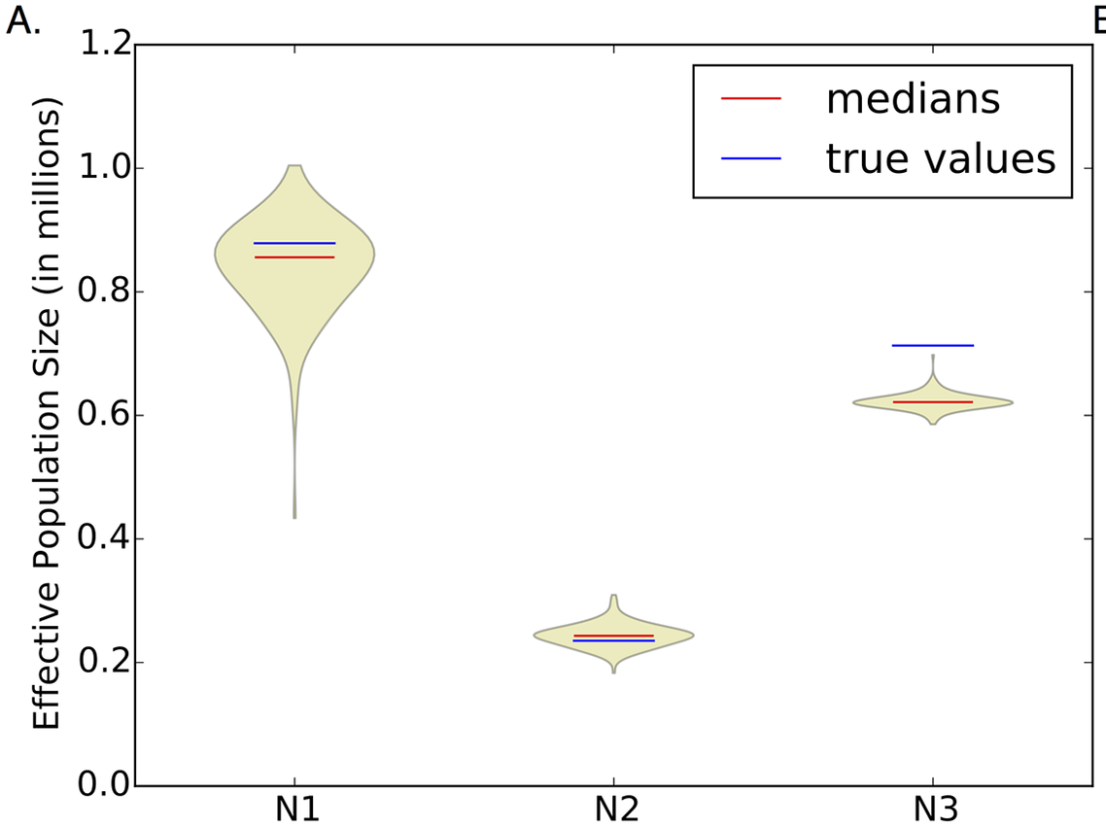
Estimating population genetic parameters
Notes:
Parameters hidden 1: 345*25+25
Parameters hidden 2: 25*25+25
Parameters hidden 3: 25*10+10
Parameters linear: 10*3+3
Parameters softmax: 10*4+4

Slide 38
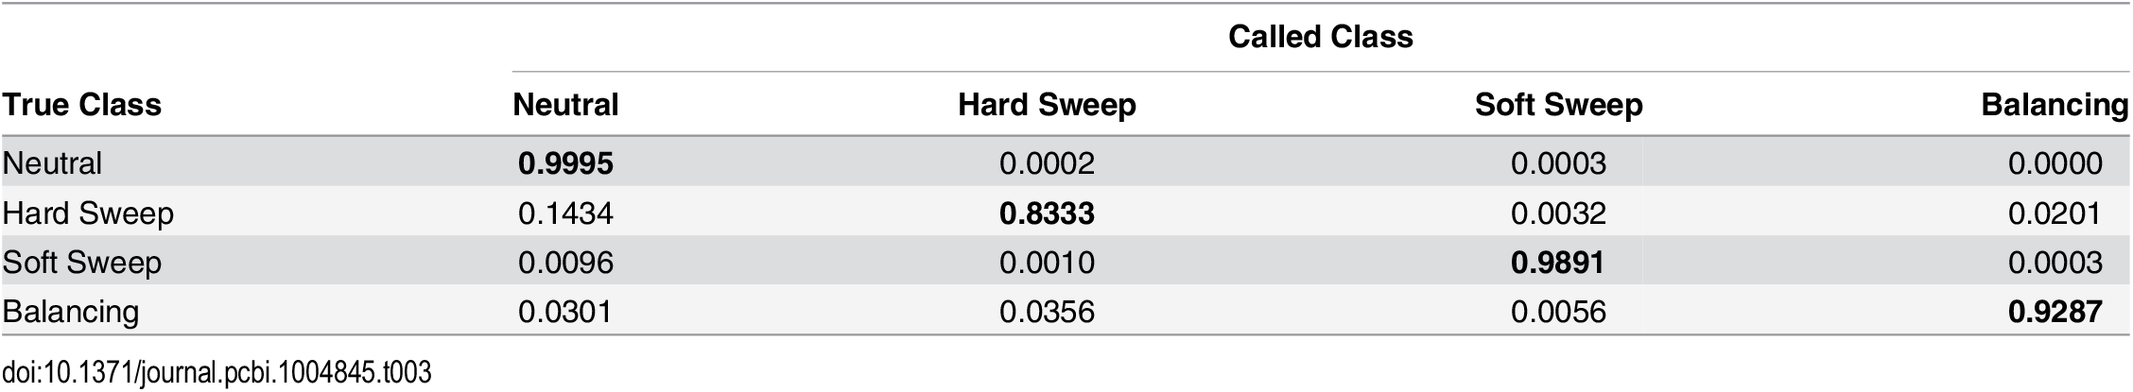
Estimating population genetic parameters
Notes:
Parameters hidden 1: 345*25+25
Parameters hidden 2: 25*25+25
Parameters hidden 3: 25*10+10
Parameters linear: 10*3+3
Parameters softmax: 10*4+4

Slide 39
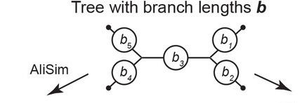
Estimating branch lengths
Goal: infer branch lengths on a phylogenetic tree.
Training data: simulated on the tree with different branch lengths
Features: summary statistics calculated from genetic data
Labels: branch lengths
Suvorov and Schrider, 2023

Slide 40
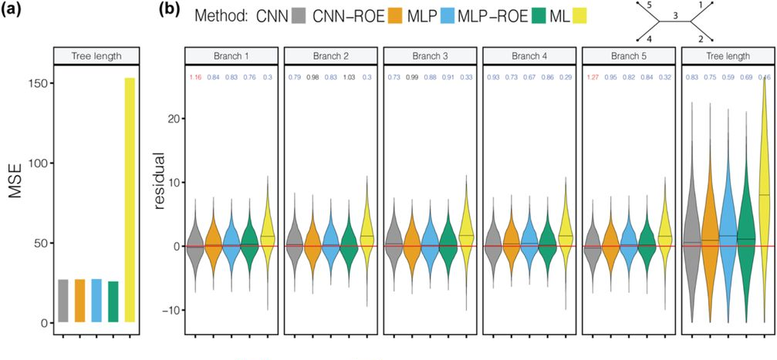
Estimating branch lengths
Suvorov and Schrider, 2023

Slide 41

Inferring epidemiological dynamics
Goal: infer R₀, an estimate of how contagious an infectious disease is (how many people will become infected from one infected person, on average) and the infectious period (1/ƛ).
Training data: phylogenies simulated under different values of R₀
Features: summary statistics calculated from trees
Labels: R₀

Slide 42
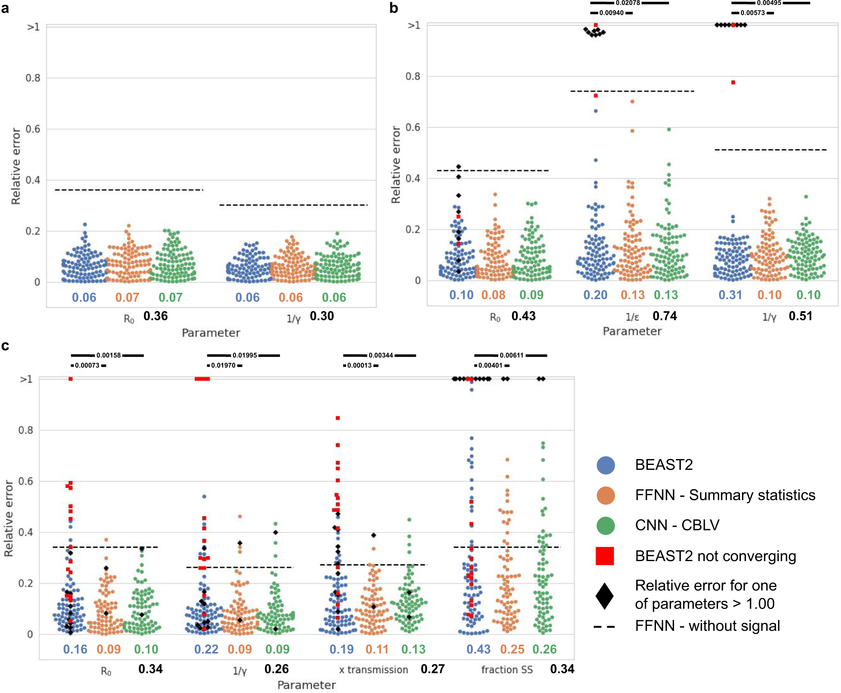
Inferring epidemiological dynamics

Slide 43
Outline
Reviewing Intuition
Backpropagation
Examples

