Slide 1
RAG for Demand forecasting
The Demand Forecasting Manager continuously analyzes sales patterns and market signals to generate accurate demand predictions using RAG to retrieve relevant market research, industry reports, and economic analysis from multiple sources.

Slide 2
Introduction & motivation
RAG is a framework for improving model performance by augmenting prompts with relevant data outside the foundational model, grounding LLM responses on real, trustworthy information. Users can easily “drag and drop” their company documents into a vector database, enabling a LLM to answer questions about these documents efficiently.
According to the 2025 Retool Report, an impressive 36.2% of enterprise LLM use cases now employ RAG technology. RAG brings the power of LLMs to structured and unstructured data, making enterprise information retrieval more effective and efficient than ever.

Slide 3
Background & prerequisites
An Azure ai search resource
Databricks workspace
Open AI model(gpt 4.0)

Slide 4
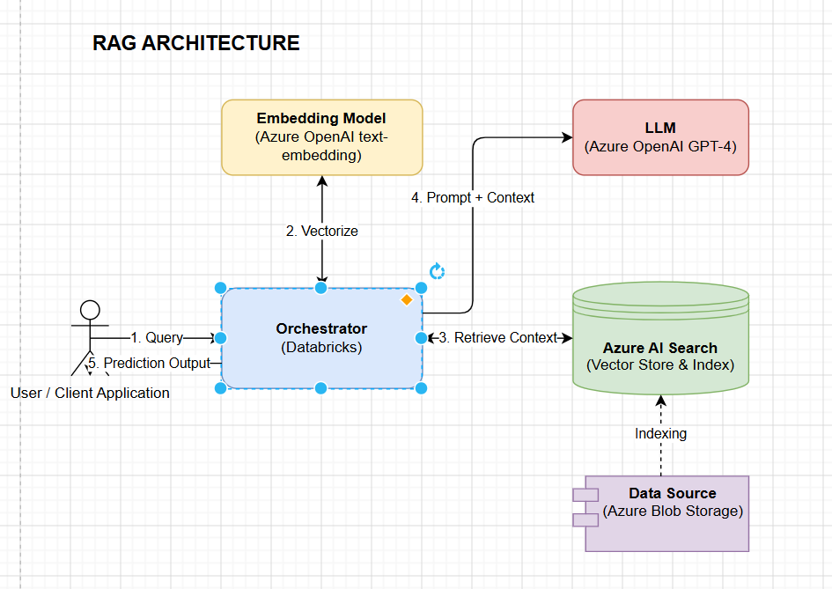
Core technical content -Architecture diagram

Slide 5
Comparison with existing Approaches
RAG's hybrid structure allows it to address the challenges of knowledge obsolescence and factual grounding, making it a promising approach for future AI systems

Slide 6
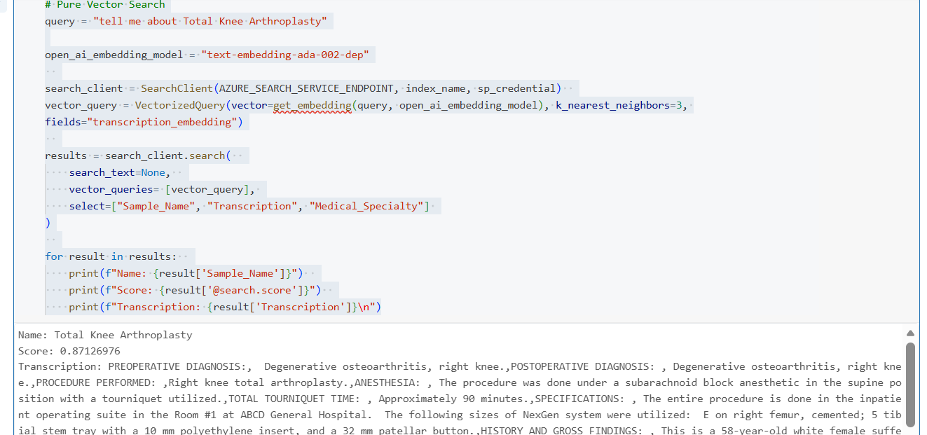
Results

Slide 7
Open problems & future directions
Find accuracy and legitimacy in information

