Slide 1
Cypress
JavaScript based automation tool

Slide 2
Cypress
It is a next generation front-end testing tool built for modern web application
Cypress uses JavaScript for writing test scripts
Cypress is built using node js and it comes packaged with node package manager
The coding is done using java script but 90% of the coding is done using cypress inbuilt methods
It is easier and faster to develop the test scripts
Cypress makes tests easy and simple compared to other tools
Cypress default framework is mocha

Slide 3
Cypress features
Time travel
Real time reloads
Spies, Stubs and clocks
Consistent results
Debug ability
Automatic waiting
Network traffic control
Screenshots and videos

Slide 4
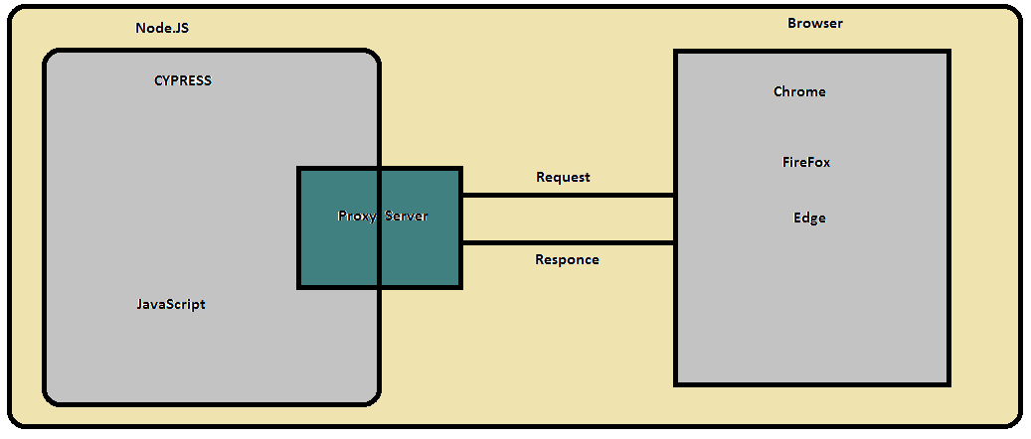
Cypress Architecture

Slide 5
Advantages of cypress
Cypress take screenshot and video recording for each and every line of the code
In cypress there is no need to add the explicit or implicit wait
It provides the automatic scrolling options
As the programmer writes commands, Cypress executes them in real-time, providing visual feedback as they run.

Slide 6
Limitations
Cannot handle multiple windows
Limitation of frame handling
Tough to read data from external file
It only support mocha framework
It doesn't support parallel execution
It doesn't handle multiple windows/ tabs

Slide 7
Thank you

