Slide 1
Spark Assignment
Karan Kant (kk4ze)

Slide 2
Motivation
Everybody assumes that a higher writing score on the SAT correlates to a higher reading score. I wanted to test this hypothesis and confirm my initial thoughts.
My model confirms a high correlation between SAT reading and writing scores. A student with a high reading score on average gets a high writing score as well.

Slide 3
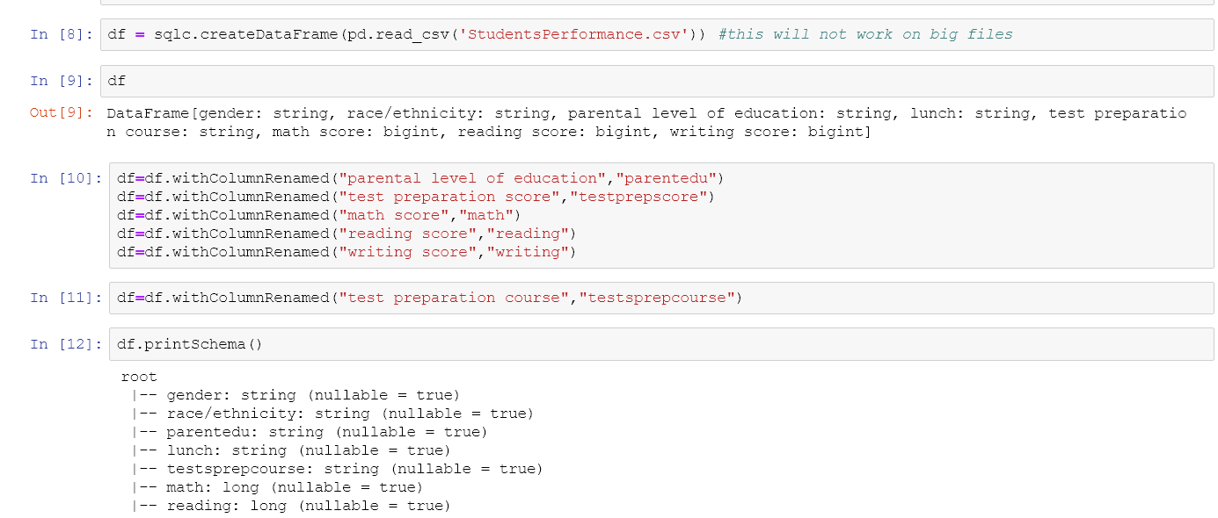
Code
The dataset was uploaded to sagemaker. Columns needed to be renamed in order to process the data through spark dataframes.

Slide 4
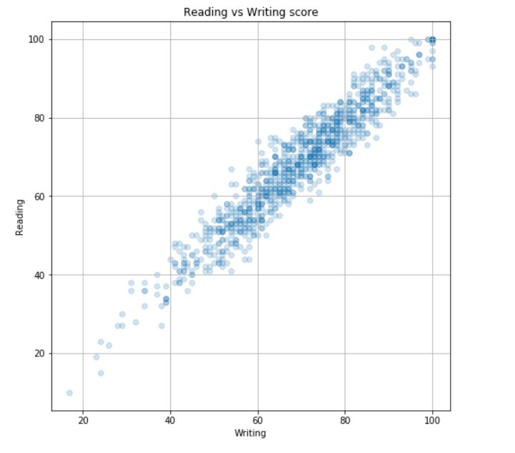
Visualization
High correlation is observed between reading and writing scores.

