Slide 1
Motivation: To understand the implementation of various Machine learning algorithms, calculation of their evaluation metrics, and in general data manipulation in Spark.

Slide 2
Code Snippet: 1. Analyzing the objective history of iterations: trainingSummary = lgModel.summary objectiveHistory = trainingSummary.objectiveHistory 2. Analyzing the model results: print("Coefficients: \n" + str(lgModel.coefficientMatrix)) print("Intercept: " + str(lgModel.interceptVector))

Slide 3
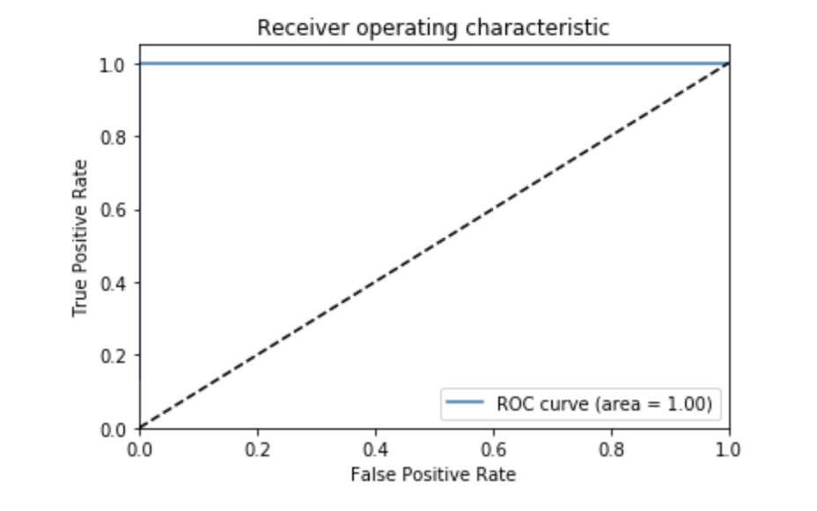
Visualization: Below is the ROC curve for Logistic regression, and random forest: Due to the limited size of the data, both algorithms fit the data perfectly and have AUC=1.0.

