Slide 1
DMA Mall chain network infrastructure design
Smith Dabreo 8382
Shaleel Rodrigues 8423
Valiant Rodrigues 8424

Slide 2
Floor Wise Plan
Total Five Floor Wise Plans:
Customer Service
Retail Services Department
Regional Demand Supply
Finance and Accounting
IT Division

Slide 3
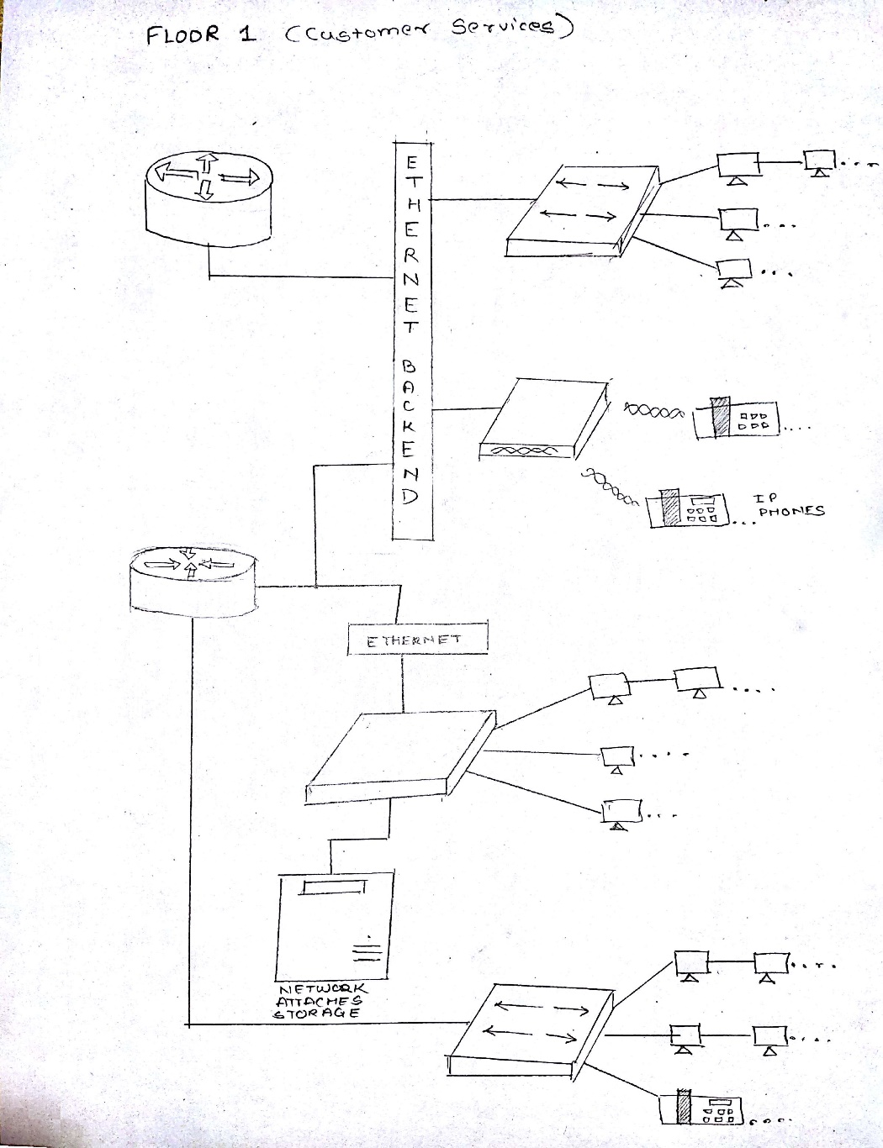
Customer Service
Customer Service Network Design

Slide 4
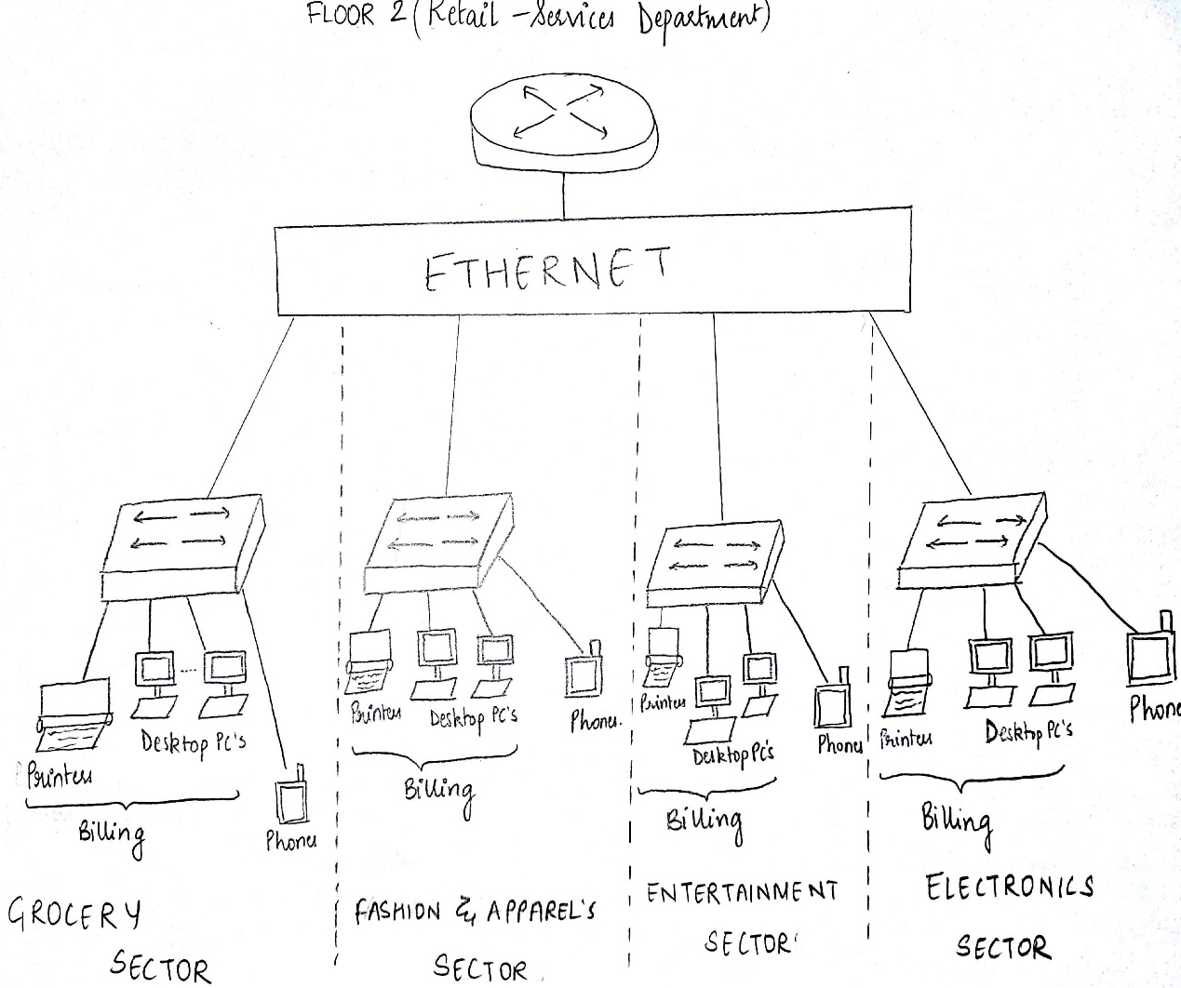
2. Retail Services Department
Retail-Services Department Network Design

Slide 5
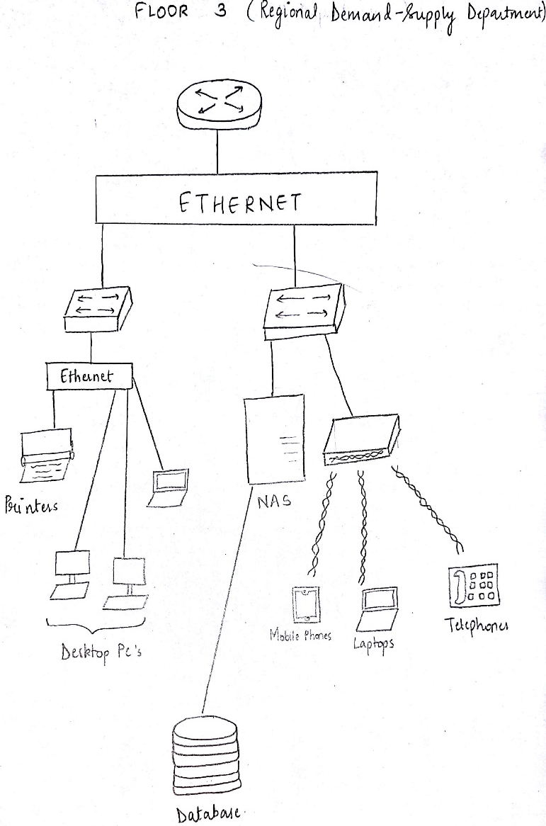
3. Regional Demand Supply
Demand Supply Department Network Design

Slide 6
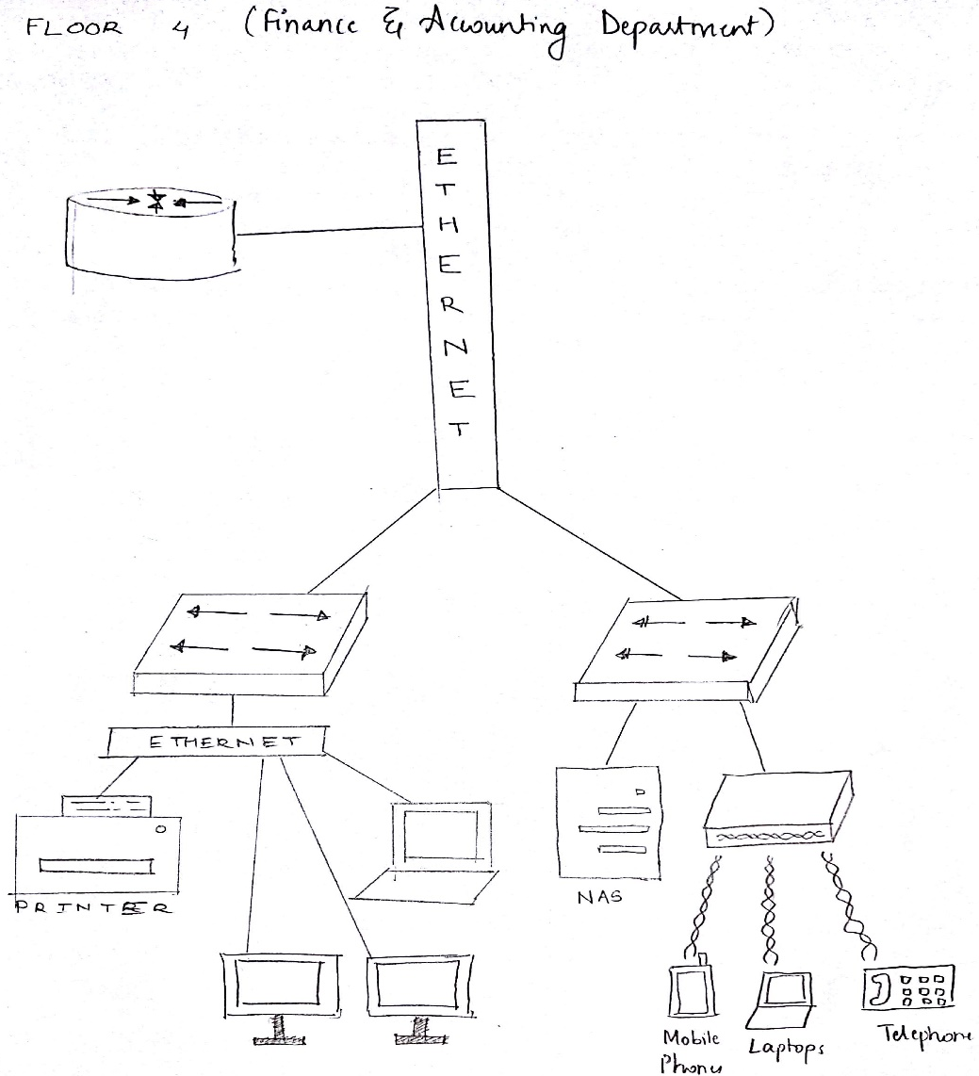
4. Finance and Accounting
Finance And Administration Network Design

Slide 7
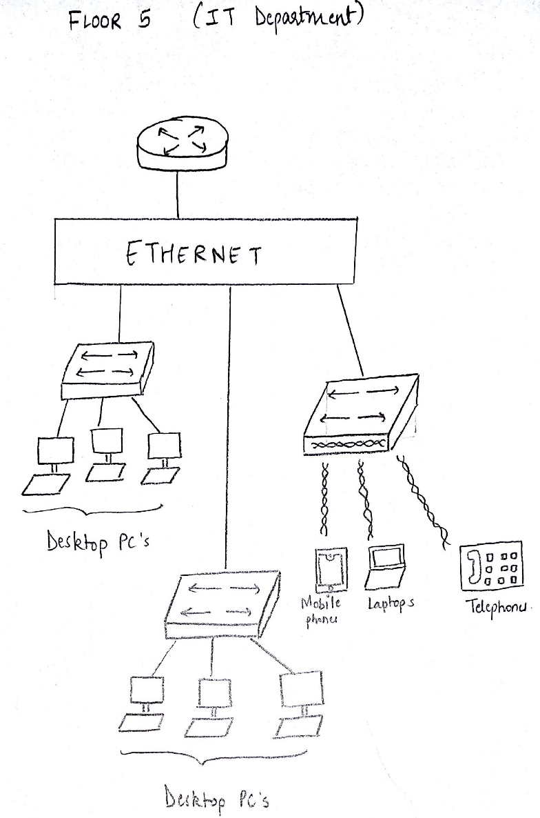
5. IT Division
IT Division Network Design

Slide 8
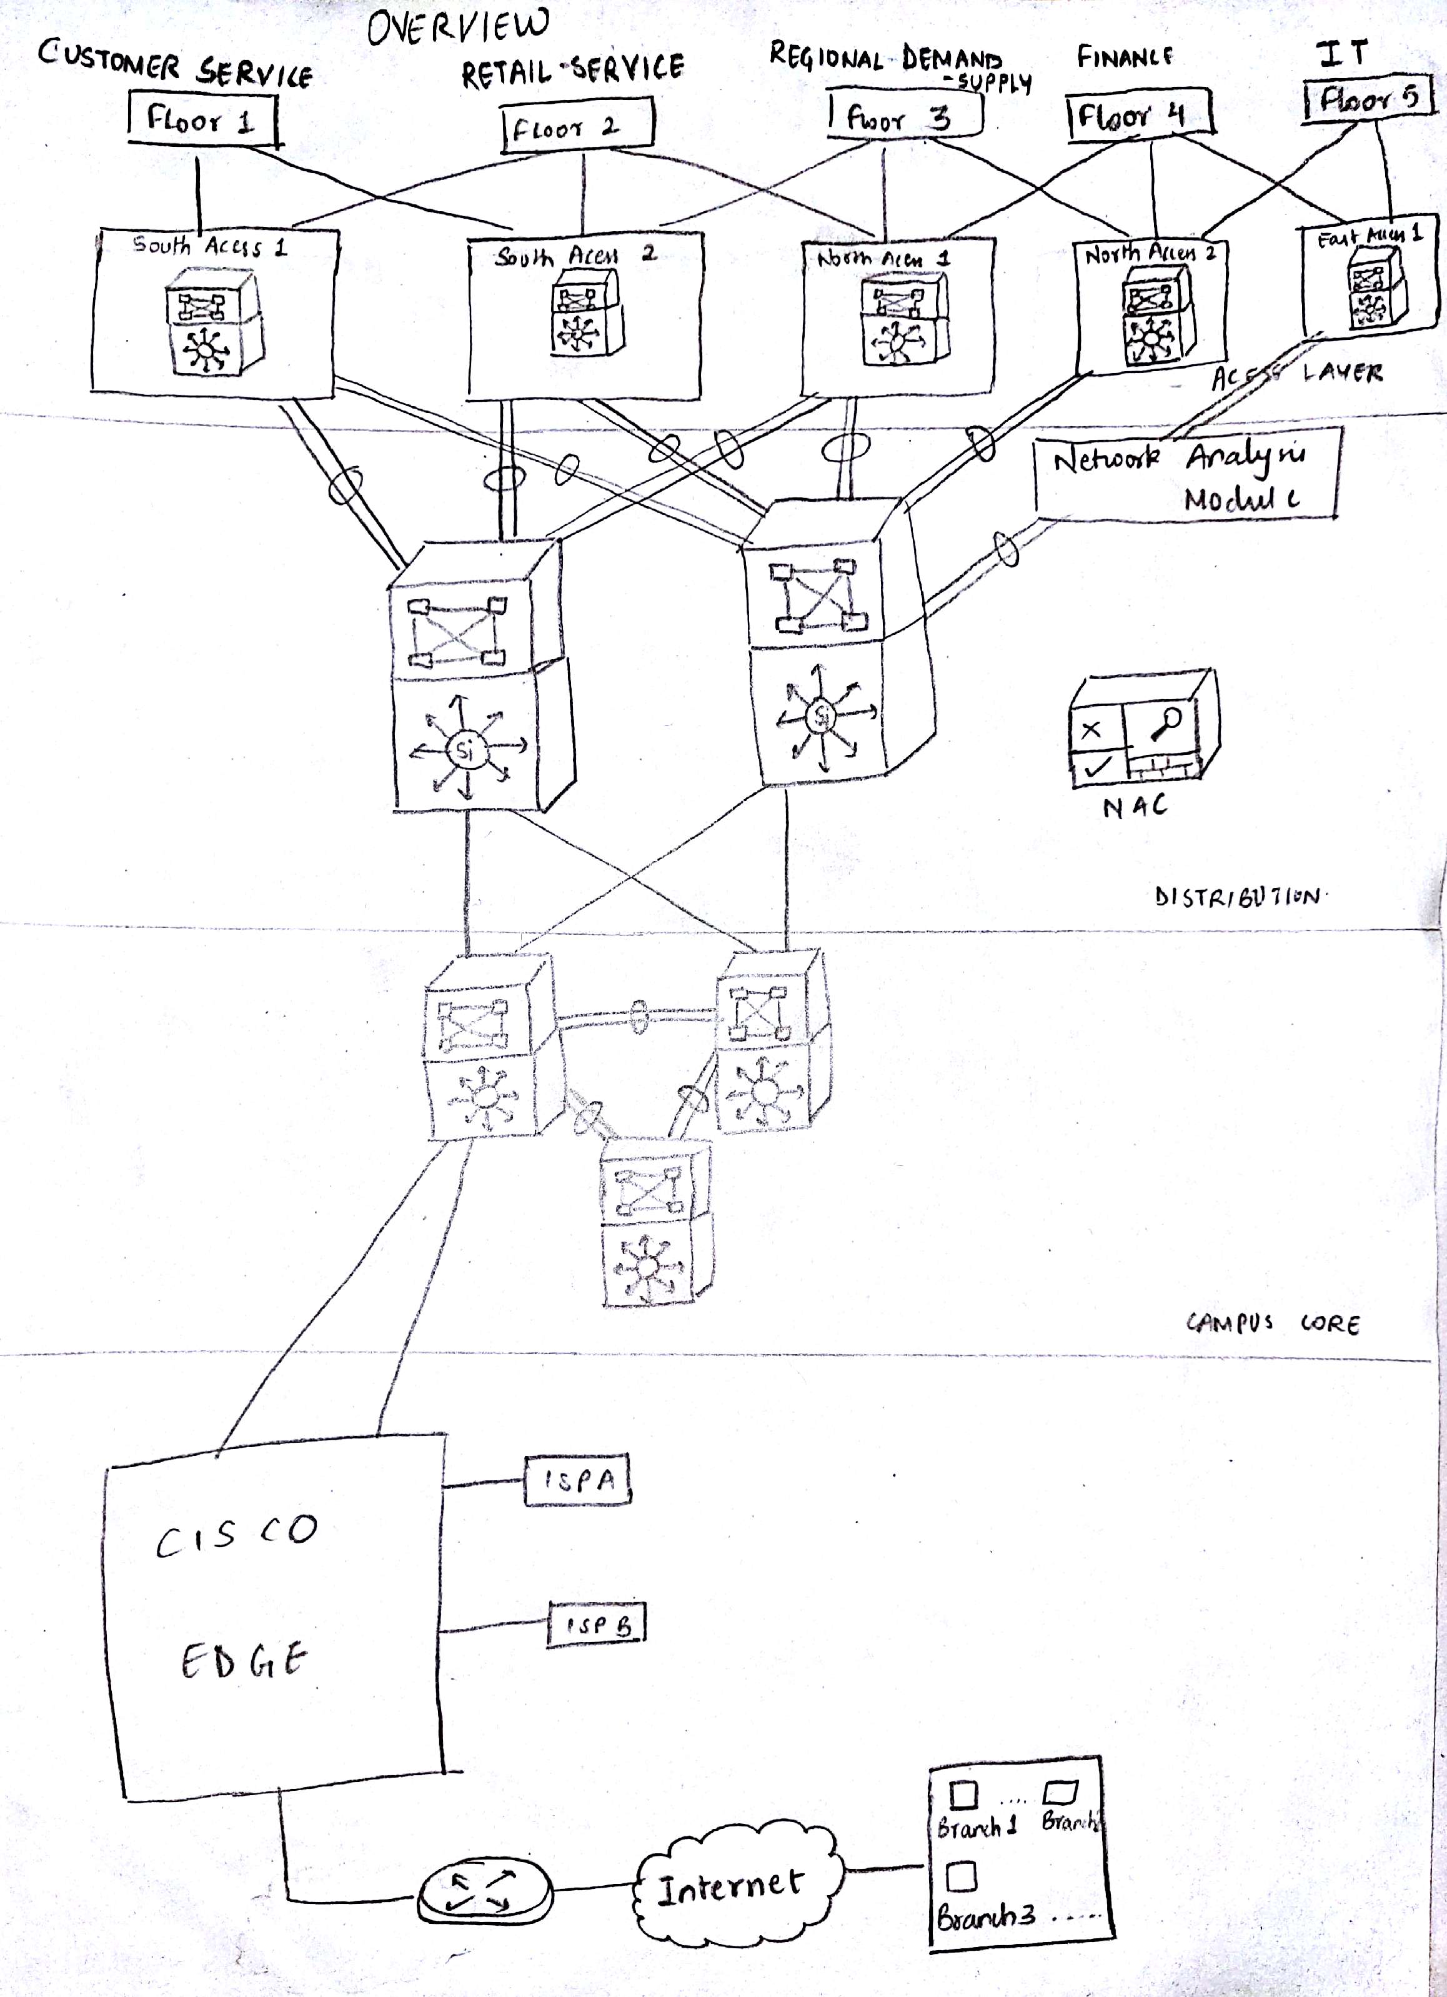
Arrangement according to campus core, access layer, distribution layer
Campus Core, Access Layer, and Distribution Layer Representation

Slide 9
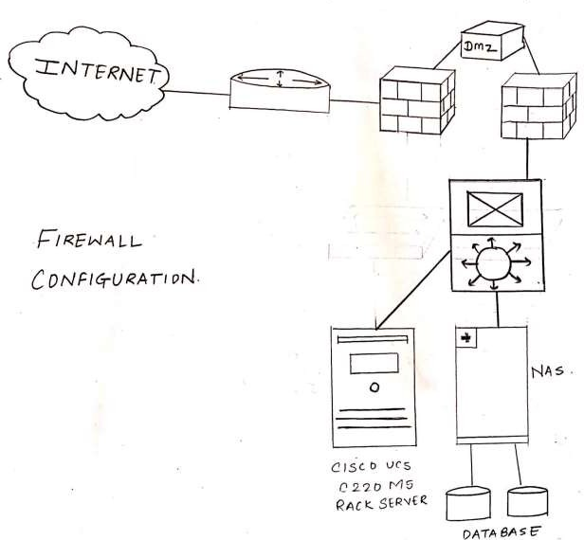
Firewall Configuration

Slide 10
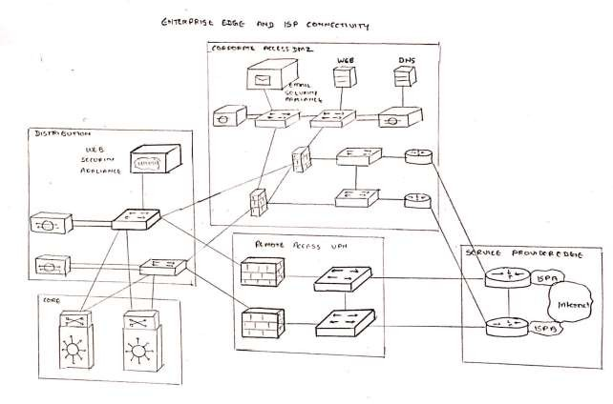
Enterprise Edge and ISP connectivity

Slide 11
Expenditure on Buying Equipment
Name of Equipment | Units Needed | Price per unit ₹ | Total ₹
Cisco Network Convergence System 5501 series Router | 7 | 1,00,000 | 7,00,000
Cisco Catalyst 9300 Series Switch | 17 | 1,05,000 | 17,85,000
Cisco Aironet 3800 WAP | 5 | 56,083 | 2,80,415
Dell Storage NX430 NAS | 4 | 174930 | 6,99,720
The Cisco UCS® C220 M5 Rack Server | 1 | 2,52,384 | 2,52,384
Cisco Unified SIP Phone 3900 Series | 50 | 2940 | 1,47,000
Verizon 960Mbps | 1 | 30000 p.m. | 30000
COX 1000Mbps | 1 | 50000 p.m. | 50000
CAT5 (500 m) | 1 | 500000 | 500000
 |  | Grand Total | ₹44,44,519/-

Slide 12

IP Addressing
The IP Address Class chosen for the project undertaken will be Class ‘A’ IP addressing. This is because class A has IP addresses which will be enough for DMA Mall Employee Strength.
For the internal network infrastructure we will use private network ranges ranging from 10.0.0.0 --- 10.255.255.255 (10.0.0.0/8)

Slide 13
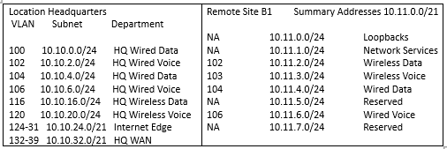
This allows the greatest flexibility with the equivalent of 255 Class A address spaces to be used as needed. The public address space can be difficult to get and can be expensive so the IP addresses will be carefully mapped to private IP addresses in the company.
IP Addressing

Slide 14
Thank You!

