Slide 1

Problem Statement:
House Price Prediction Based on its Features Using Machine Learning
BE Project

Slide 2
Literature Survey
Real Estate has become more than a necessity in this 21st century, It represents something much more nowadays. Not only for people looking into buying Real Estate but also the companies that sell these Estates. According to [4] Real Estate Property is not only the basic need of a man but today it also represents the riches and prestige of a person. Investment in real estate generally seems to be profitable because their property values do not decline rapidly. Changes in the real estate price can affect various household investors, bankers, policymakers, and many. Investment in the real estate sector seems to be an attractive choice for investments. Thus, predicting the real estate value is an important economic index. [3] suggests that Every single organization in today’s real estate business is operating fruitfully to achieve a competitive edge over alternative competitors. There is a need to simplify the process for a normal human being while providing the best results.

Slide 3
[6] proposed to use machine learning and artificial intelligence techniques to develop an algorithm that can predict housing prices based on certain input features. The business application of this algorithm is that classified websites can directly use this algorithm to predict prices of new properties that are going to be listed by taking some input variables and predicting the correct and justified price i.e. avoid taking price inputs from customers and thus not letting any error creeping in the system. [12] used Google Colab/Jupiter IDE. Jupiter IDE is an open-source web app that helps us to share as well create documents that have LiveCode, visualizations, equations, and text that narrates. It contains tools for data cleaning, data transformation, simulation of numeric values, modeling using statistics, visualization of data, and machine learning tools.
[10] designed a system that will help people to know close to the precise price of real estate. User can give their requirements according to which they will get the prices of the desired houses User can also get the sample plan of the house to get a reference for houses. In [5] Housing value of the Boston suburb is analyzed and forecast by SVM, LSSVM, and

Slide 4
PLS methods and the corresponding characteristics. After getting rid of the missing samples from the original data set, 400 samples are treated as training data and 52 samples are treated as test data. Housing value of the training data. As per [1]’s findings, the best accuracy was provided by the Random Forest Regressor followed by the Decision Tree Regressor. A similar result is generated by the Ridge and Linear Regression with a very slight reduction in Lasso. Across all groups of feature selections, there is no extreme difference between all regardless of strong or weak groups. It gives a good sign that the buying prices can be solely used for predicting the selling prices without considering other features to disseminate model over-fitting. Additionally, a reduction in accuracy is apparent in the very weak features group. The same pattern of results is visible on the Root Square Mean Error (RMSE) for all feature selection. [2] observed that their data set took more than one day to prepare. As opposed to performing the computations sequentially, we might utilize various processors and parallel the computations involved, which might possibly decrease

Slide 5
the preparation time Furthermore prediction period. Include All the more functionalities under the model, we can give choices for clients with select a district alternately locale should produce those high-temperature maps, as opposed to entering in the list.
[7] used a data set of 100 houses with several parameters. We have used 50% of the data set to train the machine and 50% to test the machine. The results are truly accurate. And we have tested it with different parameters also. Not using PSO makes it easier to train machines with complex problems and hence regression is used. [13] experimented with the most fundamental machine learning algorithms like decision tree classifier, decision tree regression, and multiple linear regression. Work is implemented using the Scikit-Learn machine learning tool. This work helps the users to predict the availability of houses in the city and also to predict the prices of the houses. [8] used ML algorithms to predict house prices. We have mentioned the step by step procedure to analyze the dataset. These feature sets were then given as an input to four algorithms and a CSV file was generated consisting of predicted house prices.

Slide 6
[9] expressed that There is a need to use a mix of these models a linear model gives a high bias (underfit) whereas a high model complexity-based model gives a high variance (overfit). The outcome of this study can be used in the annual revision of the guideline value of land which may add more revenue to the State Government while this transaction is made. [11] concludes that by conducting this experiment with various machine learning algorithms its been clear that random for-set and gradient boosted trees are performing better with more accuracy percentage and with fewer error values. when this experiment is compared with the and to the result achieved these algorithms predict well.

Slide 7
Finalized Algorithms
Decision tree algorithm
Linear Regression Algorithm
Random Forest Classifier Algorithm

Slide 8
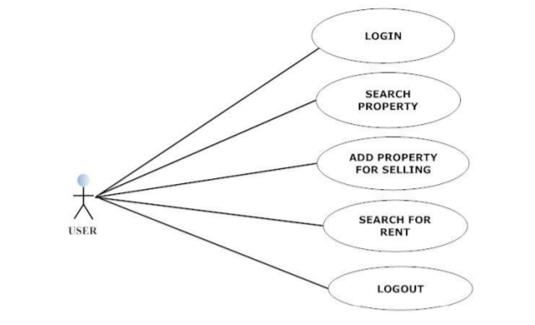
Diagrams
UML DIAGRAM

Slide 9
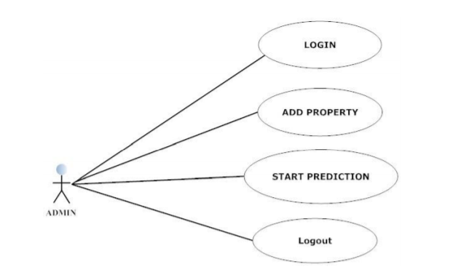

Slide 10
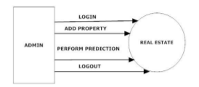
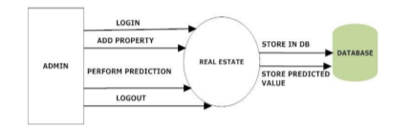
DFD Diagram
LEVEL 0(Admin)
LEVEL 0(Admin)

Slide 11
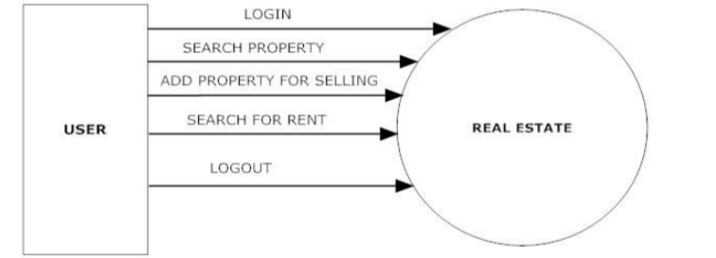
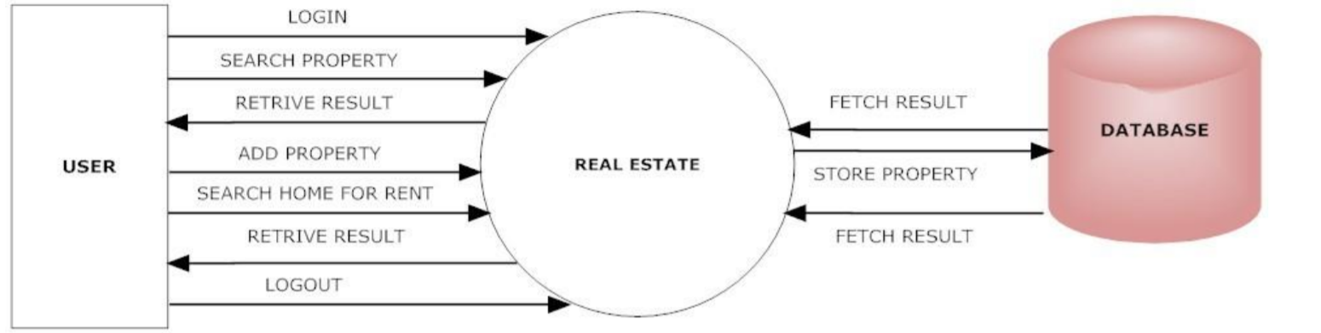
LEVEL 0(User)
LEVEL 0(User)

Slide 12
Sr.No. | Title | Authors | Publication year | Technique and algorithm
1 | Machine Learning Housing Price Prediction in Petaling Jaya, Selangor, Malaysia | Thuraiya Mohd, Suraya Masrom, Noraini Johari | 2019 | Random forest regressor, linear regression, lasso, Ridge and decision tree regressor.
2 | House Price Prediction Using Machine Learning | G. Naga Satish, Ch. V. Raghavendran, M.D.Sugnana Rao, Ch.Srinivasulu | 2019 | Linear regression algorithm
3 | House Price Fore Casting Using Machine Learning | Alisha Kuvalekar , Shivani Manchewar , Sidhika Mahadik | 2018 | Decision tree Machine Learning Algorithm
4 | Valuation Of House Prices Using Predictive Techniques | Neelam Shinde, Kiran Gawande | 2018 | Decision tree, lasso,logistic regression algorithms
5 | Housing Value Forecasting Based on Machine Learning Methods | Jingyi Mu, Fang Wu,and Aihua Zhang | 2014 | SVM, LSSVM, and PLS algorithm
6 | PropTech for Proactive Pricing of Houses in Classified Advertisements in the Indian Real Estate Market | Sayan Putatunda |  | Random Forest, Gradient boosting, ANN1, ANN2, ANN3 algorithms
7 | House Price Prediction Using Machine Learning | Atharva Chouthai, Mohammed Athar Rangila , Sanved Amate, Prayag Adhikari, Vijay Kukre | 2019 | Gradient boosting algorithm

Slide 13
8 | Predicting Housing Prices using Machine Learning Techniques | B.Balakumar, P.Raviraj, S.Essakkiammal |  | Decision tree overfit best algorithm
9 | Literature Review on Real Estate Value Prediction Using Machine Learning | Akshay Babu, Dr. Anjana S Chandran | 2019 | Support vector Regression, Random Forest, KNN, linear regression algorithms
10 | House Planning and Price Prediction System using Machine Learning | Mr. Rushikesh Naikare, Mr. Girish Gahandule, Mr. Akash Dumbre, Mr. Kaushal Agrawal, Prof. Chaitanya Manka | 2019 | Regression Algorithm
11 | Real Estate Price Prediction Using Machine Learning | Aswin Sivam Ravikumar | 2016 | Support vector, Gradient boosting, multiple regression, Random Forest algorithms
12 | House Price Prediction | Bindu Sivasankar, Arun P. Ashok, Gouri Madhu, Fousiya S | 2020 | Ridge, Lasso and XG boost algorothm
13 | House Price Prediction Modeling Using Machine Learning | Dr. M. Thamarai ,Dr. S P. Malarvizhi | 2020 | Decision tree classifier, Decision tree Regression, Multiple Linear Regression

