Slide 1
DESIGNING A
COMPUTER NETWORK
Assignment 2
Computer Networks - Semester 211

Slide 2
Team Members
Nguyễn Hoàng - 1952255 (CC05)
Nguyễn Thanh Ngân - 1911667 (CC01)
Phạm Nhựt Huy - 1952059 (CC05)

Slide 3
Requirement analytics
01
Network blueprint
02
Throughput, bandwidth
03
Packet tracer design
System testing
04
05
Result & remaining problems
06

Slide 4
01
Requirement
Requirement analytics

Slide 5
Requirement analytics
HQ | Branches
7 floors | 2 floors
1 IT room and Cabling Central Local on 1st floor | 1 IT room and cabling Central Local on 1st floor
100 workstations, 5 servers, 12 network devices or more with security devices | 50 workstations, 3 servers, 5 network devices or more with security devices

Slide 6
Requirement analytics
Use 100/1000 Mbps wired and wireless connections
Connects to outside by 2 leased lines for WAN and 1 ADSL for Internet with load-balancing
Wireless network for guest access

Slide 7
Requirement analytics
Network is organized according to the VLAN structure
Use both licensed and open-source software
Secure
Robust
Scalable

Slide 8
02
Blueprint
Network blueprint

Slide 9
Network structure
Tree topology to connect the buildings
Star topology to connect devices in a building
Load balancers for the servers

Slide 10
Recommended hardware
Router: Cisco 2911/K9
Switch: Cisco Catalyst 2960-24TT
Wireless router: Linksys WRT-300N
Cable: Ethernet

Slide 11
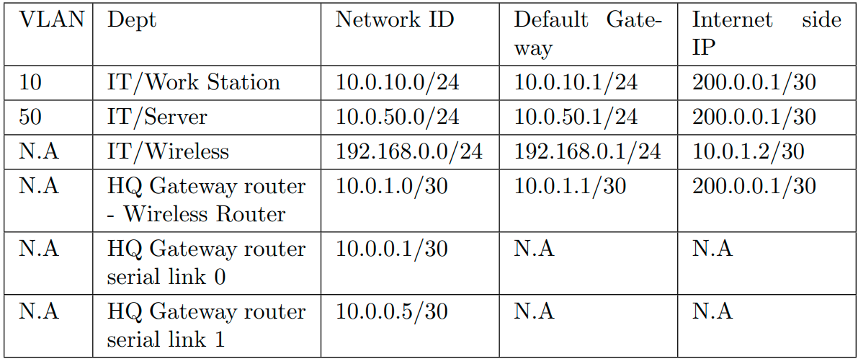
IP Address table (Headquarter)

Slide 12
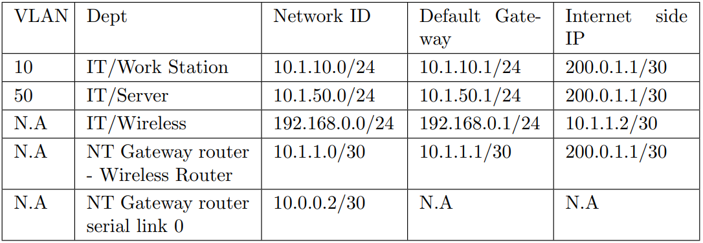
IP Address table (Nha Trang branch)

Slide 13
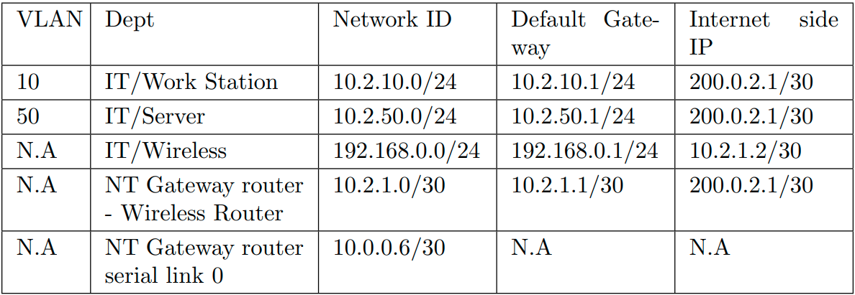
IP Address table (Da Nang branch)

Slide 14
03
Throughput
Bandwidth

Slide 15
Throughput, bandwidth
The parameters of the flow and load of the system (about 80% at peak hours 9:00-11:00 AM and 3:00-4:00 PM) can be shared for Headquarter and Branches as follow:
Servers used for updates, web access, database access, ..... The total upload and download capacity is about 500 MB / day.
Each workstation is used for Web browsing, document downloads, customer transactions, ...The total upload and download capacity is about 100 MB / day.
WiFi-connected laptop for customers’ access about 50 MB / day

Slide 16
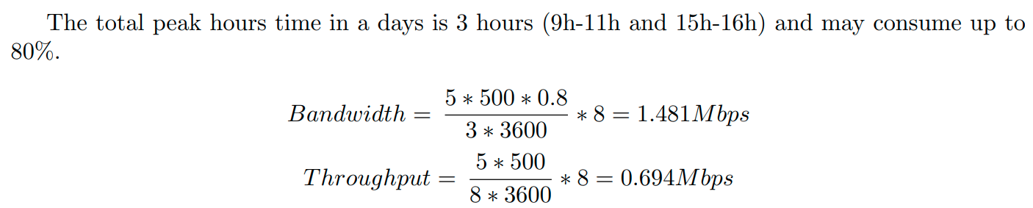
Server

Slide 17

Workstation

Slide 18
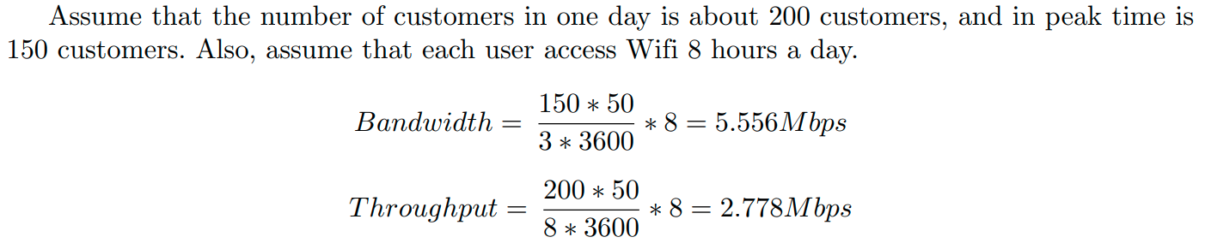
User

Slide 19
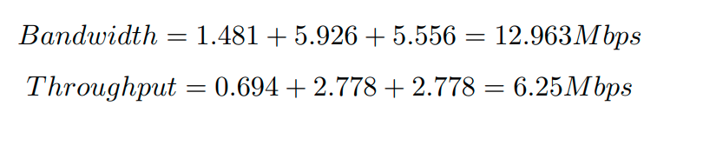
Total

Slide 20
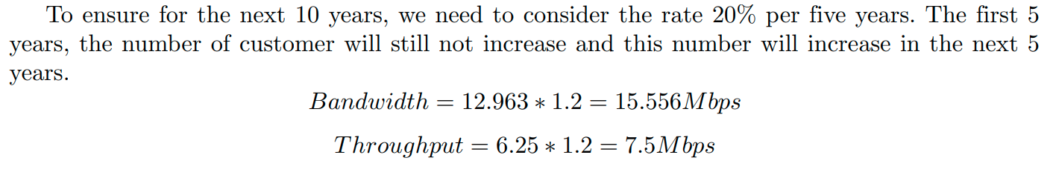
Safety parameter

Slide 21
04
Packet tracer

Slide 22
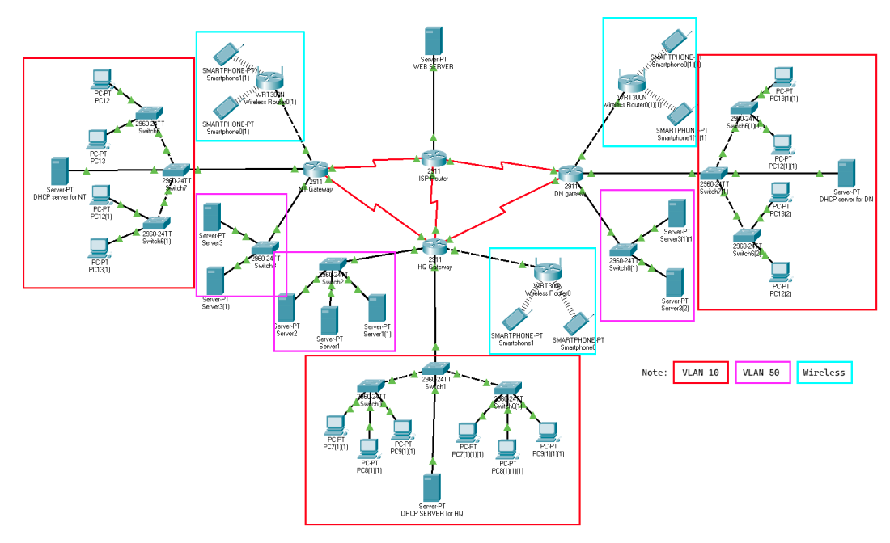
Topology diagram

Slide 23
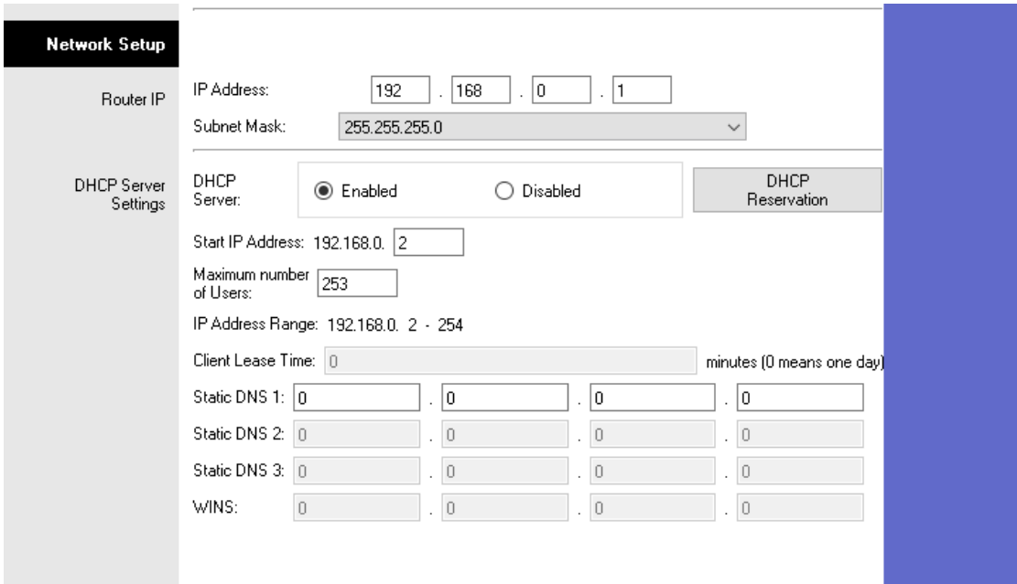
Wireless router config

Slide 24
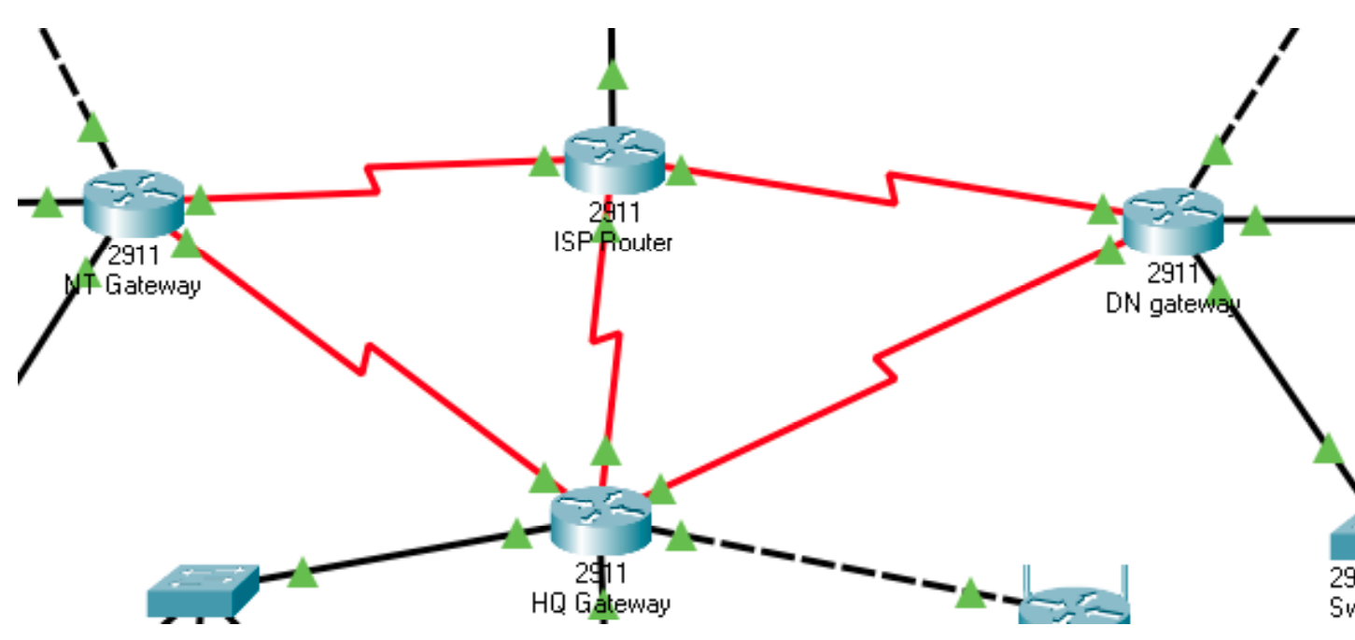
OSPF protocol setup

Slide 25
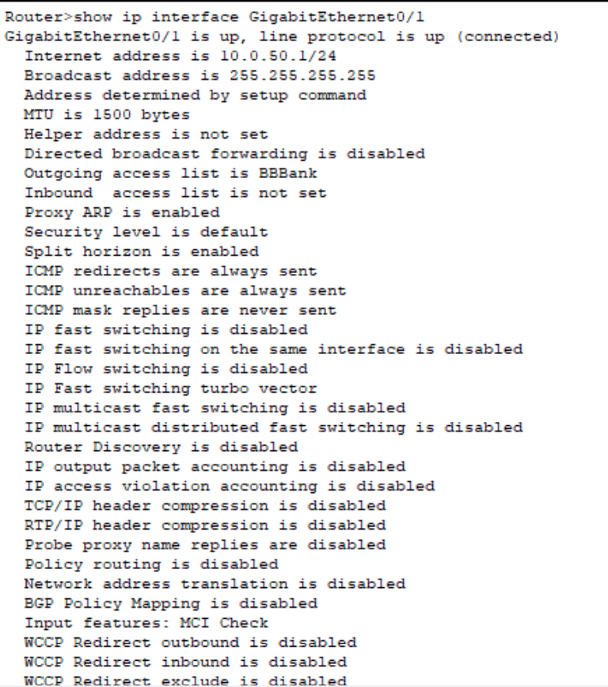
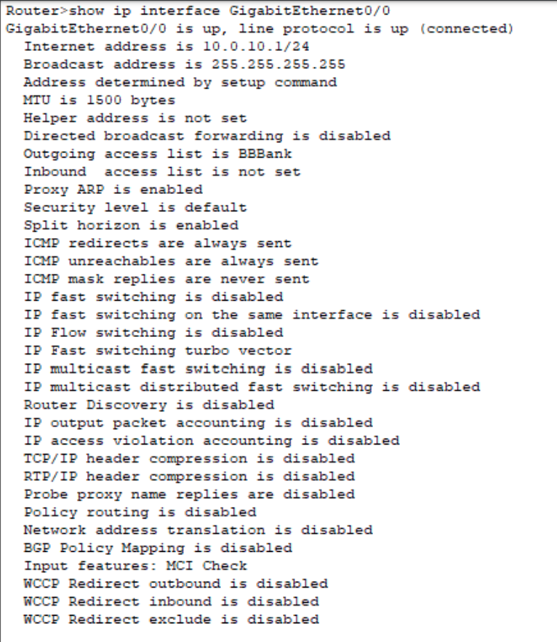
Access control list

Slide 26
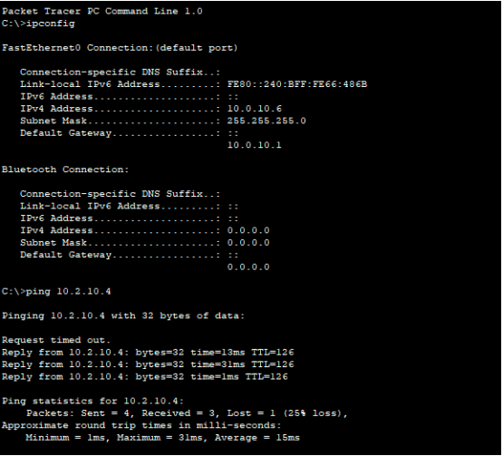
System testing (HQ to DN)

Slide 27
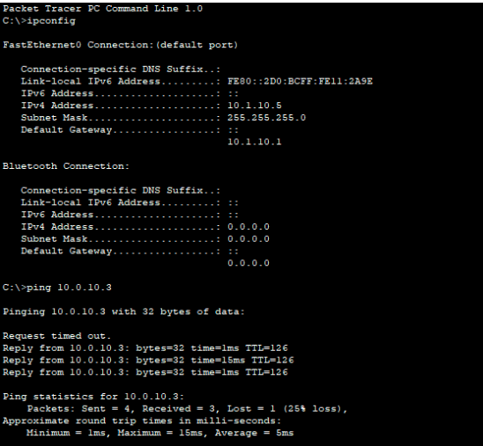
System testing (HQ to NT)

Slide 28
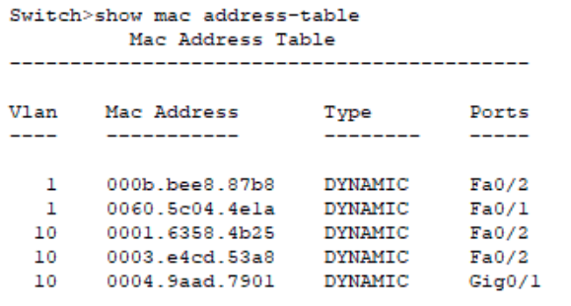
MAC address table
MAC address table of workstation switch at HQ

Slide 29
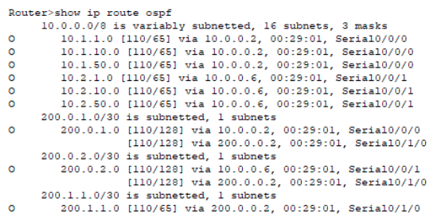
OSPF IP table
OSPF IP table at HQ

Slide 30
Result (Reality)
• The message sent by network devices are receivable to the receivers.
• Our system might have packet loss. This might be occurred in the first route or ping because the network need to fill the MAC table of the switch.

Slide 31
Result (Upgradeability)
Each subnet in a single network can provide up to 253 users, so our system can add and remove devices easily.
When we want to add new branch to the network, we just add and configure new router corresponding to that branch. Then, connect to Headquarter router through WAN links.

Slide 32
Result (Scalability)
The use of network equipment from Cisco helps us to have better technical support, more stable equipment, and especially in Cisco products that are often integrated, available new technologies.
For the problem of bandwidth, with the increment rate of 20% per 5 years so when we will safety factor of 20% to make sure the network can have good performance for the next 10 years.

Slide 33
Result (Safety)
Support the mechanism to restrict IP address to come in and out of the Internet
Providing security for wireless network by applying ACL tables to limit the access from wireless devices to other devices
Applying mechanism to prevent the wireless devices ping to other devices.
Sensitive data is kept confidential when there are packet theft attacks

Slide 34
Remaining problems (Security)
Although the ACL limit the IP from wireless access to ping other devices, this can also restrict the inter Network to receive message when the servers ping to the Internet
The wifi password might be easy to guess

Slide 35
Remaining problems (Scalability)
Our network system can support up to 15 branches, so in the future, if the bank have more branches, there should be another enhancement in the network to adapt the scalability of the bank.
Serial link for inter-branch may cause bottleneck problem when the bank grower bigger

Slide 36
THANK YOU FOR LISTENING!

