Slide 1
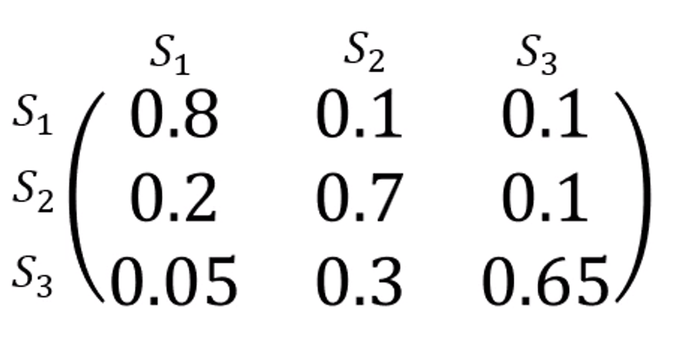
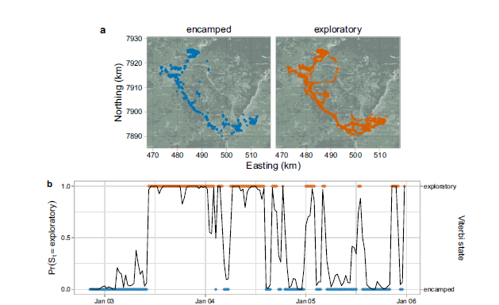

Introduction to Animal Movement Analyses
Categorizing Behavior States
Jared A. Stabach, PhD
Research Ecologist
Terrestrial Lead – Movement of Life Initiative
Conservation Ecology Center
Smithsonian’s National Zoo &
Conservation Biology Institute
This lecture is based on a graduate training course taught
at the Smithsonian-Mason School of Conservation
Many thanks to Dr. Joe Kolowski for sharing his notes.
https://smconservation.gmu.edu/programs/graduate-and-professional/
Notes:
Hello everyone.
Today we’re going to start investigating what else we can infer about the animal’s we’ve fitted with tracking devices.
As you all are aware, it is very difficult to physically observe animals in the wild. As a result, researchers often use the movement path to infer information about the animal’s behavior. Is the animal resting? Is it feeding? How much time does it spend moving or feeding? And, importantly, what habitats does it frequent and what resources does it need for survival?
So, we’re going to start addressing these questions over the next few lectures, but it’s important to realize that we are inferring these behaviors solely based on the animal movement data.
My lecture notes are heavily influenced by a course taught at the Smithsonian-Mason School of Conservation and I’ve left a link to these classes here. But, I also what to thank Dr. Joe Kolowski, the instructor for this class, for sharing his notes to help guide you. I’d encourage to you to check out this site for other courses that might be of interest to you.

Slide 2
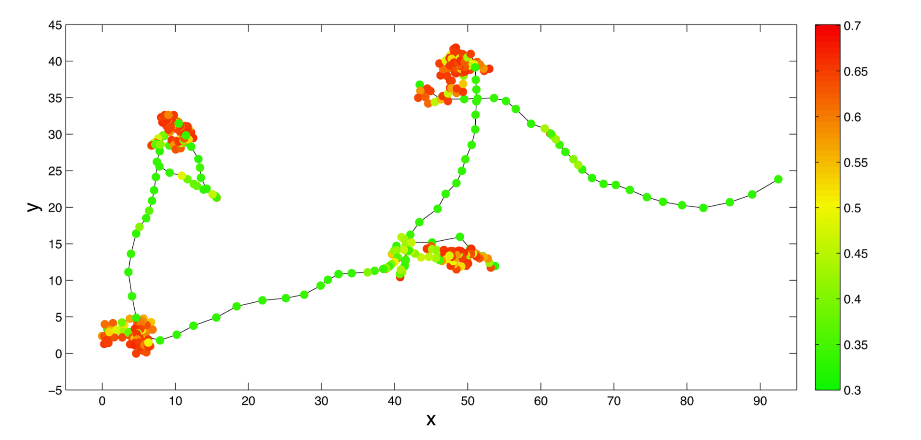
Behavioral Partitioning
Hidden Markov Models (State-switching State Space Models)
Behavioral Change Point Analysis (BCPA)
First Passage Time/Residence Time
Multi-state Random Walk
Hidden Markov Models (State-switching State Space Models)
Behavioral Change Point Analysis (BCPA)
First Passage Time/Residence Time
Multi-state Random Walk
See Gurarie et al. 2016
for summary and comparison of methods
Notes:
We’re going to start with a process called Behavioral Partitioning.
This involves using characteristics of the movement information, typically across all individuals, in order to assign a label to segments of the movement path to identify what the animal or animals were doing. More technically correct, what we are doing is identifying when is the animal doing something different from what it was previously doing. Has the movements changed over time and what does that change in movement mean?
From this, we are trying to associate these changes in movement with ideally, a specific behavior.
We have a few options available to us to answer these types of questions, all of which differ in their assumptions, the complexity of their output, and in their explanatory potential. These include:
Hidden Mark Models or so-called State-Switching State Space Models, Behavioral Change Point Analysis (BCPA), First Passage Time or Residence Time, and Multi-state Random Walks. We going to spend most of our discussion on HMMs because this is the most developed of these behavioral partitioning models.
I’ve also listed the Gurarie et al 2016 paper, as it provides a very nice summary and comparison of all 4 of these methods. The paper is also included in the lecture file notes.

Slide 3
Applications of Behavior State Assignment
Exploratory
(What is the animal doing?)
Explanatory
(Why is the animal doing it?)
Predictive
(Can we anticipate movement from behavior?)
If we modify the environment in some way, how will movement behavior change?
Metrics to describe and quantify the movement track
Are there distinct behaviors? If so, how many?
What distinguishes the behaviors?
When and where do the behaviors occur?
Associate behaviors and transitions with covariates
Season
Environmental cues
Predation or conspecifics
Notes:
So why would we want to break out these behaviors, especially as researchers or protected area managers? The Gurarie paper does a good job of explaining this, breaking out the objectives of animal movement studies into three main categories: Exploratory, Explanatory, and Predictive.
In the Exploratory phase, we are interested in what the animal is doing? This entails generating metrics to describe and quantify the movement track. How fast or slow is the animal moving? How far did it move? Then, we can start asking whether there are distinct behaviors in the animal movement track and if so, how many? What characteristics distinguish these behavior and we can investigate when and where these behaviors occur? This get’s very interesting, as we start to look at the preferences of the animal and how their movements are related to habitat, climate, and/or disturbance.
Then we can start to ask Explanatory behaviors. Why is the animal doing something? This allows us to associate behaviors with something in the animal’s environment or how the transitions are related to particular covariates, like season or some sort of environmental cue, or potential related to predation or social factors like the rank of the animal in a group or how many animals might be in a group.
And then finally we ask predictive questions. If we modify the environment in some way, how would that be expected to impact the animal.
It’s really these Explanatory and Predictive aspects that are most interesting, but require us to start at the Exploratory phase.

Slide 4
Hidden Markov Models
Discrete time, discrete state, state space models
Operate on time-series data for step lengths and turning angles
Could also be used on accelerometry data, but also occupancy data, capture-recapture data…
Parameters of step length distribution and turning angle distribution determined by an underlying observed state
Notes:
We’ll start with Hidden Markov Models, which I’ll commonly refer to as HMMs. These are also often referred to as state switching models. These are discrete time, discrete state, state space models. So, this is an important distinction from the models that Chris has been describing. The behavioral state of the animal is the unobserved, or the latent state, that we are trying to predict.
These models operate on time series data where the response variable is step length and turning angle, but this framework could be used on other time series data, for instance accelerometry data, occupancy data, capture-recapture data, and others
The key assumption is that we have some unknown number of unobserved behavioral states and these behavioral states can be distinguished by distinct statistical distributions of step lengths and turning angles. This is really the core of this approach.

Slide 5
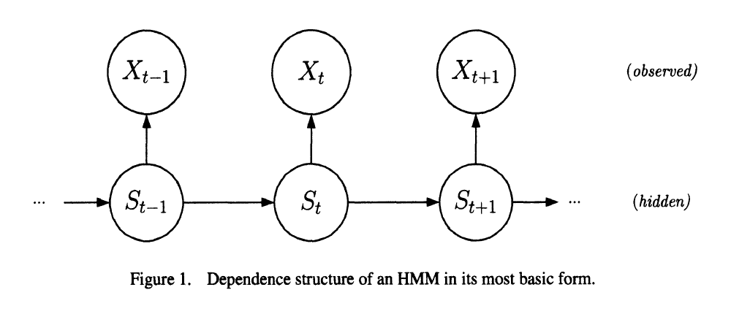
Hidden Markov Models
Observation process and latent state process
Locations are the observation process, behavior state is the latent state process
Latent state process taken to be a Markov Chain
Discrete random variable, (1,2,…N)
N is # of potential states (typically <= 4)
Data distributions (step length and turn angle) vary by state
Transition probability matrix
Governs the sequence of switching most likely and how probable these switches are
Pohle et al. 2017
Notes:
So what does this look like.
We have two processes…this is what makes this a hierarchical modeling approach. We have our observation process, which in this case is our location observations with associated step lengths and turning angles….the movement data. And, we have our latent or unobserved state…our hidden state. This is what we want to learn about.
We assume that this latent state process is a Markov process, meaning that information about the current state is used to make information about the following or future state.
You might also hear the term 1st or or 2nd or Markov process. This just mean how many previous states are used (1 or 2 or more) to inform the current or future state. So a 1st order Markov process indicates that we are only using the current state to predict our future state.
We have discrete (arguably) random variables, in this case step length and turning angles. And we have N, our number of states, which in most cases is typically 4 or less. Most likely 2 or 3 states. This is what we are trying to estimate effectively. What is the animal doing? Is it resting or feeding?
Again, the key is that these states vary in the distributions of the step length and turning angles. We’ll also have a transition matrix included in these models. This governs how likely it is for animal to switch from one state to another state.

Slide 6
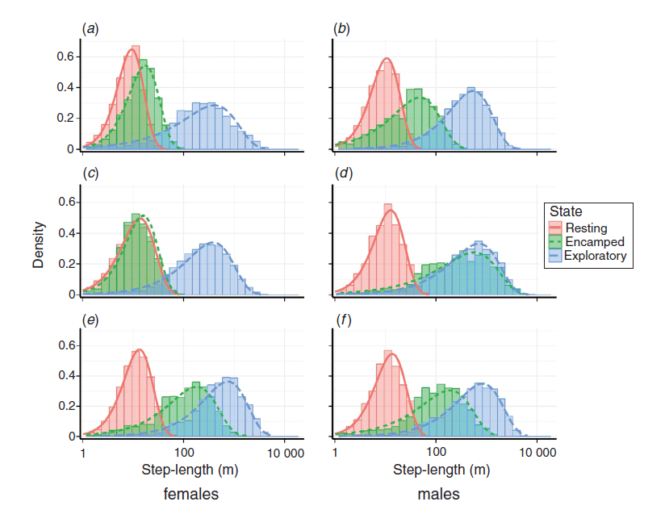
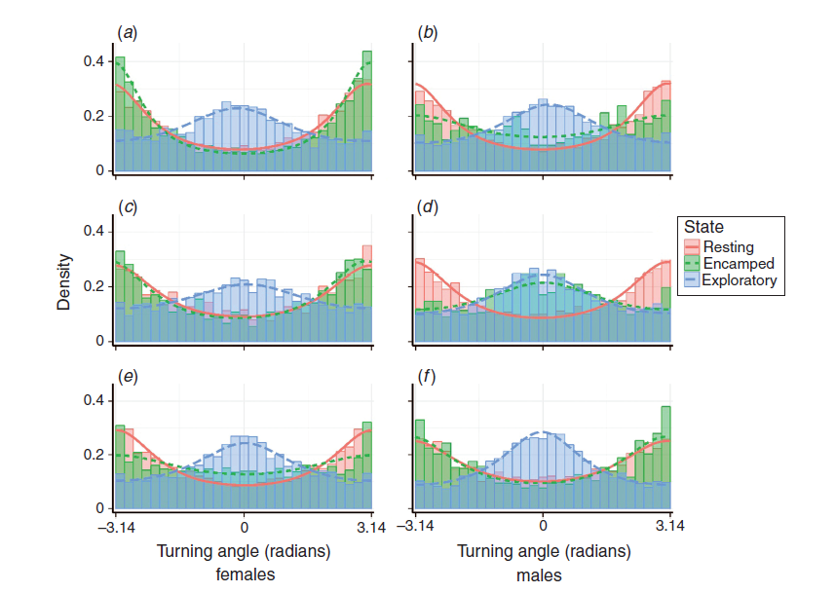
Implementing HMMs in R
Models estimate:
Transition probabilities,
Mean and variance of step length and turn angle for all states
Transition probabilities can be modeled as function of covariates
Step length
Turning angle
Notes:
So with these models, we are going to estimate transition probabilities, which we see in the matrix table on the bottom left. And it’s going to estimate the parameters of the statistical distributions of step length and turning angles for each of our states. This is the kind of output that we will see with these models. On the right, which is taken from XXX, you can see the raw data summarizes in columns, and the model fitted estimates of these parameters, shown as thick curved lines. Step lengths are at the top and turning angles on the bottom. Most important for you at this point is simply to notice the difference in the distributions between each of these states.
We also see the numerical transitions which estimates the likelihood that animals switch from 1 state to the next. This matrix is easiest read in rows…so the probability that an animal will transition from State 1 to State 1, that is stay within that state is very high (0.8 or 80 %), with smaller probabilities of transitioning from State 1 to State 2 or State 1 to State 3. Similarly, we see that this animal transitions from State 2 to State 1 with a 20% probability and from State 2 to State 3 with a 10% probability.
Interestingly, the diagonals are all quite high. This make sense. When you are in a particular state, you tend to stay in that state.
Probably most important is that we can incorporate covariates that influence these transitions between different states. This is what we will be looking at when we fit models.

Slide 7
HMM Parameters for Animal Movement
N = # of states
Starting state (typically taken to be equally likely)
Distribution of step lengths (for each state)
Gamma, Weibull, log-normal and exponential distributions
Mean
Variance (SD)
Zero-mass
Distribution of turning angles (for each state)
von Mises and wrapped Cauchy distributions
Mean
Clustering parameter
Transition probability matrix
Notes:
When we setup these models, we need to provide starting values. This can be a frustrating part, as the models will often fail if improper starting values are provided.
We have to input the number of states. This is not an estimable parameter in these models. It must be provided.
We also need to specify the starting state. Common is to simply provide an equal probability of being in any one of the starting states.
Then, we need to setup the distributions for step length and turning angles and we need to do this for each of the states. This means we first need to specify the shape of the distribution. For the steplengths, we have four potential distributions to choose from. A gamma distribution is the default, but we could also choose a Weibull, a log-normal, or an exponential distribution. These dictate the shape and behavior of the curves. For Gamma, we then need to provide the mean, variance, and zero-mass. The zero mass needs to be used if you have steplengths of 0.
For our turning angles, we have two potential distribution options, the von Mises (which is the default) and the wrapped Cauchy. Both are circular distributions, which require the mean turning angle and the clustering parameter which is similar to the variance of the turning angle distribution.
The Transition probably matrix will then be estimated based on our starting states. This will be estimated for us once we input all the other values, so we don’t need to put starting values here….this will be estimated.

Slide 8
Implementing HMMs in R
Connecting location data to latent states (decoding algorithms)
Viterbi
Finds most probable sequence of states that generated the data
Forward-backward algorithm
Computes marginal probability of each state at time t
Forward-filtering backward sampling algorithm
Generates sequences that could have resulted in observed state
Stationary probabilities available
Assume regular sampling with negligible error
Paths can be smoothed prior to analysis if error on same scale as step lengths
No date/time information is included
User specifies # of state (<= 4) and models with varying states can be compared with AIC
Notes:
Once models are run….we can then use what are called decoding algorithms to assess the most likely state for every one of our locations. As you can imagine, this is very useful. In R, we have access to three different algorithms, which differ slightly with how they decode the state values. The default is called the Viterbi algorithm.
We also have access to stationary probabilities. So instead of assign a state to every point, we can look at the state probability of each point, often times providing a value of confidence to each particular state assignment.
It’s important to note that with these models we are assuming regular sampling intervals with negligible error. If this assumption can’t be met, pre-processing of the data would be necessary. Chris highlighted some ways of removing erroneous points, but other methods exist to smooth travel path and remove or minimize erroneous data points. The problem here is that the latent states that we are estimating are completing based on the steplengths and turning angles. And, if these are incorrect or biased in some way, it can have a huge on these distributions and impact our results.
There is not date/time included in these models……we have to make sure we are feeding the data in an ordered sequence (Chronologically), which we’ll do together during the coding part of lecture. As a result, we need to be very careful about irregularly sampled data, as the model won’t differentiate.
We also can use standard model comparison techniques like AIC to assess individual models.

Slide 9
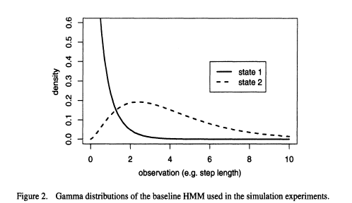
Pohle et al. 2017
Notes:
Here, I’m showing you the gamma distribution, which is taken directly from the Pohle et al paper. The nice aspect of this distribution and why it’s used is that values cannot go below 0. You can’t have a negative steplength, so it’s more appropriate, that is, it has the statistical support to be used with the animal movement data.
Here, we have 2 states. State 1 is described with a mean value of 0.5 and a shape parameter of 0.7, that’s essentially the variance in this distribution. State 2 has a mean of 4, with a shape or variance of 2.5. What you can see is the difference in the shapes for each of these states…representative of different behaviors.

Slide 10
Hidden Markov Models with moveHMM
my_mod <- fitHMM(data = my_move_object,
nbStates= 2,
stepPar0 = stepPar0,
anglePar0 = anglePar0,
formula = ~ 1)
plot(my_mod)
# Needs to be specified (≤ 4)
# Starting values, step length distribution
# Starting values, turn angle distribution
Ability to investigate impact of covariates on transition probabilities
Notes:
Okay, so in R and using the package moveHMM, this is the structure of the function that we will use.
The syntax requires us to specify the movement object….again, we need to format this data object, as moveHMM does NOT recognize the data as a time series. So, it’s very important to we clean these data and align the sequence properly before starting the modeling process. This is what we will be doing next.
We then need to specify the number of states we are interested in estimating. We then need to specify our initial starting values for the steplength and turning angles of each of these states. We then can also include a formula to investigate the impact of various covariates on our transition probabilities. These are the factors that influence whether the animal is in 1 state or another. Here, we’ve specified this in normal model notation as a null model….that is, the covariates have no impact on the transition probabilities. This could, however, be distance to water, time of day, amount of anthropogenic or human disturbance. Note, these covariates must a continuous predictor variable….something that varies over time (i.e., continuous, time varying predictors). So, for instance, you wouldn’t include something like sex, since this would not vary over time. Habitat type can also be difficult to include as the data are categorical. You could include age or age class (juvenile, sub-adult, adult) as these items do change and could have an impact on the animal transitioning from different states.
Once you have a fitted model, you can then plot the model to visualize the results by plotting the model output.

Slide 11
GRAB A FIGURE which shows an example of an animal that is switching between states.

Slide 12
Postlethwaite and Dennis 2013
Notes:
In the previous graph, each point was coded based on a predictive state assignment. But, since you also get a probability of being in one particular state, you can also graph this probability assignment over time. Here, I’m showing a simulated track from Postlethwaite and Dennis where the probabilities of being in one particular state are displayed. So you can see that the model predicts with a high level of certainty the state in red, but a lower probability of that particular state in green. So, just another visual tool to see what’s happening behind the scenes and perhaps convince yourself that the model is doing what you expect.

Slide 13
Challenges to HMMs
Starting parameters values and correct distributional forms
Choosing the # of states to model (Pohle et al. 2017)
Impact of sampling schedule (Postlethwaite and Dennis, 2013)
Higher resolution tends to improve identification of behavioral states as long as error is much smaller than step length
Irregular sampling
State space models with crawl or aniMotum to regularize
Notes:
Some things to keep in mind.
First, we need to identify starting parameter values and the correct form of the distributions. We, can test for the correct forms using sensitivity analyses, but this can be difficult, especially when models become more complex.
Second, we need to choose the # of states we aim to predict in the model. The Pohle et al paper is a particular good reference, providing recommendations on how to choose the number of states to include in your model. The model comparison tends to favor a model with more states, so that researcher really needs to think about his or her research question, rather than relying solely on quantitative metrics.
Third, the sampling schedule is absolutely going to impact your ability to identify behavioral states. This is largely due to the scale at which your species is making movement decisions. If your animal is making fine-scale complex movements, but you are sampling just a few times per day, you will be less likely to identify these behavioral changes. It’s also important to consider the error associated with your positions. You want to be modeling the movement process related to an animal’s behavior, not the error process.
Lastly, the model assumes regular sampling, which often is not the case with animal movement data. To get your data in the format required, you may need to resample your data to a different temporal interval, like crawl or aniMotum, before ingesting the data into moveHMM. These packages then smooth or regularlize the movement track so that the data can be integrated. This isn’t much of an issue when few data points are missing, but large gaps in data could be problematic and may require that you simply analyze the movement track with areas that are highly irregular.`

Slide 14
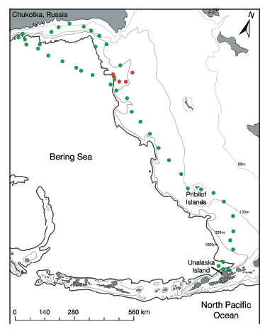
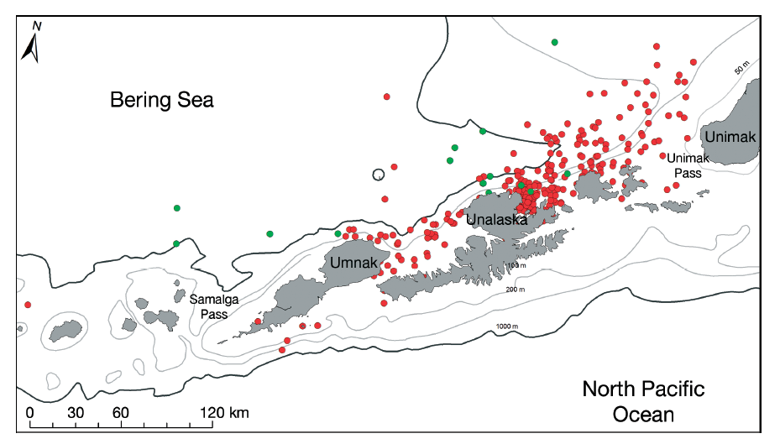
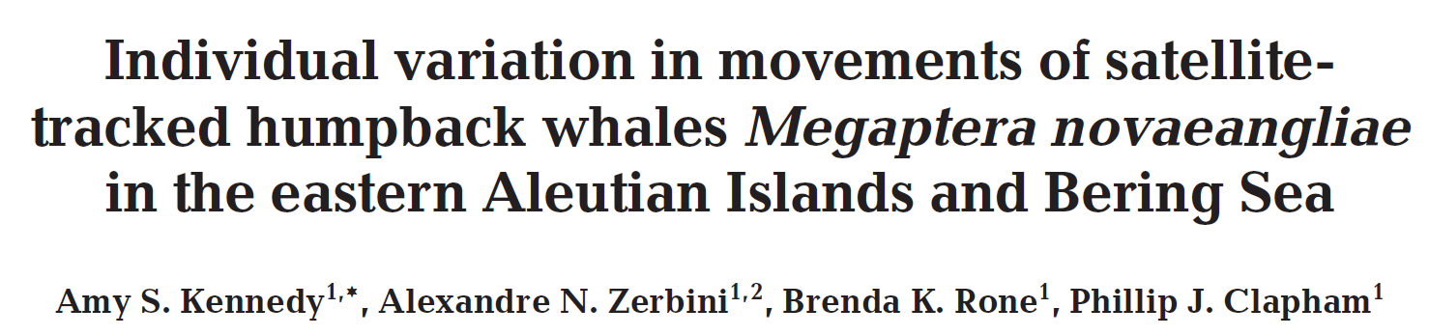
HMM Examples/Applications
Humpback whales
Notes:
To give you an appreciation for some of the applications of using a HMM to characterize animal behavior, I’ve provided a few examples for you to read through. The first is a humpback whale study where the researchers separated whale movements into two states, a foraging state which is shown in red and a traveling state in green. It’s hard to see from the graph, but you should see the difference in the scales of both of these maps. In the map of the left, whales are movement across a much smaller area, feeding mostly along the costly of these relatively small islands. In the graph on the left the scale is much larger, with whales moving broadly across the area and almost exclusively traveling rather than foraging.

Slide 15
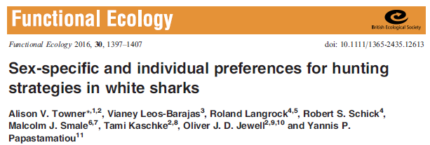
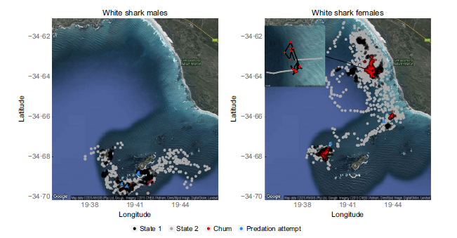
HMM Examples/Applications
White sharks
Notes:
This next example is of white sharks that are colored (black and grey) to highlight two different behavioral states. The black denotes an area restrictive search behavior and the grey denotes patrolling behavior. What they found was that area restrictive search behavior increase during morning periods and when tourist operations were chumming the water to facilitate shark viewing. They also found that found that the proportion of time that individuals spent in each state, different between sexes, the main point of the figure to show the dramatic differences observed.

Slide 16
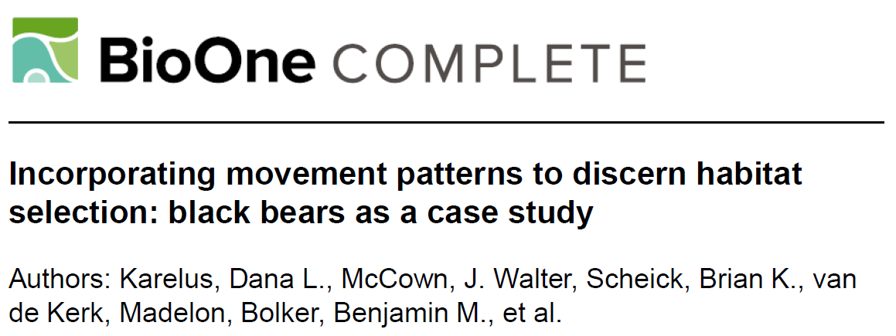
HMM Examples/Applications
Black bears
Winter
Summer
Fall
Notes:
In this next example, I wanted to show the type of output that is common to HMM analyses. These graphs are from a black bear study, showing the turning angles and steplength distributions of male and female bears in winter, summer, and fall. This is pretty interesting, as it shows changes in movement behavior across seasons. You can see that exploratory movements generally result in longer steplengths and straight line movements, with turning angles centered around zero. When animals are resting or encamped, however, they generally move with shorter steplengths and in a circular fashion…so much more of this area restricted search behavior that I mentioned previously. It’s also interesting because we can look at differences between sexes and while it’s not shown here, the authors separate out segments of these tracks based on these behaviors (resting, encamped, exploratory) to perform behavioral-based resource selection/habitat modeling. So, recognizing that habitat selection may differ when the animal is resting or foraging.

Slide 17
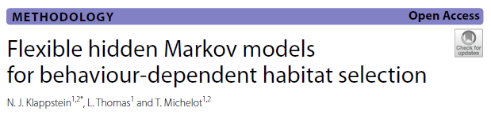
HMM Examples/Applications
Plains zebra
Notes:
And last, this paper takes this aspect a step further, fully integrating the results from a Hidden Markov Model into a step selection function analyses and trying to pull as much information from the movement track to improve a habitat selection analyses. This seems like the direction that this field is heading. Here we see two different behavioral states for plains zebra, displayed in a figure we can generate from the moveHMM package to visualize the switches in behavior that occurred over a 3 year tracking period. From the graph we see that this animal spent long periods in one behavior compared to another, allowing us to investigate other potentially more interesting questions about why this might be. Is it related, for example, to changes in habitat or climate, etc.

Slide 18
Behavior Change Point Analysis (BCPA)
Identifies points in a time series when values undergo a significant shift
•Designed to identify changes in animal behavior -Gurarieet al. 2009
•Assumes continuous-space, continuous time stochastic process
•Uses maximum-likelihood to estimate parameters within a moving window
•Portions of path where values change abruptly identified as boundaries between movement modes

Slide 19
Summary of Analytical Approach (BCPA)
Package bcpa
•Assume observations from continuous time process with mean, standard deviation and autocorrelation time scale
•Parameters vary according to an unknown number of states
•Select a response variable for analysisPersistence velocity 𝑉𝑝=𝑉cos(𝜃)where 𝑉= speed and 𝜃is turning angle (measures tendency to continue in same direction and speed)
Turning velocity 𝑉𝑡=𝑉sin𝜃(tendency to head in perpendicular direction)
Other variables could be used (e.g., 𝑉)

Slide 20
Summary of Analytical Approach (BCPA)
Moving window of fixed size swept across data
•3 parameters estimatedMean, variance, autocorrelation time scale
•Identify locations in window which split data into two sets of the 3 parameters Identify which of the three parameters describes the separation in the data
Could be null model, meaning no separation in any
•All changepoints recorded and parameters estimated on either side of change
•Which parameters change, and how, gives clue to the behavior change

Slide 21
Key Points
Larger window size more robust but more coarse
•Smaller window more sensitive but more likely to give spurious results
•Threshold parameter indicates how many windows must have selected the changepoint to be considered significantResults in dropping less significant changepoints
•Flat vs. Smooth output
•Relatively complex model output and interpretation

Slide 26
References
Cagnacci, F., Focardi, S., Ghisla, A., van Moorter, B., Merrill, E.H., Gurarie, E., Heurich, M., Mysterud, A., Linnell, J., Panzacchi, M., May, R., Nygård, T., Rolandsen, C. and Hebblewhite, M. (2016), How many routes lead to migration? Comparison of methods to assess and characterize migratory movements. J AnimEcol, 85: 54-68.
Gurarie, E., R. Andrews and K. Laidre. 2009. A novel method for identifying behaviouralchanges in animal movement data. Ecology Letters. 12: 395-408.
Gurarie, E., Bracis, C., Delgado, M., Meckley, T.D., Kojola, I. and Wagner, C.M. (2016), What is the animal doing? Tools for exploring behaviouralstructure in animal movements. J AnimEcol, 85: 69-84.
Karelus, D.L., J. Walter McCown, Brian K. Scheick, Madelonvan de Kerk, Benjamin M. Bolker, Madan K. Oli "Incorporating movement patterns to discern habitat selection: black bears as a case study," Wildlife Research, 46(1), 76-88, (15 February 2019)
Kennedy, A. S., A. N. Zerbini, B. K. Rone, and P. J. Clapham. 2014. Individual variation in movements of satellite-tracked humpback whales Megaptera novaeangliae in the eastern Aleutian Islands and Bering Sea. Endangered Species Research 23:187195
KlappsteinNJ, Thomas L, MichelotT. Flexible hidden Markov models for behaviour-dependent habitat selection. Mov Ecol. 2023 Jun 3;11(1):30. doi: 10.1186/s40462-023-00392-3.
Michelot, T., Langrock, R. and Patterson, T.A. (2016), moveHMM: an R package for the statistical modelling of animal movement data using hidden Markov models. Methods EcolEvol, 7: 1308-1315.

Slide 27
References (Cont’d)
Nicholson, K.L., Matthew J. Warren, Camille Rostan, Johan Månsson, Thomas F. Paragi, HåkanSand. 2019. Using fine-scale movement patterns to infer ungulate parturition. Ecological Indicators 101: 22-30. https://doi.org/10.1016/j.ecolind.2019.01.004.
Patin, R, Etienne, M-P, Lebarbier, E, Chamaillé-Jammes, S, Benhamou, S. Identifying stationary phases in multivariate time series for highlighting behaviouralmodes and home range settlements. J AnimEcol. 2020; 89: 44–56.
Pohle, J., Langrock, R., van Beest, F.M. et al. Selecting the Number of States in Hidden Markov Models: Pragmatic Solutions Illustrated Using Animal Movement. JABES 22, 270–293 (2017). https://doi.org/10.1007/s13253-017-0283-8
Postlethwaite CM, Dennis TE (2013) Effects of Temporal Resolution on an Inferential Model of Animal Movement. PLoSONE 8(5): e57640.
Towner, A.V., Leos-Barajas, V., Langrock, R., Schick, R.S., Smale, M.J., Kaschke, T., Jewell, O.J.D. and Papastamatiou, Y.P. (2016), Sex-specific and individual preferences for hunting strategies in white sharks. FunctEcol, 30: 1397-1407.
Zucchini, W., MacDonald, I. L., and Langrock, R. (2016). Hidden Markov models for time series: an introduction using R, Second Edition. Chapman and Hall/CRC.

