Slide 1
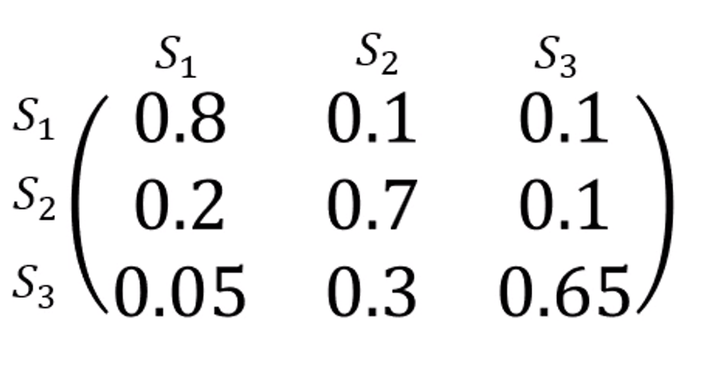
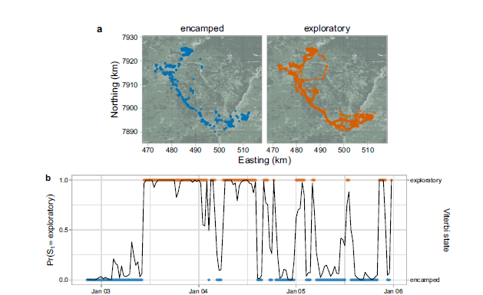

Introduction to Animal Movement Analyses
Categorizing Behavior States
Jared A. Stabach, PhD
Research Ecologist
Terrestrial Lead – Movement of Life Initiative
Conservation Ecology Center
Smithsonian’s National Zoo &
Conservation Biology Institute
This lecture is based on a graduate training course taught
at the Smithsonian-Mason School of Conservation
Many thanks to Dr. Joe Kolowski for sharing his notes.
https://smconservation.gmu.edu/programs/graduate-and-professional/
Notes:
Hello everyone.
Today we’re going to start investigating what else we can infer about the animal’s we’ve fitted with tracking devices.
As you all are aware, it is very difficult to physically observe animals in the wild. As a result, researchers often use the movement path to infer information about the animal’s behavior. Is the animal resting? Is it feeding? How much time does it spend moving or feeding? And, importantly, what habitats does it frequent and what resources does it need for survival?
So, we’re going to start addressing these questions over the next few lectures, but it’s important to realize that we are inferring these behaviors solely based on the animal movement data.
My lecture notes are heavily influenced by a course taught at the Smithsonian-Mason School of Conservation and I’ve left a link to these classes here. But, I also what to thank Dr. Joe Kolowski, the instructor for this class, for sharing his notes to help guide you. I’d encourage to you to check out this site for other courses that might be of interest to you.

Slide 2
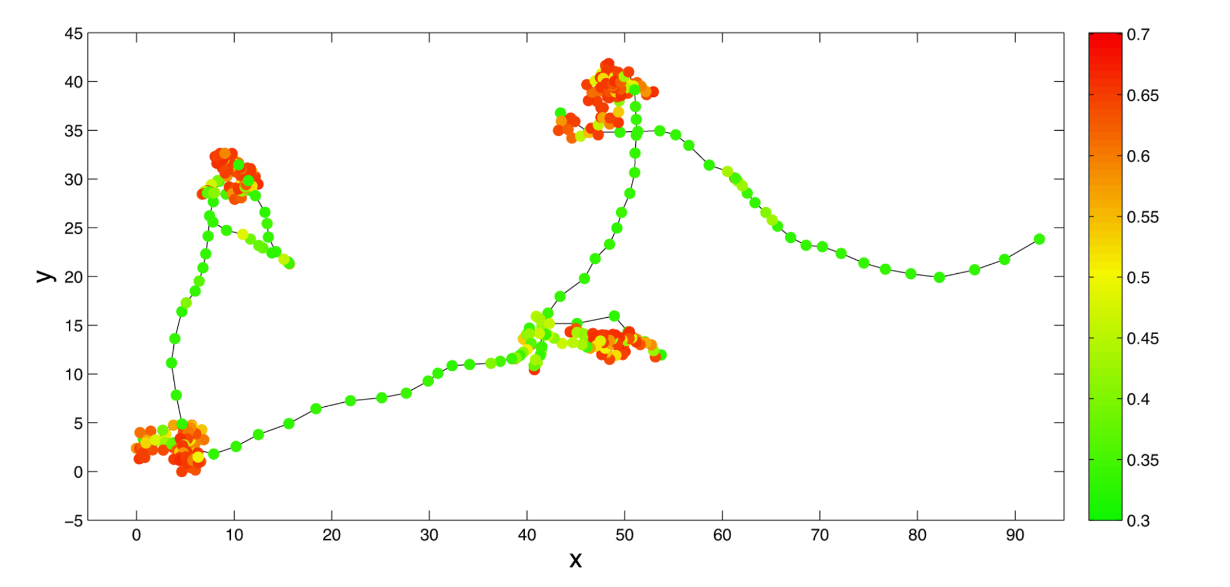
Behavioral Partitioning
Hidden Markov Models (State-switching State Space Models)
Behavioral Change Point Analysis (BCPA)
First Passage Time/Residence Time
Multi-state Random Walk
Hidden Markov Models (State-switching State Space Models)
Behavioral Change Point Analysis (BCPA)
First Passage Time/Residence Time
Multi-state Random Walk
See Gurarie et al. 2016
for summary and comparison of methods
Notes:
We’re going to start with a process called Behavioral Partitioning.
This involves using characteristics of the movement information, typically across all individuals, in order to assign a label to segments of the movement path to identify what the animal or animals were doing. More technically correct, what we are doing is identifying when is the animal doing something different from what it was previously doing. Has the movements changed over time and what does that change in movement mean?
From this, we are trying to associate these changes in movement with ideally, a specific behavior.
We have a few options available to us to answer these types of questions, all of which differ in their assumptions, the complexity of their output, and in their explanatory potential. These include:
Hidden Mark Models or so-called State-Switching State Space Models, Behavioral Change Point Analysis (BCPA), First Passage Time or Residence Time, and Multi-state Random Walks. We going to spend most of our discussion on HMMs because this is the most developed of these behavioral partitioning models.
I’ve also listed the Gurarie et al 2016 paper, as it provides a very nice summary and comparison of all 4 of these methods. The paper is also included in the lecture file notes.

Slide 3
Applications of Behavior State Assignment
Exploratory
(What is the animal doing?)
Explanatory
(Why is the animal doing it?)
Predictive
(Can we anticipate movement from behavior?)
If we modify the environment in some way, how will movement behavior change?
Metrics to describe and quantify the movement track
Are there distinct behaviors? If so, how many?
What distinguishes the behaviors?
When and where do the behaviors occur?
Associate behaviors and transitions with covariates
Season
Environmental cues
Predation or conspecifics
Notes:
So why would we want to break out these behaviors, especially as researchers or protected area managers? The Gurarie paper does a good job of explaining this, breaking out the objectives of animal movement studies into three main categories: Exploratory, Explanatory, and Predictive.
In the Exploratory phase, we are interested in what the animal is doing? This entails generating metrics to describe and quantify the movement track. How fast or slow is the animal moving? How far did it move? Then, we can start asking whether there are distinct behaviors in the animal movement track and if so, how many? What characteristics distinguish these behavior and we can investigate when and where these behaviors occur? This get’s very interesting, as we start to look at the preferences of the animal and how their movements are related to habitat, climate, and/or disturbance.
Then we can start to ask Explanatory behaviors. Why is the animal doing something? This allows us to associate behaviors with something in the animal’s environment or how the transitions are related to particular covariates, like season or some sort of environmental cue, or potential related to predation or social factors like the rank of the animal in a group or how many animals might be in a group.
And then finally we ask predictive questions. If we modify the environment in some way, how would that be expected to impact the animal.
It’s really these Explanatory and Predictive aspects that are most interesting, but require us to start at the Exploratory phase.

Slide 4
Hidden Markov Models
Discrete time, discrete state, state space models
Operate on time-series data for step lengths and turning angles
Could also be used on accelerometry data, but also occupancy data, capture-recapture data…
Parameters of step length distribution and turning angle distribution determined by an underlying observed state
Notes:
We’ll start with Hidden Markov Models, which I’ll commonly refer to as HMMs. These are also often referred to as state switching models. These are discrete time, discrete state, state space models. So, this is an important distinction from the models that Chris has been describing. The behavioral state of the animal is the unobserved, or the latent state, that we are trying to predict.
These models operate on time series data where the response variable is step length and turning angle, but this framework could be used on other time series data, for instance accelerometry data, occupancy data, capture-recapture data, and others
The key assumption is that we have some unknown number of unobserved behavioral states and these behavioral states can be distinguished by distinct statistical distributions of step lengths and turning angles. This is really the core of this approach.

Slide 5
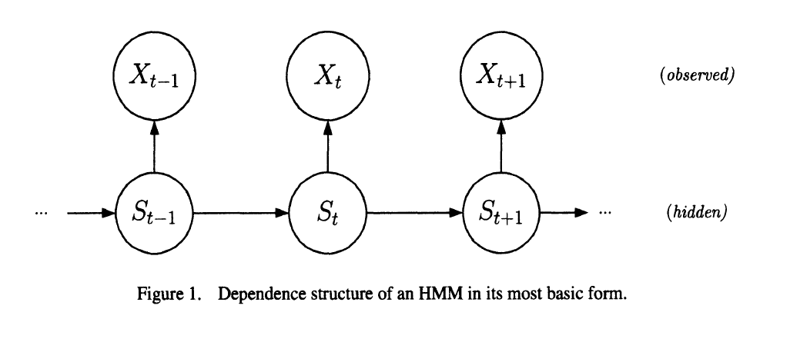
Hidden Markov Models
Observation process and latent state process
Locations are the observation process, behavior state is the latent state process
Latent state process taken to be a Markov Chain
Discrete random variable, (1,2,…N)
N is # of potential states (typically <= 4)
Data distributions (step length and turn angle) vary by state
Transition probability matrix
Governs the sequence of switching most likely and how probable these switches are
Pohle et al. 2017
Notes:
So what does this look like.
We have two processes…this is what makes this a hierarchical modeling approach. We have our observation process, which in this case is our location observations with associated step lengths and turning angles….the movement data. And, we have our latent or unobserved state…our hidden state. This is what we want to learn about.
We assume that this latent state process is a Markov process, meaning that information about the current state is used to make information about the following or future state.
You might also hear the term 1st or or 2nd or Markov process. This just mean how many previous states are used (1 or 2 or more) to inform the current or future state. So a 1st order Markov process indicates that we are only using the current state to predict our future state.
We have discrete (arguably) random variables, in this case step length and turning angles. And we have N, our number of states, which in most cases is typically 4 or less. Most likely 2 or 3 states. This is what we are trying to estimate effectively. What is the animal doing? Is it resting or feeding?
Again, the key is that these states vary in the distributions of the step length and turning angles. We’ll also have a transition matrix included in these models. This governs how likely it is for animal to switch from one state to another state.

Slide 6
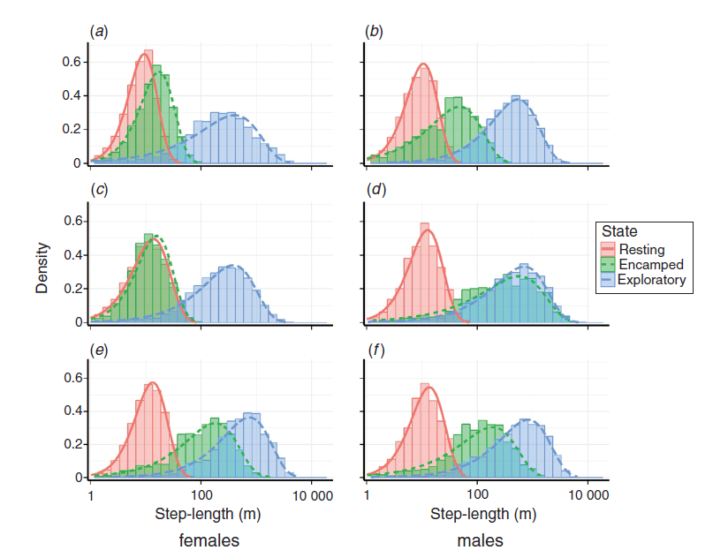
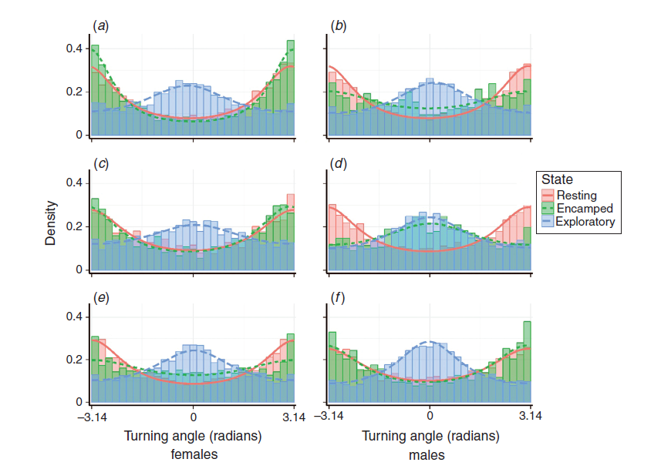
Implementing HMMs in R
Models estimate:
Transition probabilities
Mean and variance of step length and turn angle for all states
Transition probabilities can be modeled as function of covariates
Step length
Turning angle
Notes:
So with these models, we are going to estimate transition probabilities, which we see in the matrix table on the bottom left. And it’s going to estimate the parameters of the statistical distributions of step length and turning angles for each of our states. This is the kind of output that we will see with these models. On the right, which is taken from XXX, you can see the raw data summarizes in columns, and the model fitted estimates of these parameters, shown as thick curved lines. Step lengths are at the top and turning angles on the bottom. Most important for you at this point is simply to notice the difference in the distributions between each of these states.
We also see the numerical transitions which estimates the likelihood that animals switch from 1 state to the next. This matrix is easiest read in rows…so the probability that an animal will transition from State 1 to State 1, that is stay within that state is very high (0.8 or 80 %), with smaller probabilities of transitioning from State 1 to State 2 or State 1 to State 3. Similarly, we see that this animal transitions from State 2 to State 1 with a 20% probability and from State 2 to State 3 with a 10% probability.
Interestingly, the diagonals are all quite high. This make sense. When you are in a particular state, you tend to stay in that state.
Probably most important is that we can incorporate covariates that influence the transitions between different states. So, for instance, does the habitat type or time of day influence your behavioral state. This is what we will be looking at when we fit models.

Slide 7
HMM Parameters for Animal Movement
N = # of states
Starting state (typically taken to be equally likely)
Distribution of step lengths (for each state)
Gamma, Weibull, log-normal and exponential distributions
Mean
Variance (SD)
Zero-mass
Distribution of turning angles (for each state)
von Mises and wrapped Cauchy distributions
Mean
Clustering parameter
Transition probability matrix
Notes:
When we setup these models, we need to provide starting values. This can be a frustrating part, as the models will often fail if improper starting values are provided.
We have to input the number of states. This is not an estimable parameter in these models. It must be provided.
We also need to specify the starting state. Common is to simply provide an equal probability of being in any one of the starting states.
Then, we need to setup the distributions for step length and turning angles and we need to do this for each of the states. This means we first need to specify the shape of the distribution. For the steplengths, we have four potential distributions to choose from. A gamma distribution is the default, but we could also choose a Weibull, a log-normal, or an exponential distribution. These dictate the shape and behavior of the curves. For Gamma, we then need to provide the mean, variance, and zero-mass. The zero mass needs to be used if you have steplengths of 0.
For our turning angles, we have two potential distribution options, the von Mises (which is the default) and the wrapped Cauchy. Both are circular distributions, which require the mean turning angle and the clustering parameter which is similar to the variance of the turning angle distribution.
The Transition probably matrix will then be estimated based on our starting states. This will be estimated for us once we input all the other values, so we don’t need to put starting values here….this will be estimated.

Slide 8
Implementing HMMs in R
Connecting location data to latent states (decoding algorithms)
Viterbi
Finds most probable sequence of states that generated the data
Forward-backward algorithm
Computes marginal probability of each state at time t
Forward-filtering backward sampling algorithm
Generates sequences that could have resulted in observed state
Stationary probabilities available
Assume regular sampling with negligible error
Paths can be smoothed prior to analysis if error on same scale as step lengths
No date/time information is included
User specifies # of state (<= 4) and models with varying states can be compared with AIC
Notes:
Once models are run….we can then use what are called decoding algorithms to assess the most likely state for every one of our locations. As you can imagine, this is very useful. In R, we have access to three different algorithms, which differ slightly with how they decode the state values. The default is called the Viterbi algorithm.
We also have access to stationary probabilities. So instead of assigning a state to every point, we can look at the state probability of each point, oftentimes providing a value of confidence to each particular state assignment.
It’s important to note that with these models we are assuming regular sampling intervals with negligible error. If this assumption can’t be met, pre-processing of the data would be necessary. Chris highlighted some ways of removing erroneous points, but other methods exist to smooth travel path and remove or minimize erroneous data points. The problem here is that the latent states that we are estimating are completing based on the steplengths and turning angles. And, if these are incorrect or biased in some way, it can have a huge on these distributions and impact our results.
There is not date/time included in these models……we have to make sure we are feeding the data in an ordered sequence (Chronologically), which we’ll do together during the coding part of lecture. As a result, we need to be very careful about irregularly sampled data, as the model won’t differentiate.
We also can use standard model comparison techniques like AIC to assess individual models.

Slide 9
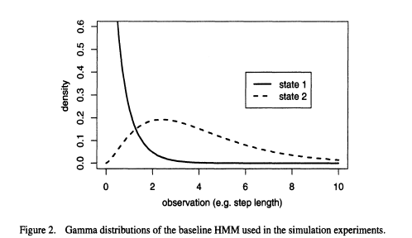
Pohle et al. 2017
Notes:
Here, I’m showing you the gamma distribution, which is taken directly from the Pohle et al paper. The nice aspect of this distribution and why it’s used is that values cannot go below 0. You can’t have a negative steplength, so it’s more appropriate, that is, it has the statistical support to be used with the animal movement data.
Here, we have 2 states. State 1 is described with a mean value of 0.5 and a shape parameter of 0.7, that’s essentially the variance in this distribution. State 2 has a mean of 4, with a shape or variance of 2.5. What you can see is the difference in the shapes for each of these states…representative of different behaviors.

Slide 10
Hidden Markov Models with moveHMM
my_mod <- fitHMM(data = my_move_object,
nbStates= 2,
stepPar0 = stepPar0,
anglePar0 = anglePar0,
formula = ~ 1)
plot(my_mod)
# Needs to be specified (≤ 4)
# Starting values, step length distribution
# Starting values, turn angle distribution
Ability to investigate impact of covariates on transition probabilities
Notes:
Okay, so in R and using the package moveHMM, this is the structure of the function that we will use.
The syntax requires us to specify the movement object….again, we need to format this data object, as moveHMM does NOT recognize the data as a time series. So, it’s very important to we clean these data and align the sequence properly before starting the modeling process. This is what we will be doing next.
We then need to specify the number of states we are interested in estimating. We then need to specify our initial starting values for the steplength and turning angles of each of these states. We then can also include a formula to investigate the impact of various covariates on our transition probabilities. These are the factors that influence whether the animal is in 1 state or another. Here, we’ve specified this in normal model notation as a null model….that is, the covariates have no impact on the transition probabilities. This could, however, be distance to water, time of day, amount of anthropogenic or human disturbance. Note, these covariates must a continuous predictor variable….something that varies over time (i.e., continuous, time varying predictors). So, for instance, you wouldn’t include something like sex, since this would not vary over time. Habitat type can also be difficult to include as the data are categorical. You could include age or age class (juvenile, sub-adult, adult) as these items do change and could have an impact on the animal transitioning from different states.
Once you have a fitted model, you can then plot the model to visualize the results by plotting the model output.

Slide 11
GRAB A FIGURE which shows an example of an animal that is switching between states.
Notes:
Here’s the type of output that you will receive after fitting your HMM. The movement trajectory, in this case it’s one of my wildebeest that we will be using, is divided into different colors. It’s then up to the researcher to assign a name to the behaviors. We don’t actually know what these behaviors are. All that we do know is that the model has identified these as two unique behavior based solely on the step lengths and turning angles. Here, we can reasonably say that one of the states, colored in orange, is more of an encamped or area restricted search behavior and the blue, is more of an exploratory state that is characterized by longer steplengths and more directed movements.

Slide 12
Postlethwaite and Dennis 2013
Notes:
In the previous graph, each point was coded based on a predictive state assignment. But, since you also get a probability of being in one particular state, you can also graph this probability assignment over time. Here, I’m showing a simulated track from Postlethwaite and Dennis where the probabilities of being in one particular state are displayed. So you can see that the model predicts with a high level of certainty the state in red, but a lower probability of that particular state in green. So, just another visual tool to see what’s happening behind the scenes and perhaps convince yourself that the model is doing what you expect.

Slide 13
Challenges to HMMs
Starting parameters values and correct distributional forms
Choosing the # of states to model (Pohle et al. 2017)
Impact of sampling schedule (Postlethwaite and Dennis, 2013)
Higher resolution tends to improve identification of behavioral states as long as error is much smaller than step length
Irregular sampling
State space models with crawl or aniMotum to regularize
Notes:
Some things to keep in mind.
First, we need to identify starting parameter values and the correct form of the distributions. We, can test for the correct forms using sensitivity analyses, but this can be difficult, especially when models become more complex.
Second, we need to choose the # of states we aim to predict in the model. The Pohle et al paper is a particular good reference, providing recommendations on how to choose the number of states to include in your model. The model comparison tends to favor a model with more states, so that researcher really needs to think about his or her research question, rather than relying solely on quantitative metrics.
Third, the sampling schedule is absolutely going to impact your ability to identify behavioral states. This is largely due to the scale at which your species is making movement decisions. If your animal is making fine-scale complex movements, but you are sampling just a few times per day, you will be less likely to identify these behavioral changes. It’s also important to consider the error associated with your positions. You want to be modeling the movement process related to an animal’s behavior, not the error process.
Lastly, the model assumes regular sampling, which often is not the case with animal movement data. To get your data in the format required, you may need to resample your data to a different temporal interval, like crawl or aniMotum, before ingesting the data into moveHMM. These packages then smooth or regularlize the movement track so that the data can be integrated. This isn’t much of an issue when few data points are missing, but large gaps in data could be problematic and may require that you simply analyze the movement track with areas that are highly irregular.`

Slide 14
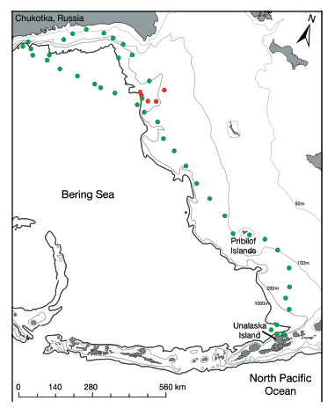
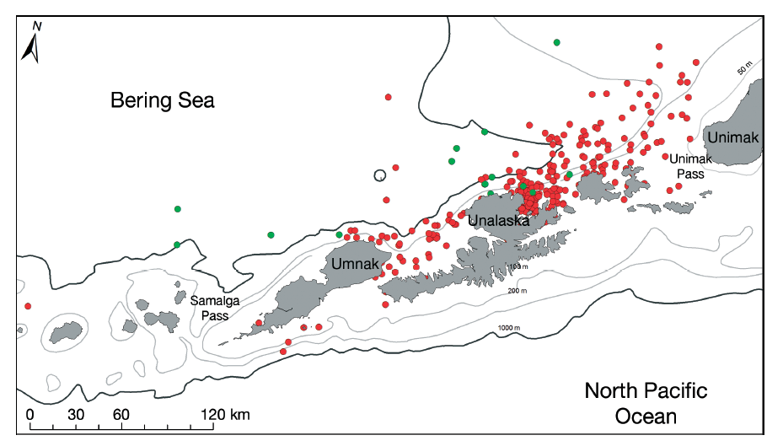
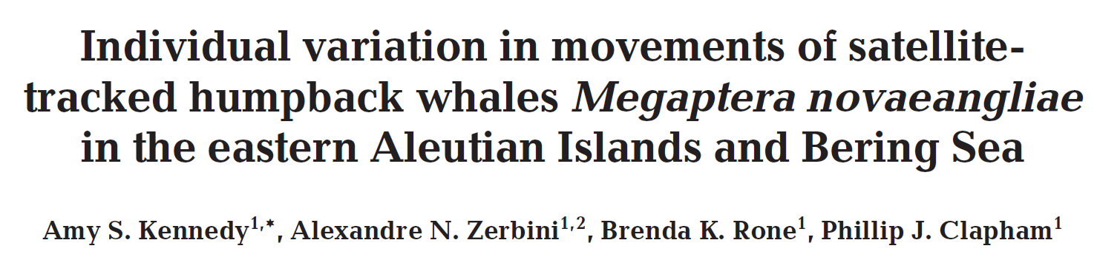
HMM Examples/Applications
Humpback whales
Notes:
To give you an appreciation for some of the applications of using a HMM to characterize animal behavior, I’ve provided a few examples for you to read through. The first is a humpback whale study where the researchers separated whale movements into two states, a foraging state which is shown in red and a traveling state in green. It’s hard to see from the graph, but you should see the difference in the scales of both of these maps. In the map of the left, whales are movement across a much smaller area, feeding mostly along the costly of these relatively small islands. In the graph on the left the scale is much larger, with whales moving broadly across the area and almost exclusively traveling rather than foraging.

Slide 15
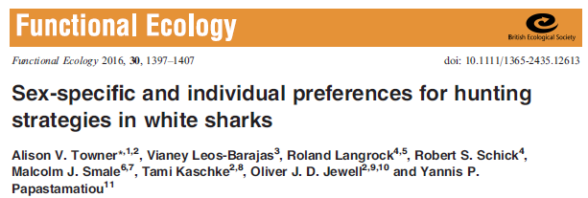
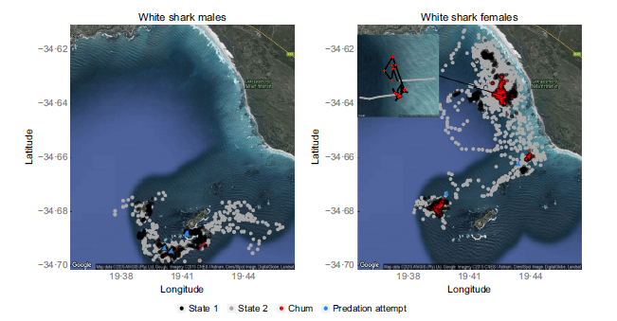
HMM Examples/Applications
White sharks
Notes:
This next example is of white sharks that are colored (black and grey) to highlight two different behavioral states. The black denotes an area restrictive search behavior and the grey denotes patrolling behavior. What they found was that area restrictive search behavior increase during morning periods and when tourist operations were chumming the water to facilitate shark viewing. They also found that found that the proportion of time that individuals spent in each state, different between sexes, the main point of the figure to show the dramatic differences observed.

Slide 16
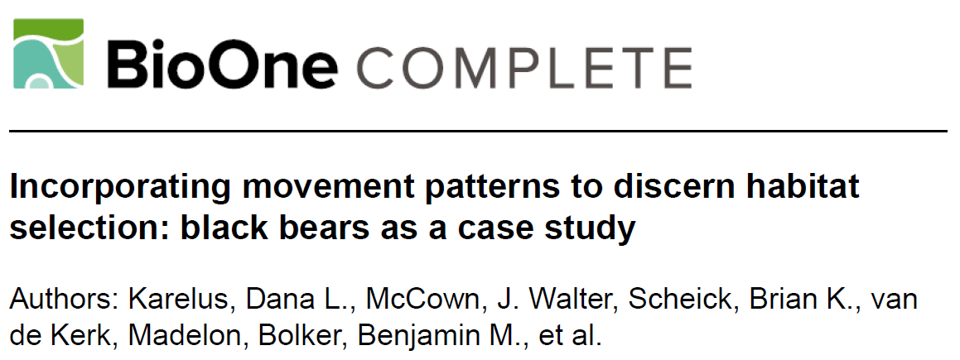
HMM Examples/Applications
Black bears
Winter
Summer
Fall
Notes:
In this next example, I wanted to show the type of output that is common to HMM analyses. These graphs are from a black bear study, showing the turning angles and steplength distributions of male and female bears in winter, summer, and fall. This is pretty interesting, as it shows changes in movement behavior across seasons. You can see that exploratory movements generally result in longer steplengths and straight line movements, with turning angles centered around zero. When animals are resting or encamped, however, they generally move with shorter steplengths and in a circular fashion…so much more of this area restricted search behavior that I mentioned previously. It’s also interesting because we can look at differences between sexes and while it’s not shown here, the authors separate out segments of these tracks based on these behaviors (resting, encamped, exploratory) to perform behavioral-based resource selection/habitat modeling. So, recognizing that habitat selection may differ when the animal is resting or foraging.

Slide 17
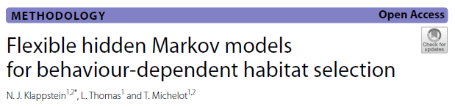
HMM Examples/Applications
Plains zebra
Notes:
And last, this paper takes this aspect a step further, fully integrating the results from a Hidden Markov Model into a step selection function analyses and trying to pull as much information from the movement track to improve a habitat selection analyses. This seems like the direction that this field is heading. Here we see two different behavioral states for plains zebra, displayed in a figure we can generate from the moveHMM package to visualize the switches in behavior that occurred over a 3 year tracking period. From the graph we see that this animal spent long periods in one behavior compared to another, allowing us to investigate other potentially more interesting questions about why this might be. Is it related, for example, to changes in habitat or climate, etc.

Slide 18
Behavior Change Point Analysis (BCPA)
Identifies points in a time series when values undergo a significant shift
Designed to identify changes in animal behavior – Gurarie et al. 2009
Assumes continuous-space, continuous time stochastic process
Uses maximum-likelihood to estimate parameters within a moving window
Portions of path where values change abruptly identified as boundaries between movement modes
Notes:
Now, let’s shift to a brief summary of a different method, Behavior Change Point Analysis or BCPA, which is also useful in looking at behaviors or changes in behavior in a time series. This method looks for points in a time series during which there are notable shifts. Similar to an HMM, you can apply it to different types of time series data where something is abruptly changing over time. We’ll once again be applying BCPA to a movement trajectory.
Different from a HMM, these models are continuous space, continuous time stochastic process models…so significantly different that what we just went over. Changes in the time series are assessed by estimating our parameters of interest using a moving window of a certain size. The portions of the path where these value change abruptly are then identified as boundaries or change points between different movement modes or behaviors.

Slide 19
Summary of Analytical Approach (BCPA)
Package bcpa
Assume observations from continuous time process with mean, standard deviation and autocorrelation time scale
Parameters vary according to an unknown number of states
Select a response variable for analysis
Persistence velocity 𝑉𝑝=𝑉cos(𝜃) where 𝑉= speed and 𝜃 is turning angle (measures tendency to continue in same direction and speed)
Turning velocity 𝑉𝑡=𝑉sin𝜃 (tendency to head in perpendicular direction)
Other variables could be used (e.g., 𝑉)
Notes:
Let’s go into this in a little more detail.
These models will be implemented using the package bcpa which was written by Gurarie
We are going to assume observations are from a continuous time process that is described by a mean, standard deviation, and an autocorrelation time scale….this should sound familiar from what Chris was talking about with CTMM.
We have an unknown number of states that we don’t need to specify a priori and those states vary according to these variables (mean, standard deviation, and autocorrelation time scale).
So what are these parameters describing. We’re not using step lengths and turning angles necessarily since this is a continuous time process. Instead, what we typically see as a variable…a quantitative description to look for change in…is what is called a persistence velocity. We’ll be taking speed (V) and multiply by the cosine of the turning angle and this generally, measure the tendency of the animal to continue in the same direction and speed….thus the name “Persistence Velocity of Vp
You’ll also see Turning velocity used as a quantity we are using, this describes the tendency to head in a perpendicular direction instead of the same direction and it’s the Velocity multiplied by the sine of the turning angle.
Other variables could also be used…such as simply using speed/velocity.

Slide 20
Summary of Analytical Approach (BCPA)
Moving window of fixed size swept across data
3 parameters estimated
Mean, variance, autocorrelation time scale
Identify locations in window which split data into two sets of the 3 parameters
Identify which of the three parameters describes the separation in the data
Could be null model, meaning no separation in any
All change points recorded and parameters estimated on either side of change
Which parameters change and how, which gives clue to the behavior change
Notes:
The analysis proceeds with a moving window of a certain size which is swept across the data. Let’s say the window includes 30 points in time. This window is going to move across the data and in each window, we’re going to calculate the mean and variance of our variable (Vp, Vt, or V) – whatever we decide and the autocorrelation time scale. So, you need a big enough window to estimate these parameters using maximum likelihood.
Then, based on these parameters that we are calculating, we’ll identify the location within the window where the parameters diverge…where are they most different. It doesn’t need to be all the variables…it could simply be one of the variables. But, the key point is the identification of where a change or the greatest change occurs to separate or split the data to make two different dataset and it’s going to assess if the two datasets are significantly different. Sometimes this different will be insignificant, so the change point will not be registered and the assessments will just move on without registering a change.
As we move through the time series, all change points are recorded with the parameters estimated on either side of the change. We can look at which of the parameters change, which will give us some idea what the behavior might be at these change points or what has changed.

Slide 21
Key Points
Larger window size more robust but more coarse
Smaller window more sensitive but more likely to give spurious results
Threshold parameter indicates how many windows must have selected the changepoint to be considered significant
Results in dropping less significant changepoints
Flat vs. Smooth output
Relatively complex model output and interpretation
Notes:
So a few key points.
First, the window size is a big decision as it will impact your results. A larger window is more robust but could miss out on the fine scale changes you might be interested in. It will have lot’s of data, but it’s only going to identification major or large changes in behavior.
A smaller window will be more sensitive to fine-scale changes and provide greater detail in behavior changes of interest, but it may also identify changes that aren’t real…known as spurious change points.
Now, we can set a threshold parameters to control over how change points we’ll end up. The threshold indicators allows us, for example, to keep a change point if a certain number of moving windows identifies the change point. This results in a smoothing of the result by dropping out less significant changepoints.
Then, in terms of visual output we can start to visualize the changes, comparing a flat vs a smooth output…which we’ll see in the next few slides.
In general, the output from these models is more complex than the output of a Hidden Markov Model and often more complicated to interpret. I generally find that it takes a lot of playing around with the models to get something that makes sense. This works in simple situations, but can get really frustrating.

Slide 22
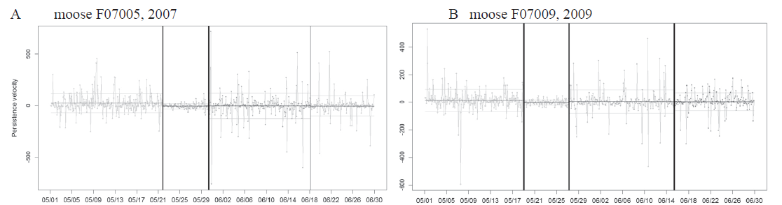
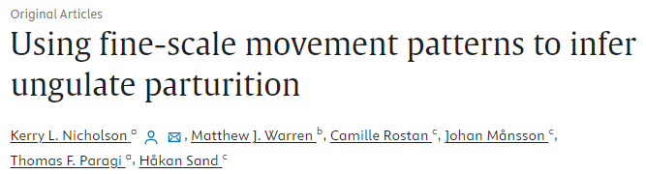
BCPA Examples/Applications
Moose
Notes:
So, let’s look at an example to see what we get or what we can get from a BCPA analysis.
Here, this figure was taken from a paper by Nicholson and colleagues that used a BCPA analyses to identify changes in movement behavior to identify parturition dates in moose. The graph shows two different female moose, animal F07005 in 2007 and animal F07009 in 2009. What you see is a graph of persistence velocity, with the change depicting a time period in May where the persistence velocity changed. In this case, the change was confirmed as a time period when each moose gave birth.
This is a particularly nice example because it then allows for the possibilities of looking for other change points, for these animals or for others, where the movement data can provide information about parturition.

Slide 23
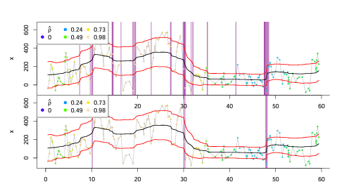
BCPA Examples/Applications
Flat vs Smooth output
See BCPA vignette for additional information
Notes:
This is an example directly from the BCPA package. The first image shows the smoothed output. You can see there is a lot of information contained within the graph.
Here, all the successive moving windows are averaged to obtain a smooth model shown by the black line. So there’s a moving window going over each of the points displayed in the graph. The vertical lines shown in purple represent significant change points, with thicker lines (the width of the line) indicating that multiple moving windows identified the change point. These are the changes that are most supported. Also being displayed is the autocorrelation time scale displayed as colored dots in the image.
The bottom image shows the same data after passive a threshold filter over the data, such that only those change points that were identified by a certain number of moving windows. This graph then distills much of the complexity and highlights the major or most significant changes.

Slide 24
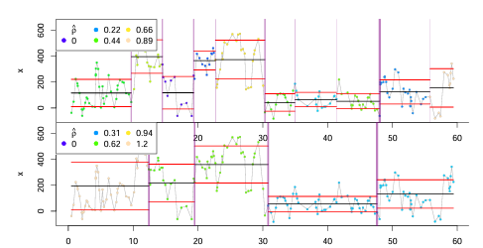
BCPA Examples/Applications
Flat vs Smooth output
See BCPA vignette for additional information
Notes:
Here’s what’s called the flat output of the same analysis. This one first selects change points that it deems significant by clustering together neighboring change points and then it estimates homogenous constant behavior between those change points. Sort of a mean value in between the identified change points. The result is fewer change points that’s perhaps a little easier to look at and identify the key change points that exist in the data time series.
With the bottom image, we can then increase the clustering threshold to get a bit more of a uniform profile of the changes. This will, however, smooth over some of the finer changes that exist in the data. So all these decisions have an impact on the output and the number of changes that are potentially identified, which is one of the criticisms of the method.

Slide 25
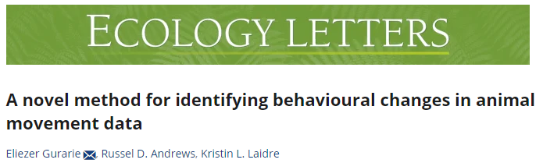
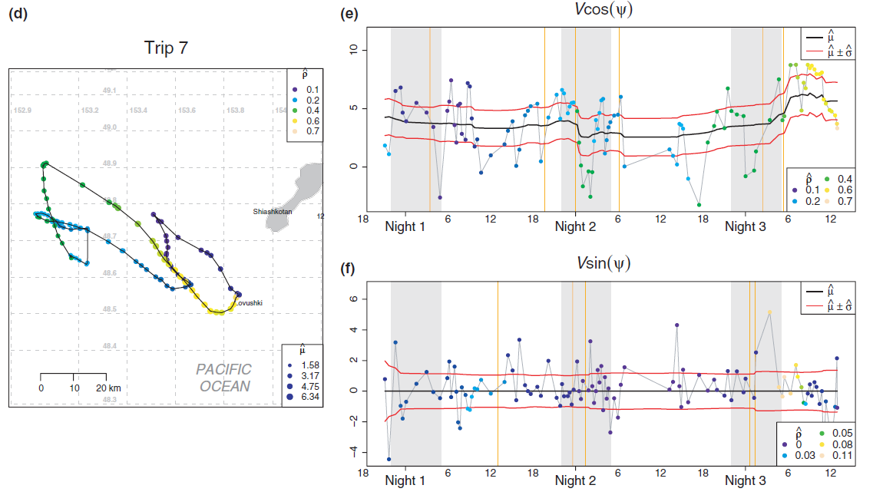
BCPA Examples/Applications
Fur seals
Notes:
As a final example, this image was taken from the Gurarie paper. This is just one forage trip of a seal that left the rookery.
The top graph is the persistence velocity…the velocity times the cosine of the turning angles. We don’t see many changes in the movement trajectory, but higher values are the higher persistence velocity, potentially related to faster, directed movements which we can see in the graph, while lower values are likely more related to feeding behavior. So these colors in the plot coincide with the colors shown in the graph. From this we can start to make some inference about what the animal was doing along this foray and we can start to calculate, for instance, how much the animal species foraging compared to navigating between foraging locations.
This method certainly has its strengths and investigating individual trips where you are interesting in identifying particular changes can be quite valuable….but also potentially very difficult when looing at lot’s of data, way a year or more from an individual animal. If doing so, you’d probably want to decrease your threshold so that you weren’t picking up small behavioral changes and instead, just keying in on specific changes of great interest.

Slide 26
References
Cagnacci, F., Focardi, S., Ghisla, A., van Moorter, B., Merrill, E.H., Gurarie, E., Heurich, M., Mysterud, A., Linnell, J., Panzacchi, M., May, R., Nygård, T., Rolandsen, C. and Hebblewhite, M. (2016), How many routes lead to migration? Comparison of methods to assess and characterize migratory movements. J Anim Ecol, 85: 54-68.
Gurarie, E., R. Andrews and K. Laidre. 2009. A novel method for identifying behavioural changes in animal movement data. Ecology Letters. 12: 395-408.
Gurarie, E., Bracis, C., Delgado, M., Meckley, T.D., Kojola, I. and Wagner, C.M. (2016), What is the animal doing? Tools for exploring behavioura lstructure in animal movements. J AnimEcol, 85: 69-84.
Karelus, D.L., J. Walter McCown, Brian K. Scheick, Madelonvan de Kerk, Benjamin M. Bolker, Madan K. Oli "Incorporating movement patterns to discern habitat selection: black bears as a case study," Wildlife Research, 46(1), 76-88, (15 February 2019)
Kennedy, A. S., A. N. Zerbini, B. K. Rone, and P. J. Clapham. 2014. Individual variation in movements of satellite-tracked humpback whales Megaptera novaeangliae in the eastern Aleutian Islands and Bering Sea. Endangered Species Research 23:187195
Klappstein NJ, Thomas L, Michelot T. Flexible hidden Markov models for behaviour-dependent habitat selection. Mov Ecol. 2023 Jun 3;11(1):30. doi: 10.1186/s40462-023-00392-3.
Michelot, T., Langrock, R. and Patterson, T.A. (2016), moveHMM: an R package for the statistical modelling of animal movement data using hidden Markov models. Methods Ecol Evol, 7: 1308-1315.

Slide 27
References (Cont’d)
Nicholson, K.L., Matthew J. Warren, Camille Rostan, Johan Månsson, Thomas F. Paragi, HåkanSand. 2019. Using fine-scale movement patterns to infer ungulate parturition. Ecological Indicators 101: 22-30. https://doi.org/10.1016/j.ecolind.2019.01.004.
Patin, R, Etienne, M-P, Lebarbier, E, Chamaillé-Jammes, S, Benhamou, S. Identifying stationary phases in multivariate time series for highlighting behavioural modes and home range settlements. J Anim Ecol. 2020; 89: 44–56.
Pohle, J., Langrock, R., van Beest, F.M. et al. Selecting the Number of States in Hidden Markov Models: Pragmatic Solutions Illustrated Using Animal Movement. JABES 22, 270–293 (2017). https://doi.org/10.1007/s13253-017-0283-8
Postlethwaite CM, Dennis TE (2013) Effects of Temporal Resolution on an Inferential Model of Animal Movement. PLoS ONE 8(5): e57640.
Towner, A.V., Leos-Barajas, V., Langrock, R., Schick, R.S., Smale, M.J., Kaschke, T., Jewell, O.J.D. and Papastamatiou, Y.P. (2016), Sex-specific and individual preferences for hunting strategies in white sharks. Funct Ecol, 30: 1397-1407.
Zucchini, W., MacDonald, I. L., and Langrock, R. (2016). Hidden Markov models for time series: an introduction using R, Second Edition. Chapman and Hall/CRC.

