Slide 1
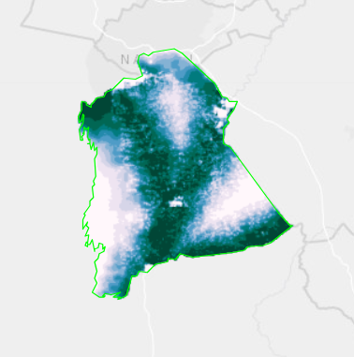
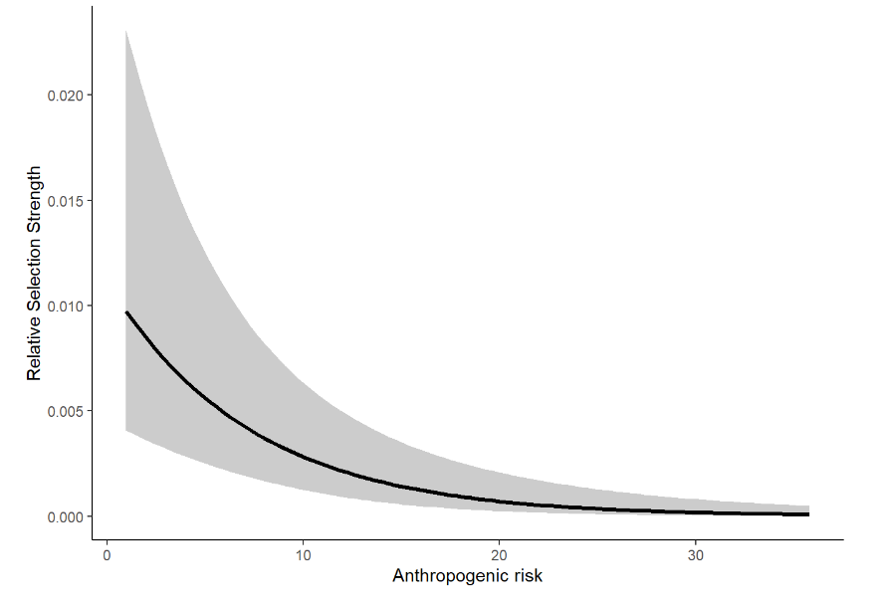
Introduction to Animal Movement Analyses
Resource Selection Function Models
Jared A. Stabach, PhD
Research Ecologist
Terrestrial Lead – Movement of Life Initiative
Conservation Ecology Center
Smithsonian’s National Zoo &
Conservation Biology Institute
Many thank to Dr. Joe Kolowski for sharing his notes and collaborating on these lectures. Additional Smithsonian-Mason School of Conservation training courses can be found at:
https://smconservation.gmu.edu/programs/graduate-and-professional/
Notes:
As a final lecture, I wanted to give you a brief background about resource selection function analyses, with a goal of introducing the tools that are being developed to more appropriately address this question. What we recognize is that animals do not move randomly across the landscape. There are certain characteristics, water, food, mates, that all govern their selection and movement.
These models can get quite complex. It’s important to know the assumptions of these models and how to apply them. So, I’m going to talk about the background of these models and then will hand things off to Chris so we can learn about the new tools being developed to account for autocorrelation and better include the movement process in analyses.

Slide 2
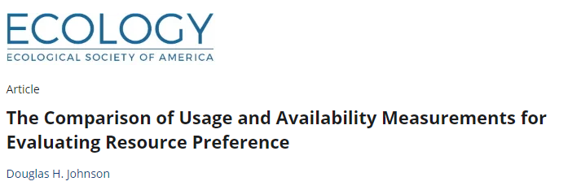
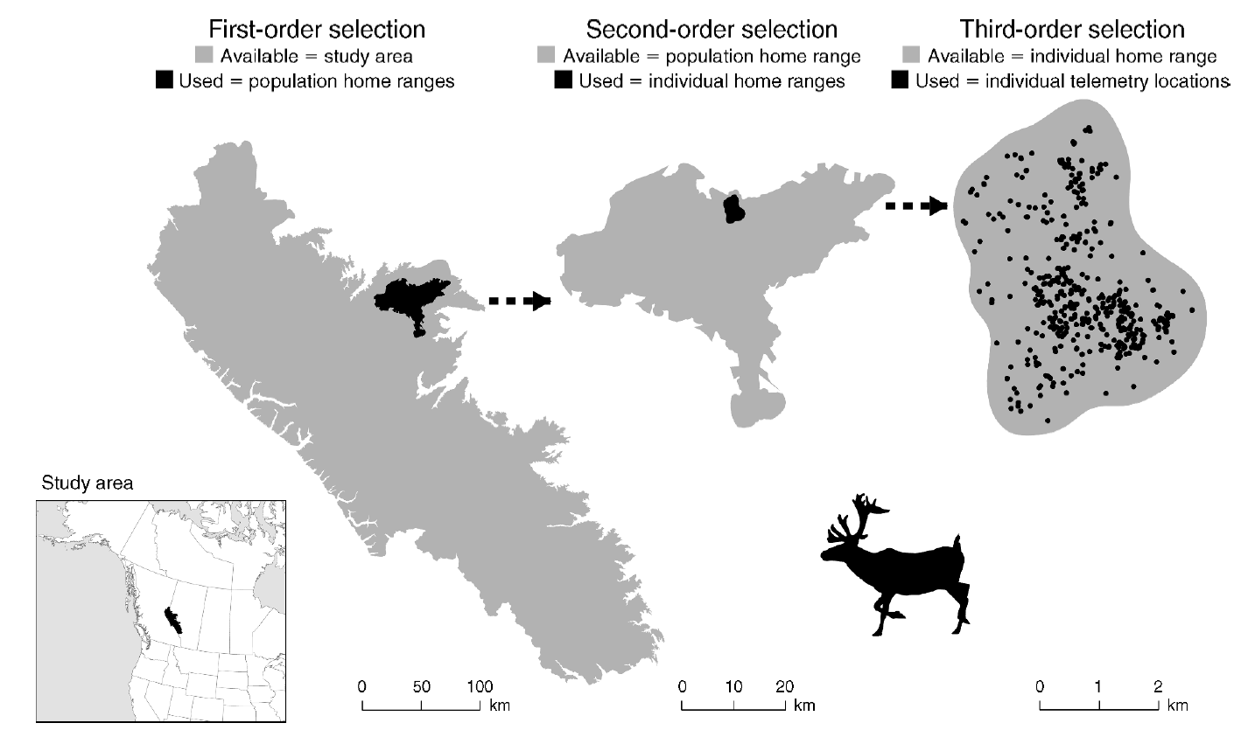
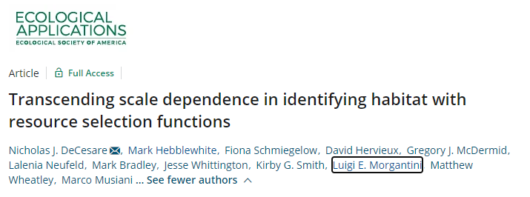
Orders of Selection
Different scales of inference
Fourth-order selection: Local habitat selection (individual steps)
Notes:
Before getting into analyses, we need to first take a step back and think about scale of our analyses. This has generally been discussed across three orders of selection, which I’m showing here. First order selection is generally described as population-level selection. So what does our population select in relation to what’s available on the landscape. What differentiates the habitat of this species from another. So a very broad scale.
Then, there’s second order selection, or more of a home range of our studied species. How does our species differ in its selection from those of the same species.
Then, there’s the individual home range selection. What does our individual animal select in relation to what’s available within its home range. This is generally the type of selection that’s most commonly conducted.
But, with the finer data that’s being collected, we can now start to look at the individual decisions that an animal makes along the period it was tracked, the individual choices, referred to as fourth order selection.

Slide 3
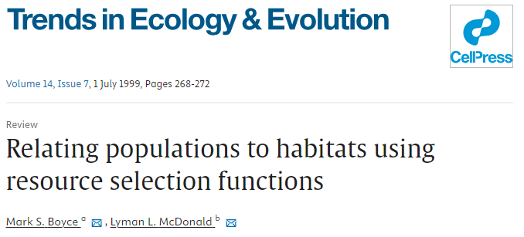
Resource Selection Function Modeling
Boyce and McDonald 1999. Relating populations to habitats using resource selection functions.
Compare environmental covariates at used locations to those at a set of locations assumed to be “available” to the animals
Based on models for spatial point processes
Coefficients (and strength of selection) typically estimated with logistic regression models (binomial GLM)
These models approximate point process models under certain conditions
Notes:
RSFs have been a topic in ecology for about 20-30 year, dating back to this publication by Boyce and McDonald. At it’s most general, the modeling approach compares a set of environmental variables/covariates at used locations, based on our animal tracking data, to what is available to the animal. These are our background points that we must generate. These are pseudo absence points that in the RSF world, we refer to with the term “Availability”.
Differences between these sets of data are used to infer selection and our model estimates/coefficients help to assess the strength of that selection.
Conceptually, the modeling approach is based on models for a spatial point process where the density of points on a surface is influenced by a set of spatial variables. We typically use logistic regression to estimate model coefficients that assess the strength of selection for these variables. These models are convenient because they are well developed in the field and they are shown to approximate point process models well.

Slide 4
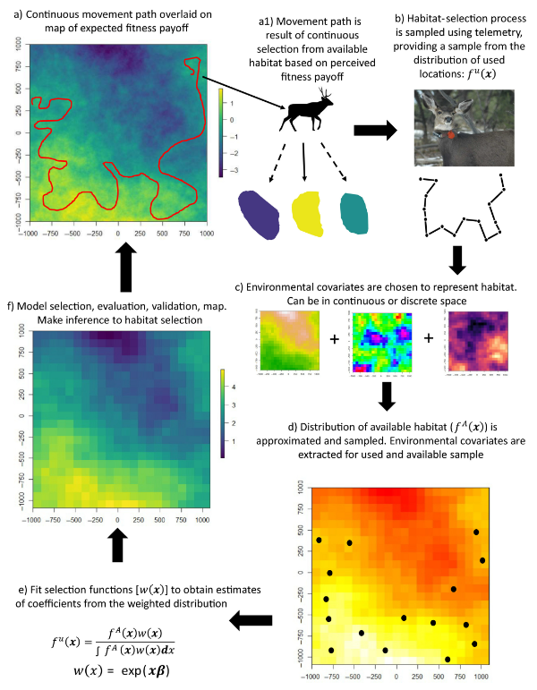
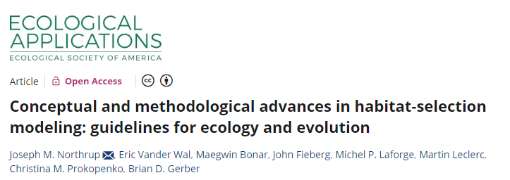
Identify habitat features preferentially used or avoided
Infer ecological needs and limitations
Generate expected distribution maps
Inform demographic projections in support of species/landscape management
Notes:
So let’s walk through the process, looking at a figure provided in a paper by Northrup. Our goal is to identify habitat features that are preferentially used or avoided by the species, with the goal of inferring or understanding ecological needs or limitations.
In many cases, researcher used the results from resource selection function models to generate expected distribution maps or relatively intensity maps (where the animal is located on the landscape), with the goal of informing species or landscape management.

Slide 5
Notes:
So let’s overview the process. What’s occurring in nature is a continuous process where the animal is moving across a changing landscape to maximize its fitness.

Slide 6
Notes:
The animal of course spends different amounts of time in each of these habitats, shown here in different colors.

Slide 7
Notes:
We sample that selection process by tracking individuals and sampling the larger unknown distribution of where this animal could have gone. This is represented here by showing the animals trajectory, which is really just a sample of our tracking period.

Slide 8
Notes:
We then choose a set of environmental covariates, either continuous or discrete, that we feel reflect the fitness landscape in which the animal is operating in.

Slide 9
Notes:
We then identify what we consider to be the available landscape that the animal had access to and we use our environmental covariates to describe our use and available distribution.

Slide 10
Notes:
We then fit a selection function, to get model coefficients which represent the strength of selection for our various covarites.

Slide 11
Notes:
Finally, we finish with model selection and evaluation to make a spatial prediction that prioritize which areas animal use more often compared to others.

Slide 12
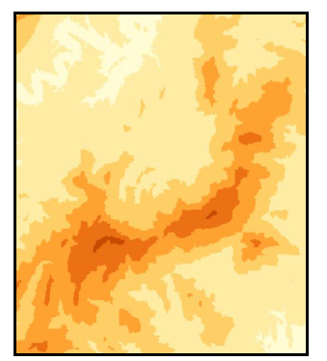
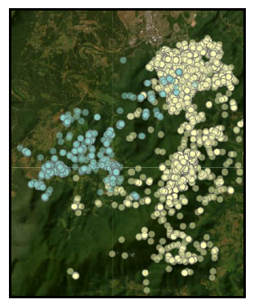
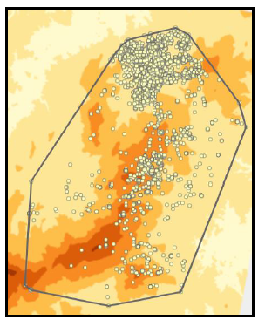
The Data
Environmental Covariates
Where to acquire?
How to represent variables?
Tracking Data (‘Use’)
Autocorrelation
Error and fix failure
Sample size of relocations AND animals
Availability
What defines the area?
How many locations are enough?
Random or Regular?
Notes:
The ingredients. In order to conduct an RSF, we need a few things. First, we need to think about the remote sensing variables that potential explain the preferences of our animal. Qianru described a number of different options for relating your animal point data. This process of creating your spatial dataframe can be a time consuming process and requires significant thought. It’s important to note, that you don’t need to solely rely on remote sensing data. You might, for instance, need a data that is specific to your study area, such as the locations or distance to small villages. This can be created and then incorporated in your analyses.
Then, there’s your tracking data. Some things to consider include autocorrelation of the tracking data, the potential error associated with your devices, and the appropriate sample size that you are using in your analyses.
And lastly, there’s defining your availability. This is generally done by creating a home range of that animal, but then there’s the question of how to make sure to appropriate sample from what is potentially available to the animal.

Slide 13
Autocorrelation
Assumption of independent locations in standard RSF models
Will lead to underestimates of uncertainty/variance when data are autocorrelated
Potential solutions:
Thin data closer to improve independence
Use robust form of SE when describing uncertainty in population level parameters
Bootstrap method (Fieberg et al. 2020)
Newey West estimate (package: sandwich) – Nielsen et al. 2002
Ctmm::rsf.fit()
Step-selection functions to incorporate movement processes directly

