Slide 1


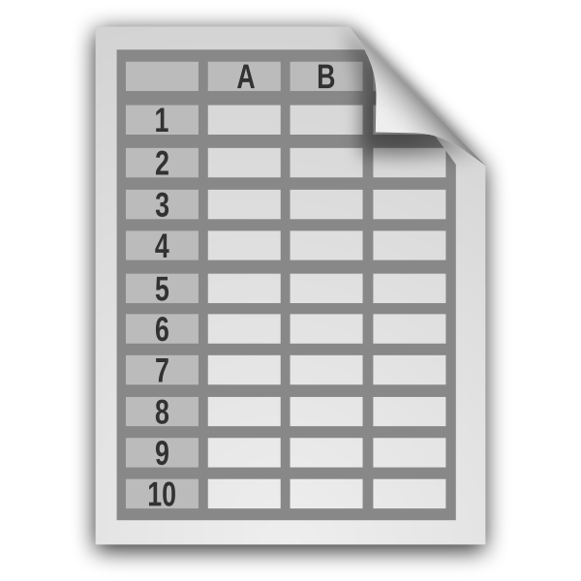
Workflow Overview
DNA sequence data (Illumina)
ASSEMBLE
ANNOTATE
EXPORT
QC sequence data
Assemble mitogenome
Map reads to assembly
BLAST
Identify gene regions
Automatic and manual curation
Flag problematic samples/annotations
Group samples
Create sequence FASTA files
Generate GenBank submission files
Submit to GenBank
User-generated mitogenomes (optional)
>Sample1
ATCCTTTACTGACTGACCCCCTTATCG
circular mitogenome
genes
> Sample1 NAD1
ATGACTTCTAATCTCCTTACTCACCTA
Sample metadata
fastp, GetOrganelle, MitoFinder, bowtie2
MITOS2, tRNAscan-SE, MitoFinder, ARWEN, ARAGORN, ORFfinder
>Feature Sample1
2729 3709 gene
gene nad1

