Slide 1
Data Visualization and Reports with Rmarkdown
SERC Summer Data Science Series

Slide 2
Science is for sharing!
Great tools exist that can help share our science digitally and support:
Summarizing findings for short term projects or tracking data produced by long term projects
Communicating data to different audiences: yourself, collaborators, stakeholders, funders, the general public
Generating reports in a variety of shareable formats

Slide 3
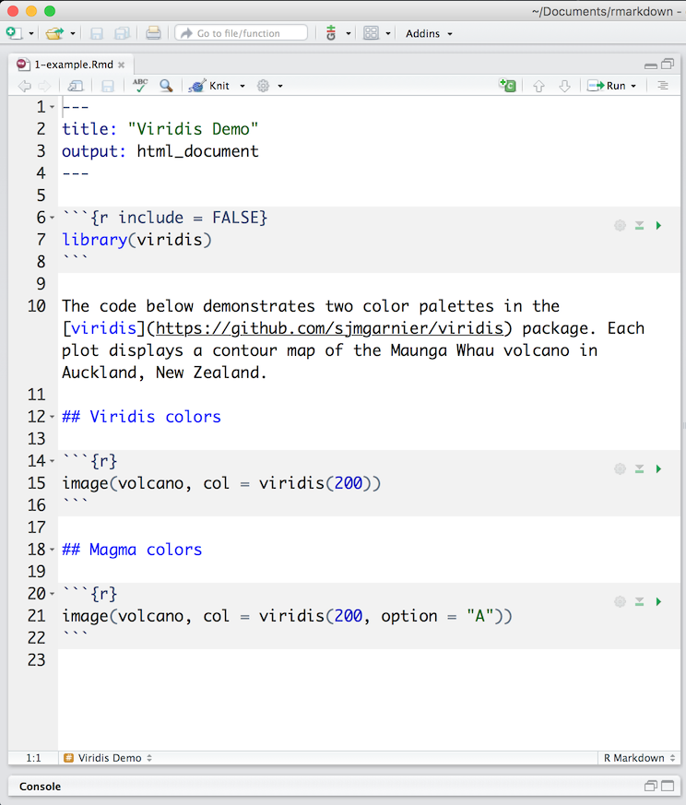
Rmarkdown
What it is: An authoring framework for data science. This notebook interface allows for technical publishing (for reports, websites, books, and more!)
What does it contain?
YAML header (metadata)
Code Chunks
Text (with some simple text formatting)

Slide 4
What is Rmarkdown good for?
Reproducible output
Capable of automation
Documents are both customizable and generalizable
Allow for narrative text and code-generated graphics to be woven together
Generation of high-quality, elegant reports
Access! Supports a variety of shareable static and dynamic output formats: PDFs, HTML, shiny apps, books (Bookdown), websites (GitHub Pages)

Slide 5




RMArkdown with Palmer Penguins
Customizing reports
Integrating tables, figures, and text
Exploring color palettes
Introducing dynamic visualization approaches
Generating PDF and HTML outputs

Slide 6


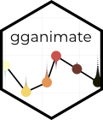
R Packages for dynamic Visualization
DT: Rendering R objects as HTML tables
Plotly: Creating interactive web-based data visualization
gganimate: Produce animated graphics (an extension of ggplot2)
Leaflet: Creating interactive web maps

Slide 7







Paramaterized Reporting
Input Data
Input
Parameters
params$state
Template
Dataset: Feederwatch
Create template with integrated web-based graphics for data visualization
Generate reports for each state by subsetting the dataset
Rmd
Maine
Oregon
Florida
Reports

Slide 8


Other tools & Hosting Platforms
Quarto (Qmd): A notebook interface for technical publishing of reports, websites, blogs, books, slides, etc. (created to expand the scope of Rmarkdown)
Bookdown: for books and long-form articles/reports (https://bookdown.org/)
GitHub Pages: host a website directly from a GitHub repository
Rpubs: free service for hosting Rmarkdown documents
Others: Posit Connect, Netlify, Quarto Pub

