Slide 1
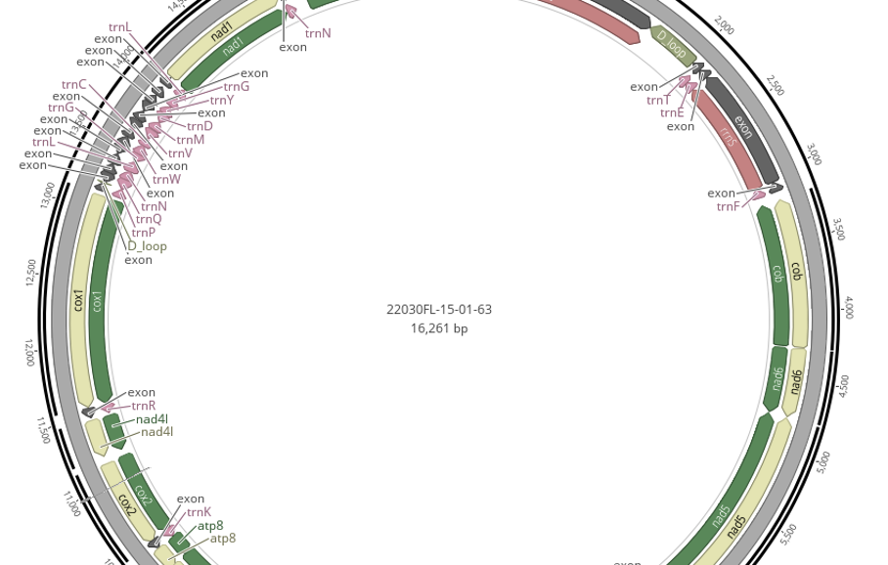
MitoPilot Overview
Dan MacGuigan
June 13, 2025

Slide 2
Introduction to MitoPilot
A software package for mitogenome assembly and annotation from Illumina genome skimming data
Developed by Devin Leopold (Jonah Ventures)
Dan MacGuigan is leading the NMNH implementation and continued support
Goals of MitoPilot
Parallelization of mitogenome assembly and annotation
Curate and format annotation results to streamline GenBank submission
Simplify execution across multiple computing environments
Provide project management tools
Improve reproducibility of analyses
Single analysis platform for a broad range of taxa

Slide 3

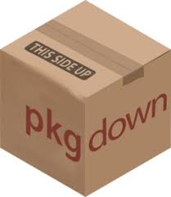



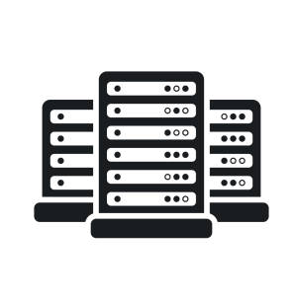

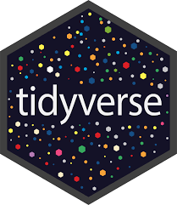



MitoPilot architecture
https://github.com/Smithsonian/MitoPilot
Code management and documentation
Dependency management
Pipeline orchestration
HPC clusters
(SI Hydra)
AWS batch
Multiple compute
environments
Database management
Project management and user interface
Local

Slide 4
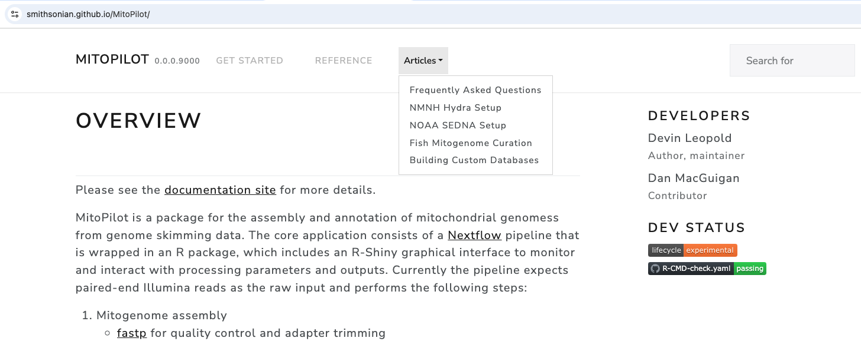
MitoPilot documentation website https://smithsonian.github.io/MitoPilot/
Test project tutorial
Documentation for all R functions
Instructions for using MitoPilot on Hydra

Slide 5
MitoPilot pipeline overview
Three workflow modules
Assemble
Read trimming with `fastp`
Assembly with `GetOrganelle`
Read mapping for coverage statistics with `bowtie2`
Annotate
Annotation of protein-coding genes with `Mitos2`
Annotation of tRNAs with `tRNAscan-SE`
Automatic curation with taxon-specific rulesets
Manual review and editing of annotations
Export
Custom scripts to parse results
Generates gene-by-gene alignment report, whole mitogenome FASTA, individual gene FASTAs, GenBank feature tables, and GFF formatted annotations

Slide 6
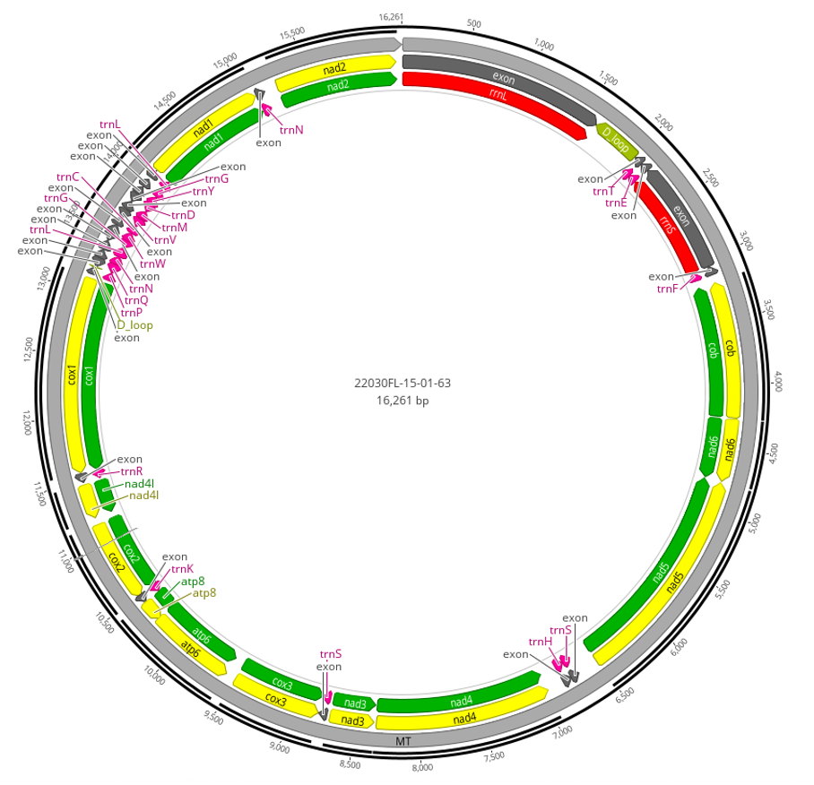
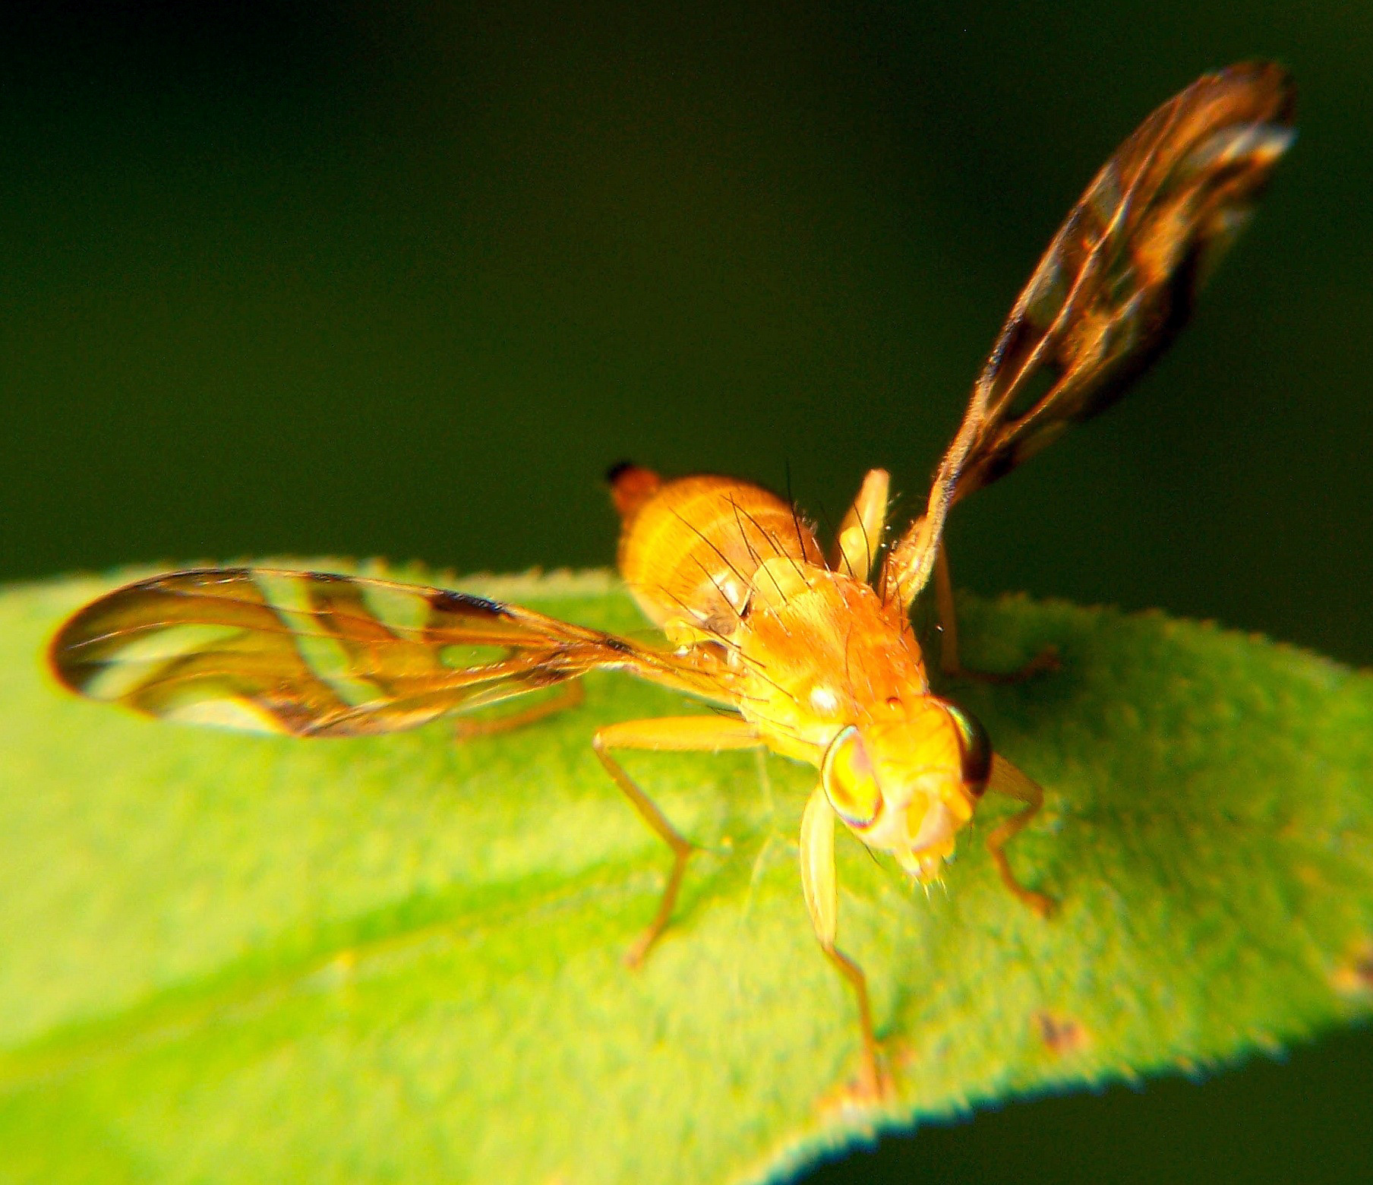
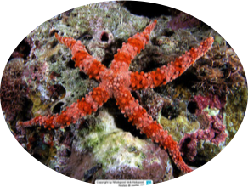
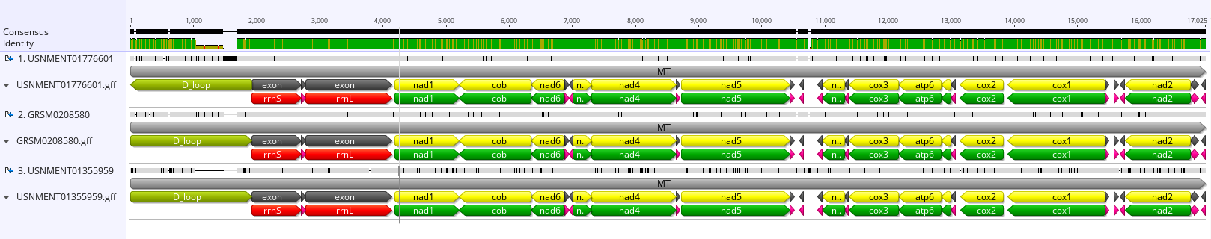
MitoPilot usage at the NMNH…so far
Matt Girard has processed 1,328 fish samples
269 published on GenBank
Dan MacGuigan has processed 65 starfish (from Allen Collins & Chris Mah) and 4 dipteran (from Julia Steier) samples
tephritid fruit fly (Strauzia) mitogenomes from MitoPilot
Nippled Sea Star (Gomophia nardoa)

Slide 7
Challenges of adapting MitoPilot for new taxa
Need existing reference mitogenomes for assembly with GetOrganelle
Taxa with “unusual” mitogenome features
Fragmented
Mitochondrial telomeres
Gene duplication
Pseudogenes
Bi-parental inheritance
NCBI GenBank has an opaque, taxon-specific review processes

