Slide 1
A Brief Primer on Reference Mitochondrial Genomes
Dan MacGuigan
NOAA National Systematics Lab

Slide 2
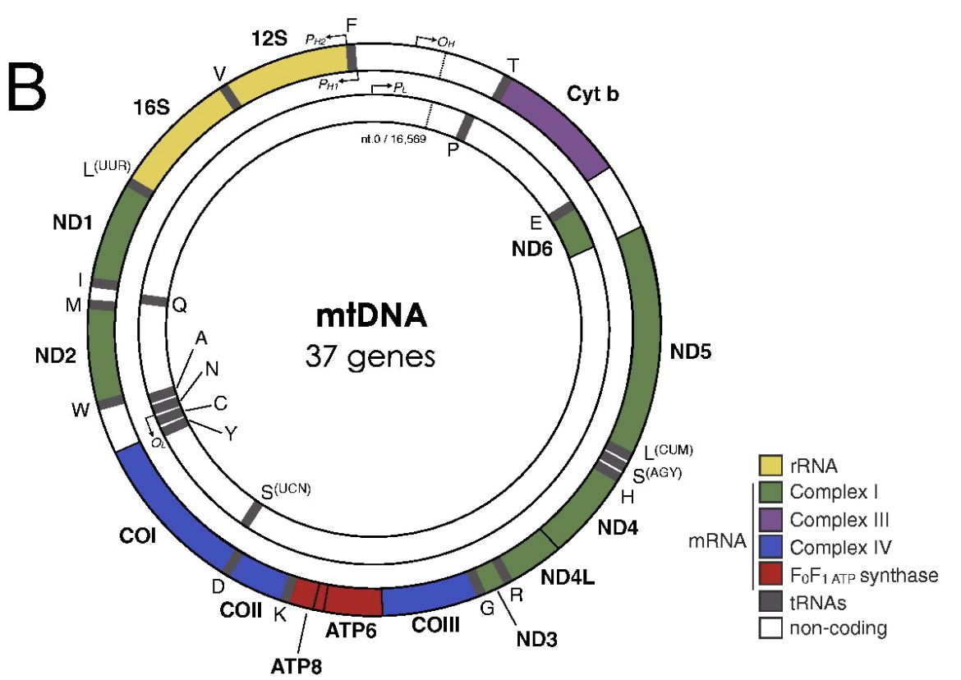
What is a mitochondrial genome?
Usually (but not always) a single circular DNA molecule
Usually (but not always) contains only genes with few non-coding regions
Usually (but not always) maternal inheritance with no recombination
Contains many important DNA barcoding genes: CO1, 12s, 16s, CytB, MutS…
human mitochondrial genome
Picard et al. 2016, Mitochondrion

Slide 3
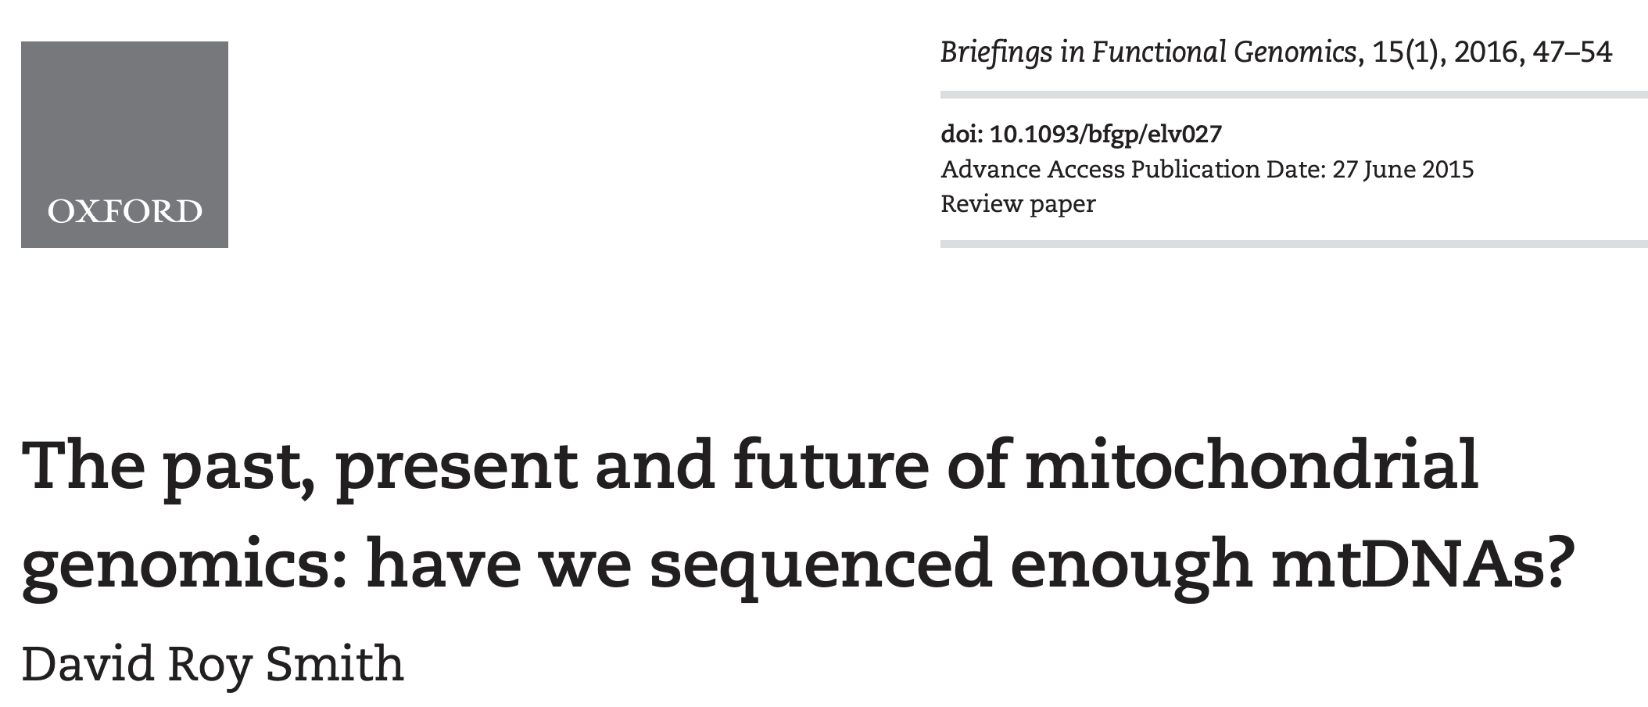
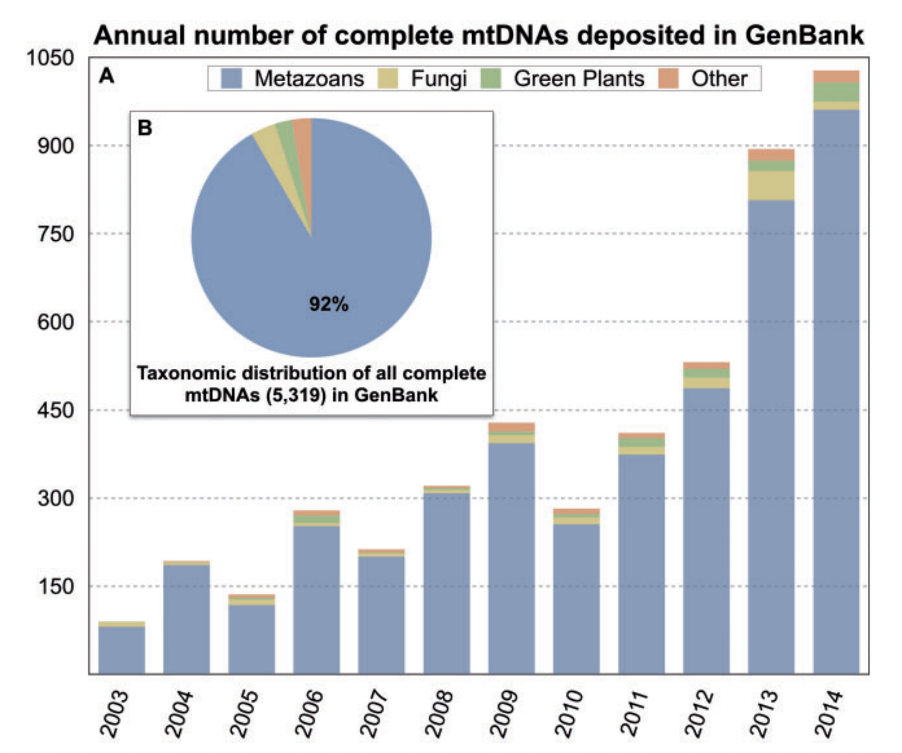
Do we need more mitochondrial genomes?
“For many groups…mtDNAs are so well sampled that newly published genomes are no longer contributing to the progression of science…”
I would argue that, even a decade later, this is simply not true.

Slide 4
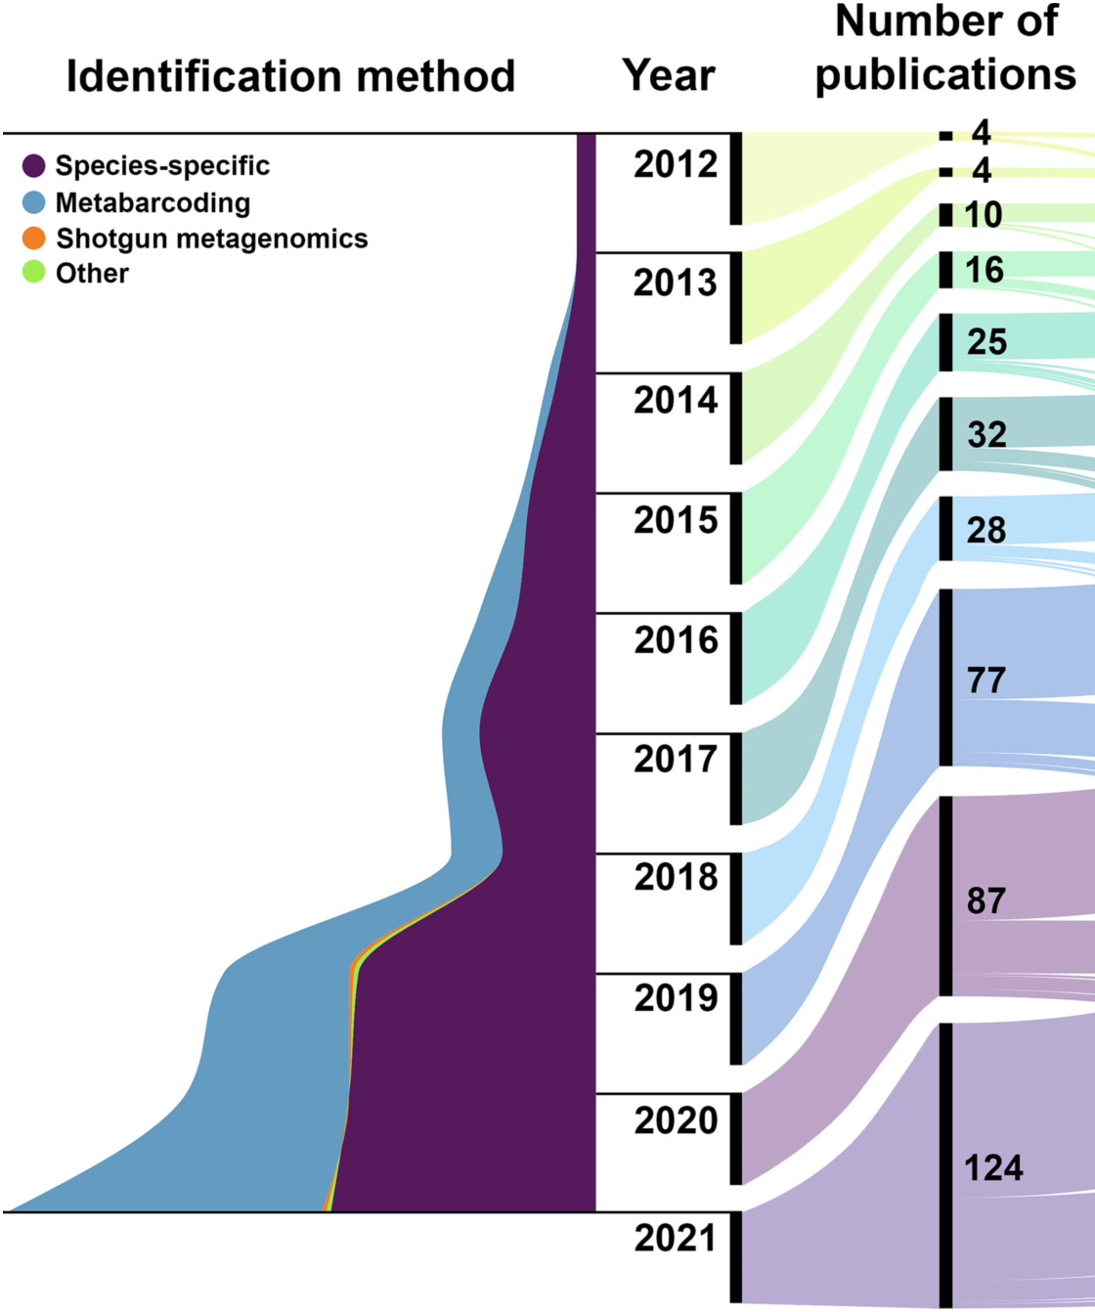
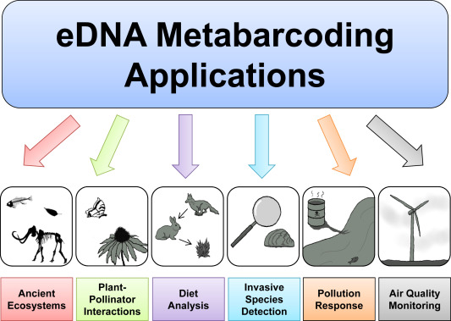
The rise of eDNA metabarcoding makes mitochondrial reference libraries more important than ever
Ruppert et al. 2019, Global Ecology and Conservation
Aquatic eDNA publications
Takahashi et al. 2023, Science of the Total Environment

Slide 5
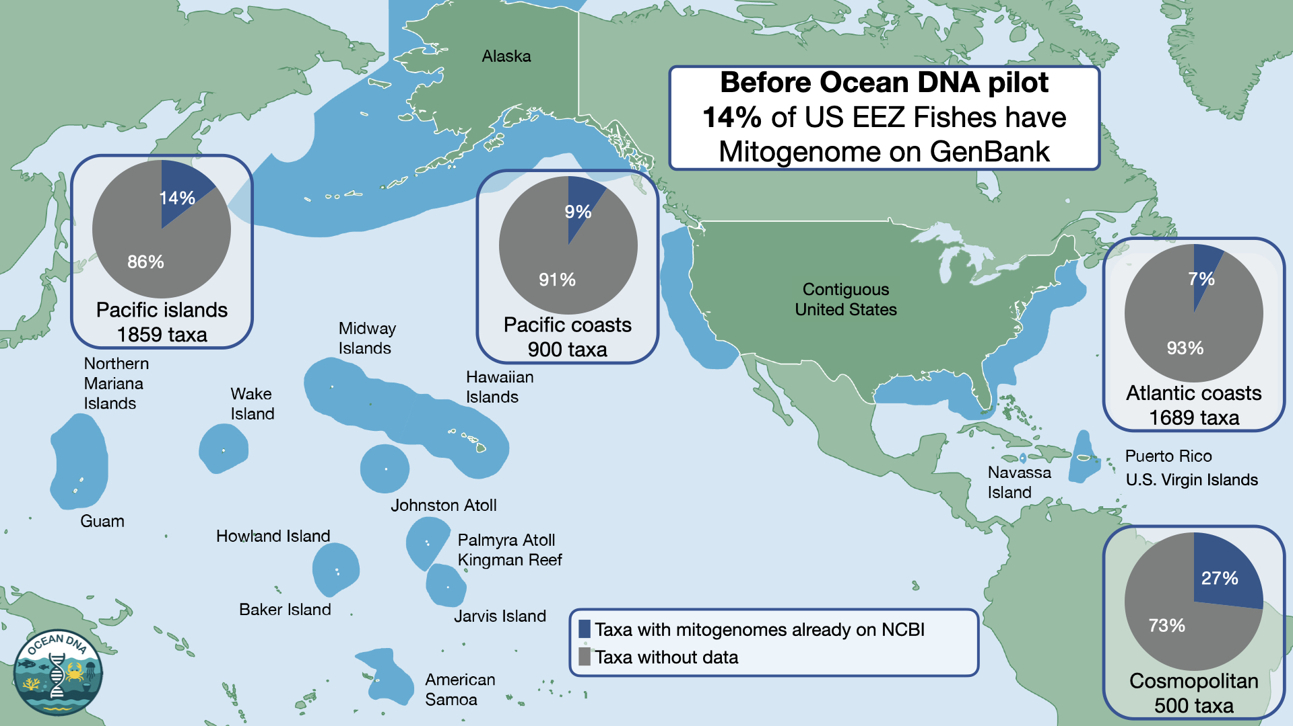
Much of biodiversity is still underrepresented,
even for well-studied taxa like fishes

Slide 6
The importance of reference-quality mitochondrial genomes
Problems with mitogenomes in public repositories (like GenBank)
Poor quality annotations
Assembly errors
Misidentification
Lack of specimen voucher information
An ideal reference-quality mitochondrial genome should have none of those issues

Slide 7
Do we need more mitochondrial genomes?
YES!
Especially voucher-based, reference-quality mitogenomes

Slide 8
How to build a reference-quality mitogenome
Step 1: sequencing
Step 2: sequence data QC and filtering
Step 3: assembly
Step 4: annotation
Step 5: curation
Step 6: submission to GenBank

Slide 9
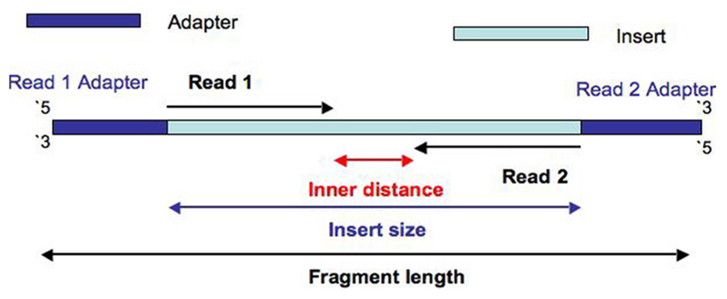
Step 1 – sequencing
Illumina short-read sequencing is the most common strategy
Long-read sequencing (Oxford Nanopore, PacBio) may be the future

Slide 10
Step 2 – sequence data QC and filtering
Filter sequence data to remove
Multiplexing indexes/barcodes
Adapter contamination
Low quality regions and reads
And possibly more
Popular software:
FastQC and MultiQC for basic quality checks – Hydra script here
fastp
cutadapt
Trimmomatic
Trim Galore
And many more

Slide 11
Step 3 – assembly
Reference-based assembly
“Map to reference” method in Geneious
MITObim (also has a de novo mode)
De novo assembly specifically for mitogenomes
GetOrganelle
MitoZ
MitoFinder
mtGrasp
MitoHiFi - specifically for PacBio long reads
Or any general de novo genome assembler, followed by manual identification of the mitochondrial contig(s)

Slide 12
Step 4 – annotation
Homology-based annotation
BLAST
MitoFinder
De novo annotation
MITOS2
DeGeCI
tRNA annotation
MiTFi
tRNAscan-SE 2.0
ARWEN
Taxon-specific annotation
MitoAnnotator
“The most important thing is…annotating [the mitogenome] correctly.”
Smith 2016, Briefings in Functional Genomics

Slide 13
Step 5 – curation
Most annotation methods produce decent gene models
But manual curation is often still required
To my knowledge, there is no software designed specifically for manual curation of mitochondrial genome annotations
“The most important thing is…annotating [the mitogenome] correctly.”
Smith 2016, Briefings in Functional Genomics

Slide 14
Step 6 – submission to GenBank
NCBI Submission Portal
Requires two files: the mitogenome assembly (FASTA) and the annotation information (feature table)
Every submission is manually reviewed by GenBank staff
No clear rules on what makes a submission acceptable
A singe problematic sample may lead to rejection of the entire submission batch
Often becomes an iterative process of correcting errors and resubmitting
“The most important thing is depositing the mtDNA into GenBank and annotating it correctly.”
Smith 2016, Briefings in Functional Genomics

