Slide 1
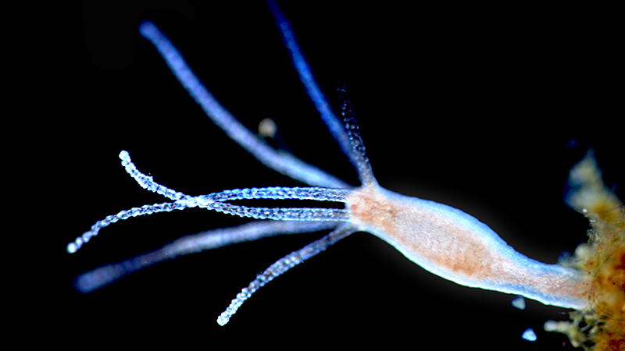
Intro to High-Performance Computing and the Smithsonian Hydra Cluster
Dan MacGuigan
June 13, 2025
Hydra vulgaris, (c) Proyecto Agua
https://www.inaturalist.org/taxa/486293-Hydra-vulgaris

Slide 2
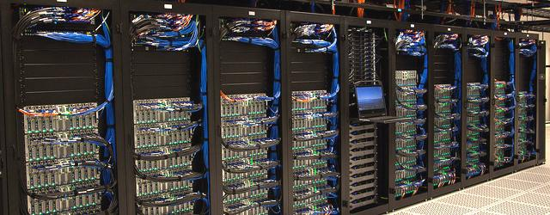
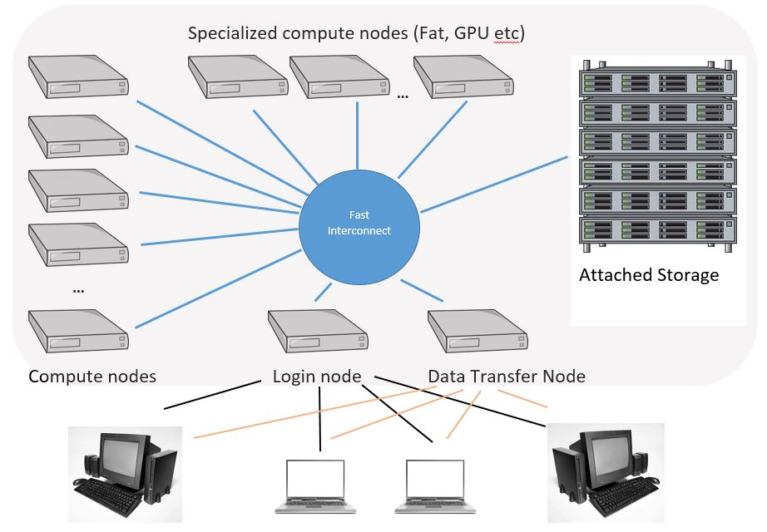
What is a High-Performance Computing (HPC) cluster?
Basically, just many individual computers linked together
Nodes ~= individual computers
Login node = the central node that all users interact with when they log in
Compute nodes = nodes that run jobs (programs, code, scripts, etc) for users
Each node has its own CPU with some number of cores and RAM

Slide 3
Why use a HPC cluster?
Access to way more computing power than any individual lab could afford
Run analyses remotely so they won’t bog down your own computer
Each user can run hundreds of computing jobs in parallel
A “safe” environment to learn
Each user only has read/write access to their own files
Can’t accidentally delete someone’s data
Hardware is maintained by professionals
Tech support is available

Slide 4
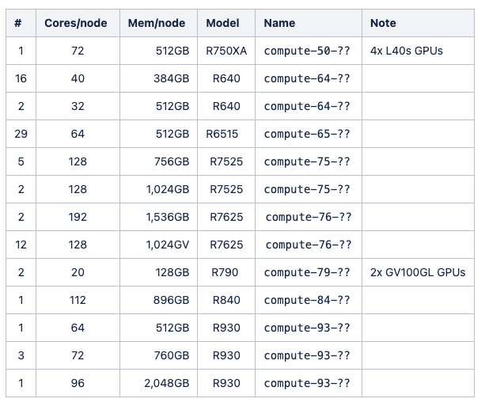
The Hydra cluster
Accessible to all Smithsonian researchers
Must have an SI account and be on the “si-staff” wifi or an SI ethernet connection
Hardware
~70 compute nodes
~6,000 CPUs
8 GPUs
45 TB RAM
https://confluence.si.edu/display/HPC/Compute+Nodes

Slide 5
Hydra resources
Hydra Wiki
Login to Hydra
Transferring data to/from Hydra
Submitting a job
Hydra hardware
Hydra software
Hydra Qsub generation tool
Hydra status

Slide 6
Hydra file system
Location | Description | User storage space | Backed up? | Old files deleted?
/home/USER_ID | Your home directory, for your basic configuration files, scripts and job files | 512 Gb | Yes, every 4 weeks | No
/pool/public/genomics/USER_ID | For storing large files, fast disk R/W speed, good for analyses | 7.5 Tb | No | Yes, after 180 days
/scratch/public/genomics/USER_ID | For storing large files, fastest disk R/W speed, best for analyses | 15 Tb | No | Yes, after 180 days

Slide 7
Basic Linux commands
command | description
pwd | Gives the full file path to your current directory.
ls | List the files and directories in my current location
ls -l | Nicer list format
ls -la | Nicer list format, show hidden files
ls -lah | Nicer list format, show hidden files, human-readable file sizes
mkdir myNewDirectory | Make a new directory. Important to avoid spaces or special characters.
cd myNewDirectory | Move into a directory
cd .. | Move up one directory
cd /full/path/to/myNewDirectory | Move to a directory using the full file path
cd ~ | Move to your home directory
touch myNewFile.txt | Create a new, empty file
nano myNewFile.txt | Modify a file from the command line using the “nano” text editor
cat my_new_file.txt | Print the contents of a file to the screen
clear | Clean up your terminal window
USE WITH CAUTION
command | description
cp myNewFile.txt fileCopy.txt | Copy a file
cp –rf myNewDirectory directoryCopy | Copy a directory
mv myNewFile.txt newName.txt | Rename a file
rm myNewFileCopy.txt | PERMANENTLY delete a file
rm -r myNewDirectory | PERMANENTLY delete a directory
Many more commands:
https://phoenixnap.com/kb/linux-commands-cheat-sheet

Slide 8
Tips for navigating on the command line
Shortcut | Description
~ | Your home directory
. | Your present directory
.. | One directory above your current directory
ctrl + arrow key (PC) opt + arrow key (Mac) | Move the cursor one word left or right
fn + arrow key left (PC) ctrl + a (Mac) | Move the cursor to the beginning of the line.
fn + arrow key right (PC) ctrl + e (Mac) | Move the cursor to the end of the line.
control + c | Cancel whatever is currently running on the command line
tab | Autocomplete the path or file name
up and down arrows | Scroll through your previous commands
exit | Close your connection to the cluster

