Slide 1
Using OpenRefine to Join Disparate Sets of Collections (Meta)data
Adam Gray, Project Archivist at National Anthropological Archives/Human Studies Film Archives, National Museum of Natural History
December 2022

Slide 2
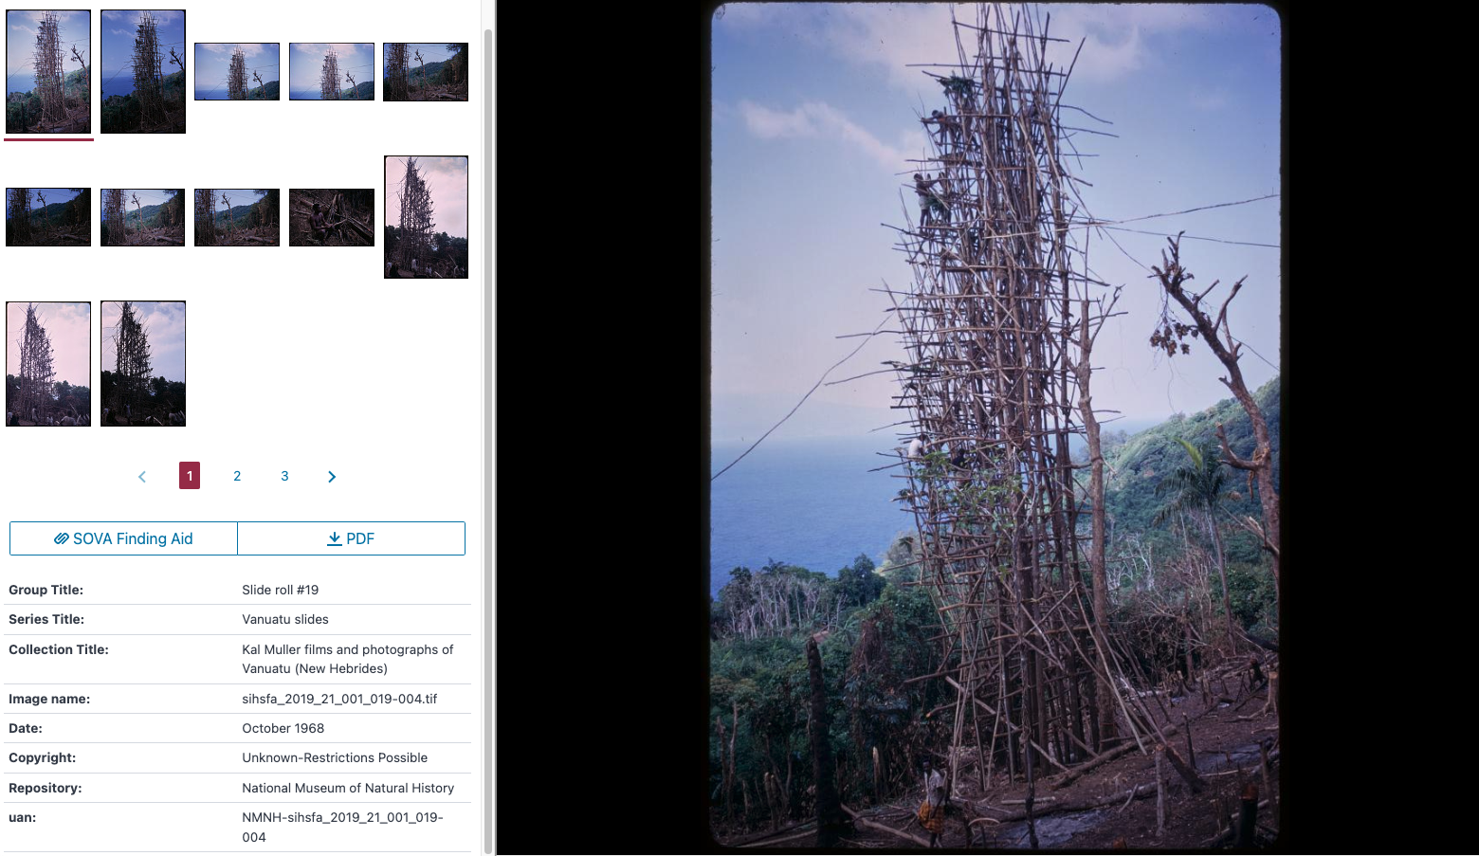
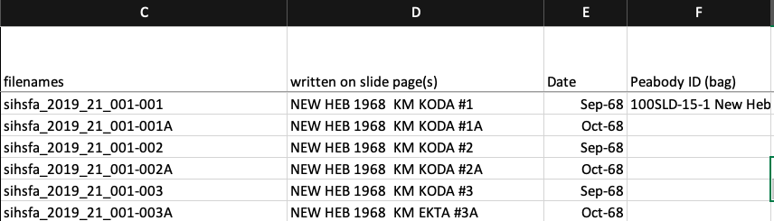
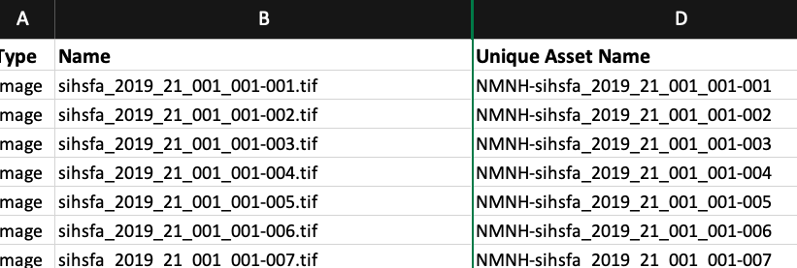
Kal Muller Slides Mass Digitization Project (2021) (“The Muller Report”)
Notes:
- Virtual Slideshows Kal Muller photographs mass digitization project
- Preparing for AV mass digitization projects (prioritization)
- The challenge: Different pieces of vital metadata are held in disparate places, but bringing them together can be necessary for managing and providing access to the collections
- Best approach?

Slide 3
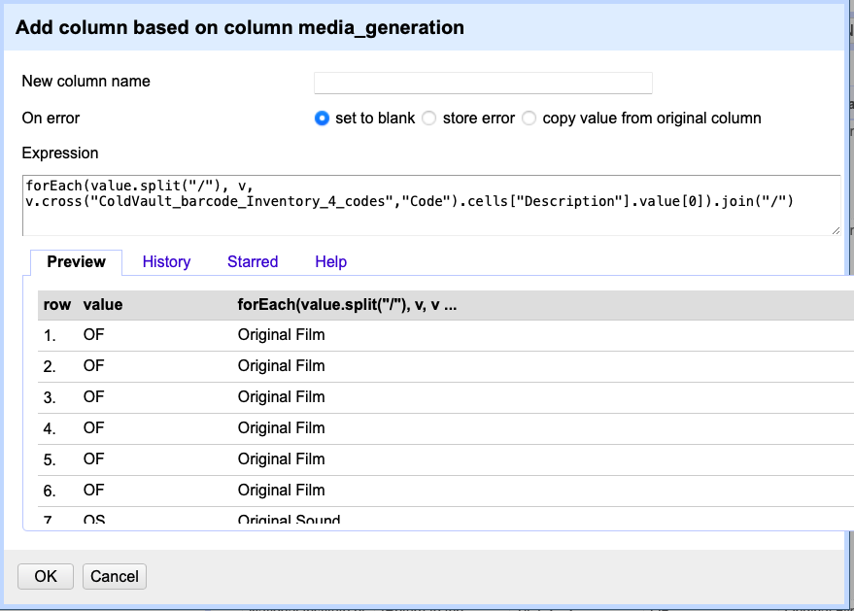
Yes, OpenRefine
cell.cross
Fairly simple syntax
Easy facet/filter
Regular expressions for
prepping/cleaning key
columns

Slide 4
cell.cross()
Similar to SQL join, Excel/Sheets Vlookup()
Pulls data from a column in one OpenRefine project into another OpenRefine project
Requires common UIDs (ie, key columns) in 2+ projects
In ”Other Functions” in OR docs (https://openrefine.org/docs/manual/grelfunctions#other-functions)
Caveats:
May need to prep data in ID columns to ensure accurate matches
Returns an array: can return >1 row that match a single ID, but it only gives you what you ask for (tip – try using forEach())
Both OpenRefine projects have to be open!

Slide 5
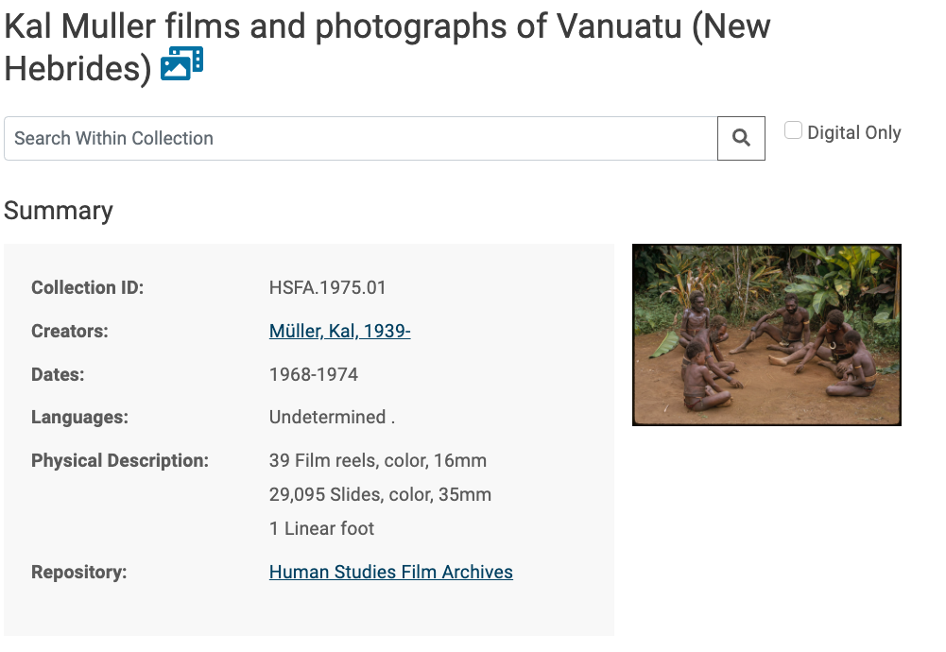
Creating Slideshows for the Kal Muller Slides Mass Digitization Project (2021) (“The Muller Report”)
Goal was to create about 900 virtual slideshows via CDIS to display about 32,000 individual images
Data sources and targets:
ArchivesSpace
Manifests to/from vendor
DAMS and CDIS
Everything in spreadsheets
Lynchpin is refid from ASpace

Slide 6
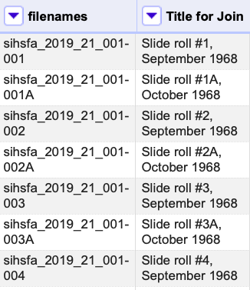
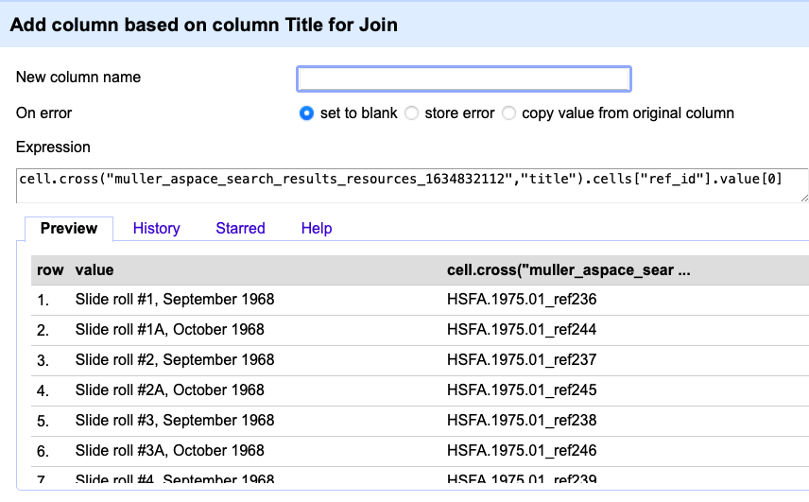
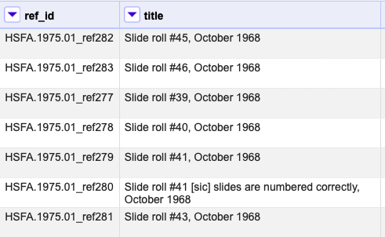
Add RefIDs from ASpace to Slide Roll inventory…
Slide roll inventory:
ASpace archival object list:

Slide 7
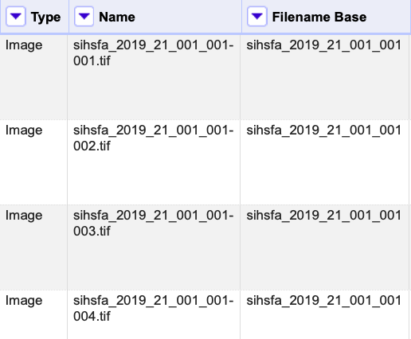
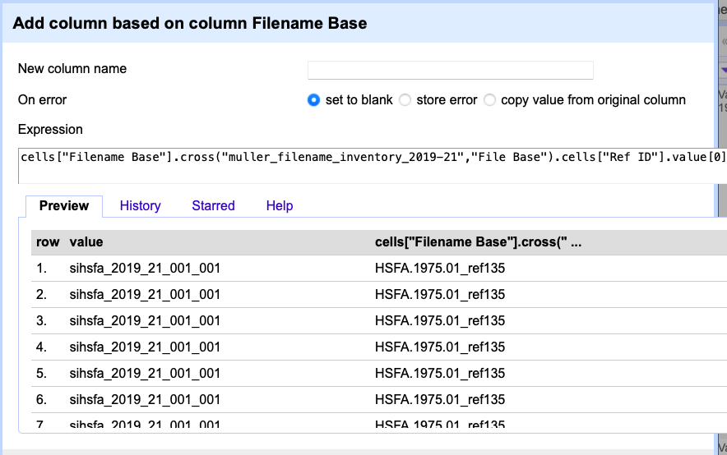
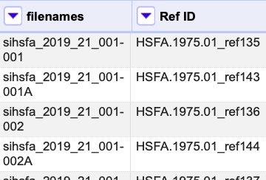
…add RefIDs to List of Individual Digital Assets…
Asset List:
Slide roll inventory

Slide 8
…Map to DAMS metadata import template and run update

Slide 9
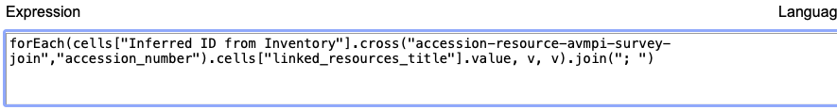
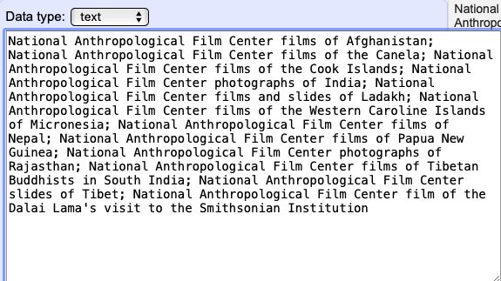
forEach()
cells.cross returns an array: can return >1 row that match a single ID, but it only gives you what you ask for (tip – try using forEach())

Slide 10
Thanks! Email: graya2 at si dot edu Adam Gray Project Archivist National Anthropological Archives/Human Studies Film Archives National Museum of Natural History

