Slide 1
Standardizing taxonomic info in R
John Pfeiffer
Carpentries Community Chat
May 25, 2022

Slide 2
Taxonomy can be messy within and between sources
Synonyms, homonyms, emendations,
Previous combinations
Misspellings
Differing levels of taxonomic precision
Differing levels of taxonomic completeness
Outdated vs recently updated
Moving target

Slide 3
Standardized taxonomic info enables synthesis/analysis

Slide 4
Standardized taxonomic info enables synthesis/analysis
46 freshwater mussel collections
410k US records
Before standardization?
4,779 unique species names

Slide 5
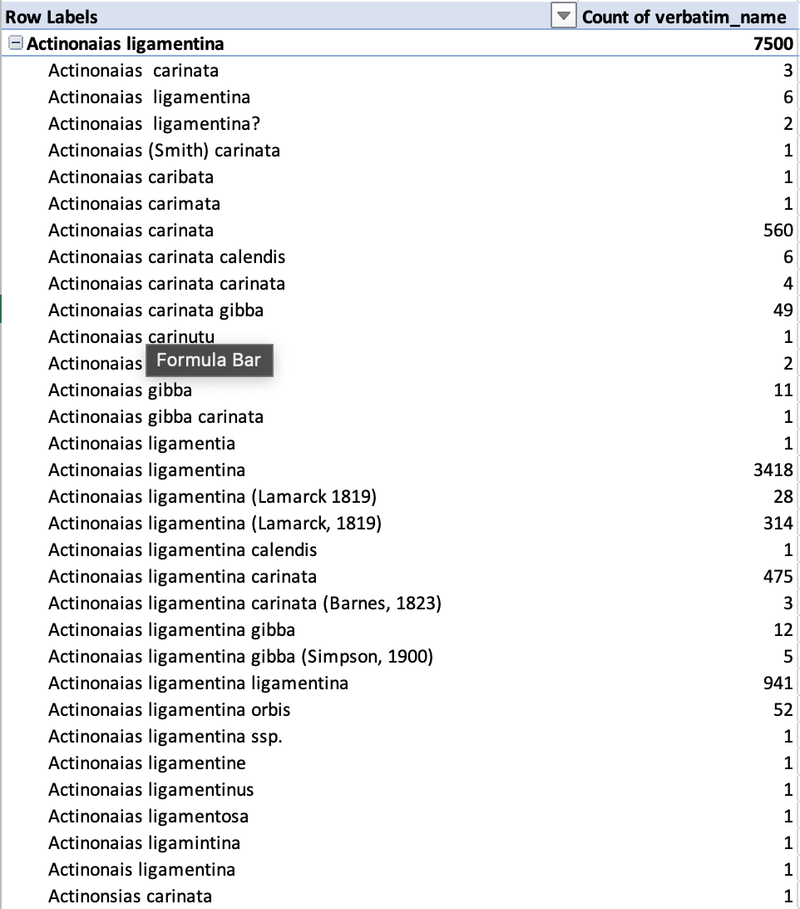
Standardized taxonomic info enables synthesis/analysis
46 freshwater mussel collections
410k US records
Before standardization?
4,779 unique species names
After standardization
303 species names
14:1 names/species ratio
Some species >100 names

Slide 6
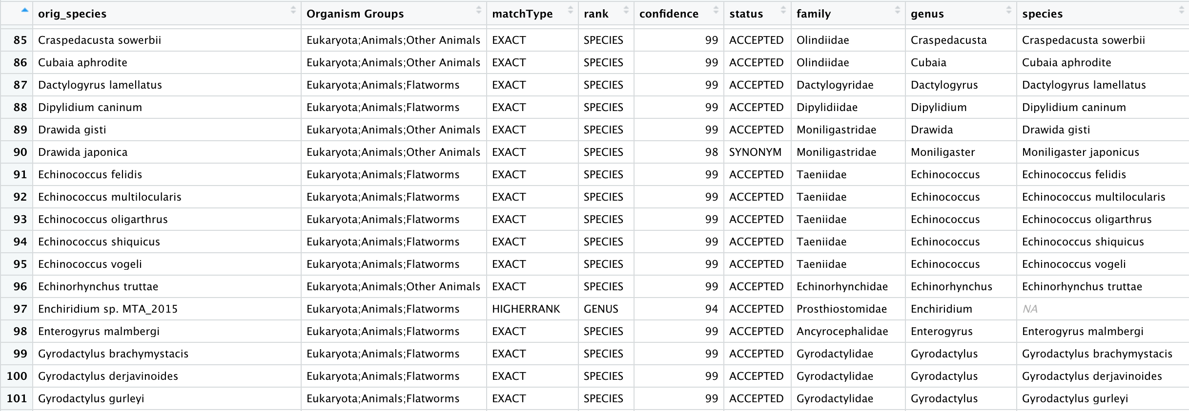
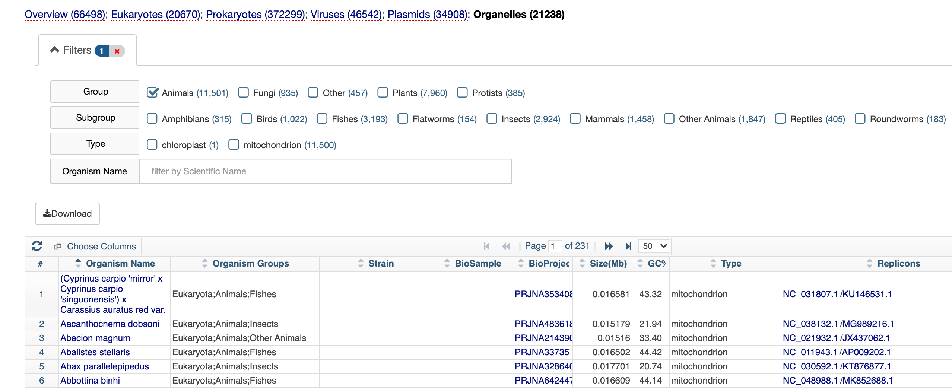
Standardized taxonomic info enables synthesis/analysis
NCBI Organelle Genome Resources

Slide 7
Standardized taxonomic info enables synthesis/analysis
NCBI Organelle Genome Resources

Slide 8


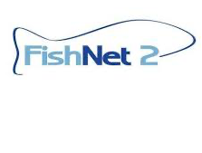









Biodiversity Aggregators

Slide 9
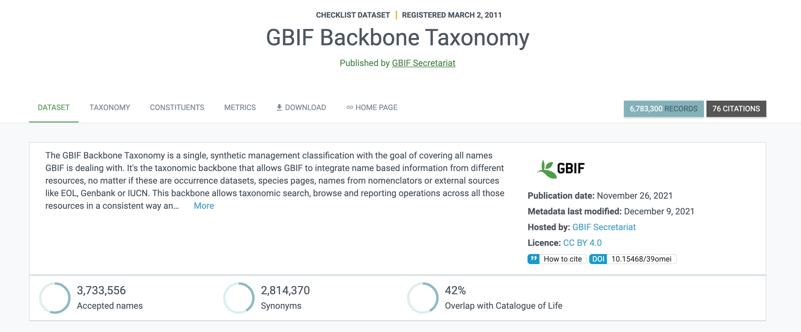
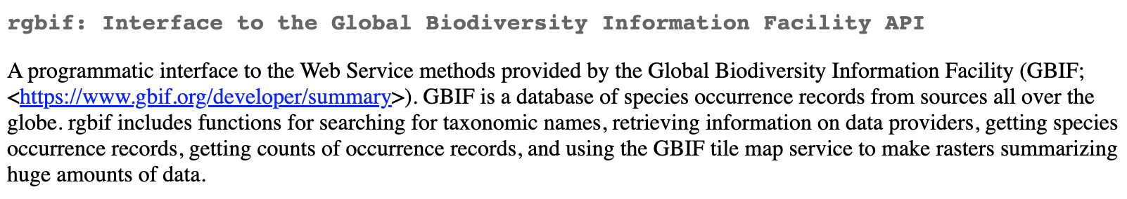

Slide 10
The Haves, the Have Nots, and the Might Could Haves: The Taxonomic Distribution of Mitochondrial Genomes in Molluscs

Slide 11
Let’s build a mt genome Reference Library for all mollusc families?
What families already have mt genomes?
What families don’t have mt genomes?
Do we have tissues for any of the families that don’t have mt genomes?
Those would be useful targets!

Slide 12
mollusc families
What are the mollusc families?
= mollusc families (GBIF)
What mollusc families have mt genome?
= the haves (NCBI)
What mollusc families do not have mt genomes?
set difference = the have nots
The Haves
The Have Nots

Slide 13
What are the mollusc families?
= mollusc families (GBIF)
What mollusc families have mt genome?
= the haves (NCBI)
What mollusc families do not have mt genomes?
set difference = the have nots
Have Nots

Slide 14
What are the mollusc families?
= mollusc families (GBIF)
What mollusc families have mt genome?
= the haves (NCBI)
What mollusc families do not have mt genomes?
set difference = the have nots
What families do we have in Biorepository
= Biorepository (NMNH)
Have Nots
Biorepository

Slide 15
What are the mollusc families?
= mollusc families (GBIF)
What mollusc families have mt genome?
= the haves (NCBI)
What mollusc families do not have mt genomes?
set difference = the have nots
What families do we have in Biorepository
= Biorepository (NMNH)
Of the Have Nots, which are in the NMNH Biorepository?
= might could haves
Have Nots
Biorepository
Might Could Haves
Theoretically pretty simple questions. Practically…

Slide 16
The family-level taxonomy in these datasets are either: 1) incongruent (e.g. GBIF, NMNH) 2) non-existent/incomplete (e.g. NCBI)
for my little Venn diagrams to work they must be IDENTICLE

Slide 17
All mollusc families
All families
Use GBIF Taxonomic Backbone to grab all valid mollusc families
‘name_lookup’ function
836 families
Perfect? Prolly no
Good enough? Prolly yes

Slide 18
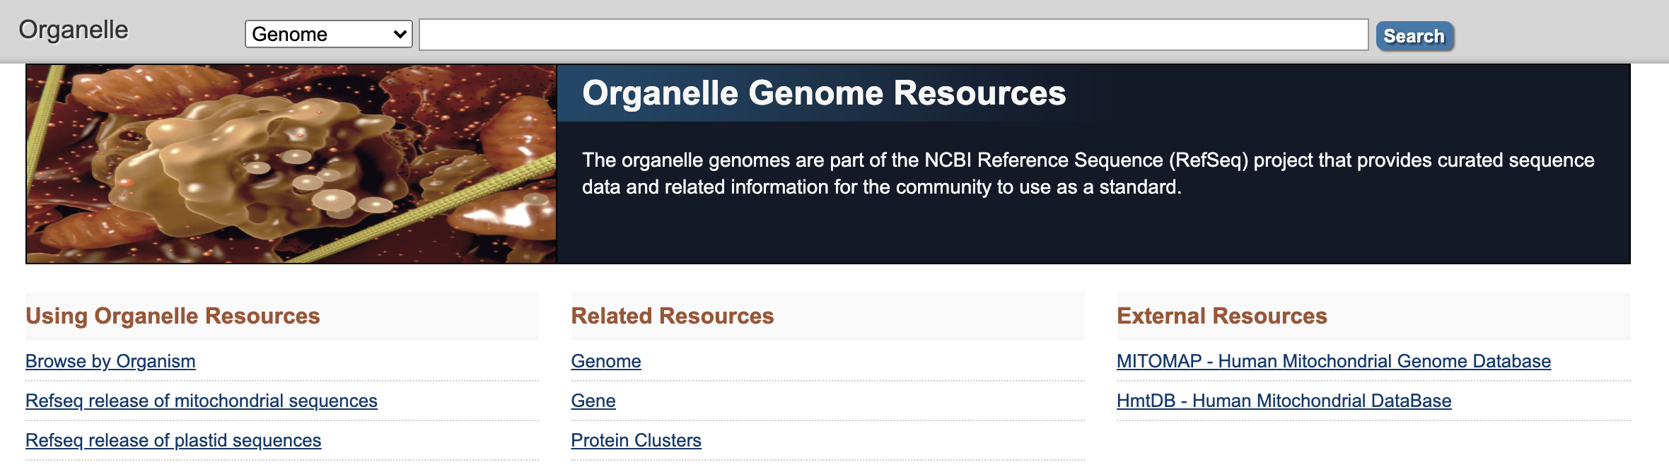
What mollusc families have mt genomes (the Haves)
NCBI Organelle Genome Resources

Slide 19
What molluscs have mt genomes (the Haves)
NCBI Organelle Genome Resources
Taxonomy kinda cray
Use GBIF Taxonomic Backbone to standardize names

Slide 20
What IZ families have mt genomes
NCBI Organelle Genome Resources
Use GBIF Taxonomic Backbone to standardize names
160 mollusc families with mt genomes
The Haves

Slide 21
All families
The Haves
How many mollusc families are there?
All families = 836
What mollusc families have mt genome?
The haves = 160

Slide 22
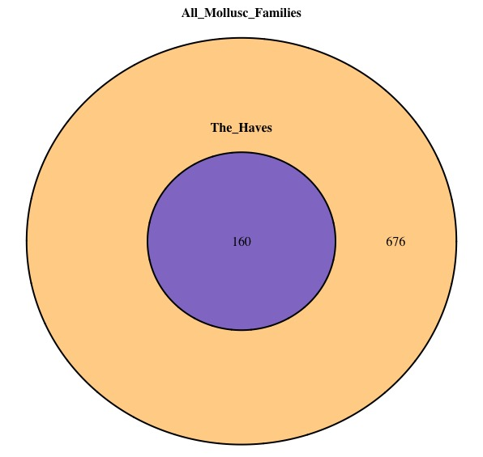
How many mollusc families are there?
All families = 836
What mollusc families have mt genome?
The haves = 160
What families do not have mt genomes?
The have nots = 676
The Have Nots

Slide 23
How many mollusc families are there?
All families = 836
What mollusc families have mt genome?
The haves = 160
What families do not have mt genomes?
The have nots = 676
What families do we have in Biorepository
Biorepository families = ?
Of the families that do not have mt genomes, which ones are in the NMNH Biorepository?
The might could haves = ?

Slide 24
NMNH Biorepository
Download all NMNH mollusc genetic samples (DNA, Tissues, etc) (Thanks Katie)
Use GBIF Taxonomic Backbone to standardize names

Slide 25
NMNH Biorepository
Download all NMNH mollusc genetic samples (DNA, Tissues, etc) (Thanks Katie)
Use GBIF Taxonomic Backbone to standardize names
Original names = 342
Standardized names = 317
Family names are pretty stable
Our taxonomy is pretty good
Imagine doing something similar at species-level with more sources

Slide 26
Have Nots
Biorepository
How many mollusc families are there?
All families = 836
What mollusc families have mt genome?
The haves = 160
What families do not have mt genomes?
The have nots = 676
What families do we have in Biorepository
Biorepository families = 317

Slide 27
Have Nots
Biorepository
How many mollusc families are there?
All families = 836
What mollusc families have mt genome?
The haves = 160
What families do not have mt genomes?
The have nots = 676
What families do we have in Biorepository
Biorepository families = 317
Of the families that do not have mt genomes, which ones are in the NMNH Biorepository?
The might could haves = ?
Might Could Haves

Slide 28
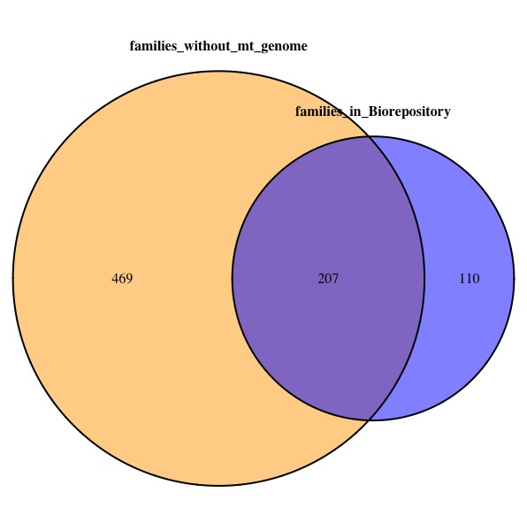
The Haves = 160
The Might Could Haves = 207
Could double family-level coverage
with resources on hand!

Slide 29
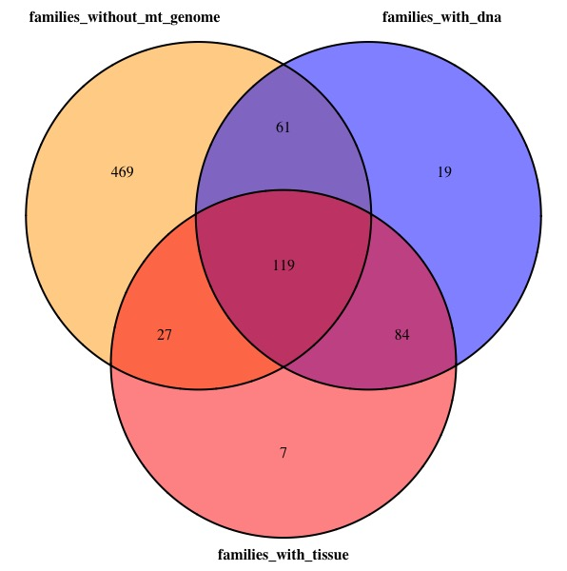

Slide 30
Filter Biorepository records to include only samples that
could improve family-level coverage of mt genomes

Slide 31
Thanks! Suggestions?

