Slide 1
Library preparation: Making a metabarcode library
Katrina Lohan
Marine Disease Ecology Lab
Smithsonian Environmental Research Center

Slide 2
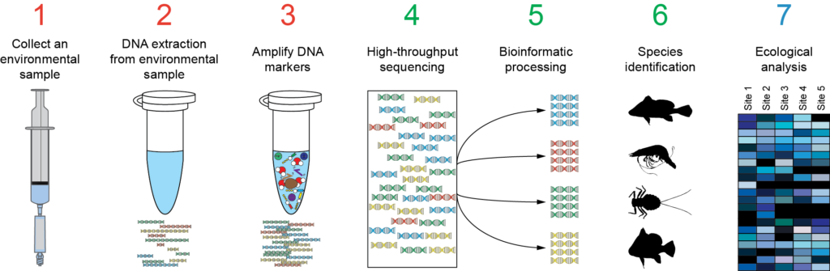
What is metabarcoding?
Part 1
Part 2
Amplifying a single gene region from “all” (or hopefully most) of the organisms in a complex sample and using those sequences to identify and conduct ecological analyses on those organisms

Slide 3
Basically...
Collect sample
Extract DNA from the sample
Do a lot of PCR per sample
Add indexes to your amplicons
Figure out how much amplicon is in each sample
Pool the same amount of amplicon from each sample into a single tube
SEQUENCE!
Notes:
I meant for this to sound really simple and in essence it is, but there a number of nuances at each step to consider...let’s break this down step and by step and talk about the options and the implications of what happens at each step.

Slide 4
Sample collection – important, but not part of this tutorial
DNA extraction
Must choose a kit that is appropriate for your sample type (tissue, water, sediment, gut contents)
Must use the same kit/method on all samples that will be analyzed together
if you use a MioBio Powersoil kit on one set of samples, you should use it on all the samples

Slide 5
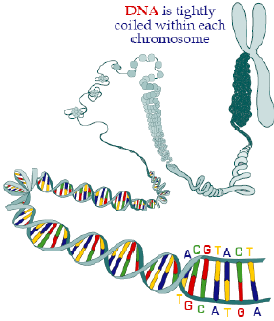
DNA Extraction
Notes:
Goal of DNA extraction is to end up with just genomic DNA and remove all the proteins, which can inhibit PCR and destroy DNA

Slide 6
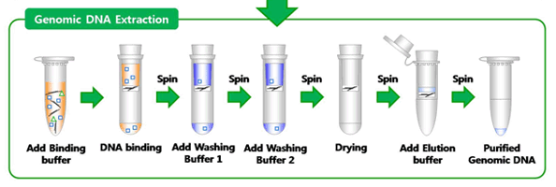
DNA Extraction
For environmental samples, insert a few additional steps for removing inhibitors (humic acids)
For environmental and plant samples, insert a homogenization step at the beginning (break up tough cell walls)

Slide 7
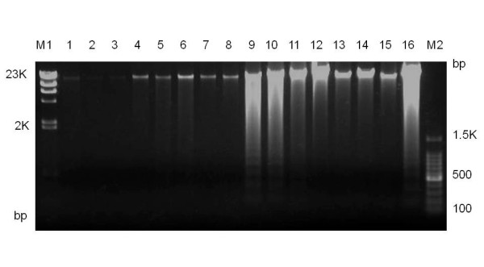
Check DNA quality – 2 options
qPCR – create dilutions of DNA extracts and run with Syber green kit on qPCR machine
Provides information about presence of PCR inhibitors
More expensive option
2) Genomic gel
Provides information about DNA degradation
Very cheap

Slide 8
Creating amplicons -- PCR
The end goal of the library preparation is to have the desired amplicons plus the adaptors needed for sequencing plus a unique “barcode” so that you can tell apart your samples...
There are a couple ways to achieve this and each method has various pros and cons.
Fusion primers
2-step PCR method
Ligate adaptors + barcodes onto your amplicons

Slide 9
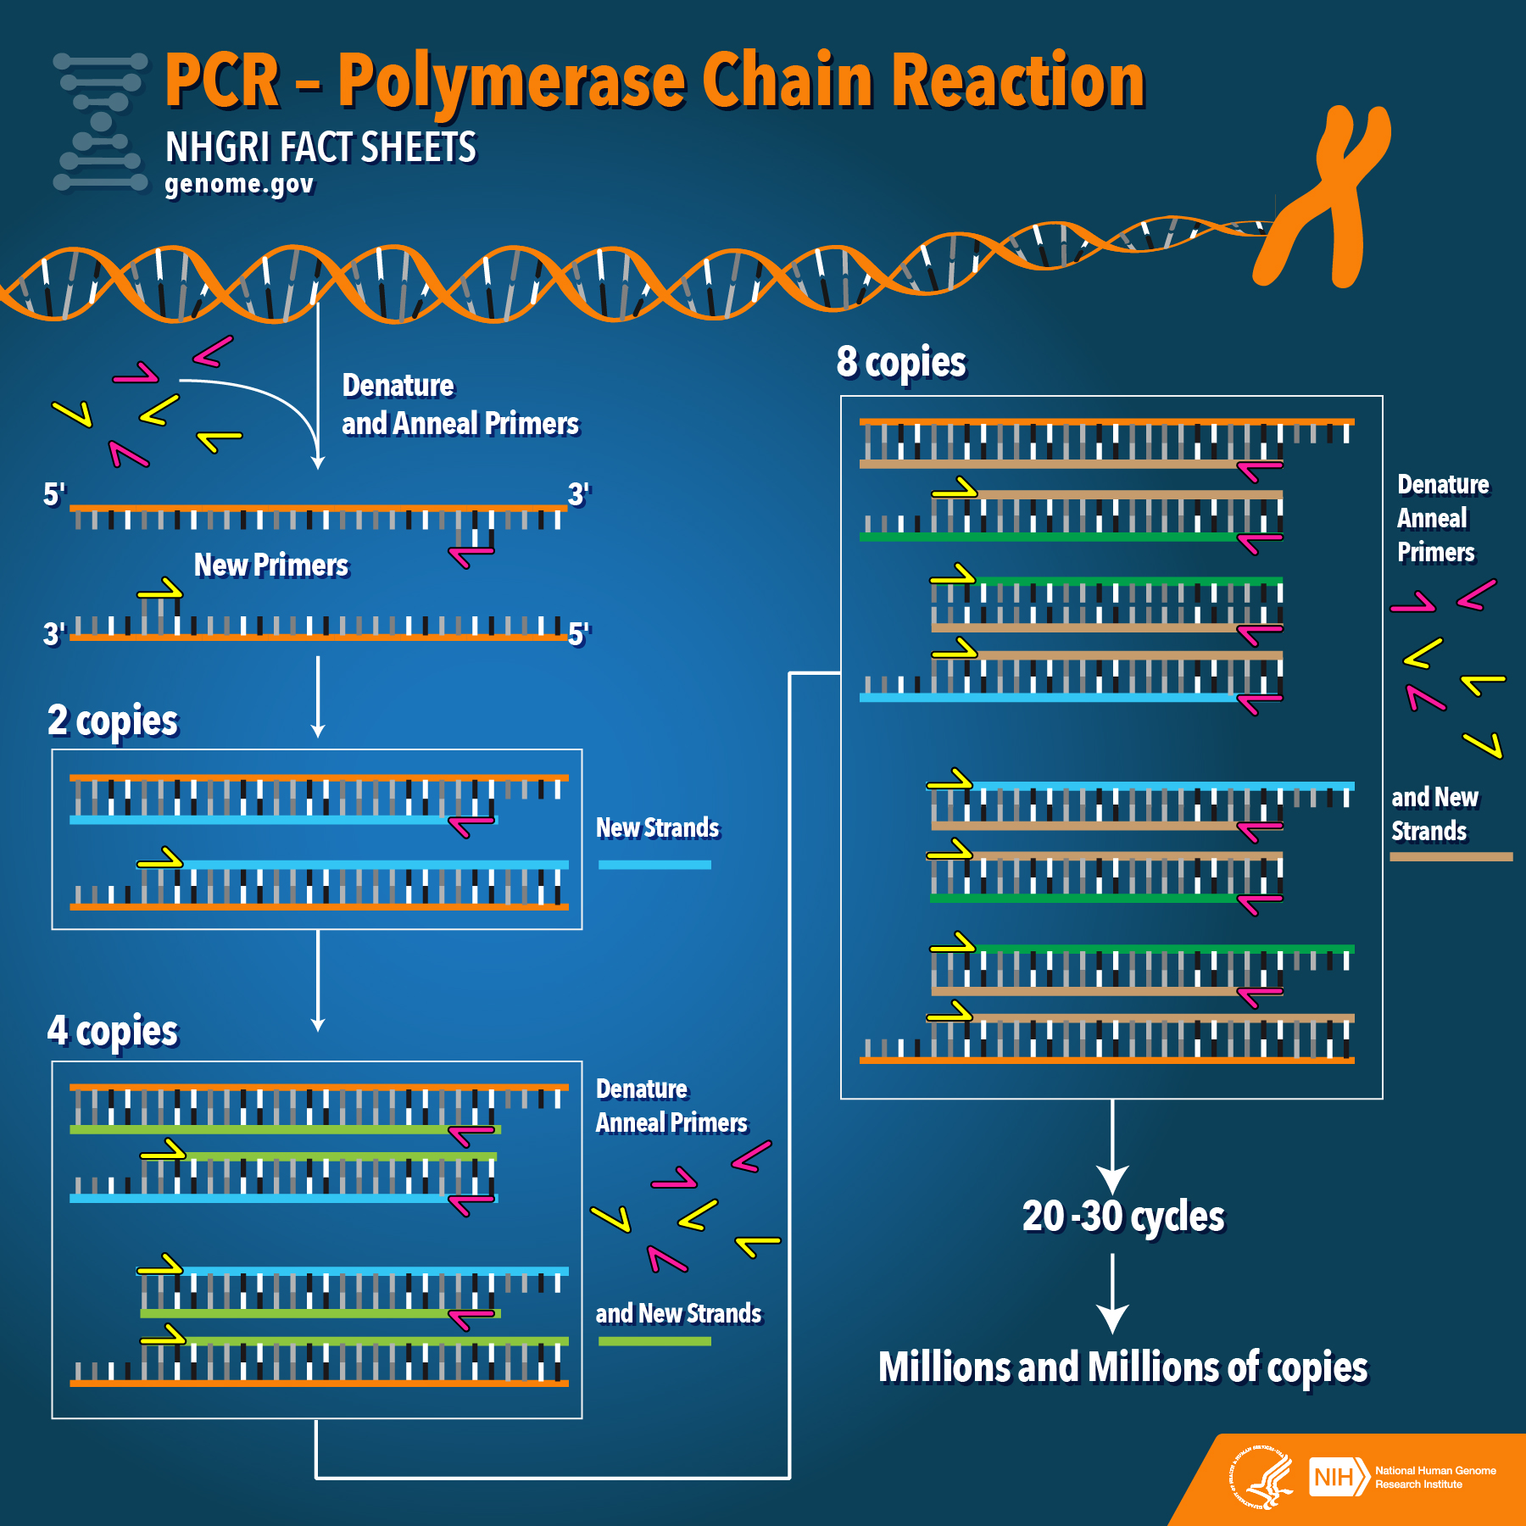
PCR
Notes:
Lots of ways to make PCR more or less specific, depending on what you want the end result to be.
Lots of different options for Taq polymerase and kits. Not going into those details, but happy to discuss later.

Slide 10
Primer selection
What do you want to know?
“Universal” primers, taxa-specific primers, V4 or V9 region of 18S??
Consider carefully....

Slide 11
Fusion primers
Illumina flow cell adapter+index+read primer adapter+Locus-specific-primer
Purchase forward and reverse primers with all the adaptors already included
Three independent PCRS – reduce impact of primer bias
Pool these amplicons
PRO: No additional PCR is required
CON: Expensive; Some PCR inefficiency due to long primers; Not as transferable across projects

Slide 12
2-Step PCR
read primer adapter+Locus-specific-primer

Slide 13
2-Step PCR
Illumina flow cell adapter+index+read primer adapter+Locus-specific-primer

Slide 14
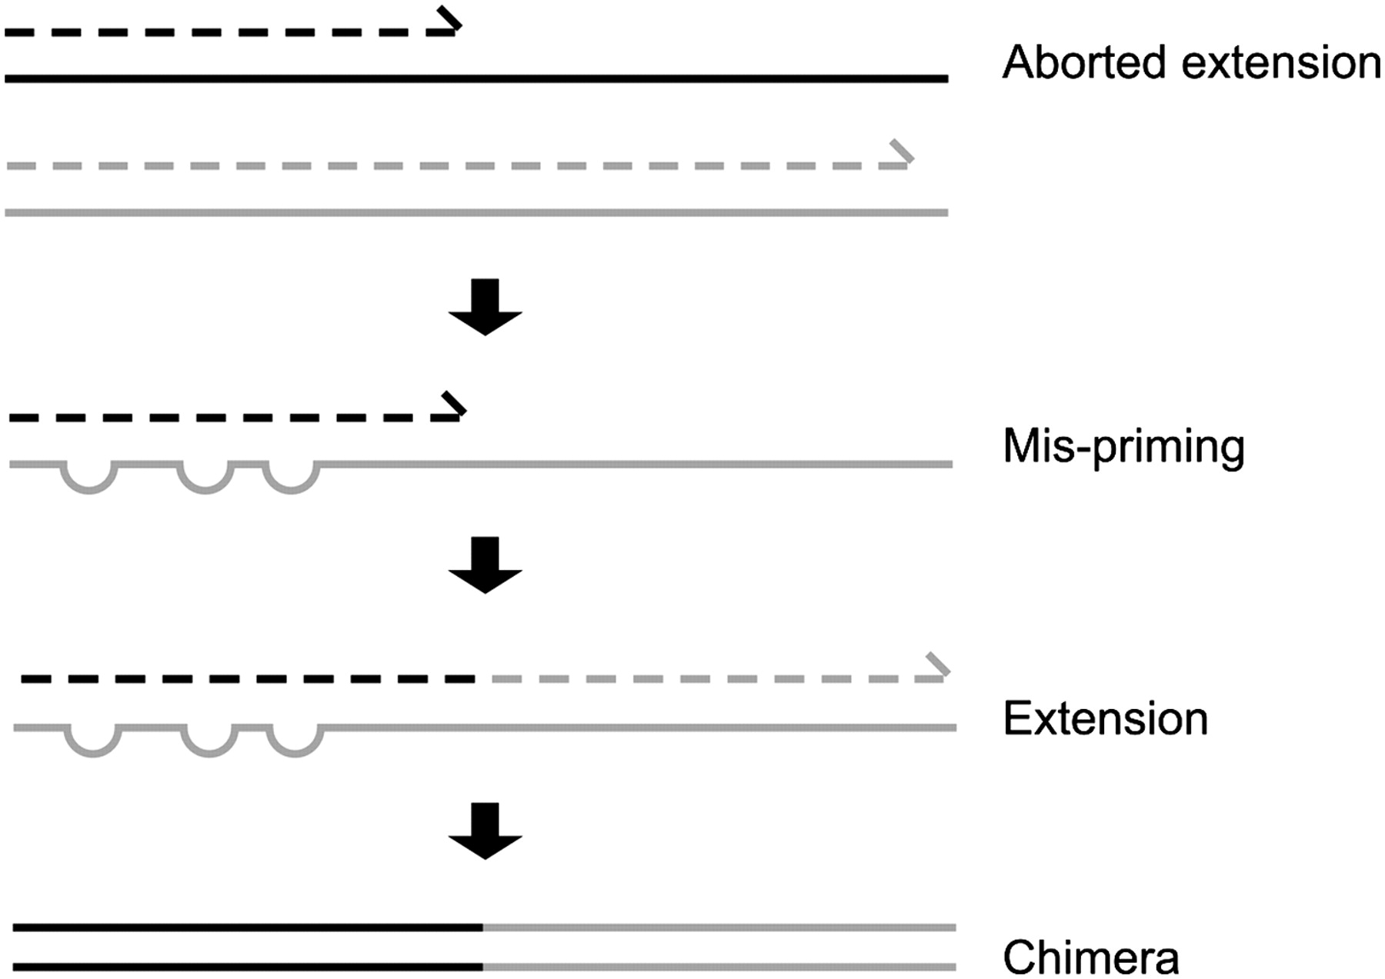
2-Step PCR
PRO: More easily adaptable across projects – can re-use adaptors with different amplicon-specific primers
- Cheaper option
- Primers are shorter = increased efficiency for both PCRs
CON: Two rounds of PCR are required, so increased likelihood of generated chimeras
-- Can inflate diversity estimates and can be difficult to detect
--generally second PCR has fewer cycles (30 cycles in round 1, 8 cycles in round 2 – need to get these cycles as low as possible)
Notes:
Probably most popular method for library preparation due to reduced cost

Slide 15
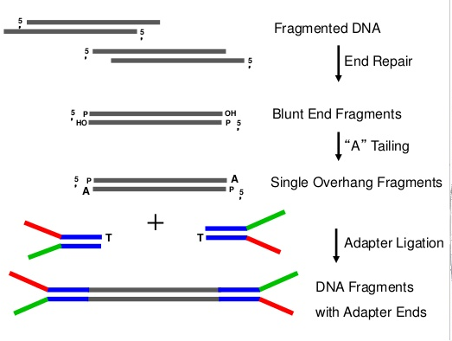
Ligation
PRO: Only one round of PCR required
CONS: Lots of additional work in lab; ligation efficiency?; enzymes are expensive!

Slide 16
Primer bias
Downside to PCR – no such thing as “universal” primer set. All primers have some level of bias. To reduce impact of bias on results – three separate rounds of PCR are performed for each sample.
Amplicons need to be pooled together. Pooling occurs after first round of PCR or before ligation (cost reduction).

Slide 17
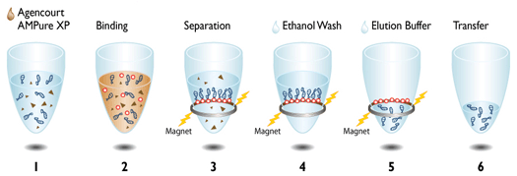
Purification
At this point, you have pooled, triplicate PCRs that have adaptors and barcodes on them for each sample.
Next step is to purify your amplicons with Ampure or SPRI beads

Slide 18
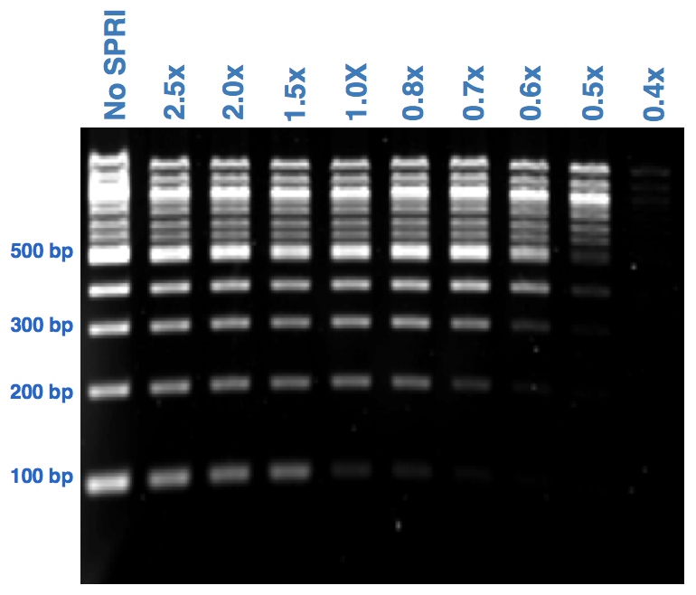
Purification
Small fragments will be preferentially sequenced, so they need to be removed before sequencing.
The concentration of beads you use depends on the size of the fragments in your library.
More beads = more small pieces kept (longer beads preferentially bind to the beads)

Slide 19
Quantification
At this point, you have purified, pooled, triplicate PCRs that have adaptors and barcodes on them for each sample.
Next step is to quantify the amount of product per sample so that you can pool them together.
Two ways to do this:
qPCR (KAPA quantification kit)
Qubit

Slide 20
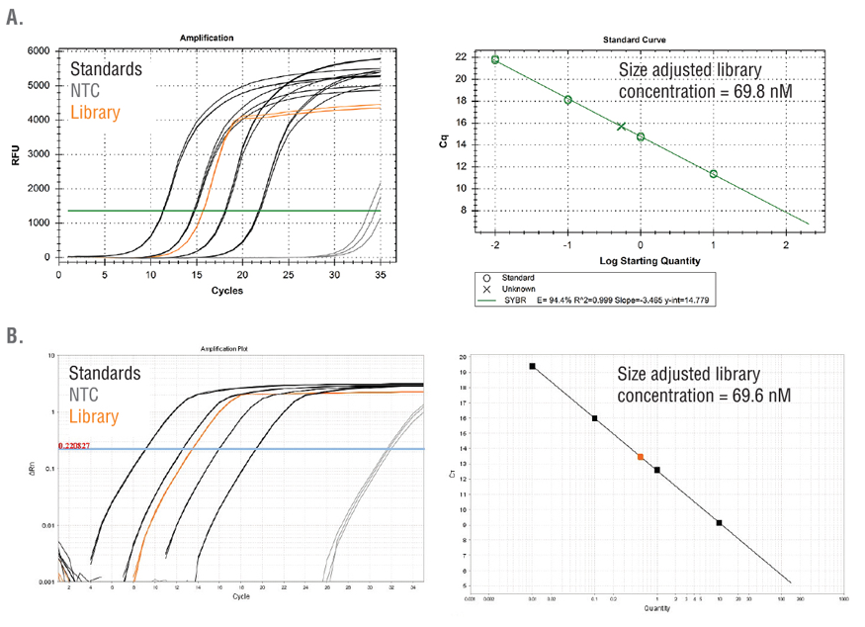
Quantification
qPCR
Kits come with standards in them that are run along with dilutions of your samples.
Based on the concentrations of the standards, you can calculate the concentration of DNA in each sample.
PRO: extremely accurate concentrations; doesn’t work if adaptors aren’t present
CON: expensive; time consuming...

Slide 21
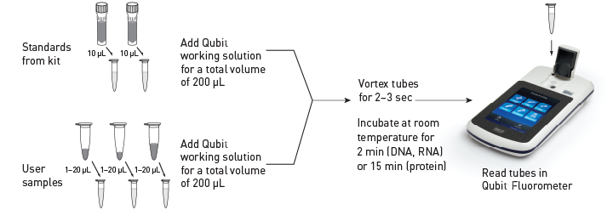
Quantification
PRO: cheaper; less time consuming
CON: not as accurate (reads all double-stranded DNA, with or without adaptors)

Slide 22
Pooling
Now that you know the concentration of DNA in each sample, you need to pool the DNA from all the samples together into a single tube and make sure that you have equal amounts of each sample in the final library.
There are two main ways to do this:
Use a spreadsheet to calculate the molar concentration of each sample (using the largest or average fragment size that could be obtained with the primers used) and then calculate the volume you would need to pipette from each sample to get a final concentration >10nM (which is what is generally required for sequencing).
This method sometimes requires having to pipette very small volumes and can push pipettes to their limits. NOTE: pipettes are less accurate at their limits, so this means you can inadvertently not add the correct volumes, even if you are a master pipettor!

Slide 23
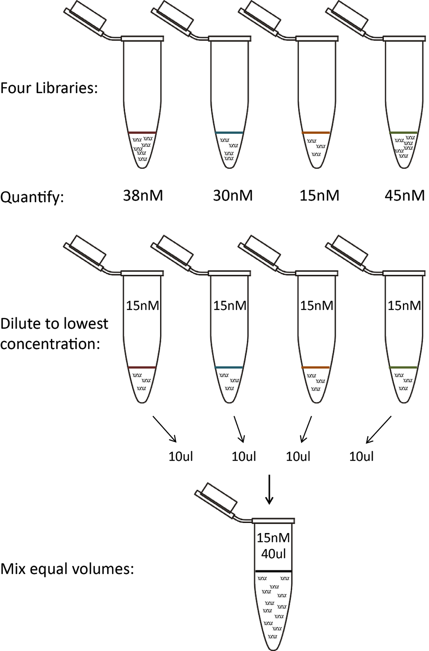
Pooling
2) Dilute first, then pool equal volumes.
This requires more pipetting overall and more tube handling, but generally means pipetting larger volumes (which means higher precision).

Slide 24
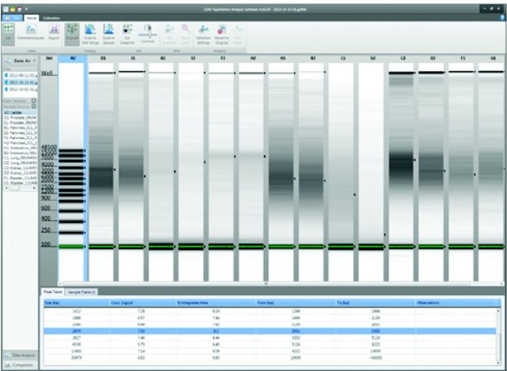
Library Quality Check
In-house sequencing = required
Sending out – core will do this for you
Need to ensure that all small fragments have been removed
Two options =
TapeStation or
Bioanalyzer

Slide 25
Sequencing
Which NGS/HTS platform should you use?
Generally, for metabarcoding, longer fragments are better = more DNA information to assign taxonomy to each organism.

Slide 26
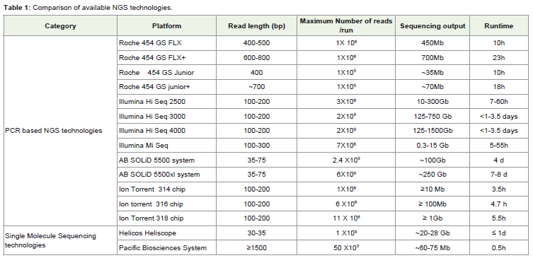
From 2015
Most researchers use Illumina MiSeq for metabarcoding now – provides long reads (500-600bp) and high coverage (= lots of sequences per run)
Alternatives: Roche 454 (long reads, less output, no longer in business); Ion Torrent (reads not as long, output not as high)
Notes:
All platforms have their downfalls

Slide 27
Sequencing
Important to note: all platforms have downsides
Low complex libraries = low quality sequences
-PHIX spike required for Illumina
Different platforms have issues with different types of errors, due to differences in chemistry
- ex. Homopolymers problem for 454
Finally, more output = greater computational needs

Slide 28
Resources at SI
CCG = All equipment for library preparation
Sequencers = 454 Junior, 454 FLX, MiSeq
LAB = All equipment for library preparation
Sequencers = Ion Torrent PGM, MiSeq
SERC = All equipment for library preparation
Sequencers = none (yet...)

Slide 29
External Resources
Not interested in all that pipetting??
Options for library preparation outside of SI:
Companies that will use standard primers to amplify from extracted DNA you send them (Ex. MrDNA)
Companies that will add adaptors to pooled amplicons you send them and sequence
Core sequencing facilities that will accept your “read to sequence” library

Slide 30
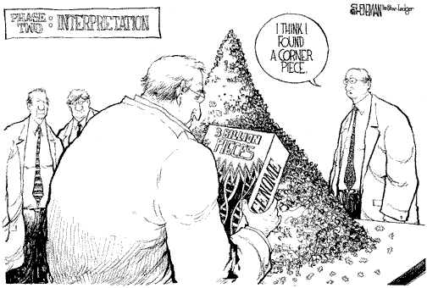
Now what?
After months of generating your libraries and waiting for all the sequencing...hopefully you now have lots (millions??) of beautiful, high quality sequence data to analyze.
Let’s learn some
bioinformatics!

