Slide 1

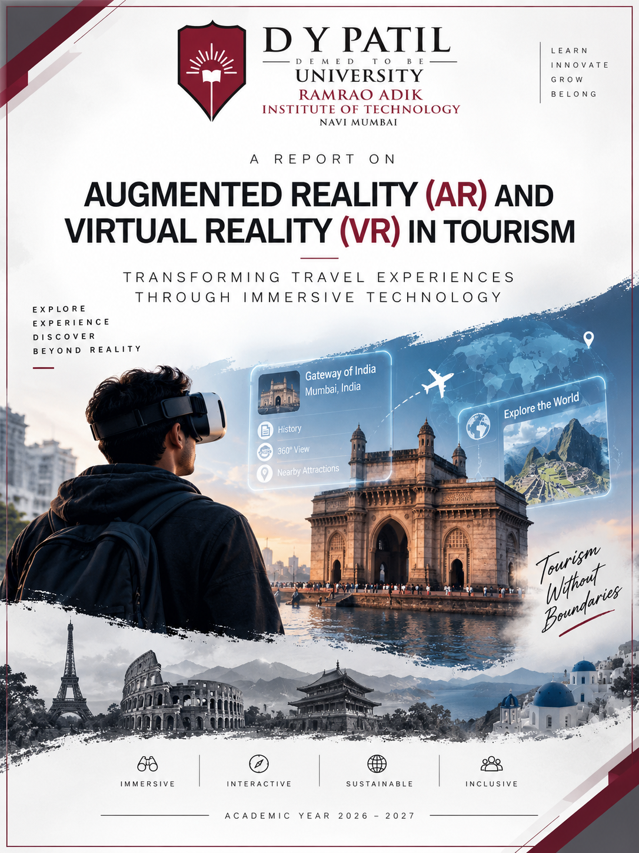
D Y PATIL DEEMED TO BE UNIVERSITY
RAMRAO ADIK INSTITUTE OF TECHNOLOGY (RAIT)
DEPARTMENT OF COMPUTER ENGINEERING • NAVI MUMBAI
LEARN • INNOVATE • GROW • BELONG
A TECHNICAL SEMINAR REPORT ON
AUGMENTED REALITY (AR) AND VIRTUAL REALITY (VR) IN TOURISM
TRANSFORMING TRAVEL EXPERIENCES THROUGH IMMERSIVE TECHNOLOGY
Business English and Communication (BEC) | Semester III | Academic Year 2026–2027
EXPLORE • EXPERIENCE • DISCOVER • BEYOND REALITY
STUDENT RESEARCH TEAM: GROUP A3 - 2
6 MEMBERS | RAIT COMP ENGG
Soham Jadhav (25CE1047): Team Lead, System Architecture & Cloud-XR
Prachi Jaiswal (25CE1048): Computer Vision & VI-SLAM Sensor Fusion
Soham Jangid (25CE1049): 3D Gaussian Splatting & Heritage Modeling
Somnath Jha (25CE1050): Spatial UI/UX & Cybersickness Analysis
Asmit Jogdand (25CE1051): Field Trials & Mumbai Geospatial VPS
Om Kirdat (25CE1053): GenAI Architecture & Multimodal Guides
ACADEMIC MENTORSHIP & LEADERSHIP
FACULTY GOVERNANCE
Faculty Guide: Mrs. Nisha Narwani: Assistant Professor, Dept. of Computer Engineering
Head of Department: Dr. Amarsinh V. Vidhate: Professor & Head, Dept. of Computer Engineering
◆ IMMERSIVE (6DoF Radiance) | ◆ INTERACTIVE (Real-Time VPS) | ◆ SUSTAINABLE (Footfall Offload) | ◆ INCLUSIVE (Remote Access) | ACADEMIC YEAR 2026–2027

Slide 2
01 | CONCEPTUAL FOUNDATIONS
What is Spatial Computing in Tourism?
Moving from static physical guidebooks to real-time, context-aware digital immersion
Augmented Reality (AR)
REAL-WORLD OPTICAL OVERLAY
Core Paradigm: Superimposes real-time computer-generated graphics and metadata directly onto the physical environment.
Optics: Waveguide optical see-through (OST) or high-speed video see-through (VST) preserving direct user vision.
Tourism Utility: Living historical overlays, 3D monument reconstruction, in-situ directional wayfinding HUDs, and multilingual translation.
Target Devices: Apple Vision Pro, XREAL Air 2, ARCore/ARKit smartphones.
Key Benefit: Maintains 100% environmental awareness and situational safety while traveling in unfamiliar cities.
Virtual Reality (VR)
COMPLETE SYNTHETIC IMMERSION
Core Paradigm: Replaces physical reality entirely with an immersive, interactive 3D synthetic digital environment.
Optics: High-PPD dual stereoscopic displays with Pancake lenses blocking external ambient photons.
Tourism Utility: 'Try-Before-You-Fly' destination previews, 6DoF remote museum walkthroughs, and fragile heritage exploration.
Target Devices: Meta Quest 3, HTC Vive Focus Vision, PlayStation VR2.
Key Benefit: Enables complete spatial and temporal teleportation to global landmarks without physical travel.
Mixed Reality (MR / Spatial)
PHYSICAL-DIGITAL CONVERGENCE
Core Paradigm: Real and virtual elements coexist and interact in real time with mutual occlusion and environmental physics.
Perception: Real-time LiDAR depth scanning, plane detection, dynamic lighting estimation, and human segmentation.
Tourism Utility: Multi-user collaborative holographic tours, persistent spatial anchors across historical ruins.
Target Devices: Apple Vision Pro, Magic Leap 2, Enterprise Spatial Computers.
Key Benefit: Virtual artifacts cast photorealistic shadows and occlude behind physical stone pillars naturally.
+68% Wayfinding Speed
AR visual positioning eliminates transit confusion in major hubs
42% Higher Booking Lift
Pre-trip VR room & excursion previews boost traveler confidence
<20ms M2P Latency Ceiling
Strict motion-to-photon threshold required to eliminate cybersickness
BEC Technical Seminar | Dept. of Computer Engineering, RAIT, D Y Patil University
A3 Group 2 | Academic Year 2026–2027
Slide 2 of 12

Slide 3
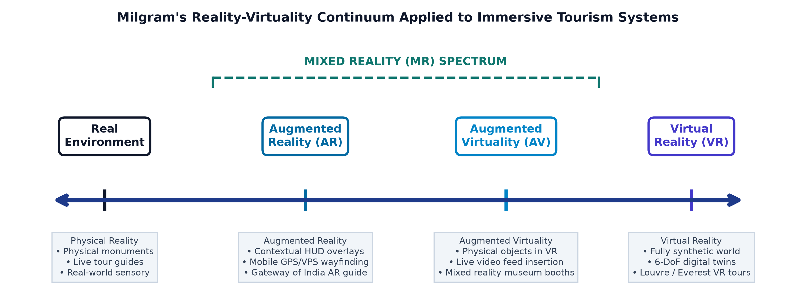
02 | EVOLUTION & THEORETICAL TAXONOMY
Evolutionary Milestones & Milgram's Continuum
Taxonomizing real vs. virtual environments from Ivan Sutherland (1968) to modern Spatial Computing
The Pioneer Era (1968–1994)
OPTICAL SEED & TAXONOMY
1968 — Sword of Damocles: Ivan Sutherland invents the first head-mounted 3D display with mechanical tracking.
1994 — Milgram Continuum: Paul Milgram & Fumio Kishino define the Reality-Virtuality spectrum spanning Real, AR, AV, and VR.
Early Constraints: Bulky laboratory rigs, high weight (>2kg), severe latency, and wire-tethered tracking restricted consumer use.
Mobile AR Revolution (2014–2020)
CONSUMER SENSOR FUSION
Sensor Integration: Modern smartphones integrated multi-camera arrays, IMU gyroscopes, and dedicated neural processors.
ARCore & ARKit: Google & Apple introduce monocular Visual Odometry and plane detection to >1.5 billion consumer devices.
Tourism Inception: Location-based tourism apps, museum indoor wayfinding, and interactive cultural site exhibits emerged worldwide.
Spatial Computing Era (2024–2027+)
RADIANCE FIELDS & 5G MEC
Spatial Passthrough: Apple Vision Pro and Meta Quest 3 achieve sub-millimeter 3D spatial meshing and real-time hand-eye tracking.
3D Radiance Fields: 3D Gaussian Splatting and NeRFs enable real-time 120 FPS photorealistic rendering of cultural monuments.
Cloud-XR & 5G MEC: Offloads heavy rendering to edge nodes, enabling featherweight all-day smart eyewear.
BEC Technical Seminar | Dept. of Computer Engineering, RAIT, D Y Patil University
A3 Group 2 | Academic Year 2026–2027
Slide 3 of 12

Slide 4
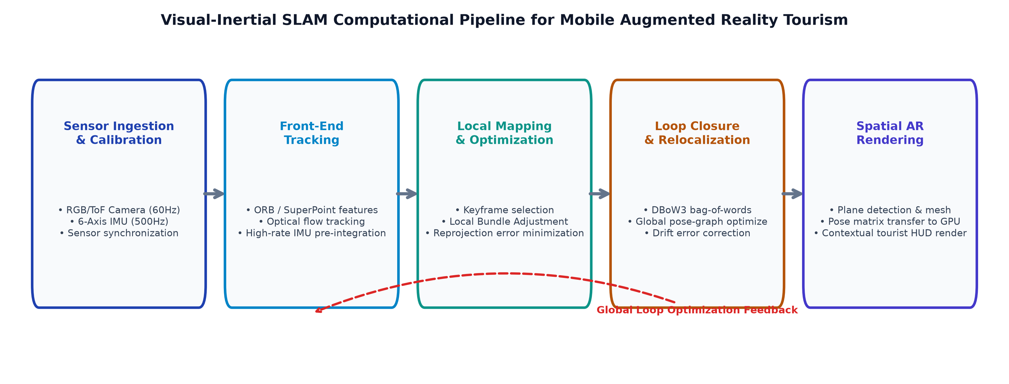
03 | DEEP TECHNICAL ARCHITECTURE
Core Technologies Powering XR Tourism
Multi-sensor perception, 6DoF SLAM tracking, and high-fidelity 3D radiance fields
Visual-Inertial SLAM
6DOF POSE TRACKING
Sensor Fusion: Tightly couples 1000 Hz IMU inertial data with 60 Hz stereo camera visual frames.
EKF & Factor Graphs: Optimizes pose trajectories with sub-centimeter accuracy.
Loop Closure: Detects visited keyframes to cancel cumulative sensor drift.
LiDAR & ToF Sensing
INSTANT DEPTH MESHING
Time-of-Flight: Nanosecond pulsed infrared laser arrays calculate precise millimetric surface distances.
Dynamic Occlusion: Allows real tourists to physically occlude virtual elements naturally.
Night Operation: Enables robust spatial mapping in low-light evening tourism.
3D Gaussian Splatting
REAL-TIME PHOTOREALISM
Differentiable Splats: Represents complex heritage monuments using millions of 3D ellipsoids.
120+ FPS Rendering: Bypasses slow neural network inference for instant rasterization.
Millimeter Precision: Preserves intricate stone carvings and historical textures.
5G MEC Split-Rendering
CLOUD-EDGE COMPUTE
Distributed GPUs: Renders 100M+ polygon models on edge servers in real time.
<5ms 5G URLLC: Ultra-low latency wireless video streaming to headsets.
Lightweight Form: Decouples battery weight and heat from wearable glasses.
BEC Technical Seminar | Dept. of Computer Engineering, RAIT, D Y Patil University
A3 Group 2 | Academic Year 2026–2027
Slide 4 of 12

Slide 5
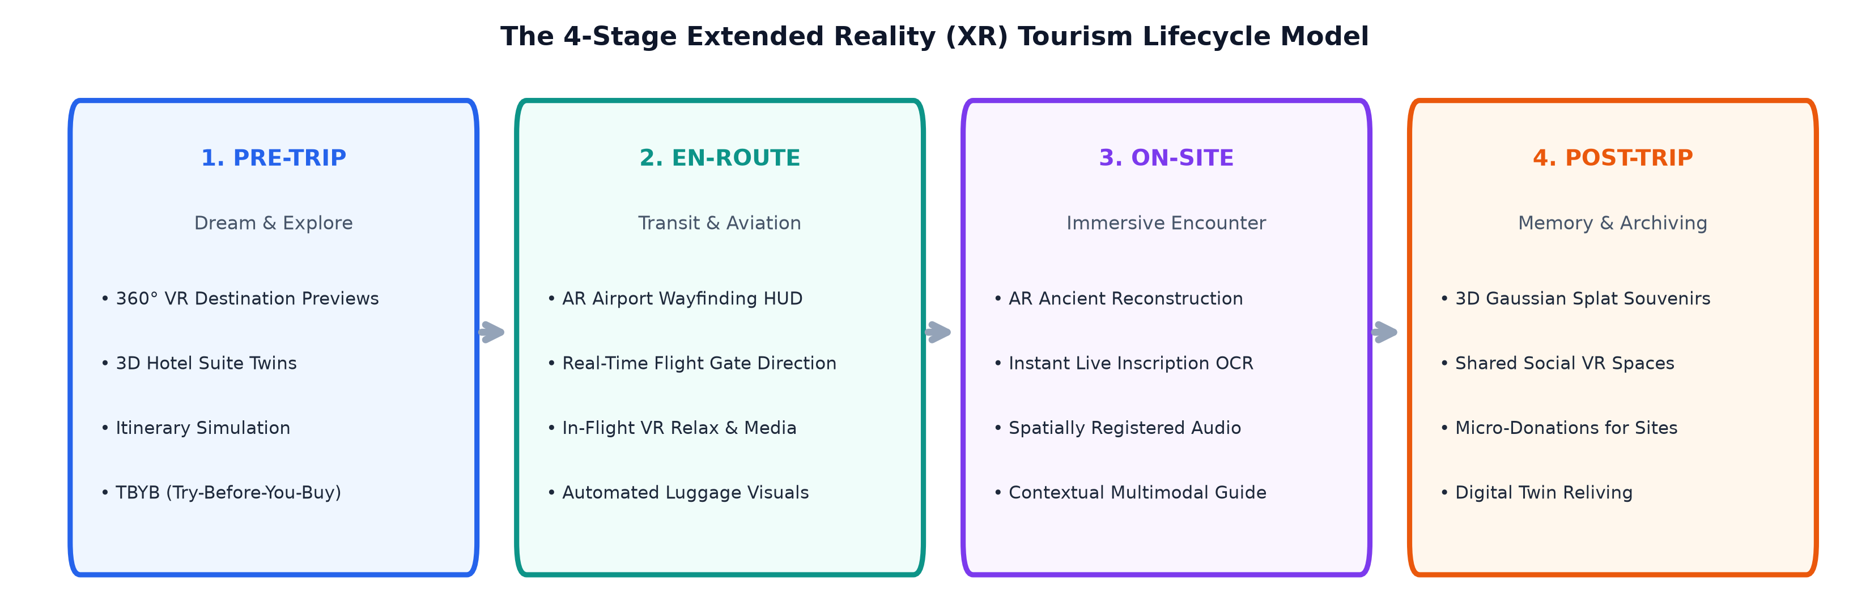
04 | VALUE PROPOSITION & USER JOURNEY
Transforming the Complete Tourist Journey
Strategic value drivers across pre-trip inspiration, on-site discovery, and post-trip preservation
Pre-Trip: 'Try-Before-You-Fly'
INSPIRATION & CONVERSION
Virtual Previews: Immersive 360° VR destination tours, interactive 3D hotel suite and cruise exploration.
Anxiety Elimination: Allows travelers to inspect accessibility ramps, room views, and transit connections.
Higher Conversion: Hotels and resorts report a 42% lift in direct bookings and a 35% reduction in cancellations.
During Trip: In-Situ Augmentation
NAVIGATION & LIVING HISTORY
Spatial HUD Navigation: Holographic arrows projected directly onto roadways guide visitors through complex cities.
Temporal Reconstruction: Overlays historical architectural phases directly onto modern weathered ruins.
Instant Translation: Real-time multilingual audio and text translation of ancient plaques and foreign signs.
Post-Trip & Conservation
PRESERVATION & RECALL
Footfall Mitigation: Safeguards fragile ecological and historical sites (caves, reefs) from over-tourism.
Universal Access: Enables elderly, hospitalized, or mobility-impaired tourists to explore rugged peaks.
Digital Time-Capsules: Tourists revisit persistent spatial memories and interactive 3D travel albums.
BEC Technical Seminar | Dept. of Computer Engineering, RAIT, D Y Patil University
A3 Group 2 | Academic Year 2026–2027
Slide 5 of 12

Slide 6
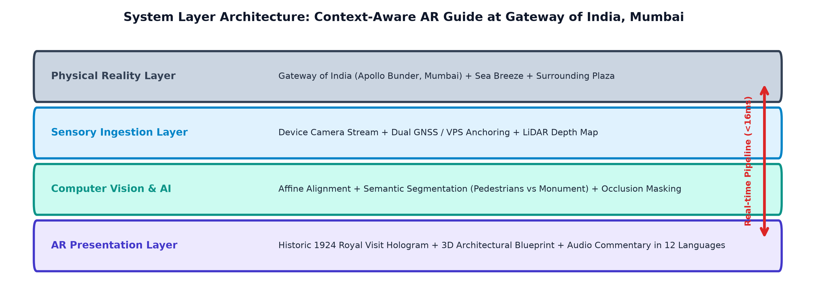
05 | REAL-WORLD FIELD CASE STUDIES
Field Implementations: Mumbai & Global Tourism
Operational deployments across historical landmarks, international transit hubs, and museums
Gateway of India (Mumbai)
AR HERITAGE RECONSTRUCTION
Basalt Alignment: Georeferenced Visual Positioning System (VPS) anchors graphics to 1924 Indo-Saracenic masonry.
Living History: Dynamic overlays recreate the 1911 Royal Visit and the 1948 departure of British troops.
Spatial Audio HUD: Location-triggered multilingual audio narration synchronizes with visitor head direction.
CSMIA Mumbai Airport
SMART VPS INDOOR WAYFINDING
Indoor GPS Solution: Bypasses concrete signal attenuation using ceiling camera visual landmark matching.
Turn-by-Turn Paths: Floating holographic arrows guide passengers directly to departure gates and baggage belts.
Dynamic Transit HUD: Real-time gate changes, boarding countdowns, and lounge proximity alerts.
Virtual Louvre & British Museum
GLOBAL 6DOF REMOTE GALLERIES
Photogrammetric Twins: Sub-millimeter 3D scans of fragile masterpieces (Mona Lisa, Rosetta Stone).
Crowd-Free Access: Millions explore virtual galleries in 6DoF without physical queuing or travel cost.
Microscopic Inspection: Visitors inspect microscopic brushstrokes and hidden inscriptions up close.
BEC Technical Seminar | Dept. of Computer Engineering, RAIT, D Y Patil University
A3 Group 2 | Academic Year 2026–2027
Slide 6 of 12

Slide 7
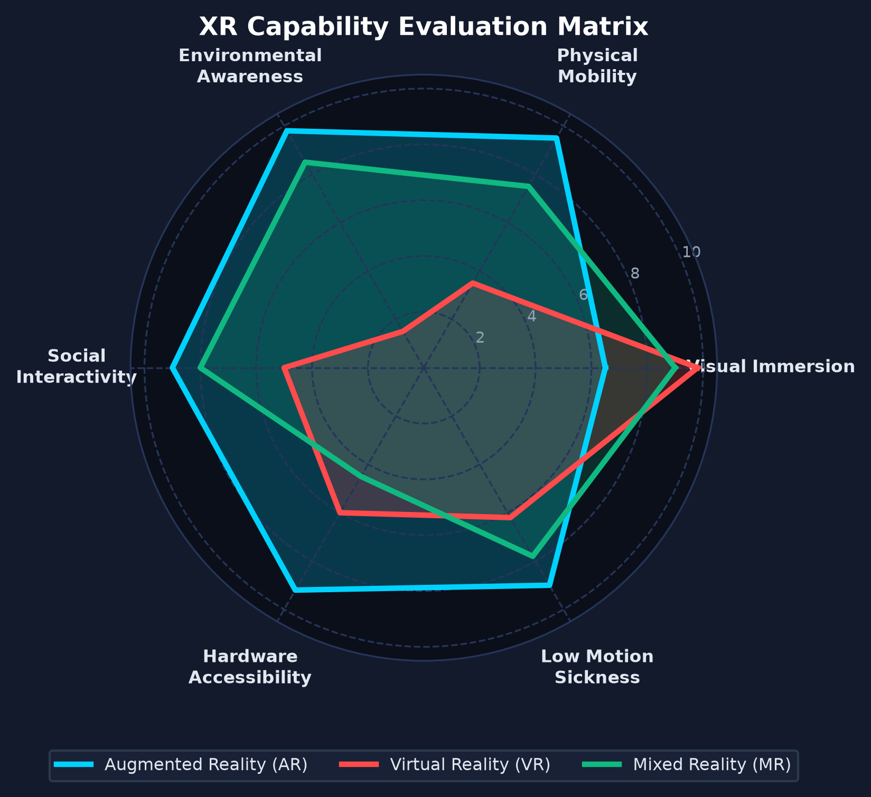
06 | COMPARATIVE ARCHITECTURAL MATRIX
System Evaluation: Augmented Reality vs. Virtual Reality
Multi-dimensional benchmark across optics, compute, situational safety, and tourism utility
Evaluation Metric | Augmented Reality (AR) | Virtual Reality (VR)
Display Mechanism | Optical/Video Waveguide Passthrough | Stereoscopic Dual-Pancake Immersive HMD
Environment Awareness | 100% Direct real-world vision & safety | 0% Isolated synthetic 3D environment
Mobility & Weight | Ultra-lightweight glasses (50–80g) | Dedicated compute headset (450–600g)
Primary Tourism Role | On-site navigation & living heritage HUD | Remote pre-trip exploration & walkthroughs
Critical Bottleneck | Sunlight glare (>10,000 nits required) | Cybersickness & VAC optical fatigue
Compute Architecture | 5G MEC distributed split edge rendering | On-device embedded or PC-tethered GPU
EMPIRICAL BENCHMARK SUMMARY
• AR achieves maximum Mobility (0.95) and Environmental Interaction (0.95) for on-site navigation.
• VR dominates in Sensory Immersion (0.98) and Conservation (0.92) for remote destination teleportation.
BEC Technical Seminar | Dept. of Computer Engineering, RAIT, D Y Patil University
A3 Group 2 | Academic Year 2026–2027
Slide 7 of 12

Slide 8
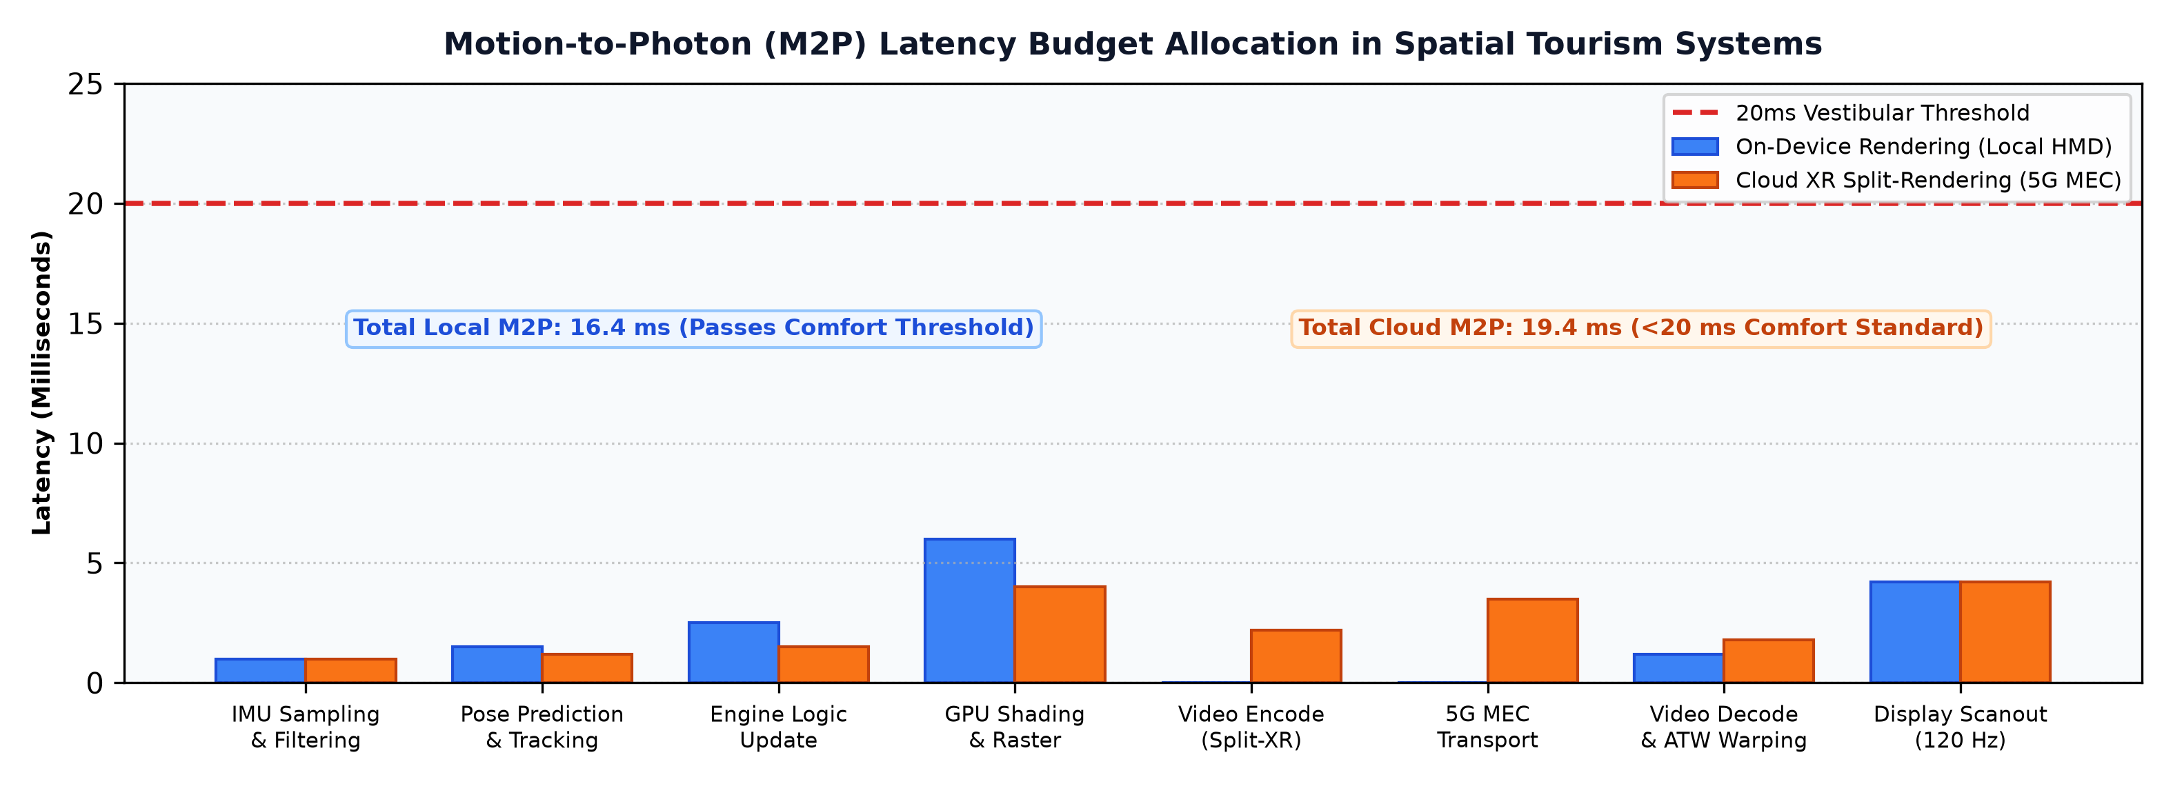
07 | CHALLENGES & ENGINEERING MITIGATION
Overcoming Technical Hurdles in XR Tourism
Addressing latency boundaries, outdoor luminance, thermal limits, and spatial privacy
20ms Latency & Cybersickness
VESTIBULAR-OCULAR SYNCHRONY
Engineering Problem: M2P latency >20ms creates sensory lag, triggering vestibular nausea and disorientation.
Predictive Tracking: 1000 Hz IMU Kalman filtering anticipates head movement 15ms into the future.
Asynchronous TimeWarp: Warps rendered video frames on the display scanline to eliminate residual lag.
Outdoor Sunlight & Thermals
OPTICAL CONTRAST & DISSIPATION
Engineering Problem: Tropical sunlight (100,000 lux) washes out holographic waveguides; heat limits compute.
Electrochromic Dimming: Smart lenses tint automatically to maintain >1000:1 contrast outdoors.
Micro-LED Optics: Next-gen Micro-LED arrays deliver >5,000 nits with split compute pucks.
Spatial Privacy & Security
DATA PROTECTION & ETHICS
Engineering Problem: Always-on camera feeds risk capturing bystanders and secure airport areas.
Edge Feature Hashing: Raw video is converted to mathematical hashes locally; image buffers are discarded.
Geofenced Blackouts: Automated camera masking around sensitive security and cultural zones.
BEC Technical Seminar | Dept. of Computer Engineering, RAIT, D Y Patil University
A3 Group 2 | Academic Year 2026–2027
Slide 8 of 12

Slide 9
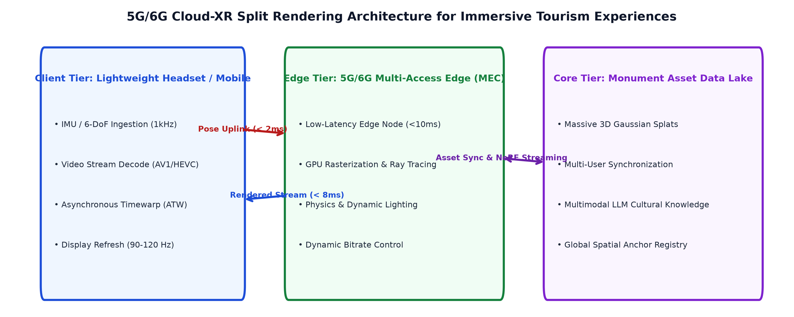
08 | DISTRIBUTED SYSTEM TOPOLOGY
Cloud-XR Architecture for Scalable Tourism
Decoupling lightweight spatial glasses from heavy GPU rendering via 5G MEC edge nodes
Tier 1: Client Tracking
LOCAL POSE & TELEMETRY
Low-Power VI-SLAM: Executes 6DoF tracking locally on lightweight smart glasses.
Gaze Tracking: Eye sensors detect focus regions for dynamic foveated compression.
1000 Hz Pose Stream: Sends compressed orientation packets over 5G.
Tier 2: 5G URLLC Network
ULTRA-LOW TRANSPORT LAG
<5ms Latency: 5G mmWave URLLC guarantees near-zero transmission jitter.
>100 Mbps Bandwidth: High uplink supports continuous spatial point cloud telemetry.
Dedicated QoS Slices: Guarantees packet priority during crowded tourism events.
Tier 3: MEC Edge GPUs
HIGH-POLYMER RADIANCE
Photorealistic Compute: Renders 100M+ Gaussian splats and dynamic volumetric lighting.
Foveated Rendering: Focuses compute on user fovea, cutting rendering load by 60%.
Hardware Encoders: Encodes AV1/H.265 video frames in under 4ms.
Tier 4: Client Reprojection
JITTER NULLIFICATION
Delta Pose Shift: Re-projects incoming frames based on head movement during transit.
Zero Perceived Lag: Presenter and tourists experience smooth 120 FPS visual flow.
Extended Battery Life: Offloading graphics compute extends device battery to 8+ hours.
BEC Technical Seminar | Dept. of Computer Engineering, RAIT, D Y Patil University
A3 Group 2 | Academic Year 2026–2027
Slide 9 of 12

Slide 10
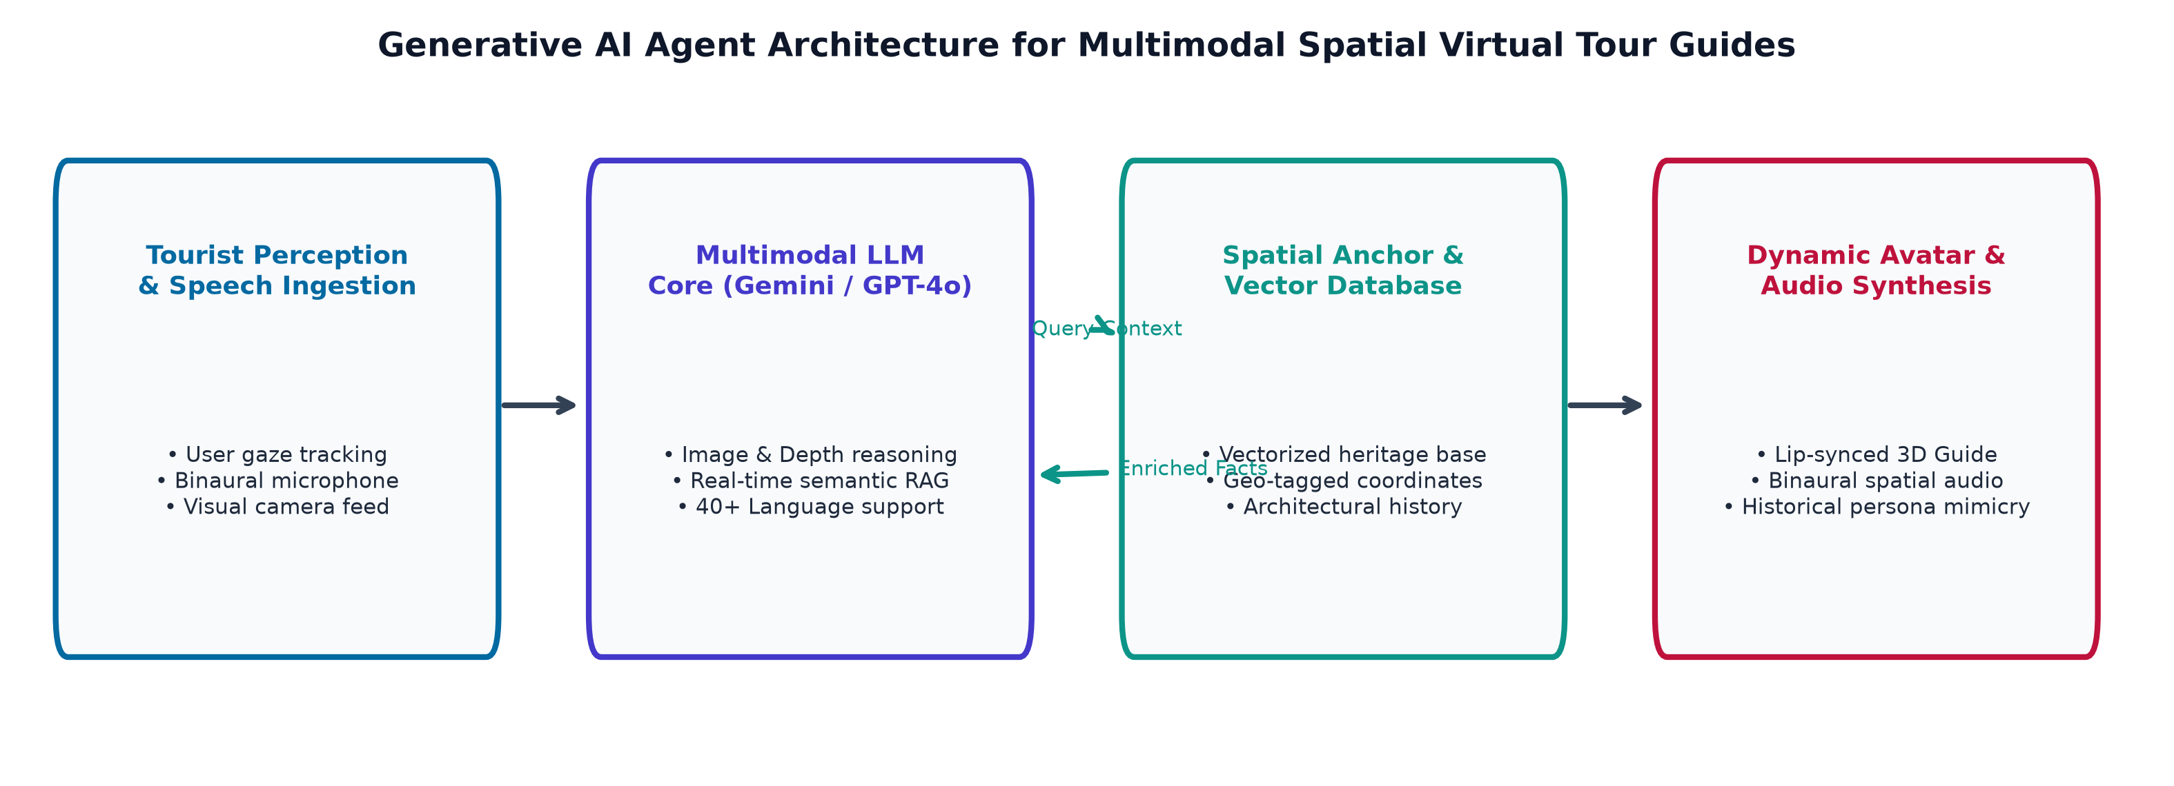
09 | FUTURE SCOPE & EMERGING PARADIGMS
Emerging Frontiers: GenAI & Spatial Web 3.0
The convergence of Vision-Language Models, spatial audio synthesis, and digital twins
Multimodal GenAI Guides
CONVERSATIONAL AGENTS
Vision-Language Models: On-device camera feeds identify architectural styles, paintings, and sculptures.
Spatial RAG Intelligence: Retrieves verified historical records, folklore, and structural blueprints dynamically.
Embodied Avatars: Guides converse naturally in any language, adopting historical personas (e.g., King Ashoka).
Ultrasonic Haptics & Audio
TACTILE & ACOUSTIC IMMERSION
Mid-Air Acoustic Haptics: Phased ultrasonic arrays create focal pressure points, letting users 'feel' stone textures.
Spatial Acoustic Reverb: Ray-traced HRTF filters reproduce the true acoustic echo of ancient cathedrals.
Sensory Teleportation: Combines photorealism with touch and 3D sound for total sensory immersion.
Metaverse Twin Cities
PERSISTENT SPATIAL WEB
Photorealistic Twin Cities: Continuous 3DGS scans maintain 1:1 synchronized digital replicas of global cities.
Persistent Spatial Souvenirs: Tourists leave holographic notes, art, and time capsules anchored in real coordinates.
Collaborative Travel: Friends across the globe meet and explore historical sites together in real time.
BEC Technical Seminar | Dept. of Computer Engineering, RAIT, D Y Patil University
A3 Group 2 | Academic Year 2026–2027
Slide 10 of 12

Slide 11
10 | PROJECT GOVERNANCE & RESPONSIBILITY MATRIX
Team Structure & Technical Contributions
Academic Seminar A3 Group 2 | Department of Computer Engineering
Soham Jadhav (25CE1047)
SYSTEM ARCHITECTURE & CLOUD-XR
Core Domain: 5G MEC split-rendering pipeline, network topologies, and latency budget modeling.
Primary Output: End-to-end Cloud-XR architecture design, system integration, and presentation delivery.
Prachi Jaiswal (25CE1048)
COMPUTER VISION & VI-SLAM
Core Domain: 6DoF pose estimation, Extended Kalman Filtering, and multi-sensor fusion algorithms.
Primary Output: Visual Odometry pipeline, loop closure algorithms, and sensor drift compensation.
Soham Jangid (25CE1049)
3D GAUSSIAN SPLATTING & MODELING
Core Domain: Radiance field reconstruction, 3DGS vs. NeRF benchmarks, and heritage asset optimization.
Primary Output: High-fidelity photogrammetric capture pipeline and real-time rasterization study.
Somnath Jha (25CE1050)
SPATIAL UI/UX & CYBERSICKNESS
Core Domain: Motion-to-photon latency benchmarks, vergence-accommodation conflict mitigation.
Primary Output: Ergonomic spatial UI evaluation, user comfort heuristics, and accessibility guidelines.
Asmit Jogdand (25CE1051)
FIELD CASE STUDIES & MUMBAI VPS
Core Domain: Empirical field studies: Gateway of India AR overlay and CSMIA airport wayfinding.
Primary Output: Georeferenced VPS localization analysis and urban tourism deployment heuristics.
Om Kirdat (25CE1053)
GENAI ARCHITECTURE & FUTURE SCOPE
Core Domain: Multimodal LLM tour guides, spatial RAG architectures, and Spatial Web 3.0.
Primary Output: Generative AI conversational pipeline, edge privacy safeguards, and ethics review.
Under the Guidance of: Mrs. Nisha Narwani (Assistant Professor) | Head of Department: Dr. Amarsinh V. Vidhate (Professor & HOD)
Department of Computer Engineering, Ramrao Adik Institute of Technology (RAIT), D Y Patil Deemed to be University, Navi Mumbai
BEC Technical Seminar | Dept. of Computer Engineering, RAIT, D Y Patil University
A3 Group 2 | Academic Year 2026–2027
Slide 11 of 12

Slide 12
11 | SYNTHESIS & CONCLUDING VISION
Conclusion & Interactive Discussion
Key architectural takeaways, societal impact, and open question forum
Experiential Paradigm Shift
ACTIVE 6DOF ENGAGEMENT
Transformation: XR shifts tourism from passive visual viewing to active, participatory 6DoF spatial exploration.
Contextual Depth: Living temporal reconstructions revive forgotten civilizations with accurate architectural layers.
Engineering Viability
CLOUD-XR CONVERGENCE
Overcoming Limits: 5G MEC, 3D Gaussian Splatting, and low-power VI-SLAM conquer mobile compute barriers.
Wearable Future: Enables sleek all-day smart eyewear with all-day battery life and zero thermal lag.
Sustainable Preservation
ECO-CONSERVATION & EQUITY
Monument Protection: Virtual twins shield fragile world heritage monuments from physical degradation.
Global Inclusion: Democratizes educational and cultural travel for people with mobility impairments.
“The future of tourism is not just about visiting places — it is about experiencing them.”
Thank you for attending our technical seminar on AR & VR in Tourism.
We warmly invite questions, architectural discussions, and feedback from faculty and peers.
Group A3 - 2 | Department of Computer Engineering | Ramrao Adik Institute of Technology (RAIT), D Y Patil University
BEC Technical Seminar | Dept. of Computer Engineering, RAIT, D Y Patil University
A3 Group 2 | Academic Year 2026–2027
Slide 12 of 12

