Slide 1
Building and Testing the
W6NBC Double Delta Slot HF Antenna
by Mark Smith
BayCon 2021, February 6

Slide 2
Who am I?
Mark Smith, aka Smitty or SmittyHalibut
Callsign, bad timing:
  I‘m KR6ZY as I write this.
  I hope to be N6MTS by the time you see this.
SmittyHalibut on Twitter and YouTube

Slide 3
What are we talking about today?
Background and Goals
Antenna Build
Measurements
Analysis
Conclusions
What‘s next?

Slide 4
What are we talking about today?
Background and Goals
Antenna Build
Measurements
Analysis
Conclusions
What‘s next?

Slide 5
What is this antenna?
John Portune, W6NBC
Many articles in many publications, such as QST
Interested in Slot antennas
Presented an HF Slot Antenna at QSO Today Ham Expo 2020
https://w6nbc.com/articles/2020-TBDdoubledelta.pdf

Slide 6
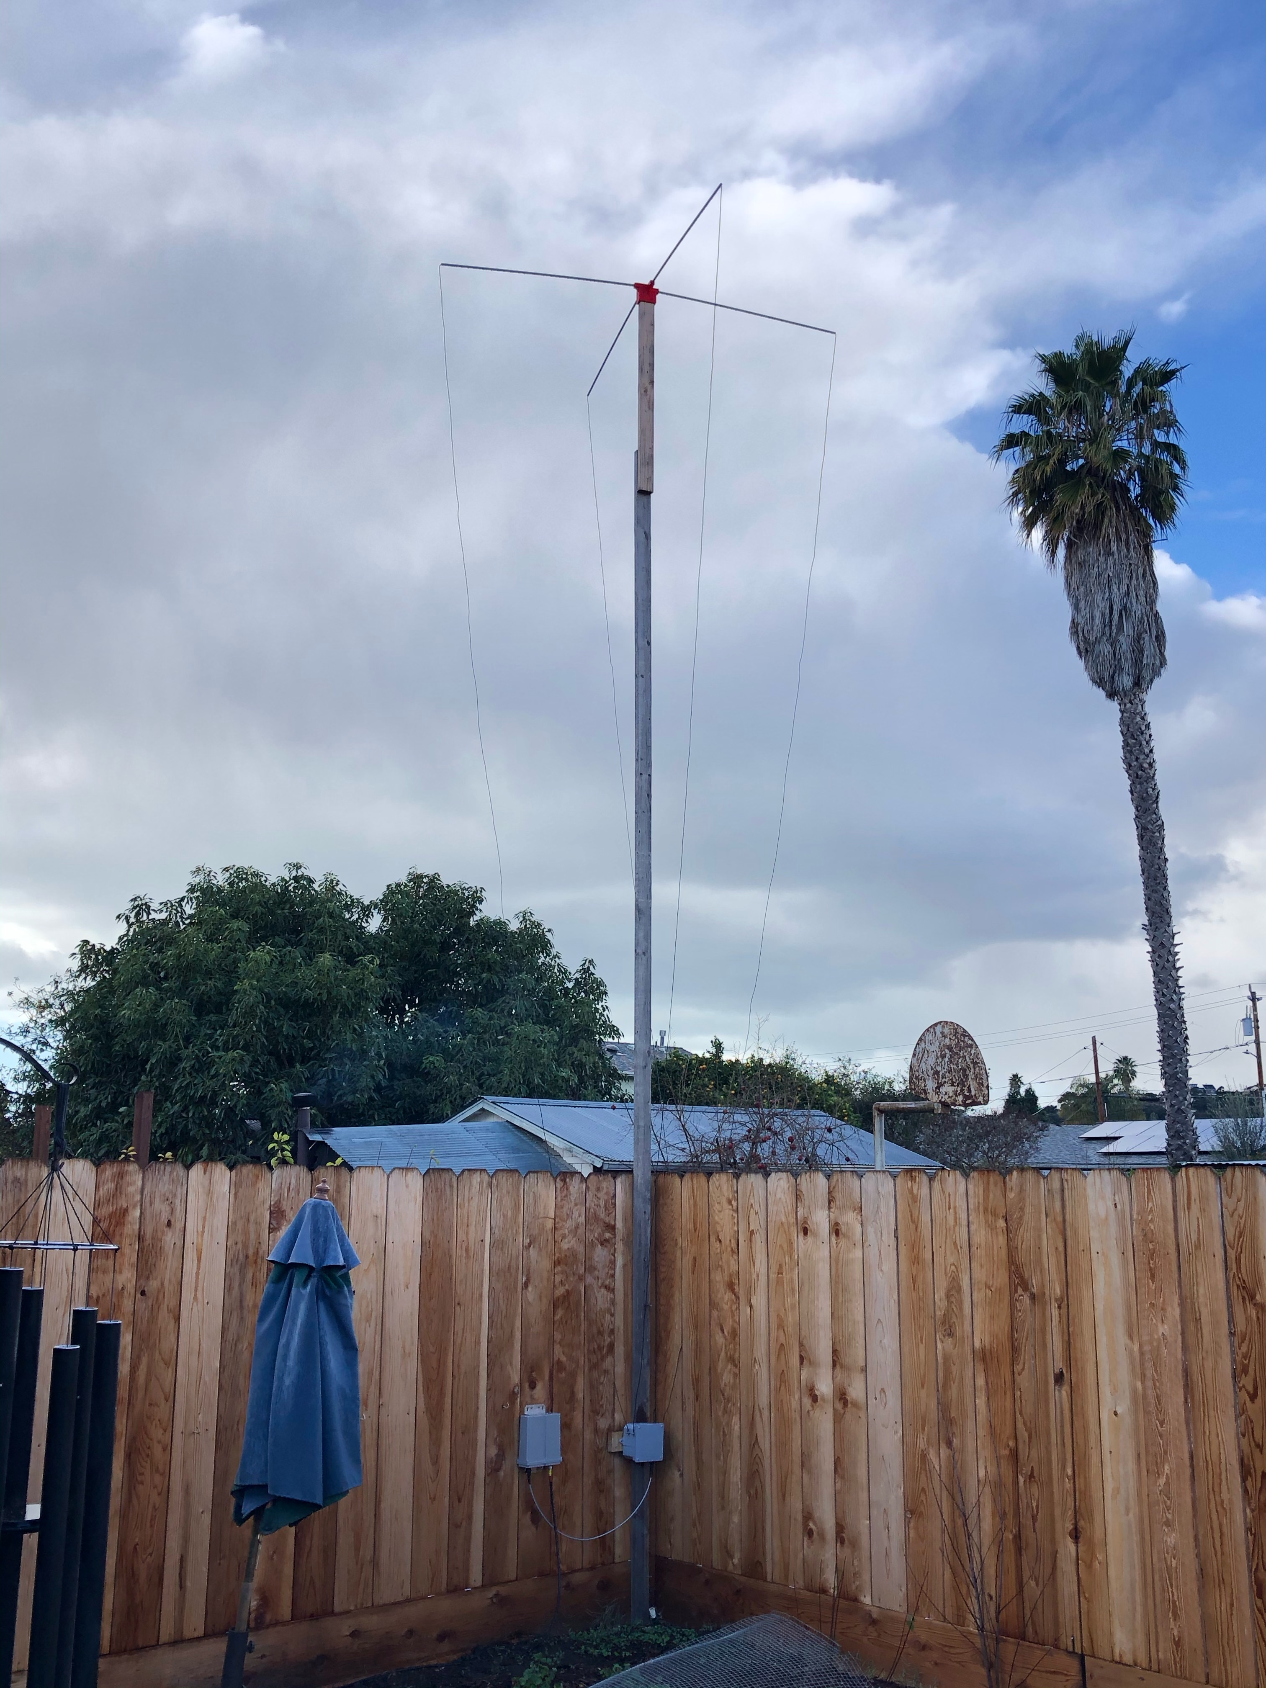
Why this antenna?
Small footprint like a vertical half wave (no ground plane)
Radiates like a horizontal dipole at the elevation of the top of the antenna
Multi-band (requires remote tuner)
Electrically pointable, no rotator.

Slide 7
Why this antenna?
Small footprint like a vertical half wave (no ground plane)
Radiates like a horizontal dipole at the elevation of the top of the antenna
Multi-band (requires remote tuner)
Electrically pointable, no rotator.
Looks great, right?

Slide 8
Goals: I blame George
Build options:
  Two loops in Parallel
  Two loops in Series

Slide 9
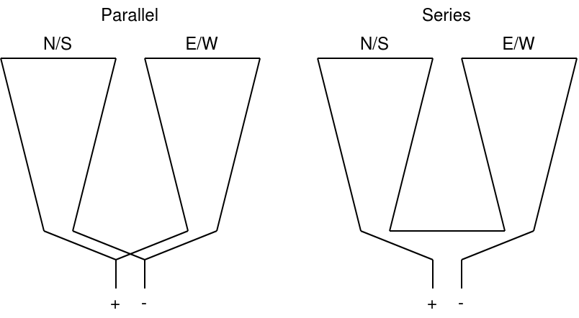
Parallel or Series?

Slide 10
Goals: I blame George
Build options:
  Two loops in Parallel
  Two loops in Series
Rotation options:
  90 degrees: Reverse phase of one loop, consistent impedance
  45 degrees: Two loops, or single loop, different impedances.

Slide 11
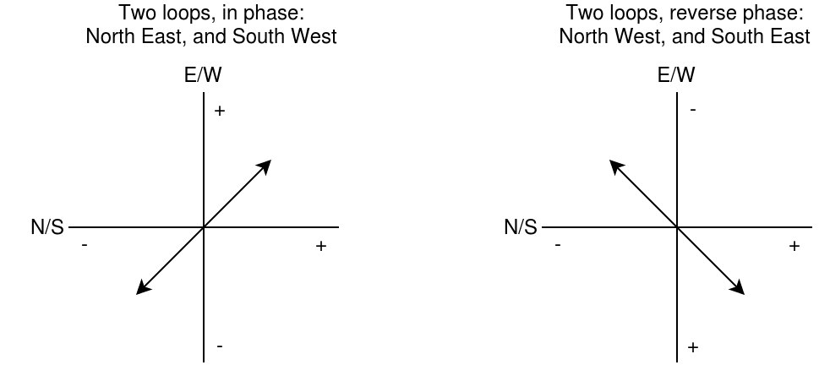
Dual loops, 90 degree rotation

Slide 12
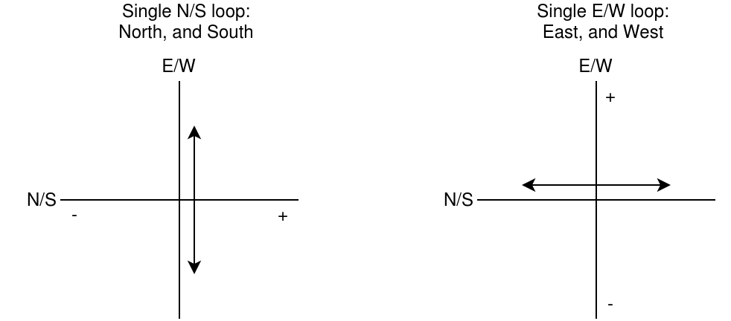
Single loop, fill in the 45 degrees

Slide 13
Goals: I blame George
Is one of these options better than the other?

Slide 14
Goals: I blame George
Is one of these options better than the other?
Can we build the antenna to use any/all of those options?

Slide 15
Goals: I blame George
Is one of these options better than the other?
Can we build the antenna to use any/all of those options?
Is it worth the added complexity?

Slide 16
What are we talking about today?
Background and Goals
Antenna Build
Measurements
Analysis
Conclusions
What‘s next?

Slide 17
What are we talking about today?
Background and Goals
Antenna Build
Measurements
Analysis
Conclusions
What‘s next?

Slide 18
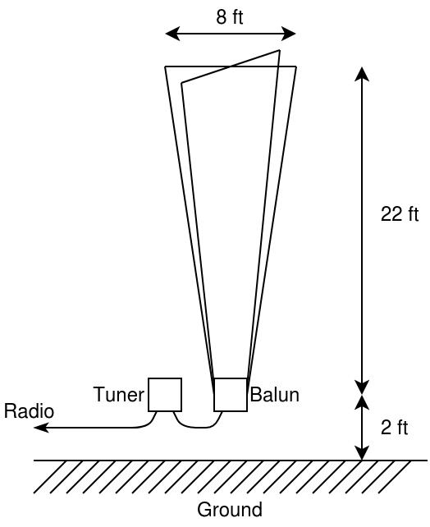
Let‘s build it!
Mast: 24ft 2x4 lumber (metal is fine)
Base is 2ft off the ground
Spreader: 4ft (from mast) fiberglass,
8ft total width at top.
1:1 Balun: 11 turns on FT140-43 toroid
Tuner: LDG RT-600 remote tuner
Feedline: 200ft of RG-213
(replacing with DXE 400MAX)

Slide 19
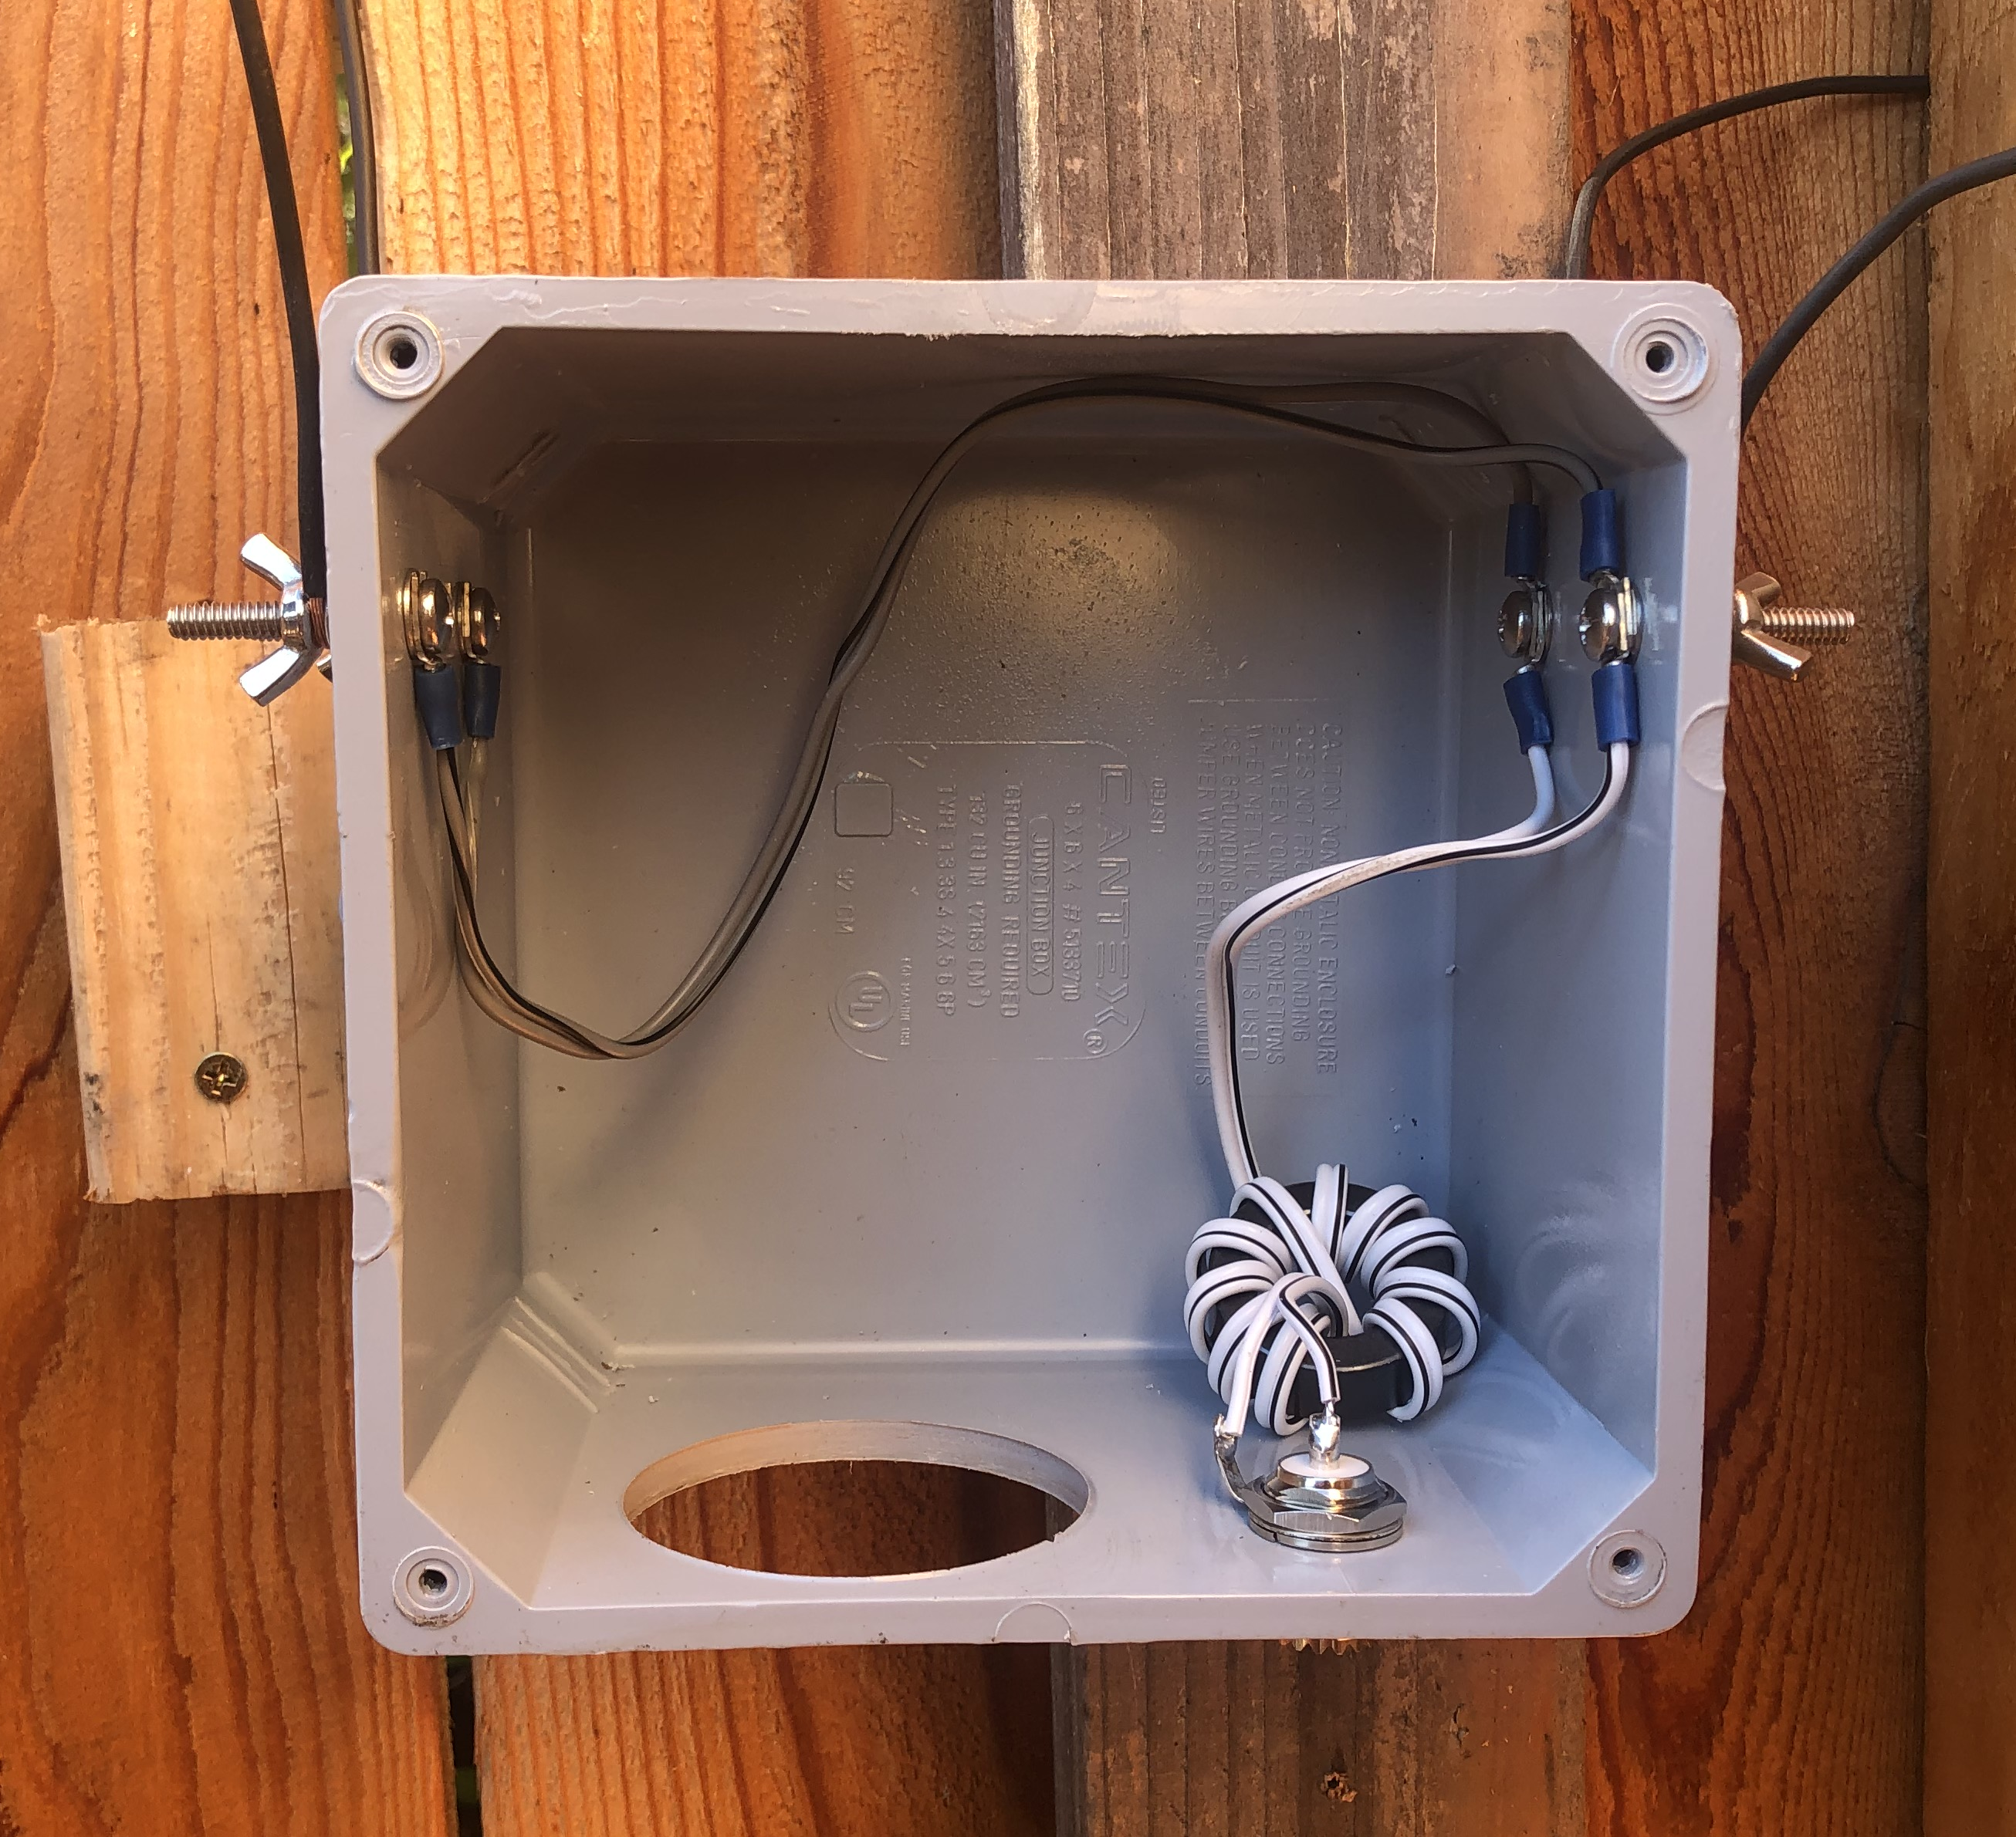
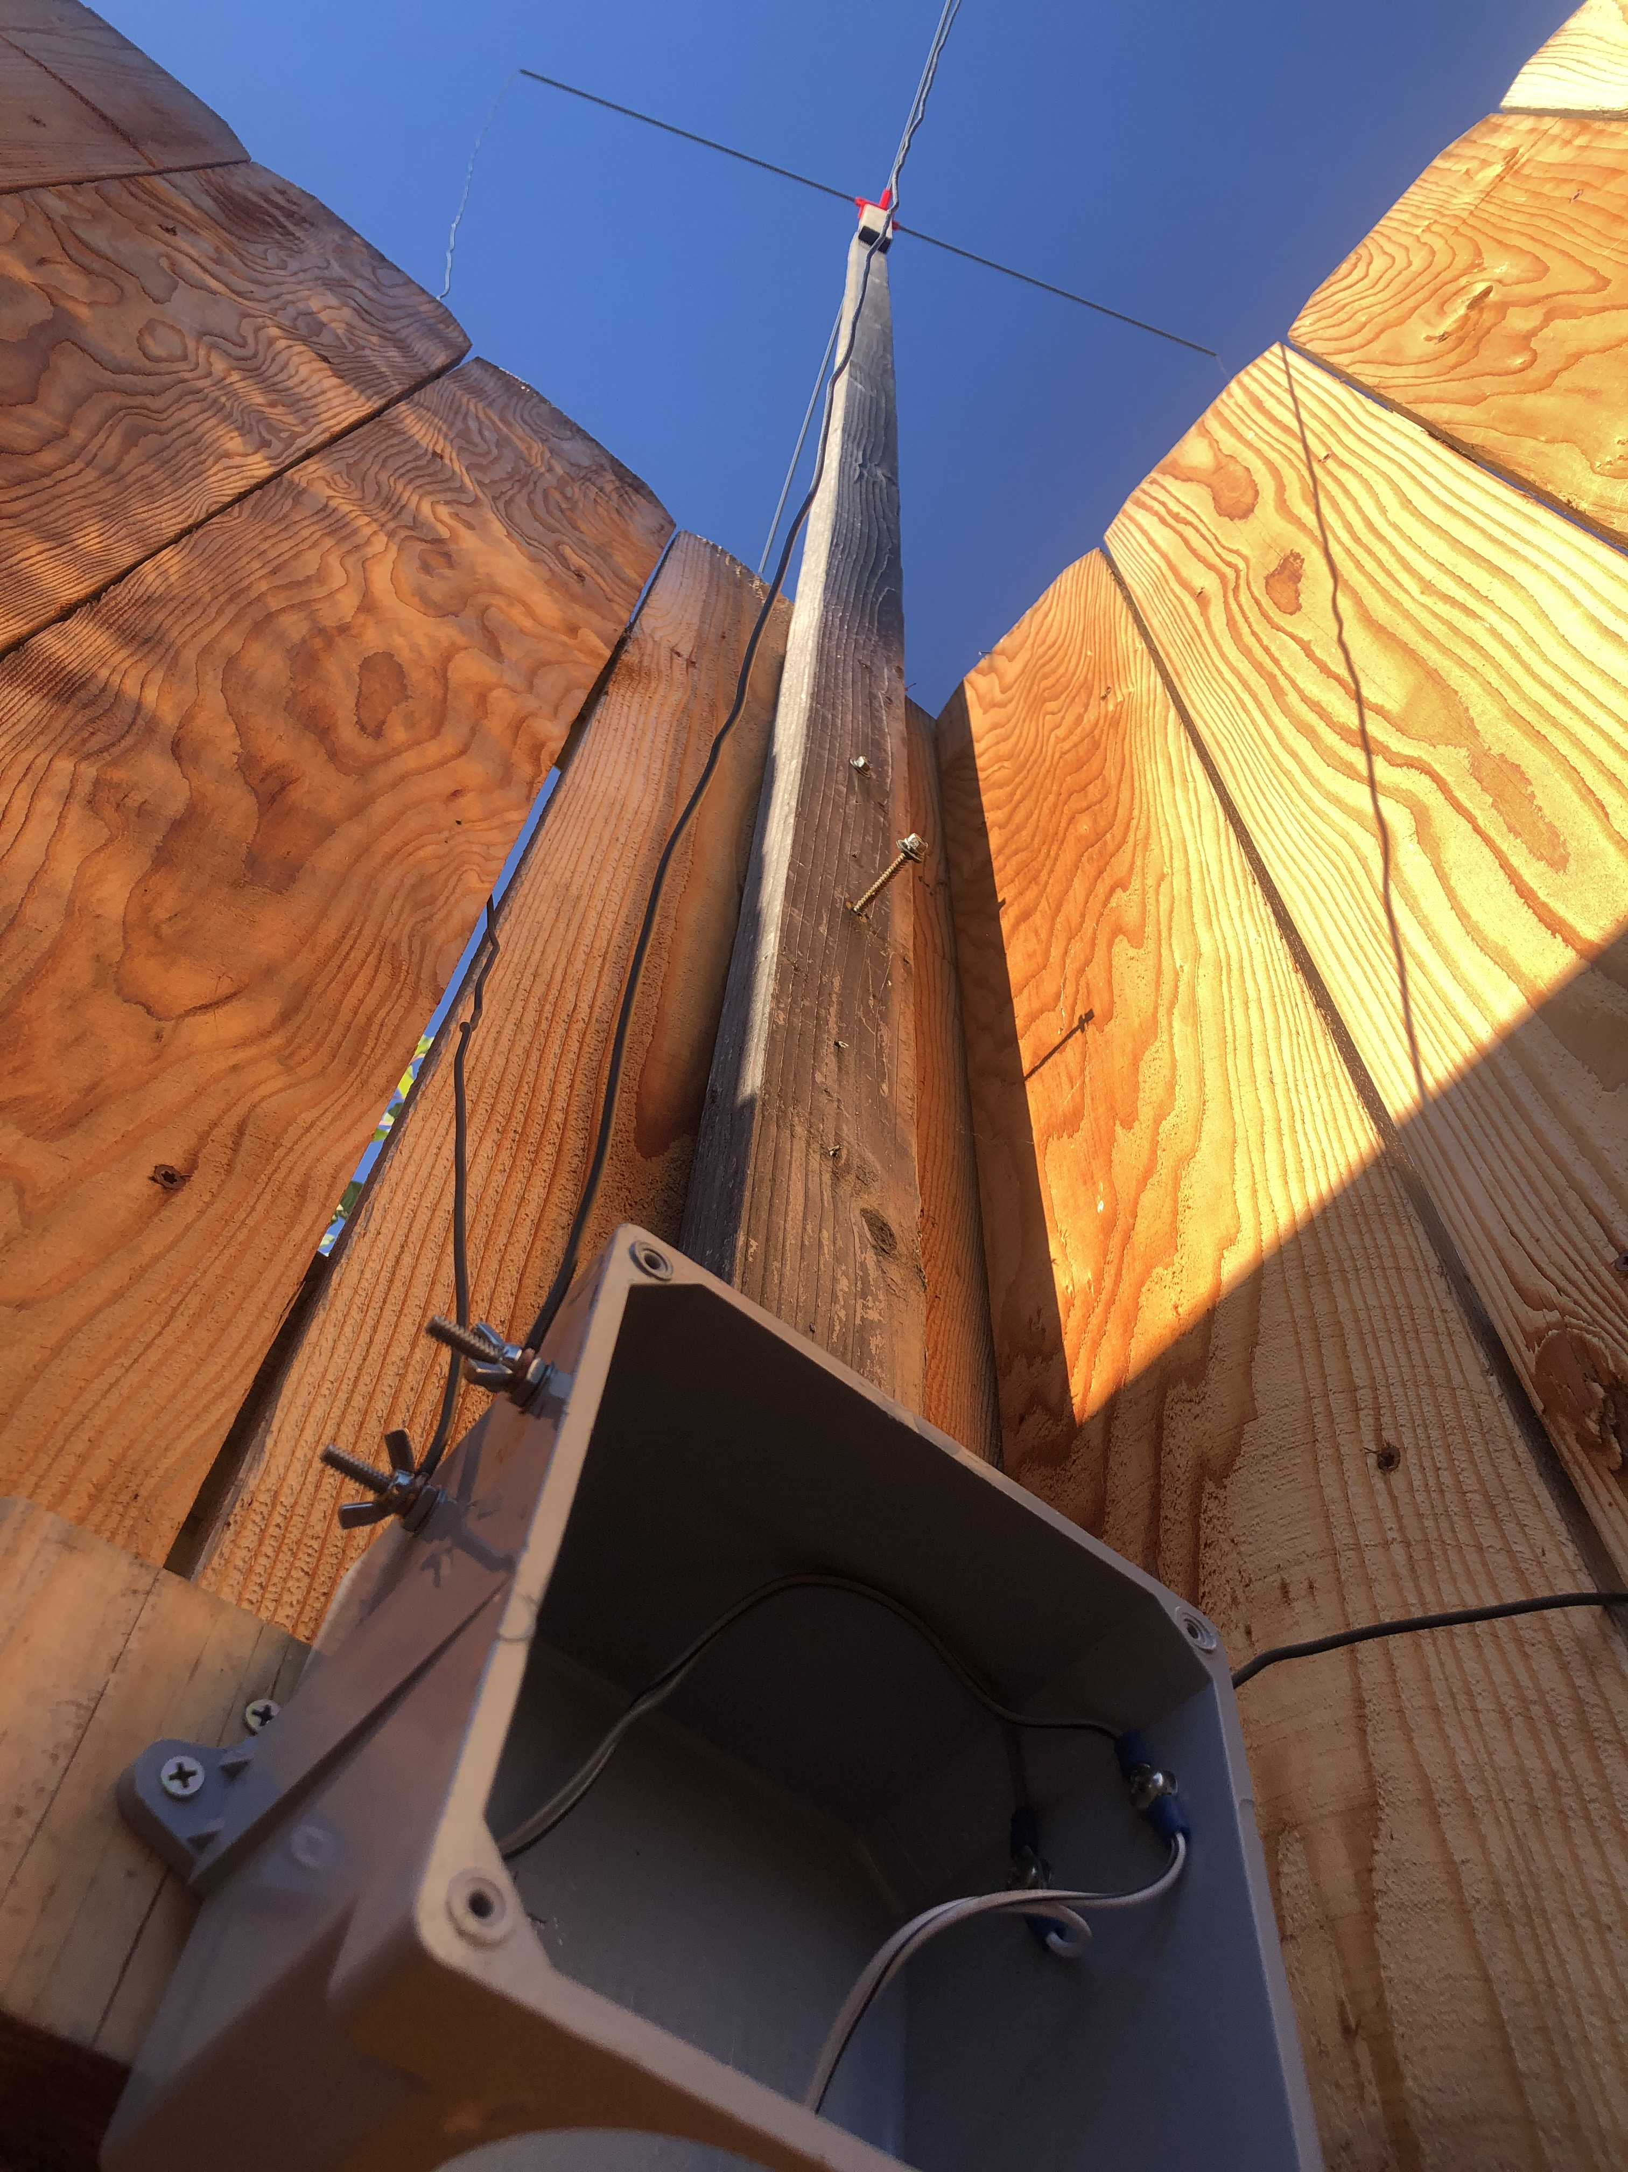
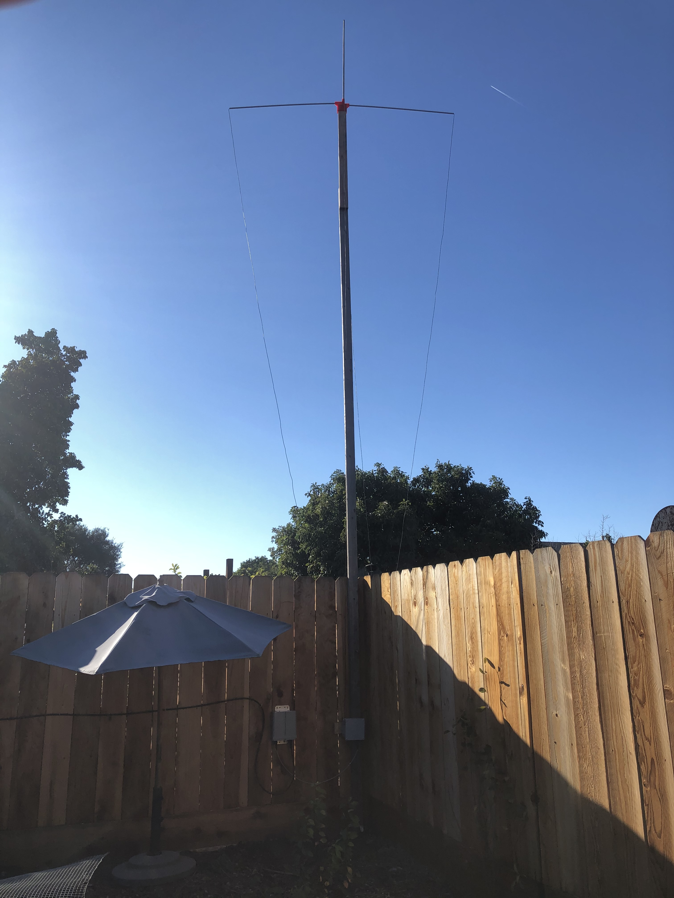
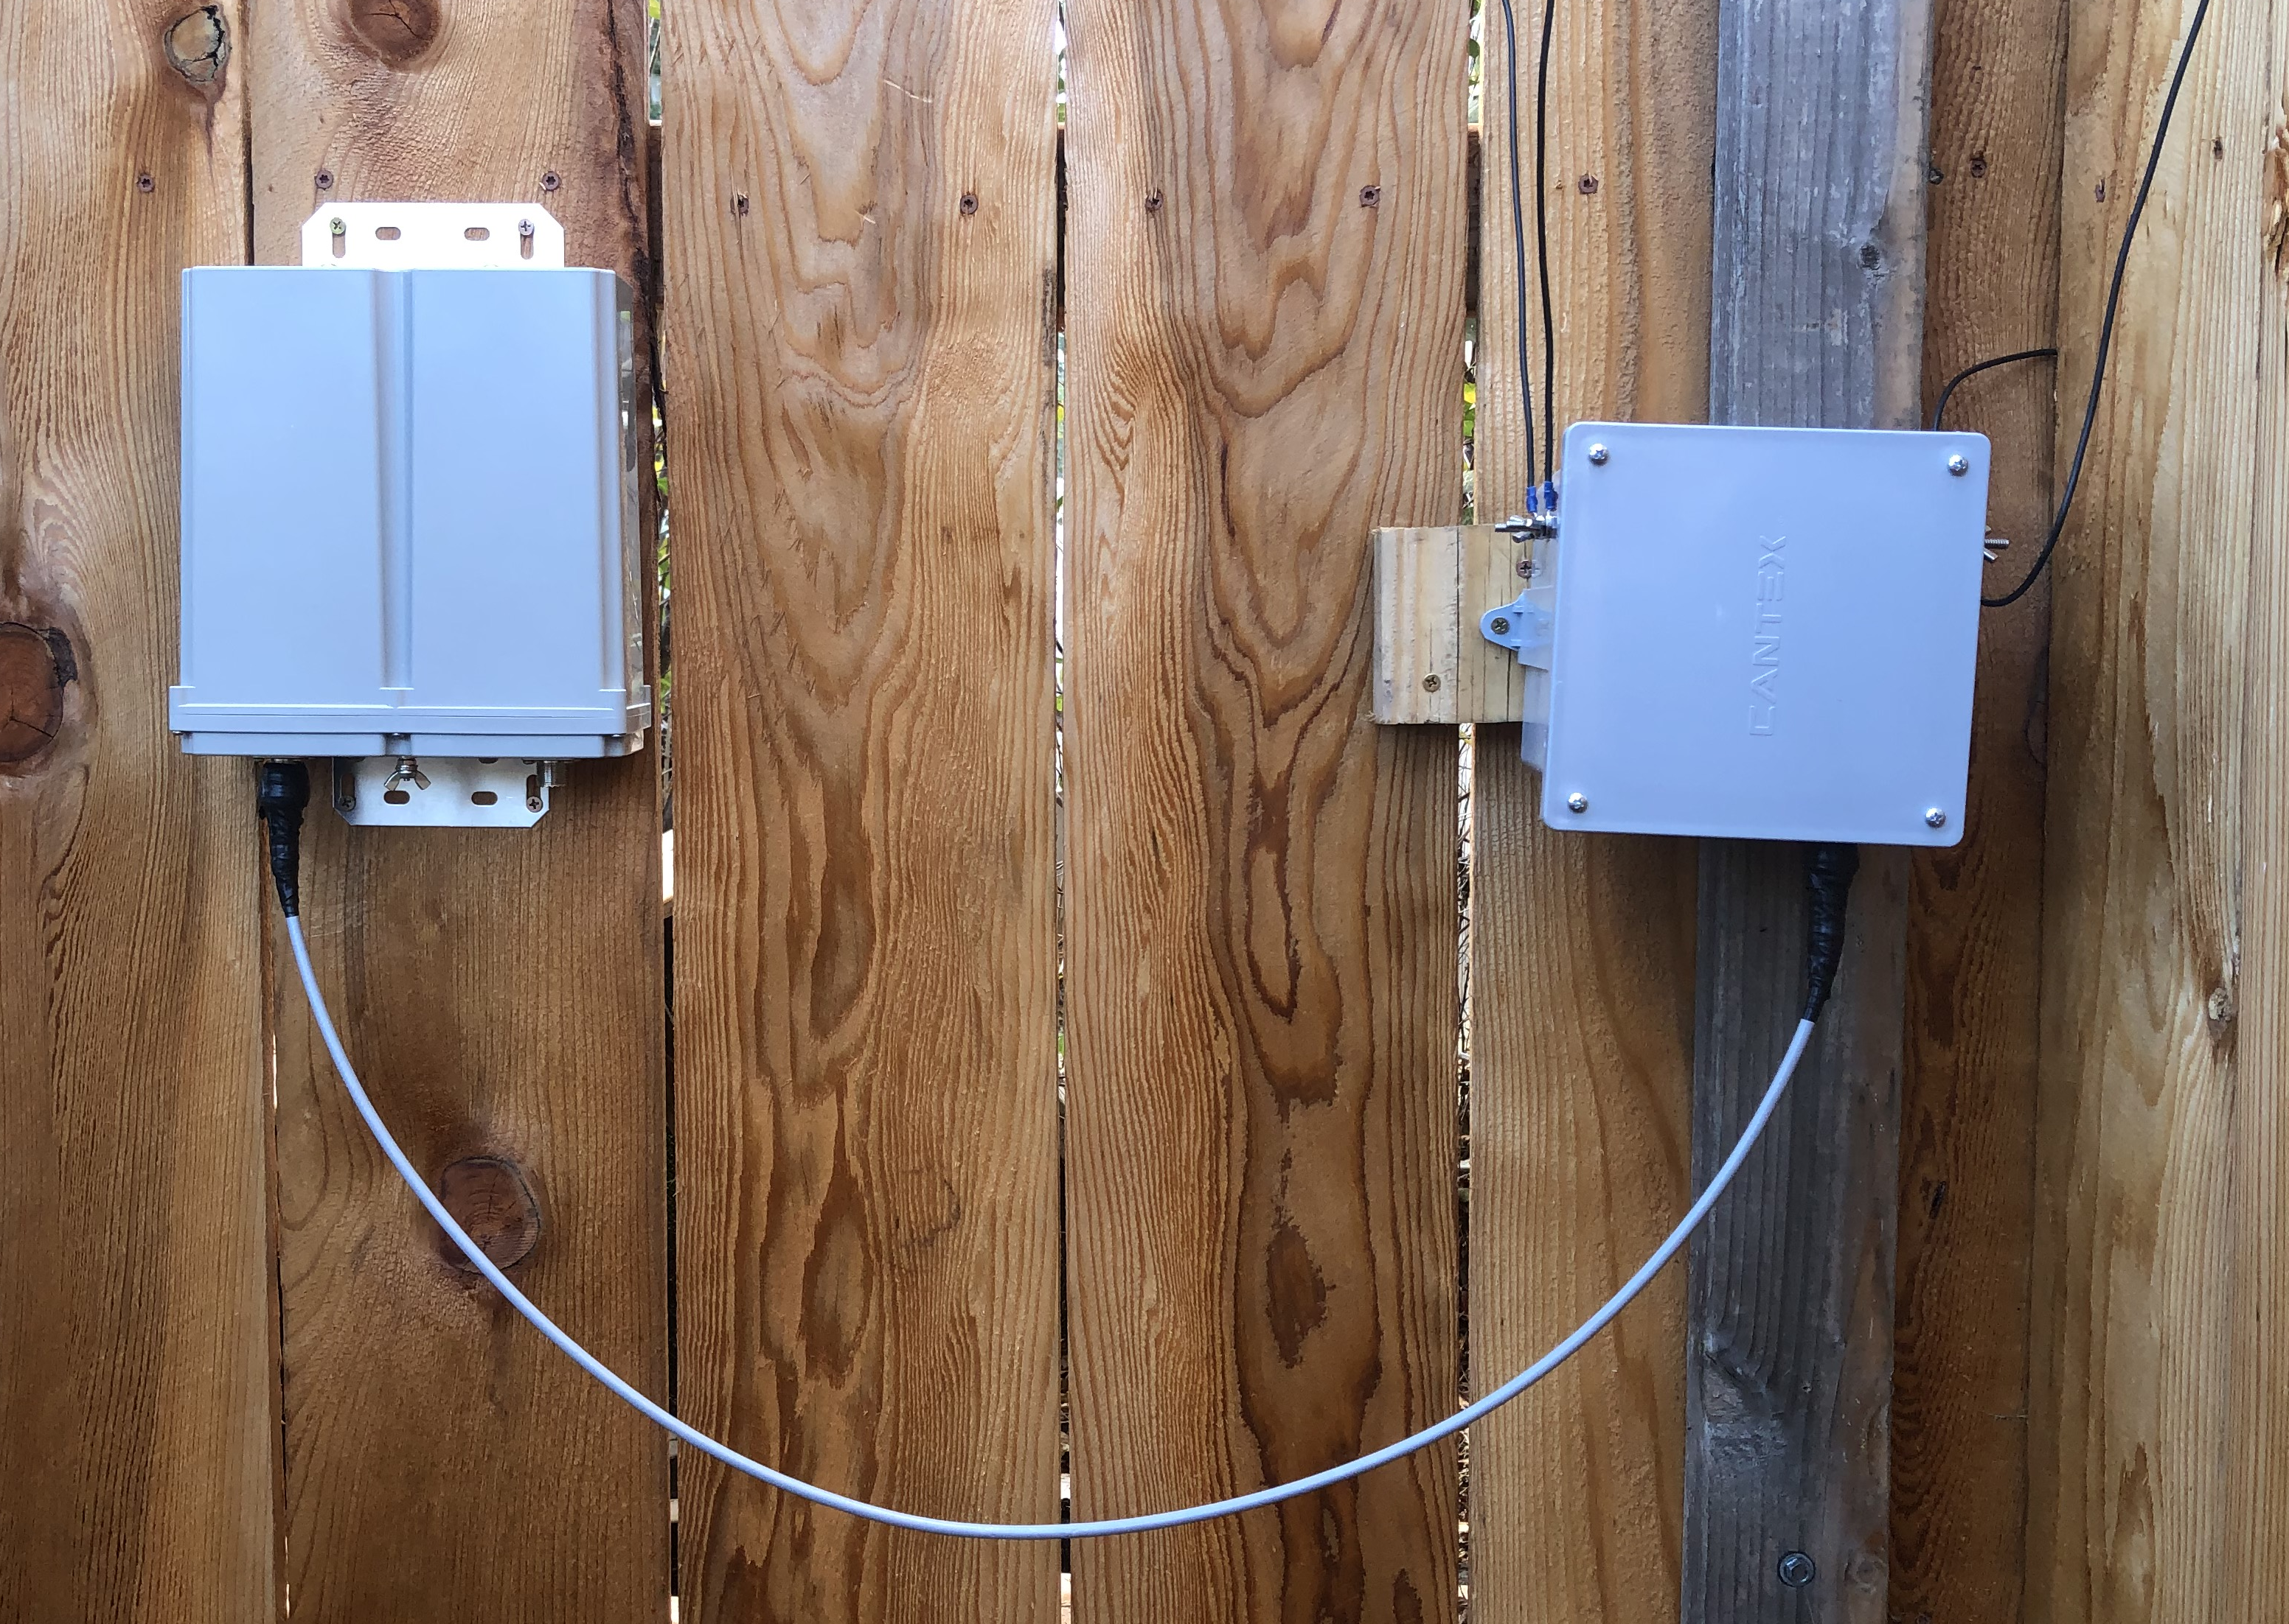
Let‘s build it!

Slide 20
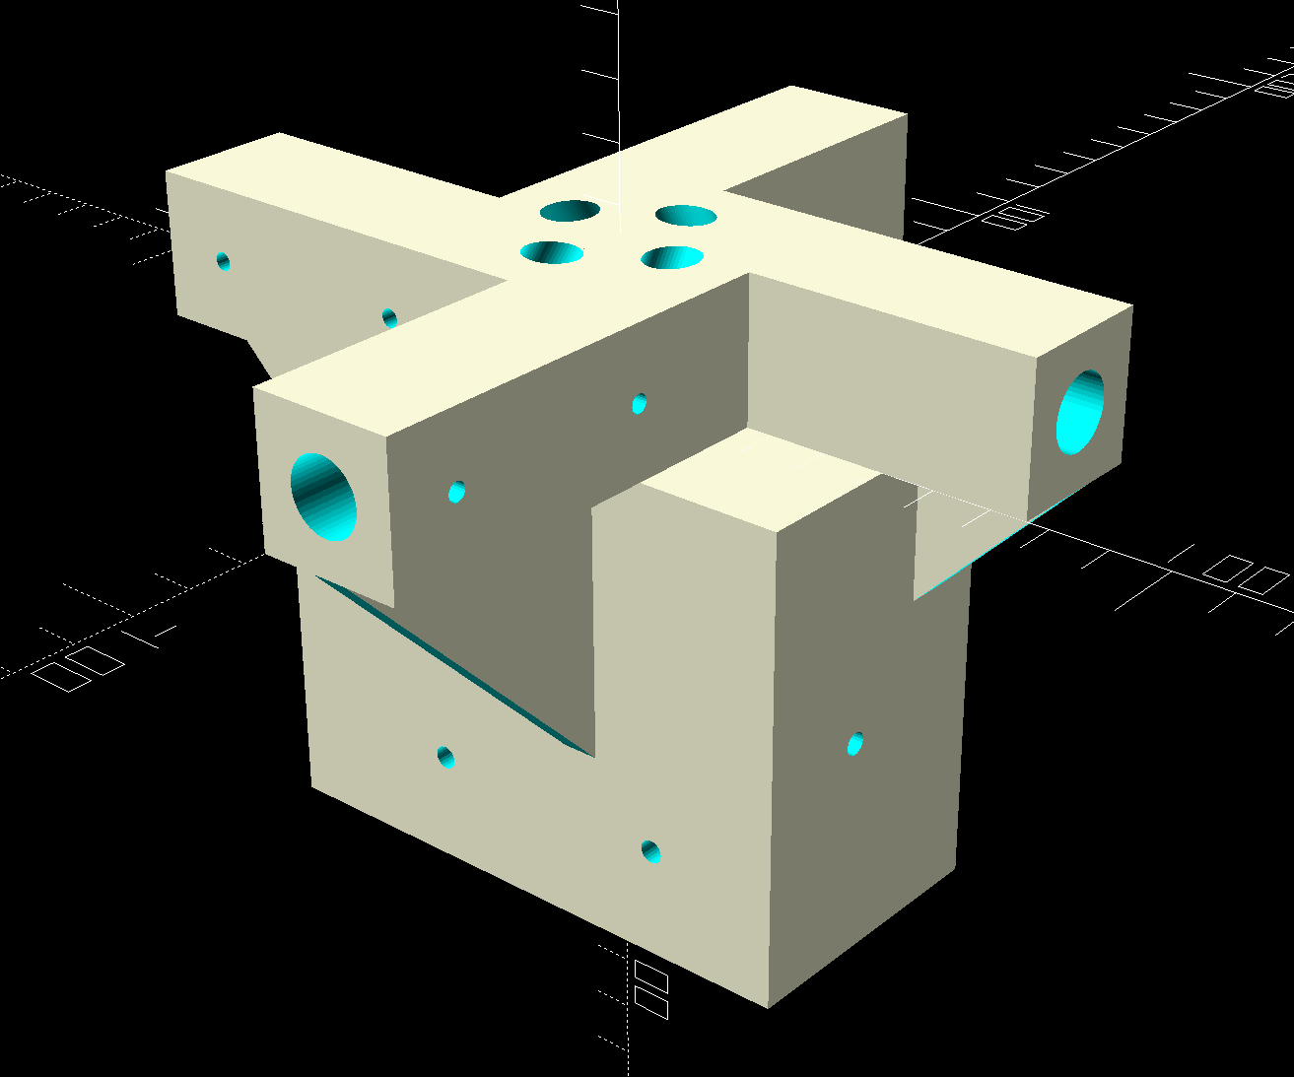
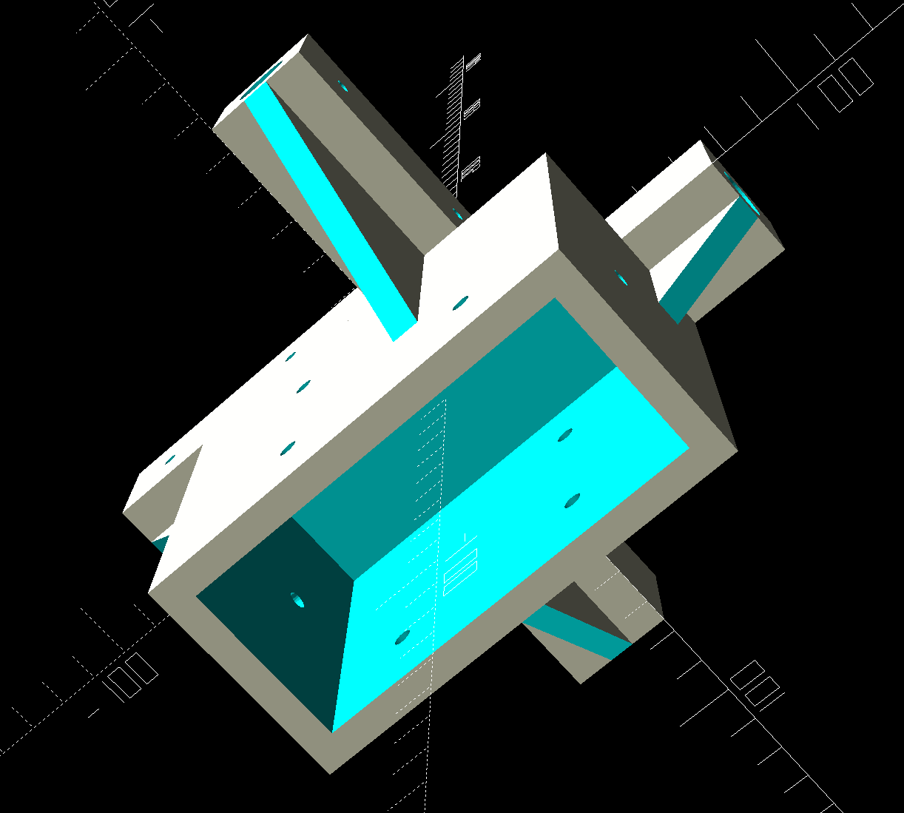
Let‘s build it!
Spreader bracket model is parametric OpenSCAD, 3D printed.

Slide 21
Let‘s build – Oops...
W6NBC‘s design is:
Radio → Feedline → Balun → Tuner → Antenna
What I built is:
Radio → Feedline → Tuner → Balun → Antenna

Slide 22
Let‘s build – Oops...
W6NBC‘s design is:
Radio → Feedline → Balun → Tuner → Antenna
  Unbalanced tuner, in balanced circuit
What I built is:
Radio → Feedline → Tuner → Balun → Antenna
  Balun designed for 50+j0 ohms, used in wildly complex impedance circuit

Slide 23
Let‘s build – Oops...
W6NBC‘s design is:
Radio → Feedline → Balun → Tuner → Antenna
  Unbalanced tuner, in balanced circuit
What I built is:
Radio → Feedline → Tuner → Balun → Antenna
  Balun designed for 50+j0 ohms, used in wildly complex impedance circuit
Neither are great.
I‘m proceeding with my design .. becuase ..

Slide 24
What are we talking about today?
Background and Goals
Antenna Build
Measurements
Analysis
Conclusions
What‘s next?

Slide 25
What are we talking about today?
Background and Goals
Antenna Build
Measurements
Analysis
Conclusions
What‘s next?

Slide 26
Let‘s measure it!
I used a NanoVNA-F
  Hopefully you saw Alan Wolke W2AEW‘s presentation on the NanoVNA
  Adventures in NanoVNA calibration!

Slide 27
Let‘s measure it!
I used a NanoVNA-F
  Hopefully you saw Alan Wolke W2AEW‘s presentation on the NanoVNA
  Adventures in NanoVNA calibration!
NanoVNA Saver software
  3.0MHz to 30.27MHz in 2727 steps of 10kHz each.
  Measured S11 parameters.
  Saves data in standard „Touchstone“ file format: .s1p files
  Does lots of visualizations of the data too, but I‘m interested in
  the .s1p files.

Slide 28
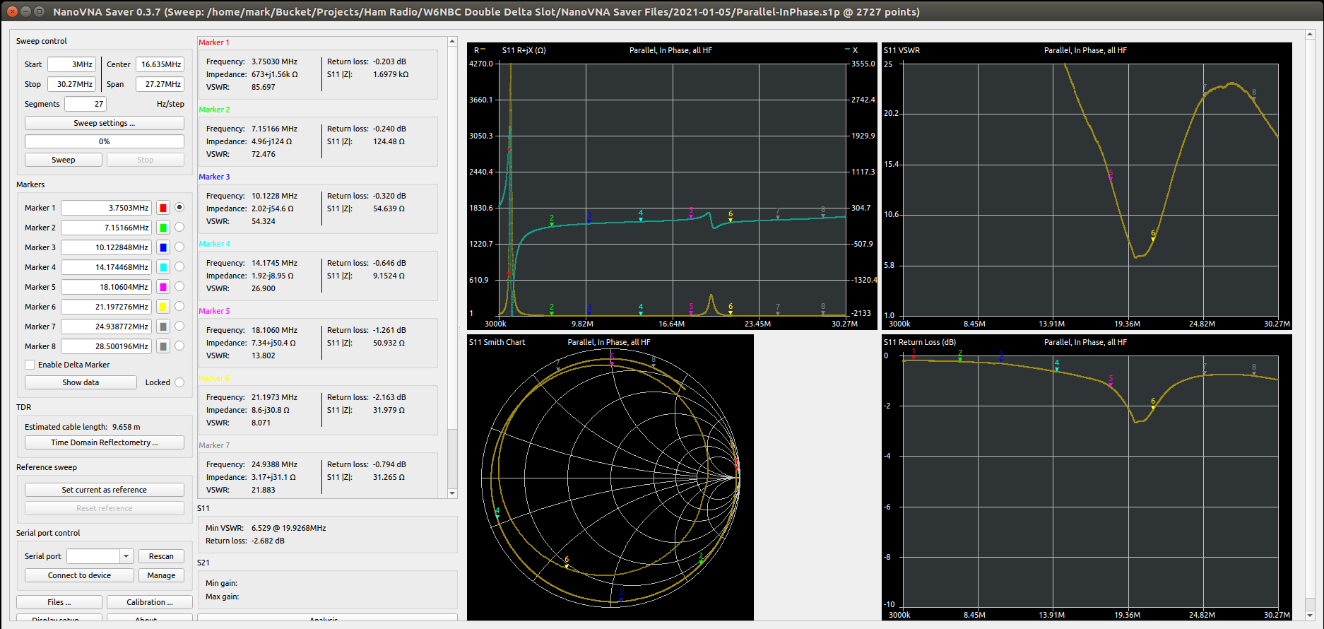
Let‘s measure it!

Slide 29
What are we talking about today?
Background and Goals
Antenna Build
Measurements
Analysis
Conclusions
What‘s next?

Slide 30
What are we talking about today?
Background and Goals
Antenna Build
Measurements
Analysis
Conclusions
What‘s next?

Slide 31
How do we analize this?
What does the antenna look like natively?

Slide 32
How do we analize this?
What does the antenna look like natively?
What is the theoretical perfect matching network?

Slide 33
How do we analize this?
What does the antenna look like natively?
What is the theoretical perfect matching network?
What matching network can the RT-600 actually make?
  0 to 1270pF in 10pF steps
  0 to 12700nH in 100nH steps

Slide 34
How do we analize this?
What does the antenna look like natively?
What is the theoretical perfect matching network?
What matching network can the RT-600 actually make?
  0 to 1270pF in 10pF steps
  0 to 12700nH in 100nH steps
What impedance is presented to the radio given the actual matching network?

Slide 35
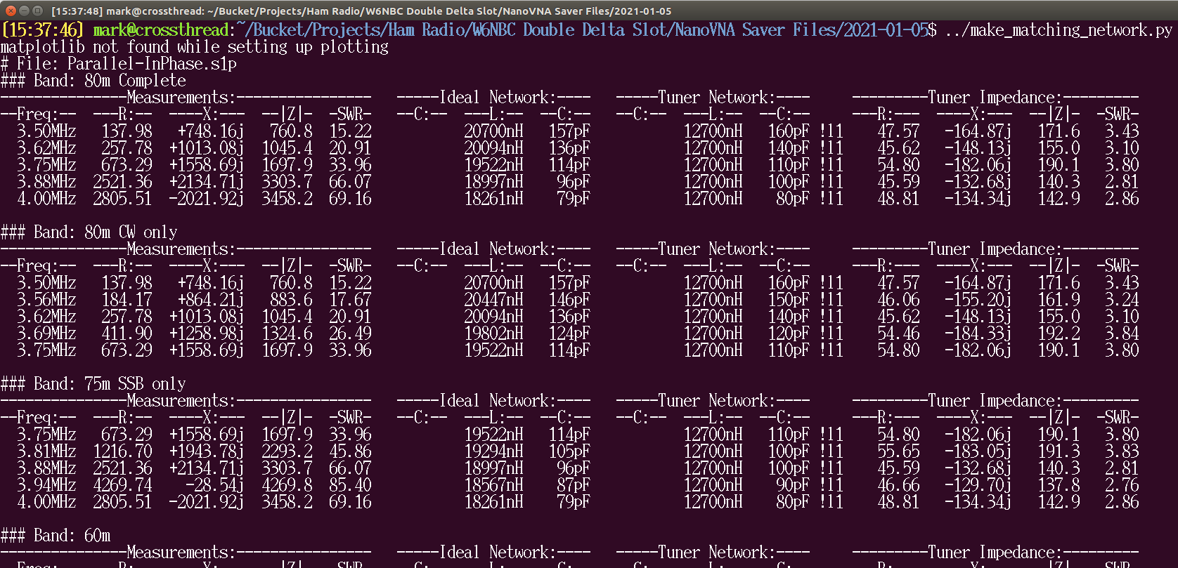
How do we analize this?
I wrote a Python script that performs all these calculations

Slide 36
How do we analize this?
Too much data, I won‘t present it all here. Go to my github:
https://github.com/SmittyHalibut/DoubleDeltaSlotAntenna

Slide 37
What are we talking about today?
Background and Goals
Antenna Build
Measurements
Analysis
Conclusions
What‘s next?

Slide 38
What are we talking about today?
Background and Goals
Antenna Build
Measurements
Analysis
Conclusions
What‘s next?

Slide 39
But first! A DISCLAIMER
All of this is based on my particular build of this antenna.

Slide 40
But first! A DISCLAIMER
All of this is based on my particular build of this antenna.
The antenna design is very flexible, thanks to the tuner.

Slide 41
But first! A DISCLAIMER
All of this is based on my particular build of this antenna.
The antenna design is very flexible, thanks to the tuner.
If you build yours with different dimentions, your numbers
will be different.

Slide 42
But first! A DISCLAIMER
All of this is based on my particular build of this antenna.
The antenna design is very flexible, thanks to the tuner.
If you build yours with different dimentions, your numbers
will be different.
That‘s why all my tools are freely available on GitHub, so you can similarly analize your own antenna if you want.

Slide 43
Actual Impedance, With Tuner
Band | Parallel | Series | Single | Notes
80m | SWR! | SWR! | SWR! | None are good, 3:1 to 4:1. L is out of range.
75m | SWR! | Hi X | SWR! | L is out of range. Series SWR is low, but very reactive.
60m | Great | Good | Great | Series is ok, but reactive. C is out of range
40m | Good | Hi X | Good | All could use more C, but close. Series is 2.2:1
30m | Hi X | Great | SWR! | Parallel and Single need more C, very reactive
20m | Hi X | Hi X | SWR! | Very low R, high X, hard to match. Varies over band.
17m | Great | Hi X | Great | Series is still better than 2:1, just reactive.
15m | Good | Good | Good | All good, not great. Better than 2:1, a bit reactive.
12m | Great | Good | Good | All better than 2:1, a bit reactive.
10m | Good | Good | Good | All good, not great. Better than 2:1, a bit reactive.

Slide 44
What does this all mean?
Parallel:
  Good or Great from 60m to 10m, except 30m and 20m

Slide 45
What does this all mean?
Parallel:
  Good or Great from 60m to 10m, except 30m and 20m
Series:
  Good (not Great) on 60m, and 15m up.
  Great on 30m! Usable but reactive on 40m, 20m, and 17m.

Slide 46
What does this all mean?
Parallel:
  Good or Great from 60m to 10m, except 30m and 20m
Series:
  Good (not Great) on 60m, and 15m up.
  Great on 30m! Usable but reactive on 40m, 20m, and 17m.
Single:
  Good or Great from 60m to 10m, except…
  Unusably high SWR on 30m and 20m

Slide 47
What does this all mean?
Parallel:
  Good or Great from 60m to 10m, except 30m and 20m
Series:
  Good (not Great) on 60m, and 15m up.
  Great on 30m! Usable but reactive on 40m, 20m, and 17m.
Single:
  Good or Great from 60m to 10m, except…
  Unusably high SWR on 30m and 20m
Minimal on-air testing matches this.

Slide 48
What‘s it good at?
It has all the benefits John mentions in his presentation and article.

Slide 49
What‘s it good at?
It has all the benefits John mentions in his presentation and article.
Coveres all bands from 60m to 10m to varying degrees.
  Might also work on 6m, I didn‘t measure.

Slide 50
What‘s it good at?
It has all the benefits John mentions in his presentation and article.
Coveres all bands from 60m to 10m to varying degrees.
  Might also work on 6m, I didn‘t measure.
It‘s easy to construct, could be made „field-day“ portable.
  Probably not SOTA portable.

Slide 51
What‘s it not so good at?
80m and lower are a complete loss.
  A taller/larger loop would fix this.

Slide 52
What‘s it not so good at?
80m and lower are a complete loss.
  A taller/larger loop would fix this.
20m is not great in any configuration. It‘s usable, but reactive.

Slide 53
Is it worth the complexity for Parallel and Series?
If I cared strongly about 30m, I might build a switching network to change between Parallel and Series configuration.
I‘m willing to trade 30m for a simpler build, so I will keep mine in Parallel.

Slide 54
Is it worth the complexity for Parallel and Series?
If I cared strongly about 30m, I might build a switching network to change between Parallel and Series configuration.
I‘m willing to trade 30m for a simpler build, so I will keep mine in Parallel.
Someone with different goals, or an antenna with different numbers, could easily justify the complexity.

Slide 55
Is it worth supporting Single loops for 45 deg?
Would it help?
  The modeled beam width of the antenna is 90deg at -3db, so rotating 45deg would only get you 3db.
  The side nulls are narrower, so it might be worth it for pointing nulls.

Slide 56
Is it worth supporting Single loops for 45 deg?
Would it help?
  The modeled beam width of the antenna is 90deg at -3db, so rotating 45deg would only get you 3db.
  The side nulls are narrower, so it might be worth it for pointing nulls.
Can it be done?
  Single is very similar to Parallel: Good from 60m to 10m, except 30m and 20m

Slide 57
Is it worth supporting Single loops for 45 deg?
Should it be done?
  The RT-600 remembers the matching network for a given frequency.
  Changing the antenna from Parallel/Series to Single changes its impedance, causing the tuner to have to re-tune every time, losing the benefit of remembering the matching network for that frequency.
  The tuner is more of a pain than I expected; anything that makes it even less convenient is not good.

Slide 58
Is it worth supporting Single loops for 45 deg?
Should it be done?
  The RT-600 remembers the matching network for a given frequency.
  Changing the antenna from Parallel/Series to Single changes its impedance, causing the tuner to have to re-tune every time, losing the benefit of remembering the matching network for that frequency.
  The tuner is more of a pain than I expected; anything that makes it even less convenient is not good.
So, No. I don‘t think it‘s worth bothering with Single loops.

Slide 59
Summary, For My Antenna
Dual loops, in Parallel.

Slide 60
Summary, For My Antenna
Dual loops, in Parallel.
Remote switch the phase of one loop, for 90 deg rotation.

Slide 61
Summary, For My Antenna
Dual loops, in Parallel.
Remote switch the phase of one loop, for 90 deg rotation.
No support for Series, or Single loops.

Slide 62
Summary, For My Antenna
Dual loops, in Parallel.
Remote switch the phase of one loop, for 90 deg rotation.
No support for Series, or Single loops.
Covers 60m to 10m, but 30m and 20m require additional tuning in the shack.

Slide 63
Summary, For My Antenna
Dual loops, in Parallel.
Remote switch the phase of one loop, for 90 deg rotation.
No support for Series, or Single loops.
Covers 60m to 10m, but 30m and 20m require additional tuning in the shack.
I will probably make a second one for my club (CQ805) for portable use, like Field Day.

Slide 64
What are we talking about today?
Background and Goals
Antenna Build
Measurements
Analysis
Conclusions
What‘s next?

Slide 65
What are we talking about today?
Background and Goals
Antenna Build
Measurements
Analysis
Conclusions
What‘s next?

Slide 66
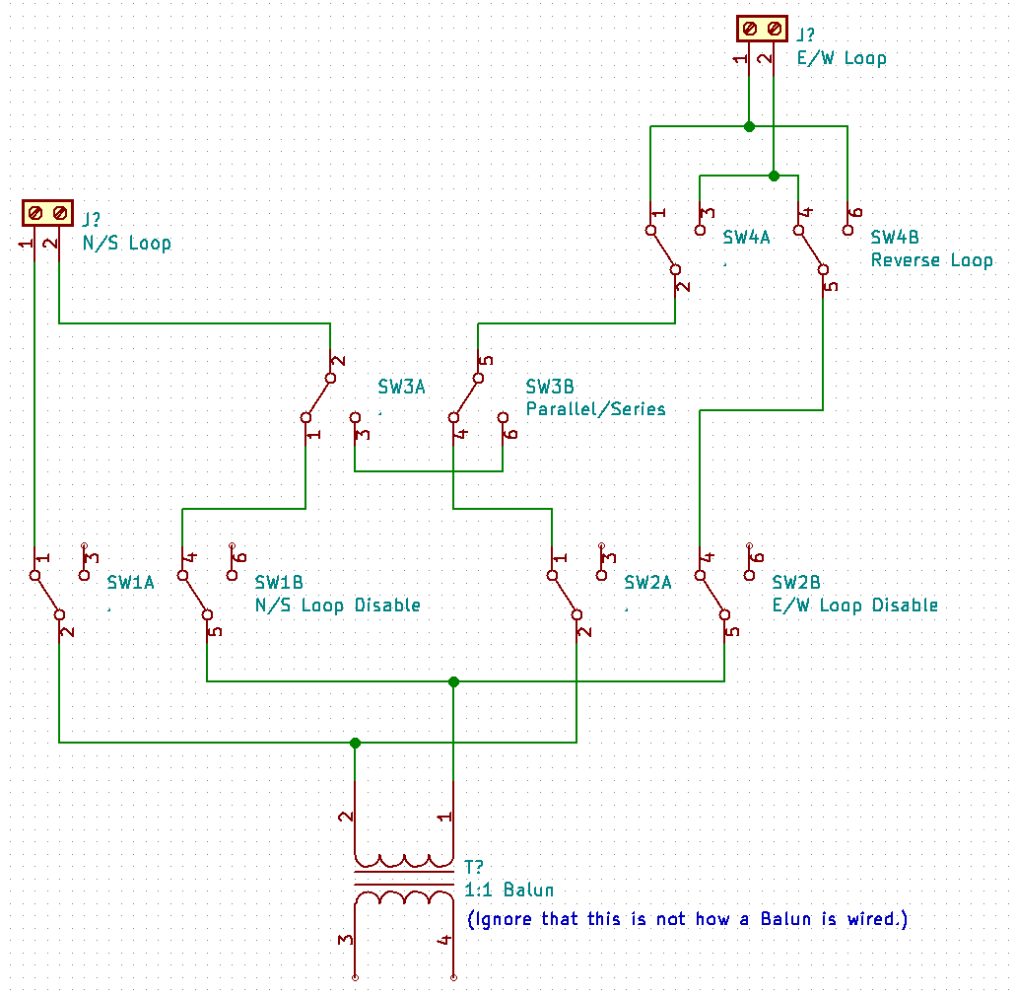
What if I want all the options!?
Switching Network:
  SW1, SW2 disable each loop. (normally enabled)
  SW3 configures for Series (normally Parallel)
  SW4 reverses polarity of E/W loop.
Run power for SW1/2 through SW3 (third pole) for safety interlock.

Slide 67
What if I want all the options!?
Could design a board:
  SO-239 input, spot for 1:1 balun, relays, terminals for loops.
  Microcontroller to control the relays.
  Using George‘s serial protocol for remote control over RS-485 or ZigBee

Slide 68
More work from W6NBC soon
John Portune is continuing development of this antenna.
I won‘t steal his thunder here, but it‘s pretty cool.
Watch his presentation in the QSO Today Expo, March 2021

Slide 69
Notes, and Q&A
Me: @SmittyHalibut on Twitter and YouTube
John‘s article on the Double Delta Slot HF Antenna:
https://w6nbc.com/articles/2020-TBDdoubledelta.pdf
My data and analysis:
https://github.com/SmittyHalibut/DoubleDeltaSlotAntenna

