Slide 1




Human Computer Interaction
Project: Kidedu Form Designing
Kids application for learning
Group 07:
Mahad Mustafa (BCSF23M008)
Shahram Munsaf (BCSF23M023)
Muazzam Ali (BCSF23M047)

Slide 2
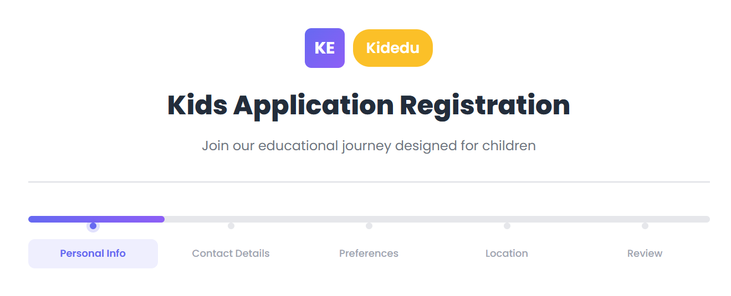
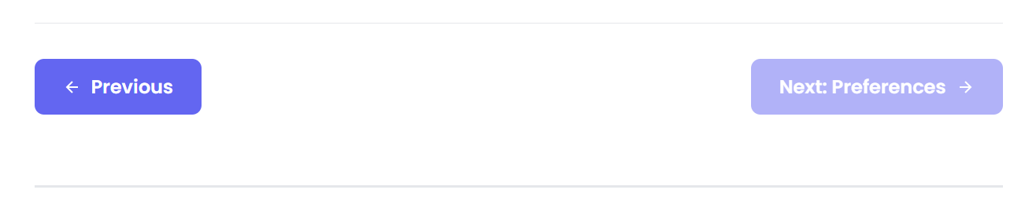
Multi-Step Form (Pagination)
1. Progressive Disclosure
Sequential Field Dependencies

Slide 3
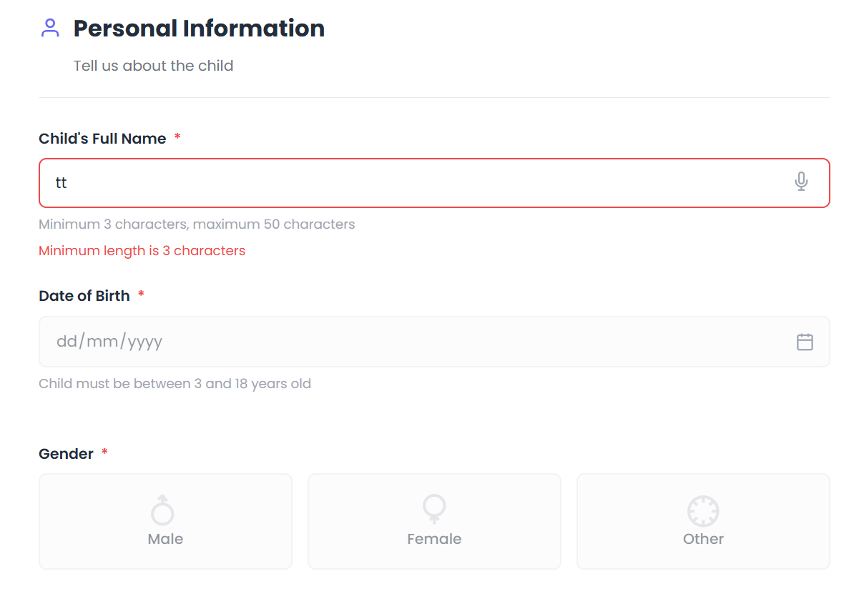
Real time Input Validation on all fields
2. Input Validation & Error Prevention
Error Prevention by disabling next fields
Custom Validation Messages
Error Prevention by disabling next sections

Slide 4
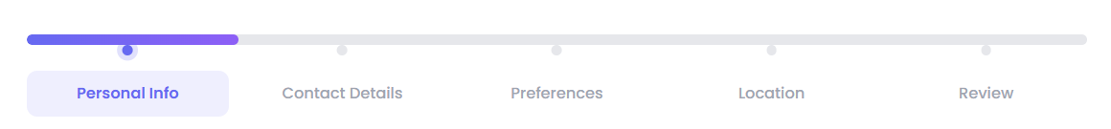
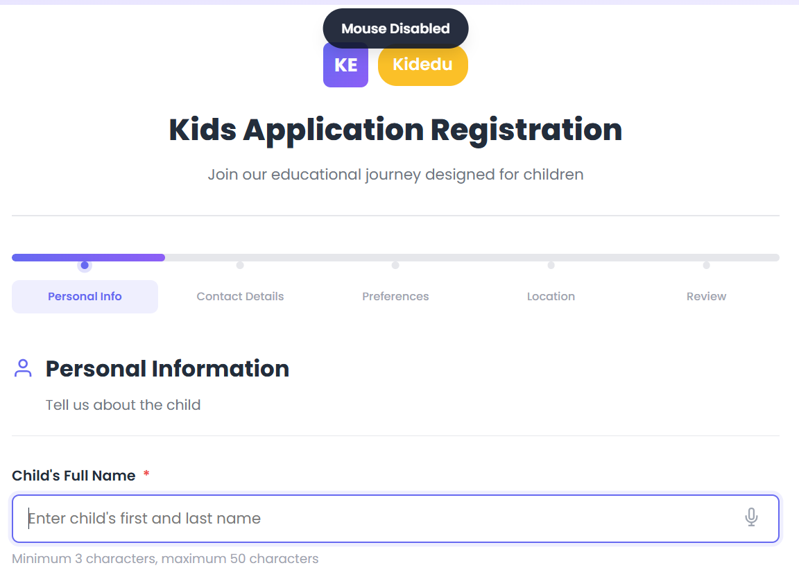
Visual Feedback(Progress bar, color-coded validation etc)
3. User Guidance & Feedback
User instructions (notifications & section descriptions)
Placeholder & Hints

Slide 5
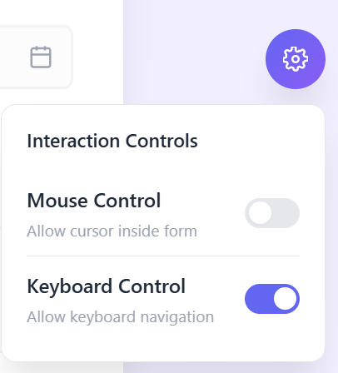
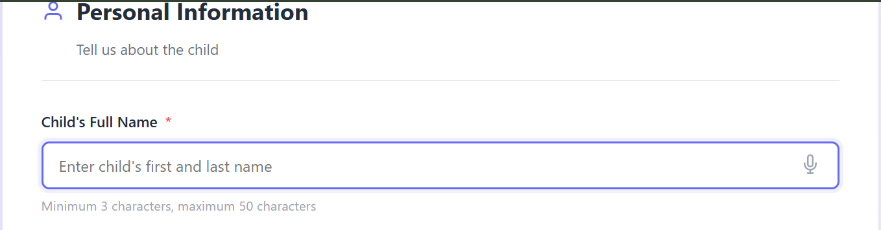
Mouse/Keyboard Toggle (Interaction Controls)
4. Interaction Control
Focus Management (Auto Focus on first field)

Slide 6
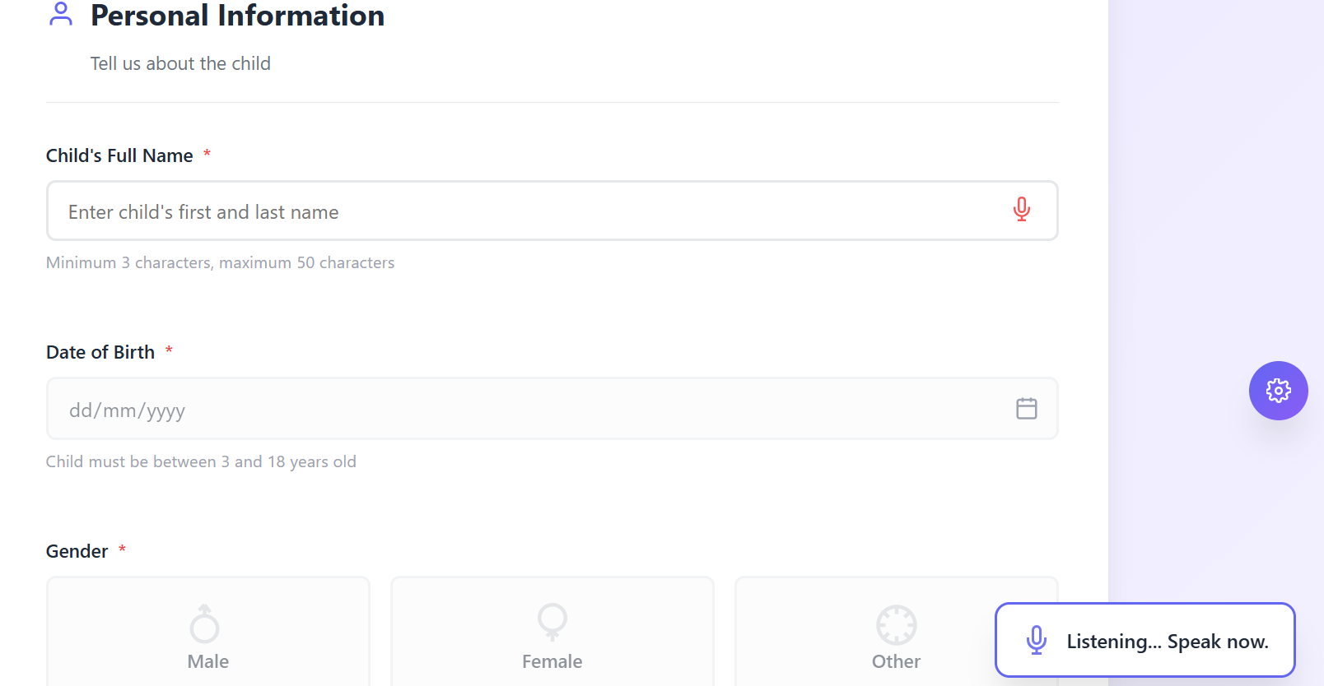
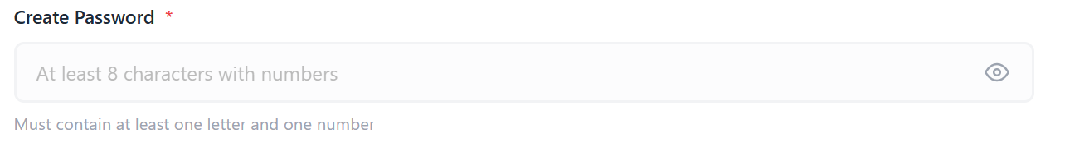
Voice Input (Web Speech Integration)
5. Advanced Input Methods
Date Picker with Calendar
Password hide/show toggle

Slide 7
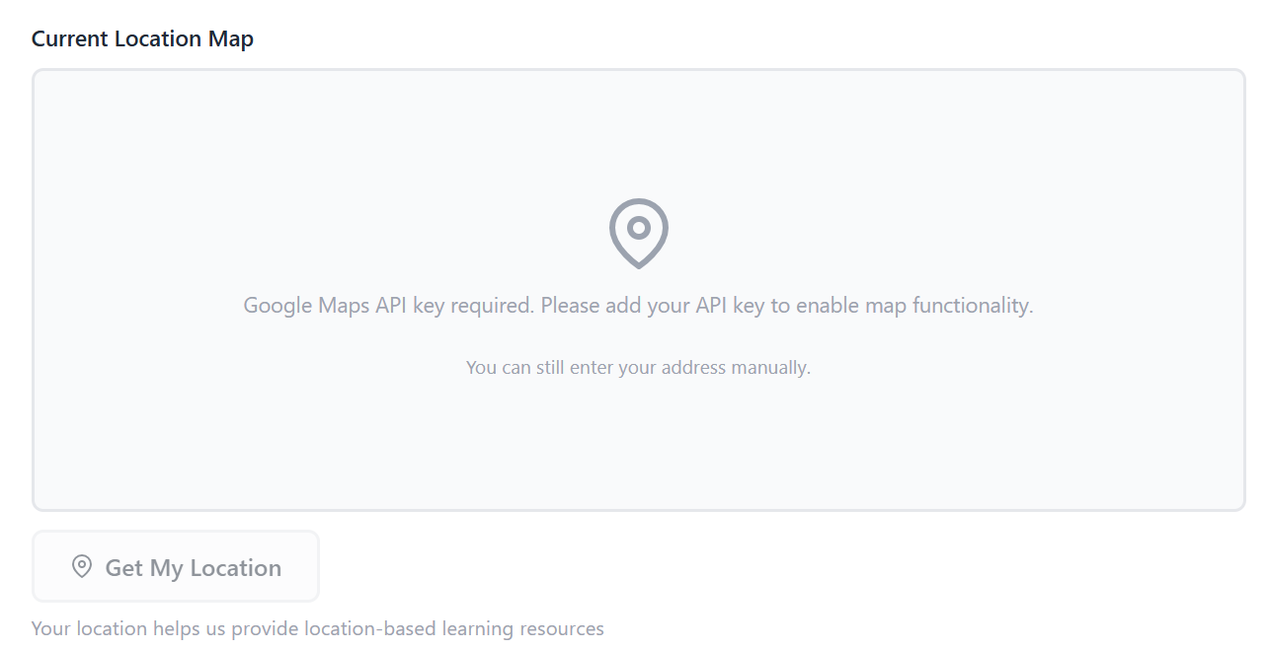
5. Advanced Input Methods
Google Map API integration to get current location

