Slide 1
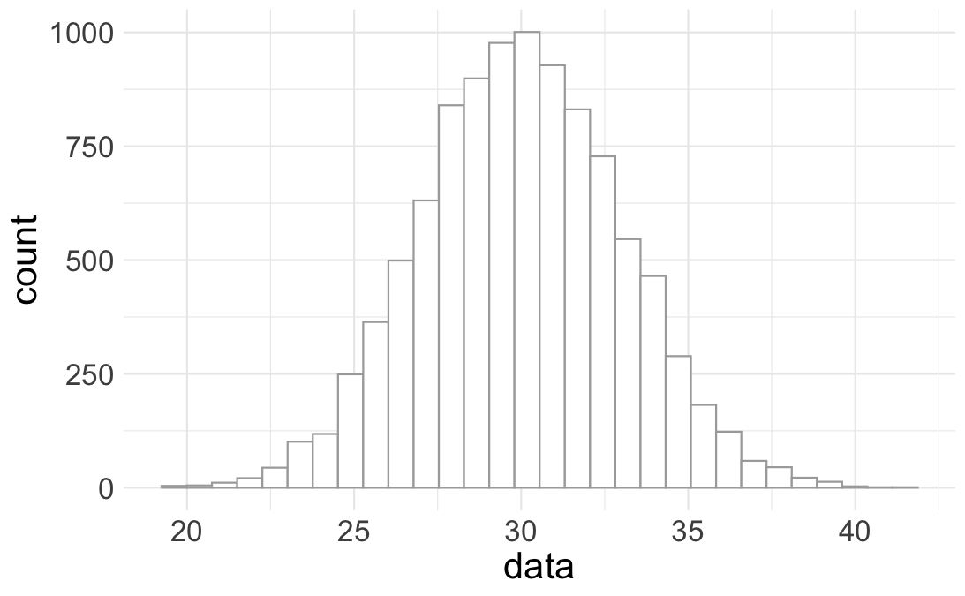



The Central Tendency: Where do most of the values show up?
How variable are the data about the central tendency?
Spread
Range
What are the limits of the data?

Slide 2
The Central Tendency: Where do most of the values show up?
How variable are the data about the central tendency?
Spread
Range
What are the limits of the data?

Slide 3
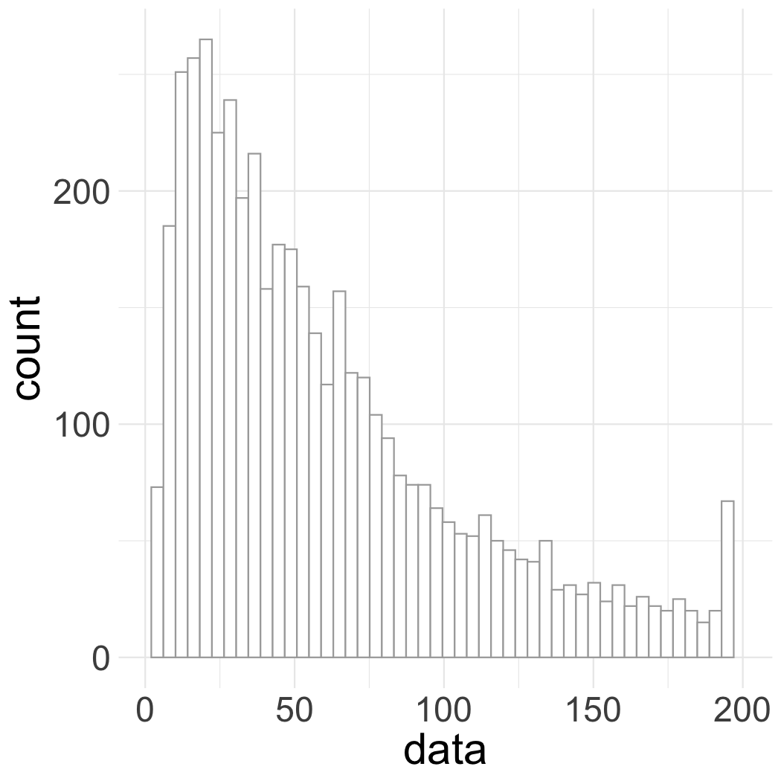
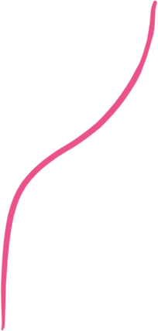

Skewed: the shape of the distribution is NOT symmetrical about the central tendency
Outliers. What’s
going on here?

Slide 4

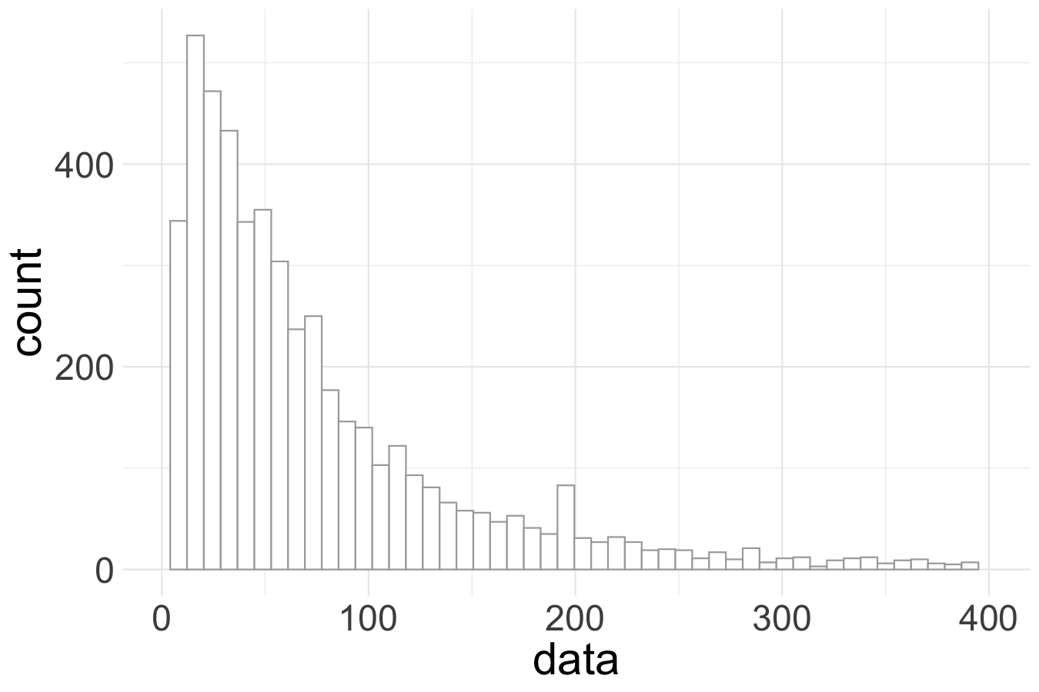
Mode: 14
Skewed data are “non-normal”, which means that the sample mean is not equal to other measures of central tendency (i.e., the median or mode).
Median: 53
Mean: 87
If you characterize the spread of these data with standard deviations about the mean (one SD = 113), that implies the existence of negative values, which is often impossible for data that describe physical phenomena!
- 113
+ 113

Slide 5
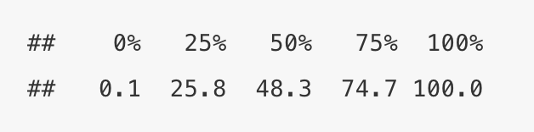
2nd Quartile
4th Quartile (defined at the maximum value)
1st Quartile (0 to 25th%, values: 0.1 to 25.8)
3rd Quartile
0th Quartile (the minimum value)
Quartiles are defined at their “upper bound” value
The median (48.3) is the upper bound of the 2nd Quartile because this occurs at the 0.5 quantile value

Slide 6
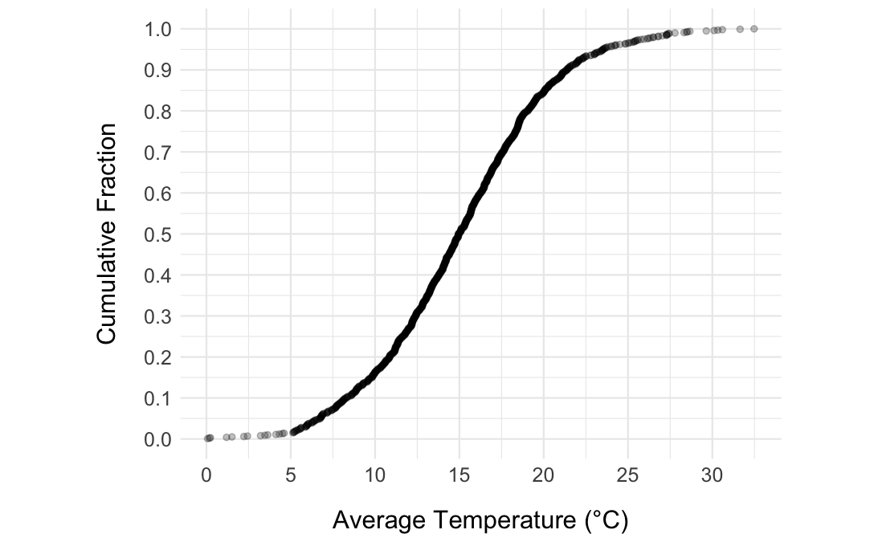
90th percentile
Max
0.5 quantile
<
= median
Min (0th quantile)
90% of data
data < 21ºC
quantiles
on y-axis
~ 32.5ºC
data values on x-axis

Slide 7
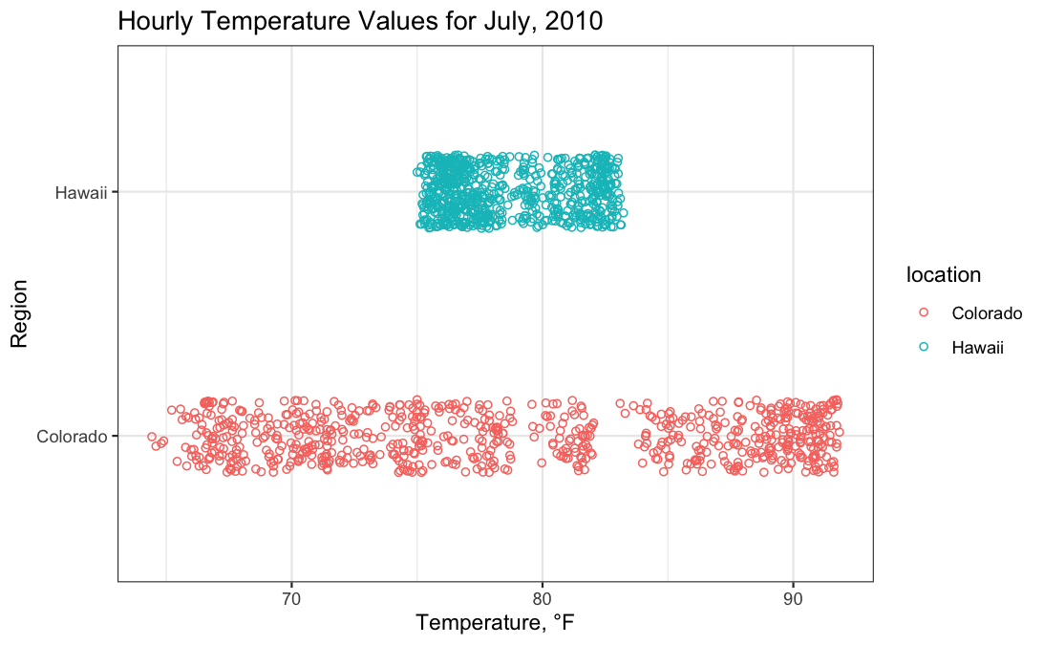
Similar location,
differing dispersion

Slide 8
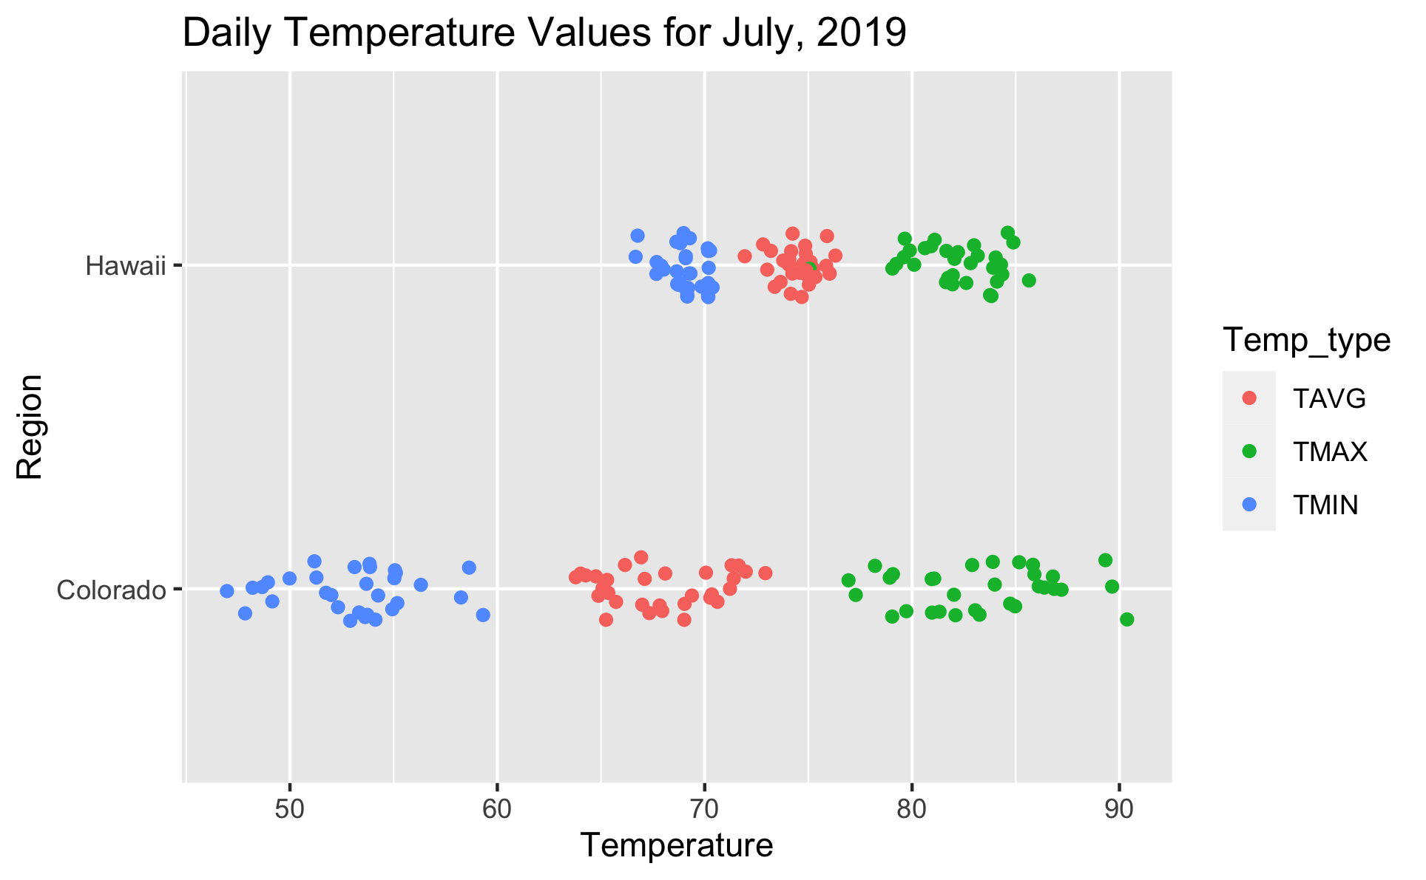
differing location
and dispersion
similar location,
differing dispersion

Slide 9



