Slide 1

INT322
Internet II: Web Programming on UNIX
M1: UNIX / Linux Review

Slide 2
What is the difference between UNIX and Linux?
  Linux is for PCs
    ~1991
  UNIX
    = UnICS
      UNiplexed Information and Computing System.
      name was intended as a pun on an earlier
      system called "Multics" (Multiplexed
      Information and Computing Service)
        Multiplexed: communications system able to carry many
        messages simultaneously.
        UNiplexed: kind of senseless word b/c 1 msg. at a time.
    Term covers all variations:
      Linux, FreeBSD, and Solaris.
    developed at Bell Labs starting in 1969.

Slide 3
UNIX
Portable
Interactive
  i.e. users can use the computer directly, and immediately see the results of their actions
Multitasking
  the operating system creates the illusion of performing multiple tasks at the same time by rapidly switching between them
Multiuser
written in C
  Most OSs are written in C
  Fast, powerful, high level, widely known
  Wrapper to assembly

Slide 4
Unix File System
Learning command-line navigation of the file system is essential for efficient system usage
Unix/Linux file system is hierarchical
  Files are organized in directories
  Directories may contain sub-directories
  similar to other operating systems today
Different from Win. b/c no drive letters (such as C:, or D:)
  All files and directories appear under a single root,
    even if multiple storage devices are used

Slide 5
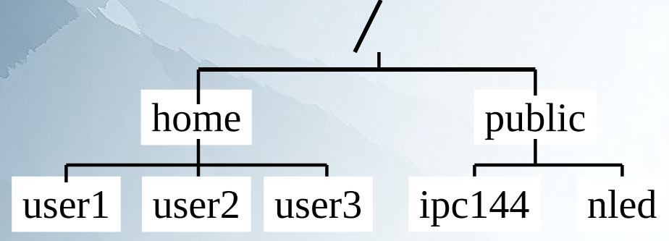
Hierarchical File System
"root directory" / is the starting directory
  and other "child directories“ "grandchild directories”, etc. are created
hierarchical structure resembles an "upside-down tree“
  tree command: display a “tree diagram”

Slide 6
Typical Unix/Linux Directories
/
  Root directory (ancestor to all directories).
/home
  Used to store users’ home directories.
/bin
  Common system binaries (commands).
/usr/bin
  Common utilities (commands) for users.
/usr/sbin
  Common utilities for user administration.
/etc
  General System Admin. Files (e.g. passwd)
/var
  Dynamic files (log files)
/tmp, /var/tmp
  Temporary files for programs
/dev
  Device files (terminals, printers, etc.)

Slide 7
Home directory
Every user when receiving an account has a “home” directory created
  To keep your personal files
~
  represents your home
  can use in the path names
cd command without any parameter
  will get you directly to your home directory
Remember to keep your files private

Slide 8
Types of Files
On a Unix/Linux file system a “file” can be anything
  Not just a text document, video, music, photo etc.
  A directory is really an index file
    containing references to file locations on the physical disc and other related information
  Devices are also files
    E.g., terminal or printer
hidden file
  Any file (or directory) name starting with a period

Slide 9
Types of Files
ls –l command
  i.e., list (ls) using a long listing (l) format
    Use to determine the type of file
  For Example:
    ls -l /dev/tty
crw-rw-rw- 1 root root 5, 0 2003-03-14 08:07 /dev/tty
    ls -l monday.txt w1.c
-rw-r--r-- 1 someuser users 214 2006-01-23 14:20 monday.txt
-rw-r--r-- 1 someuser users 248 2005-10-12 13:36 w1.c
    ls –ld uli101
drwxr-xr-x 2 someuser users 4096 2006-01-17 16:43 uli101
NOTE: 1st char. Tell you file type:
  “-” indicates a regular file
  b or c is a device file
  d is a directory
ls –ld
  Long listing of directories not content.
    [lists the names of the directories not what is inside them
  E.g., ls –ld /home/myacct
Notes:
ls –l lists all files and directories in current directory
ls –ld lists only current directory (.)
Ls –l * lists all files and directories, and the contents of the directories
Ls –ld * lists all the files and directories, but NOT the contents of the directories.

Slide 10
ls –l lists all files and directories in current directory
ls –ld lists only current directory (.)
ls –l * lists all files and directories, and the contents of the directories
ls –ld * lists all the files and directories, but NOT the contents of the directories.

Slide 11
Hidden Files
A file is hidden if its name starts with a “.”
  For example: .profile
  Exercise create an invisible file, verify it is invisible, then delete it.
    Sol’n: touch .filename
      Test: ls –l (you can’t see the file) → ls –lA (now you see it)
      rm .filename
ls –a will show all files including hidden
. and .. directories are hidden
– ls –A will show “Almost” all files – not including . and ..
    Note: Caps make a difference
Why make files hidden?
– To clean up directories
– To hide backups
– To protect important files from accidental deletion
Remember: directories are really files, you can hide them as well

Slide 12
Working With The File System
there is no undo command or a Trash/Recycling Bin
  Changes are instant and permanent
  A single command can wipe out your entire account
    Sol’n:
      Make backups of important files
        preferably outside of your account
        - USB storage is a good option
      control file access through file permissions

Slide 13
Basic Commands
mkdir directorypath
  creates subdirectory with a directory.
  Multiple arguments can be used to create many subdirectories.
    E.g. mkdir d1 d1/d2 d1/d2/d3
      Makes 3 directories with one command. Final result d1/d2/d3
      This way is better (shorter)
        –p option allows for parent directories to be created.
        Note: mkdir d1/d2/d3 doesn’t work
        Sol’n mkdir –p d1/d2/d3
rmdir directorypath
  Used to remove only empty directories
    (i.e. directories that contain no subdirectories or regular files).
  cannot remove a directory from within the directory location itself.
  rmdir –p
    -p stands for parent
      Removes directory and its ancestors
    E.g. rmdir –p d1/d2/d3 is same as rmdir d1/d2/d3 d1/d2 d1
Notes:
Note: mkdir d1/d2/d3 doesn’t work but md d1/d2/d3 does

Slide 14
pwd
  displays user’s present working directory.
    So you know where you are in the computer system
      Helps build directories, copy files, etc…
cd directorypath
  Used to change to a directory.
  Entering the cd command without the directory path will change to the user’s home directory.
ls
  display contents of directory
    Default: displays non-hidden filenames only.
    (eg. regular files or sub-directories)
  common options:
    -a short display of hidden & non-hidden files
      Including . And ..
    -l detailed display of files (excl. hidden files)
    -F displays / after directory, * after executable file
    Options can be combined
      example: ls -la (or ls -l -a)
Notes:
-f do not sort, enable –aU (i.e., a = show all files, and U = do not sort; list entries in directory order), disable -ls --color
--color[=WHEN] WHEN can be ‘always’, ‘never’, ‘auto’
[note: -- used because muliple characters in option. So it indicates the characters are to be treated like 1, otherwise Linux would interpret -color as 5 different options]

Slide 15
mv sourcepath destinationpath
  move a file from one location to another
  and/or
rename the file.
  used to move directories and files.
  –i option
    asks for confirmation if the destination filename already exists.
cp sourcepath destinationpath
  copy a file from one location to another.
  used to backup.
  –i option
    asks for confirmation if the destination filename already exists.
  -r option
    allows copying of directories and their contents

Slide 16
rm filepath
  remove a regular file.
  rm -r filepath
    recursively remove a directory and it's contents.
      Recursive: to descend to lower levels
        in this case, indicates that subdirectories and it contents are also removed.
  What option would you use to reduce the risk of accidental deletion?
    –i option
      confirm deletion of subdirectories and its contents!

Slide 17
cat filepath
  joins files (i.e. to concatenate files) (or standard input)
    and then prints to standard output (the screen)
  example, cat file1 file2 file3
    Displays contents of file1 and file2 and file3 on the screen at the same time.
  To display the contents of small files
    (files longer than the screen will scroll to the end).
  example, cat .profile in your home directory
    display the contents of your setup file.
  What is .bash_history (in your ~ directory)?
    Sol’n: cd ~ → cat .bash_history
      you will see the commands you have entered
        (not just in this session, but earlier ones too)

Slide 18
more filepath
  display contents of large regular files
    one screen at a time.
  navigate throughout the file by pressing keys
    such as:
      spacebar Move to next screen
      b Move to previous screen
      enter Move to next line
      /car Search for pattern "car"
      q Exit to shell
      +linenumber Starts at linenumber
  E.g., more +5 file.txt
    Starts displaying file.txt at line 5.
less filepath
  Works like more command (more emulation)
    but contains more navigation features.
      allows backward & forward movement in file.
        use the arrow keys and the Page-Up and Page-Down keys to move through the file.
        G to go to end.
        g: - goes to a particular line (e.g., typing in the line number followed by "g“)
        -g alone goes to beginning.
  Faster than more
    does not have to read the entire input file before starting
  run on a variety of terminals
  E.g., less fileName.txt will display the top of fileName.txt.

Slide 19
touch [options] path
  update the date and time of existing files.
  also used to create empty files.
  E.g. touch filename.txt → ls –l (notice the time and date of filename.txt → touch filename.txt (what do you notice?)
    changes its time and date (ls –l) to current time and date
  e.g., touch -d YYYY-MM-DD filename.txt makes a file with that particular date
file path
  Determines a file type
    Useful when a particular file:
      has no file extension
      or the extension is unknown/incorrect
clear
  Clear screen

Slide 20
The find Command
searching for files recursively throughout the file system by:
  file name,
  Size
  file attributes
optional action can be performed on matches
Examples:
  find ~ -name bob
    Search for a file named bob [starting from from directory]
  find / -user alice -empty -delete
    Delete empty files belonging to user Alice [starting from root dir.]
  find / -mmin -5
    Find all files modified less than 5 minutes ago
    find ~ -mmin -5 searches [recursively through the root directory]

Slide 21
File Naming
Adopt a consistent file naming scheme
  case sensitive!
  Helps find files later
Make names meaningful
Avoid:
  non alphanumeric characters
    Have special meaning to the system
      will make your work more difficult
  spaces in file names
    consider periods, hyphens and underscores
use file name extensions to describe the file purpose

Slide 22
Getting Help with Commands
man command
  comprehensive online manual for common UNIX/Linux commands
  man [options] command
    -k provides short (one-line) explanation relating to the commands matching the character string.
      used if user doesn’t know name of command.
        b/c lists everything that has “your command” in the explanation or as part of the command name
      E.g. man -k calendar
      E.g. man –k find
Info Command
  Mainly GNU commands and utilities.
Help Command
  In BASH

Slide 23
Text Editing
Define Editing
What needs to be edited?
  System configuration files
  Scripts and programs
  Documentation
  Web pages
  …
Editors?
  GUI
    gedit, gvim, nedit, sublime
  command-line text editors
    windows: Edit, type (not really an editor)
    UNIX: vi (visual) editor, nano, nled
both Unix/Linux and Windows use ASCII to encode text files
  BUT small differences that may cause problems (particularly with scripts) when copying files between different systems
    Sol’n: use the unix2dos and dos2unix utilities to convert between the two systems

Slide 24
vi (Visual) Editor
vi is a powerful, interactive, visually-oriented text editor
Features:
  Efficient editing
    by using keystrokes instead of mouse.
  Use of regular expressions
  Possibility to recover files after accidental loss of connection
  Features for programmers (eg. line numbering, auto-indent, etc…)
present on all Unix-like systems

Slide 25
Starting vi Session
two ways to start vi:
  vi filename
    recommended
      filename has already been assigned and changes will be saved to filename
        by entering ZZ [capitals] while in vi [command mode]
        - saves and exits
  Enter vi
    filename is not assigned
      user has to type <ESC> :w filename <ENTER> in order to save file.

Slide 26
3 operational modes
  while using the vi editor:
    Command Mode (default mode / you start here)
      User presses letter for a command
        for example, insert text (I, i), delete text (r, R, dd, :d), append text (a, A), etc.
    Input Mode
      Lets user enter or edit text.
      ESC to return to command mode.
    Last-line Mode
      Pressing colon “:”
        opens a prompt to enter letter or word commands.
      More complex operations such as search and replace can be performed.

Slide 27
Copy your hidden profile file to a file called play
  cp ~/.profile ~/play
What kind of file is it?
  file play
    It is a txt file
Give it the proper extension
  mv play play.txt
Open play.txt in vi and play with it using the command on the next slide
  Whatever you do DON’T overwrite your .profile file; that might be playful but it won’t be fun.

Slide 28
Moving in Command Mode
  move around to text in the screen w/:
    h (left), j (down), k (up), and l (right).
      may be able to move around by using the arrow keys
        (depends on version)
    w (right one word to special character),
    W (right one word including special characters)
    b (left one word to special character),
    B (left one word including special characters)
    0 (zero) (beginning of line), $ (end of line)

Slide 29
Input Mode allows user to enter or edit text.
Getting into Input Mode
  in command mode, you can issue the following commands to input text:
    i – insert to left of cursor
    I – insert at beginning of line
    o – insert line below current line
    0 – insert line above current line
    a - append to right of cursor
    A - append at end of current line
    r - replace character
    R – overwrite text

Slide 30
Common Editing Commands
  x – Delete single character
    [the char you are on, and shifts characters after it to the left]
  d – Delete
    [press d + arrow key]
  c – Change
  y – Yank (copy)
  p – paste below cursor
  P – paste above cursor
  u – undo previous edit
  . – repeat previous edit
  Editing commands can be preceded with a number, for example:
    3X = delete the next three characters
      [capital X not lower case. Lower case only deletes 1 char. Regardless of the number preceding it]
    2u = undo the last two edits
    12dd = delete 12 lines

Slide 31
visual mode:
  flexible & easy way to select a piece of text for operator.
  only way to select a block of text.
  In Command mode hit:
    v – select characters
    V – select lines
Searching for text
  In Command mode
    /pattern Search forward for pattern
    ?pattern Search backwards for pattern
    n Display next match
    // Repeat previous search

Slide 32
Saving Edited File
  Work stored in a Work Buffer (temporary storage)
    until the user saves their work.
  When saving, changes in the work buffer:
    are placed in a new file
      if creating a new file
    or
    modify existing file.
  To save your vi session
    you must be in command mode
      [press <ESC> if not]
    To save and exit
      enter ZZ (i.e. two capital z’s)
      OR
      :x in last line mode
    :w
      save without exiting

Slide 33
Aborting Editing Session
  i.e. exit without modifying the contents of your file
    (dump the work buffer)
  Press <ESC> :q! <ENTER>

Slide 34
UNIX shell
● Command interpreter for UNIX
● Acts as a mediator between user and UNIX kernel
● Processes and/or executes user commands
● More than one command can be executed on one command line
  when separated by a semi-colon
● 1000+ Unix commands
  You will be learning approx. 30 Unix commands
● command and utility mean the same in UNIX

Slide 35
UNIX shell
● allows you to run programs and see their output
● Each user on one machine can run a different Shell
● UNIX scripting = UNIX shell programming

Slide 36
UNIX shell
● Idea: We want a powerful, programmable shell that let’s us control our environment
  several kinds of shells
    not part of the operating system kernel
      Idea comes from Multics
      Have Different features
    Bourne shell (original UNIX shell) had limitations.
      New shell improve by:
        Command/filename completion (e.g. - spell part of the command name, hit a "hot key," and the shell will try to complete the name of the command/file;
        History manipulation; some ability to re-run previous commands;
        Command line editor (so you can edit and re-invoke previously run commands);
        Definition schemes for aliases/functions to allow you to create custom behaviours.
    Most popular shells:
      C shell (this is not the C programming language)
        Less popular
      Korn shell (ksh)– used with Unix
      BASH shell (Bourne-Again Shell)– Linux users like[d] it [being replaced by faster but limiting shells].

Slide 37
Why command line?
● Why don’t we just use the GUI (KDE, Gnome, etc.)?
– GUI:
● may not always be available
      ● What if something is broken?
      ● What if you are connecting through a terminal remotely?
● is for regular users
● Many administrative tools are hard to find in the menus
– Command line:
● is more efficient
      ● Tasks are completed faster
      ● Less system resources are wasted
● allows you to automate repeating tasks
● through scripting
● Writing scripts requires you to know commands

Slide 38
Command Execution
While command is being executed the shell waits for it to finish
  called sleep
When the command finishes executing the shell brings back the prompt
Can you get the command prompt before command finishes?
  Yes: requires executing a process in the background

Slide 39
Command Line Syntax
command line
  A line which includes:
      UNIX commands
      program and shell script names
    and their arguments
Typical command line execution would include:
  Command line parsing
  Breaking it up into tokens
  Executing tokens
Command line tokens are separated by whitespace
Command line executed when the Enter key is pressed

Slide 40
Command Editing
● Previously executed commands can be recalled
– Recalled commands can be easily edited before re-executing
– Bourne shell
- uses the up/down arrow keys
– Korn shell
- uses vi-style command editing
● Useful BASH keyboard shortcuts:
  – Go to the beginning of the line: CTRL+A
  – Go to the end of the line: CTRL+E
  – Erase Characters: Backspace or CTRL-Backspace (2 at a time) or CTRL-h
  – Delete a word before the cursor: CTRL-w
  – Delete everything from to the beginning of line: CTRL-u
  – Clear Screen: CTRL-l (‘el’)
  – Search for a keyword in previous commands: CTRL+R
  – Auto complete file/directory names: Tab

Slide 41
Quoting in UNIX
Sometimes use characters that have special meaning to the shell
  These characters may need to be quoted
    several ways:
      Backslash (\) – quotes one character that follows
      Double quotes (“ “) – quote a group of characters
        Variable substitution
      Single quotes (‘ ‘) – quote a group of characters
        No Variable substitution

Slide 42
\ Quote
Quotes one character
  that immediately follows
prevents variable substitution when the $ character is quoted
  Recall $ is a wild card
Example:
  echo *
    will show files in your pwd, but
  echo \*
    will show *
  To quote a \
    another \ is used (\\)

Slide 43
Double Quoting
Commands can have their arguments quoted using double quotes
  E.g., such as echo
  Such quoting can preserve and/or include whitespace
Double quotes do not:
  Prevent shell variable substitution
    Variable substitution takes place
  Stop escape characters interpretation

Slide 44
‘ ‘ Quotes
Forward single quote – different than the back tick (backward single quote)
Quotes all that is inside
  preventing wildcard and variable substitution
Example:
  echo .*
    will show all hidden files in pwd, while
  echo '.*'
    will show .*

Slide 45
File Permissions
Unix/Linux recognizes everything as a file:
  Regular files
    to store data, programs, etc…
  Directory files
    to store regular files and subdirectories
  Special Device files
    which represent hardware such as hard disk drives, printers, etc…
Files can be deleted.
  What prevents someone from removing important files on purpose or by accident?”
    Answer: Ownership of the file, and file permissions

Slide 46

File Permissions
Exercise:
  How would you display the detailed listing of the tty?
    ls –l /dev/tty
    crw-rw-rw- 1 root tty 5, 0 Sep 24 13:11 /dev/tty
    (recall that b and c are device files. The next 3 groups of 3(rwx) are permissions for owner, group, world)

Slide 47
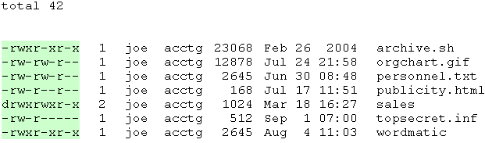
chmod tells system how much (or little) access it should permit to a file.
  ls –l gives listing to right (top, left to right):
    total line: how many blocks in directory
      (usually 1024 bytes per block)
    - is normal files, d is directory
    rwx – are permissions
      X is execute file or access directory
      - means don’t have that permission
      Permission sets: Owner, group, world
    Number of hardlinks
    Owner of file
      can change ownership using chown
        If you own it
    Department file belongs to
    Size of file / directory
      For directory does not give total of directory’s contents
        [E.g., does not include subdirectory size]
    Date and time file last modified.
      get time of day if the modification was during this year
        Else only the year
    File name
Notes:
catcode.com/teachmod
http://linuxgazette.net/105/pitcher.html

Slide 48
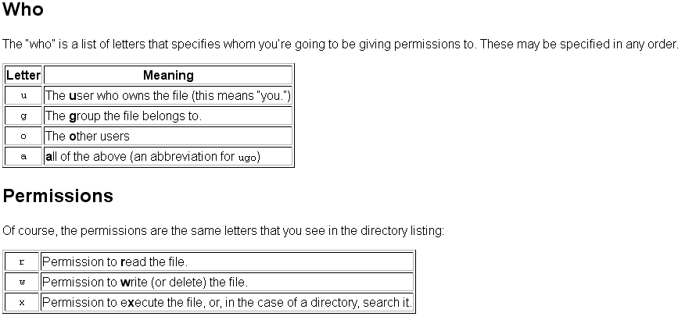
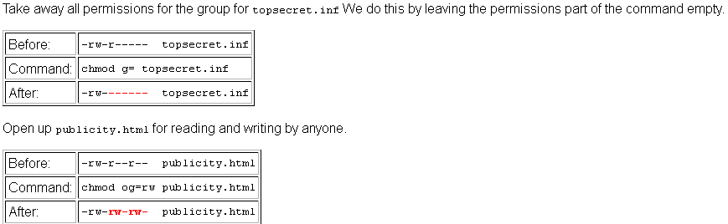

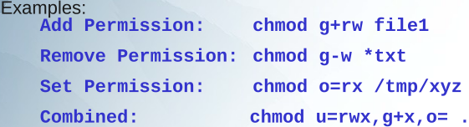
Chmod (cont.)
  chmod who=permissions filename
    2 methods
      Symbolic (w/o numbers)
      Absolute (numbers)
  Symbolic Method
What happens here?
  d------rwx joe acctg sales
  -rw-r--r-- joe acctg info.dat
  chmod ug=o
  Answer:
  Gives users of the u and g class the same permissions that o class has
  chmod g=wu info.dat
  Answer:
  Can’t mix the standard permissions (r, w, and x) with the copying shortcuts: e.g., is illegal

Slide 49
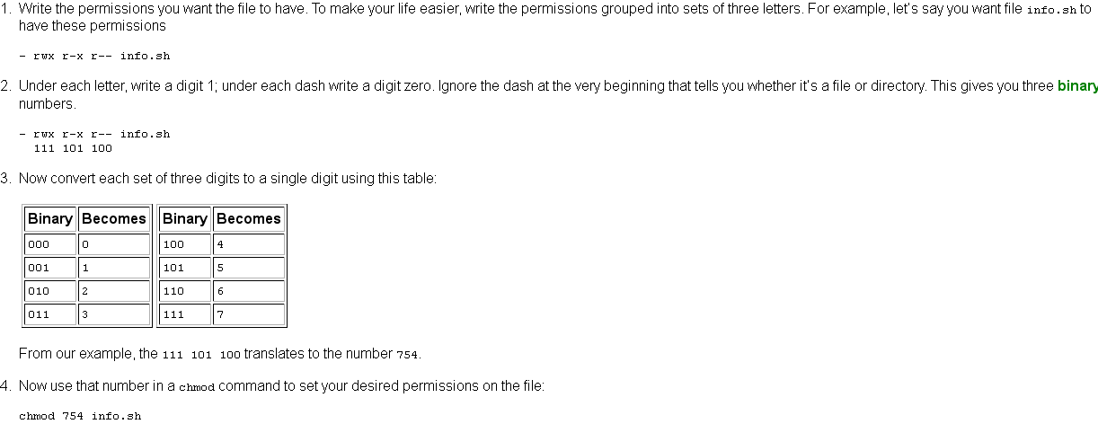
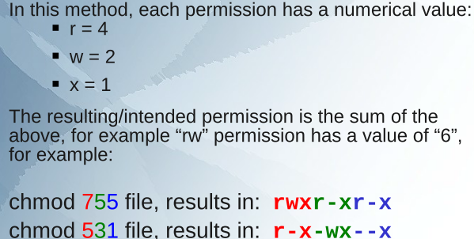
Chmod (cont.)
  chmod who=permissions filename
  absolute method (numbers)

Slide 50
Directory Permissions
directory is a special kind of file which holds lists of other files
  So permissions work different
    r – allows listing contents of the directory
    w – allows creating and deleting files inside
    x – allows access to files inside
      In order to have access to directory contents, at least the “x” permission is necessary.
        called the “pass-through” permission

Slide 51
Pass-Through Permissions
The pass-through permission is the key to grant access to only selected directories and/or files
Consider this example – you are giving others access to the following:
/home/you/documents/uli101/jokes.txt
  The following directories need pass-through permissions set by you for others:
    you, documents, uli101
  Even if the above directories have other files, possibly readable by others, they would have to know/guess their name before accessing them
  Just in case, you should not grant access permissions to others by default
    Only in specific case, such as this one (jokes.txt), give read permissions to specific files

Slide 52
umask (user file-creation mode mask)
Sets default file permissions for new files and directories in the current shell
  reverse effect to chmod – you set permissions which you do not want to grant
  Default Permission - umask value = Allowed Permission
  Default Permissions
    777 → For executable files / directories
    666 → for text files
  umask value: you pick such that you get the allowed permission
  Allowed permission: the permission given to new files.
  umask is set in /etc/profile
    E.g.,
    # Set the user's default umask
    umask 022

Slide 53
Exercise
  What should you use for the umask value if you want the owner of a binary file to read, write, and execute, while group members & others can only read and execute it?
    Answer:
    777 – 022 = 755
    If you use the same umask value for a text file will the result be the same? Show the calculation and explain the meaning.
    No. 666 – 022 = 644.
    i.e., owner can read and write. Group and others can only read

Slide 54
UNIX processes
process
  Almost everything that is “running” on a UNIX
  has a[n]
    owner
    unique ID (PID)
  can run in:
    Foreground
    Background

Slide 55
Process structure
UNIX processes are hierarchical
  has a root, parents and children
forking / spawning
  Creation of a new process
  Parent can fork a child
  children can fork their own children
Processes keep their PID for their entire life
Usually parent sleeps when a child is executing its task
  Exception: when child process run in background

Slide 56
Process identification
ps (process status) command
  displays snapshot information about processes
  Default
    displays information only about current terminal
    Solution: ps -U username
      shows all
top command
  provides a continuous update including resource usage
  Like Windows’ task manager [ctrl + alt + delete] without the GUI

Slide 57
Foreground and background
Foreground processing:
  Is the default
  Takes away the command line
    until processing is finished
Background processing:
  invoked by putting the ampersand (&) operator at the end of the command line
  User gets the command line back immediately
Both foreground and background processes can be executed on one command line
Background processes run concurrently (at the same time)

Slide 58
Process suspending & restarting
Ctrl + Z
  Suspends (temporarily stops) foreground job
fg command
  Restarts stopped jobs in foreground
    Brings them to the foreground.
    Lets you switch between processes.
      Like switching windows, but no GUI.
  Command Syntax:
    fg
      bring the last background process to foreground
    fg job_number (1,2, …)
      Jobs command
        show a list of background/suspended processes
        jobs -l shows background/suspended process number and PID
    fg PID
      Doesn’t work on Matrix
        Not PID is not listed as an operand in “man fg”

Slide 59
Process suspending & restarting
bg command
  Restarting in the background
  bg PID
  bg job_number
Terminating a Process
Ctrl+C
  Terminates Foreground processes
  To use with background process bring it to foreground first
kill
  Terminates:
    Background process
    Foreground process
    killed

Slide 60
kill command
Terminates a process
One or more processes can be terminated at once
Regular users can only kill processes they own
Syntax:
  kill PID
    May be ignored by shell
    Sol’n: Kill -9 PID
  kill –9 0
    terminates all background processes
    Can kick you off ssh / putty.
pkill command
  kill processes based on the program name,
    example: pkill firefox
  Use pkill -9 name
    To be sure it dies.

Slide 61
Storage Quotas
All file systems have finite capacity
du
  Estimate file space usage
df
  Report file system disk space usage
Most regular user accounts have a quota
  quota limits the amount of disk space you can use
    ensures that single user cannot interfere with file system use for others
quota command
  Displays your quota (limits) and disk usage
If you want more disk space…
  Temporarily – use the /tmp directory
  Permanently – ask the administrator

Slide 62
head and tail commands
Head
Display the beginning of a file
E.g. head [-line_count] file
    example: head –3 users.log
Tail
Display the end of a file
Example: tail -20 tmp
  Displays last 20 lines of file tmp
By default, 10 lines are displayed by both head and tail
  entire file displayed if less than 10 lines in length
  E.g. head tmp
  E.g. tail tmp

Slide 63
cut
Selects fields or columns from:
  files
  or standard input
Range can be specified in multiple ways:
  1–10 (first 10)
  3–8 (3rd to 8th)
  –10 (up to 10th)
  2– (from 2nd until the end of line)
  1–3,4,10– (combination of above)
Important options:
  -c
    Cut [select] characters
    Example: cut -c 1-2
      cuts first 2 characters
  -f
    Cut [select] fields
    Example: cut –f 2,5 (will cut 2nd and 5th field)
i.e. it does NOT permanently remove data from the file

Slide 64
cut fields
Field delimiters:
Tab key
  Default field delimiter
–d option
  Specifies other field delimiter
  Field delimiter must be a single character
    only one delimiter is supported
    example:
      cut –d, –f1–2
        cuts first 2 fields delimited with a comma
  If special characters used for delimiters they MUST be quoted
    example:
      cut –d” “ –f1
        space is the field delimiter

Slide 65
cut
Exercise
  Put this months calendar into a file
    type it into a text file, e.g. using vi.
    or cal > tmp
  View the file
    cat tmp
      Short for concatenate files—this also prints to screen
  Cut out only the calendar dates for Tuesday and Thursday.
    cut -d" " -f 3,5 tmp
  Did the original file change?
    cat tmp
    No it did not. The fields selected [cut] were displayed NOT removed.

Slide 66
sort command
sorts
  a file according to fields (the individual pieces of data on each line)
    default, fields assumed to be words separated by blanks [tabs]
      can specify an alternative field delimiter
  SINGLE files
  or standard input
Merges and sorts multiple files
Notes:
http://lowfatlinux.com/linux-sort.html

Slide 67
sort command
Popular options:
  -f
    ignore case in comparisons
  -n
    numeric sort (i.e. sort the numbers, don’t sort alphabetically)
  -u
    display unique entries
  -r
    reverse sort
  -tx
    Uses x as the field delimiter
      (i.e., replace it with whatever is separating your fields. E.g., -t, for a CSV file)
  -k
    Column to sort
    E.g. -k 3 sorts based on third field.
Notes:
http://lowfatlinux.com/linux-sort.html

Slide 68
Exercise
  Stop several processes (e.g., top, vi, cat)
  Put the contents of the ps command into a text file called tmp
  Sort the file in reverse order according to the name of the process.
    sort -r -k 4 tmp
    Is it sorted correctly? Why or why not?
      Headings are at bottom, not in desending order
      Should the headings be at the bottom?
        How can you change their position?
        - change the case and resort
        - logic: capital letters have lower values [ascii / unicode ]
        than lower case

Slide 69
wc [word count]
Counts the number of lines, words and/or characters in a file
Usage:
  wc option [filename]
    Options:
      -l
        count lines
      -w
        count words (delimited by whitespace)
      -m
        count characters
    If no option is specified all 3 counts are displayed
    E.g., wc tmp wc –l tmp

Slide 70
grep utility
grep [option(s)] pattern [file(s)]
Acts like a filter
  Searches for literal text and text patterns in a file
  and
  outputs only lines (i.e., chars between /n (newline characters)) which are successfully matched to a given regular expression
    A successful match can be:
      entire line
      or any part of it
Works with:
  files
  and/or standard input
Etymology: from ed command g/re/p (search g]obally for matches to the regular expression and print). Ed is UNIX’s first editor.
Notes:
http://www.linfo.org/grep.html

Slide 71
Useful grep options:
-i
  ignores case
-n
  numbers lines in the output
-v
  reverse match
    Matches lines that do NOT contain the pattern
-c
  displays the count of matched lines
  Does not display the matched lines
Example usage:
  grep IamLookingForThisMatch file1 file2 file3
  grep ‘I am Looking For This Match’ file1 file2 file3 (“ “ is okay too)
    Each result is displayed on a separate line preceded by the name of the file it is in
  grep -ir ‘I am Looking For This Match’ *
    Ignores case
    and searches all text files in current directory and all its subdirectories.
  ls | grep IamLookingForThisMatch
    Gives a list of all files, directories and links in current directory containing IamLookingForThisMatch

Slide 72
Standard File Descriptors
standard file descriptors
The 3 connections that are opened when a Unix shell starts a command:
  Number Name Short Name
  0 Standard Input stdin
  1 Standard Output stdout
  2 Standard Error stderr
Many commands use these three connections for input and output.
When using the shell interactively the standard file descriptors are connected to your terminal (or telnet session).
  i.e., when the program needs input, it gets it from the keyboard, when it displays output or error messages, they appear on the screen.

Slide 73
Standard Input, Standard Output, Standard Error
Standard input (stdin)
  general term which describes how, or from where, a command receives information
    [Usually the keyboard]
  When no information is coming from standard input a command usually:
    has defaults
    or expects an argument (parameter)
      Typically such parameter would be a file name
    Some commands take their input from stdin if there is no file argument on the command-line.
      i.e., 'cat < test' and 'cat test' do the same thing.
  can be:
    redirected from a file
    or piped from another command

Slide 74
Standard Input, Standard Output, Standard Error
Standard output (stdout)
  describes how, or the place where, the command sends its output
    [Usually the screen]
  can be:
    redirected to a file
    or piped to another command

Slide 75
Standard Input, Standard Output, Standard Error
Often useful to separate error messages from program's normal output.
  example, redirect output from command into a file, but still have any error messages go to the screen
    so you can tell when something is wrong
Standard error
  the place where error messages are sent
  Default: terminal
  Can be redirected

Slide 76
Redirection
Three kinds:
  Standard INPUT Redirection
  Standard OUTPUT Redirection
  Standard ERROR Redirection

Slide 77
Redirection
Standard Input Redirection
command < filename
  Example:
    tr ‘a-z’ ‘A-Z’ < ls.txt
      The file ls.txt is being sent to the command tr for processing
      The lower case letters in ls.txt are translated to upper case as displayed on the screen (stdout)
      tr [OPTION]... SET1 [SET2]
        takes two sets of characters and replaces occurrences of the characters in the first set with the corresponding elements from the other set
        translate or delete characters.
        Translate, squeeze, and/or delete characters from standard input, writing to standard output.
        -squeeze: replace many same characters with just one.
  Used for commands which do NOT accept a file as argument
  E.g., cat < tmp, cat 0< tmp. (b/c 0 is the stdin descriptor)
    BUT NOT cat <0 tmp, cat 1< tmp or cat <1 tmp, cat 2< tmp, cat <2 tmp [b/c of syntax]
Notes:
http://www.cyberciti.biz/faq/how-to-use-linux-unix-tr-command/
http://www.computerhope.com/unix/utr.htm
http://linux.about.com/library/cmd/blcmdl1_tr.htm
echo "12345678 9247" | tr 123456789 computerh
This example takes an echo response of '12345678 9247' and pipes it through the tr replacing the appropriate numbers with the letters. In this example it would return computer hope.
tr -cd '\11\12\40-\176' < myfile1 > myfile2
This example would take the file myfile1 and strip all non printable characters and take that results to myfile2. Why: SETs are specified as strings of characters. Most represent themselves, but these are Interpreted sequences b/c they start with a \.

Slide 78
Redirection
Standard Output Redirection
Redirects a command's standard output to a file
command > filename
  Symbol >
    Represents Stdout redirection
    If the file exists its content will be replaced
command >> filename
  symbol >>
    appends a file
Example:
  ls > ls.txt
    saves output from the ls command into a file called ls.txt

Slide 79
Redirection
Standard ERROR redirection operators :
2> or 2>>
2>&1
  Redirect standard error to the same place as standard output
Note: 2 is the file descriptor number for stderr (2)
Notes:
Example

Slide 80
Inter-process communication
Commands can send their standard output directly to standard input of other commands
  achieved by using pipes and tees
  A few simple commands can form a more powerful one
  No temporary files are necessary

Slide 81
Inter-process communication
Pipe (|)
  connect the stdout of one command to the stdin of another.
  Many commands can be “piped” together
    filter commands use them especially often
      Each filter processes the initial input based on it's design
      Filters must be chained in specific order
  Example:
    ls | less

Slide 82

Inter-process communication
Tee
  used to split the flow of information
    Read from an input
    and write to a:
      standard output
      and file.
    Need to use pipe with the tee utility
  E.g., ls | tee unsorted.txt | sort

Slide 83
tee [OPTIONS] [FILES]
Examples
  ls | tee myfile
    writes output of ls to the screen (stdout) and to the file.
    Faster than using two statements: ls, and ls > myfile
  ls | tee myfile1 myfile2 myfile3
    write the output to multiple files
  ls *.txt | wc -l | tee /dev/tty count.txt
    ls command lists all .txt files in the current directory → count lines → output displayed on /dev/tty (terminal) AND sent to count.txt.
    Overwrites existing file b/c -a option not used

Slide 84
3 rules to remember:
  Redirection ONLY works with files (>, >>, <).
    Exercise: What Works?
      cal -y > today
        Works
      cal -y > sort –n
        Doesn’t work
      sort -n < cal –y
        Doesn’t work
  (2) Pipes ONLY work with commands (|).
    Exercise: What works?
    cal -y | outputfile
      Doesn’t work
    cal -y | sort –n
      Works
  (3) Data goes in the start of a pipe and flows out the end.

Slide 85
(3) Data goes in the start of a pipe and flows out the end (Cont.)
  Pipes are written left-to-right: a | b | c
    stdout of command 'a' is connected to the stdin of 'b', and the stdout of 'b' is connected to the stdin of 'c'.
  To combine file redirection with pipes:
    any input redirection needs to be connected to 'a'
    and any output redirection needs to be connected to 'c'.
    Exercise: What works?
      a <inputfile | b | c
        Works
      a | b | c <inputfile
        Doesn’t work b/c the stdin of 'c' connected to both 'inputfile‘ and the stdout of 'b'.

Slide 86
/dev/null file
/dev/null file (AKA the bit bucket or black hole)
a special system file that:
  discards all data written into it
    Useful to discard unwanted command output
    Example: Next slide
  Reading from /dev/null gives you an End of File (EOF) character / null data.
    You can provide null data (EOF only) to processes reading from it
      Useful to purge (empty) files etc.
      Example: 2nd slide over
Notes:
http://archive09.linux.com/articles/22150

Slide 87
/dev/null file
/dev/null file (AKA the bit bucket or black hole)
a special system file that:
  discards all data written into it
    Useful to discard unwanted command output (Cont.)
      example: find / -name “homer” 2> /dev/null
        Search whole system (b/c starts at / and is recursive)
        do a name search (-name) for the file homer and list their pathnames.
        Error messages are redirected (2>) and destroyed (/dev/null).
        - b/c error message displayed for each directory on which you don't have read permission. Could cause you to scroll past file of interest.
Notes:
http://archive09.linux.com/articles/22150

Slide 88
/dev/null file
/dev/null file (AKA the bit bucket or black hole)
a special system file that:
  discards all data written into it
    Useful to discard unwanted command output
  Reading from /dev/null gives you an End of File (EOF) character / null data.
    You can provide null data (EOF only) to processes reading from it (Cont.)
      Useful to purge (empty) files etc.
        example: cat /dev/null > ~/.bash_history
        -[i.e., cat reads /dev/null and redirects the content (EOF) (overwriting in this case because > not >>) the file ~/.bash_history.
Notes:
http://archive09.linux.com/articles/22150

Slide 89
Find command
(find where-to-look criteria what-to-do )
Recursively used to locate files
search any set of directories you specify
  for files that match the supplied criteria.
Examples:
  find
    displays pathnames of all files in current directory and all subdirectories.
  find /tmp /var/tmp . $HOME -name myfile
    Specifies many places to search
Notes:
http://content.hccfl.edu/pollock/unix/findcmd.htm

Slide 90
“Here” documents
<< symbol
  indicates a “here” document
    here document
      a special-purpose code block.
      It uses a form of I/O redirection to feed a command list to an interactive program or a command (like cat, ftp, ex text editor).
      tells the shell to read input from the current source (between the EOFs in case below)
Example:
  sort << EOF
  word
  name
  car
  EOF
  Anything between EOF…EOF is sent to the standard input of a utility
  You CAN use some other string/symbol instead of “EOF”
    E.g., <<HERE … HERE

Slide 92
Shell Start-up and Configuration Files
Shell Start-up/Configuration files
  settings that are applied every time a shell is created
    also apply when users log in, as it creates a shell
  start-up files are sequences of shell commands (scripts)
User / Root configuration files
  /etc/profile
    a single system-wide configuration file that belongs to the root user
  User-specific configuration files belonging to the user
    are hidden files found in the user’s home directory
      .bash_profile
        executed for login shells
        put things here that you only want to execute 1 time when you log in.
        - e.g., diagnostic information
      .bashrc
        executed for interactive non-login shells
        - i.e., if you’ve already logged into your machine and open a new terminal window
        -i.e., when you start a new bash instance by typing /bin/bash
      .bash_logout
        Executed when you log out
Notes:
http://www.joshstaiger.org/archives/2005/07/bash_profile_vs.html
http://hacktux.com/bash/bashrc/bash_profile
When BASH is invoked as a login shell, the following files are executed in the displayed order.
/etc/profile
~/.bash_profile
~/.bash_login
~/.profile
Although ~/.bashrc is not listed here, most default ~/.bash_profile scripts run ~/.bashrc.

Slide 93
/etc/profile
can only be modified by the root user
Affects the environment of ALL users
  regardless of their default shell
Bash users can change their environment
  by modifying:
    .bash_profile
      [matrix doesn’t have it. Our /etc/profile uses .bashrc setting for the login shell so it is redundant. See cat .bashrc]
    .bashrc
  Different shells have different configuration files
Other configuration files such as .profile exist
  read comments in .bash_rc file to find out more
  .profile Loaded ONLY for the user

Slide 94
.bashrc and .bash_profile
Located in the user’s home directory
executed every time a user logs in or creates a new shell
  Things vary depending whether the shell is interactive or not
each user can change his individual working environment
  By modifying either one of these files
They can be used for:
  Setting the prompt and screen display
  Creating local variables
  Creating temporary Linux commands (aliases)
    [E.g., alias dir=ls]
  Mapping new keys on the keyboard

Slide 95
Shell History
history
  recently executed command lines
    kept in a file
    Many shells maintain one
  used by users to save time
    when executing same or similar commands over and over
  Bash uses the up/down arrow keys
  Use the Ctrl+r to search by keyword
  Bash stores it’s history in the .bash_history file
    [In home directory]

Slide 96
Alias
A way to create:
  “shortcuts”
  or temporary commands in UNIX
Syntax:
  Simple command:
    alias name=value
      example: alias dir=ls
      E.g., alias pk=“pkill -9”
        kill processes based on the program name, example: pkill firefox
  complex command lines:
    enclose the command within double quotes
    example: alias clearfile=”cat /dev/null >”
Stored in memory
  while the user is logged in
Usually found in the .bash_profile
To view aliases type alias at command prompt.
Unalias name
  To erase alias e.g., unalias pk

Slide 97
Introduction to Shell Scripting
Shell programming
  Script can:
    automatically execute commands
    run executable files.
    automate routine tasks
  Shell-dependent
    each shell script is written for a specific shell
      such as bash
  Scope ranges from simple day-to-day tasks to large database-driven CGI (Common Gateway Interface) applications
    CGI: a standard for programming languages to communicate with web server
      Lets server run programs in language and send the output to a browser

Slide 98
Introduction to Shell Scripting
Scope ranges from simple day-to-day tasks to large database-driven CGI (Common Gateway Interface) applications (Cont.)
Note: PHP can run as stand alone language (i.e., uses CGI) or as a module in Apache (i.e., part of Apache = controlled by Apache)
  CGI:
    Slower
      b/c modules are built into server they run faster
        [whereas with CGI, PHP is being mediated]
    and security more lax
      Security CGI PHP
        mostly addressed through OS b/c PHP only partly controlled by server (Apache).
        Permissions are more permissive: rwxr-xr-x (755) vs -rw---r-- (604)
      Security PHP Module
        b/c of 1 and 2, no need to separate PHP source files from static web pages (i.e., can put them all in one directory)

Slide 99
Shell programming tips
Avoid script filenames that are reserved for Linux or Unix commands
consider the user running the script.
  example, what type of operating system and shell will script be executed on (bash, Korn, Z, C, etc.).
    If unsure:
      make the script portable
        (write using Bourne shell syntax)
    If sure:
      provide an extension to indicate in which shell the shell script should run.
        FILENAME SHELL
        file_name.sh Bourne
        file_name.ksh Korn
        file_name.bash bash

Slide 100
You can specify a shell for the script to run in.
  MUST PLACE #! IN 1st LINE OF SCRIPT FOLLOWED BY THE PATHNAME OF THE SHELL.
    if placed on another line, treated like comment
    E.g., to specify bash shell type #!/bin/bash
There are many special characters that the shell does not interpret as text.
  Sol’n:
    “” quote
      contain the argument(s) within double quotation marks " “
        E.g.: printf “You can listen as well as you can hear. \n“
        - [\n is new line character. Must be in quotes.]
    \ (backslash)
      Use directly in front of a special character
      E.g., echo "\$0 is: $0“
        This escapes ("quote-out“) the shell's interpretation of special characters
        Otherwise the value of variable would be displayed

Slide 101
Introduction to Shell Scripting
  #
    Two meanings
      Comment
        Any line other than first one starting with a # is treated as a comment
        can place # anywhere within script
        - even if it follows a command
        do NOT have to end comments with # symbol.
      #! statement
        First line of each script usually specifies the path to the program which executes the script - #! Statement.
        - example: #!/bin/bash
        MUST be the first line and nothing can precede it
        - not even a space
        which utility
        -identifies location of executables by searching directories in PATH environment variable.
        - similar to where in windows
        -use to find out what path to use there
        - [e.g. which bash gives you /bin/bash]
        This line is not necessary if the script will be executed in the default shell of the user

Slide 102
E.g. comments:
  # COURSE: CourseCode
  # USERNAME: FirstName_LastName
  # SCRIPT #1
    -double #s is okay
Ways to display text on the screen:
  echo
    E.g., echo My username is FirstName_LastName
    See next slide
  print
    Used to display formatted text.
    Used commonly in Korn and Zshell programming
    not available in the Bash shell
    Not in matrix
  printf
    Used to display text in a formatted method.
      [E.g. printf “Hi \t today is a good \n day to learn Linux”.]
        [Formatting: \t is tab, \n is new line. They don’t work with echo.]
    very similar to printf command in C
    available in most shells

Slide 103
echo command
Displays:
  unformatted text
  messages to the terminal followed by a newline
    –n option
      suppresses the default newline
      E.g.: echo -n “Are you sure Pluto’s a planet [Yes/No]? “
        Lets cursor stay on same line as the prompt
        works in bash shell
Output can be redirected or piped
  So can printf
“ ” (double quote)
  Arguments are usually double quoted
Available in most shells

Slide 104
Variables
We can prompt the user for input
  Then store response in a variable
2 major categories of variables:
  User-Created Variables
    Variable names cannot begin with a number
    "=" sign
      Assigns variables
      NO spaces on either side of "=" sign
    "$" in front of variable name
      displays contents of variable
  Read-only Shell Variables
    (AKA Positional Parameters)

Slide 105
Assigning a Value
Syntax: name=value
  example: course=CourseCode
  “” (double) quotes
    Use if variable values contain spaces or table
    example: phone=“1 800 123-4567”
Exercise:
  At the command prompt try:
    x = 10
      Spaces around = are problem
    x=10
      works
    echo x
      Displays x, need $ to display value (variable substitution)
    echo $x
      Displays x’s value
    X=5; echo $x

Slide 106
Read-Only Variables
readonly keyword
  prevent you from changing the variable afterwards
  Include before the command assignment
    example: readonly phone=“123-4567”
    E.g., readonly x=100
readonly command
  Protects variable from being changed
  After a variable is set
    Syntax: readonly variable
      example: readonly phone
      E.g.: y=50; readonly y
  If no variable name is supplied
    a list of defined read only variables will be displayed
    E.g.: readonly

Slide 107
Removing Variable’s value / Resetting
variable=
  For example: course=
  E.g., w=12; echo $w=12; w=; echo $w
OR
unset variable
  For example: unset phone
  e.g.: z=45; echo $z; unset z; echo $z
Read-only variables CANNOT be removed
  you MUST log out for them to be cleared
  unset x → get error message: -bash: unset: x: cannot unset: readonly variable
Notes:
[Note: z=45; echo $z; unset z; echo $z gives the result 45. But z=45; echo $z; → displays 45 → unset z; echo $z →displays nothing (so it works the way it should). Similarly doing the commands individually works too.]

Slide 108
Variable Substitution
dollar sign ($)
  Use to read a variable (its contents)
    use the variable name preceded by dollar sign ($)
This is called variable substitution
  Example:
    name=Bob
    echo $name

Slide 109
Storing value in User Created Variable
read command
  allows obtaining user input
  and
  storing it in a variable
  Everything captured until Enter key is pressed
  Type at the command prompt [by chaining i.e. a;b;c]:
    echo –n “What is your name? ”
    read name
    echo Hello $name
variable
Command
Displays variable’s value
Notes:
Chianing:
http://www.linuxnix.com/23-awesome-less-known-linuxunix-command-chaining-examples/

Slide 110
Storing value in User Created Variable
assign values for variables
  If text contains spaces or tabs, quote it when assigning it to a variable.
  E.g.: VariableName=“Value“
    MyTown=“Toronto Ontario”
  Exercise
    Show that the above assignment works
      Sol’n: echo "I am from $MyTown.“

Slide 111
export command
  sends values of variables when child processes are created
    [also use to work with env. variables: view, add, append]
  Variables Without Export
    Exercise: Assign a variable with a value in an interactive shell, and try to access the same in your shell script.
      MYAPP=1 //this assigns a value to the variable MYAPP
      Type $ cat myApp.sh to display the contents of the script, which are:
        #!/bin/bash
        echo "MYAPP=$MYAPP"
        MYAPP=2
        echo "MYAPP=$MYAPP"
      ./myApp.sh // Runs the script (same as myApp). The result is:
      MYAPP=
      MYAPP=2
      Why did you get no value for MYAPP initially?
      - b/c shell stores variable MYAPP only in the current shell. During the execution of myapp.sh, it spawns a new shell and it executes the script. So the variable MYAPP will not have the value in the spawned shell.
      Sol’n: export variable (for it to be inherited by another program – including a shell script.)
  export variables permanently
    add the export command in any of the following start-up files:
    ~/.profile
    ~/.bash_profile
    /etc/profile
      Limitations: e.g., ~/.profile is not read by bash, if ~/.bash_profile or ~/.bash_login exists.
        understand execution sequence of .bash_profile, .bashrc, .bash_login, .profile and .bash_logout, to decide which file to use to set the environment variable.
Notes:
http://www.thegeekstuff.com/2012/07/linux-export-command-examples/
http://www.thegeekstuff.com/2008/10/execution-sequence-for-bash_profile-bashrc-bash_login-profile-and-bash_logout/

Slide 112
export command (cont.)
  View environment variables:
    export –p: to view all the env variables
      you can also see this list using the ‘env’ command
    Use echo command to display a specific environment variable
      E.g., echo $PATH
        displays the value of the PATH env variable.
  add a new environment variable
    e.g., export MYAPP=1
      creates a new environment variable called “MYAPP” and assigns the value of 1
      Note: no space around equal sign
  to append a new path to PATH variable
    Use : to separate values
    E.g., export PATH=$PATH:/home/practice/
Avoid creating variables with the same name as variables that are used by the shell
  Keyword Variables or Read-only shell variables
Notes:
http://www.thegeekstuff.com/2012/07/linux-export-command-examples/
http://www.thegeekstuff.com/2008/10/execution-sequence-for-bash_profile-bashrc-bash_login-profile-and-bash_logout/

Slide 113
Shell Variables
Shell variables classified in 2 groups
  System (shell) variables
    describe the working environment
  User-created variables
    associated with scripts
Variables can be:
  read/write
  or read-only
Name can be any sequence of letters and numbers
  must NOT start with a number
Test cond (slide 125) Use –z (the length of string is 0) and -n (length of string is not 0) to check string length
  example: [ ! -z “$name” ]

Slide 114
Common Shell Variables
Shell environment variables
  Environment variable definition:
    a named object that can be used by multiple applications as it contains some valuable information required by these applications
  used by most activities taking place on system.
    E.g. executing ‘ls’, installing new software
      each activity either uses or alters the environment variable list.
  shape the working environment
    whenever you are logged in
Common shell variables:
  PS1 – primary prompt
  PWD – present working directory
  HOME – absolute path to user’s home
  PATH – list of directories where executables are
  HOST – name of the host
  USER – name of the user logged in
  SHELL – current shell
set command
  displays all available variables
  E.g. set
  E.g. set | grep ^PATH echo $PATH
Notes:
e.g., set | grep USER; set | grep HOST; set | grep PWD;
e.g., set | grep PATH will show all lines with PATH. To see only path use regular expression in grep: set | grep ^PATH (i.e. PATH must be at beginning of line)
e.g. echo $PATH
To change env. Variable: http://www.cyberciti.biz/faq/environment-variable-change-on-linux-freebsd-unix-bash/
PS1
Customises your command prompt
http://www.thegeekstuff.com/2008/09/bash-shell-ps1-10-examples-to-make-your-linux-prompt-like-angelina-jolie/
\u – Username
\h – Hostname
\w – Full path of the current working directory
http://help.cadcorp.com/en/7.0/sis/help/Named%20Objects_Named%20Objects.html
What is a Named Object?
By using Named Object Library Classes, each item does not need to remember, for example, a definition for its Pen. Instead, each item just remembers a Pen name. This saves a lot of memory, especially when thousands of items all use the same pen.

Slide 115
The PATH variable
PATH
  an environment variable present in Unix/Linux operating systems, listing directories where executable programs are located
  Each user can customize a default system-wide PATH
  When command invoked, shell searches these directories in sequence for match
Use ./ prefix or modify the PATH as needed
: (colon)
  Multiple entries are separated by a colon (:)
which utility
  Use to determine which match has a precedence
    In case of multiple matches
present working directory may not be included in the PATH by default
  Depends on system

Slide 116
Positional Parameters
store arguments in their relative position as numbered variables.
  useful for storing arguments after a script as separate variables.
    Every script can have parameters supplied
Traditionally command line parameters are referred to as $0…$9
  $1 - $9 store first 9 arguments
  $0 stores shell, command, or script that was issued
Parameters > $9
  Additional 10 - n arguments are stored as ${10} - ${n}
  can be accessed by using the shift command
    shift command will literally shift parameters to the left
      by one or more positions

Slide 117
Positional Parameters
${ } form
  enables direct access to parameters >$9
  example: echo ${10}
  Only some shells can use it
$* and $@
  represent all command line arguments
$#
  represents the number of parameters
  (not including the script name)

Slide 118
Exercise
Make a script called “MyScript.bash"
set it up to run in the bash shell.
  #!/bin/bash (on the first line only.)
How would you display the contents of the positional parameters, and what are the values of the positional parameters if you were to run MyScript.bash I love coming here?
  enter the following lines into your script:
    echo "\$0 is: $0"
    echo "\$1 is: $1"
    echo "\$2 is: $2"
    echo "\$3 is: $3“
    echo "\$4 is: $4“
  bash MyScript.bash I love coming here
    $0 is: MyScript.bash
    $1 is: I
    $2 is: love
    $3 is: coming
    $4 is: here

Slide 119
set command
  Can use within script to assign arguments
    [to positional parameters]
  Exercise
    Type this: set Postional1 Postional2 Positional3
      Display the values of the relevant positional parameters individually
        echo $1 displays Positional1
        echo $2 displays Positional2
        echo $3 displays Positional3
      Display the values of the relevant positional parameters all at once
        echo $* or echo $@
        - Tells us what user entered on command line
      Display the number of positional parameters that have values, excluding the script name
        echo $#
        - use to check if user entered correct number of arguments after script

Slide 120
Caveat:
  values of any arguments stored in the positional parameters may be lost
    Sol’n: assign values of positional parameters PRIOR to using the set command
    Example:
      var_arg1="pens"
      var_arg2="pencils"

Slide 121
shift command
  shifts one positional parameter to the left.
shift followed by a number
  shift a positional parameter to the left by the specified number.
Exercise
  Put the value Positional3 into the:
    2nd slot
      Shift
      What happened? How many values are there? What are they?
        All values shifted to left by 1 slot. The leftmost fell off (vanished). Only 2 are left and they are in the position to the left of where they were.
        echo $# and echo $* (or $@) prove this.
        How do you get value back?
        - only 1 way: redo the set Postional1 Postional2 Positional3 command
    1st slot (assume you didn’t do the first part)
      Shift 2
Notes:
set p1 p2 p3 p4 p5
echo $1, $2, $3, $4, $5
(result: p1, p2, p3, p4, p5)
shift
echo $1, $2, $3, $4, $5
(result: p2, p3, p4, p5)
shift 2
echo $1, $2, $3, $4, $5
(result: p4, p5)

Slide 122
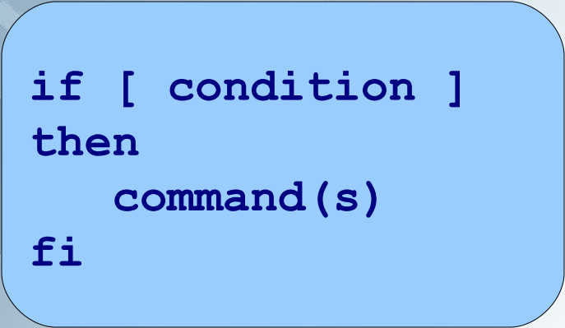
Using Logic
if statement
  executes a command(s) based on a condition
  condition is evaluated by a test command,
    represented below by a pair of square brackets

Slide 123
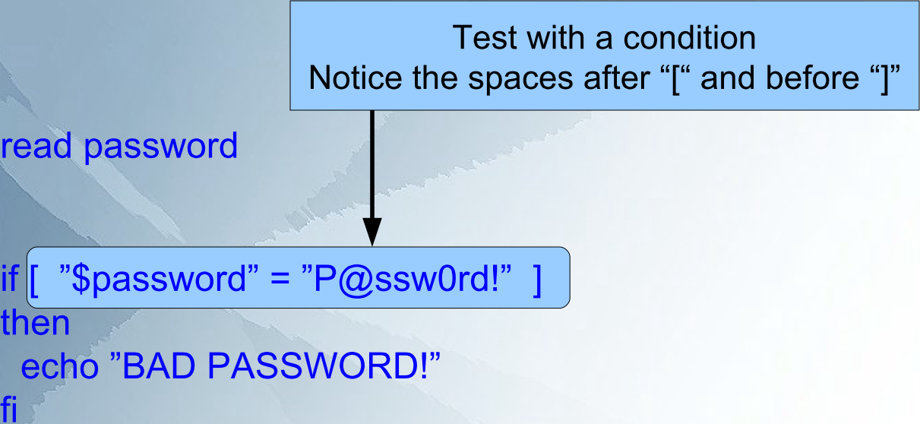
if Statement Example
Spaces required

Slide 124
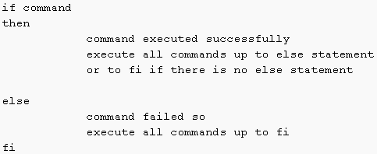
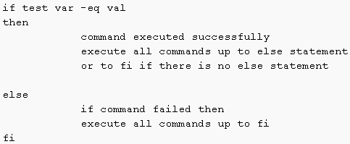
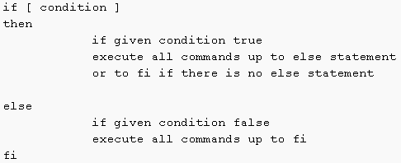
If then else syntax
  3 ways to write it:
  or
  or
Notes:
http://bash.cyberciti.biz/guide/If..else..fi

Slide 125
The test Command
test command can be used in two ways:
  As a pair of square brackets: [ condition ]
  The test keyword: test condition
The condition test can result in:
  true (0)
  or false (1),
unless the negation ”is not” (!), is used
The test can compare:
  Numbers
  strings
  and evaluate various file attributes
Use = and != to compare strings
  example: [ ”$name” = ”Bob” ]
Use –z (the length of string is 0) and -n (length of string is not 0) to check string length
  example: [ ! -z “$name” ]

Slide 126
The Test Command
For numbers use:
  -gt, -lt [greater / less than]
  -eq, -ne [equal / not equal to]
  -le, -ge [less than / greater than or equal to]
  example: [ ”$salary” -gt 100000 ]
Common file test operations include:
  -e (file exists)
  -d (file exists and is a directory)
  -s (file exists and has a size greater than zero)
  -w (file exists and write permission is granted)
Check man test for more details

Slide 127
Sample if then else code
echo -n "enter a password: "
read password
if [ $password != P@ssw0rd! ]
then
echo "bad PW"
else
echo "good choice"
fi
if [ -z $password ]
then
echo "no password entered"
fi
echo -n "enter a number: "
read num
if [ $num = 1 ]
then
echo "you are number 1"
else
echo "you are not number 1"
fi
if test $num -ge 0
then
echo "$num is a pos. or zero num"
else
echo "$num number is neg. num"
fi

Slide 128
#checks if file exists and is directory
file=/tmp
if test -d "$file"
then
echo "$file is a directory and exists"
fi
echo -n "enter a password: "
read password
if [ $password != P@ssw0rd! ]
then
echo "bad PW"
else
echo "good choice"
fi
if [ -z $password ]
then
echo "no password entered"
fi
if [ -n $password ]
then
echo "password entered"
fi

Slide 129

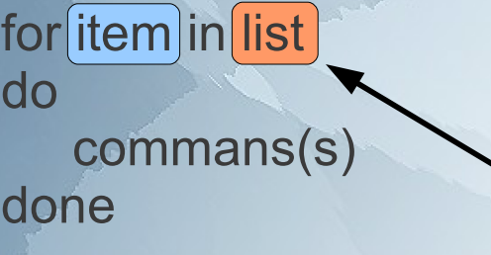

Using Loops
for loop
  way to repeat the same command(s) for several arguments (such as file names)
Syntax:

Slide 130
Syntax: for loop
Numeric ranges
  for VARIABLE in 1 2 3 4 5 .. N
  do
  command1
  commandN
  done
  characterized by counting.
  range specified by a beginning number (1) and ending number (N).
  E.g.,
    for i in 1 2 3
    do
    echo "looping $i st/rd time"
    done
  Can
    Provide range: e.g., for i in {1..100}
    Have a step value: {START..END..INCREMENT}
      E.g. for I in {1..100..5}
Notes:
http://www.cyberciti.biz/faq/bash-for-loop/

Slide 131
three-parameter loop control expression
  Has an initializer (EXP1), a loop-test or condition (EXP2), and a counting expression (EXP3).
    for (( EXP1; EXP2; EXP3 )) ← Double bracket not typo
    do
    command1
    commandN
    done
    e.g.,
      for (( x=1; c<=3; c++ ))
      do
      echo "using 3 parameter loop"
      done
    e.g., infinite loop: for (( ; ; ))

Slide 132
Break statement
  Lets you quit the loop early
  E.g.,
    for i in {1..1000.. 2}
    do
    echo "looping $i st/rd time“
    if (objective reached)
    break
    fi
    statement #executed only if break not hit
    done

Slide 133
Break example
for file in /etc/*
do
if [ "${file}" == "/etc/resolv.conf" ]
then
countNameservers=$(grep -c nameserver /etc/resolv.conf)
echo "Total ${countNameservers} nameservers defined in ${file}"
break
fi
done
goes though all files stored in /etc directory.
loop abandoned when /etc/resolv.conf file found.
Notes:
http://www.cyberciti.biz/faq/bash-for-loop/

Slide 134
Continue statement
  Lets start a new iteration of the loop early
  E.g.,
    for i in {1..1000.. 2}
    do
    echo "looping $i st/rd time“
    if (objective reached)
    continue
    fi
    statement #executed only if break not hit
    done

Slide 135
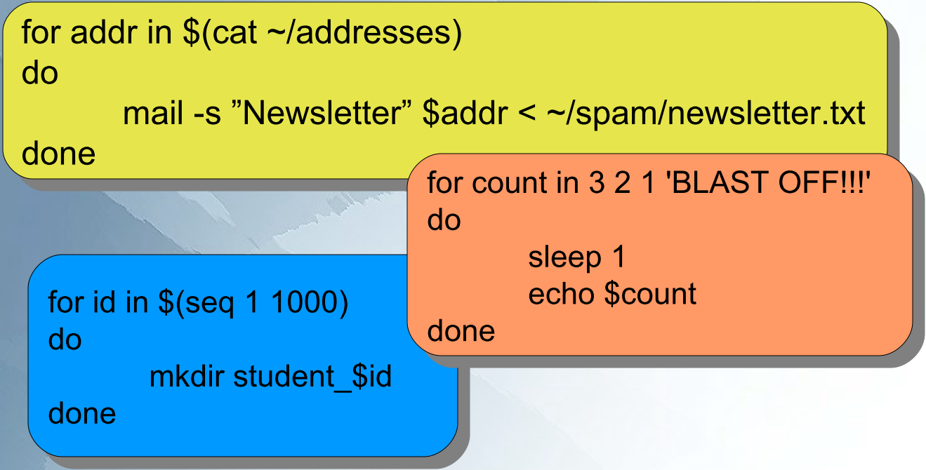
Loop Examples
sleep() makes the calling thread sleep until seconds seconds have elapsed or a signal arrives which is not ignored.
seq command
  print a sequence of numbers
  Avoid using
    no good reason to use an external command such as seq to count and increment numbers
  Only okay in old version of bash
Notes:
http://www.cyberciti.biz/faq/bash-for-loop/
http://www.cyberciti.biz/tips/how-to-generating-print-range-sequence-of-numbers.html

Slide 136
Running a script
2 ways to run script:
    ensure that script has executable permissions
    Or
    Type name of shell BEFORE script name
      E.g., bash MyScript.bash

Slide 138
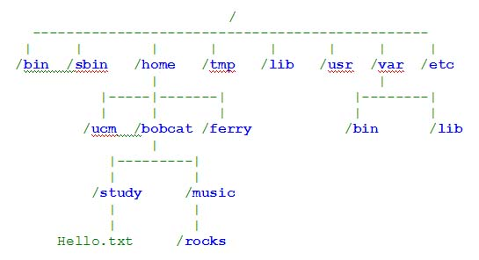
What is a file system Link?
Data structure:
  organisation of the data
    to use efficiently
File system = directory tree
  the hierarchy of files
  File is:
    named
    A grouping of related information
    From user’s perspective: a contiguous block of data
    Stored
    NOT containing metadata [unless you add it]
      Metadata:
        data about data.
        E.g., file name, size, timestamps, physical location (i.e., addresses of the blocks of data on the disk), owner, group, permissions, reference count (how many hardlinks point to the inode)
  Directory [= folder in windows]:
    A special file
    Associates file name with bunch of inodes
Notes:
http://www.linfo.org/inode.html
Space for inodes must be set aside when an operating system (or a new filesystem) is installed and that system does its initial structuring of the filesystem. Within any filesystem, the maximum number of inodes, and hence the maximum number of files, is set when the filesystem is created.
http://www.linfo.org/inode.html
[File system definintion more for windows]:
A variant of this definition is the part of the entire hierarchy of directories or of the directory tree that is located on a single hard disk drive (HDD) or other storage device or on a single partition (i.e., a logically independent section of a HDD).
There are two ways in which a filesystem can run out of space: it can consume all the space for adding new data (i.e., to existing files or to new files), or it can use up all the inodes. The latter can bring computer use to a sudden stop just as easily as can the former, because exhaustion of the inodes will prohibit the creation of additional files even if sufficient HDD space exists. It is particularly easy to run out of inodes if a filesystem contains a very large number of very small files. A typical system, however, runs out of file space first, because the average file size on most system is larger than two kilobytes.
The decision as to how many inodes to create is made on Linux using an algorithm that considers the size of the partition and the average file size. The default setting creates an inode for every 2K bytes contained in the filesystem, but the number can be adjusted by the user when creating the filesystem. For example, it can be wise to create fewer inodes when setting up a filesystem that will contain just a few large files.

Slide 139
What is a file system Link?
When created, a file given a(n):
  name
  inode number
    A unique integer in filesystem.
    doesn’t mean anything.
      Closest sensible meanings:
        Index node
        Information node
  Both are stored as entries in directory that contains files
    i.e., directory associates file names with inodes.
Notes:
http://www.linfo.org/inode.html
[File system definintion more for windows]:
A variant of this definition is the part of the entire hierarchy of directories or of the directory tree that is located on a single hard disk drive (HDD) or other storage device or on a single partition (i.e., a logically independent section of a HDD).

Slide 140
What is a file system Link?
When a filename is used the OS looks up the inode
  Lets system get information needed about file to do other operations.
  i.e., in UNIX/Linux a file name ISN’T directly associated with a file
    just an entry in a table with inode numbers
    MS Windows is DIFFERENT
  inode tables store inode numbers and their inodes
    Located in strategic locations in filesystem
      including near its beginning
  Stat [option] file
    A system call that gets the inode number and information
      OS uses this to get the inode number and information
    System call:
      request by an active process for a kernal’s service.
        Active Process: a process currently running on the CPU
        Process: A program that is running
        - [not necessarily on the CPU, could be sleeping]
      i.e., a well defined direct connection to the kernal
        that gets you what you want.
Notes:
http://www.linfo.org/inode.html
http://www.linfo.org/inode.html
[File system definintion more for windows]:
A variant of this definition is the part of the entire hierarchy of directories or of the directory tree that is located on a single hard disk drive (HDD) or other storage device or on a single partition (i.e., a logically independent section of a HDD).

Slide 141

What is a file system Link?
This detaches the name from the metadata:
  Lets us have hardlinks
    Multiple filenames for a file
    hard link
      an entry in a directory containing a pointer directly to the inode
        Inode has the file's metadata.
      So, all links share the same inode number
        because link is only a pointer
        - NOT a copy of the file
A link is a pointer to a file.
  pointer associates file name with an i-node number
    i-node
      The control structure for a file
        Data structure storing ALL the info about a file
        -Except:
        - File Name
        - and Data
      on a UNIX/Linux file system
    two file names with same i-node number are links to the same file
Notes:
http://www.linfo.org/inode.html
The concept of inodes is particularly important to the recovery of damaged filesystems. When parts of the inode are lost, they appear in the lost+found directory within the partition in which they once existed.
[File system definintion more for windows]:
A variant of this definition is the part of the entire hierarchy of directories or of the directory tree that is located on a single hard disk drive (HDD) or other storage device or on a single partition (i.e., a logically independent section of a HDD).

Slide 142
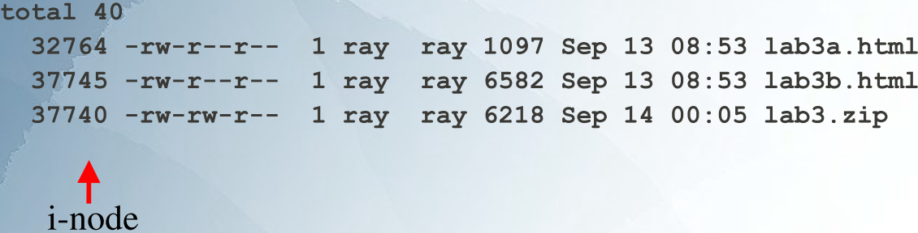
What is a file system Link?
ls -i
  Prints i-node number of each file
ls -il
  Prints i-node number and long list of each file
(Each is different)

Slide 143
2 kinds of links
  Hard links
    reference to the physical data on a file system
  Soft / symbolic links

Slide 144
Hard Links
Reference to the physical data on a file system
More than one hard link can be associated with the same physical data
Hard links can only refer to data that exists on the SAME file system
  E.g., can’t link to other device or partition
  [b/c the inode is made for a / valid on a particular filesystem]
Only the root user can create hard links to a directory
Can access file through any of its links
  If you remove a link you can still access file through the remaining links.
Notes:
http://www.linfo.org/inode.html
Space for inodes must be set aside when an operating system (or a new filesystem) is installed and that system does its initial structuring of the filesystem. Within any filesystem, the maximum number of inodes, and hence the maximum number of files, is set when the filesystem is created.
http://www.linfo.org/inode.html
[File system definintion more for windows]:
A variant of this definition is the part of the entire hierarchy of directories or of the directory tree that is located on a single hard disk drive (HDD) or other storage device or on a single partition (i.e., a logically independent section of a HDD).
There are two ways in which a filesystem can run out of space: it can consume all the space for adding new data (i.e., to existing files or to new files), or it can use up all the inodes. The latter can bring computer use to a sudden stop just as easily as can the former, because exhaustion of the inodes will prohibit the creation of additional files even if sufficient HDD space exists. It is particularly easy to run out of inodes if a filesystem contains a very large number of very small files. A typical system, however, runs out of file space first, because the average file size on most system is larger than two kilobytes.
The decision as to how many inodes to create is made on Linux using an algorithm that considers the size of the partition and the average file size. The default setting creates an inode for every 2K bytes contained in the filesystem, but the number can be adjusted by the user when creating the filesystem. For example, it can be wise to create fewer inodes when setting up a filesystem that will contain just a few large files.

Slide 145
Hard Links Examples
(vi myfile)
  When “vi” creates a new file, it creates the first hard link
  To Create the 2nd, 3rd, etc. hard links use command:
    ln myfile link-name
      If you open hardlink in vi and make changes the original file will be changed accordingly.
      You can open the original file directly or by opening the new hardlink.
      b/c hard link is
        an entry in a directory containing a pointer directly to the inode
        - Inode has the file's metadata.
        So, all links share the same inode number
        - because link is only a pointer
        - NOT a copy of the file

Slide 146

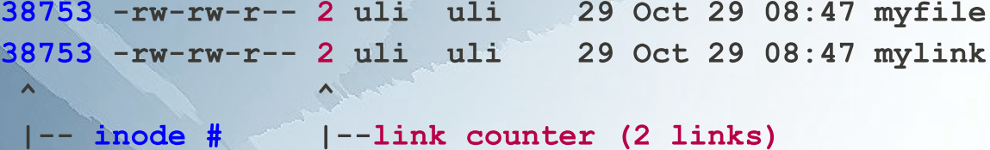
Display Hard Links info
Exercise:
Create hardlinks and Demonstate that the number of hardlinks has increased.
Create a new file called “myfile”
  E.g. vi myfile → i → type something → :w → :q
Use “ls -il” to display the i-node number and link counter
Create a 2nd link to the same data:
  ln myfile mylink
Run the command “ls -il”:
The value for the original file and the hardlink increased.
Inode’s are the same

Slide 147
Symbolic / Soft / Sym Links
Symbolic Link (Symlink):
  An indirect pointer to a file
    a pointer to the hard link to the file
  Can
    create a symbolic link to a directory
    point to a file on a different file system
      Hardlink CAN’T
    point to a “broken link”
      nonexistent file

Slide 148
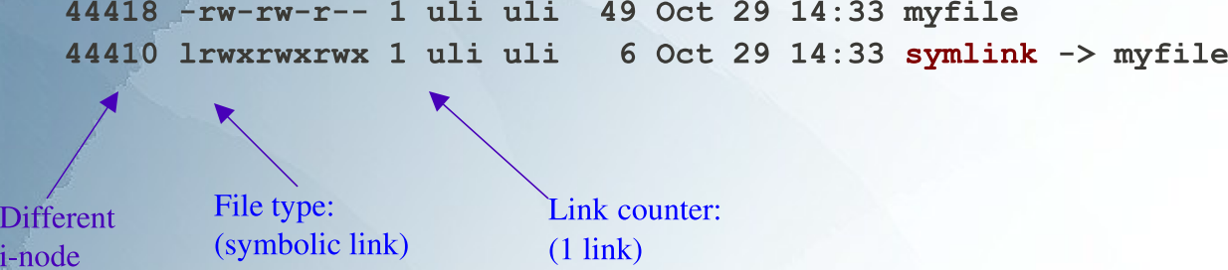
Symbolic Links
Exercise:
Make a symbolic link to the hardlink you created above. (Hint: use the ln command)
Compare the results to the hardlink exercise.
Answer:
To create a symbolic link to the file “myfile” use:
  ln -s myfile symlink
  or
  ln --symbolic myfile symlink
  Notice same as for hard link except with a –s switch.
ls -li myfile
44418 -rw-rw-r-- 1 uli uli 49 Oct 29 14:33 myfile
ln -s myfile symlink
ls -li myfile symlink
Different status information (e.g. file size, last modification time ...)
  Between symlink and original file.
The Number of links didn’t change
  Increased in hardlink example.

Slide 149
Properties of Symbolic Links
i-node number is different from the pointed to file
The link counter of the new symbolic link file is “1”
Symbolic link file does not affect the link counter of the pointed to file
The type field of symblic file contains the letter “l”
The symbolic link file and the pointed to file have different status information (e.g. file size, last modification time etc.)

Slide 150
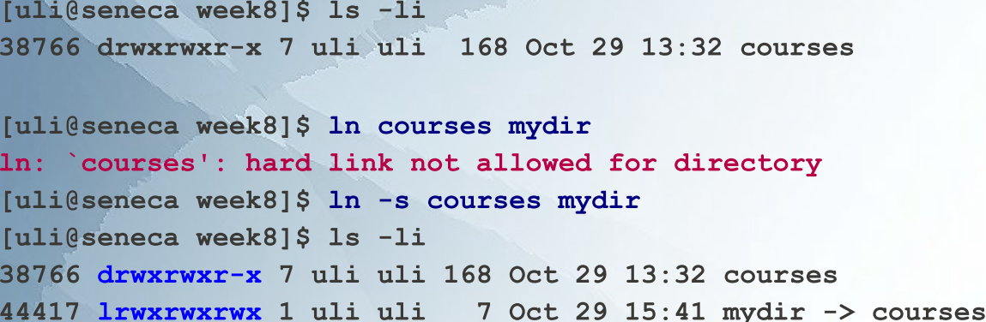
Create Symbolic Link Directory
Exercise:
Make a hard link and soft link to a directory.
Answer:
syntax is the same as linking to a file
  ln -s target_directory link_directory
  ln --symbolic target_directory link_directory

Slide 151
Note: in the man pages (man ln) it says:
-d, -F, --directory
  allow the superuser to attempt to hard link directories (note: will probably fail due to system restrictions, even for the superuser)"
  Why?
    GNU tools might run in a different number of operating systems with a variety of kernels.
      ln may not be part of Linux
    The main problem with hardlinking directories is that when you make a hard link, there's no difference between the names of a given file or directory. And the file remains accessible until you delete the last one (unlike with symbolic links). This can confuse the programs that walk recursively the directory tree, who knows where our rm -rf could end. Unlike with symlinks, you don't have to deference anything, virtually, the directory is just there like if you created it with mkdir, and whatever hangs inside it will be recursed as well.
    Symbolic links on the contrary are easily identifiable and avoidable to deference when needed.
    You see that on the man page because simply no one has ever forbidden that, and posix don't say anything against that either. But I know of no OS/fs that actually implemented the feature (that doesn't mean it doesn't exist, maybe it does).
    inode of a hard link is always the same as the inode of the file it points to - it is is in fact simpy another directory entry for the same inode. A directory has a strict position within the filesystem hierarchy and so cannot be linked to with a hard link - effectively the directory would appear in 2 places. The OS itself can create hard links to directories but a user cannot.
    A soft link is simply a pointer to another inode and so can point to a drectory and span filesystems since it's inode is not the same as that of it's target.
    all files in Linux/Unix are called inodes. This is the physical data-structure that contains the file. Directory entries point to these inodes. (Directories are, themselves, contained in inodes.)
    A hard link creates a case where two or more directory entries contain the same inode number. No additional search is required. The inode is not released until its hard-link count (normally '1') reaches zero.
    A symbolic link is, in effect, a special type of file which contains a file-name or directory-name. Upon encountering a symbolic link, a search is made for the target of the symbolic link, using an ordinary search.
Notes:
http://www.linuxforums.org/forum/newbie/149236-creating-hard-link-directory-2.html
http://www.tek-tips.com/viewthread.cfm?qid=533673

Slide 152
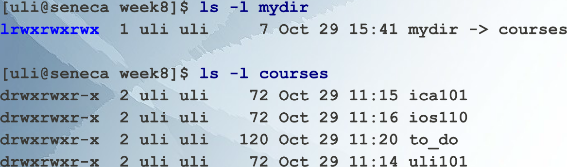
Directory Listing
Exercise:
Do a long listing of the symbolic link to a directory
Do a long listing of the directory itself
Answer:
symlink
Actual directory
[suggests the symLink is just a link to the directory. It is not the directory itself. You can’t peak inside.]

Slide 153
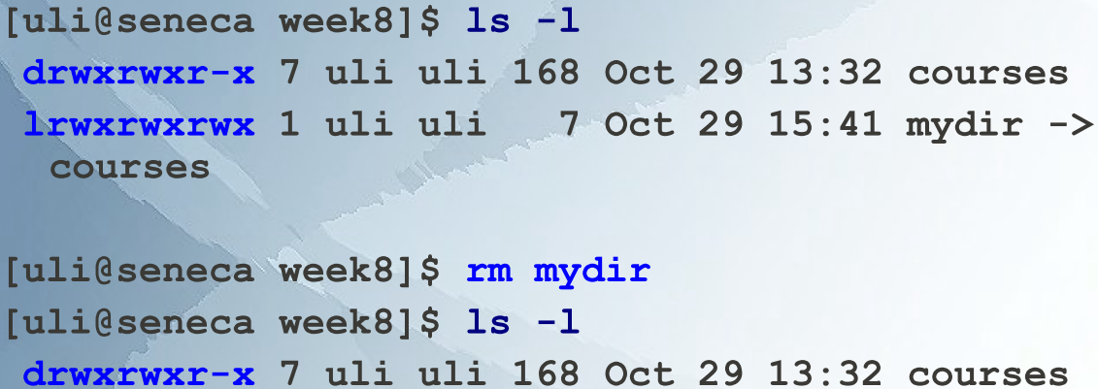
Delete link to a directory
Exercise:
Delete the symlink to the directory
Answer:
“rm” command:
  Removes files or directories
    deletes link to directory.

Slide 154
Properties of Symbolic Link Directory
a file type of “l”
  (the first letter of the permission field).
permissions on the link are set to “rwx” for all.
chmod on the link
  applies to the actual directory (or file)
    permissions on the link stay same
Can point to a non-existent directory
  [Think of a symbolic link as a special type of file that contains a file-name or directory-name. When using the link you have to search for the file it points to using an ordinary search.]
    [If the file it points to is deleted then the link will break but symlink will still exist.]
Notes:
http://www.linuxquestions.org/questions/linux-kernel-70/why-we-cant-create-hard-links-for-directories-in-linux-451989/

