Slide 1
INT322
Internet II: Web Programming on UNIX
M2: PHP Programming Fundamentals

Slide 2
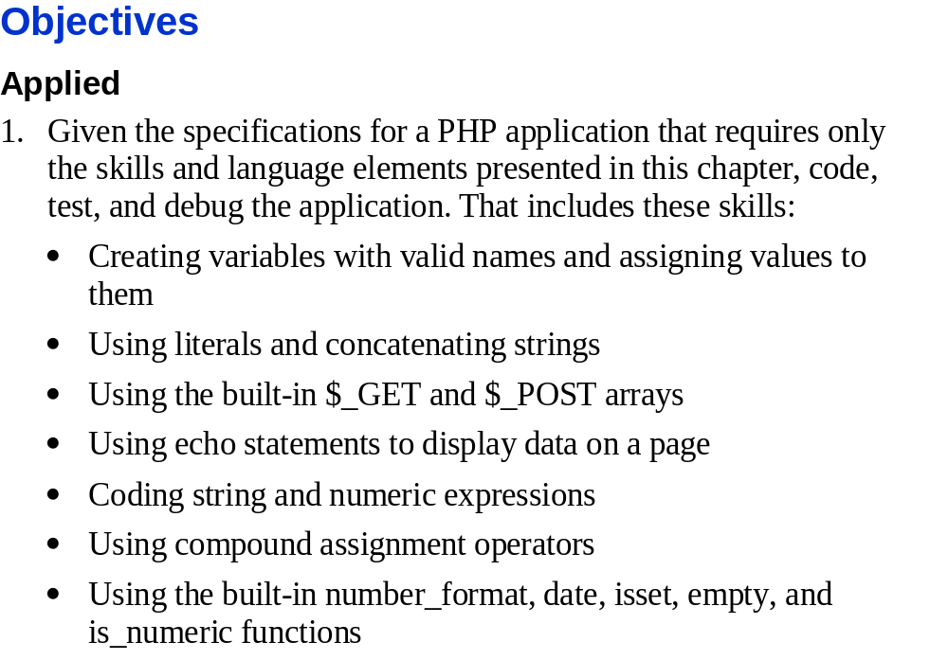
Slide <number>

Slide 3
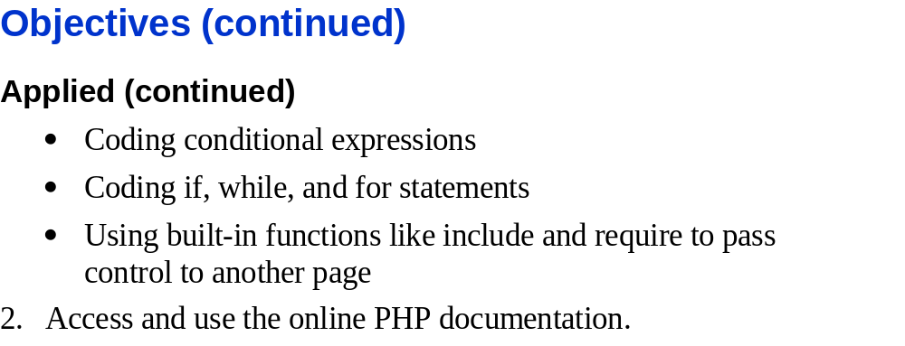
Slide <number>

Slide 4
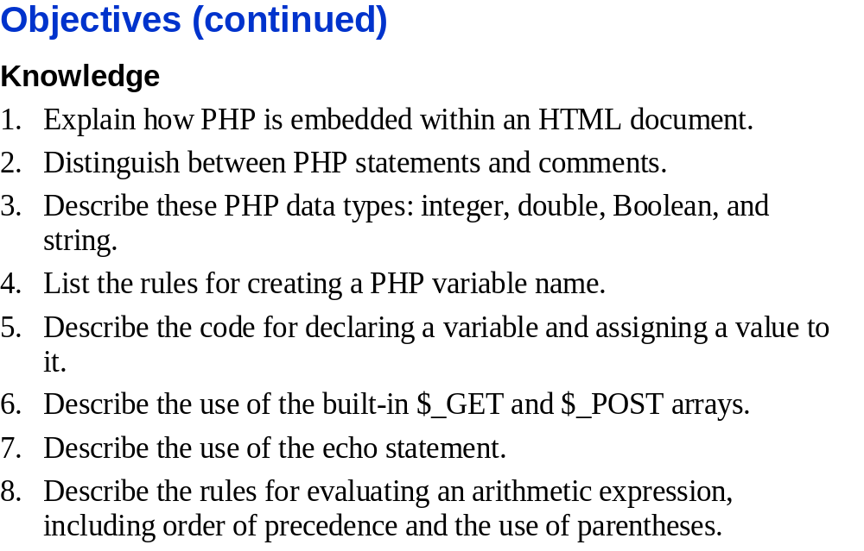
Slide <number>

Slide 5
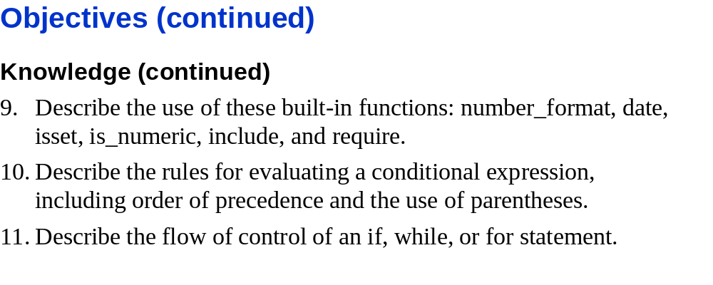
Slide <number>

Slide 6
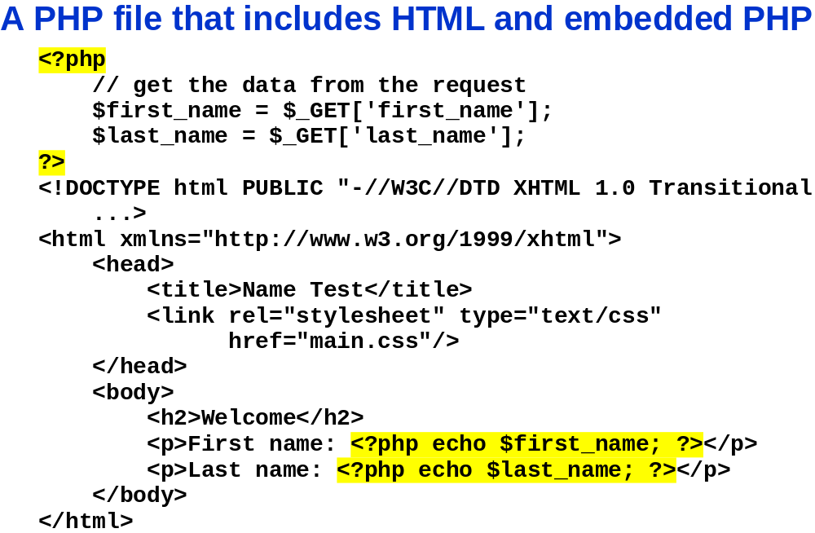
Slide <number>

Slide 7
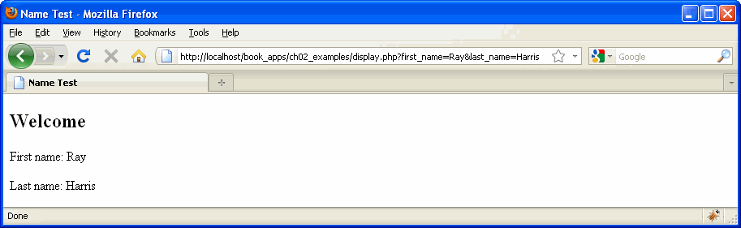
Slide <number>

Slide 8
Embedded language refers to code that is embedded within a Web page (XHTML document)
  PHP code is typed directly into a Web page as
  a separate section
must be saved with an extension of .php
PHP code never sent to browser
  only the output is.
Slide <number>

Slide 9
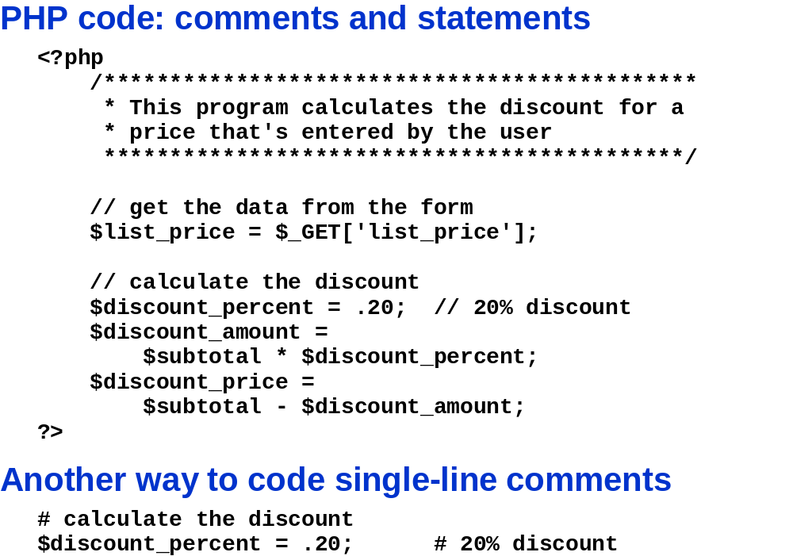
Slide <number>

Slide 10
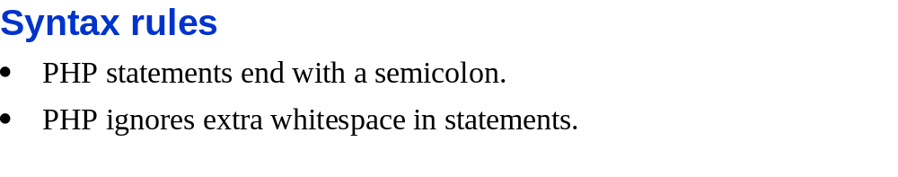
Using Variables and Constants
Variables
  values stored in computer memory
  Identifier
    name you assign to a variable
    must begin with a dollar sign ($)
    may not have a number or underscore as 1st character
    cannot include spaces
    is case sensitive
Slide <number>

Slide 11
Declaring and Initializing Variables
Specifying and creating a variable name is called declaring the variable
Assigning a first value to a variable is called initializing the variable
MUST declare and initialize a variable in the SAME statement:
  $variable_name = value;

Slide 12
Defining Constants
A constant contains information that does not change during the course of program execution
Constant names DON'T begin with a dollar sign ($)
Constant names use all uppercase letters
Use the define() function to create a constant
  define("CONSTANT_NAME", value);
The value you pass to the define() function can be a text string, number, or Boolean value

Slide 13
Working with Data Types
Data types
  Classification of values, or data in variables
  primitive types
    Data types that can be assigned only a single value
    E.g. float, numbers, bool, string, NULL
    -In PHP bool can only be TRUE or FALSE
    -NOT 1 or 0
  resource data type – a special variable that holds a reference to an external resource such as a database or XML file
  Reference or composite data types, which contain multiple values or complex types of information
    Two reference data types: arrays and objects

Slide 14
Working with Data Types (continued)
Strongly typed programming languages require you to declare the data types of variables
  Static or strong typing refers to data types that do not change after they have been declared
Loosely typed programming languages do not require you to declare the data types of variables
  Dynamic or loose typing refers to data types that can change after they have been declared

Slide 15
Creating PHP Code Blocks
Code declaration blocks
  separate sections on a Web page
    interpreted by the scripting engine
  4 types of code declaration blocks:
    Standard PHP script delimiters
    The <script> element
    Short PHP script delimiters
    ASP-style script delimiters
Slide <number>

Slide 16
Standard PHP Script Delimiters
delimiter
  character or sequence of characters that mark the beginning and end of code segment
<?php and ?>
  standard PHP script delimiters
  E.g., <?php
    echo “Welcome to”;
    echo “PHP”;
    ?>
Statements
  individual lines of code
Slide <number>

Slide 17
The <script> Element
<script> element
  identifies a script section in Web page
  Assign value of "php" to the language attribute
    identify the code block as PHP
    E.g. <script language = “php”>
      echo “I Love PHP”;
      </script>
  Depreciated in XHTML
Slide <number>

Slide 18
Short PHP Script Delimiters
<? statements; ?>
  Syntax of short PHP script delimiters
  Avoid using
    can be disabled in a Web server’s php.ini configuration file
    will not work if ISP does not support them
    can be used in XHTML, but not in XML documents
Slide <number>

Slide 19
ASP-Style Script Delimiters
<% statements; %>
  syntax for the ASP-style script delimiters
  Avoid
    can be used in XHTML, but not in XML documents
    may be disabled in the php.ini configuration file
      To enable or disable assign “On” or “Off ” to the asp_tags directive in the php.ini configuration file
Slide <number>

Slide 20
Displaying Script Results
echo and print statements
  language constructs
    built-in features of a programming language
  create new text on Web page
  Return a response to client
    Use the echo and print statements to return the results of a PHP script within a Web page that is returned to a client
    print statement
      returns a value of 1 if successful or a value of 0 if not successful
    echo statement
      does NOT return a value
Slide <number>

Slide 21
Displaying Script Results
literal string
  text passed to echo statement
    must be enclosed in quotation marks:
      single (More efficient b/c no variable substitution)
      double (For variable substitution--just like UNIX/Linux)
To pass multiple arguments to echo
  echo 'This ','string ','was ','made ','with multiple parameters';
Slide <number>

Slide 22
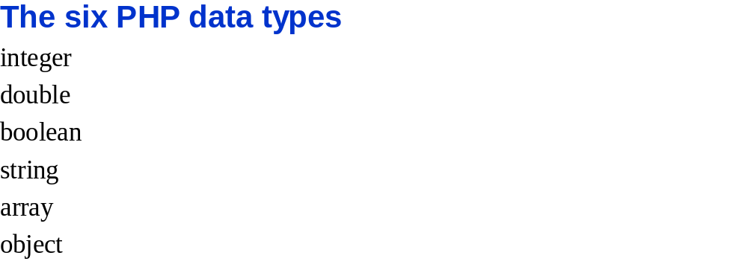
Slide <number>

Slide 23
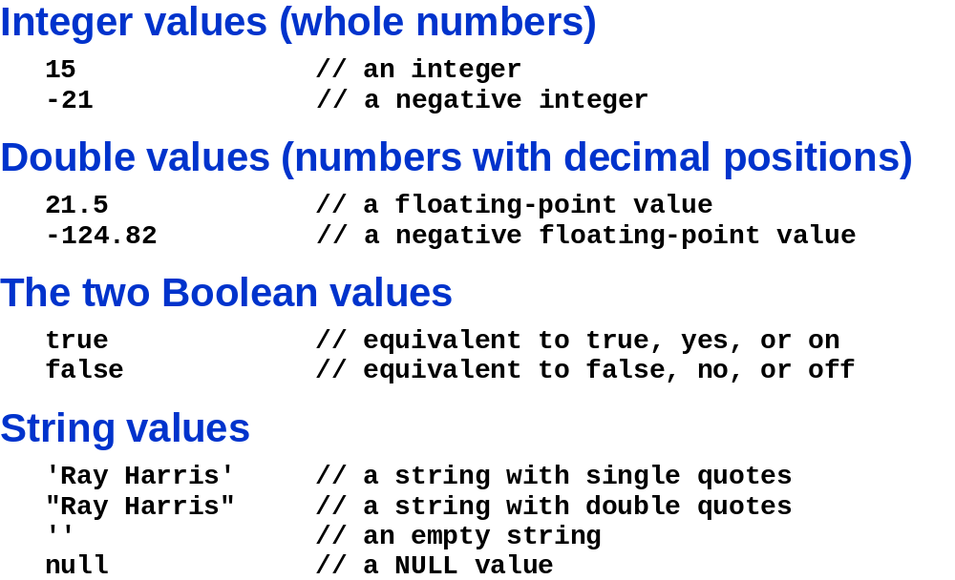
Slide <number>

Slide 24
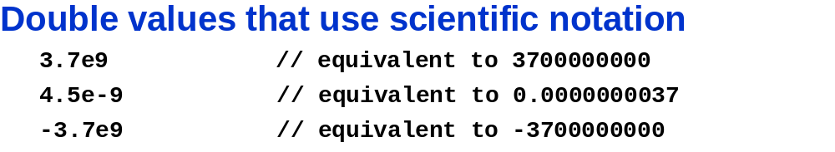
Slide <number>

Slide 25
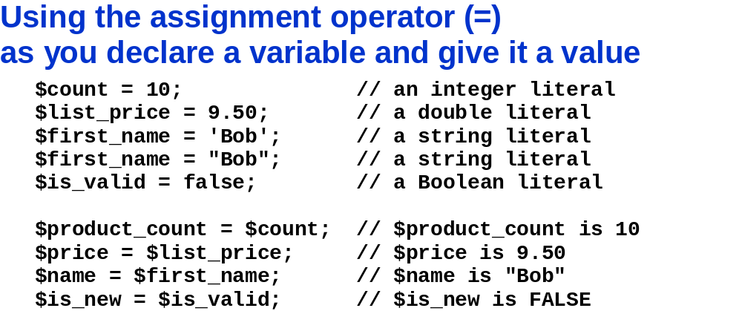
What are the values?
Slide <number>

Slide 26
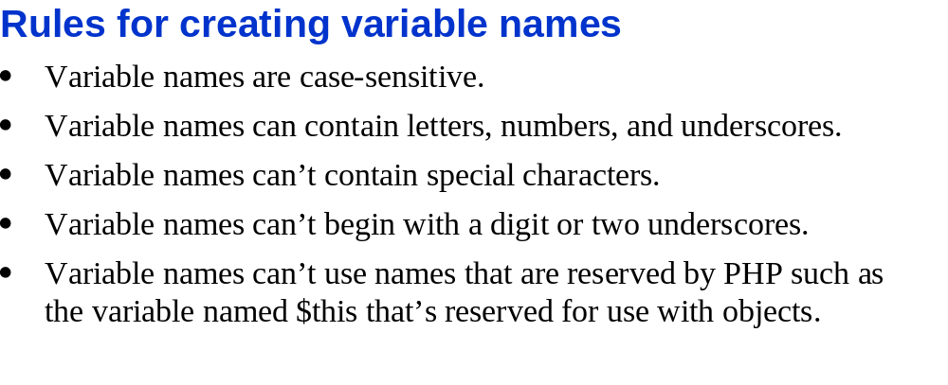
Slide <number>

Slide 27
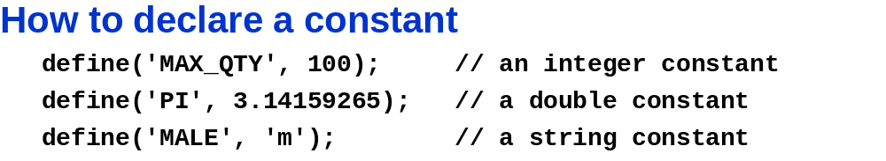
Slide <number>

Slide 28
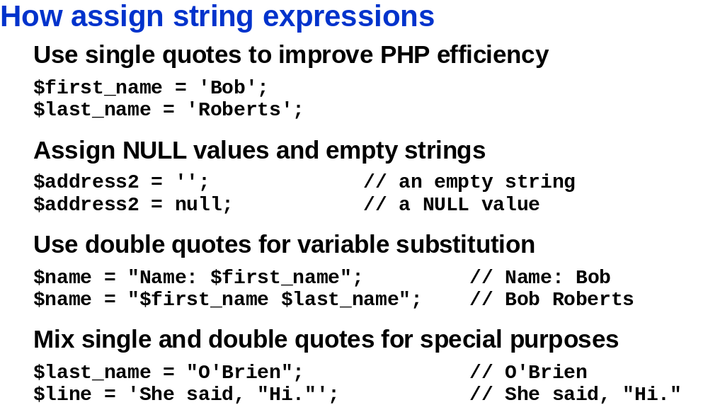
What are the values?
What are the values?
Interpolation
  “ ” are used to insert variable values
  Interpreter MUST check entire string to see if any variables that need to be inserted
    Slower than ‘ ‘
Slide <number>

Slide 29
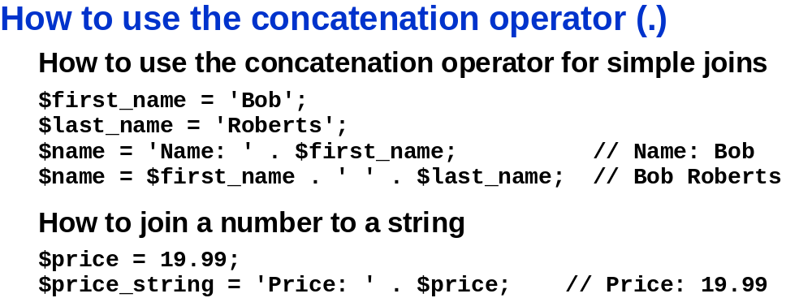
Slide <number>

Slide 30
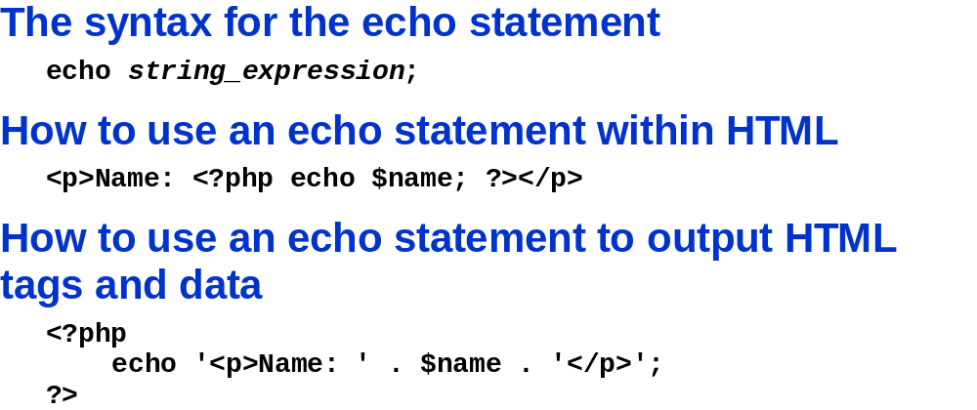
‘ ‘ around HTML tags NECESSARY
    else error: Parse error: syntax error, unexpected '<'
Slide <number>

Slide 31
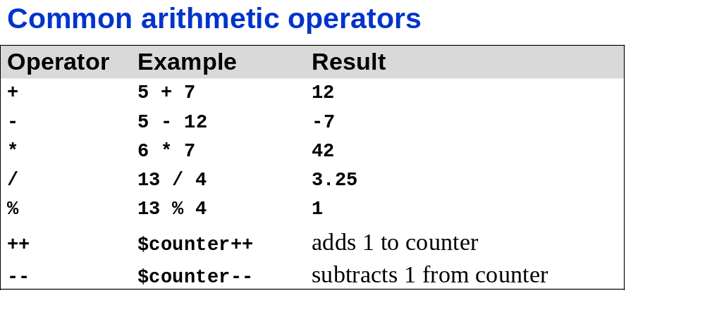
Slide <number>

Slide 32
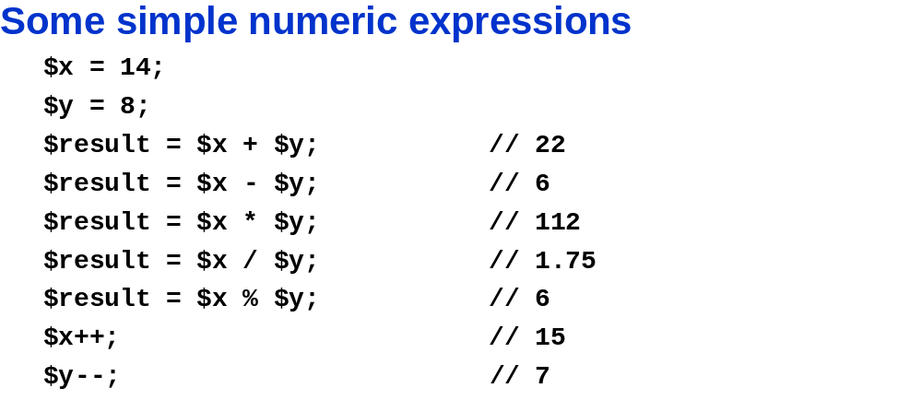
Slide <number>

Slide 33
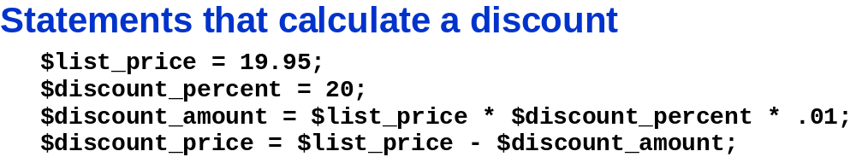
Slide <number>

Slide 34
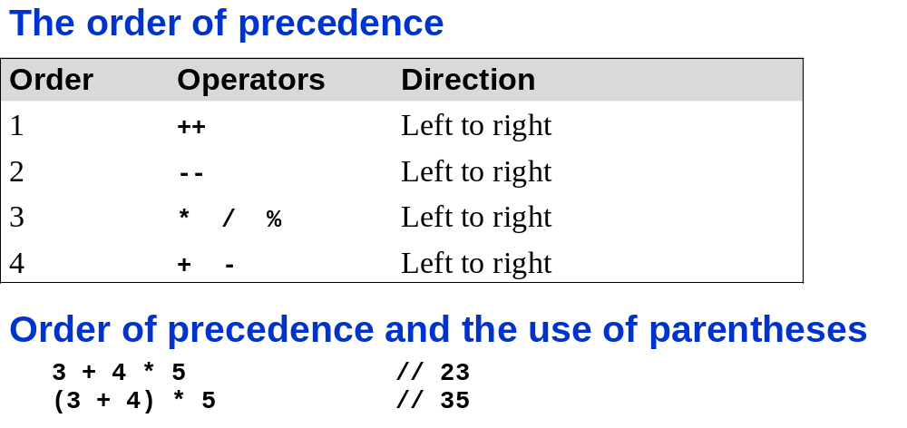
Slide <number>

Slide 35
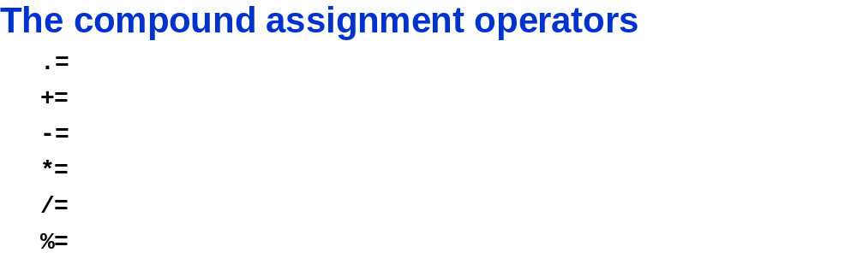
Use when SAME variable on BOTH SIDES of the assignment operator
E.g.:
$me = I;
$me = $me . ‘ think therefore I am’;
Same as
$me = I;
$me .= ‘ think therefore I am’;
Slide <number>

Slide 36
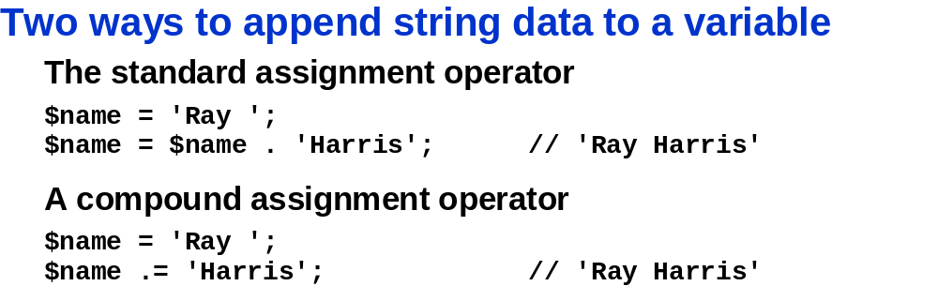
Slide <number>

Slide 37
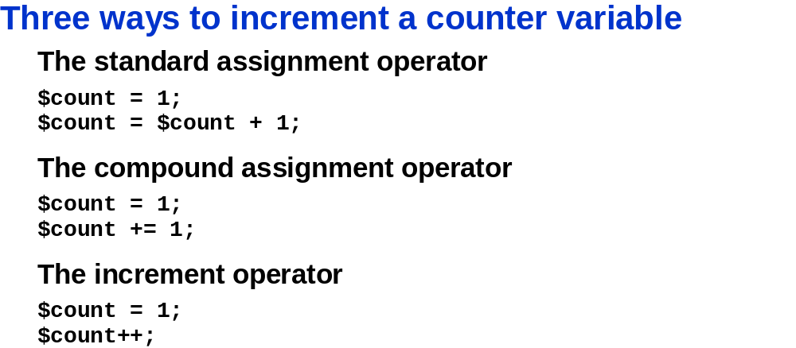
Slide <number>

Slide 38
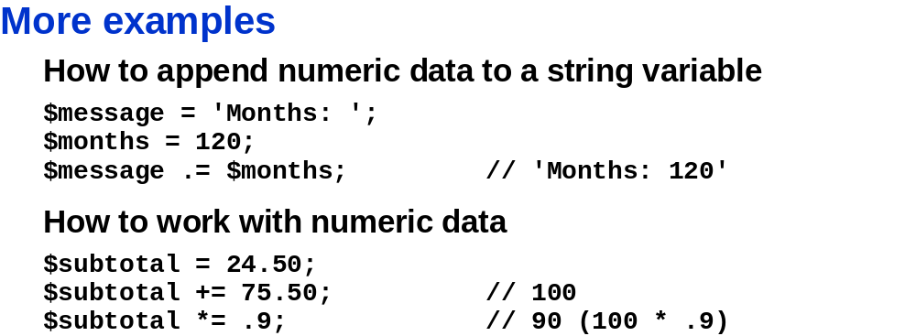
What is the value?
What is the value?
Slide <number>

Slide 39
Functions
Function
  a subroutine (or individual statements grouped into a logical unit) that performs a specific task
    Gives a single answer
executing / using function
  Must invoke / call
    function name followed by arguments
      arguments or actual parameters
        The data (in parentheses following the function name)
  passing arguments
    Sending data to function
Slide <number>

Slide 40
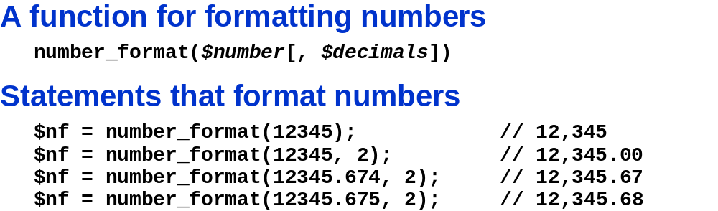
Slide <number>

Slide 41
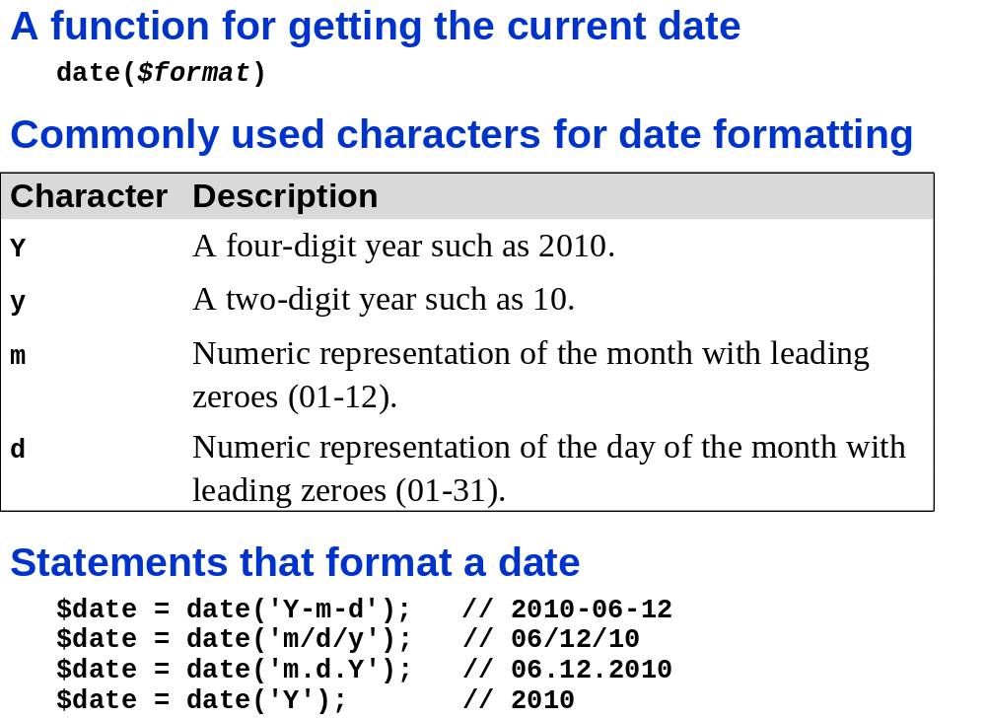
Slide <number>

Slide 42
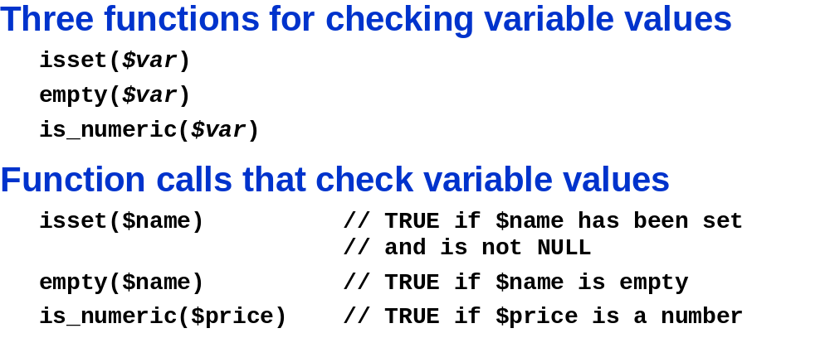
isset($var …)
  multiple parameters can be supplied
    returns TRUE only if ALL are set.
  Evaluation:
    left to right
    stops as soon as an unset variable found.
unset(&var)
  To unset a variable
Slide <number>

Slide 43
bool empty(mixed $var)
Tell you if the varable has a non-empty value
no warning generated when variable not set
ONLY checks variables
  E.g. not functions:
Return Values: TRUE or FALSE
  FALSE if $var is:
    non-empty
    and non-zero
  empty:
    "" (an empty string)
    0 (0 as an integer)
    0.0 (0 as a float)
    "0" (0 as a string)
    NULL
    FALSE
    array() (an empty array)
    var $var; (a variable declared, but without a value in a class)

Slide 44
bool is_numeric(mixed $var)
Tells if $var is numeric.
Return Values:
  TRUE
    if $var is:
      number
      or numeric string
  else FALSE
Numeric string has:
  - optional sign
- digits (any amount)
- decimal (optional)
- exponential (optional)
- Hexadecimal notation allowed
  -only without sign, decimal & exponent.

Slide 45
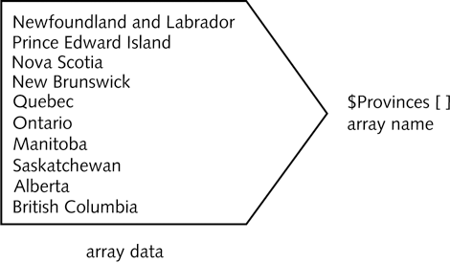
Arrays
Array
  set of data
    represented by a single variable name

Slide 46
Declaring and Initializing Indexed Arrays
element
  refers to each piece of data stored in array
index
  an element’s numeric position in array
  Default: indexes begin with zero (0)
  element referenced by enclosing its index in brackets at the end of the array name:
  $Provinces[1]

Slide 47
Declaring and Initializing Indexed Arrays (continued)
2 ways to declare and index arrays
array() construct syntax:
  $array_name = array(values);
  $Provinces = array(
  "Newfoundland and Labrador",
  "Prince Edward Island",
  "Nova Scotia",
  "New Brunswick",
  "Quebec",
  "Ontario",
  "Manitoba",
  "Saskatchewan",
  "Alberta",
  "British Columbia"
  );

Slide 48
Declaring and Initializing Indexed Arrays (continued)
Array name and brackets syntax:
$array_name[ ]
$Provinces[] = "Newfoundland and Labrador";
$Provinces[] = "Prince Edward Island";
$Provinces[] = "Nova Scotia";
$Provinces[] = "New Brunswick";
$Provinces[] = "Quebec";
$Provinces[] = "Ontario";
$Provinces[] = "Manitoba";
$Provinces[] = "Saskatchewan";
$Provinces[] = "Alberta";
$Provinces[] = "British Columbia";

Slide 49
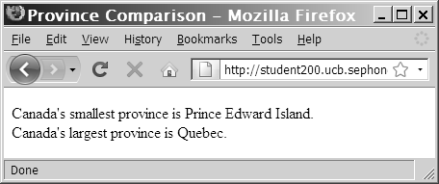
Accessing Element Information (continued)
  echo "<p>Canada's smallest province is $Provinces[1].<br />";
  echo "Canada's largest province is $Provinces[4].</p>";

Slide 50
Accessing Element Information
(continued)
count()
  finds total number of elements in array
$Provinces = array("Newfoundland and Labrador", "Prince Edward
Island", "Nova Scotia", "New Brunswick", "Quebec", "Ontario", " Manitoba", "Saskatchewan", "Alberta", "British Columbia");
$Territories = array("Nunavut", "Northwest Territories", "Yukon
Territory");
echo "<p>Canada has ", count($Provinces), " provinces and ", count($Territories), “ territories.</p>";

Slide 51
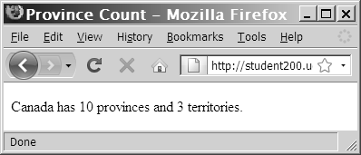
Accessing Element Information (continued)

Slide 52
Accessing Element Information (continued)
print_r(), var_dump()
  Use to display or return information about variables
  print_r()
    displays the index and value of each element in an array
  var_dump()
    displays the index, value, data type and number of characters in the value

Slide 53
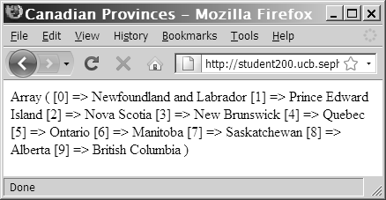
Accessing Element Information (continued)
print_r(): Output of the $Provinces[ ] array

Slide 54
Modifying Elements
include index for an individual element of the array:
$HospitalDepts = array(
"Anesthesia", // first element(0)
"Molecular Biology", // second element (1)
"Neurology"); // third element (2)
To change the first array element in the $HospitalDepts[] array from “Anesthesia” to “Anesthesiology” use:
  $HospitalDepts[0] = "Anesthesiology";

Slide 55
Building Expressions
literal
  a static value
    E.g., a literal string or a number
expression
  literal value or variable
    that can be evaluated by PHP scripting engine to produce a result
Operands
  variables and literals contained in expression
Operators
  symbols (+) (*)
    used in expressions to manipulate operands

Slide 56
Building Expressions (continued)
A binary operator requires an operand before and after the operator
  $MyNumber = 100;
A unary operator requires a single operand either before or after the operator

Slide 57
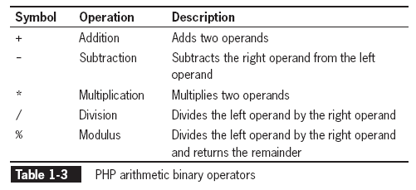
Arithmetic Operators
Arithmetic operators are used in PHP to perform mathematical calculations (+ - x ÷)

Slide 58
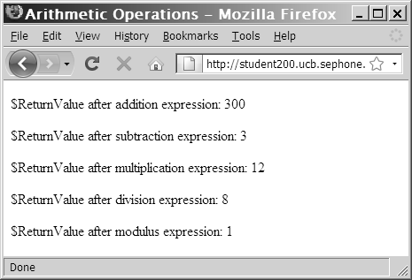
Arithmetic Operators (continued)

Slide 59
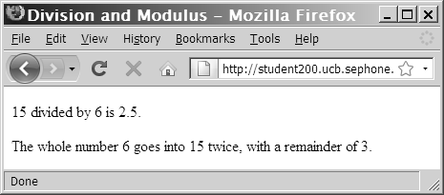
Arithmetic Operators (continued)
  $DivisionResult = 15 / 6;
  $ModulusResult = 15 % 6;
  echo "<p>15 divided by 6 is
  $DivisionResult.</p>"; // prints '2.5'
  echo "The whole number 6 goes into 15 twice, with a
  remainder of $ModulusResult.</p>"; // prints '3'

Slide 60
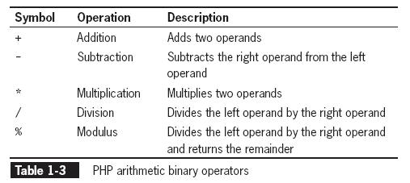
Arithmetic Binary Operators

Slide 61
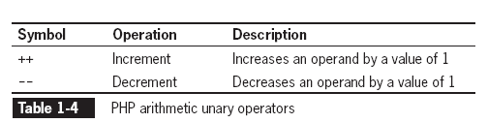
Arithmetic Unary Operators
The increment (++) and decrement (--) unary operators can be used as prefix or postfix operators
A prefix operator is placed before a variable
A postfix operator is placed after a variable

Slide 62
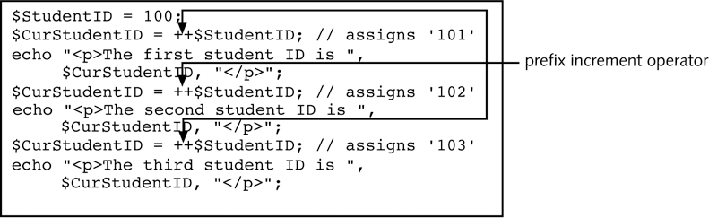
Arithmetic Unary Operators (continued)
Script that uses the prefix
increment operator

Slide 63
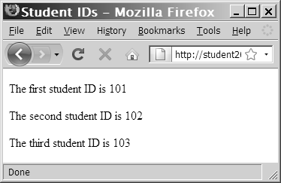
Arithmetic Unary Operators (continued)
Output of the prefix version of the student ID script

Slide 64
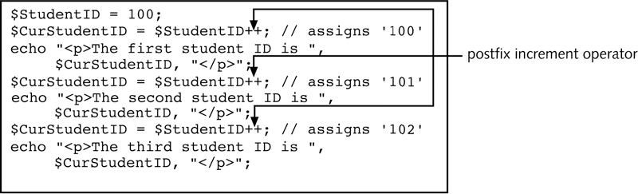
Arithmetic Unary Operators (continued)
Script that uses the postfix increment operator

Slide 65
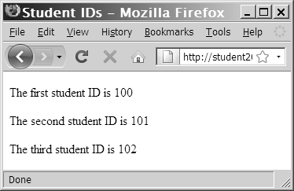
Arithmetic Unary Operators (continued)
Output of the postfix version of the student ID script

Slide 66
Assignment Operators
Assignment operators are used for assigning value to a variable:
$MyFavoriteSuperHero = "Superman";
$MyFavoriteSuperHero = "Batman";
Compound assignment operators perform mathematical calculations on variables and literal values in an expression, and then assign new value to the left operand

Slide 67
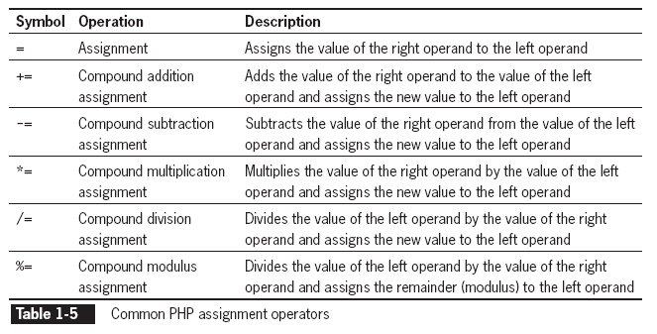
Assignment Operators (continued)

Slide 68
Comparison and Conditional Operators
Comparison operators are used to compare two operands and determine how one operand compares to another
A Boolean value of TRUE or FALSE is returned after two operands are compared
The comparison operator compares values, whereas the assignment operator assigns values
Comparison operators are used with conditional statements and looping statements

Slide 69
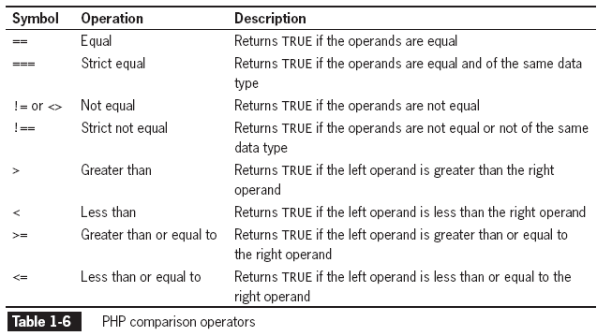
Comparison and Conditional Operators (continued)

Slide 70
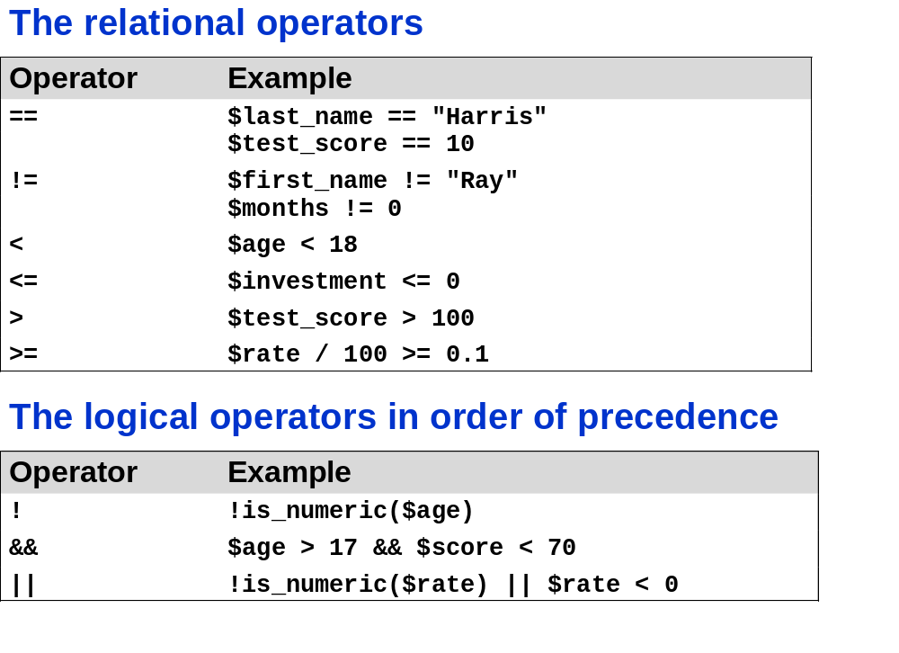
Slide <number>

Slide 71
Comparison and Conditional Operators (continued)
conditional operator
  executes one of two expressions
    based on results of conditional expression
  syntax:
  conditional expression ? expression1 :
  expression2;
  If the conditional expression evaluates to TRUE, expression1 executes
  If the conditional expression evaluates to FALSE, expression2 executes

Slide 72
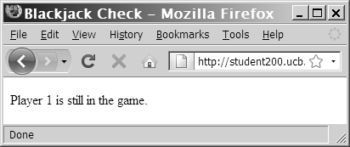
Comparison and Conditional Operators (continued)
  $BlackjackPlayer1 = 20;
  ($BlackjackPlayer1 <= 21) ? $Result =
  "Player 1 is still in the game. "
  : $Result = "Player 1 is out of the action.";
  echo "<p>", $Result, "</p>";
Question: Is Player one in the Game?

Slide 73
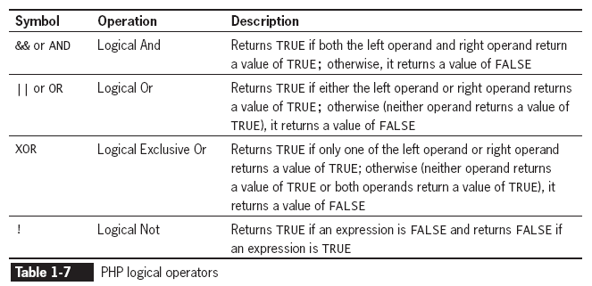
Logical Operators
Logical operators
  compare two Boolean operands for equality
  Returns Boolean (TRUE or FALSE) after two operands are compared

Slide 74
Type Casting
Casting or type casting
copies value in a variable → converts it to new data type → assigns value to new variable
  Does NOT change data type of original variable
syntax:
$NewVariable = (new_type) $OldVariable;
  (new_type)
    type-casting operator
      represents type to which you want to cast the variable

Slide 75
Understanding Operator Precedence
Operator precedence
  order in which operations in an expression are evaluated
Associativity
  order in which operators of equal precedence execute
  evaluated on a left-to-right or a right-to-left basis
    E.g. right to left: !TRUE is really FALSE. ++, --. Cast operator.

Slide 76
Creating Multiple Code Declaration Blocks
have a separate code declaration block for each script section
  ...
  </head>
  <body>
  <h1>Multiple Script Sections</h1>
  <h2>First Script Section</h2>
  <?php echo "<p>Output from the first script section.</p>";
  ?>
  <h2>Second Script Section</h2>
  <?php echo "<p>Output from the second script
  section.</p>";?>
  </body>
  </html>

Slide 77
Creating Multiple Code Declaration Blocks (continued)
declaration blocks execute on a Web server
  THEN Web page sent to client
  ...
  </head>
  <body>
  <h1>Multiple Script Sections</h1>
  <h2>First Script Section</h2>
  <p>Output from the first script section.</p>
  <h2>Second Script Section</h2>
  <p>Output from the second script section.</p>
  </body>
  </html>

Slide 78
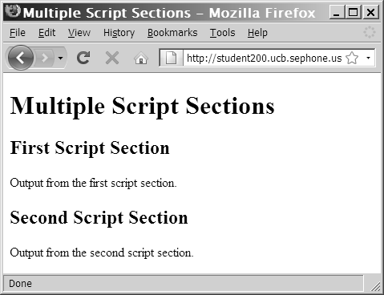
Creating Multiple Code Declaration Blocks (continued)
Output of a document with two PHP script sections

Slide 79
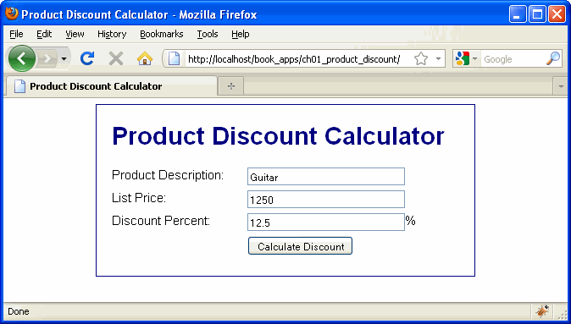
Slide <number>

Slide 80
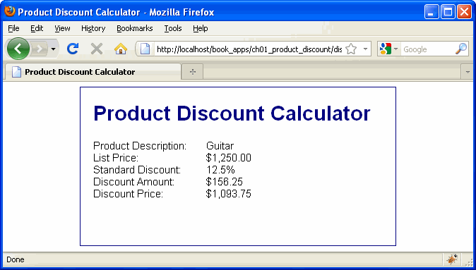
Slide <number>

Slide 81
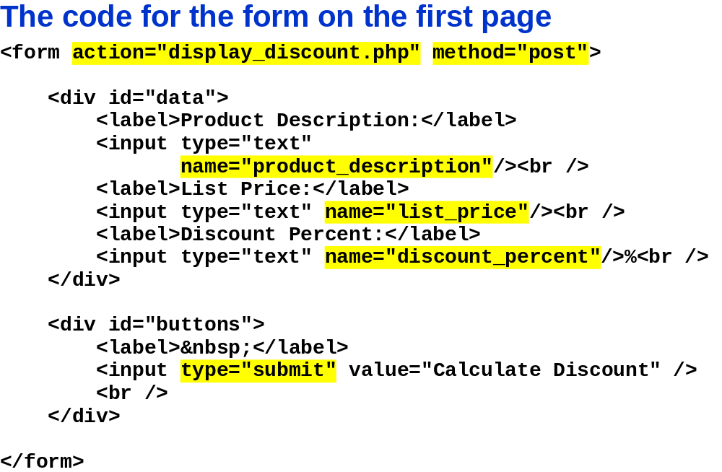
Slide <number>

Slide 82

Slide <number>

Slide 83

Slide <number>

Slide 84

Slide <number>

Slide 85

Slide <number>

Slide 86

Slide <number>

Slide 87

Slide <number>

Slide 88

Slide <number>

Slide 89

Slide <number>

Slide 90
Slide <number>

Slide 91

Slide <number>

Slide 92

Slide <number>

