Slide 1
INT322
M4: Functions & Control Structures

Slide 2
Objectives
In this chapter, you will:
Study how to use functions to organize your PHP code
Learn about variable scope
Make decisions using if statements, if...else statements, and switch statements
Repeatedly execute while statements, do...while statements, for, and foreach statements
Learn about include and require statements

Slide 3
Defining Functions
Functions
  groups of statements
    can execute as a single unit
Function definitions
  the lines of code that make up a function
    Statements + everything else (like the braces, function name, parameters)
The syntax for defining a function is:
  <?php
  function name_of_function(parameters) {
  statements;
  [return [value];]
  }
  ?>

Slide 4
Defining Functions (continued)
MUST be contained within <?php ... ?> tags
  like all PHP code
Parameter / Formal Parameter
  a variable that is passed to a function when it is called
  placed within the parentheses that follow the function name
  NOT required in functions
Function braces
  the set of curly braces
  contain the function statements

Slide 5
Defining Functions (continued)
Function statements
  MUST be contained within function braces
  do the actual work of the function
  function displayCompanyName($Company1, $Company2, $Company3) {
  echo "<p>$Company1</p>";
  echo "<p>$Company2</p>";
  echo "<p>$Company3</p>";
  }

Slide 6
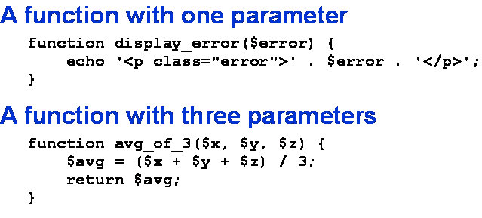
Exercise:
Identify the:
function definition
function braces
function statements
parameters

Slide 7
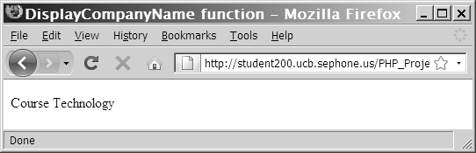
Calling Functions
  function displayCompanyName($CompanyName) {
  echo "<p>$CompanyName</p>";
  }
  displayCompanyName("Course Technology");

Slide 8
Returning Values
return statement
  returns a value to the statement that called the function
  Not all functions return values
  function averageNumbers($a, $b, $c) {
  $SumOfNumbers = $a + $b + $c;
  $Result = $SumOfNumbers / 3;
  return $Result;
  }

Slide 9
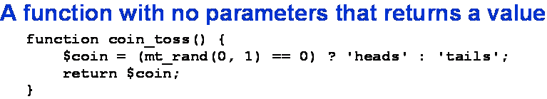

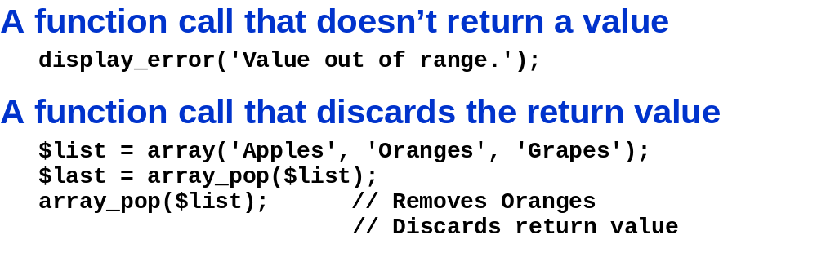
avg_of_3() and display_error are NOT PHP functions, they are made by us see above slides.
mt_rand() IS a PHP function.
Yes: Stores return value = grapes
// Does this discard the value?
array_pop removes the last element in array and returns it.
Notes:
avg_of_3() and display_error are NOT PHP functions, they are made by us see above slides.
mt_rand() IS a PHP function.

Slide 10
Returning Values (continued)
mt_rand(min, max)
  Mersenne-Twister random number generator algorithm
    4x faster than earlier algorithms (rand()) (depending on system)
      Note rand() has been improved so the speed difference is gone.
    Random number generation characteristics are known (less dubious)
    Efficient use of memory
      Uses 624 words of working area
  Min:
    lowest value to return
    Optional
    default = 0
  Max
    Highest value to return
    Optional
    Default = mt_getrandmax(void)
      Shows/ Returns highest random value that can be returned by mt_rand() without scaling
        (i.e., highest number and most random number)
Notes:
http://php.net/manual/en/function.mt-rand.php
http://www.math.sci.hiroshima-u.ac.jp/~m-mat/MT/emt.html
http://php.net/manual/en/function.mt-getrandmax.php

Slide 11
Returning Values (continued)
can pass a function parameter by:
  value
    parameter is a local copy of the variable
      So function can use it / modify it
        Any changes are LOST when control is passed back to the program
    PHP does this
  reference
    parameter is a reference to the original variable
      ACTUAL value is used in function
        Changes will STAY when control passes to the program
    &$VariableName in the function DECLARATION
      NOT in the call (stays the same: $VariableName)

Slide 12
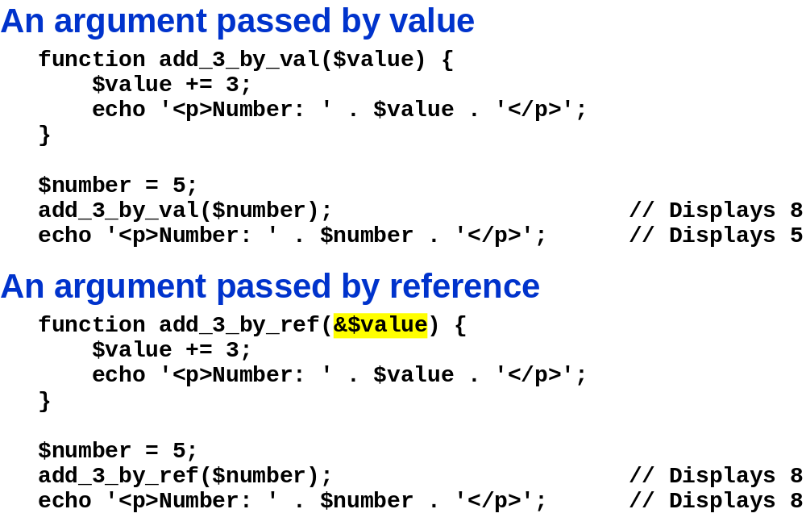


Slide 13
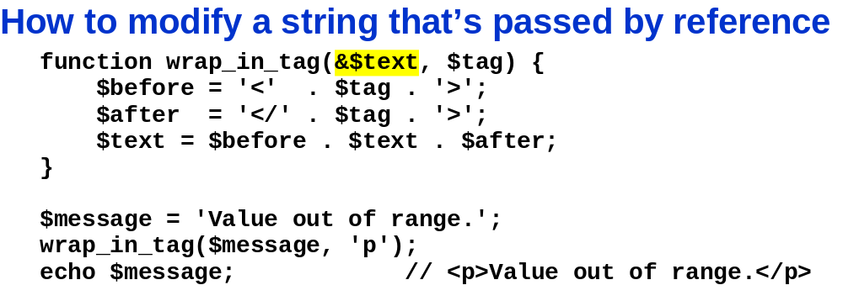
$message has been modified permanently
  Because used & in function definition

Slide 14
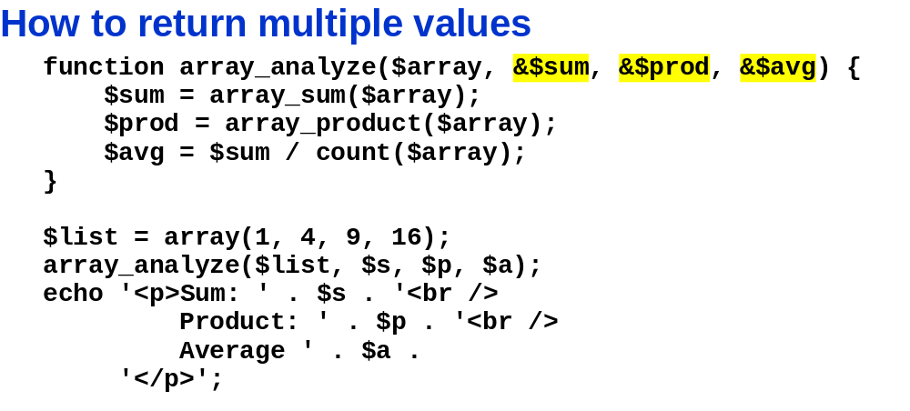
$s, $p, $a are not initialised because they are only used to store return values from the function [they are initialised in the function]
  No return statement is used. So how are the values returned?
    The variables are passed by reference → a new value is stored in them → These changes are reflected outside the function because the variables are NOT copies they are references to the original variables.
Avoid this technique
  Use another variable or array as a return value

Slide 15
Exercise. Write:
1 PHP function that passes a number by value
-also include an echo statement like “This function passes variables by value. The value of the variable is: ” and concatenate the value.
1 PHP function that passes a number by reference
- include an appropriate echo state that states the value of the variable passed by reference
1 Main Program that calls both functions and shows how the value of a variable defined in the main program changes.
-display the starting and ending values of a variable you define in the main program.
-show how its value changes after the above functions are executed.

Slide 16
Understanding Variable Scope
Variable scope
  is where in your program a declared variable can be used
    i.e., the visibility of variables. It determines what code can access the variables and functions
  Works differently than in other languages
  can be either:
    global
    local
global variable
  Variable that is declared outside a function
  and
  is available to all parts of your program
local variable
  declared inside a function
  and
  is only available within the function in which it is declared

Slide 17
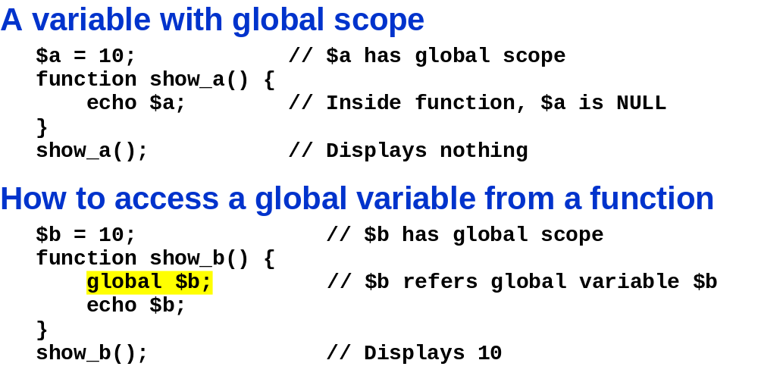
The global Keyword
must declare a global variable with the global keyword inside a function definition
  to make the variable available within the scope of that function
  Don’t need to assign a value to the variable if you declare it with the global keyword

Slide 18
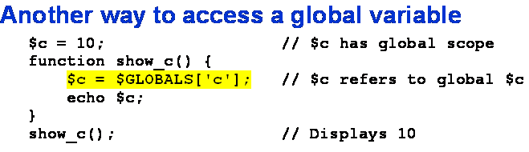
$GLOBALS (alternative way to access global variables)
$GLOBALS array
Use if you need to access several global variables
Predefined variable
  Like the $_POST and $_GET variables
Autoglobal variable
  Available everywhere in code

Slide 19
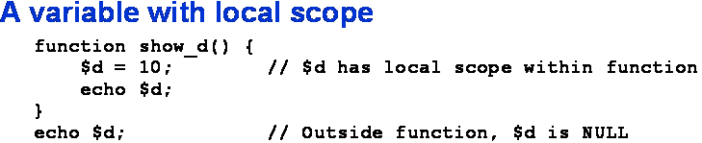
Understanding Variable Scope
local variable
  declared inside a function
  and
  is only available within the function in which it is declared

Slide 20
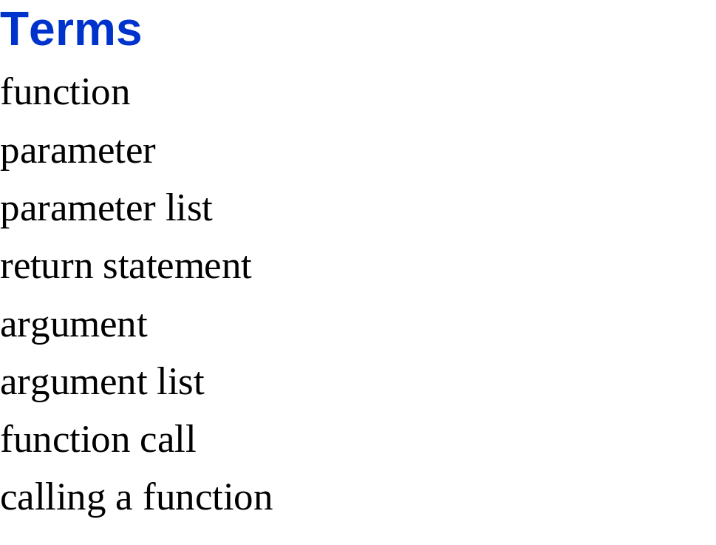
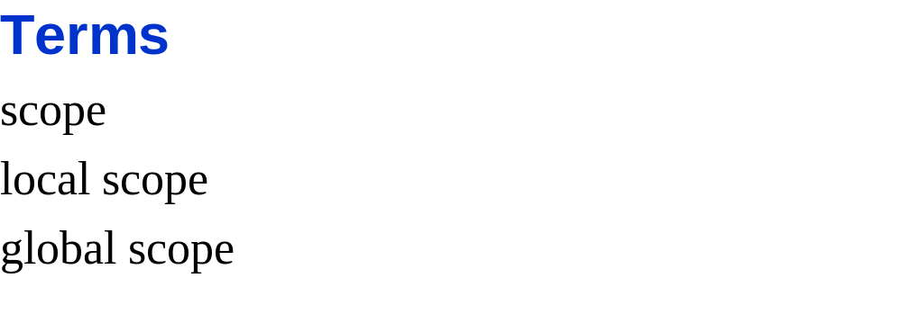

Slide 21
In Class Assignment
Write a function that uses global variables.
  Ensure you use:
    the correct tags
    The correct function declarations
  The function should compute the number of days left in the month.
    You may assume all months have 30 days.
Is it possible to do the same task without using a global variable?
  Why or why not?
  If yes:
    Write a function that accomplishes the same task WITHOUT using global variables
    Which method is better or worse? Why?

Slide 22
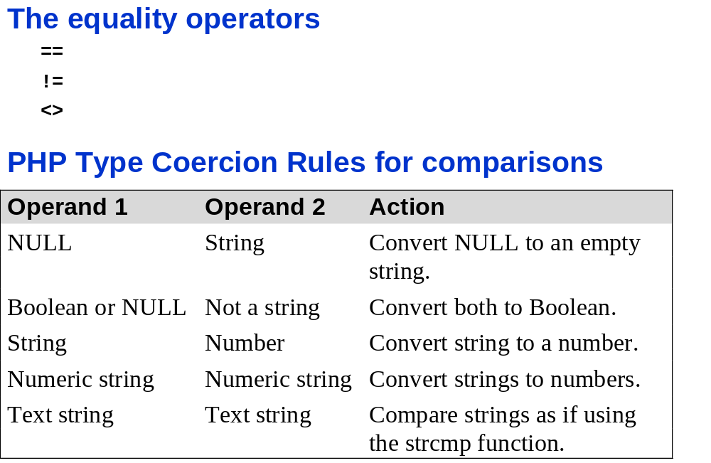
What is type Coercion?
  Different data types are converted to the same data type
    so they can be compared
  Only done with equality operators
  Can give strange results. Sol’n?
    Do your own type conversion before the comparisons
      To ensure that the same types are being compared

Slide 23
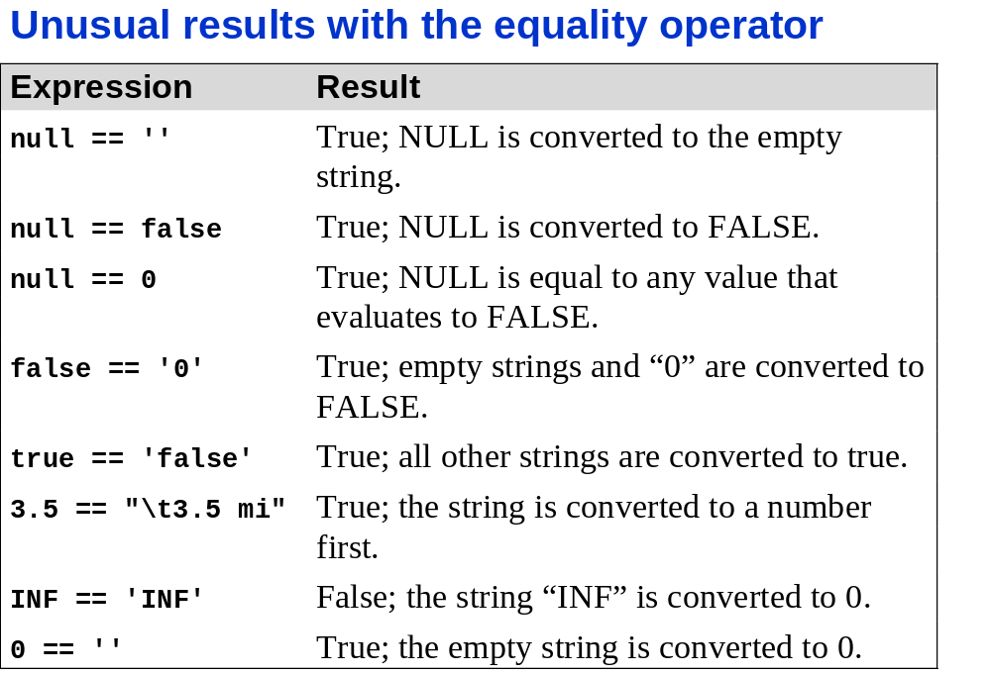
When converting to Boolean equivalents to FALSE are:
  NULL, 0, 0.0, “0”, empty string, empty array

Slide 24
When converting to Boolean equivalents to FALSE are:
  NULL, 0, 0.0, “0”, empty string, empty array

Slide 25
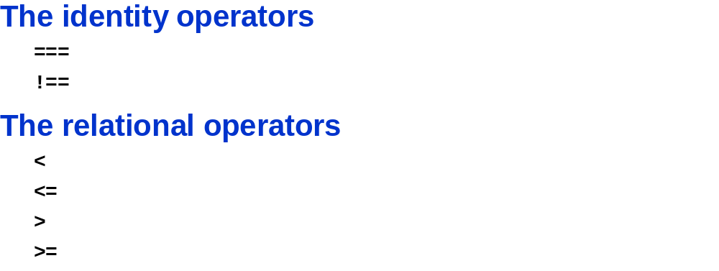
Data type and values must be the same
Data type and values must NOT be the same

Slide 26
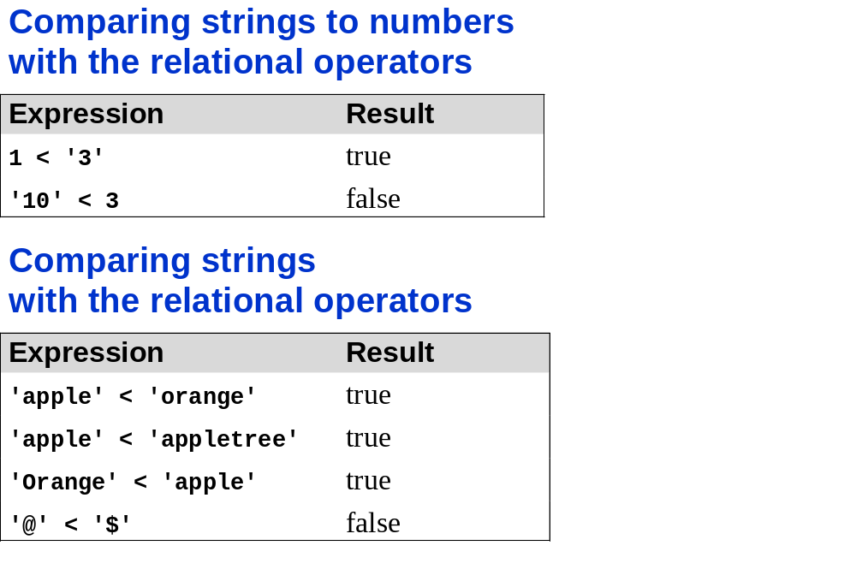
Which one is correct?
  Apple < apple → FALSE
  Apple > apple → FALSE
To avoid problems?
  Don’t use relational operators
  Use the string comparison functions
    Strcmp()
Relational operators do type Coercion
  String converted to numerical
  Comparing strings:
    Less than means the letter comes before (based on ASCII value)
    Upper case comes before lower case

Slide 27
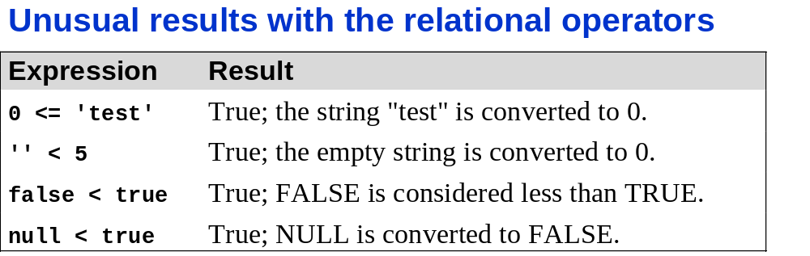

Slide 28
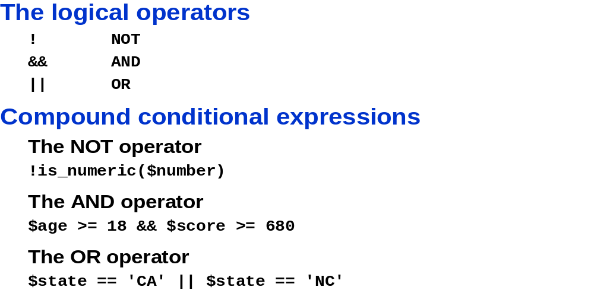
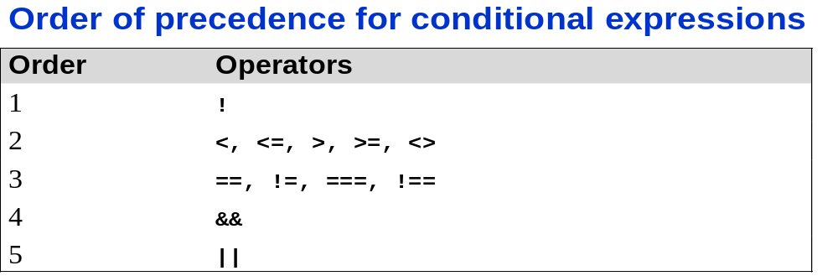
What happens here? $state == ‘CA’ || ‘NC’
Result is always true b/c:
$state might no be CA, so $state == ‘CA’ is FALSE (this is evaluated 1st because of the order of precedence).
But strings are converted to true (except empty string, ‘0’), so ‘NC’ becomes TRUE.
  So the OR operator will always evaluate to TRUE b/c FALSE || TRUE is TRUE by definition of OR
    i.e., Left of || is meaningless!
Solution

Slide 29
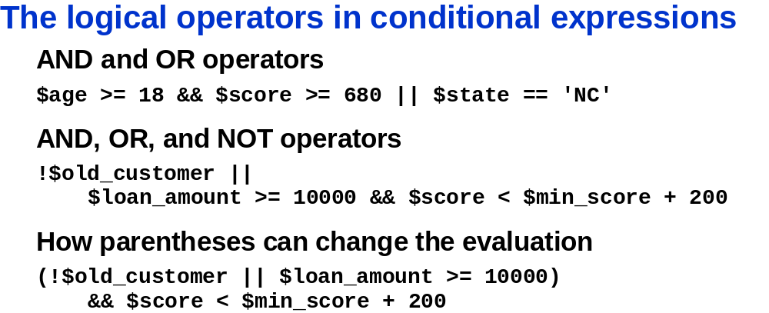
Complex Conditionals
What is the order of evaluation here?
>= → && → ||
Result?
If left of the || is TRUE the expression is always TRUE, same if rightside is TRUE.

Slide 30
Complex Conditionals
What is the order of evaluation here?
!→relational→&& → ||
Result?
True if young, True if right of || is True (i.e., reading it with the relational,&&, and arithmetic operators together; note Artihmatic operators have lowest precedence in this e.g.)

Slide 31
Making Decisions
Decision making or flow control
  process of determining the order in which statements execute in a program
decision-making statements or decision-making structures
  special types of PHP statements used for making decisions

Slide 32
if Statements
executes code if the evaluation of a conditional expression returns a value of TRUE
syntax for simple if statement:
  if (conditional expression)
  statement;

Slide 33
if Statements (continued)
Contains three parts:
  keyword if
  conditional expression
    enclosed within parentheses
  executable statements
command block
  group of statements contained within a set of braces: { }
    must have

Slide 34
if Statements (continued)
Is there an output, if so what?
$ExampleVar = 5;
if ($ExampleVar == 5) {
echo " <p>The condition evaluates to true.</p> ";
echo '<p>$ExampleVar is equal to ',
" $ExampleVar.</p> ";
echo " <p>Each of these lines will be printed.</p> ";
}
echo " <p>This statement always executes after the if
statement.</p> ";
There is an output
// condition evaluates to 'TRUE'
Efficient code

Slide 35
if...else Statements
if...else statement
  An if statement that includes an else clause
  else clause
    executes when the condition in an if...else statement evaluates to FALSE
  syntax :
    if (conditional expression)
    statement;
    else
    statement;

Slide 36
if...else Statements (continued)
  An if statement can be constructed without the else clause
  The else clause can only be used with an if statement
  What day does the program tell the user?
  $Today = " Tuesday ";
  if ($Today == " Monday ")
  echo " <p>Today is Monday</p> ";
      else
      echo " <p>Today is not Monday</p> ";

Slide 37
Nested if and if...else Statements
nested decision-making structures
  When one decision-making statement is contained within another decision-making statement
In class assignment:
Write a program that prints an output only if the value of a given variable is from 50 to just under 100.
  if ($Revenue >= 50)
  if ($Revenue < 100)
  echo " <p>The sales total is between 50 and 100.</p> ";

Slide 38
switch Statements
execute specific set of statements
  depending on the value of an expression
    Compare the value of an expression to a value contained within a case label
  case label
    specific value
    contains one or more statements
      execute if value of case label = value of switch statement’s expression

Slide 39
switch Statements (continued)
The syntax for the switch statement is:
  switch (expression) {
  case label:
  statement(s);
  break;
  case label:
  statement(s);
  break;
  ...
  default:
  statement(s);
  break;
  }
Label: literal value or variable name
Statements NOT in command block
Executes up to the break
Default case is optional

Slide 40
switch Statements (continued)
components:
  The switch keyword
  An expression
  An opening brace
  One or more case labels
  The executable statements
  The break keyword
  A default label
  A closing brace

Slide 41
switch Statements (continued)
case label
  consists of:
    keyword case
    A literal value or variable name
    A colon (:)
  Multiple statements for a case label do NOT need to be enclosed within a command block

Slide 42
switch Statements (continued)
default label
  contains statements that execute when the value returned by the switch statement expression does not match a case label
  consists of keyword default followed by a colon (:)

Slide 43
Repeating Code
loop statement
  control structure
  repeatedly executes a statement or a series of statements while:
    a specific condition is TRUE
    or until a specific condition becomes TRUE
four types of loop statements:
  while statements
  do...while statements
  for statements
  foreach statements
    For arrays

Slide 44
while Statements
Tests the condition prior to executing the series of statements at each iteration of the loop
syntax:
  while (conditional expression) {
  statement(s);
  }
statement or command block executes repeatedly
  As long as the conditional expression evaluates to TRUE

Slide 45
while Statements (continued)
Iteration
  Each repetition of a looping statement
while statement keeps repeating until its conditional expression evaluates to FALSE
counter
  a variable that
    increments
    or decrements
  with each iteration of a loop statement

Slide 46
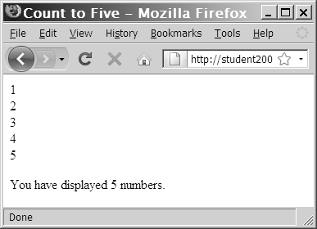
while Statements (continued)
  $Count = 1;
  while ($Count <= 5) {
  echo " $Count<br /> ";
  ++$Count;
  }
  echo " <p>You have printed 5 numbers.</p> ";
Output of a while statement using an increment operator

Slide 47
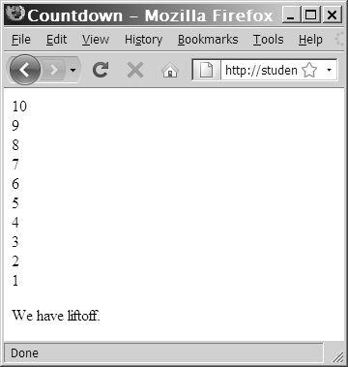
while Statements (continued)
  $Count = 10;
  while ($Count > 0) {
  echo “$Count<br />”;
  --$Count;
  }
  echo " <p>We have liftoff.
  </p> ";
Output of a while statement using a decrement operator

Slide 48
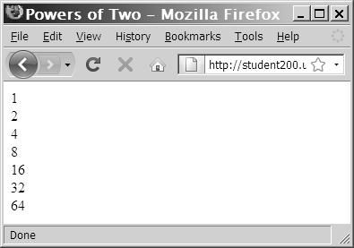
while Statements (continued)
  $Count = 1;
  while ($Count <= 100) {
  echo " $Count<br /> ";
  $Count *= 2;
  }
Output of a while statement using the assignment operator *=

Slide 49
while Statements (continued)
What happens here?
  $Count = 1;
  while ($Count <= 10) {
  echo " The number is $Count ";
  }
infinite loop
  loop statement never ends
    because conditional expression is never FALSE

Slide 50
do...while Statements
Tests condition after executing statements
  then repeats the execution as long as a given conditional expression evaluates to TRUE
syntax:
do {
statement(s);
    } while (conditional expression);

Slide 51
do...while Statements (continued)
do...while statements always execute once
  before a conditional expression is evaluated
  $Count = 2;
  do {
  echo " <p>The count is equal to $Count</p> ";
  ++$Count;
  } while ($Count < 2);

Slide 52
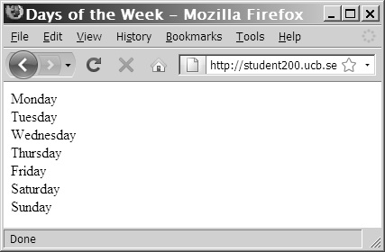
do...while Statements (continued)
Exercise: make an array → use a loop to display its contents
$DaysOfWeek = array(" Monday ", " Tuesday ", " Wednesday ", " Thursday ",
" Friday ", " Saturday ", " Sunday ");
$Count = 0;
do {
echo $DaysOfWeek[$Count], "<br />";
++$Count;
} while ($Count < 7);
Output of days of week script in Web browser

Slide 53
for Statements
Combine:
  Initialize
  conditional evaluation
  and update
  portions of a loop into a single statement
Repeat statement or series of statements
  as long as a given conditional expression evaluates to TRUE
If conditional expression evaluates to TRUE
  for statement executes
    continues to execute repeatedly until conditional expression evaluates to FALSE

Slide 54
for Statements (continued)
Can include code that initializes a counter and changes its value with each iteration
The syntax of the for statement is:
for (counter declaration and initialization; condition; update statement) {
  statement(s);
  }
  e.g.,
  for ($x =3; $x<4; ++$x) {
  echo ‘this loop is inefficient man’;
  }

Slide 55
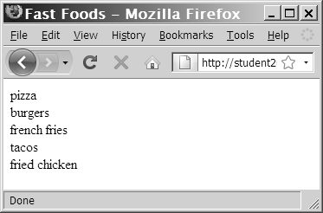
for Statements (continued)
Exercise: Convert the loop in your previous code to a for statement
$FastFoods = array(" pizza”, " burgers ", " french fries ", " tacos ", " fried chicken ");
for ($Count = 0; $Count < 5; ++$Count) {
echo $FastFoods[$Count], " <br /> ";
}
Output of fast foods script

Slide 56
foreach Statements
Used to iterate or loop through the elements in an array
Do not require a counter
  instead, specify an array expression within a set of parentheses following the foreach keyword
syntax:
  foreach ($array_name as $variable_name) {
  statements;
  }
  $array_name
    the name of the array
  $variable_name
    During each iteration, the value of the current array element is assigned to $variable_name

Slide 57
foreach Statements (continued)
$DaysOfWeek = array(("Monday", "Tuesday", "Wednesday", "Thursday", "Friday", "Saturday", "Sunday");
foreach ($DaysOfWeek as $Day) {
echo "<p>$Day</p>";
}
This displays the days of the week

Slide 58
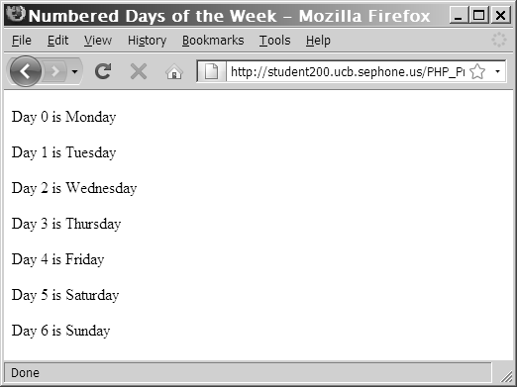
foreach Statements (continued)
$DaysofWeek = array("Monday", "Tuesday", "Wednesday", "Thursday", "Friday", "Saturday", "Sunday");
foreach ($DaysOfWeek as $DayNumber => $Day) {
echo "<p>Day $DayNumber is $Day</p>";
}
Gets both the index and the value of each element
  key points (=>) to the value
Read as: For each element of the $DaysofWeek associative array refer to the key as $DayNumber and the value as $Day.
Output of the foreach script with index values

Slide 59
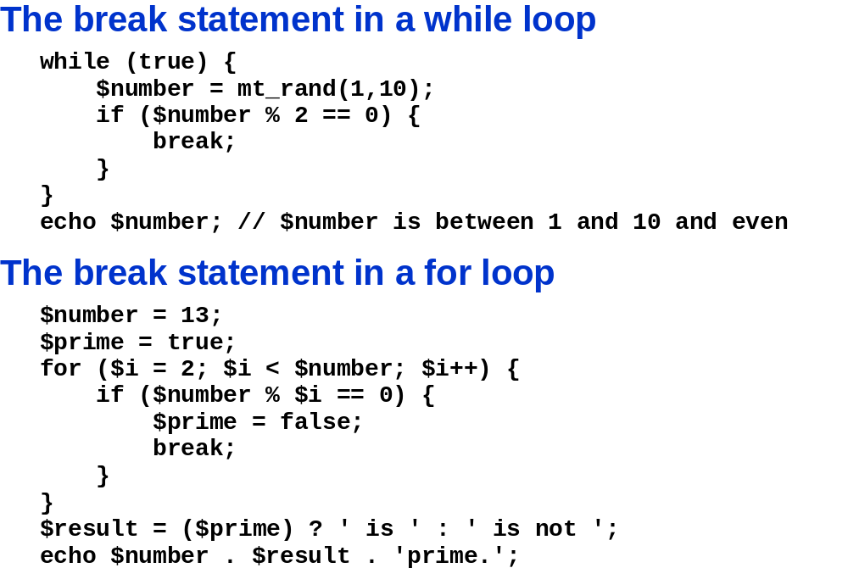

Slide 60
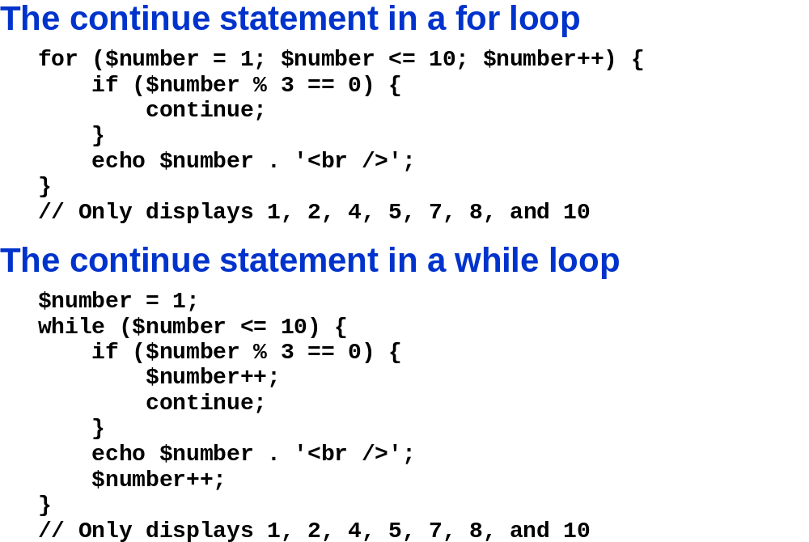

Slide 61
Including Files
include and require statements reuse content
  by allowing you to insert the content of an external file on multiple Web pages
  include statement
    generates a warning if the include file cannot be found
  require statement
    halts the processing of the Web page and displays an error if the include file cannot be found
include_once and require_once statements
  assure that the external file is added to the script only one time

Slide 62
Summary
The lines that make up a function are called the function definition
A function parameter that is passed by value is a local copy of the variable
A function parameter that is passed by reference is a reference to the original variable
A global variable is declared outside a function and is available to all parts of your program

Slide 63
Summary (continued)
A local variable is declared inside a function and is only available within the function in which it is declared
The process of determining the order in which statements execute in a program is called decision making or flow control
The if statement is used to execute specific programming code if the evaluation of a conditional expression returns a value of TRUE

Slide 64
Summary (continued)
An if statement that includes an else clause is called an if...else statement. An else clause executes when the condition in an if...else statement evaluates to FALSE
When one decision-making statement is contained within another decision-making statement, they are referred to as nested decision-making structures

Slide 65
Summary (continued)
The switch statement controls program flow by executing a specific set of statements, depending on the value of an expression
A loop statement is a control structure that repeatedly executes a statement or a series of statements while a specific condition is TRUE or until a specific condition becomes TRUE
A while statement tests the condition prior to executing the series of statements at each iteration of the loop

Slide 66
Summary (continued)
The do...while statement tests the condition after executing a series of statements
The for statement combines the initialize, conditional evaluation, and update portions of a loop into a single statement
The foreach statement is used to iterate or loop through the elements in an array

Slide 67
Summary (continued)
The include, require, include_once, and require_once statements insert the contents of an external file at the location of the statement

