Slide 1
M4
Regular Expressions

Slide 2
Writing Regular Expression Patterns
regular expression pattern
  a special text string describing a search pattern
  consist of literal characters and metacharacters
    Metacharacter: character that has a special meaning to a program
      special characters that define the pattern-matching rules
      E.g., PowerShell: ; is separator. HTML: & precedes HTMLentity
  patterns are enclosed in opening and closing delimiters
    Can be any char except letter, number, \
      Opening delimiter: 1st character in pattern.
      forward slash (/)
        most common character delimiter
    E.g., preg_match(“/This pattern MUST be between delimiters/”)
      To include / as part of pattern escape it: \/

Slide 3
Writing Regular Expression Patterns
regular expression pattern (Cont.)
  Can include literal values
    Any strings validated against regular expression must contain exact matches for the literal values contained in the pattern.
regular expression pattern
  Pattern Modifier
    Comes after the closing delimiter
      Pattern is Case Sensitive by Default
        To turn off:
preg_match(“/This pattern MUST be between delimiters/i”);

Slide 4
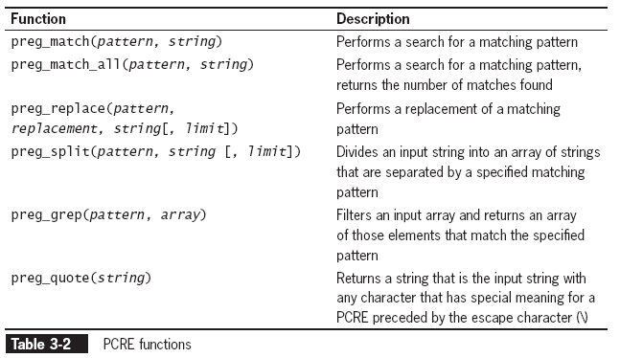
Working with Regular Expressions
(continued)

Slide 5
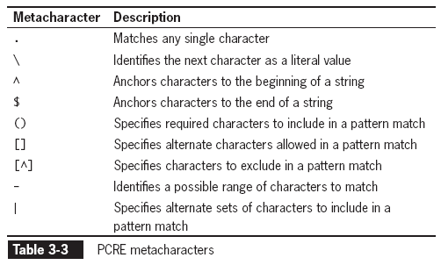
Writing Regular Expression Patterns
(continued)

Slide 6
Working with Regular Expressions
(continued)
Preg_match()
  Most used PCRE f’n
preg_match(pattern, string);
    Pattern
      Pass regular expression pattern as first argument
    String
      the text you want to search
    Returns
      1 = match
      0 = no match

Slide 7
Matching Any Character
period (.) (in a regular expression pattern )
  specifies that the pattern MUST contain a value at the location of the period
  return value:
    0
      indicates string does not match the pattern
    1
      it does
$ZIP = "015";
preg_match("/...../", $ZIP); // returns 0
$ZIP = "01562";
preg_match("/...../", $ZIP); // returns 1

Slide 8
Matching Characters at the Beginning or End of a String
An anchor
  specifies that pattern must appear at a particular position in a string
  ^ metacharacter
    anchors characters to the beginning of a string
$URL = "http://www.site.com";
preg_match("/^https/", $URL); // returns 0
  $ metacharacter
    anchors characters to the end of a string
$Identifier = "http://www.site.com";
preg_match("com$", $Identifier); // returns 1

Slide 9
Matching Special Characters
To match any metacharacters as literal values in a regular expression:
  escape the character with a backslash
  What is returned?
$Identifier = http://www.site,com";
preg_match("/.com$/", $Identifier);
//returns 1 b/c . Is a metacharacter that matches any char, so comma is matched.
Sol’n?
$Identifier = http://www.site,com";
preg_match("/\.com$/", $Identifier);
// \ escapes the . So it becomes a literal.
  (in the previous example, the last four characters in the string must be ‘.com’)

Slide 10
Matching Special Characters
To match any metacharacters as literal values in a regular expression (cont):
  escape the character with a backslash (Cont.)
    except for $
      Complicated b/c it indicates a variable
        So MUST be preceded by \ to be interpreted as literal
      When using “ “
        MUST enter \\
        - inserts a literal \
        + a \$
        - inserts a literal $
        i.e. \\\$
      When using ‘ ‘
        \$ is enough
    $money = “$1456.34”;
    Echo preg_match(‘/^\$/’, $money); //returns 1
    Echo preg_match(“/^\\\$/”, $money); //returns 1

Slide 11
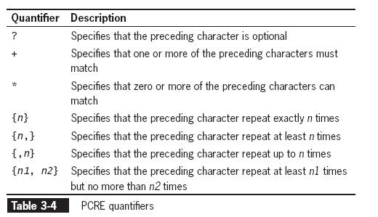
Specifying Quantity
Quantifiers
  Metacharacters that specify quantity of a match
Notice: all these quantifiers operate on the preceding character(s)

Slide 12
Specifying Quantity
(continued)
question mark (?) quantifier
  specifies that the preceding character in the pattern is optional
$URL = "http://www.site.com";
preg_match("/^https?/", $URL); // returns 1
What does above mean?
the string must begin with ‘http’ or ‘https’

Slide 13
Specifying Quantity
(continued)
addition(+) quantifier
  specifies that >= 1 sequential occurrences of the preceding characters match
$Name = "Don";
preg_match("/.+/", $Name); // returns 1
What does above mean?
the string must have at least one character
b/c the . can be any character

Slide 14
Specifying Quantity
(continued)
asterisk (*) quantifier
  specifies that zero or more sequential occurrences of the preceding characters match
  Write a preg_match statement where the string must begin with one or more leading zeros
  NumberString = "00125";
preg_match("/^0*/", $NumberString);//returns 1

Slide 15
Specifying Quantity
(continued)
{ } quantifiers
  specify the number of times that a character must repeat sequentially
preg_match("/ZIP: .{5}$/", " ZIP: 01562");
// returns 1
What does above mean?
string must contain at least five characters
{ } quantifiers
  can also specify the quantity as a range
  preg_match("/(ZIP: .{5,10})$/", "ZIP: 01562-2607");// returns 1
What does above mean?
    string must contain between five and ten characters

Slide 16
Specifying Subexpressions
subexpression or subpattern
  When set of characters enclosed in parentheses are treated as a group
  Let you determine determine format and quantities of enclosed characters as a group
preg_match("/^(1 )?(\(.{3}\) )?(.{3})(\-.{4})$/
What does above mean?
the 1 and the area code are optional
  if included must be in format:1 (707) 555-1234 (including spaces)
    b/c everything in () is treated as group (loosely 1 character). ^(1 )? Means 1[space] is optional. \( \) and \- are the literal characters. .{3} means any three char. Will do, etc.

Slide 17
Defining Character Classes
Character classes in regular expressions
  treat multiple characters as a single item
    inside the[] metacharacters, char’s. represent alternate characters allowed in pattern match
Write a preg_match statement that says that both spellings of Analyse / Analyze are okay
preg_match("/analy[sz]e/", "analyse");//returns 1
preg_match("/analy[sz]e/", "analyze");//returns 1
preg_match("/analy[sz]e/", "analyce");//returns 0

Slide 18
Defining Character Classes
(continued)
hyphen metacharacter (-)
  specifies a range of values in a character class
  Write a 2 line code that guarantees that your mark conforms to the grading system: A, B, C, D, F.
  $LetterGrade = "B";
  echo preg_match("[A-DF]", $LetterGrade); // returns true
  The above ensures that A, B, C, D, or F are the only values assigned to the $LetterGrade variable

Slide 19
Defining Character Classes
(continued)
^ metacharacter
  When placed immediately after the opening bracket of a character class
    specifies optional characters to exclude in pattern match
    Modify your grading system code so that it detects if the letter grade conforms to the grading system by excluding the irrelevant characters in the alphabet. Be efficient.
$LetterGrade = "A";
echo preg_match("[^EG-Z]", $LetterGrade); // returns true
      the above code excludes the letter E and G-Z from an acceptable pattern match in the $LetterGrade variable)

Slide 20
Queston:
  If you want to detect only the letters of the alphabet will these ranges [A-z] or [a-Z] work? Why or why not?
  No b/c:
    Ranges are based on ASCII values (like with strings)
      [A-z] includes non-alphabetic characters like [ and ^
        ASCII range is 65-122
      [a-Z] means 97-90
        This doesn’t include all the alphabet
        Note: It is not in order from smallest to largest

Slide 21
Defining Character Classes
Character classes in regular expressions (Reprise)
  \ is NOT an escape character inside a char. Class
    To include a literal hyphen (-)
      it MUST be the LAST char. before the closing bracket
        Else interpreted as range indicator
    To include a literal circumflex (^)
      it MUST be the LAST char. before the:
        closing bracket
        or literal hyphen
    To include a literal ]
      it MUST be:
        the FIRST char. after the [
        Or negation symbol [i.e. ^]

Slide 22
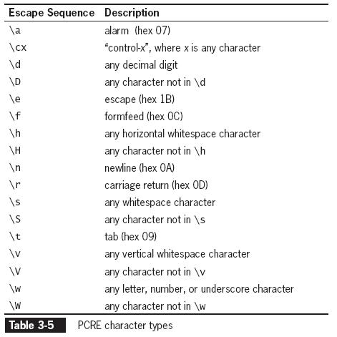
Defining Character Classes
(continued)
PCRE includes special character type
  Used to represent different types of data
    E.g., \w
      Same as:_0-9a-zA-Z
  True or False?
  preg_match(“/\d/”, “5”);
    Returns 1
  preg_match(“/\D/”, “5”);
    Returns 0

Slide 23
Matching Multiple Pattern Choices
| metacharacter
  used to specify an alternate set of patterns
    essentially the same as using the OR operator (||) to perform multiple evaluations in a conditional expression
e.g., vegitarian | vegan
Write a preg_match statement that ensures the web address ends in .ca, .fr, .in
  echo preg_match”/\.(ca | fr | in)$/i”, “www.intlCompany.biz”)
    Returns 0

Slide 24
Pattern Modifiers
Pattern modifiers
  letters placed after the closing delimiter that change the default rules for interpreting matches
    i
      Case insensitivity: indicates that the case of the letter does not matter when searching
    s
      changes how the . (period) metacharacter works
        Normally . does not match newline character
        - it does with s modifier
Notes:
http://php.net/manual/en/reference.pcre.pattern.modifiers.php

Slide 25
Pattern Modifiers
Pattern modifiers
  letters placed after the closing delimiter that change the default rules for interpreting matches
    m
      To process multiline strings
        i.e., Those that have a newline character
        Without this preg_match stops at the first newline character.
      allows searches across newline characters
        By default, PCRE treats the subject string as consisting of a single "line"
        - "start of line" metacharacter (^) matches only at the start of the string
        - "end of line" metacharacter ($) matches only at the end of the string, or before a terminating newline (unless D modifier is set).
        When this modifier is set
        - "start of line" and "end of line" constructs match:
        -immediately following or immediately before any newline, respectively.
        -and at the very start and end.
        -If no "\n" characters, or no occurrences of ^ or $ in a pattern, setting this modifier has no effect.
Notes:
http://php.net/manual/en/reference.pcre.pattern.modifiers.php

Slide 26
Regular Expressions UNIX / LINUX and Utilities

Slide 27
Regular Expressions
Used by various UNIX utilities:
  vi
    Text editor
  grep
    Searches text files for lines matching a regular expression.
    Case sensitive
    Grep regexp fileName
      E.g., grep “howdy” myFile.txt
        “” not always needed

Slide 28
Regular Expressions
Used by various UNIX utilities: (Cont.)
  awk
    AWK: Interpreted programming language
      used for data extraction and reporting
      Inspiration for PERL
      Versions exist for almost all operating systems
      Variants: GAWK (GNU), POSIX AWK
    awk: program that runs AWK files
  sed (stream editor)
    special editor for modifying files automatically
    Reads input line by line → Applies an operation (that you specify on the command line or script) → Outputs the line
    Inspired PERL
    No variables.
    Some branching functionality, and goto

Slide 29
Literal Matching
Contains no special characters
Matches:
  only itself (literally)
  entire words
  or parts of it
Examples:
  Note: use the vi help sheet
    Can type: “:/” or just “/” “/” at end is not necessary
  /disk/
    matches: diskette, disk, disks…
  /my book/
    matches: my book, Sammy book

Slide 30
Regular Expression Delimiters
Each regular expression should be delimited
  prevents the shell from interpreting special characters
  Delimiter
    marks beginning and end of the regular expression
    different characters can be used
    double quote (“)
      For grep it is usually the double quote (“)

Slide 31
Special Characters
some utilities / versions:
  support standard regular expressions
    Based on oldest versions of grep
  Others support extended regular expressions
    Based on egrep
    More special symbols
      E.g., Quantifiers:
        ? repeat the preceding token zero or once
        + once or more
        {n} n times
        {n,m} between n and m times
        {n,} n or more times
        | Alternation
        Unadorned parentheses create a group
        - e.g. (abc){2} matches abcabc.
Notes:
http://www.regular-expressions.info/posix.html
POSIX or "Portable Operating System Interface for uniX" is a collection of standards that define some of the functionality that a (UNIX) operating system should support. One of these standards defines two flavors of regular expressions. Commands involving regular expressions. Commands and databases implement these standards.
http://how-to.linuxcareer.com/understanding-regular-expressions
Perl Regular Expressions (PRCE)
Basic Regular Expressions
standardizes a flavor similar to the one used by the traditional UNIX grep command.
had only bracket expressions, dot, caret, dollar and star.
One thing that sets this flavor apart is that most metacharacters require a backslash to give the metacharacter its flavor. The reason is that the oldest versions of UNIX grep did not support these. The developers of grep wanted to keep it compatible with existing regular expressions, which may use these characters as literal characters.
Most other flavors, including POSIX ERE, use a backslash to suppress the meaning of metacharacters.
Extended Regular Expressions or ERE flavor standardizes a flavor similar to the one used by the UNIX egrep command.
quantifiers ?, +, {n}, {n,m} and {n,} repeat the preceding token zero or once, once or more, n times, between n and m times, and n or more times, respectively. Alternation is supported through the usual vertical bar |. Unadorned parentheses create a group, e.g. (abc){2} matches abcabc.

Slide 32
Period (.)
Matches any single character
  The ONLY wildcard in regular expressions
  To match more characters, put more periods in a row.
    [E.g., /he.o/ will match helo but NOT hello.
    e.g., /he..o/ will match hello but NOT helo.]
Example:
/.nix/
  Matches: Unix, unix...
/leaf./
  Matches: leafs, leafy…
/a.t/
  Matches: a t, ant, act…
grep “he.lo” MyFile.txt
Note: grep "he.l" MyFile.txt will find hello because it matches part of a word. So will vi.
  Note, in vi:
  use n and N to search for next/prev matches.
  NOT * or # (these match the current word forward / backward)

Slide 33
Asterisk (*)
Represents >= 0 occurrences of regular expression directly preceeding it
  By itself, it does not match anything
    it is NOT a wildcard
    used in conjunction with:
      literal matches
      period
      or other special characters
Example:
/cart*/
  Matches: car, carpool, cart, cartt, carttt:, caret
  [b/c looking to match car and >=0 of the letter t]
"do*g" [remember in grep delimiter is double quote]
  Matches: "dg", "dog", "doog", "dooog", ...

Slide 34
Asterisk (*)
Example:
/of.*ice/
  Matches any number of any characters
    wildcard means any character, asterisk means zero or more repetitions
  Matches: office, off ice
  [ >=0 matches of The period (which is a wild card).
  ice has to be at the back ]
/car.*t/
  which of these will it match: cart, caret, cartt, carttt?
    Answer: all

Slide 35
Square brackets ([])
Enclose a character class or group
  character class matches only ONE character within the brackets.
    E.g., M[rs] matches Mr and Ms
    E.g., /file[12] will match file1, file2, file12, file123, but NOT files or file3
    Character must be in that spot. Following characters don’t matter
      E.g. /file[321] matches file3, file3x
    Hyphen can be used for defining a range of characters
      E.g. /file[1-4] matches file1, file2, file321 but NOT file7
  Similar to the shell

Slide 36
Square brackets ([])
Most special characters lose their special meaning [except]:
  The caret sign at the beginning of the list means exclusion
    ([^a] = not a)
    [^xyz] matches every letter except x or y or z
    E.g. /file[^1] matches file, file321, files. But NOT file123 or file1
Examples:
  /practi[cs]ing/
    Matches: practicing and practising
  /file[12s]/
    Matches: file1, file2 and files

Slide 37
Caret (^)
Matches strings at the beginning of the line (anchoring it)
Means:
Special character [Character inclusion]:
  only if the beginning of the regular expression
  For example:
    ^[0-9]
      Matches: any input that begins with a digit
    /file^[1]
      does NOT work even though file exists (says e486: Pattern not found) [bad syntax b/c ^ not at beginning of the expression]
character exclusion
  When inside square brackets means
  For example:
    1[^0-3] – will match 1a, 1., 145, but not 10 and 13
  See previous slide.
literal match
  If not at the beginning of the regular expression

Slide 38
Anchors
Anchors
  let you search for text only at the:
    start
    or end
  of the line.
  ^ anchor to the start of the line
    E.g., grep "^Hello" data
    e.g., ^Miss will match Miss Jennifer but NOT Melissa (Missy) [Assume both start a new line]
  $ anchor to the end of the line
    grep “Bye$" data
    E.g., 625$

Slide 39
Grouping Regular Expressions
Parentheses can be used to create bracketed regular expressions
  The parentheses group the regular expression inside
  The parentheses are not matched, only what is inside
  quantifier (e.g. *) applies to the entire group
  grep requires the -E option to enable grouping
    E.g., grep -E "a(abc)*z" myFile
      will match: az, aabcz, aabcabcz, aaabcz …
        but NOT acz [b/c abc is treated as a whole]
      Doesn’t work in vi
Grouping offers alteration/choice represented by the pipe (|)
  For example:
    “(Mr|Mrs) Smith” - will match “Mr Smith” and “Mrs Smith”

Slide 40
Search and Replace in vi
Utilities are able to perform string substitution
  E.g. vi
Such substitution is done using regular expressions
  need to be careful when using non alpha-numeric characters
    quote them if necessary
Substitution syntax:
:[address]s/original-string/replacement-string[/g]
[address] – specifies a line range.
– If not supplied only current line is parsed
[/g] – global substitution
(more than one per line)
See week 2 vi notes
  /c confirms
  /& repeats last :s command

Slide 41
Example vi Substitution Ranges
7
  line 7
  Example: :7s/a/A/
7,10
  lines 7 to 10 (inclusive)
  Example: :7,10s/a/A/
%
  entire document
  Example: :%s/a/A/
1,.
  beginning of document to current line
  Example: :1,.s/a/A/
.,.+5
  between current line and following 5 (inclusive)
  Example: :.,.+5s/a/A/

