Slide 1
Introduction to Working with Databases and MySQL
Week 5 & 7
Murach Ch 3

Slide 2
Objectives
In this chapter, you will:
Study the basics of databases and MySQL
Work with MySQL databases
Define database tables
Modify user privileges
Work with database records
Work with phpMyAdmin

Slide 3
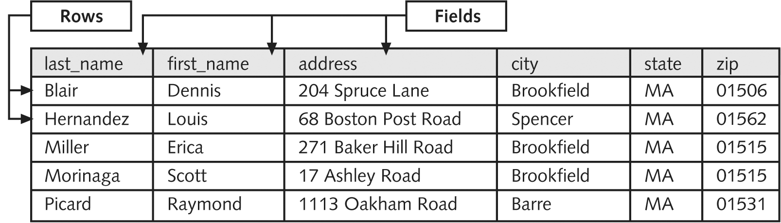
Introduction to Databases
Database
  an ordered collection of information
    from which a computer program can quickly access information
Record / Instance
  row in a database table
  a single complete set of related information
Field / Attribute
  column in a database table
  the individual categories of information stored in a record
    Attribute: E.g.,code, price, name
Employee directory database

Slide 4
Introduction to Databases (continued)
Table
  Has columns and rows
    Intersection is a Cell
  Modeled after a “real world entity”
    E.g., product, customer
flat-file database
  stores information in a single table
relational database
  stores information across multiple related tables
    primary table
      the main table in a relationship that is referenced by another table
    related table / “child table”
      references a primary table in a relational database

Slide 5
Understanding Relational Databases
primary key
  a field that contains a unique identifier
    for each record in a primary table
  type of index
    identifies records in a database to speed up:
      retrievals
      and sorting
  A single field
  Unique Key / Non-primary Key
    Other key that uniquely identifies each row in table
      E.g., productCode in the products table below
        b/c it has unique data
    A single field
  Composite Key
    a primary key made up of >=2 fields

Slide 6

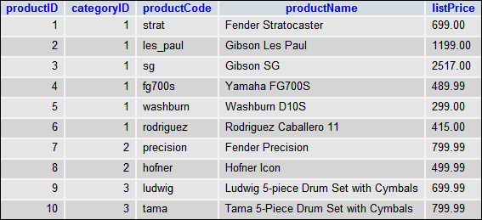
Primary Key Non Primary /
Unique Key
(Not a composite Key – Why?)
-b/c only 1 field makes it up

Slide 7
Understanding Relational Databases
Foreign key
  >= 1 field / column in a related table that refer to the primary key in another table / primary table
  Table can have 1 or more foreign keys
  Can’t add rows to table with foreign key unless there’s matching primary key
Primary and foreign keys link [relate] records across multiple tables
Index
  Makes accessing rows more efficient
  Based on the values in >= 1 column
  Automatically made for primary and non-primary keys
  Can define for other keys
    Don’t have to be unique values
      E.g. city

Slide 8


Slide 9
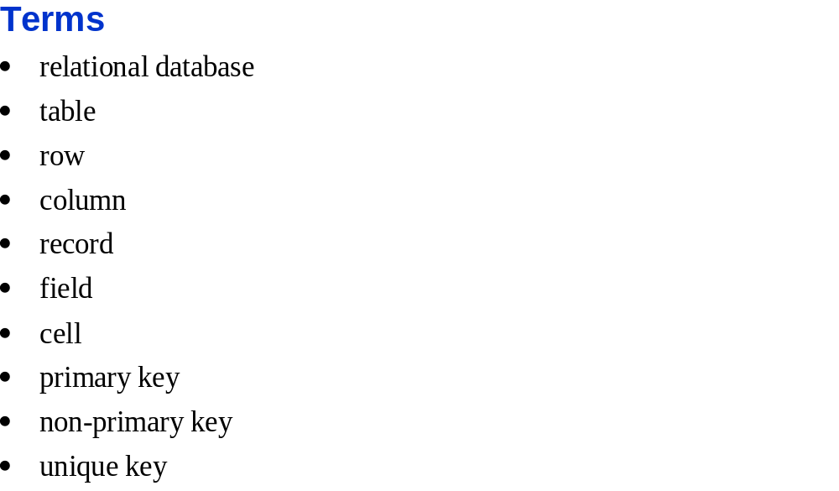

Slide 10
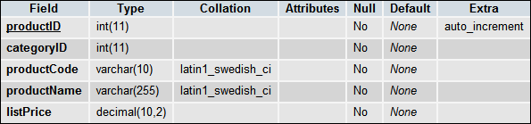
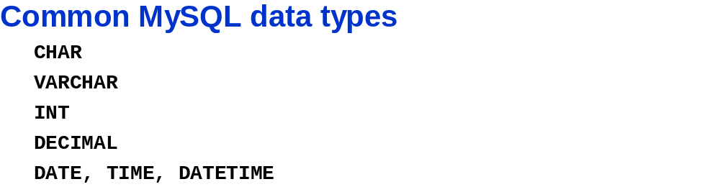
When defining a column you assign properties
  Type
    Pick a type that minimises storage
      b/c performance on queries improves
Fixed length character
Variable length character

Slide 11
When defining a column you assign properties
  Collation
    set of rules for comparing characters in a particular character set.
      Each character set can have more than one collation
        Minimum of one default collation.
    Two character sets CAN'T have the same collation
    SHOW CHARACTER SET statement
      Shows default collations of character sets
    SHOW COLLATION LIKE 'character_set_name'
      Gives all collations for a characterset
      e.g., SHOW COLLATION LIKE 'Latin1%';
Notes:
http://www.mysqltutorial.org/mysql-collation/
https://dev.mysql.com/doc/refman/5.7/en/show-columns.html

Slide 12
When defining a column you assign properties
  Identify if column can store a NULL value
    NULL
      Value is:
        Unknown
        Unavailable
        Not applicable
    If not allowing
      Must provide value for column
        Else can’t store row

Slide 13
Default
  Value used if one not entered
Auto-incremented / Numeric Column
  Value generated automatically by DBMS

Slide 14
One-to-One Relationships
3 basic relationships in relational databases:
  1 – 1, 1 - *, and * - *
one-to-one relationship (1-1)
  when a related table contains EXACTLY one record for each record in the primary table
    Prob: Information can be placed within a single table
      So rarely used b/c takes up space
    So why use it?
      Create to break information into multiple, logical sets
        Better organisation
      Make the information in one of the tables confidential and accessible only by certain individuals
        E.g. make a 2 HR tables:
        1. that has basic info about personnel
        2. with private personnel info (e.g., pay)
        -only accessible by the right people

Slide 15
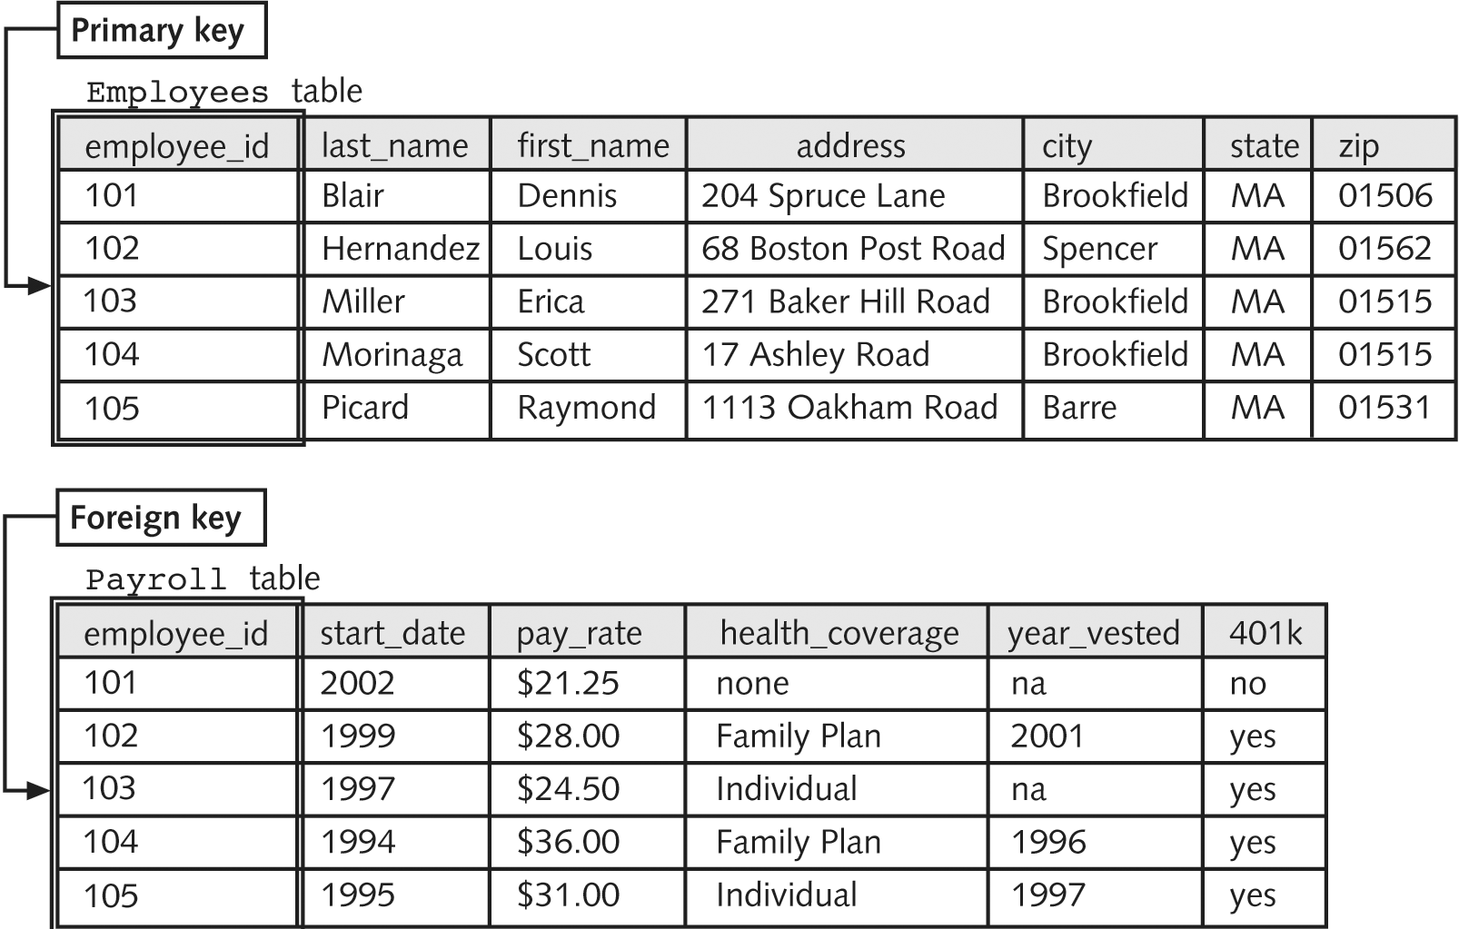
One-to-One Relationships (continued)
One-to-one relationship
Notice foreign key is same as primary key
This CREATES the relationship

Slide 16
One-to-Many Relationship
one-to-many relationship (1-*)
  when one record in a primary table has many related records in a related table
  Done to eliminate redundant information
    normalization
      Breaking tables into multiple related tables to reduce redundant information
        Ideal: primary and foreign keys are only info. duplicated
      Why do it?
        Reduces size of database
        -saves storage space
        Decrease chance of error
        -when information is repeated
        -e.g, can be entered wrong

Slide 17
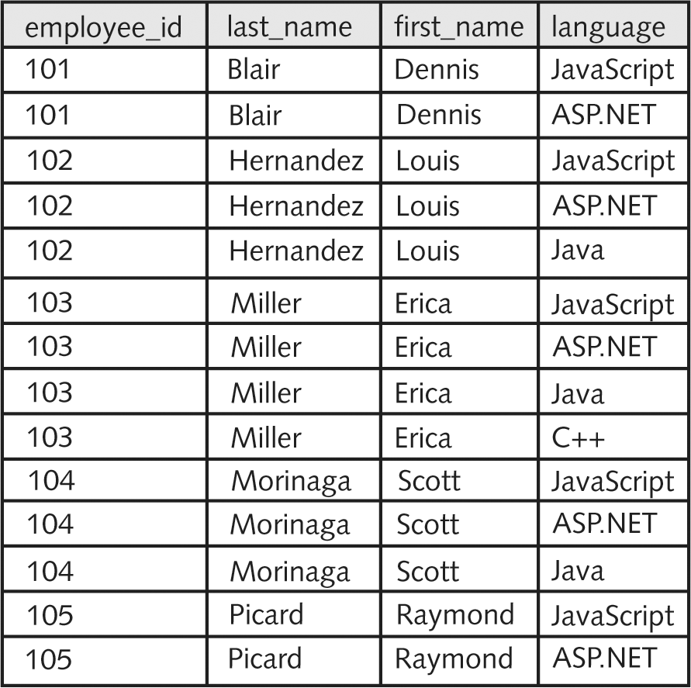
One-to-Many Relationship (continued)
Table with redundant information
What is the redundancy?
e.g., programmers names are repeated

Slide 18
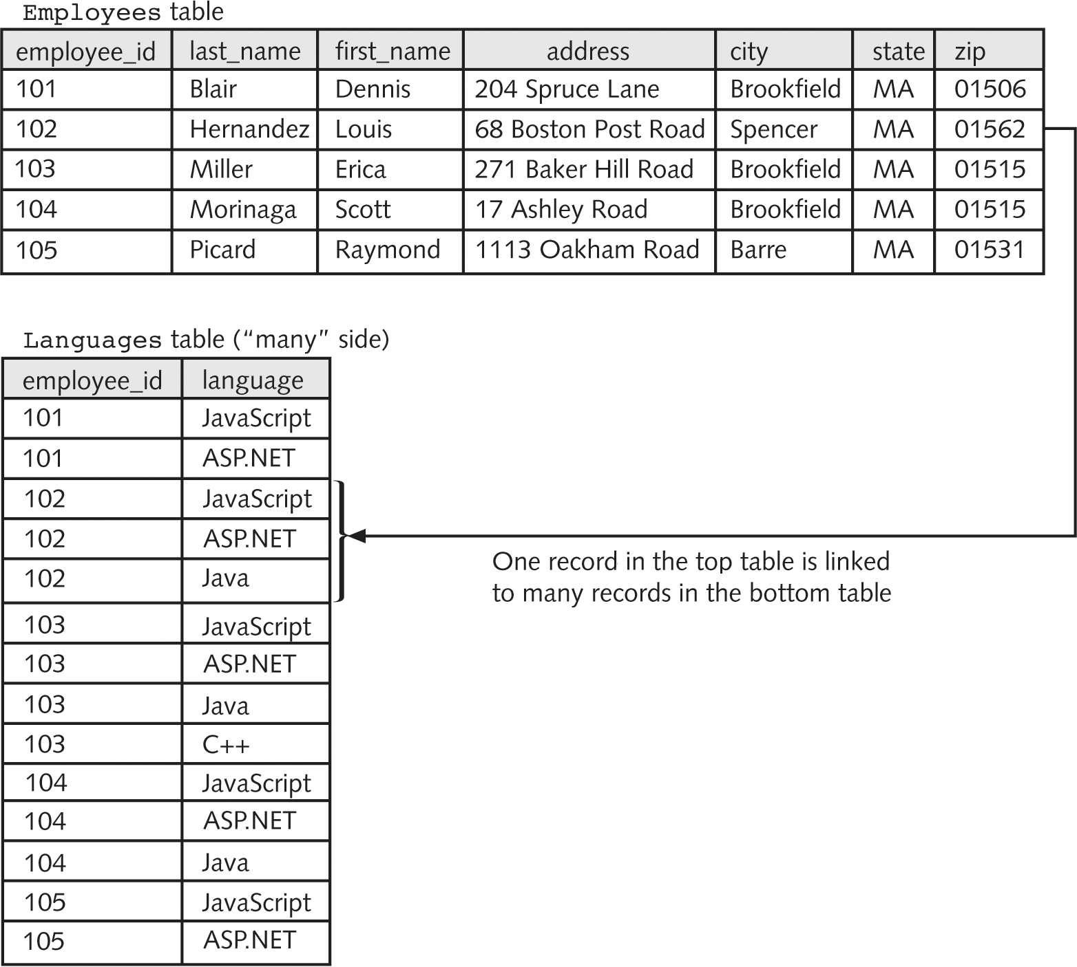
One-to-Many Relationship (continued)
One-to-many relationship
Is this okay? (i.e., is it normalised?)
  No! the language field has duplicatations
Is some duplication okay?
  Yes! primary & foreign keys
How can we make it better?
  Break the languages table into another 1-* relationship
  Or BETTER
  Make a *-* relationship
*-1: when the table with multiple records for an entity (e.g. the programming languages table) is the primary table.

Slide 19
Many-to-Many Relationship
many-to-many relationship
  when many records in one table are related to many records in another table
  E.g., relationship between programmers and programming languages:
    a programmer can use many languages
    and a language can be used by many programmers
  MUST use junction table to make a * - * relationship
    b/c most relational databases can’t work directly with *-* relations
    junction table / linking table / cross-reference table
      creates a one-to-many relationship for each of the two tables in a many-to-many relationship
      Has foreign keys from the two tables in the * - * relation
        and any other fields that correspond to a * - * relationship

Slide 20
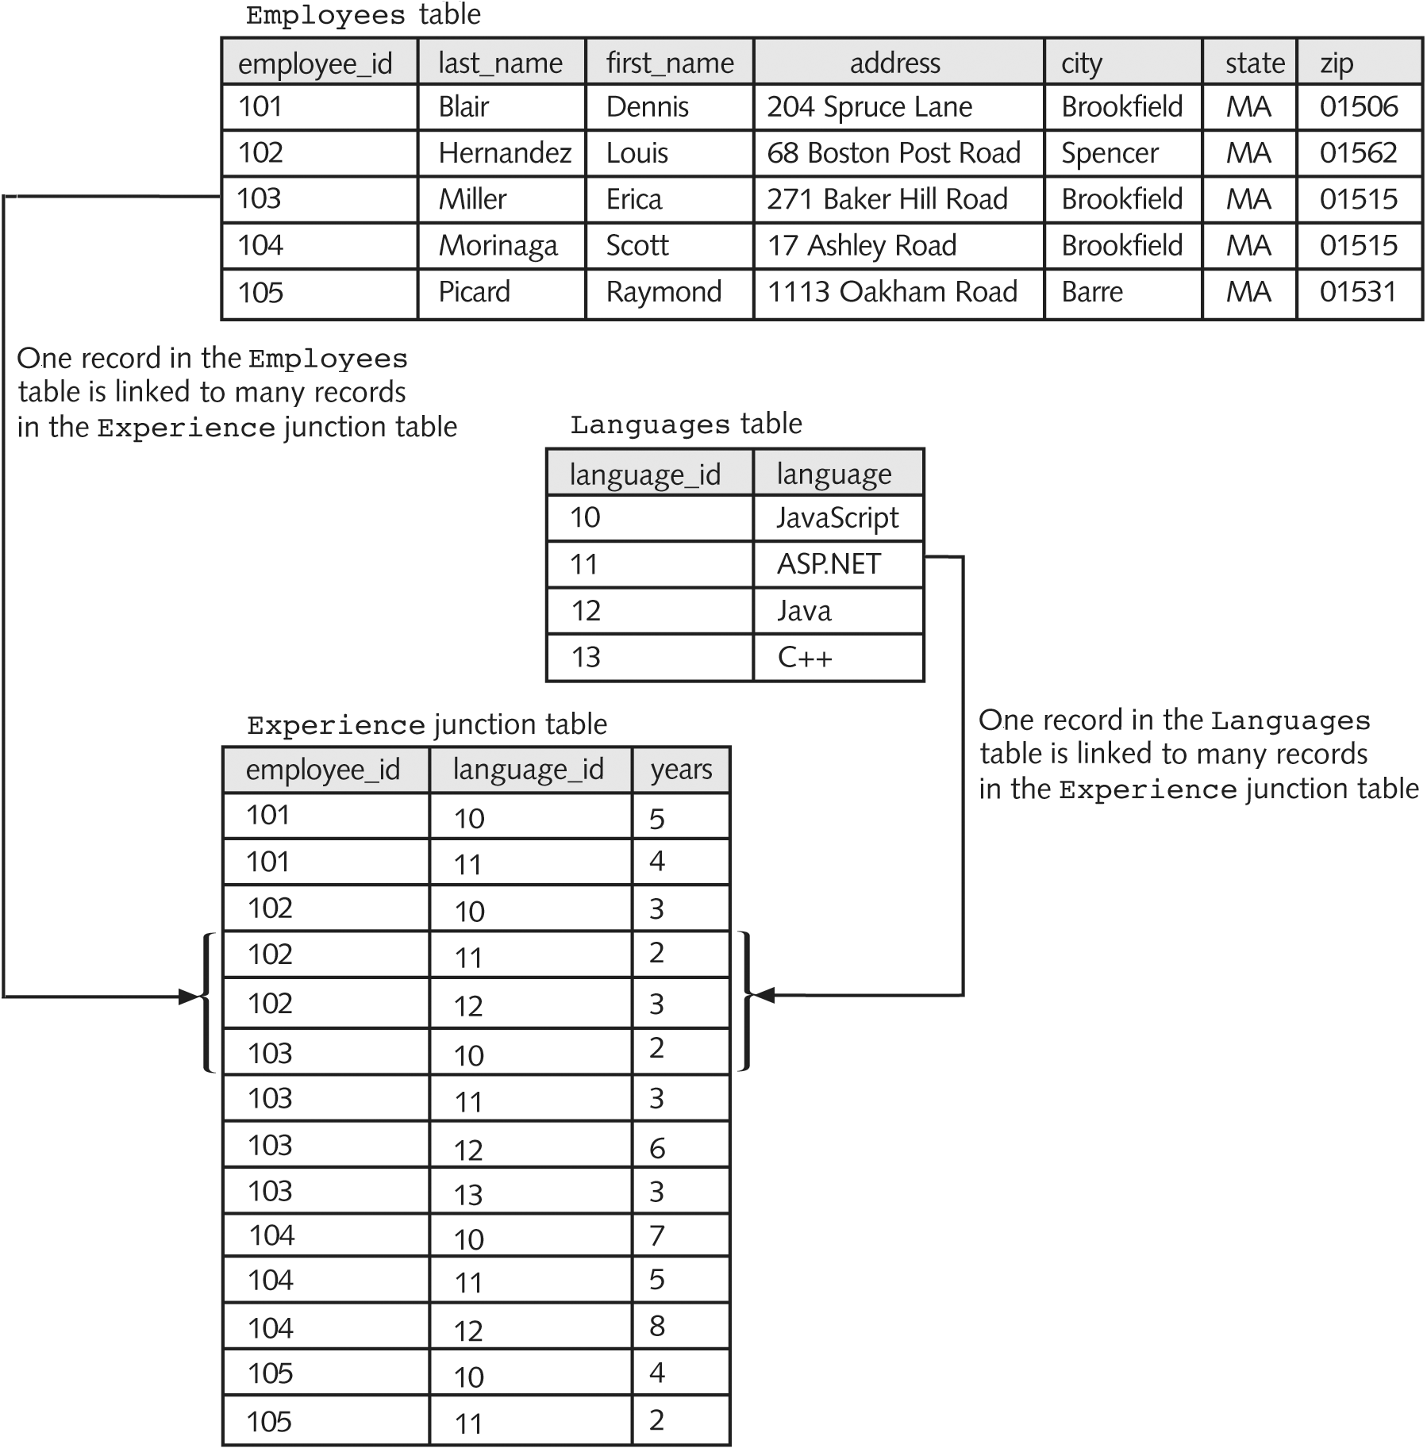
Working with Database Management Systems (continued)
What is (are) the primary key(s)?
Employee_id, language_id
Are there any foreign keys? If so where?
In the Experience Junction Table—Employee_id, language_id
Is there a key in the junction table?
Yes, a compound primary key / composite key made of employee_id and language_id
  b/c the combination of these fields is unique
  What is the advantage of using this?
    Don’t need to make a new primary key field
      Saves space and our time
Many-to-many relationship

Slide 21
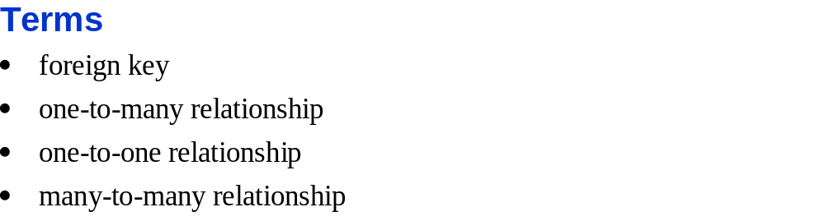

Slide 22
Working with DBMS
database management system (or DBMS)
  an application or collection of applications used to access and manage a database
schema
  the structure of a database
    including its tables, fields, and relationships
  Often used interchangeably with database
flat-file database management system
  a system that stores data in a flat-file format
    Only 1 table
relational database management system (or RDBMS)
  a system that stores data in a relational format

Slide 23
Working with Database Management Systems (continued)
Important aspects of database management systems:
  The structuring and maintenance of the
  database file
  Ensuring that data is stored correctly in a database’s tables, regardless of the database format
    Flat
    Relational
    Hierachical
    network
  Querying capability

Slide 24
Working with Database Management Systems (continued)
query
  a structured set of instructions and criteria for:
    Retrieving
    Adding
    Modifying
    and deleting
  database information
Structured query language (or SQL)
  a standard data manipulation language
  used in many database management systems
  2 components
    Data Definition Language
      For creating databases, tables, fields, etc.
    Data Manipulation Language
      For acting on data, e.g., delete, add, modify
      PHP uses it to access database

Slide 25
Working with Database Management Systems (continued)-- History/Background
Every major programming language tries to provide uniform access to relational database systems.
Microsoft attempts: ODBC, OLEDB, ADODB, DAO
  ODBC (Open Database Connectivity)
    de facto standard on most platforms
    low level engine for accessing DB
    requires dealing with DOBC APIs in order to be able to access a DB, this will make it a little bit tedious but efficient (much faster than ADO)
    created to access relational databases
    Users of an ODBC application can add drivers
      Driver: creates an interface between an application and a specific DBMS
  ADODB (ActiveX Data Objects)
    A Database abstraction library
      For PHP and Python
    ADO is for windows only
    Set of COM objects that wrap ODBC functionality
    Based on ODBC
    quick and easy
      Less efficient
Notes:
http://www.ozgrid.com/forum/showthread.php?t=28221
When should you use OLE-DB, ADO, DAO, or ODBC ?
ADO is a wrapper around OLE-DB so you can use ADO or OLE-DB.
Non-OLE environment : If a database supports ODBC and and that database is on a server that don't support OLE then ODBC is your best choice.
Non-SQL environment : ODBC is designed to work with SQL. If you have non-SQL environment then OLE-DB is better choice.
OLE environment : If you already have ODBC drives then you can use ODBC, otherwise use OLE-DB.
Interoperability required : If you need interoperable database components, then OLE-DB is your best choice.
16-Bit data access support : ADO don't support 16 bit so ODBC is the only choice.
Using multiple databases - If you are using databases that support Microsoft's jet engine then definite choice is ADO or DAO. By using ADO you get workspace level support for transaction. That means you can connect more than one database at a time in an application, which is impossible by using ODBC. You can only connect one database at a time by using ODBC.
ADO vs. DAO
ADO is a superset of DAO in functionality point of view. In fact ADO is a combination of DAO + RDO. I would prefer ADO in these cases. 1. If you are proficient in COM programming. 2. If your server supports OLE environment. 3. If you want workspace-level and multi database type ( Relational, indexed, ISAM type, text files supports ). DAO is best choice when you have DAO components installed on your machine and you are using Microsoft's jet database engine based databases such as MS-Access, SQL Server, MS-Excel or Paradox. This is fastest and easiest mathod o access databases.
DAO vs. ODBC
DAO is best choice when you have DAO components installed on your machine and you are using Microsoft's jet database engine based databases such as MS-Access, SQL Server, MS-Excel or Paradox. This is fastest and easiest method to access databases. ODBC is for various type of database which provides ODBC drives such as SQL Server, Oracle, MS-Access. Additional advantage is DAO is workspace-level support.
Advantages of DAO: Easy to use. Workspace level support. Both MFC and API provides DAO support. Speed is relatively faster than ODBC for jet database engine databases.
Advantages of ODBC : Easy to use specially when developer are not familiar with COM environment. SQL support. Both API and MFC support. Good for relational databases only.
Advantages of ADO or OLE-DB : Workspace-level support. Fastest method to access various kind of databases. Easy to use fi you are familiar with COM environment. Provides access to relational, non relational and other types of data.

Slide 26
Working with Database Management Systems (continued)-- History/Background
Every major programming language tries to provide uniform access to relational database systems.
Microsoft attempts: ODBC, OLEDB, ADODB, DAO (cont.)
  DAO (Database Access Object)
    works best with .mdb files (e.g., MS Access)
    Optimised for Microsoft Jet database engine
      provides set of data access objects: querydef, recordset, tabledef, database objects, etc.
  OLEDB (Object Linking and Embedding Database)
    Successor to ODBC
    OLEDB components offer much better performance than the older ODBC.
    strategic system-level programming interface to data across organization.
Notes:
http://www.ozgrid.com/forum/showthread.php?t=28221
When should you use OLE-DB, ADO, DAO, or ODBC ?
ADO is a wrapper around OLE-DB so you can use ADO or OLE-DB.
Non-OLE environment : If a database supports ODBC and and that database is on a server that don't support OLE then ODBC is your best choice.
Non-SQL environment : ODBC is designed to work with SQL. If you have non-SQL environment then OLE-DB is better choice.
OLE environment : If you already have ODBC drives then you can use ODBC, otherwise use OLE-DB.
Interoperability required : If you need interoperable database components, then OLE-DB is your best choice.
16-Bit data access support : ADO don't support 16 bit so ODBC is the only choice.
Using multiple databases - If you are using databases that support Microsoft's jet engine then definite choice is ADO or DAO. By using ADO you get workspace level support for transaction. That means you can connect more than one database at a time in an application, which is impossible by using ODBC. You can only connect one database at a time by using ODBC.
ADO vs. DAO
ADO is a superset of DAO in functionality point of view. In fact ADO is a combination of DAO + RDO. I would prefer ADO in these cases. 1. If you are proficient in COM programming. 2. If your server supports OLE environment. 3. If you want workspace-level and multi database type ( Relational, indexed, ISAM type, text files supports ). DAO is best choice when you have DAO components installed on your machine and you are using Microsoft's jet database engine based databases such as MS-Access, SQL Server, MS-Excel or Paradox. This is fastest and easiest mathod o access databases.
DAO vs. ODBC
DAO is best choice when you have DAO components installed on your machine and you are using Microsoft's jet database engine based databases such as MS-Access, SQL Server, MS-Excel or Paradox. This is fastest and easiest method to access databases. ODBC is for various type of database which provides ODBC drives such as SQL Server, Oracle, MS-Access. Additional advantage is DAO is workspace-level support.
Advantages of DAO: Easy to use. Workspace level support. Both MFC and API provides DAO support. Speed is relatively faster than ODBC for jet database engine databases.
Advantages of ODBC : Easy to use specially when developer are not familiar with COM environment. SQL support. Both API and MFC support. Good for relational databases only.
Advantages of ADO or OLE-DB : Workspace-level support. Fastest method to access various kind of databases. Easy to use fi you are familiar with COM environment. Provides access to relational, non relational and other types of data.

Slide 27
Working with Database Management Systems (continued)-- History/Background
Every major programming language tries to provide uniform access to relational database systems.
Microsoft attempts: ODBC, OLEDB, ADODB, DAO (cont.)
  OLEDB (Object Linking and Embedding Database) (Cont.)
    open specification to access all types data
      relational and non relational information
        -mainframe ISAM/VSAM -hierarchical databases
        -e-mail -file system store
        -Text -Graphical data
        -geographical data -custom business objects
        Etc.
    defines collection of COM interfaces
      encapsulate various database management system services.
      enable creation of software components to implement these services.
      OLEDB components consist of:
        data providers: contain and expose data
        data consumers: use data
        service components: process and transport data (such as query processors and cursor engines)
      interfaces help components integrate smoothly
        vendors can bring high-quality OLE DB components to market quickly.
    includes a bridge to ODBC
      enables support of ODBC relational database drivers
Notes:
http://www.ozgrid.com/forum/showthread.php?t=28221
When should you use OLE-DB, ADO, DAO, or ODBC ?
ADO is a wrapper around OLE-DB so you can use ADO or OLE-DB.
Non-OLE environment : If a database supports ODBC and and that database is on a server that don't support OLE then ODBC is your best choice.
Non-SQL environment : ODBC is designed to work with SQL. If you have non-SQL environment then OLE-DB is better choice.
OLE environment : If you already have ODBC drives then you can use ODBC, otherwise use OLE-DB.
Interoperability required : If you need interoperable database components, then OLE-DB is your best choice.
16-Bit data access support : ADO don't support 16 bit so ODBC is the only choice.
Using multiple databases - If you are using databases that support Microsoft's jet engine then definite choice is ADO or DAO. By using ADO you get workspace level support for transaction. That means you can connect more than one database at a time in an application, which is impossible by using ODBC. You can only connect one database at a time by using ODBC.
ADO vs. DAO
ADO is a superset of DAO in functionality point of view. In fact ADO is a combination of DAO + RDO. I would prefer ADO in these cases. 1. If you are proficient in COM programming. 2. If your server supports OLE environment. 3. If you want workspace-level and multi database type ( Relational, indexed, ISAM type, text files supports ). DAO is best choice when you have DAO components installed on your machine and you are using Microsoft's jet database engine based databases such as MS-Access, SQL Server, MS-Excel or Paradox. This is fastest and easiest mathod o access databases.
DAO vs. ODBC
DAO is best choice when you have DAO components installed on your machine and you are using Microsoft's jet database engine based databases such as MS-Access, SQL Server, MS-Excel or Paradox. This is fastest and easiest method to access databases. ODBC is for various type of database which provides ODBC drives such as SQL Server, Oracle, MS-Access. Additional advantage is DAO is workspace-level support.
Advantages of DAO: Easy to use. Workspace level support. Both MFC and API provides DAO support. Speed is relatively faster than ODBC for jet database engine databases.
Advantages of ODBC : Easy to use specially when developer are not familiar with COM environment. SQL support. Both API and MFC support. Good for relational databases only.
Advantages of ADO or OLE-DB : Workspace-level support. Fastest method to access various kind of databases. Easy to use fi you are familiar with COM environment. Provides access to relational, non relational and other types of data.

Slide 28
Working with Database Management Systems (continued)-- History/Background
Problem: conventional programming language can’t interact transparently with different databases.
  E.g., dates stored in different formats, NULL can mean different things
Solutions:
  Traditional (pre-ODBC) solutions:
    Use language extensions where static SQL is embedded inside the programming language (e.g., COBOL, C).
      Results are stored in static data structures.
      Problem:
        There are different:
        SQL dialects
        Languages
        Methods to access DBs are specific to the manufacturer.
        Result:
        binding is specific to a database vendor’s SQL “dialect”.
        developer’s life is miserable.

Slide 29
Working with Database Management Systems (continued)—History / Background
Every major programming language tries to provide uniform access to relational database systems (Cont.)
  Last twenty years:
    Most DB systems using common dialect of SQL (SQL-92)
      still variations (especially with stored procedures)
    Systems like ODBC developed
      Give call-level interfaces
        SQL statements dynamically passed to DB and results dynamically accessed.
      JDBC (Java Database Connectivity) (Not in this course)
        Specification allow:
        provide a standard Java call-level interface for any database product.
        -allows platform independence
        Allows for innovation
        -Clear Specifications on JDBC compliance, but no details on how to implement technology given.
        -consequence: you must select database driver developed by vendor
        -might cost $ (e.g., have to buy an application server that has the driver)
        JDBC 2.0 improvements include:
        built-in support for:
        - connection pooling
        - resource management
        bidirectional scrolling through results
        system to actively edit results

Slide 30
Working with Database Management Systems (continued)
Open database connectivity (or ODBC)
  allows ODBC-compliant applications to access any data source for which there is an ODBC driver
    Useful b/c:
      Different database vendors have different proprietary formats
        Can be imported but DB files are not completely interchangeable
        -can’t directly read each other’s files
      Need to access multiple DBs created in different DBMSs
        E.g., PHP script to access simultaneously legacy and new DBs. Conversion is too expensive and using old system is impractical b/c doesn’t suit needs.

Slide 31
Working with Database Management Systems (continued)
Open database connectivity (or ODBC) (Cont.)
  Uses SQL commands
    Called ODBC SQL
  Process:
    ODBC app:
      connects to DB that has ODBC driver
      executes ODBC SQL statements
    3. ODBC Driver translates SQL into commands DB can understand

Slide 32
Working with Database Management Systems (continued)
PHP includes:
  strong support for ODBC
    (indirect database access)
  Direct Database Access
    Functionality to work directly with different DBs w/o using ODBC
      E.g., Oracle, Informix, MySQL, PostgreSQL
    Pros:
      Faster scripts
      can use proprietary DBMS functions not supported by ODBC

Slide 33

Intro. To MySQL
Free
One of fastest RDMS
Easy to install and use
Runs on most OS

Slide 34
Support for multiple Clients
  From many interfaces and programmng languages (Java, Perl, PHP, C, Python
Connectivity
  Via Internet or intranet
  Can write PHP app that uses SQL statements
    Connect to DB, update data.
Security
  Only authorised users access data

Slide 35
Referential Integrity
  Keeps relationship between tables intact
    can’t delete row in one table that is related to a row in another table
      E.g., can’t delete row in one table that has a primary key that is referred to by a foreign key in another table
  If you use InnoDB tables option
  Pretty new
    So now like commercial products
Transaction Processing
  Processing related statements at once
    Batch processing
    Pro:
      If one statement fails you can undo all of the changes at once
        E.g., if want to change product table and billing table, only will be done if all changes worked fine.
  New in v. 5,.0
    So now like commercial products

Slide 36
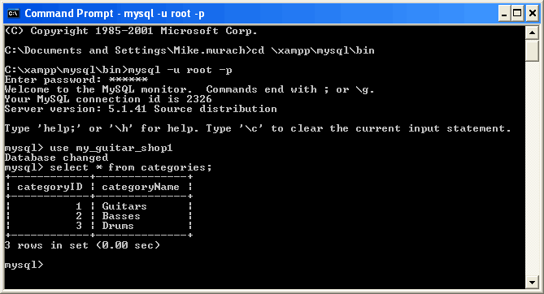
2 WAYS to use MySQL (Comes with XAMPP)
  Command line client (MySQL monitor)
  GUI (phpMyAdmin, which is a web-based client)

Slide 37
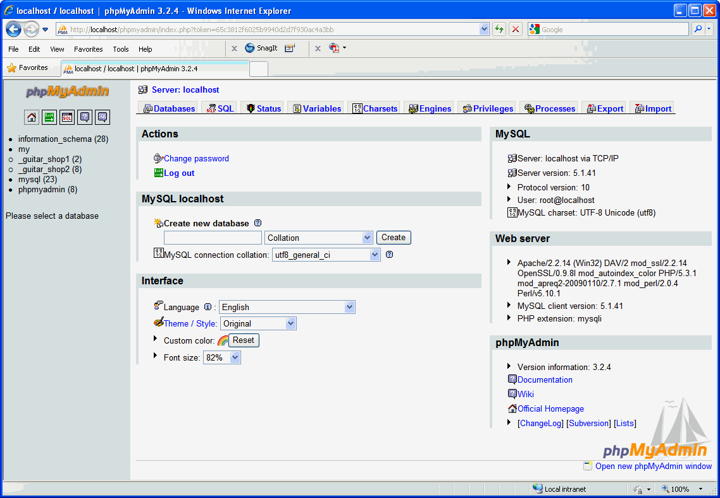

Slide 38
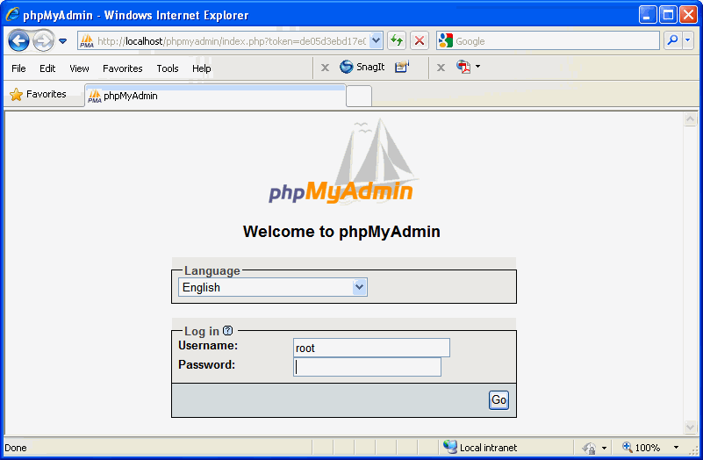

Slide 39
To start command line:
c:\xampp\mysql\bin\mysql.exe –u root –p
-u is the user you want to log in as
-p the password will be prompted
-h the host address
    Don’t need since localhost is default.
    Can use to logon remotely
2 ways to start GUI:
  XAMPP control panel → click Admin for MySQL
    Make sure web server (Apache) is running (b/c it is a web based tool) + MySQL server
  Use browser
    http://localhost/phpmyadmin
    http://domainName/phpmyadmin
      e.g., www.website.com/phpmyadmin
For both tools, Login as Root
    has NO password
      DON’T change it!

Slide 40
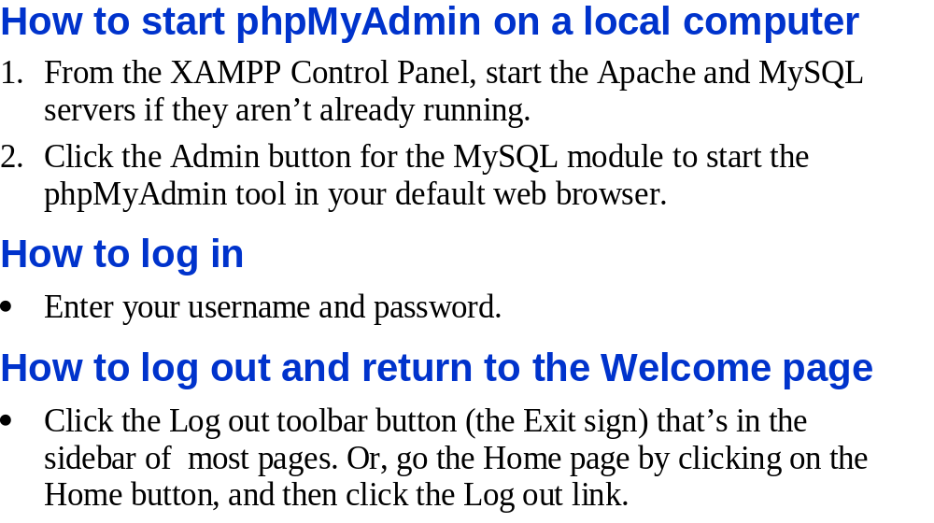

Slide 41
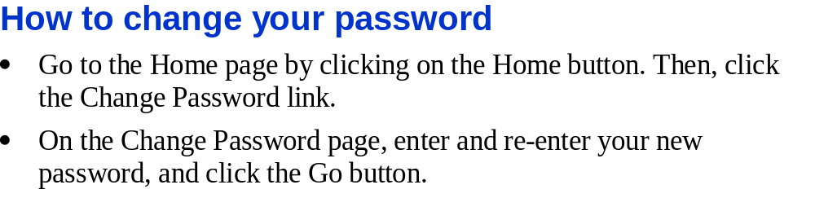
Don’t do this

Slide 42
Getting set up for running a scipt
Directions
Go to your xampp\htdocs folder
Make the following folders: book_apps\_create_db
put the create_db, my_guitar_shop1, and my_guitar_shop2 files there
In xampp\htdocs\book_apps put the file ch03_select_script

Slide 43
Import and Run a Script
SQL Script
  File with >=1 SQL statement
    Can be:
      Data Definition Language
        Makes the structure of the DB
      Data manipulation Language
        To change the content of the DB
  Can use to restore the DB to its original data
    Useful if you make a mistake
  To run
    Import tab → File to import section → Browse → choose file → click go
      Might need to select DB first
        If script has been designed to run against a particular DB
        USE command selects DB
        -Or can use phpMyAdmin

Slide 44
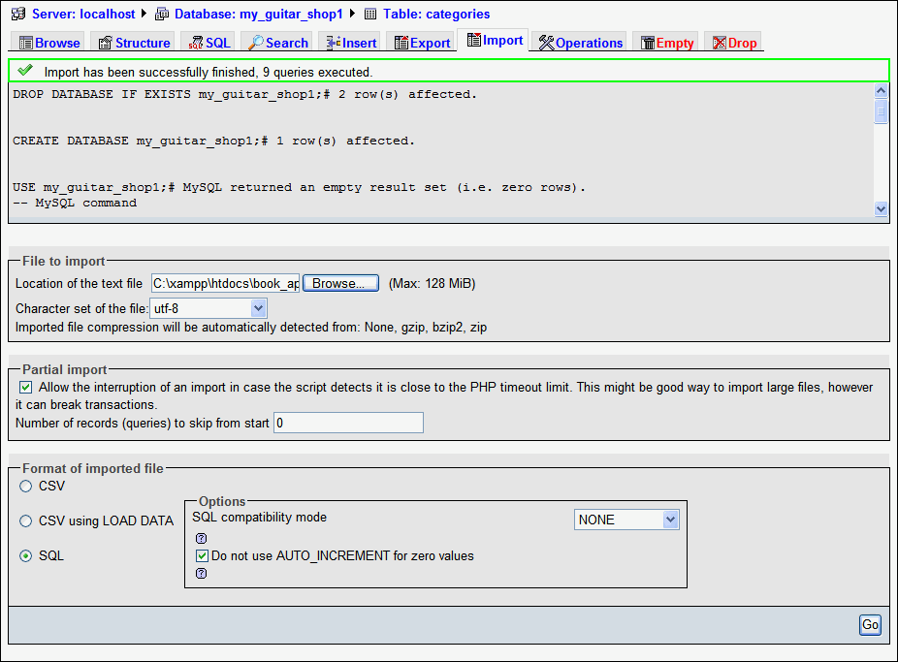
import the file: xampp\htdocs\book_apps\_create_db\create_db
What does this file do?
creates the DBs: my_guitar_shop1 and my_guitar_shop2

Slide 45
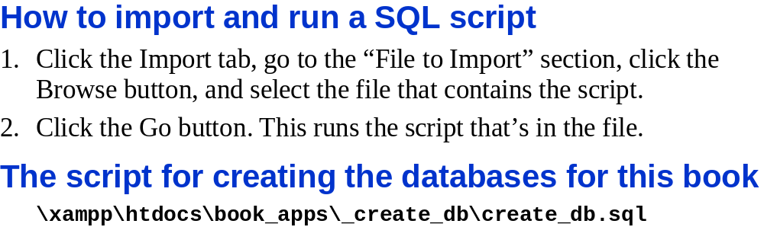

Slide 46
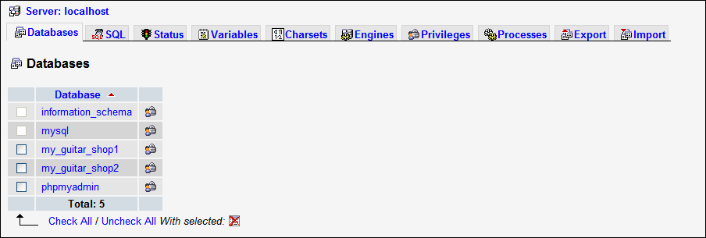
Select DB from
Left Menu
or
Databases Tab
Notice these DBs:
Created by our script: my_guitar_shop1, & my_guitar_shop2
Used by Phpmyadmin: Phpmyadmin
Used by MySQL (to manage its own operations): mysql, & information_schema
Installed automatically: test
Click: my_guitar_shop1 → structure tab appears

Slide 47
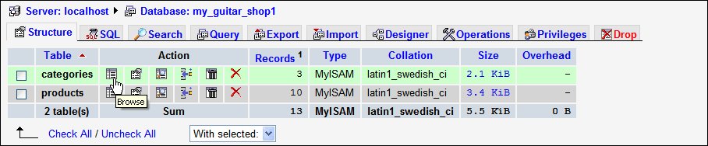
Action Columns
Browse
  View 1st 30 records (default)
    To prevent accidental display of thousands of records
Structure
  View column names and data types for table
Search
  Look for a row
Insert
Empty
  Delete ALL rows
  Keeps table’s structure
Drop
  Deletes structure and content

Slide 48
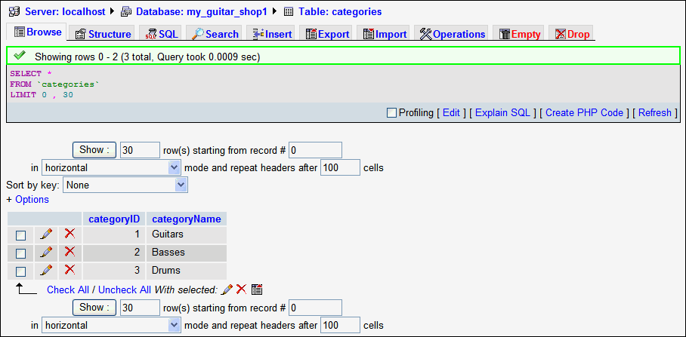
Action Columns
Browse (cont.)
  View 1st 30 records (default)
    To prevent accidental display of thousands of records
    To change see highlights
  Can:
    Edit (click edit icon (pencil))
    Delete (click on x)

Slide 49
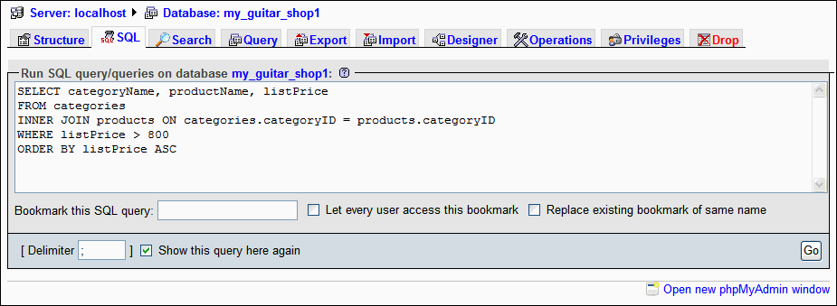
Use to test statements before put in PHP
  Easier
Single statement
  Don’t need semicolin
Script
  Separate statements with ;
Captialise keyword
  optional
  E.g., SELECT
  beware:
    DB on Unix
      Table and column names case sensitive

Slide 50
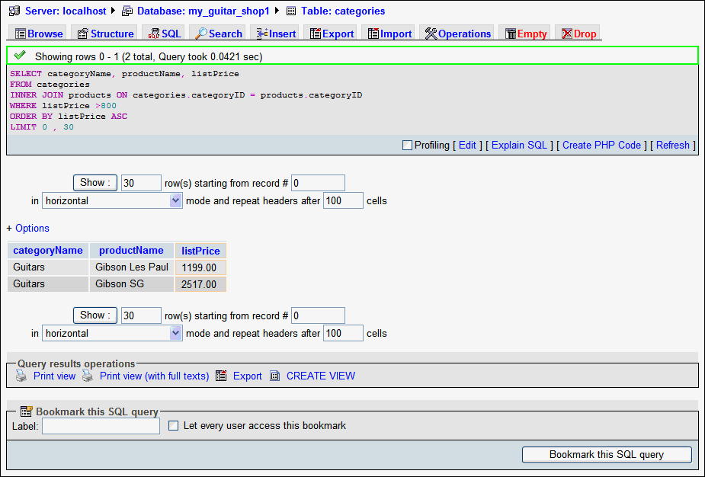

Slide 51
Select
Retrieves data
  From >= 1 table
  output:
    Table
      Called Result Set / Result Table
  *
    Wild card. Gets all columns
  FROM
    Identifies table to select columns from
  WHERE
    Constraint on the rows
      E.g., get the rows where cateforyID = 2
  ORDER BY
    Sorts results in asending order of the given column

Slide 52
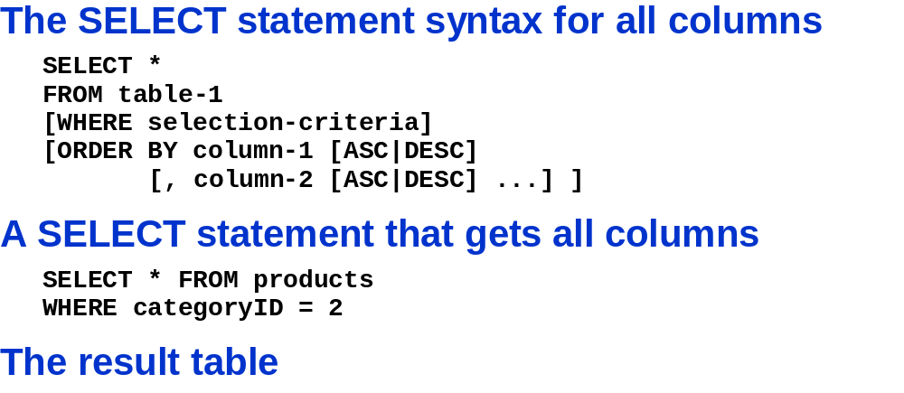

Choice
Optional
How many fields does the products table have EXACTLY?
Answer: 5 b/c * returns all columns
query
A question
Select and other SQL statement are called query when run
Keep number or columns and rows to minium in results
  Minimises network traffic

Slide 53
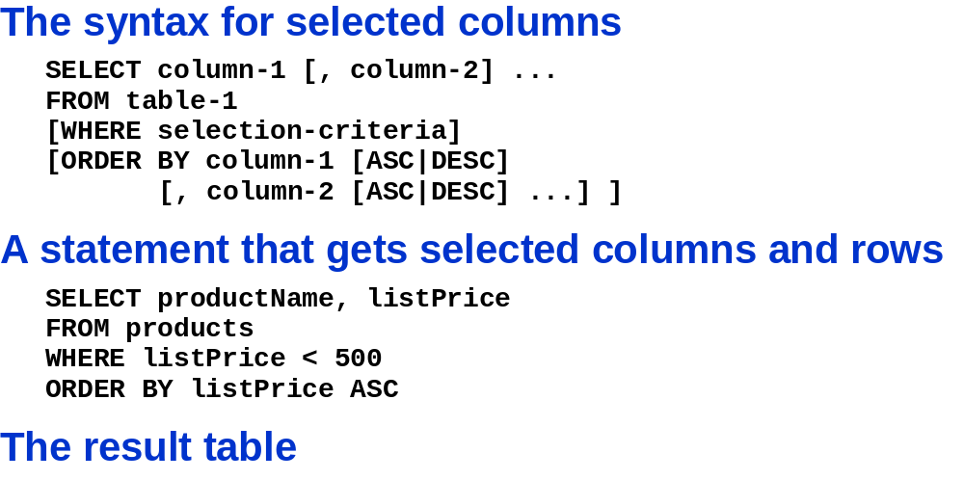
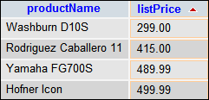
Interpret these statements.
How many columns does the products table have EXACTLY?
Answer: indeterminate

Slide 54
In Class Assignment
Write a select query on the my_guitar_shop1 DB
  It should:
    Pick out all of the products with a categoryID of 2
      What are the names of the products?
  Sol’n:
  SELECT * FROM `products` WHERE categoryID = 2
  Is it possible to pick out product from more than 1 categoryID at the same time? If so demonstrate it.
  Sol’n:
  SELECT * FROM `products` WHERE categoryID = 2 OR categoryID = 3
  Alternatively,
  SELECT * FROM `products` WHERE categoryID = 2 || categoryID = 3

Slide 55
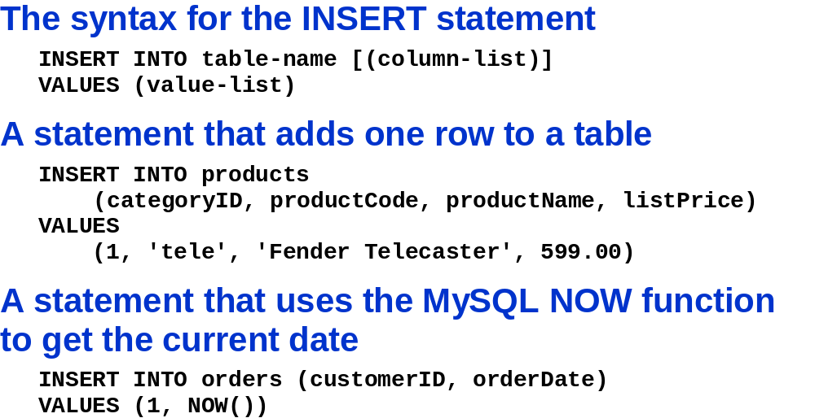
Column list is optional. If not provided MUST give values in order columns defined in table
Say what?
Is there a mistake in the column list?
Where is the productID?
It is intenitionally left out b/c it is automatically generated
Current date and time inserted into orderDate
Action query
Statements modifying data
  E.g. delete, update, insert
Insert
Don’t need to include values for columns whose values are: NULL, default or automatically generated

Slide 56
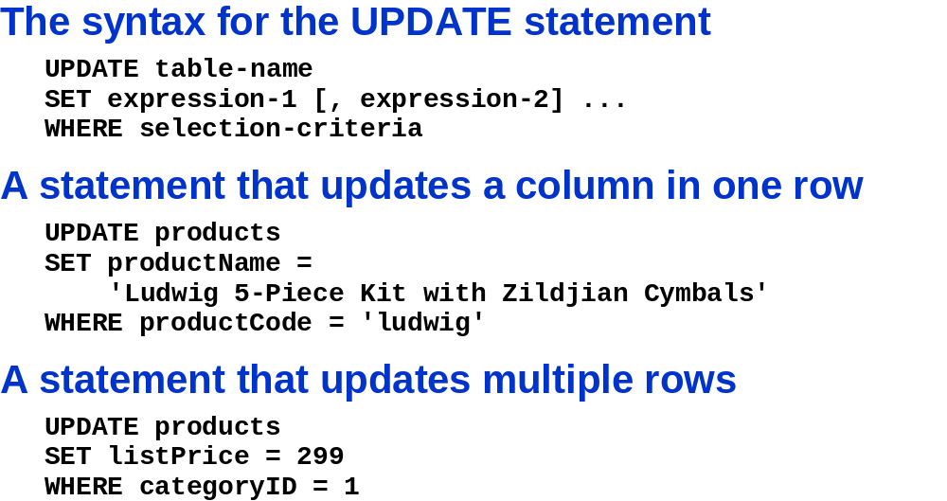

Slide 57
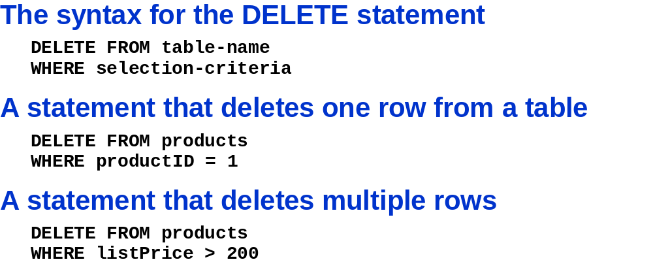

Slide 58
IN CLASS ASSIGNMENT
Insert the value Test into the table categories under the column categoryName
INSERT INTO categories (categoryName)
VALUES ('Test')
Delete the entry using the GUI
Insert into the orders table the following new rows at the simulataneously:
1) using the current date and time as the only value.
2) a customerID of 100 and any date other than the current time and date
3) a customerID of 201 and any date and time other than the current time and date
INSERT INTO orders (orderDate)
VALUES (NOW());
INSERT INTO orders (customerID, orderDate)
VALUES (100, '2010-11-05');
INSERT INTO orders (customerID, orderDate)
VALUES (201, '2002-01-25 6:26:12');
Change the customerID from 201 to 101 for all rows in the orders table
UPDATE orders
SET customerID = 101
WHERE customerID = 201
Delete all records with categoryID not equal to 1 from the products table
DELETE FROM products
WHERE `categoryID` > 1

Slide 60
In Class Assignment
Use the GUI to make a table
  Call it MyFirstTable
  Make at least 3 columns
    Fill out the columns with different value
  Look up anything that is new to you
  Do you need the auto_increment? Why or why not?

Slide 61
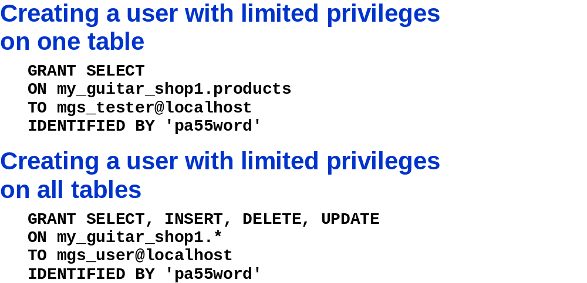
Creates user on localhost with the given password

Slide 62
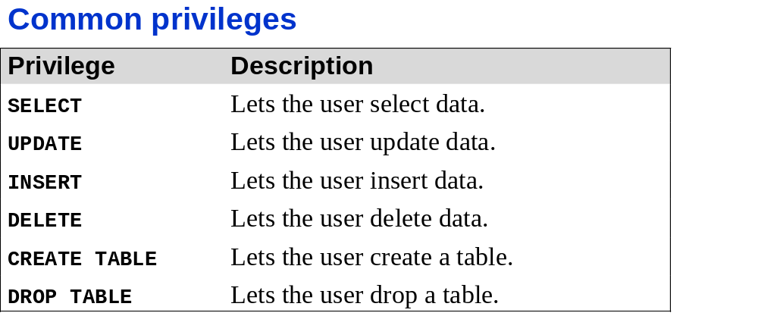
Other related Keywords
SHOW GRANTS
REVOKE
  Cancels grants given
DROP USER

Slide 63
In Class Assignment
Create a user name destroyer who has access to the local host and only the ability to destroy the the my_guitar_shop2 DB contents and structure. His name is his passport.
Sol’n:
GRANT DELETE, DROP
ON my_guitar_shop2.*
TO destroyer@localhost
IDENTIFIED BY 'destroyer‘

Slide 64

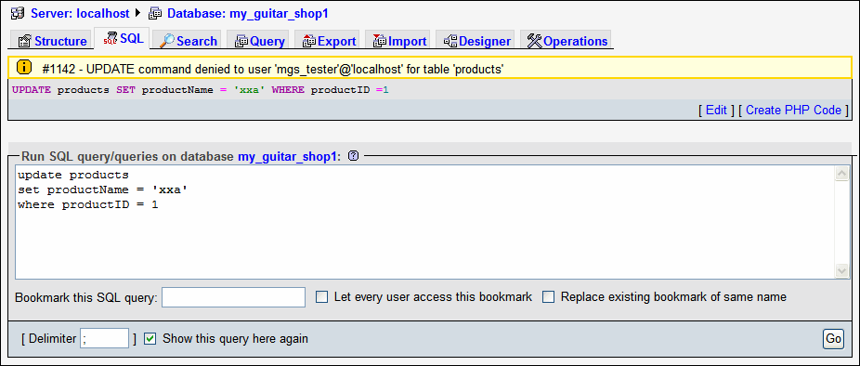

Slide 65
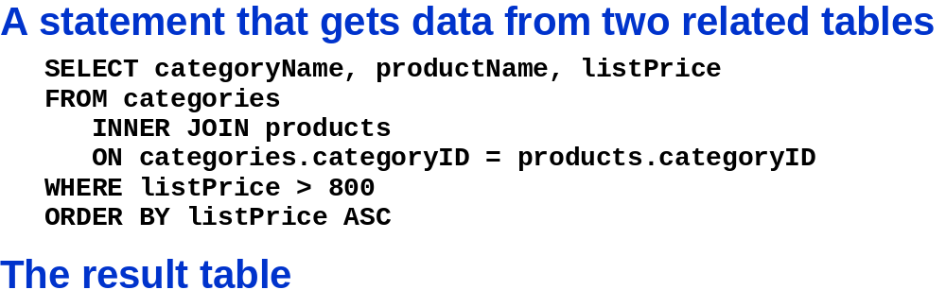


Slide 66
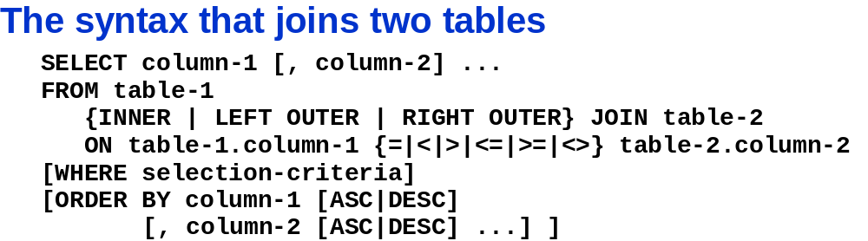
Join
Getting the results from 2 tables
Result
  Single table
Inner Join
  Most common join
  The data from the rows of the 2 tables only included in result if their related columns match

Slide 67


Slide 69
Getting Started with
MySQL
MySQL Monitor
  a command-line program
    for manipulating MySQL databases
Commands are entered at the mysql-> command prompt in the console window
Connect to the MySQL server using a command-line connect
  /r
    Short form
    E.g., /r databaseName

Slide 70
Logging in to MySQL
Enter the following command:
  mysql –h host –u user –p
Two accounts are created:
  Anonymous user account
    allows login without specifying a username or password
  root account
    the primary administrative account for MySQL
    created without a password
  mysql –u root
exit or quit commands
  Log out

Slide 71
Logging in to MySQL (continued)
$ mysql –h php_db -u johnQuser -p[ENTER]
Enter password: **********[ENTER]
Welcome to the MySQL monitor. Commands end with ; or \g.
Your MySQL connection id is 6611 to server version: 4.1.9-nt
Type 'help;' or '\h' for help. Type '\c' to clear the buffer.
mysql>
up and down arrow keys
  scroll through previously entered commands

Slide 72
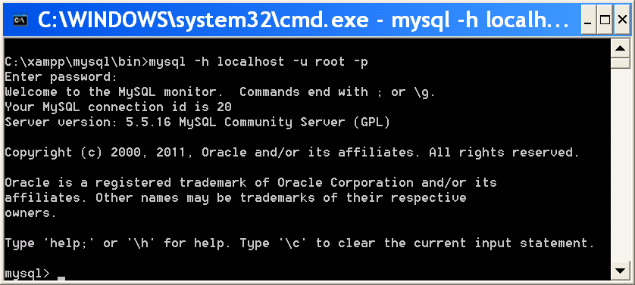
Logging in to MySQL (continued)
MySQL Monitor on a Windows platform

Slide 73
Working with the MySQL Monitor
; (semicolon)
  terminates the command
  mysql> SELECT * FROM inventory;
  Without semicolon
    MySQL Monitor enters a multiple-line command
      changes the prompt to ->
  mysql> SELECT * FROM inventory
  ->

Slide 74
Understanding MySQL Identifiers
Alias
  an alternate name
    used to refer to a table or field in SQL statements
case sensitivity
  keywords NOT case sensitive
    E.g., DELETE, FROM, INSERT, INTO, ORDER BY, SELECT, UPDATE, WHERE
  Identifiers:
    database and table identifiers depends on the operating system
      Not case sensitive on Windows platforms
      Case sensitive on UNIX/Linux systems
    Field and index identifiers case INSENSITIVE on ALL platforms
MySQL stores each database in a directory of the same name as the database identifier

Slide 75
Understanding MySQL Identifiers (continued)
Backtick
  or left single quote, character (`)
    below the tilde (~)
  Any identifier can be enclosed in backticks
    Identifiers that MUST be quoted using backtick are those that:
      include any character EXCEPT:
        standard alphanumeric characters
        underscores (_)
        dollar signs ($)
      contain >= 1 space characters
        E.g., SELECT * `Postal Code` FROM Addresses
      Are a reserved word in MySQL
      made are entirely of numeric digits
      contain a backtick character
        MUST escape ` but preceding with `
        - E.g., Wang`s → `Wang``s`
For even more confusing characters visit: www.cs.sfu.ca/~ggbaker/reference/characters

Slide 76
MySQL Identifiers
Identifier = Name
  Max 64 char except for alias
  Must define for:
    Databases
      Any character OS allows for directory / file names except: /, ., \
    Tables
      Any character OS allows for directory / file names except:
    Fields
      Any character OS allows for directory / file names + /, ., \
    Indexes
      Any character OS allows for directory / file names + /, ., \
    Aliases
      Any character OS allows for directory / file names + /, ., \
      Up to 255 char.

Slide 77
MySQL Identifiers
NOTE on Portability:
    Many DBMSs don’t allow:
      special characters
        E.g., space
      Identifiers to start with digit
      If you use these your database isn’t as portable
        Sol’n
        use common naming convention
        -first character is a letter
        -rest are ONLY:
        -letter
        -number
        -underscore

Slide 78
Getting Help with MySQL Commands
Exercise:
  Get a list of commands available in MySQL
  Using uppercase characters execute the command that gets the current information for the server
    Use both the full form and short form of the command
  Using lowercase characters execute the command that gets the current information for the server
    Use both the full form and short form of the command
  What happens if you omit the ;
  Answer
    Type: Help contents → help [area] → …
    Command for Current information: status (short form \s)
    Command
      Long form of command NOT case sensitive, Short form is.
      ; NOT required

Slide 79
Working with MySQL Monitor
Exercise
What does this do:
  SHOW DATABASES;
    Type it without a semicolin
      What happens
      How do you get out of it?
        Type ; and hit enter.
    Does this work: show databases?
      Yes, but standard:
        Capitalise KEYWORDS
        Lower or mixed case for database, tables, fields

Slide 80
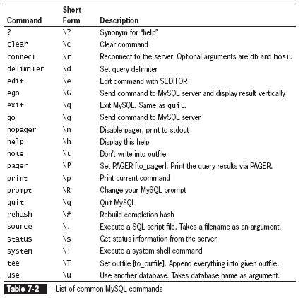
Getting Help with MySQL Commands
Some commands on UNIX
  Edit, nopager, system

Slide 81
Creating Databases
Exercise
  Make a DATABASE called DB1.
  Is the DB1 database the current database?
  How do you switch to another (or same) database?

Slide 82
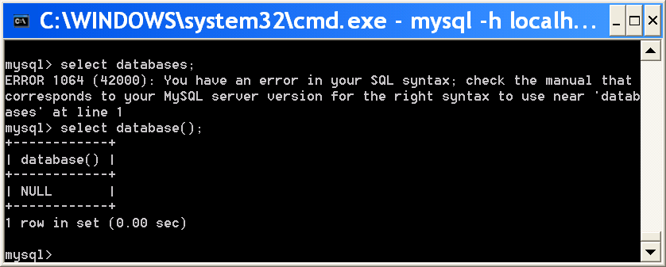
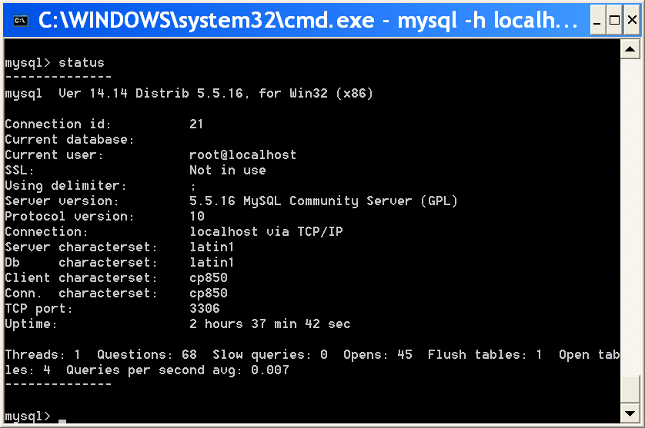
Creating Databases
Answer
CREATE DATABASE statement
  creates a new database:
  mysql> CREATE DATABASE DB1;[ENTER]
Is the DB1 database the current database?
  Type STATUS OR SELECT DATABASE();
    No it is not
USE DATABASE statement
  select database you want to use
  mysql> USE DATABASE DB1;[ENTER]

Slide 83
Selecting a Database
DATABASE() function
  return name of the currently active database
mysql> SELECT DATABASE();[ENTER]
  MUST use SELECT keyword before the function
    Select
      execute function
      + return result
SHOW DATABASES statement
  View the available databases
mysql> SHOW databases;[ENTER]

Slide 84
Removing a Database
Exercise
  Login as anonymous
  Verify that the DB1 database exists
  If not create it
  How would you Delete it totally? Do it.
Answer
  Mysql –u anonymous
  SHOW DATABASES;
    NOT SELECT DATABASE();
  Can’t create or delete from anonymous b/c don’t have privilages
    Must be in root or account with drop / delete prilages
  Login to root
    DROP DATABASE DB1;
DROP DATABASE statement
  remove all tables and deletes database / structure
    mysql> DROP DATABASE database;

Slide 85
Defining Database Tables
Data types are assigned to fields
  determine how much storage space allocated for the data in the database
    Choose smallest data type possible for each field

Slide 86
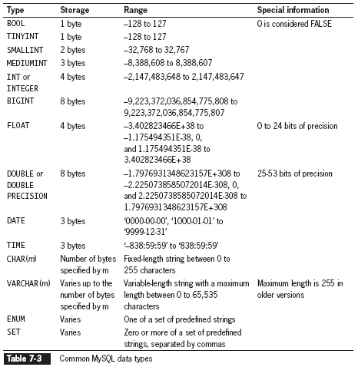
Defining Database Tables
(continued)
Which should you use and why?
Varchar
  its size can change according to number of characters in a field

Slide 87
Creating Tables
CREATE TABLE statement
  create new table and:
    define column names
    and data types for each column
  mysql> CREATE TABLE autos
  (license VARCHAR(10), make VARCHAR(25),
  model VARCHAR(50), miles FLOAT,
  assigned_to VARCHAR(40));[ENTER]

Slide 88
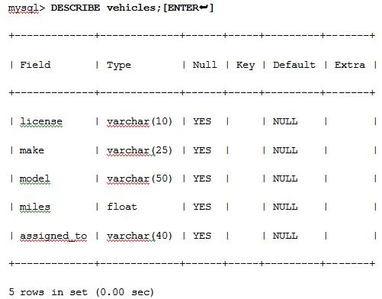
Viewing Table Structure
DESCRIBE table_name statement
  view the structure of the table
Values Last 4 cols. Can be defined when table created
  Null
    Indicates if field can be left empty
  Key
    Type of key defined
      Primary
      Unique
      Index
  Default
    Value that will be inserted automatically
  Extra
    Special features
      E.g., autoincrement

Slide 89
Changing Table Field Names
ALTER TABLE
  Add fields in a table
  ALTER TABLE table_name ADD [COLUMN] (column_name column_type [, column_name column_type ...]);
    In MySQL Monitor, enter the following:
      mysql> ALTER TABLE vehicles ADD COLUMN (model_year INT);[ENTER]
      e.g., alter table autos ADD COLUMN (model_year INT NOT NULL PRIMARY KEY NULL AUTO_INCREMENT)
        Sets 2nd to 6th fields in result of “describe autos” to No and PRI NULL AUTO_INCREMENT

Slide 90
Modifying Column Types
ALTER TABLE (Cont)
  rename columns of an existing field in a table
    ALTER TABLE table_name CHANGE [COLUMN] column_name new_name column_type;
    In MySQL Monitor, enter the following:
      mysql> ALTER TABLE vehicles CHANGE COLUMN miles mileage FLOAT;[ENTER]
      [Changes name and data type to floating point]

Slide 91
Renaming Columns
ALTER TABLE (Cont)
  Change data type of existing fields
    ALTER TABLE table_name MODIFY [COLUMN] column_name column_type;
    In MySQL Monitor, enter the following:
      mysql> ALTER TABLE vehicles MODIFY COLUMN
      model_year SMALLINT;[ENTER]

Slide 92
Renaming Tables
Use the ALTER TABLE to change the name of an existing table using the following syntax
ALTER TABLE table_name RENAME [TO] new_name;
mysql> ALTER TABLE vehicles RENAME TO
company_cars;[ENTER]

Slide 93
Removing Columns
Use the ALTER TABLE to remove an existing field from a table using the following syntax
ALTER TABLE table_name DROP [COLUMN]
column_name;
mysql> ALTER TABLE company_cars DROP COLUMN
assigned_to;[ENTER]

Slide 94
Deleting Tables
Execute the DROP TABLE statement to remove all data and the table definition from a database
DROP TABLE table;
In MySQL Monitor, enter the following at the mysql> prompt:
mysql> DROP TABLE company_cars;[ENTER]
You must be logged in as the root user or have DROP privileges to delete a table.

Slide 95
Modifying User Privileges
Privileges
  actions and operations a user can perform with a table or a database
  accounts should only be assigned the MINIMUM necessary privileges to perform given tasks
    For security purposes

Slide 96
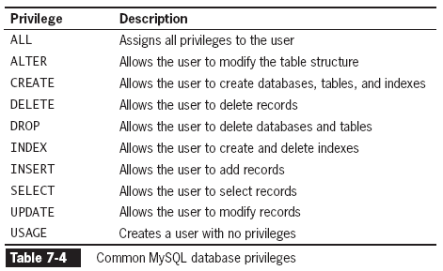
Modifying User Privileges
(continued)

Slide 97
Granting Privileges
GRANT statement:
  if account does not exist:
    creates user account
    and assigns privileges
  If account exists:
    updates the privileges
  GRANT privilege [(column)] [, privilege [(columns)]] ...
  ON {table | * | *.* | database.*}
  TO user [IDENTIFIED BY 'password'];
  [e.g., GRANT CREATE ON db1 TO anon@’localhost’ IDENTIFIED BY ‘password’;
    i.e., makes a new user (because of the IDENTIFIED BY) called anon on the local host who is given the password ‘password’, and is granted the ability to create tables on the database db1]
Notes:
http://www.mysqltutorial.org/mysql-grant.aspx
http://kb.mediatemple.net/questions/788/HOWTO%3A+GRANT+privileges+in+MySQL#dv

Slide 98
Revoking Privileges
REVOKE
  Cancels grants given
REVOKE ALL PRIVILEGES statement
  removes all privileges from a user account
    for a specified table or database
  You must be:
    logged in with the root account
    or have sufficient privileges to revoke privileges
    from another user account
The syntax for the REVOKE statement is:
  REVOKE privilege [(column)] [, privilege [(columns)]] ...
  ON {table | * | *.* | database.*}
  FROM user;

Slide 99
Other related Keywords
SHOW GRANTS
DROP USER

Slide 100
In Class Assignment
1) To the user called mgs_tester, Grant the select privilege only on the my_guitar_shop1 database and only for the products table. His server is on the localhost. His password is pa55word
2) To the user called mgs_user, Grant the select, insert, delete, update privileges only on all tables in the my_guitar_shop1 database. His server is on the localhost. His password is pa55word
Sol’n:
Creates user on localhost with the given password

Slide 101
In Class Assignment:
Login to the mgs_tester account
Check which account is loged in.
Check what grants the user has.
What database are you using?
Use the my_guitar_shop1 DB.
Read the contents of the orders table.
  What happened and why?
Read the contents of the products table.
Note if you do not have the my_guitar_shop1 DB set up import the script file (as describes above on slide 37) in myphpadmin. OR in mysql monitor: SOURCE pathOfScript.
e.g. SOURCE xampp\htdocs\ book_apps\_create_db\create_db
Notes:
Note if you do not have the my_guitar_shop1 DB set up import the script file (as describes above on slide 37) in myphpadmin. OR in mysql monitor: SOURCE pathOfScript.
e.g. SOURCE xampp\htdocs\book_apps\_create_db\create_db

Slide 102
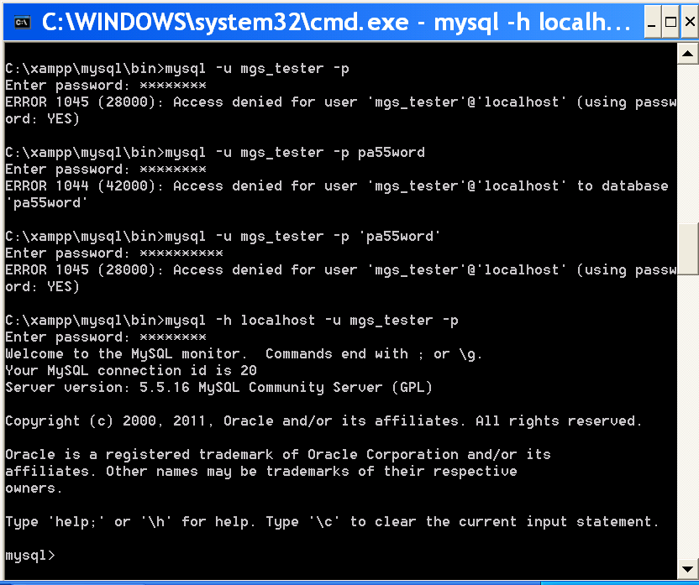
Sol’n:
MUST login explicitly to local host

Slide 103
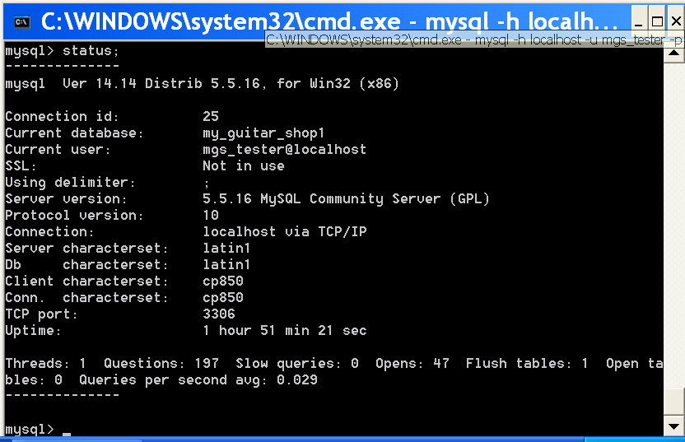

Slide 104
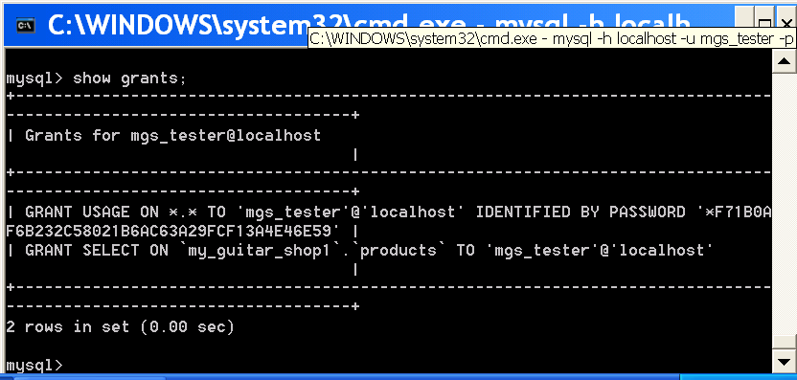
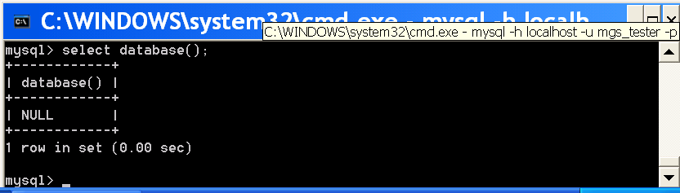
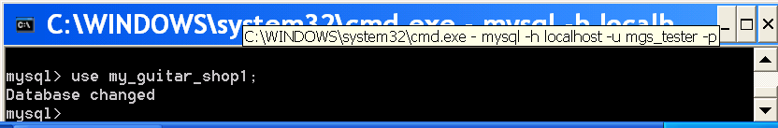
Yours will be NULL unless you used ‘use’
  Then displays DB you are using

Slide 105
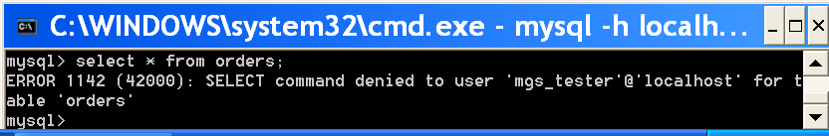
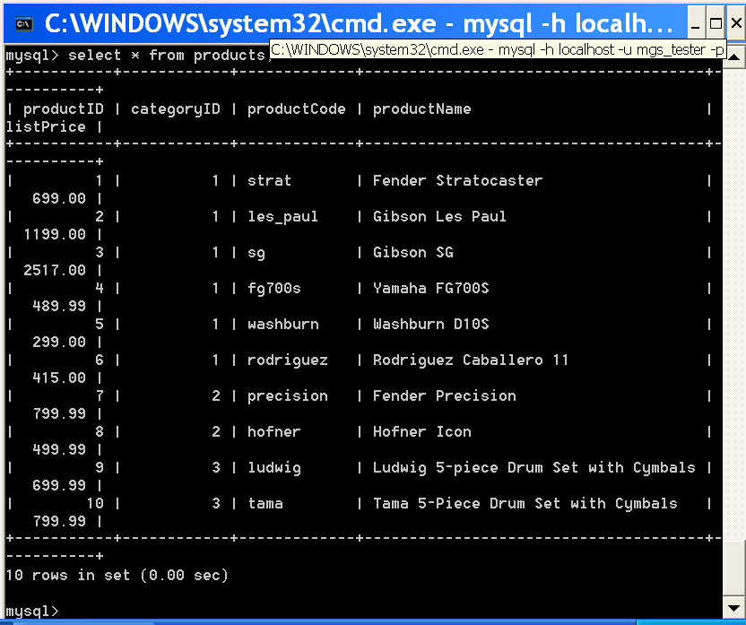

Slide 106
In Class Assignment
Create a user name destroyer who has access to the local host and only the ability to destroy the the my_guitar_shop2 DB contents and structure. His name is his passport.
Sol’n:
GRANT DELETE, DROP
ON my_guitar_shop2.*
TO destroyer@localhost
IDENTIFIED BY 'destroyer‘

Slide 108
In Class Assignment
Use the GUI to make a table
  Call it MyFirstTable
  Make at least 3 columns
    Fill out the columns with different value
  Look up anything that is new to you
  Do you need the auto_increment? Why or why not?
Notes:
http://trebleclick.blogspot.ca/2009/01/mysql-set-auto-increment-in-phpmyadmin.html

Slide 109
Adding Records
INSERT statement
  adds individual records to a table
  INSERT INTO table_name (column1, column2, …)
  VALUES(value1, value2, ...);
    values entered in the VALUES list MUST
    be in the SAME ORDER in which you defined the table fields
    Specify NULL in any fields for which you do not have a value

Slide 110
In Class Assignment
  In the table company_cars
    Add a row that has these values:
      Fields:
        license, model_year, make, model, mileage
      VALUES:
        'CK-2987', 2009, 'Toyota', 'Corolla', 3508.4

Slide 111
Adding Records (continued)
Answer:
In MySQL Monitor:
  Create Table
  CREATE TABLE company_cars
  (license VARCHAR(10), model_year INT, make VARCHAR(25), model VARCHAR(50), mileage FLOAT);[ENTER]
  Enter the following code at the mysql> prompt:
mysql> INSERT INTO company_cars(license,
model_year, make, model, mileage)
VALUES('CK-2987', 2009, 'Toyota',
'Corolla', 3508.4);[ENTER]

Slide 112
Adding Records (continued)
LOAD DATA statement
  with the full path and name of a local text file
    used to add multiple records to a table
LOAD DATA INFILE 'file_path' INTO TABLE
table_name (column1, column2, …);
  Each record in the text file MUST:
    be placed on a separate line
    with a tab delimiter between each field

Slide 113
Adding Records (continued)
LOAD DATA statement
  If column list omitted
    the values on each line must be in the same order you defined the table fields
  to designate a column with no value:
    Use consecutive tabs with nothing between them
    DON’T use NULL
      Interpreted as a NULL value
  FIELDS TERMINATED BY clause
    optional
    allows you to change the field separator
      to a character such as (~ or ,)
        instead of the default tab character

Slide 114
In Class Assignment
load several record into the company_cars table
Answer
Create a text file in the directory:
  C:\xampp\mysql\data\
    This acts as the root directory: i.e., if you type c:\fileName in the load statement, MySQL looks for it in this directory, NOT c:\.
  OR
  C:\xampp\mysql\data\DB_Name\
    Store in this directory if you type only ‘fileName’ in the load statement
In MySQL Monitor, enter the following code at the mysql> prompt:
mysql> LOAD DATA INFILE 'company_cars.txt‘
INTO TABLE company_cars;[ENTER]

Slide 115
Retrieving Records
SELECT statement
  to retrieve records from a table:
SELECT criteria FROM table_name;
  asterisk (*)
    wildcard
    Use with the SELECT statement
      to retrieve all fields from a table
  To return multiple fields
    separate field names with a comma

Slide 116
Retrieving Records (continued)
In MySQL Monitor, enter the following code at the mysql> prompt:
mysql> SELECT model, mileage FROM
company_cars;[ENTER]

Slide 117
Using Aggregate Functions
Aggregate functions
  summarize data in record sets
    rather than display the individual records
COUNT() function
  unique in that
    The wildcard (*) can be used as a function argument instead of a field name
    The keyword DISTINCT can be used after the opening parentheses
      DISTINCT keyword
        can also be used to retrieve records with a unique value
        - with the SELECT statement in the WHERE clause

Slide 118
Using Aggregate Functions (continued)
To retrieve aggregate values for groups of records, use the GROUP BY clause and include the fields that you use to group the records as part of the query
In MySQL Monitor, enter the following code at the mysql> prompt:
  mysql> SELECT model_year, AVG(mileage)
  FROM company_cars GROUP BY
  model_year;[ENTER]

Slide 119
Sorting Query Results
Use the ORDER BY keyword with the SELECT statement to perform an alphanumeric sort of the results returned from a query
In MySQL Monitor, enter the following code at the mysql> prompt:
  mysql> SELECT make, model FROM inventory
  ORDER BY make, model;[ENTER]

Slide 120
Sorting Query Results (continued)
To perform a reverse sort, add the DESC keyword after the name of the field by which
you want to perform the sort
In MySQL Monitor, enter the following code at the mysql> prompt:
mysql> SELECT make, model FROM
company_cars ORDER BY make DESC,
model;[ENTER]

Slide 121
Filtering Query Results
The criteria portion of the SELECT statement determines which fields to retrieve from a table
You can also specify which records to return by using the WHERE keyword
In MySQL Monitor, enter the following code at the mysql> prompt:
mysql> SELECT * FROM inventory WHERE
make='Martin‘;[ENTER]

Slide 122
Filtering Query Results (continued)
Use the keywords AND and OR to specify more detailed conditions about the records you want to return
In MySQL Monitor, enter the following code using the AND keyword at the mysql> prompt:
mysql> SELECT * FROM company_cars
WHERE model_year=2007 AND
mileage<60000;[ENTER]

Slide 123
Filtering Query Results (continued)
In MySQL Monitor, enter the following code using the OR keyword at the mysql> prompt:
mysql> SELECT * FROM company_cars
WHERE make='Toyota’ OR
make='Honda‘ ORDER BY mileage ;[ENTER]

Slide 124
Updating Records
To update records in a table, use the UPDATE statement
The syntax for the UPDATE statement is:
      UPDATE table_name
      SET column_name=value
      WHERE condition;
  The UPDATE keyword specifies the name of the table to update
  The SET keyword specifies the value to assign to the fields in the records that match the condition in the WHERE keyword

Slide 125
Updating Records (continued)
In MySQL Monitor, enter the following code using the OR keyword at the mysql> prompt:
  mysql> UPDATE company_cars SET mileage=368.2
  WHERE make='Ford’ AND model='Fusion';[ENTER]

Slide 126
Deleting Records
Use the DELETE statement to delete records in a table
The syntax for the DELETE statement is:
DELETE FROM table_name
WHERE condition;
The DELETE statement deletes all records that match the condition
To delete all the records in a table, leave off the WHERE keyword

Slide 127
Deleting Records (continued)
In MySQL Monitor, enter the following code at the mysql> prompt:
mysql> DELETE FROM company_cars WHERE
model_year=2006 AND make='Honda'
AND model='Accord';[ENTER]
To delete all records from a table, omit the WHERE clause

Slide 128
Summary
A database is an ordered collection of information from which a computer program can quickly access information
A record in a database is a single, complete set of related information
Fields are the individual categories of information stored in a record
A flat-file database stores information in a single table

Slide 129
Summary (continued)
A relational database stores information across multiple related tables
A query is a structured set of instructions and criteria for retrieving, adding, modifying, and deleting database information
Structured query language, or SQL (pronounced sequel), is a standard data manipulation language among many database management systems

Slide 130
Summary (continued)
MySQL Monitor is a command-line program that you use to manipulate MySQL databases
To work with a database, you must first select it by executing the USE DATEBASE statement
You use the CREATE DATABASE statement to create a new database
To delete a database, you execute the DROP DATABASE statement, which removes all tables from the database and deletes the database itself

Slide 131
Summary (continued)
The fields in a table also store data according to type
To keep your database from growing too large, you should choose the smallest data type possible for each field
To create a table, you use the CREATE TABLE statement, which specifies the table and column names and the data type for each column

Slide 132
Summary (continued)
To modify a table, you use the ALTER TABLE statement, which specifies the table being changed and the change to make
To delete a table, you execute the DROP TABLE statement, which removes all data and the table definition
You use a GRANT statement to create user accounts and assign privileges, which refer to the operations that a user can perform with a database

Slide 133
Summary (continued)
You use the REVOKE statement to take away privileges from an existing user account for a specified table or database
You add individual records to a table with the INSERT statement
To add multiple records to a database, you use the LOAD DATA statement with a local text file that contains the records you want to add

Slide 134
Summary (continued)
You use the SELECT statement to retrieve records from a table
You use the ORDER BY keyword with the SELECT statement to perform an alphanumeric sort of the results returned from a query
To perform a reverse sort, add the DESC keyword after the name of the field by which you want to perform the sort

Slide 135
Summary (continued)
You can specify which records to return from a database by using the WHERE keyword
You use the UPDATE statement to update records in a table
You use the DELETE statement to delete records from a table
The phpMyAdmin graphical tool simplifies the tasks associated with creating and maintaining databases and tables

Slide 136
Coding Practice – Functions and Control Structures
The following code is supposed to fill an array with the #’s 1 to 110 and print them on the monitor. Check to see if it works. If it doesn’t Identify and Fix the logical flaws in the code:
  <?
  $C = 0;
  While ($C > 110);
  $N[] = $C;
  ++$C;
  Foreach ($C as $CNum)
  echo “<p>$C</p>”;
  }
  ?>
  Save the file and test it on gblearn.
  Make sure you use Filezilla correctly.

Slide 137
Make a small PHP site.
  The header and footer should be the same for all pages on the website.
    You should NOT add the same header and footer manually to all pages on the site.
  You must make:
    at least:
      2 main pages
      Make sure they Have:
        Headers
        1 list
        Use formatting like bold or italic somewhere
        Suggestions:
        -price list
        -schedule
        -inventory list
    1 header file
    1 footer file

Slide 138
Write a short program (i.e., script) displaying the Celsius to Kelvin conversions from 0 Kelvin up to the burning point of paper. Display the Celsius temperature to only 2 decimal places.
Make sure that the code and the results are displayed on gblearn.

