Slide 1
M5B
Manipulating MySQL
Databases with PHP
Lab Slides

Slide 2
Objectives
In this chapter, you will:
Connect to MySQL from PHP
Work with MySQL databases using PHP
Create, modify, and delete MySQL tables with PHP
Use PHP to manipulate MySQL records
Use PHP to retrieve database records

Slide 3
Determining which MySQL Package to Use
PHP < version 5 automatically supported MySQL
PHP > Version 5 you need to turn on MySQL support
  Configure it to use the mysqli or mysql package.
  mysqli (MySQL Improved) package
    the object-oriented equivalent of the mysql package
    became available with PHP 5
    designed to work with MySQL v. 4.1.3 and later
      Earlier versions must use the mysql package

Slide 4
Opening and Closing a MySQL Connection
mysql_connect() function
  Open a connection to a MySQL database server
  Returns:
    positive integer
      if it connects to the database successfully
    or FALSE
      if it does not
  Assign the return value to a variable
      used to access the database in your script

Slide 5
Opening and Closing a MySQL Connection (continued)
mysql_connect()function (Cont.):
$connection = mysql_connect("host" [, "user", "password"]);
  host argument
    specifies host name
      where MySQL database server is installed
  user and password arguments
    specify a MySQL account name and password

Slide 6
Opening and Closing a MySQL Connection (continued)
mysql_connect()function (Cont.):
$DBConnect = mysql_connect("localhost", “citizen_kane", "rosebud");
  What does $DBConnect do?
    Holds database connection / return value of mysql_connect
mysql_close() function
  Close a database connection
mysql_close($DBConnect);

Slide 7
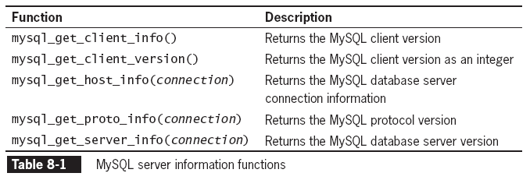
Opening and Closing a MySQL Connection (continued)
Client
  The web server that is running the PHP script
Server
  The server running the MySQL DB
First 2 f’ns get info on the mysql package PHP is using
Rest of f’ns get info on the DB server and MySQL apps running on it.

Slide 8
In Class Assignment
Write a PHP script that connects to the local DB and uses each of the functions listed:

Slide 9
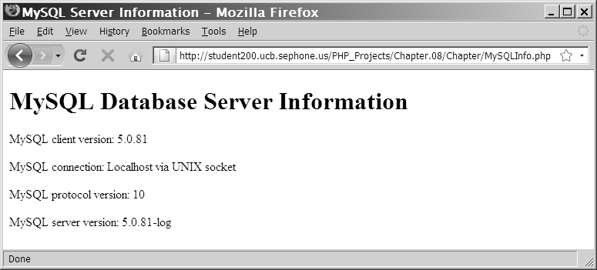
Opening and Closing a MySQL Connection (continued)
Results of the functions 1, 3, 4, 5 above in a Web browser

Slide 10
Reporting MySQL Errors
Reasons for not connecting to a DB server:
  The database server is not running
  Insufficient privileges to access the data source
  Invalid username and/or password

Slide 11
Reporting MySQL Errors (continued)
mysql_errno() function
  Returns:
    error code from last attempted MySQL function call
    or 0 if no error occurred
mysql_error()
  Returns text describing error.
Return results of the previous mysql*() function ONLY

Slide 12
Reporting MySQL Errors (continued)
Abbreviated syntax to handle errors when connecting:
  $DBConnection = (mysql_connect (…) || die(mysql_error));
  Die()
    Exits script immediately
      Don’t use if you need rest of web page to display
Note: in the mysqli package connection errors are reported with:
  mysqli_connect_error()
  mysqli_connect_errno()
  They DON’T take parameters
  Other DB errors use mysqli_error() and mysqli_errno() the same way as mentioned.

Slide 13
Suppressing Errors with the Error Control Operator
By default, functions in the mysql package display errors and warnings as they occur
  Never show these in a live site
    Security risk
    Users feel they made mistake
error control operator (@)
  Use to suppress error messages
  can be prepended to any expression
    although commonly used with built in functions
  E.g., $DBConnect = @mysql_connect("localhost", “citizen_kane", "rosebud");

Slide 14
Creating a Database
mysql_create_db() function
  creates new database
  syntax:
    $result = mysql_create_db( "dbname" [, connection]);
  returns a Boolean:
    TRUE
      if successful
    FALSE
      if there was an error

Slide 15
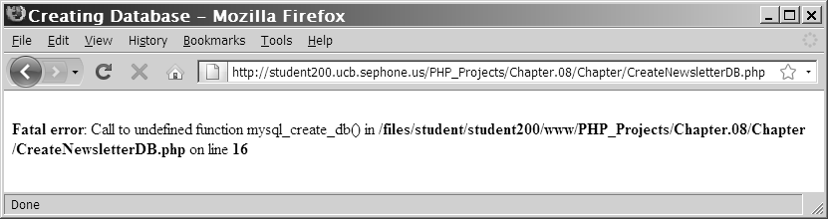
Creating a Database (continued)
Figure 8-2 Error message when the mysql_create_db() function is unavailable because of insufficient privileges

Slide 16
Selecting a Database
syntax for the mysql_select_db() function is:
  mysql_select_db(database [, connection]);
returns a value of
  TRUE
    if it successfully selects a database
  FALSE
    if it does not
For security purposes, use an include file to:
  connect to the MySQL server
  and select a database

Slide 17
Deleting a Database
mysql_drop_db() function.
  delete a database
  format:
    $Result = mysql_drop_db("dbname" [, connection]);
  returns:
    TRUE
      if it successfully drops a database
    FALSE
      if it does not

Slide 18
Executing SQL Statements
mysql_query() function
  sends SQL statements to MySQL
  syntax:
mysql_query(query [, connection]);

Slide 19
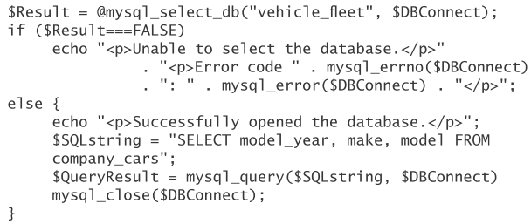
Executing SQL Statements (continued)
mysql_query() function returns one of three values:
  For SQL statements that DON'Treturn results
      (CREATE DATABASE and CREATE TABLE statements)
    returns TRUE if statement executes successfully
  For SQL statements that return results
      (SELECT and SHOW statements)
    returns a result pointer that represents the query results
      result pointer
        is a special type of variable
        - that refers to the currently selected row in a resultset
        resultset: list of records returned by MySQL
        Keeps track of where you are in the result set
        -assign the result pointer to a variable that is used to access the resultset in PHP
  for any SQL statements that fail
    regardless of whether they return results
    returns a value of FALSE
Result pointer is assigned to the variable $QueryResult
Notes:
p.460

Slide 20
Creating and Deleting Tables
To create a new table:
  Use the mysql_select_db() function
    to verify that you are in the right database
  Use the CREATE TABLE statement
    with the mysql_query() function

Slide 21
Creating and Deleting Tables (continued)
$SQLstring = "CREATE TABLE drivers (name VARCHAR(100), "
. "emp_no SMALLINT, hire_date DATE, "
. "stop_date DATE)";
$QueryResult = @mysql_query($SQLstring, $DBConnect);
if ($QueryResult===FALSE)
echo "<p>Unable to execute the query.</p>"
. "<p>Error code " . mysql_errno($DBConnect)
. ": " . mysql_error($DBConnect) . "</p>";
else
echo "<p>Successfully created the table.</p>";

Slide 22
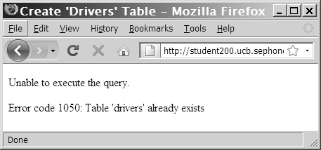
Creating and Deleting Tables (continued)
Figure 8-3 Error code and message that displays when you attempt to create a table that already exists

Slide 23
Creating and Deleting Tables (continued)
to prevent code from trying to create a table that already exists.
  Use the SHOW TABLES LIKE command
    [in mysql_query]
    If the table does not exist:
      the mysql_num_rows()function will return a value of 0 rows
$TableName = "subscribers";
$SQLstring = "SHOW TABLES LIKE '$TableName'";
$QueryResult = @mysql_query($SQLstring, $DBConnect);
if (mysql_num_rows($QueryResult) > 0)
echo “tables exists”;
else
…

Slide 24

Creating and Deleting Tables (continued)
Primary Keys
To identify a field as a primary key
  include the PRIMARY KEY keywords
    when you define a field with the CREATE TABLE statement
AUTO_INCREMENT keyword
  often used with a primary key to generate a unique ID for each new row in a table
NOT NULL keywords
  often used with primary keys to require that a field include a value

Slide 25
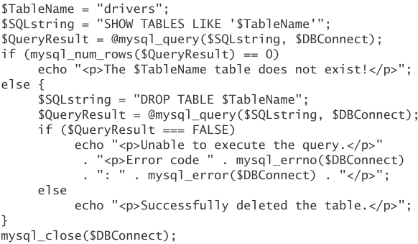
Creating and Deleting Tables (continued)
To delete a table, use:
  the DROP TABLE statement
    with the mysql_query() function

Slide 26
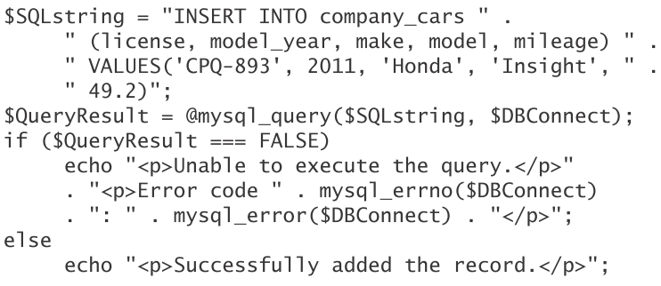
Adding, Deleting, and Updating Records
To add records to a table:
  use the INSERT and VALUES keywords
    with the mysql_query() function

Slide 27
Adding, Deleting, and Updating Records
To add multiple records to a database:
  use the LOAD DATA statement
    with the name of the local text file
      containing the records you want to add

Slide 28
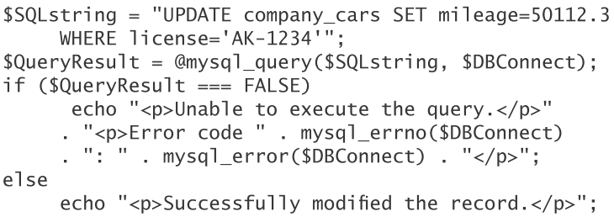
Adding, Deleting, and Updating Records (continued)
To update records in a table use:
  UPDATE statement
    UPDATE keyword specifies the name of the table to update
  SET keyword:
    Specifies value to assign to the fields in the records
      that match the condition in the WHERE clause

Slide 29
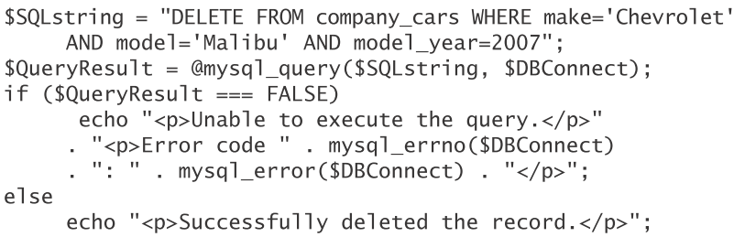
Adding, Deleting, and Updating Records (continued)
To delete records in a table:
  use the DELETE statement
    with the mysql_query() function
to delete all records in a table:
  Omit the WHERE clause

Slide 30
Using the mysql_affected_rows() Function
mysql_num_rows() function
  Use to find the number of records returned from the query
    With queries that return results
      (SELECT queries)
mysql_affected_rows() function
  Use to determine the number of affected rows
    With queries that modify tables
      but do not return results
        (INSERT, UPDATE, and DELETE queries),

Slide 31
Using the mysql_affected_rows() Function (continued)
$SQLstring = "UPDATE company_cars SET mileage=50112.3
WHERE license='AK-1234'";
$QueryResult = @mysql_query($SQLstring, $DBConnect);
if ($QueryResult === FALSE)
echo "<p>Unable to execute the query.</p>"
. "<p>Error code " . mysql_errno($DBConnect)
. ": " . mysql_error($DBConnect) . "</p>";
else
echo "<p>Successfully updated "
. mysql_affected_rows($DBConnect) . " record(s).</p>";

Slide 32
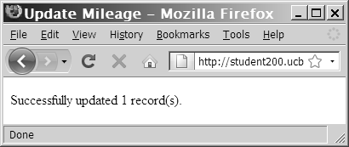
Using the mysql_affected_rows() Function (continued)
Figure 8-5 Output of mysql_affected_rows() function
for an UPDATE query

Slide 33
Using the mysql_info() Function
mysql_info(databaseConnection) function
  return information about queries that:
    add or update records
    or
    Alter table’s structure
  Returns:
    the number of operations
      for various types of actions, depending on the type of query
    information about the last query that was executed
      on the database connection
    Empty string for non-add/update/alter queries
  mysql_info($DBConnect)
    Recall: $DBConnect = mysql_connect("host", “user", "Password")

Slide 34
Using the mysql_info() Function (continued)
The mysql_info() function returns information about queries that match one of the following formats:
  INSERT INTO...SELECT...
  INSERT INTO...VALUES (...),(...),(...)
  LOAD DATA INFILE ...
  ALTER TABLE ...
  UPDATE
  For any queries that do not match these formats:
    mysql_info() returns empty string

Slide 35
Using the mysql_info() Function (continued)
$SQLstring = "INSERT INTO company_cars " .
" (license, model_year, make, model, mileage) " .
" VALUES " .
" ('CPQ-894', 2011, 'Honda', 'Insight', 49.2), " .
" ('CPQ-895', 2011, 'Honda', 'Insight', 17.9), " .
" ('CPQ-896', 2011, 'Honda', 'Insight', 22.6)";
$QueryResult = @mysql_query($SQLstring, $DBConnect);
if ($QueryResult === FALSE)
echo "<p>Unable to execute the query.</p>"
. "<p>Error code " . mysql_errno($DBConnect)
. ": " . mysql_error($DBConnect) . "</p>";
else {
echo "<p>Successfully added the record.</p>";
echo "<p>" . mysql_info($DBConnect) . "</p>";
}

Slide 36
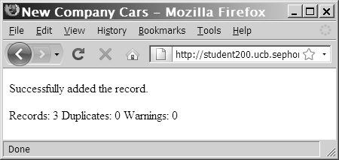
Using the mysql_info() Function (continued)
Figure 8-6 Output of mysql_info() function for an
INSERT query that adds multiple records

Slide 37
Using the mysql_info() Function (continued)
The mysql_info() function also returns information for LOAD DATA queries
  $SQLstring = "LOAD DATA INFILE 'company_cars.txt'
  INTO TABLE company_cars;";
  $QueryResult = @mysql_query($SQLstring, $DBConnect);
  if ($QueryResult === FALSE)
  echo "<p>Unable to execute the query.</p>"
  . "<p>Error code " . mysql_errno($DBConnect)
  . ": " . mysql_error($DBConnect) . "</p>";
  else {
  echo "<p>Successfully added the record.</p>";
  echo "<p>" . mysql_info($DBConnect) . "</p>";
  }

Slide 38
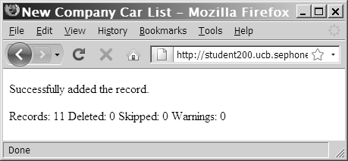
Using the mysql_info() Function (continued)
Figure 8-7 Output of mysql_info() function for a
LOAD DATA query

Slide 39
Retrieving Records into an
Indexed Array
Mysql_query returns a result pointer
  For statements that return results
    E.g., Select, show.
  Result pointer
    Represents query results
    Assigned to a variable
      Used to access resultset in PHP
    To access DB records through result pointer you MUST use a function
      There are many functions
        E.g., mysql_fetch_row($Result)

Slide 40
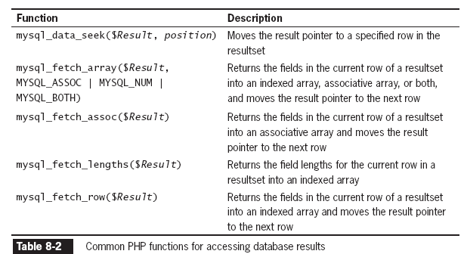
Working with Query Results

Slide 41
Retrieving Records into an Indexed Array
mysql_fetch_row() function
  returns the fields in the current row of a resultset into an indexed array
  and
  moves the result pointer to the next row
echo "<table width='100%‘ border='1'>";
echo "<tr><th>Make</th><th>Model</th>
<th>Price</th><th>Quantity</th></tr>";
$Row = mysql_fetch_row($QueryResult);
do {
echo "<tr><td>{$Row[0]}</td>";
echo "<td>{$Row[1]}</td>";
echo "<td align='right'>{$Row[2]}</td>";
echo "<td align='right'>{$Row[3]}</td></tr>";
$Row = mysql_fetch_row($QueryResult);
} while ($Row);

Slide 42
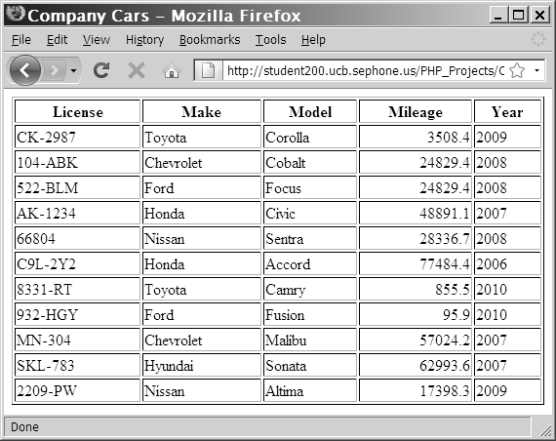
Retrieving Records into an Indexed Array
$SQLstring = "SELECT * FROM company_cars";
$QueryResult = @mysql_query($SQLstring, $DBConnect);
echo "<table width='100%' border='1'>\n";
echo "<tr><th>License</th><th>Make</th><th>Model</th>
<th>Mileage</th><th>Year</th></tr>\n";
while (($Row = mysql_fetch_row($QueryResult)) !== FALSE) {
echo "<tr><td>{$Row[0]}</td>";
echo "<td>{$Row[1]}</td>";
echo "<td>{$Row[2]}</td>";
echo "<td align='right'>{$Row[3]}</td>";
echo "<td>{$Row[4]}</td></tr>\n";
}
echo "</table>\n";
Figure 8-8 Output of the company_cars table in a Web Browser

Slide 43
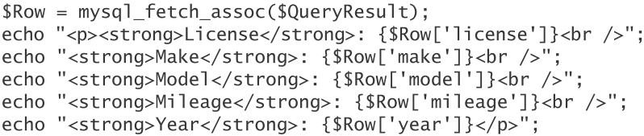
Retrieving Records into an Associative Array
mysql_fetch_assoc() function
  returns the fields in the current row of a resultset into an associative array
    uses each field name as the array key
  and
  moves the result pointer to the next row
mysql_fetch_row()
  returns the fields into an indexed array

Slide 44
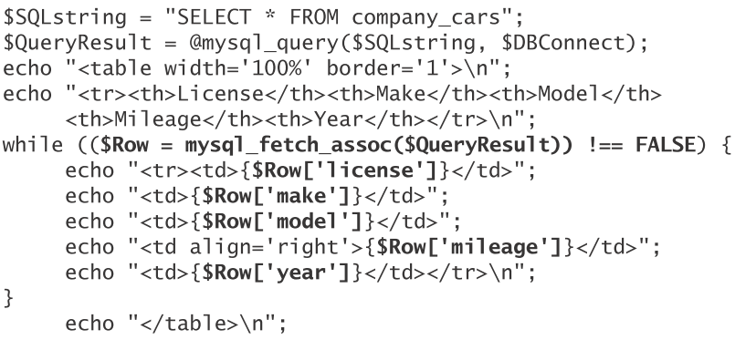

Slide 45
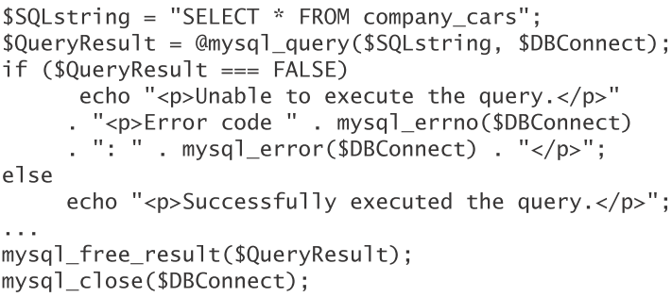
Closing Query Results
use the mysql_free_result() function to
  close the resultset
    After done working with query results
      retrieved with the mysql_query() function
To close the resultset:
  pass the variable containing the result pointer (from the mysql_query() function) to the mysql_free_result() function

Slide 46
Accessing Query Result Information
mysql_num_rows() function
  returns the number of rows in a query result
mysql_num_fields() function
  returns the number of fields in a query result

Slide 47
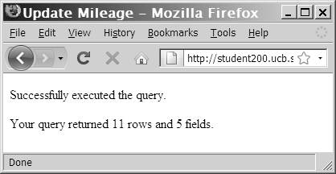
Accessing Query Result Information (continued)
$SQLstring = "SELECT * FROM company_cars";
$QueryResult = @mysql_query($SQLstring, $DBConnect);
if ($QueryResult === FALSE)
echo "<p>Unable to execute the query.</p>"
. "<p>Error code " . mysql_errno($DBConnect)
. ": " . mysql_error($DBConnect) . "</p>";
else
echo "<p>Successfully executed the query.</p>";
$NumRows = mysql_num_rows($QueryResult);
$NumFields = mysql_num_fields($QueryResult);
if ($NumRows != 0 && $NumFields != 0)
echo "<p>Your query returned " .
mysql_num_rows($QueryResult) . " rows and "
. mysql_num_fields($QueryResult) . " fields.</p>";
else
echo "<p>Your query returned no results.</p>";
mysql_close($DBConnect);
Figure 8-10 Output of the number of rows and fields returned from a query

Slide 48
Summary
The mysql_connect() function opens a connection to a MySQL database server
The mysql_close() function closes a database connection
The mysql_errno() function returns the error code from the last attempted MySQL function call or zero if no error occurred

Slide 49
Summary (continued)
The mysql_error() function returns the error message from the last attempted MySQL function call or an empty string if no error occurred
The error control operator (@) suppresses error messages
You use the mysql_create_db() function to create a new database
The mysql_select_db() function selects a database

Slide 50
Summary (continued)
You use the mysql_drop_db() function to delete a database
The mysql_query() function sends SQL statements to MySQL
A result pointer is a special type of variable that refers to the currently selected row in a resultset
You use the CREATE TABLE statement with the mysql_query() function to create a table

Slide 51
Summary (continued)
The PRIMARY KEY clause indicates a field or fields that will be used as a referential index for the table
The AUTO_INCREMENT clause creates a field that is automatically updated with the next sequential value for that column
The NOT NULL clause creates a field that must contain data
You use the DROP TABLE statement with the mysql_query() function to delete a table

Slide 52
Summary (continued)
You use the LOAD DATA statement and the mysql_query() function with a local text file to add multiple records to a database
You use the UPDATE statement with the mysql_query() function to update records in a table
You use the DELETE statement with the mysql_query() function to delete records from a table

Slide 53
Summary (continued)
The mysql_info() function returns the number of operations for various types of actions, depending on the type of query.
The mysql_fetch_row() function returns the fields in the current row of a resultset into an indexed array and moves the result pointer to the next row.

Slide 54
Summary (continued)
The mysql_fetch_assoc() function returns the fields in the current row of a resultset into an associative array and moves the result pointer to the next row
The mysql_free_result() function closes a resultset

Slide 55
Summary (continued)
The mysql_num_rows() function returns the number of rows in a query result, and the mysql_num_fields() function returns the number of fields in a query result
With queries that return results, such as SELECT queries, you can use the mysql_num_rows() function to find the number of records returned from the query

