Slide 1
PHP: Managing States

Slide 2
Objectives
Understand state information
Save state information
  Use hidden fields
  Use query strings
  Use cookies
  Use sessions

Slide 3
Understanding State Information
state information
  Data on each website visit
Maintaining state
  store persistent information
    about website visits
    using hidden form fields, query strings, cookies, and sessions
HTTP was originally designed to be stateless
  browsers store NO persistent data about website visit

Slide 4
Understanding State Information (continued)
Customize individual Web pages
  based on user preferences
Temporarily store information for a user
  as browser navigates within a multipart form
Allow a user to create bookmarks
  for returning to specific locations in website
Provide shopping carts
  that store order information

Slide 5
Understanding State Information (continued)
Store user IDs and passwords
Use counters
  to track how many times user has visited site
Four tools for maintaining state information:
  Hidden form fields
  Query strings
  Cookies
  Sessions

Slide 6
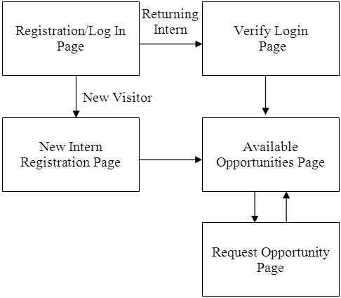
Understanding State Information (continued)
Figure 9-1 College Internship Available Opportunities
website page flow

Slide 7
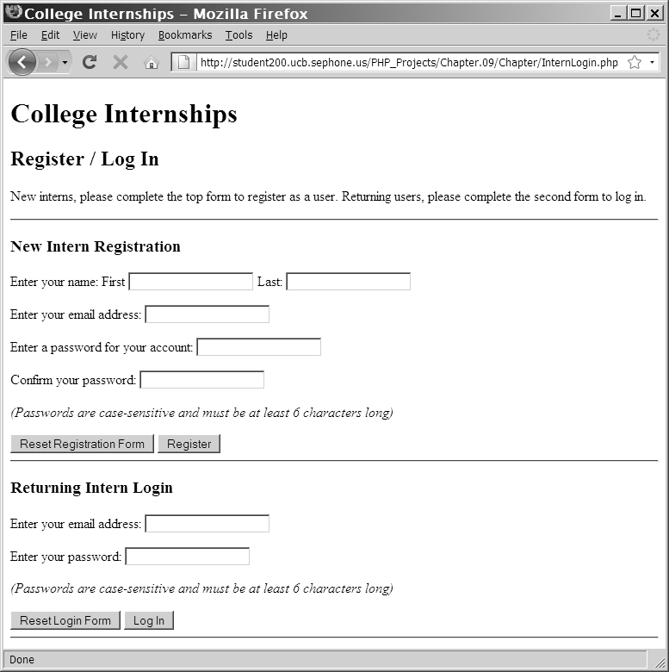
Understanding State Information (continued)
Figure 9-2 Registration/Log In Web page

Slide 8
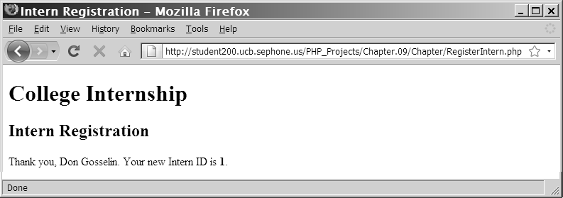
Understanding State Information (continued)
Figure 9-3 New Intern Registration Web page
after successful registration

Slide 9
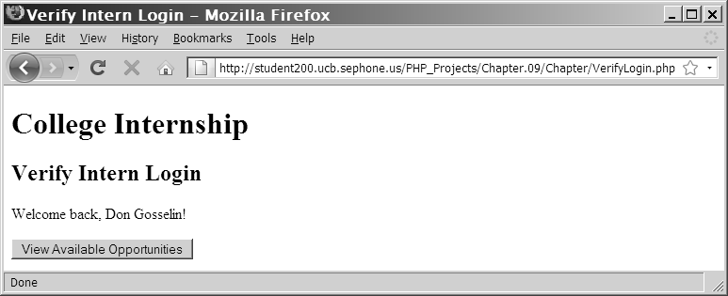
Understanding State Information (continued)
Figure 9-4 Verify Login Web Page for a successful login

Slide 10
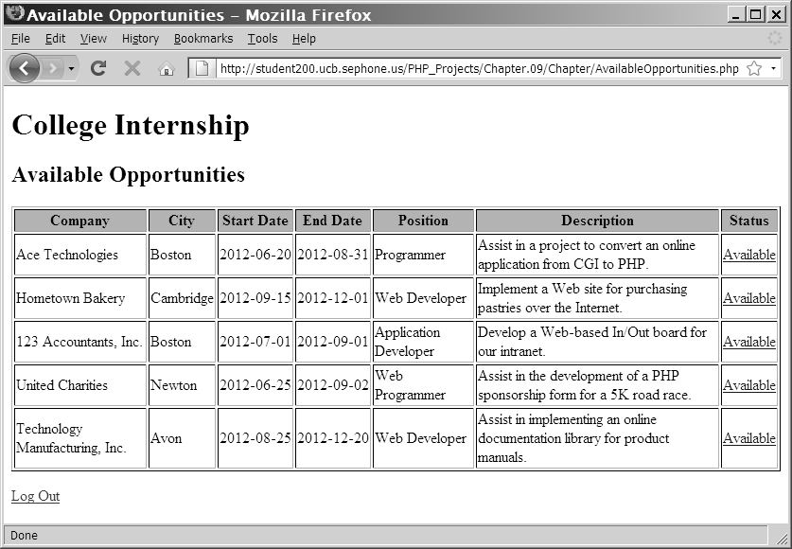
Understanding State Information (continued)
Figure 9-5 The Available Opportunities Web page
with the Intern information at top of screen

Slide 11
Using Hidden Form Fields to Save State Information
<input> element
  Create hidden form fields
    syntax :
<input type="hidden">
  Hidden form fields
    temporarily store data that:
      needs to be sent to a server
      user does not need to see
      is passed from one PHP script to another

Slide 12
Using Hidden Form Fields to Save State Information (continued)
Hidden form field attributes are name and value
$_GET[] and $_POST[] autoglobals
  access values submitted from the form
    When submitting a form to a PHP script
echo "<form method='post' " .
" action='AvailableOpportunities.php'>\n";
echo "<input type='hidden' name='internID' " .
" value='$InternID'>\n";
echo "<input type='submit' name='submit' " .
" value='View Available Opportunities'>\n";
echo "</form>\n";

Slide 13
Using Query Strings to Save State Information
Query string
  a set of name=value pairs APPENDED to a target URL
  Consists of 1 text string containing >=1 pieces of information
  Question mark (?)
    Add after URL
      followed by query string containing information you want to preserve in name/value pairs
        Ampersands (&)
        Separate individual name=value pairs
  Question mark (?) and query string automatically appended to URL of server-side script for forms submitted with GET method

Slide 14
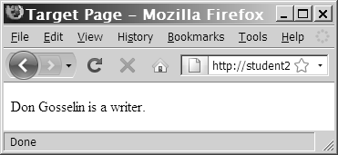
Using Query Strings to Save State Information (continued)
<a href="http://www.example.com/TargetPage
.php?firstName=Don&lastName=Gosselin&
occupation=writer">Link Text</a>
echo "{$_GET['firstName']} {$_GET['lastName']}
is a {$_GET['occupation']}. ";
Figure 9-6 Output of the contents of a query string

Slide 15
Using Query Strings to Save State Information (continued)
Problem:
  Query strings do NOT permanently maintain
  state information
    After a Web page that reads a query string closes, the query string is lost
Solution:
  Use cookies / magic cookies
    STORE state information beyond CURRENT Web page session
    Invented by Netscape

Slide 16
Using Cookies to Save State Information
cookies / magic cookies (cont.)
  Small pieces of information about a user
    stored by a Web server in text files on the user’s computer
  Temporary cookies
    available ONLY for the CURRENT BROWSER SESSION
  Persistent cookies
    available beyond current browser session
      stored in a text file on a client computer
  Individual server or domain can store between 20 & 70 cookies
  Total cookies per browser: <= 300
  Largest cookie: 4 kilobytes

Slide 17
Creating Cookies
setcookie() function syntax :
setcookie(name [,value ,expires, path, domain, secure])
    MUST pass each argument in syntax's order
      To skip:
        value, path, and domain arguments
        specify empty string as argument value
        expires and secure arguments
        specify 0 as argument value
  Call f'n BEFORE sending browser any output
    including white space, HTML, or echo() / print()output
  Users CAN CHOOSE whether to ACCEPT cookies that a script attempts to write to their system
    TRUE returned EVEN IF user REJECTS cookie

Slide 18
Creating Cookies (continued)
Special Characters in Cookies:
  CANNOT contain them when transmitted between Web browsers and Web servers using HTTP:
      e.g., “;” “,” space
  CAN contain them when created with PHP
    Because encoding converts them to hexadecimal ASCII value
Value argument is optional
  BUT it should be included else value = NULL so that cookie same as not having a cookie.

Slide 19

The name and value Arguments
Cookies created with only the name and value arguments are temporary cookies
  because available only for current browser session
  <?php
  setcookie("firstName", "Don");
  ?>
  <!DOCTYPE html PUBLIC "-//W3C//DTD XHTML 1.0 Strict//EN"
  "http://www.w3.org/TR/xhtml1/DTD/xhtml1-strict.dtd">
  <html xmlns="http://www.w3.org/1999/xhtml">
  <head>
  <title>College Internships</title>
  ...

Slide 20
The name and value Arguments (continued)
setcookie() can be called multiple times
  creates additional cookies
    if setcookie() statements come BEFORE any other output on Web page
  setcookie("firstName", "Don");
  setcookie("lastName", "Gosselin");
  setcookie("occupation", "writer");

Slide 21
The name and value Arguments (continued)
[Syntax for array containing cookie values]:
  setcookie(“arrayName[index]”, “value”)
  In Class Assignment: create associative and indexed cookie arrays called professional[]holding3 values:
    Sol'n: Associative array:
    setcookie("professional['firstName']", "Don");
    setcookie("professional['lastName']", "Gosselin");
    setcookie("professional['occupation']", "writer");
      Indexed array:
    setcookie("professional[0]", "Don");
    setcookie("professional[1]", "Gosselin");
    setcookie("professional[2]", "writer");

Slide 22
The expires Argument
expires argument
  determines how long to keep cookie on client before deleting
  Cookies created WITHOUT expires argument are only available for CURRENT BROWSER SESSION
  To specify expiration time use PHP’s time() function
e.g., setcookie("firstName", "Don", time()+3600);
  Means: firstName cookie expires 3600 seconds from current time

Slide 23
The path Argument
path argument
  Makes cookie available to all Web pages in the path and all subdirectories
    Determines availability of cookie
      to other Web pages on a server
    allows cookies to be shared across a server
In Class Assignment: make cookie named firstName available to all Web pages in /marketing directory and its subdirectories:
setcookie("firstName", "Don", time()+3600, "/marketing/");
In Class Assignment: make cookie called firstName available to all Web pages in server:
setcookie("firstName", "Don", time()+3600, "/");

Slide 24
The domain Argument
domain argument
  used for sharing cookies across multiple servers in the SAME domain
    Cookies cannot be shared outside of a domain
[In Class Exercise: write the code to create a cookie named firstName, with a value of Don, that expires in 3600 seconds, is available to all webpages on the server, and available to all servers in the programming.gosselin.com and writing.gosselin.com domains.]
Solution:
setcookie("firstName", "Don”, time()+3600, "/", ".gosselin.com");
[This works because the programming.gosselin.com and writing.gosselin.com have the same second and top level domains (i.e., .gosselin.com)]

Slide 25
The secure Argument
secure argument
  indicates that cookie can ONLY be transmitted across a secure Internet connection
    i.e., using HTTPS or other security protocol
  assign a value of 1 (for TRUE) or 0 (for FALSE)
    To last argument of setcookie() function
Example: take the previous statement and modify it so that it is only sent across a secure connection
  setcookie("firstName”, "Don", time()+3600, "/", ".gosselin.com", 1);

Slide 26
Reading Cookies
$_COOKIE autoglobal
  associative array
    automatically holds cookies available to current Web page
    Access cookie by using the cookie name as a key
      e.g., echo $_COOKIE['firstName'];
Newly created cookies are NOT available until AFTER the current Web page is RELOADED

Slide 27
Reading Cookies (continued)
isset() function
  use to ensure that cookie is set before using it
setcookie("firstName", "Don");
setcookie("lastName", "Gosselin");
setcookie("occupation", "writer");
if (isset($_COOKIE['firstName'])
&& isset($_COOKIE['lastName'])
&& isset($_COOKIE['occupation']))
echo "{$_COOKIE['firstName']} {$_COOKIE['lastName']}
is a {$_COOKIE['occupation']}.";

Slide 28
Reading Cookies (continued)
Use multidimensional array syntax to read
each cookie value
  [i.e. when reading from the $_COOKIE autoglobal the value of an array you made]
setcookie("professional[0]", "Don");
setcookie("professional[1]", "Gosselin");
setcookie("professional[2]", "writer");
if (isset($_COOKIE['professional']))
echo "{$_COOKIE['professional'][0]}
{$_COOKIE['professional'][1]} is a
{$_COOKIE['professional'][2]}.";

Slide 29
Deleting Cookies
To delete a persistent cookie
  assign new expiration value that is in the past
    e.g., subtract any value from the time() function
setcookie("firstName", "", time()-3600);
setcookie("lastName", "", time()-3600);
setcookie("occupation", "", time()-3600);

Slide 30
Using Sessions to Save State Information
Spyware
  gathers user information from a local computer
    without the user’s knowledge
    for marketing and advertising purposes
Session
  a period of activity when a PHP script stores state information ON a WEB SERVER
  allow you to maintain state information EVEN WHEN clients DISABLE COOKIES in their Web browsers

Slide 31
Starting a Session
session_start() function
  starts a new session or
  continues existing session
  generates a unique session ID
    to identify session
    session ID
      random alphanumeric string, e.g.:
      7f39d7dd020773f115d753c71290e11f
  creates a text file on the Web server
    same name as the session ID, preceded by sess_
      e.g., sess_7f39d7dd020773f115d753c71290e11f

Slide 32
Starting a Session (continued)
session_start() function (Cont)
  DOESN'T:
    accept arguments
    return a value that you can use in your script
  MUST call before sending browser any output (like setcookie())
    Else: get error message and returns FALSE
PHPSESSID
  temporary cookie
  session ID is assigned here
    If Client’s Web browser configured to accept cookies
SHOULD pass the session ID as a query string or hidden form field too
  to any Web pages that are called as part of the current session
    Because can't be sure if client will accept cookies
    PHPSESSID = session ID

Slide 33
Starting a Session (continued)
E.g.1) using session_id
  Retrieves session id for current session
  <?php
  session_start(); ...
  ?>
  <p><a href='<?php echo "Occupation.php?PHPSESSID=".session_id() ?>'>Occupation</a> </p>
E.g.2) Or use constant (SID) instead of session_id()
  SID contains PHPSESSID= and the session ID
  <a href='<?php echo "Occupation.php?"
  . SID ?>'>Occupation</a>

Slide 34
Starting a Session (continued)
E.g, 3) For hidden form ﬁelds
assign to:
  name attribute: PHPSESSID and
  value attribute: session_id() function
  <input type="hidden" name="PHPSESSID"
  value='<?php echo session_id() ?>' />
session.save_path directive
  Session ID text files are stored in this Web server directory
  Found in php.ini configuration file

Slide 35
Working with Session Variables
$_SESSION[] autoglobal
  Stores Session state information
  When session_start() function is called, PHP either:
    initializes a new $_SESSION autoglobal or
    retrieves any variables for the current session (based on the session ID) into the $_SESSION autoglobal

Slide 36
Working with Session Variables (continued)
e.g.) code declares & initializes 3 variables (ﬁrstName, lastName, & occupation) in $_SESSION[] autoglobal
  <?php
  session_start();
  $_SESSION['firstName'] = "Don";
  $_SESSION['lastName'] = "Gosselin";
  $_SESSION['occupation'] = "writer";
  ?>
  <p><a href='<?php echo "Occupation.php?"
  . session_id() ?>'>Occupation</a></p>
  When user clicks the Occupation link, ﬁrstName, lastName, & occupation variables are available in the $_SESSION[] autoglobal on the Occupation.html page.
    So can use them, e.g., to print message as in next example (isset())

Slide 37
Working with Session Variables (continued)
isset() function
  Use to ensure that a session variable is set
    before you attempt to use it
<?php
session_start();
if (isset($_SESSION['firstName']) && isset($_SESSION['lastName'])
&& isset($_SESSION['occupation']))
echo "<p>" . $_SESSION['firstName'] . " "
. $_SESSION['lastName'] . " is a "
. $_SESSION['occupation'] . "</p>";
?>

Slide 38
Deleting a Session
Sessions end:
  Automatically when current browser session ends
  Manually by deleting it
    e.g., let user choose to log out
    e.g., end session after inactivity period
    steps:
  1. Execute the session_start() function
      B/c must call it whenever working with sessions in PHP script
  2. Use the array() construct
      to reinitialize the $_SESSION autoglobal
  3. Use the session_destroy() function
      to delete the session

Slide 39
Deleting a Session (continued)
  <?php
  session_start();
  $_SESSION = array();
  session_destroy();
  ?>

Slide 40
Summary
Information about individual visits to a website is called state information. Maintaining state means to store persistent information about website visits
To pass form values from one PHP script to another, you can store the values in hidden form fields, which are submitted along with other types of form fields

Slide 41
Summary (continued)
One way to preserve information following a user’s visit to a Web page is to append a query string to the end of a URL. To pass information from one Web page to another using a query string, add a question mark (?) immediately after a URL, followed by the query string containing the information you want to preserve in name/value pairs.

Slide 42
Summary (continued)
Cookies, also called magic cookies, are small pieces of information about a user that are stored by a Web server in text files on the user’s computer. Cookies can be temporary or persistent.
  Temporary cookies remain available only for the current browser session
  Persistent cookies remain available beyond the current browser session and are stored in a text file on a client computer

Slide 43
Summary (continued)
You use the setcookie() function to create cookies in PHP. You must call the setcookie() function before you send the Web browser any output, including white space, HTML elements, or output from the echo or print statements.
Cookies created with only the name and value arguments of the setcookie() function are temporary cookies, because they are available for only the current browser session

Slide 44
Summary (continued)
For a cookie to persist beyond the current browser session, you must use the expires argument with the setcookie() function
The path argument of the setcookie() function determines the availability of a cookie to other Web pages on a server
The secure argument of the setcookie() function indicates that a cookie can only be transmitted across a secure Internet connection using HTTPS or another security protocol

Slide 45
Summary (continued)
To delete a persistent cookie before the time elapses in the assigned expires argument, assign a new expiration value to a time in the past and clearing the value. You do this by subtracting any number of seconds from the time() function and setting the value of the cookie to the empty string.

Slide 46
Summary (continued)
Sessions refer to periods of activity when a PHP script stores state information on a Web server. When you start a new session, the session_start() function generates a unique session ID to identify the session. If a client’s Web browser is configured to accept cookies, the session ID is assigned to a temporary cookie named PHPSESSID.

Slide 47
Summary (continued)
You must call the session_start() function before you send the Web browser any output, including white space, HTML elements, or output from the echo or print statements
You store session state information in the $_SESSION[] autoglobal

Slide 48
Summary (continued)
To delete a session, execute the session_start() function, use the array[] construct to reinitialize the $_SESSION[] autoglobal and call the session_destroy() function

