Slide 1



NANOTECHNOLOGY – ORIGIN TILL DATE
APARNA G RAJ
ROLL NO. 19
CT

Slide 2

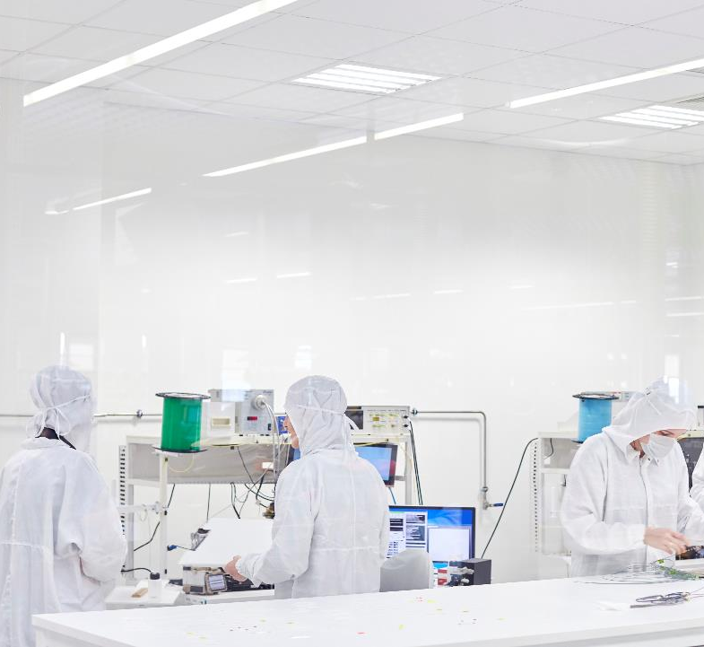
INTRODUCTION
HISTORY AND ORIGIN
DEVELOPMENT OF NANOTECHNOLOGY
APPLICATIONS OF NANOTECHNOLOGY
ADVANTAGES
DISADVANTAGES
FUTURE PROSPECTS
REFERENCE
CONTENTS

Slide 3

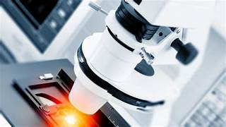
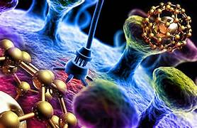
INTRODUCTION
Nanotechnology is a wonderful new technology in which scientists rearrange atoms and molecules of matter to nano specifications. Or, to put it differently, the use and control of tiny matter is called nanotechnology. The tiny matter is referred to as nanoparticles. These particles are measured in nanometers. In modern times, nanotechnology has become increasingly important. It has many uses from developing sports equipment to medical applications and is a faster, cheaper, and better technology for use in many applications.

Slide 4
History and origin
Ideas of nanotechnology were first used in talk “There's plenty of room at the Bottom", a talk given by the scientist Richard Feynman at an American Physical Society meeting at Caltech on December 29, 1959. Feynman described a way to move individual atoms to build smaller instruments and operate at that scale. Properties such as surface tension and van der walls force would become very important. The word "nanotechnology" was explained by Tokyo science university professor Norio Taniguchi in1974 . He said that nanotechnology was the work of changing materials by one atom or by one molecule.

Slide 5
In the 1980s this idea was studied by Dr. K. Eric Drexler, who spoke and wrote about the importance of nano-scale events . "Engines of Creation: The Coming Era of Nanotechnology" (1986) is thought to be the willy thirst book on nanotechnology. Nanotechnology and Nano science started with two key developments: the start of cluster science and the invention of the scanning tunneling microscope (STM). Soon afterwards, new molecules with carbon were discovered – first fullerenes in 1986 and carbon nanotubes a few years later. In another development, people studied how to make semiconductor nano crystals. Many metal oxide nanoparticles are now used as quantum dots. In 2000, the United States National Nanotechnology Initiative began to develop science in this field.

Slide 6
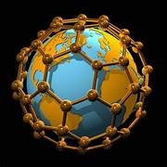
development of nanotechnology
Nanotechnologies are attracting increasing investment from governments and industry around the world. Total global spend is thought to be around $6.25 billion at present, but this is set to rise. The USA's 21st century nanotechnology research and development act (2003) allocated almost $3.7 billion to fund nanotechnologies during 2005-2008. This compares with just $750 million spent in 2003. Between 2001 and 2003, the Japanese government doubled its nanotechnology funding to $800 million. Within Europe, about $1.25 billion is currently spent on nanotechnology research and development per annum, and the UK govt has allocated about $81.9 million per year from 2003 to 2009.

Slide 7
APPLICATIONS OF NANOTECHNOLOGY
MEDICAL FIELD
TEXTILES
DEVICES
Cancer treatment
Drug delivery
Imaging tools and equipment
Gene therapy
Treating wound injuries
Making anti-bacterial
Stain-resistance
Wrinkle
Fuzz resistant textiles
Glucose sensors
Lithium-ion batteries
Thin film
Solar panels
High-efficiency sensors

Slide 8
ENHANCING WATER QUALITY
Space SCIENCE
CHEMICAL SENSORS
The applications of nanotechnology is visible in space science and research. Apart from making the outer structure of satellites durable and lightweight using materials like CNT, research is also being done on how to send spacecraft with lesser fuel.
Improve the quality of water by removing chemical and industrial waste such as TCE from the river and groundwater. Using nanotechnology for purification of water is highly effective and comparatively cheaper.
Nanomaterials like zinc oxide nanowires, carbon nanotubes as well as palladium nanoparticles, various sensors have been designed which can easily detect even the smallest amounts of hazardous chemicals.

Slide 9
ELECTRONICS AND IT
ENERGY APPLICATIONS
Nanotechnology has played a major role in advancing electronics and computers that has led to faster portable systems with the ability to store large amounts of information.
Transistors have gotten smaller in size.
MRAM or magnetic random access memory is able to get started or ‘boot’ easily.
Hazardous materials used in fuse electronics are now replaced with nanoparticle copper suspensions.
Nanotechnology has improved the efficiency of fuel production from raw petroleum materials through better catalysis.
New kinds of batteries are being developed by the use of nano technology for better charging and more efficiency.
Wind mill blades are now being made by using epoxy containing carbon nanotubes to increase the amount of electricity wind mills can generate

Slide 10
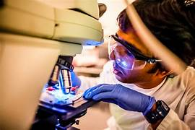
ADVANTAGES
Durable
Lightweight
Stronger
Cheaper
Precise
More efficient
Devices are very small in size
Faster
Uses smaller batteries

Slide 11
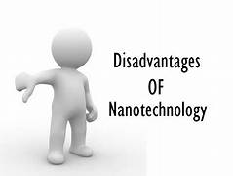
DISADVANTAGES
Negative impact on environment
Unemployment may prevail
Economical imbalance
Hazardous weapons accessible
Costly
Negative impact on people’s health

Slide 12
Future prospects
Space exploration: Nanotechnology has the potential to revolutionize space exploration by enabling lightweight and durable materials, advanced sensors, and improved energy systems. nano sensors could be used for exploration of extraterrestrial environments, while nanomaterials could provide protection against radiation and extreme temperatures.
Quantum technologies: Nanotechnology will play a crucial role in the development of quantum technologies. Nanoscale structures, such as quantum dots and nanowires, can be used to manipulate and control quantum states, leading to advancements in quantum computing, quantum communication, and quantum sensing.

Slide 13
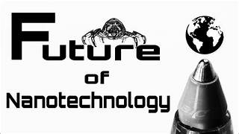
Materials Science and Engineering: Nanotechnology will continue to transform materials science and engineering. By manipulating materials at the nanoscale, scientists can create novel materials with extraordinary properties, such as enhanced strength, improved conductivity, and superior durability.
Electronics and Computing: Nanotechnology will continue to drive advancements in electronics and computing. Further miniaturization of electronic components using nanoscale materials and structures will lead to faster, more energy-efficient devices with increased computing power.

Slide 14
REFERENCE https://factlo.com/introduction-to-nanotechnology-origin-and-history/ https://simple.wikipedia.org/wiki/nanotechnology https://leverageedu.com/blog/applications-of-nanotechnology/

Slide 15


THANK YOU

