Slide 1
Assignment 1 Writeup DO NOT TAG
Name: Prateek Gupta
GT Email: pgupta353@gatech.edu

Slide 2
Two-Layer Neural Network
DO NOT TAG

Slide 3
Learning Rates
Tune the learning rate of the model with all other default hyper-parameters fixed. Fill in the table below:
 | lr=1 | lr=1e-1 | lr=5e-2 | lr=1e-2
Training Accuracy | 0.9431 | 0.9219 | 0.9089 | 0.7292
Validation Accuracy | 0.9503 | 0.9276 | 0.9155 | 0.7744
Test Accuracy | 0.9471 | 0.9250 | 0.9134 | 0.7640

Slide 4
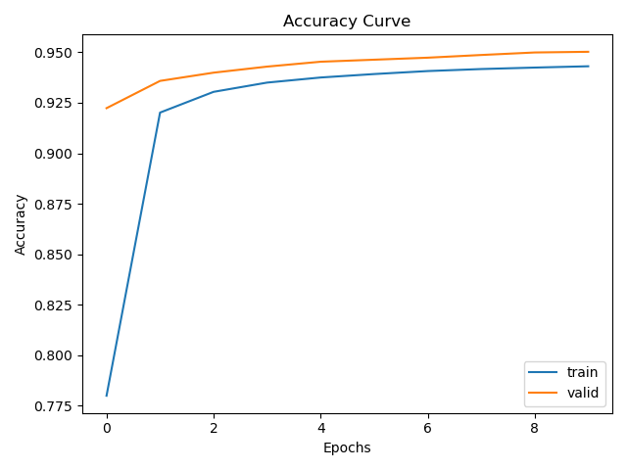
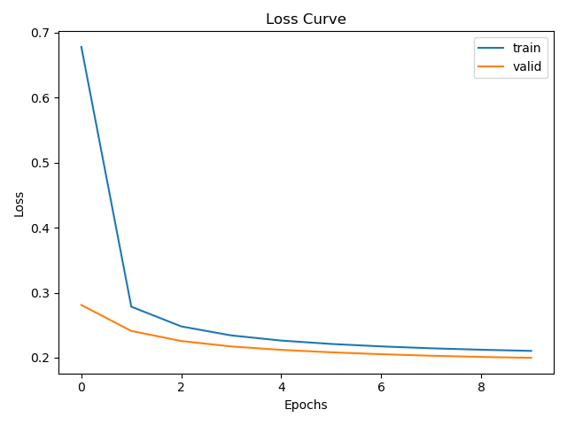
Learning Curve
Plot the learning curves using the learning rates = 1

Slide 5
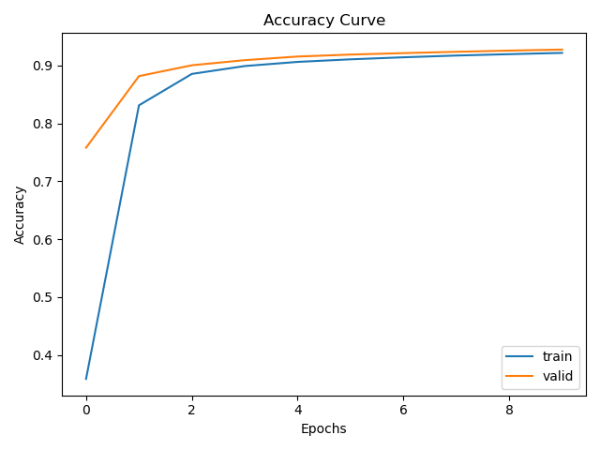
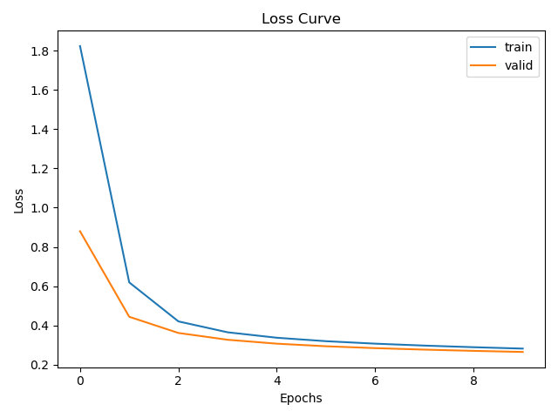
Learning Curve
Plot the learning curves using the learning rates = 1e-1

Slide 6
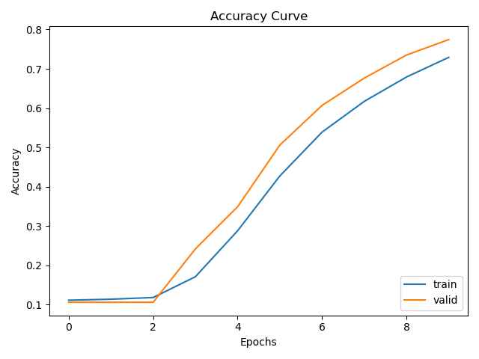
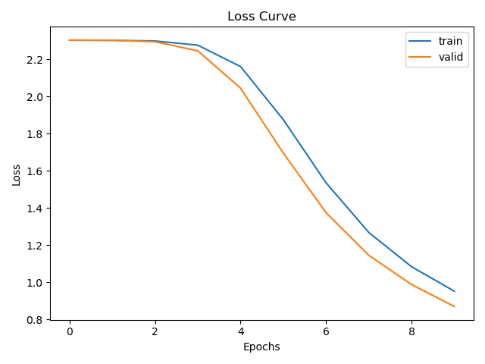
Learning Curve
Plot the learning curves using the learning rates = 1e-2

Slide 7
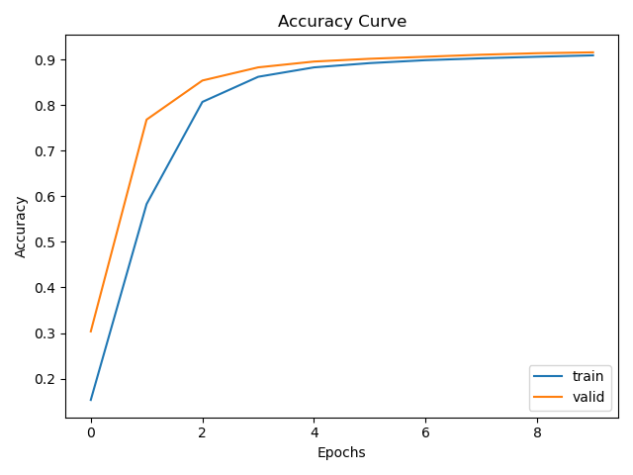
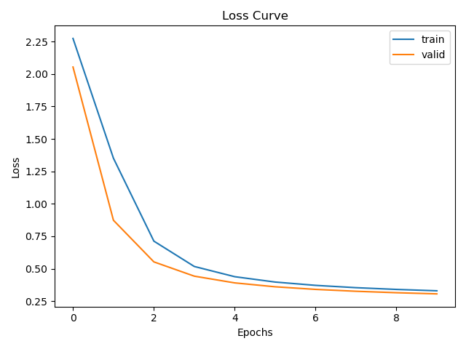
Learning Curve
Plot the learning curves using the learning rates = 5e-2

Slide 8
Learning Rates
Describe and Explain your findings:
From the experiment on learning rates for 1e-2, we see the learning is stuck on saddle points at the start of the training process. This could be due to the initialization for weights. By using a higher learning rate, we see that we are able to come out of the saddle point. However, we also know that a high learning rate can lead to unstable learning where the gradients are in constant flux instead of majority of stable weights. From the theory, we know that if the learning rate is extremely high, the model can diverge instead of converging. This can also be understood from Taylor series expansion where a high learning rate can start dominating the curve part instead of linear, leading to increase the loss function.
Also, a small learning rate means we move very slowly towards the minima which could be very far off. So, a high learning rate for the initial epochs can move quickly towards the minima and can later be scheduled to exponentially decay for stable learning.
Learning rate helps in controlling the gradients received from a mini batch. A high learning rate may move towards minima quickly but may start diverging. It may not be able to find the minima as the weights are always in flux. A smaller learning rate works well near minima but are prone to getting stuck in local minima and saddle points.

Slide 9
2. Regularization
Tune the regularization coefficient of the model with all other default hyper-parameters fixed. Fill in the table below:
 | alpha=1 | alpha=1e-1 | alpha=1e-2 | alpha=1e-3 | alpha=1e-4
Training Accuracy | 0.1028 | 0.3370 | 0.8836 | 0.9219 | 0.9295
Validation Accuracy | 0.1060 | 0.3167 | 0.8912 | 0.9276 | 0.9354
Test Accuracy | 0.1135 | 0.3232 | 0.8906 | 0.9250 | 0.9346

Slide 10
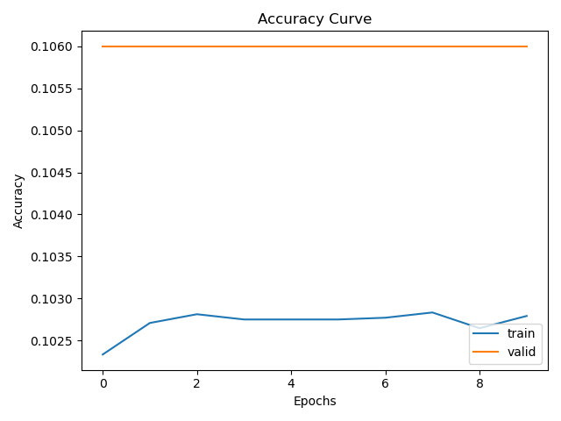
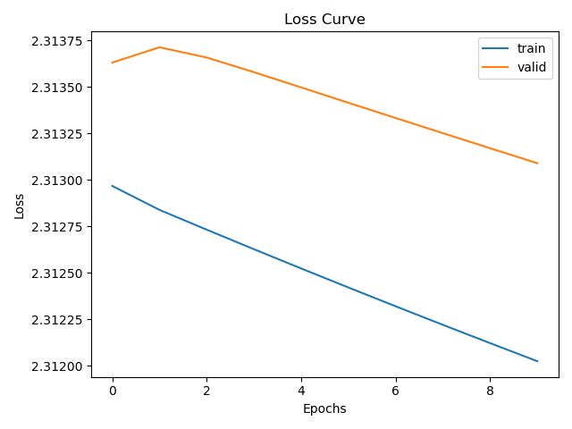
2. Regularization
Plot the learning curves using the regularization coefficients = 1

Slide 11
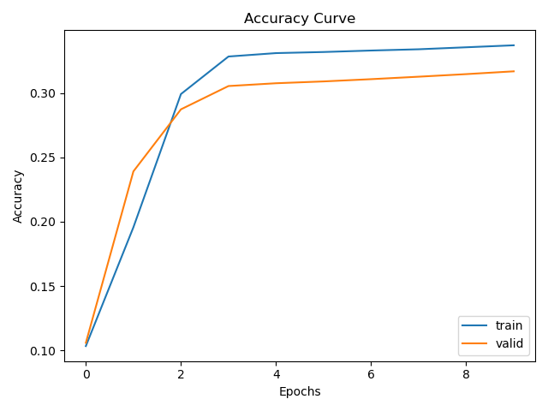
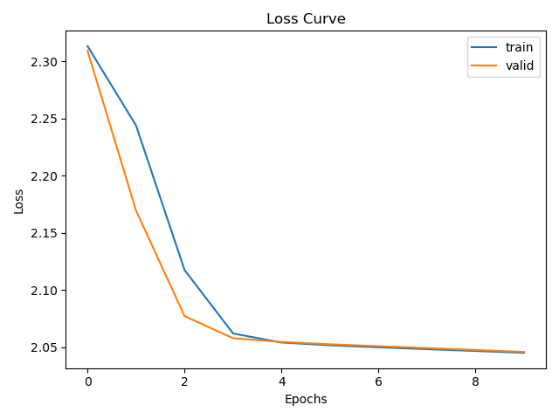
2. Regularization
Plot the learning curves using the regularization coefficients = 1e-1

Slide 12
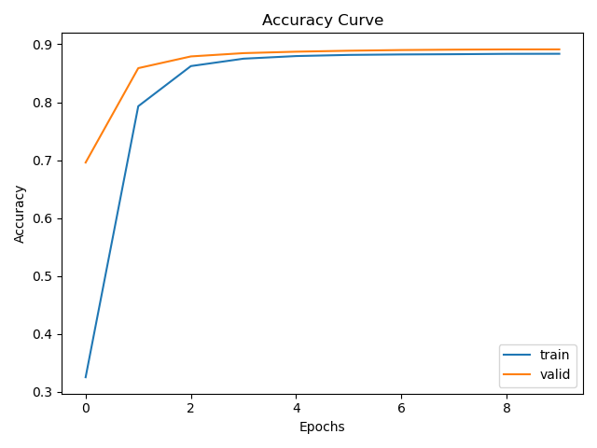
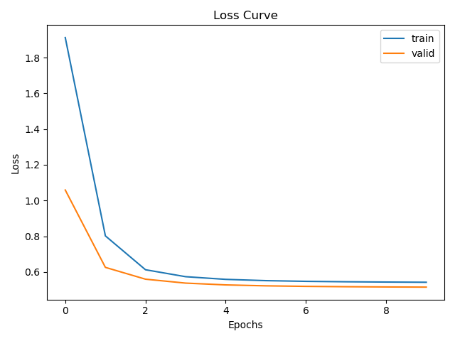
2. Regularization
Plot the learning curves using the regularization coefficients = 1e-2

Slide 13
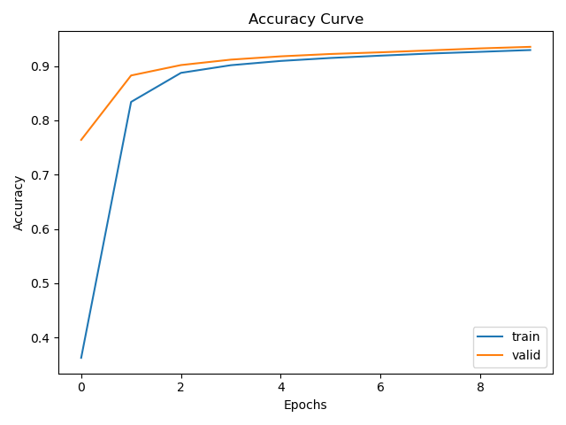
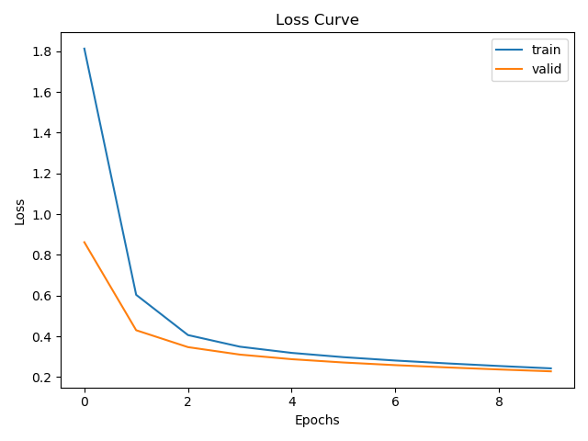
2. Regularization
Plot the learning curves using the regularization coefficients = 1e-4

Slide 14
2. Regularization
Describe and Explain your findings: Explanation should go into WHY things work the way they do in the context of Machine Learning theory/intuition, along with justification for your experimentation methodology. DO NOT just describe the results, for example, you should explain why the regularization value affects performance as well as model weights. If you need more than one slide to answer the question, you are free to create new slides.
From the experiment on regularization, we see that the training loss is more than the validation loss. Regularization is used in over parameterized high capacity models to control out of sample performance on unseen data. However, we have the reverse here implying the model can fit the training data better by reducing the constraints.
Regularization adds additional penalty on using large weights in the model. So, the trained model is forced to learn model that fits the training data and is using smaller weights. This helps in reducing overfitting on training data as large weights could change the classification for a minor change in input data.
Using a very large penalty can lead to model not learning anything at all and hence this hyper parameter is often tuned after turning the learning rate.

Slide 15
3. Hyper-parameter Tuning
You are now free to tune any hyper-parameters for better accuracy. Create a table below and put the configuration of your best model and accuracy into the table:
 | Accuracy
Training Accuracy | 0.9777
Validation Accuracy | 0.9680
Test Accuracy | 0.9671
Train: batch_size: 64
learning_rate: 0.05
reg: 0.0001
epochs: 100
momentum: 0.9
hidden_size: 64
seed=41

Slide 16
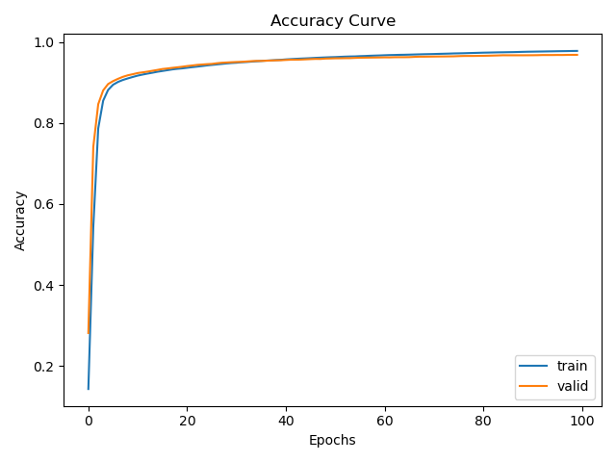
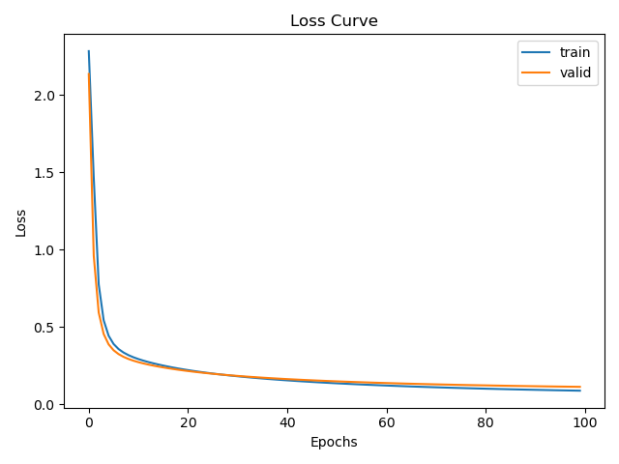

Slide 17
3. Hyper-parameter Tuning
Explain why your choice works: Explanation should go into WHY things work the way they do in the context of Machine Learning theory/intuition, along with justification for your experimentation methodology. DO NOT just describe the results, you should explain the reasoning behind your choices and what behavior you expected. If you need more than one slide to answer the question, you are free to create new slides.
With the experiments on learning rate, we understand that the model architecture needs tweaking to overcome initial saddle points. For this, we under parameterize the hidden layers and set them to 64. This now allows to use a smaller learning rate of 0.05 for stable learning. The reduction in learning rate is accompanied by increase in epochs which is increased to 100.
As the training error is always less than validation error and we have under parameterize the architecture, we use a very small regularization value of 0.0001. If we had increase the parameters, we would have to use a larger regularization value for controlling the out of fold performance.
Both our choices works in the final experiment setup, and we are able to generate a smoother and stable learning curve, and is able to outperform the default settings for accuracy.
We did not reduce the batch size as both the curves are already smooth. An increase in batch size would allow using a higher learning rate as we have more confidence in the gradients received. A decrease in batch size leads to frequent gradient updates but they can contain noise. From our experiments, we find that the batch size of 64 is good enough hyper parameter.

