Slide 1
COMPUTER ORGANIZATION LAB
GROUP NUMBER-10(TUESDAY BATCH)
JAY SHAH-1741084
MANAV SHAH-1741042
JAINAM AJMERA-1741051

Slide 2
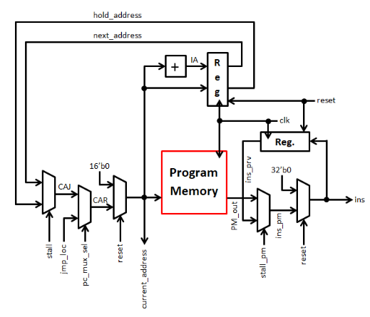
Instruction Memory Block
Input:
jump_loc
pc_mux_sel
stall, stall_pm
Reset
clk
Output :
ins
current_address
Functionality: -This block generates instruction for decode, execution and data memory block. Program counter generates the address of the next instruction.

Slide 3
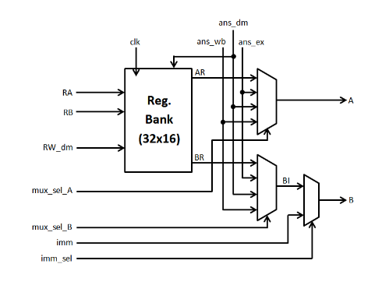
Register Bank
Input:
ans_ex
ans_dm
ans_wb
Imm
RA
RB
RW_dm
mux_sel_A
mux_sel_B
imm_sel
clk
Output:A,B
Functionality:- Loads data from register bank and generates optimized input for ALU.

Slide 4
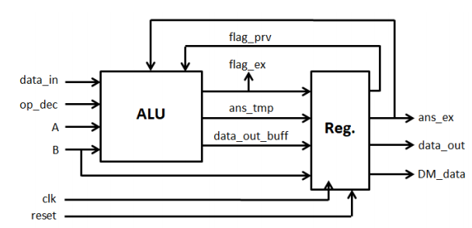
Execution Block
Inputs:
Clk
Reset
A&B(operands)
opcode
data_in(data from external input port)
Outputs:
ans_ex (output of execution block)
DM_data (data for data memory block)
flag_ex (zero and overflow flag)
Functionality:- It performs arithmetic and logical operations and also generates the flag.

Slide 5
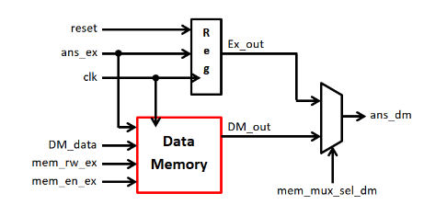
Data Memory Block
Input:
Clk(1-bit),
reset
ans_ex
DM_data
mem_en_ex
mem_rw_ex
mem_mux_sel_dm
Output: ans_dm
Functionality:- Data memory is designed using Xilinx IP Core. Single Port RAM is used and RAM size is 128KB.

Slide 6
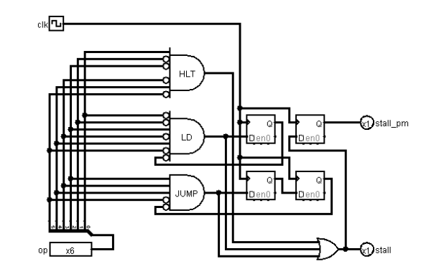
Stall Control Block
Inputs:
opcode
clk
reset
Output: stall, stall_pm
Functionality:- Provides signals for stalling the pipeline.

Slide 7
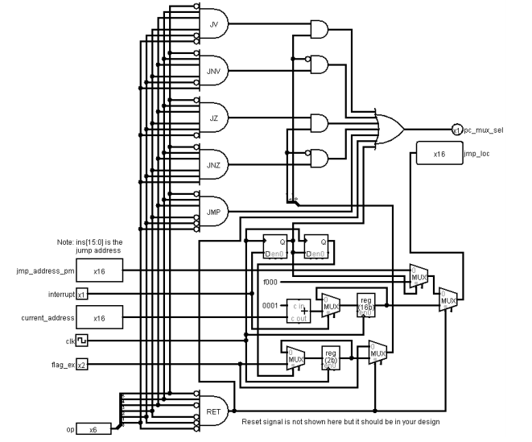
Jump Control Block
Input:
jump_address_pm
current_address
op(Opcode)
flag_ex
clk
Reset
interrupt
Output:
jump_loc
pc_mux_sel
Functionality:-Determines jump location and provide signal for branching.

Slide 8
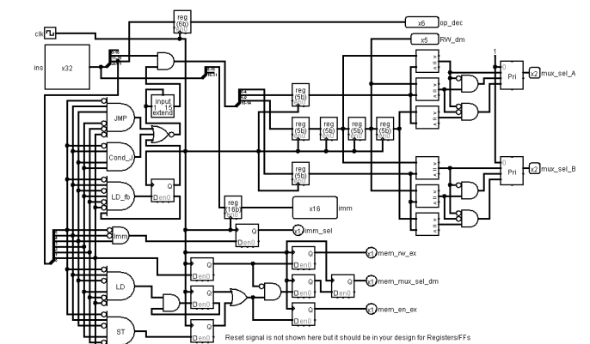
Dependency Check Block
Input:
Ins
Clk
reset
Output:
Imm
op_dec
RW_dm
mux_sel_A
mux_sel_B
imm_sel
mem_en_ex
mem_rw_ex
mem_mux_sel_dm
Functionality:- Checks data dependency amongst instruction and generates signals for forwarding.

Slide 9
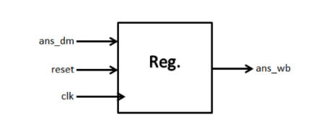
Write Back Block
Input:
clk
reset
ans_dm
Output:
ans_wb
Functionality:- Writes data back into register bank.

Slide 10
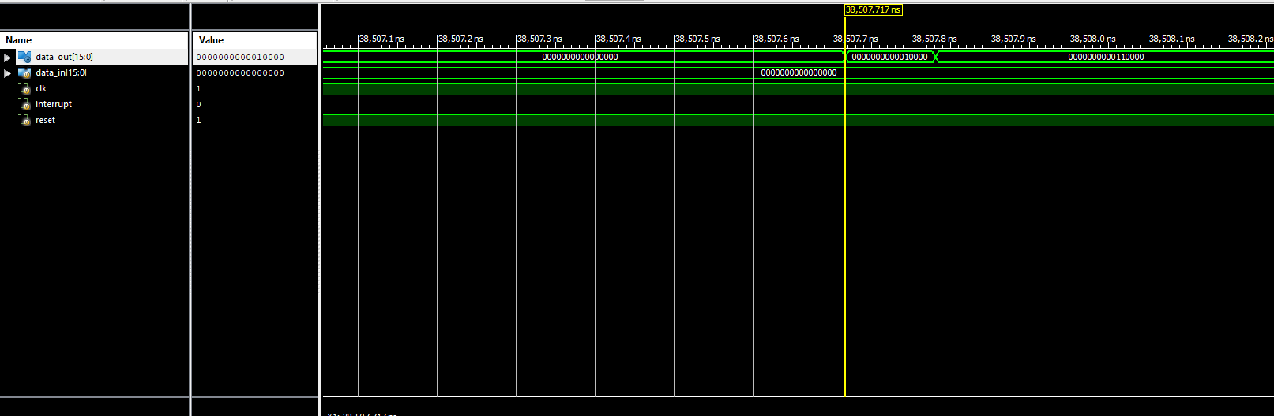
RESULTS
The post route simulation result that we obtained by multiplying two numbers:

Slide 11
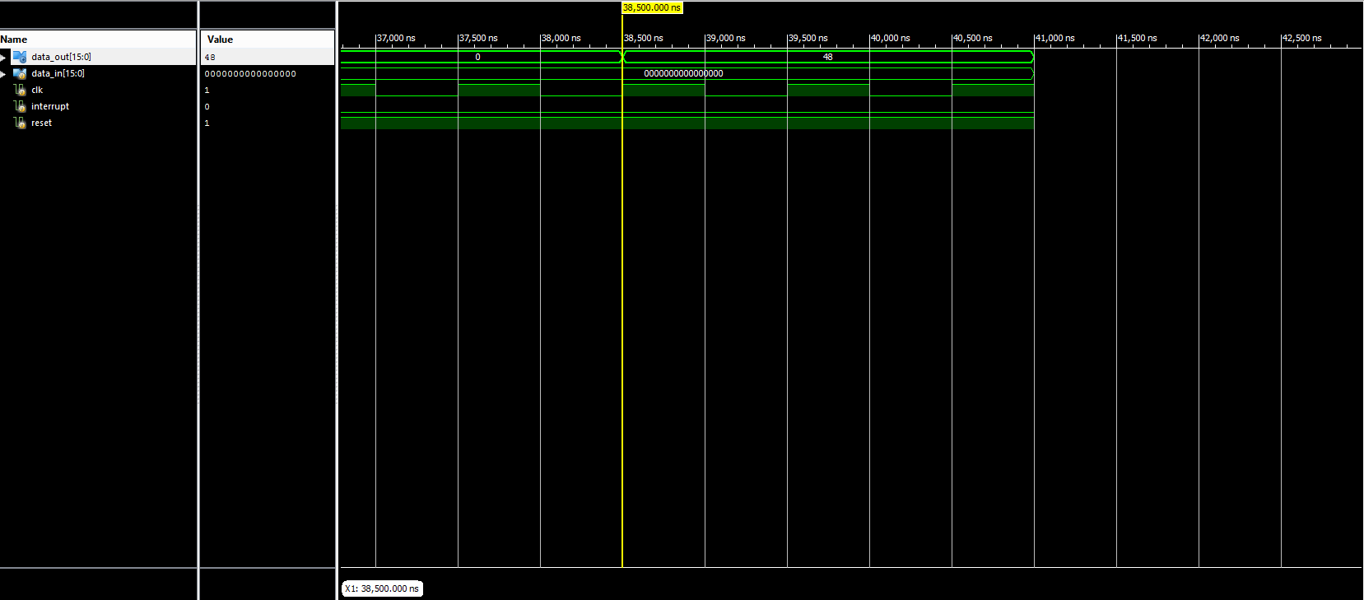
BEHAVIOURAL SIMULATION OF MULTIPLICATION

Slide 12
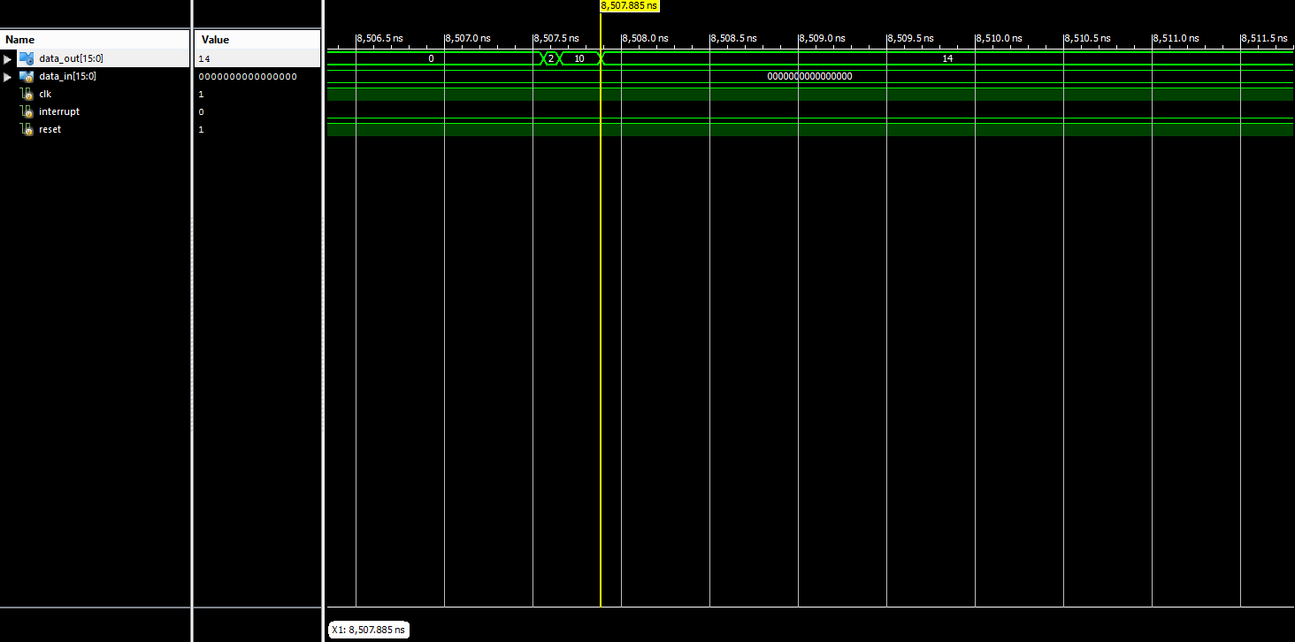
RESULTS
The post route simulation result obtained by adding two numbers:

Slide 13
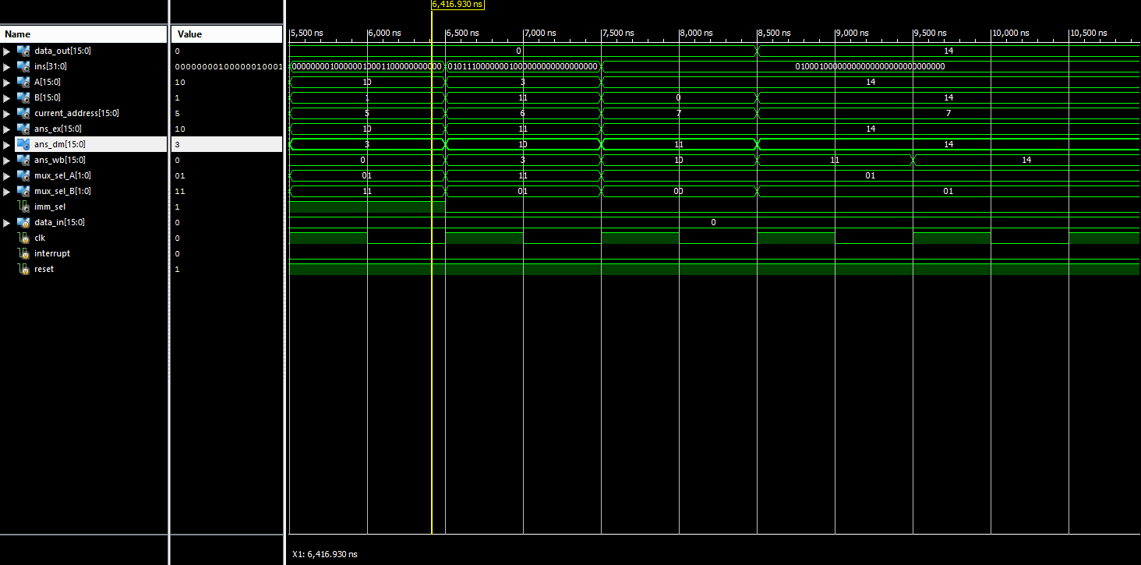
BEHAVIOURAL SIMULATION OF ADDITION

Slide 14
COMPARISON BETWEEN MIPS AND 8085 PROCESSOR
MIPS
8085
Multiple Cycle Processor.
RISC based Architecture.
No temporary register.
It generates 2 flags(Zero & Overflow flag).
Operating Frequency: 1MHz
Data Bus: 16 bits
Stores the output of ALU in data memory or it is written directly back.
In our MIPS there is no stack pointer register.
Memory Size:128KB
It has 32 registers. Each register is of 16bit.
It has only one interrupt which is vectored interrupt
Single Cycle Processor.
Semi CISC based Architecture.
Temporary register is available.
It generates 5 flags.(Sign, Parity, Carry, Zero & Auxillary carry flag)
Operating Frequency: 3-6MHz
Data Bus: 8 bits
Stores the output of ALU in accumulator.
It has stack pointer register.
Memory Size:64KB
It has 6 general purpose registers. Each register is of 8 bit and can combine with other register and forms a register pair which is of 16-bit.
It has both vectored and non-vectored interrupt.

Slide 15
PROBLEMS FACED AND THEIR SOLUTION
The problems we faced were mainly while integrating all the blocks.
For the process of addition of two numbers we got answer xxxx which was wrong. This error was due to as we were having opcode(op_dec) for individual blocks.
To overcome the above error we have taken 6 bits of instruction[31:26] as opcode.
Also RA(address of operand A) and RB(address of operand B) were to be stored as 5 bits each in instruction i.e. we have to take ins[20:16] and ins[15:11].

Slide 16
FUTURE WORK
Implementing Cache Memory:
Cache memory can be added after the ALU block in MIPS architecture and before the Data memory block.
It intercepts read and write requests to the Data memory and caches them for reuse.
This reuse decreases the number of memory operations needed which helps save time in CPU.
A request for accessing a memory element is made by the processor through issuing the address of the requested element.
If the data requested by the processor appears in some block in cache then it is called hit and if data is not found in cache request is called a miss.

Slide 17
The main memory is then accessed to retrieve the block containing the requested data, during that the whole pipelined MIPS must be stalled.
We have to use Set Associative Mapping as it is optimized method which provides flexibility and less complicated hardware.
Generally the size of cache memory is between 2-16KB.

Slide 18
Implementing Modified Booth’s Algorithm:
The algorithm for multiplication that we have used in our MIPS i.e. For eg: we want to multiply 7 x 8 than we are adding 7, 8 times which can take a lot more time for multiplication of big numbers. So we can use Modified Booth’s algorithm.
Also if we multiply 2, 16-bit numbers than we have to store the output which will be of 32 bit but in our MIPS, ALU is of 16 bit and so it can’t store 32 bit. So to implement Booth’s algorithm the above point should be taken into mind.
So the maximum number we can multiply in our MIPS will be of 8 bit x 8 bit(i.e. 512 x 512) and hence we can obtain the final output of 16 bit which can be stored in ALU. Also the sequence counter will be number of bits divided by 2. Hence that much clock cycle will be wasted.

Slide 19
For addition and subtraction of two numbers in Modified Booth Algorithm we can use adder and subtractor available in ALU and for comparing the bits we have to develop the logic by using gates that are available in ALU.

Slide 20
REFERENCES
https://www.researchgate.net/figure/MIPS-Cache-Memory_fig3_228399585
https://www.researchgate.net/publication/283778569_Pipelined_MIPS_processor_with_cache_controller_using_VHDL_implementation_for_educational_purposes
https://www.irjet.net/archives/V3/i4/IRJET-V3I4590.pdf

