Slide 1
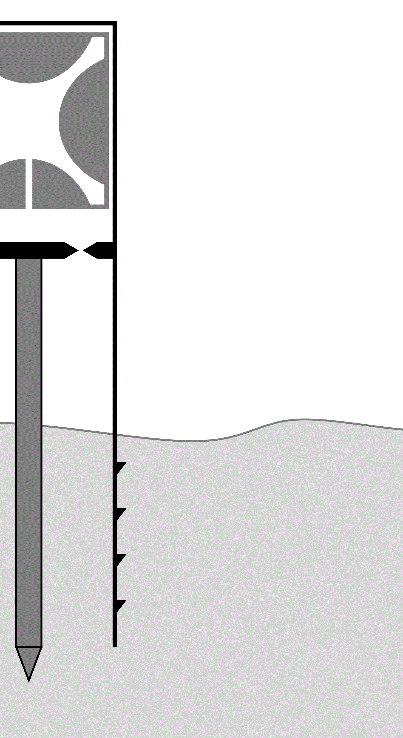
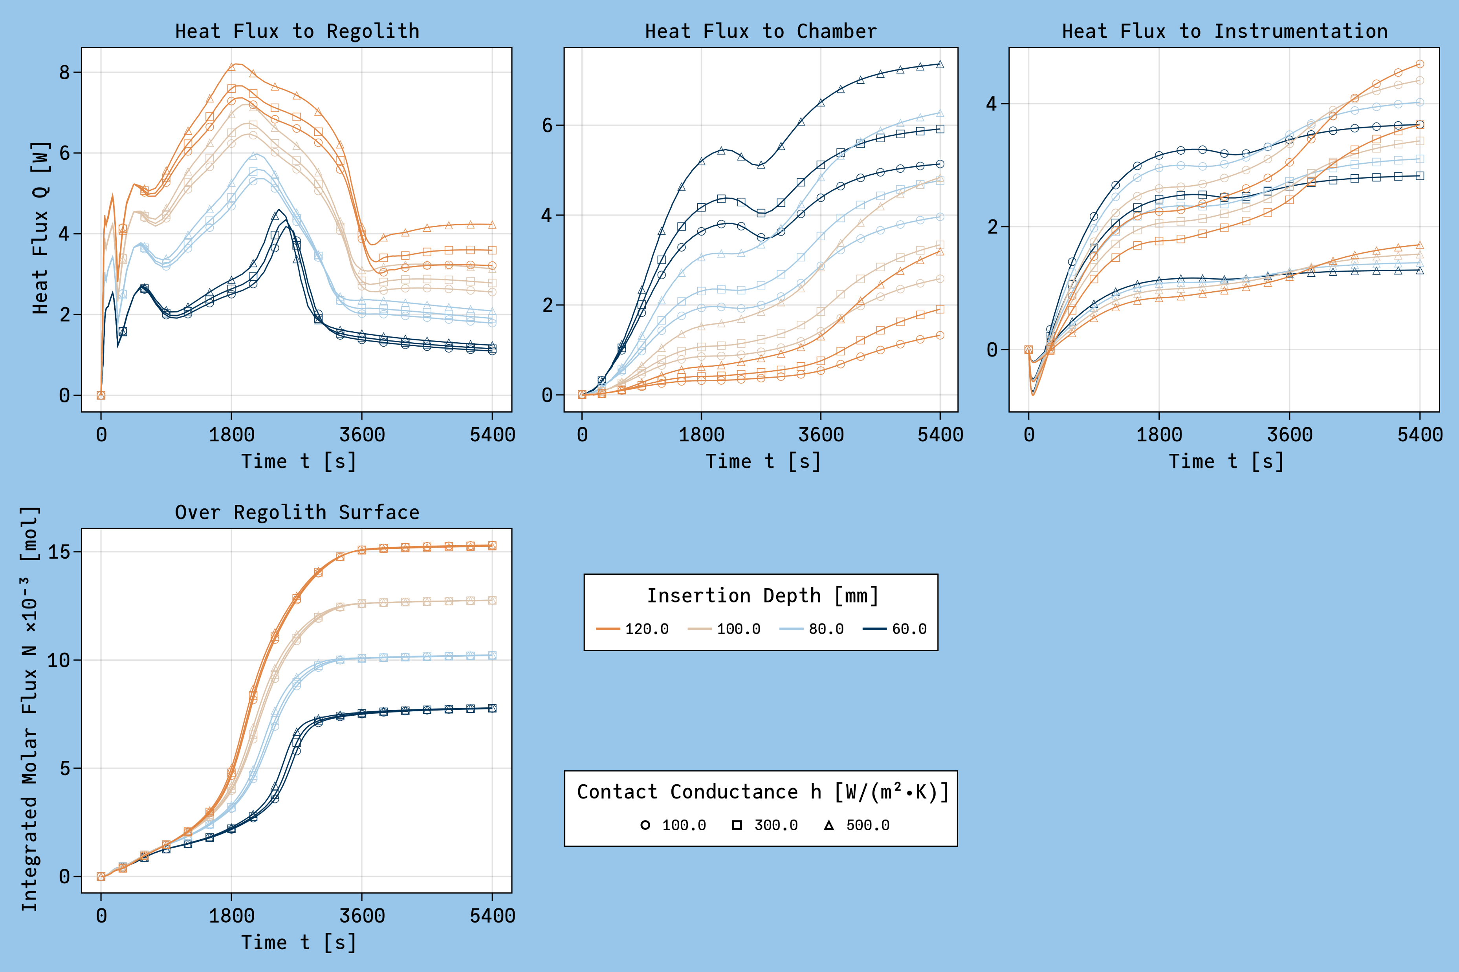

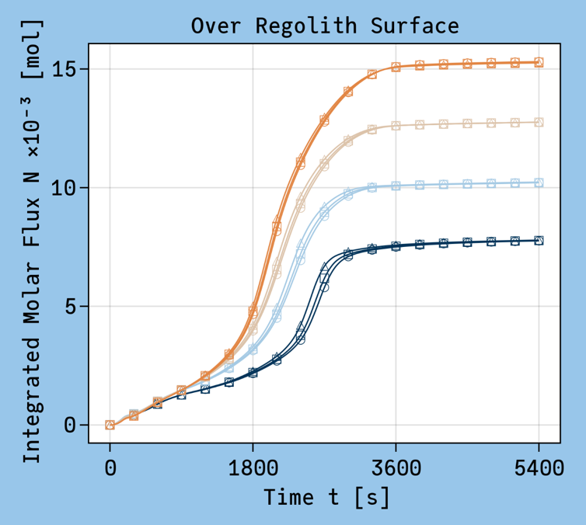
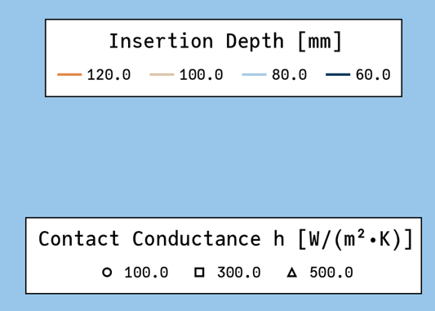



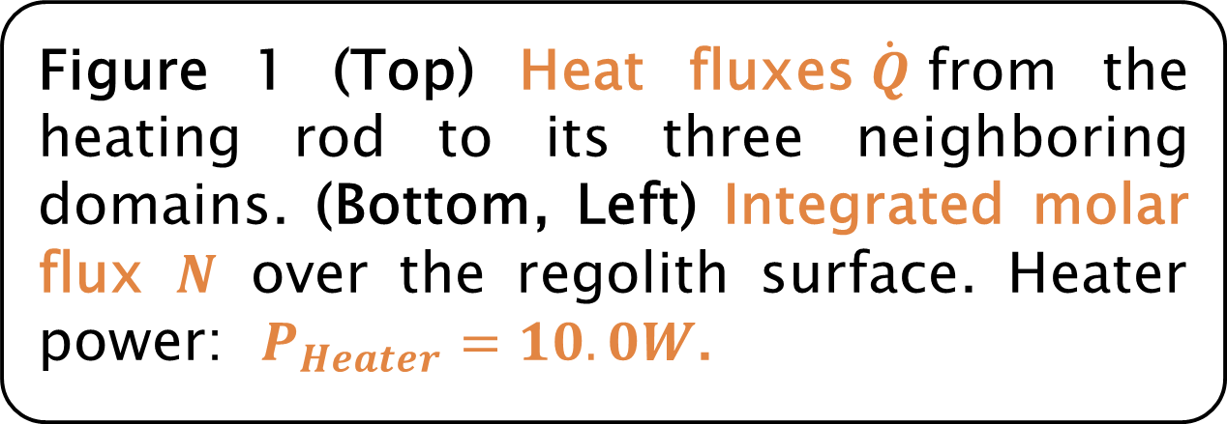


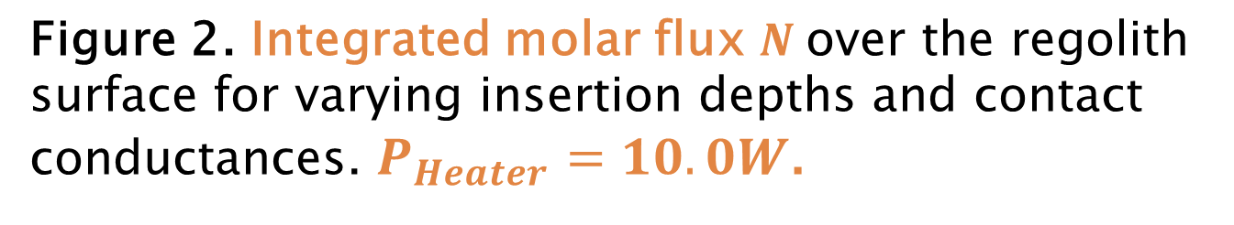

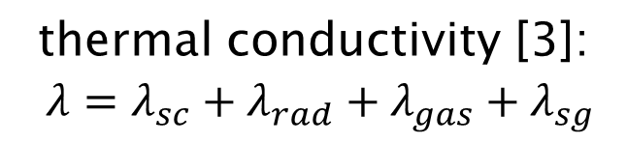
Mass Spectrometer
(Instrumentation)
Investigating the Operational Setup for the Lunar Volatiles Scout
Smolka A.¹, Gscheidle C.¹, Biswas J.¹
¹Chair of Astronautics (LRT), Technical University of Munich (TUM), Boltzmannstr. 15, 85748 Garching, Germany
Lunar Volatiles Scout [1]
based on Reiss’ model, an updated numerical model was developed in COMSOL Multiphysics [2]
soil sampling & analysis device
mass spectrometer to analyze desorbed water
investigation of the influence of heater power, insertion depth, heat zone (powered part of the heating rod), and contact conductance to the instrumentation
$${\dot{Q}}_{instrumentation}$$
investigation of volatiles trapped at lunar poles
thermal extraction
measures include the molar flux of desorbed particles, and the heat fluxes from the heating rod to its neighboring domains
results show dominating influence of the insertion depth and the heater power on the main measures, see Figure 1
Heat and Mass Transfer [2]
while the measures are mostly invariant with respect to the heat zone, the contact conductance clearly controls the heat flux to the instrumentation
$${\dot{Q}}_{chamber}$$
ordinary and Knudsen diffusion [4]
thermal conductivity [3]:
$λ=λ_{sc}+λ_{rad}+λ_{gas}+λ_{sg}$
implementation in COMSOL Multiphysics and MATLAB
advection-diffusion PDE’s
Figure 1 (Top) Heat fluxes$\dot{Q}$from the heating rod to its three neighboring domains. (Bottom, Left) Integrated molar flux $N$ over the regolith surface. Heater power: $P_{Heater}=10.0W$.
P_{Heater}
Figure 1. Heat fluxes $\dot{Q}$from the regolith to its neighboring domains for varying insertion depths and contact conductances. $P_{Heater}=10.0W$.
Operational Setup Study
This study investigated the setup of the operational parameters of the LVS [1] through numerical simulations of the instrument and the surrounding regolith. The latter was initialized with a specific absorbed water content so that heating the soil leads to a molar flux of desorbed water molecules.
The model for the study is based on Reiss’ research [2]. COMSOL Multiphysics was used for the numerical implementation and discretization. The goal of this study was to investigate the influence of the heater power, the insertion depth, the heat zone (powered part of the heating rod), as well as the contact conductance to the instrumentation on the resulting heat and molar fluxes.
The heat flux from heating rod to the regolith domain, Fig. 1 left, shows a dominating influence of the insertion depth. With the contact conductance limiting the heat transfer to the instrument section, the average heating rod temperature and, thus, the radiative heat flux to the chamber, Fig. 1 center, increases with an increasing conductance. The remaining energy flows either to the instrumentation, Fig. 1 right, or is used to increase the rods temperature.
Similar to the heat flux to the regolith, the molar flux over the surface, Fig. 2, is also invariant with respect to the conductance term. The four distinct final values correspond nicely to each insertion depth, which makes the factor the dominant influence on the desorbed water flux.
The remaining two factors, the heater power and the heat zone, have been omitted from the figures. The former linearly scales the heat fluxes and leads to earlier plateauing behavior for the molar flux, while the latter has little to no influence at all on either of the shown quantities.
Variations of the heater power led to roughly identical, though scaled results for the heat fluxes. The molar flux reached its plateau earlier for higher power inputs.
Heat Zone
Insertion Depth
Figure 2. Integrated molar flux $N$over the regolith surface for varying insertion depths and contact conductances. $P_{Heater}=10.0W$.
$${\dot{Q}}_{regolith}$$
[1] Biswas et al., “Searching for potential ice-rich mining sites on the Moon with the Lunar Volatiles Scout”, 2020, [2] Reiss P., “A combined model of heat and mass transfer for the in-situ extraction of volatile water from lunar regolith”, 2018, [3] Parzinger, S. ,. Analytische Modellierung der temperatur- und gasdruckabhängigen effektiven Wärmeleitfähigkeit von Pulvern, 2014, [4] Schorghofer, N., Taylor, G.J., Subsurface migration of H₂O at lunar cold traps., J. Geophys. Res. 112, 2007.
Heating Rod
Augered Drill Shell
Scan me to receive the poster, or contact the author at alexander.smolka@tum.de.
Technische Universität München
Lehrstuhl für Raumfahrttechnik
Fakultät für Luftfahrt, Raumfahrt und Geodäsie

