Slide 1
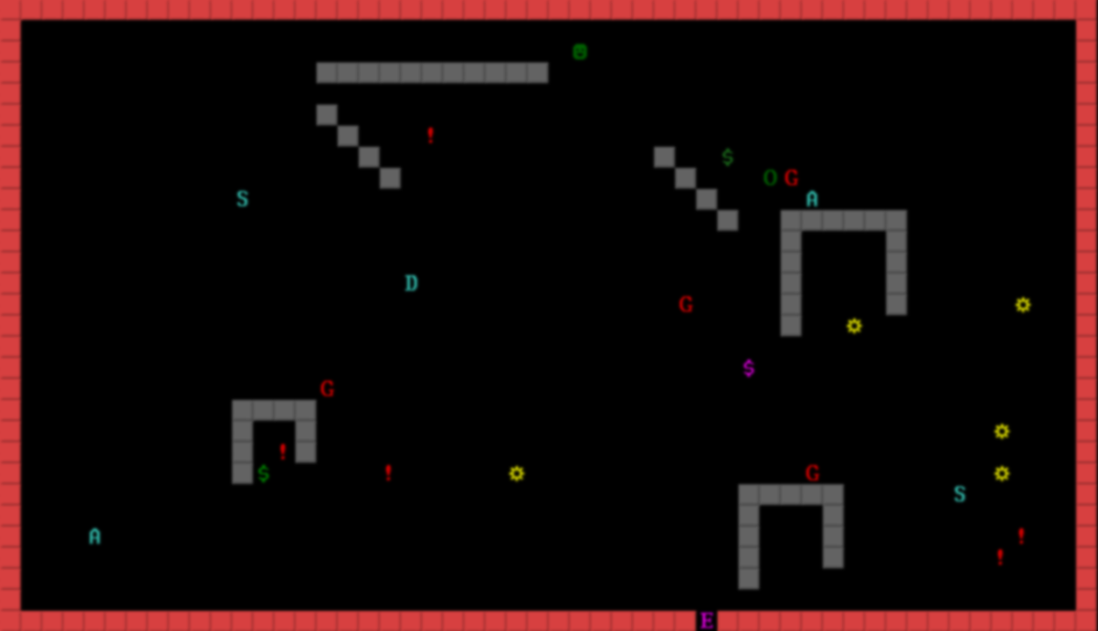




Slide 2
A "dungeon crawler" is a genre of game where players navigate and explore complex dungeon-like environments while battling monsters, solving puzzles, and collecting treasure.
Let’s see how our game works

Slide 3
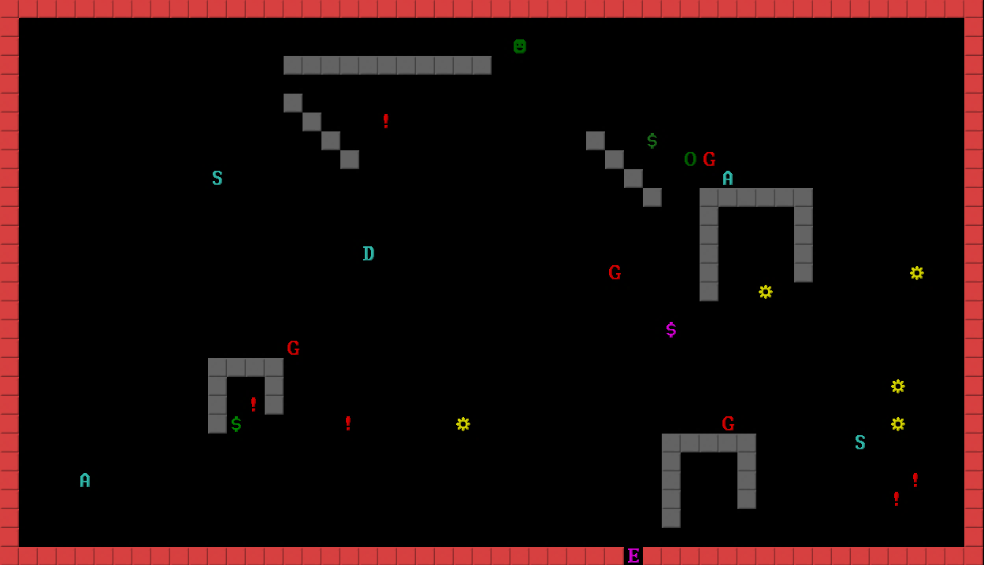
First the game initializes our border walls This creates our current room

Slide 4
Then the game creates the inner walls randomly, with random patterns

Slide 5
Our player spawns in a random location
Different kinds of monsters
The game creates a field where items and enemies can’t spawn
These assets get placed randomly around the map in every room that the player enters
Differently colored keys
The player can move in any directions
Different kinds of weapons
Then the game creates different assets around the map randomly
Treasures
Exits get generated depending on what color keys are on the map
Health potions

Slide 6
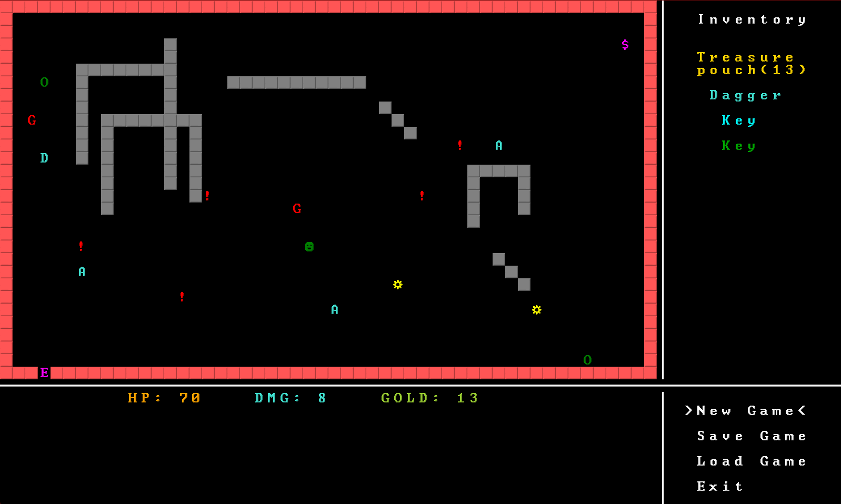
Inventory, where your items will appear
All UI elements dinamically change as the game goes on
Here we can see different UI elements
Different menu options
Your stats during the game

Slide 7

Let’s see the game shall we?
Here we can see different UI elements

Slide 8

Thank you all for your attention!
Here we can see different UI elements
If you have any questions ask them now!
Have a nice time crawlin’!

