Slide 1


Slide 2
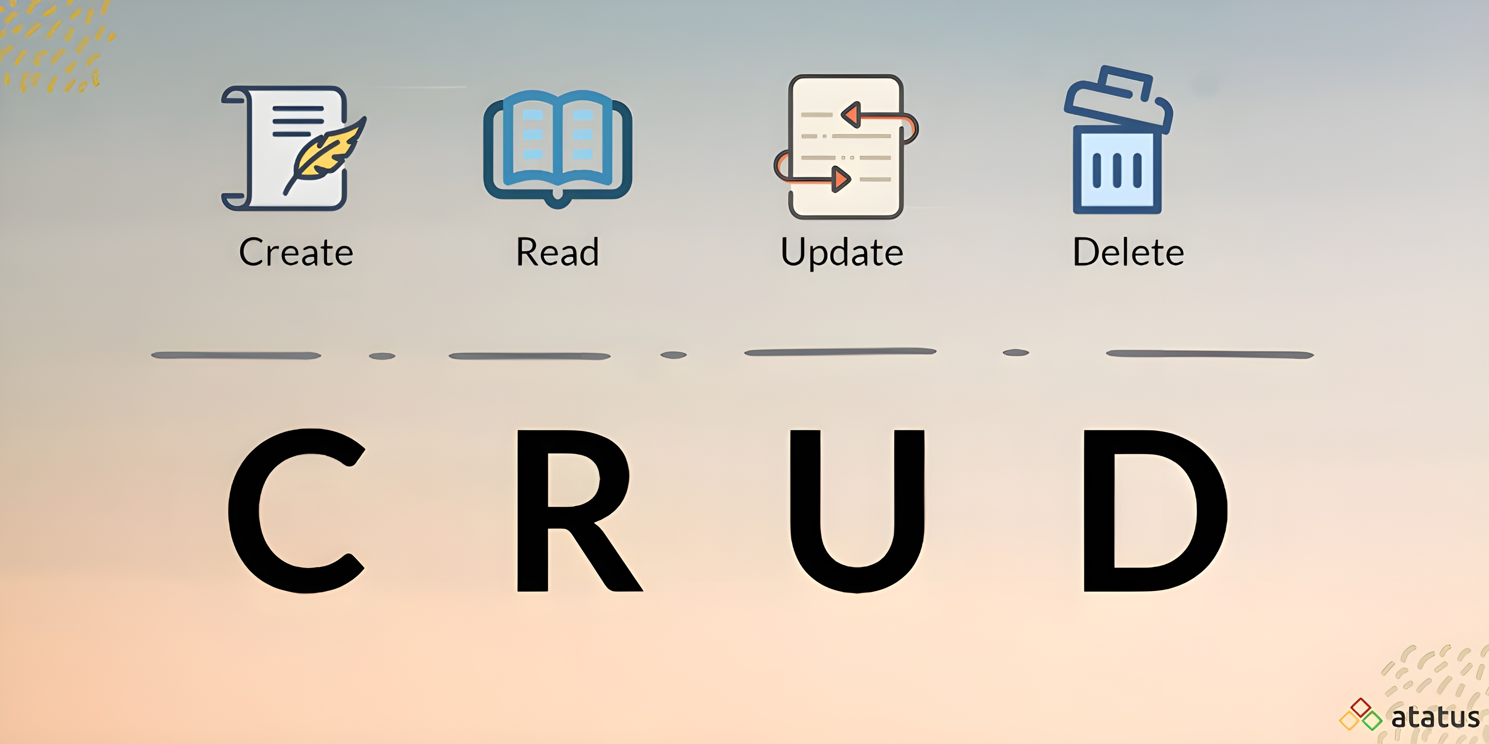

Slide 3

CRUD
Create a New Question
Adds a new question to the database
Uses the POST method on the /Question endpoint
Requires: title, description, and submission time
Returns the new question’s ID for reference
Each question is uniquely identified and stored
Register a User
Adds a new user to the system
Uses the POST method on the /User endpoint
Requires: username, email, password, registration time
Each user gets a unique ID
Enables participation in asking and answering
Create an Answer
Adds a new answer to a specific question
Uses the POST method on the /Answer endpoint
Requires: message, related question ID, and submission time
Returns the new answer’s ID for tracking
Allows users to contribute answers

Slide 4

CRUD
Get All Questions
Retrieves a list of all questions from the database
Uses the GET method on the /Question endpoint
Returns the questions sorted by most recent first
Useful for displaying an overview of all submitted questions
Get One Question by ID
Retrieves a single question and its related answers
Uses the GET method on the /Question/{id} endpoint
Helps users view detailed information about one question
Useful for question pages with answers

Slide 5

CRUD
Log In a User
Authenticates an existing user
Uses the POST method on the /User/Login endpoint
Accepts email or username with password
Required before asking or answering questions
Accept an Answer
Marks an answer as accepted for a question
Uses the PATCH method on the /Answer/Accept/{id} endpoint
Only the user who asked the question can accept answers
Highlights the best solution for future readers
Log Out a User
Ends the session for a logged-in user
Uses the POST method on the /User/Logout endpoint
Prevents further actions until the user logs back in

Slide 6

CRUD
Delete a Question
Removes a question from the database by ID
Uses the DELETE method on the /Question/{id} endpoint
Helps clean up or remove unwanted questions
Only existing questions can be deleted
Delete an Answer
Removes an answer from the database by ID
Uses the DELETE method on the /Answer/{id} endpoint
Ensures only valid and useful answers remain

Slide 7
Thank you for your attention!
It's Q&A time. And yes, this endpoint accepts all inputs!
Have a wonderful time asking, or answering!
Project made by: Szabi, Zoli, Imi, Dani

