Slide 1
Prediction of Little Red Dot Density Through JWST Spectroscopy
By Ian Bishop, Akshaj Vyas, and Kelcey Davis.

Slide 2
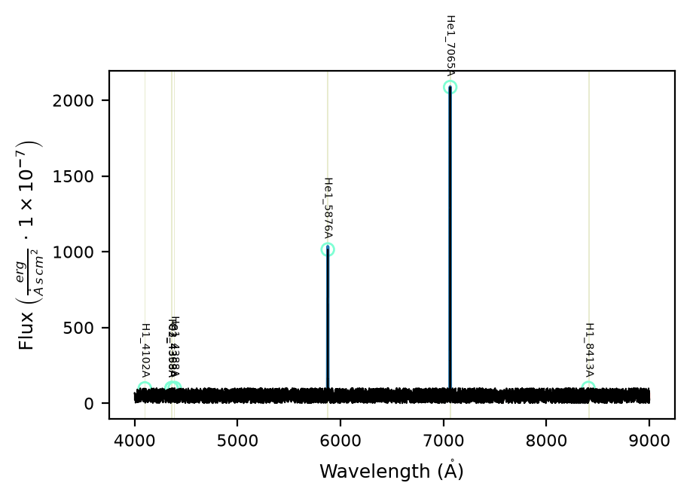
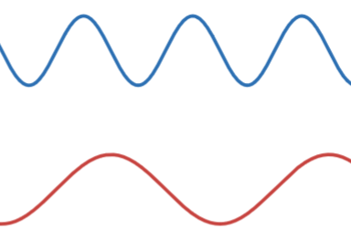
Introduction to Spectroscopy
Wavelength: the distance between peak to peak of a light wave
Flux: the amount of light emitted per wavelength

Slide 3


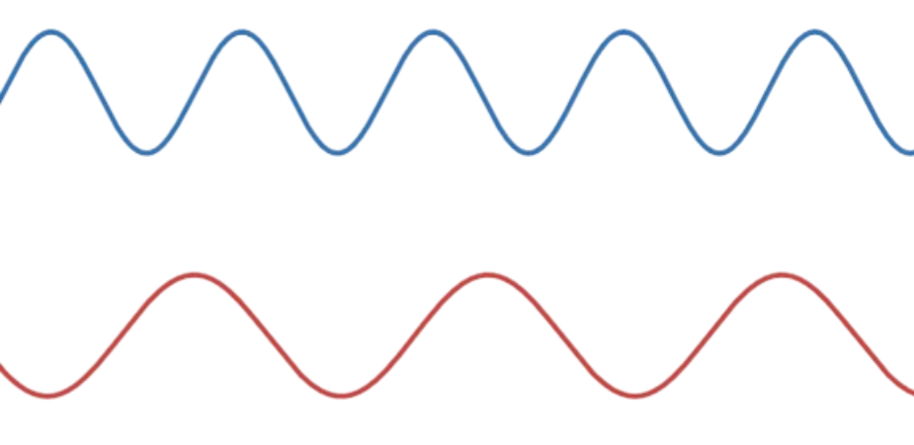
Scientific Background – Doppler effect
Doppler effect
Redshift vs Blueshift

Slide 4
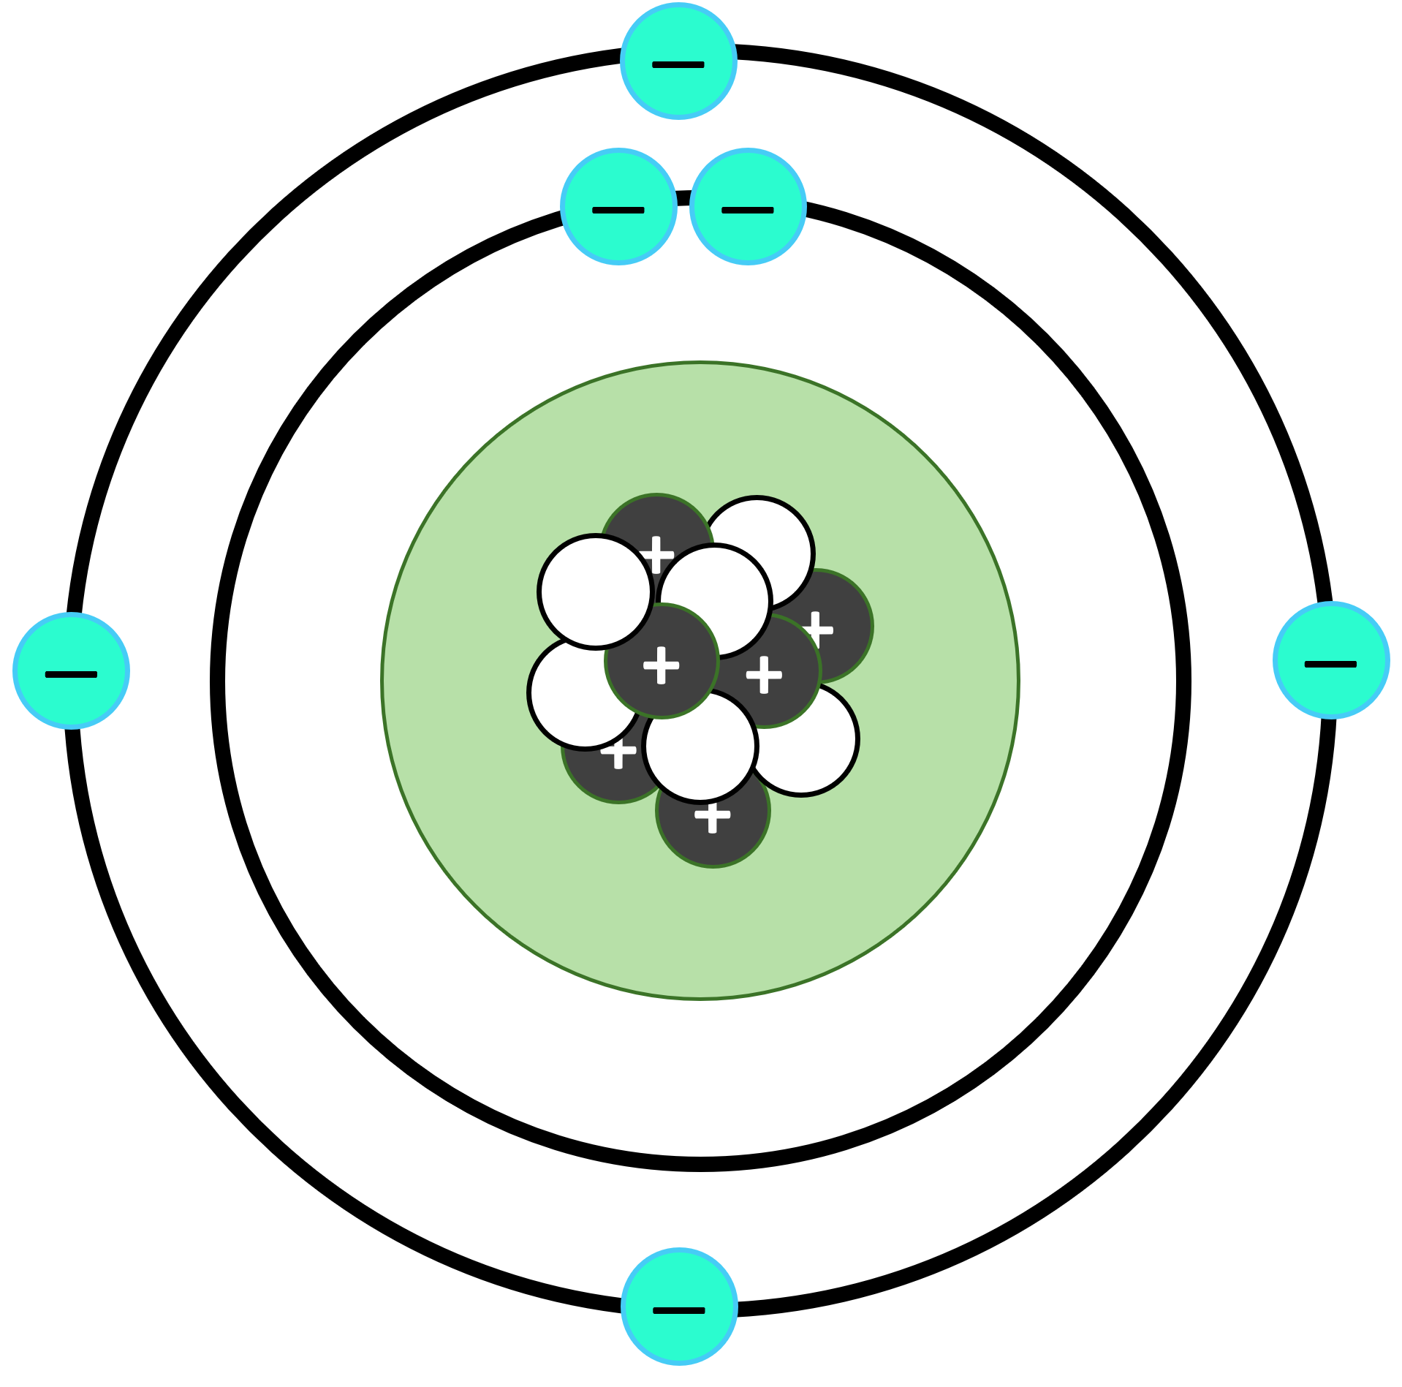
Scientific Background – Excited Electrons
Electrons absorb energy and jump to the next level
Fall back down and emit specific wavelengths
SrKellyOP, CC0, via Wikimedia Commons
File location

Slide 5
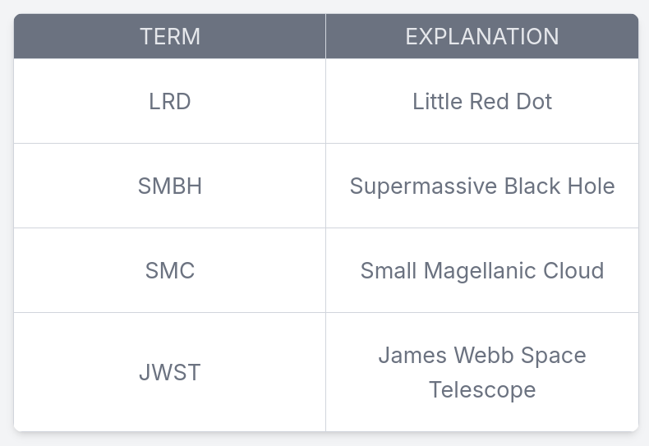
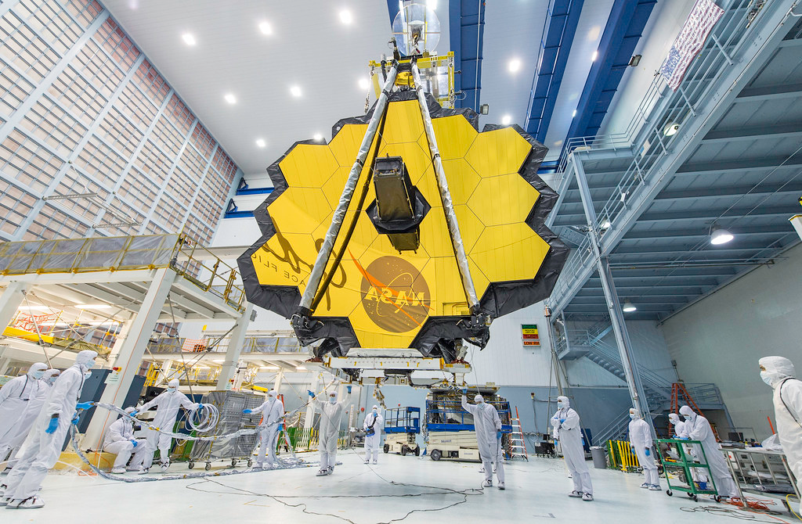
Term Explanation
NASA/Desiree Stover
File location

Slide 6
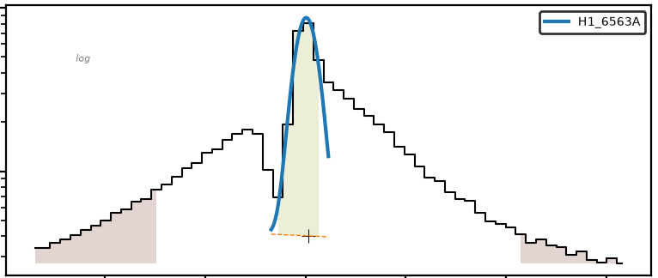
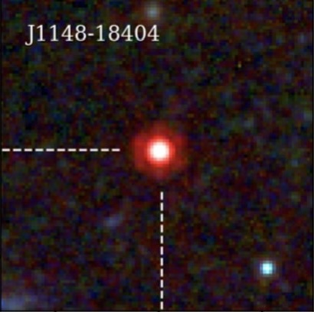
History
Discovered by JWST images
Originally considered to be early galaxies
Hypothesized “cocoons” of gas surrounding dense SMBHs
Jorryt Matthee et al., CC BY 4.0 <https://creativecommons.org/licenses/by/4.0>, via Wikimedia Commons
File location

Slide 7
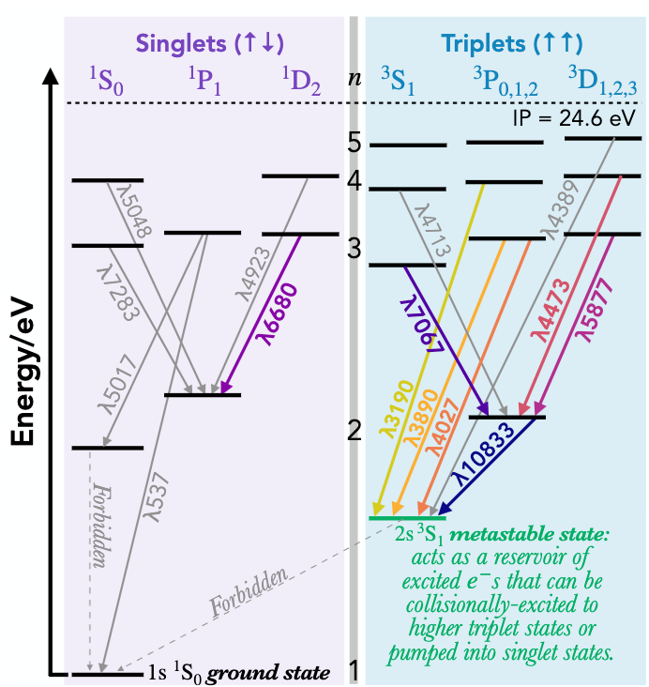
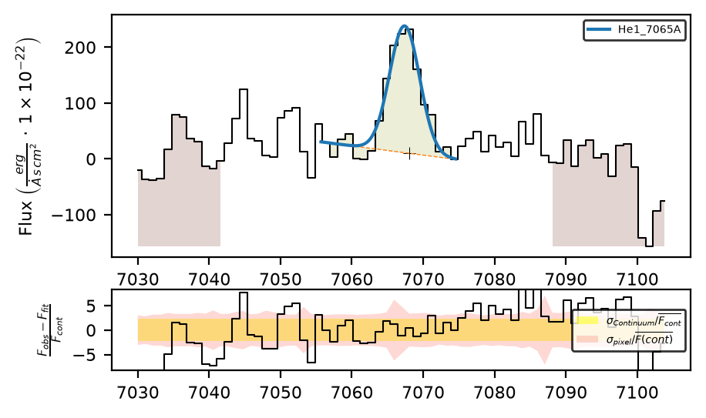
Helium
Two line ratios will be measured
  He I 7065Å / He I 5876Å
  He I 10830Å / H I Paγ
“Measuring” means integrating around the wavelength
Danielle A. Berg et al 2026 ApJ 996 68
File Location

Slide 8
Goals
Predict density of LRDs using Helium emission lines
Determine the accuracy of generated predictions
Build a foundation for more accurate future simulations

Slide 9
Motivation
To understand the early universe better
To come up with a conclusive theory for LRDs
To determine how SMBHs could have formed

Slide 10
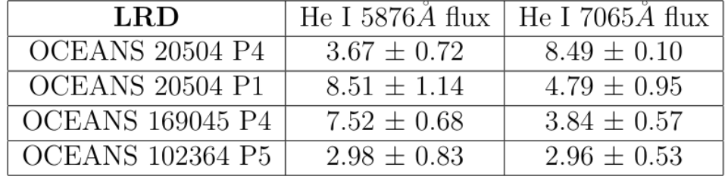
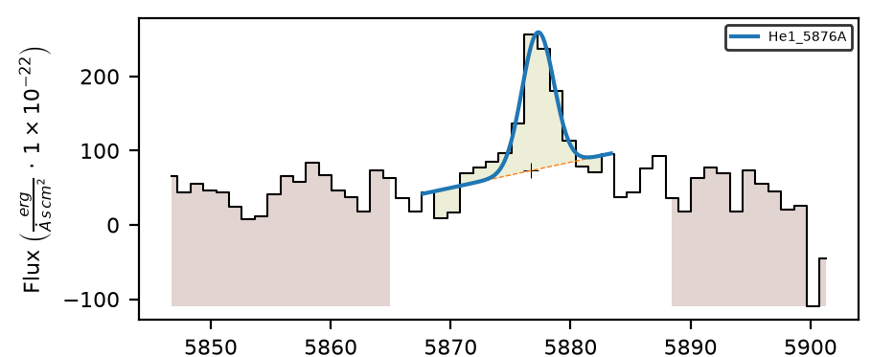
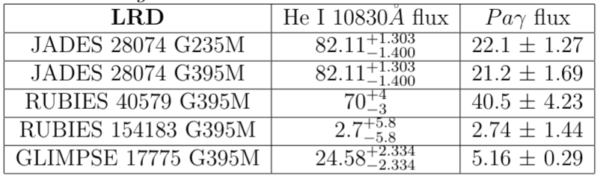
Flux Measurement
Use a Gaussian distribution to accurately model flux
Calculate ratios between paired fluxes

Slide 11
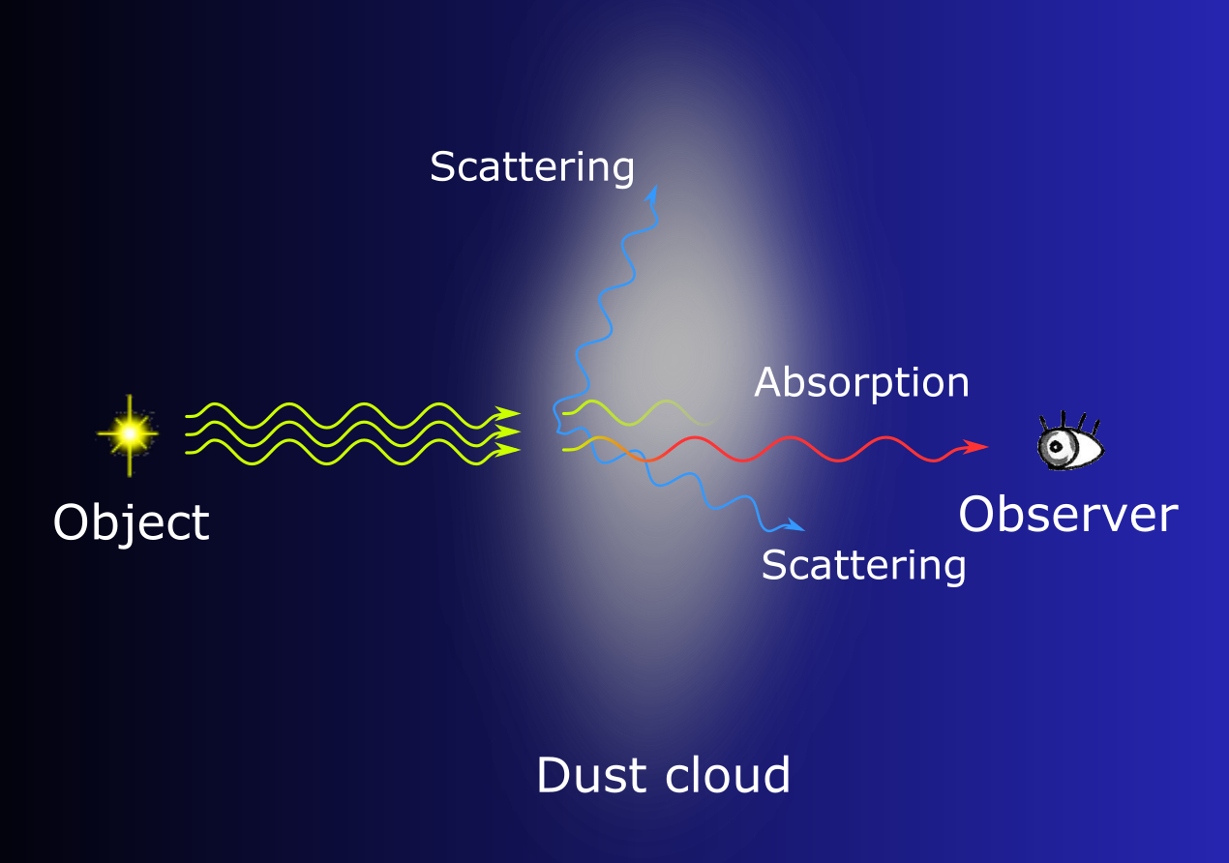
Dust Correction
Dust clouds interrupt light’s travel
Causes bluer fluxes to decrease
Correct by modeling a dust extinction curve (G24_SMCAvg)
ぷんすけ, CC BY-SA 4.0 <https://creativecommons.org/licenses/by-sa/4.0>, via Wikimedia Commons
File Location

Slide 12
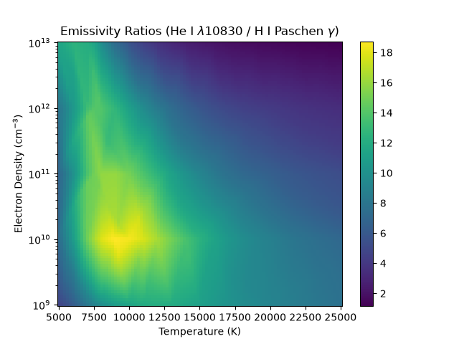
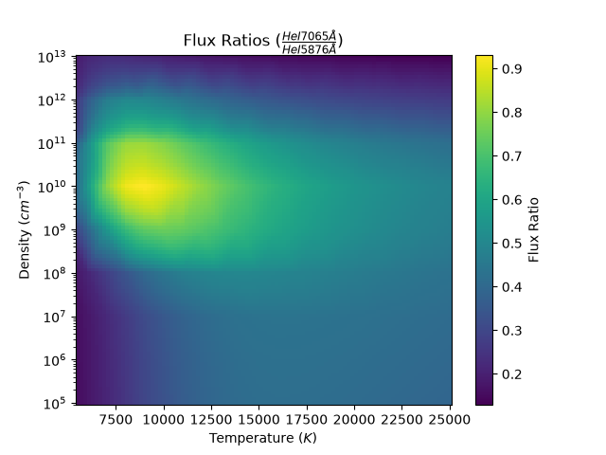
Theoretical Predictions
Generate a wide array of theoretical conditions
Run simulation on each combination
Compare theoretical combinations with observational values

Slide 13
Summary of Methods
Temp
Pyneb
Predicted
Density
Comparison
LiME
Observation
Spectrum
Dust Correction

Slide 14
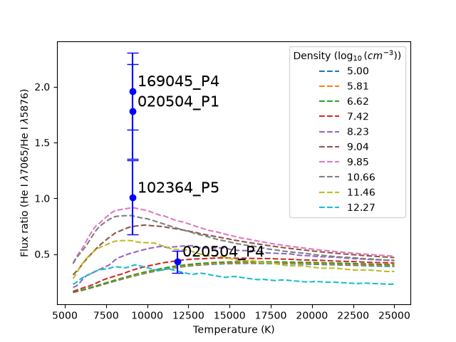
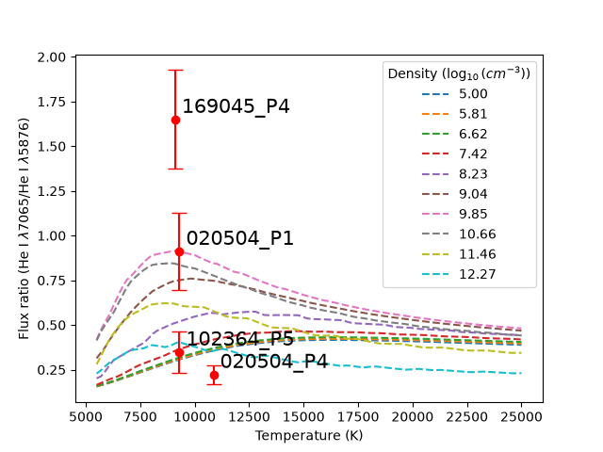
Comparison 1
Without Dust Correction
Dust Correction
Dust Correction
Dust Correction

Slide 15
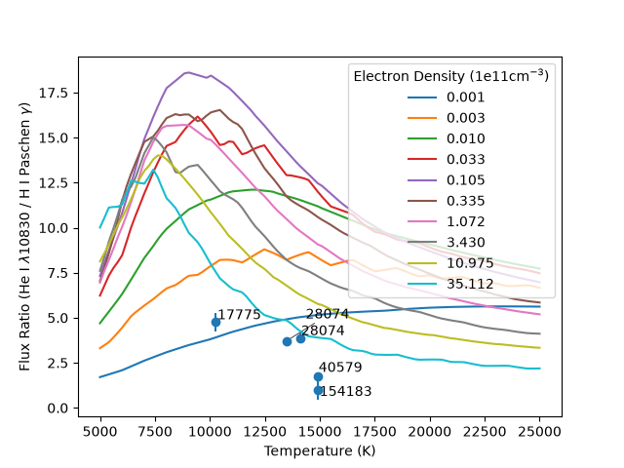
Comparison 2

Slide 16
Discussion – Predicted Physical Conditions
Flux values exceed Pyneb’s predictions
Density > 10¹⁰ cm⁻³, temperature ~10000 K.
High flux ratios support enshrouded gas hypothesis!

Slide 17
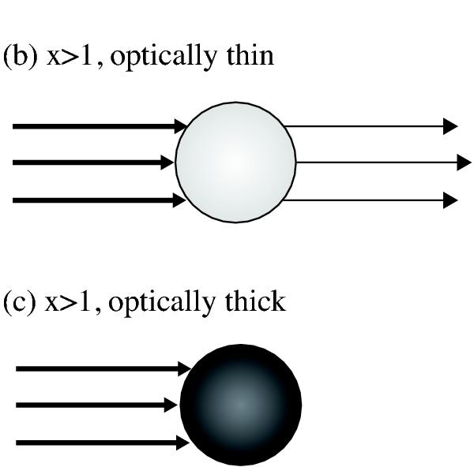
Discussion – Limitations
High density indicates optical thickness; Pyneb assumes optically thin region
High flux = Collisional effects; Pyneb assumes recombination
Future work: use CLOUDY to resolve these issues
Akimasa Kataoka, Satoshi Okuzumi, Hidekazu Tanaka and Hideko NomuraA&A, 568 (2014) A42
File Location

Slide 18
Discussion – Dust Correction
Dust correction reduces observed flux values
Some exceed Pyneb predictions despite correction
Cause behind high flux: Pyneb or dust clouds? Ian’s data indicates Pyneb is the root cause.

Slide 19
Thank You
Questions?

Slide 20


Key Citations
These are key citations that we mention while presenting. For a full bibliography containing all of the information used in this report, please see the corresponding report to this presentation.

