Slide 1
Calculus
By Akshaj Vyas

Slide 2
What’s a Limit?
When a function becomes arbitrarily close to a value at a point, but is undefined when evaluated at that point.
f(x) = (x - 2)/(x - 2)
f(2.01) = 1, but f(2) = undefined???
But the graph tells us it should be 1!

Slide 3

What’s a Limit?
When a function becomes arbitrarily close to a value at a point, but is undefined when evaluated at that point.
f(x) = (x - 2)/(x - 2)
f(2.01) = 1, but f(2) = undefined???
But the graph tells us it should be 1!
We now call this

Slide 4

Differential Calculus
“Instantaneous” rate of change!

Slide 5
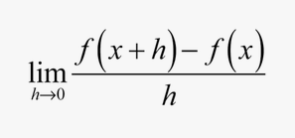
Differential Calculus
How can we resolve this paradox?
By using a limit!

Slide 6
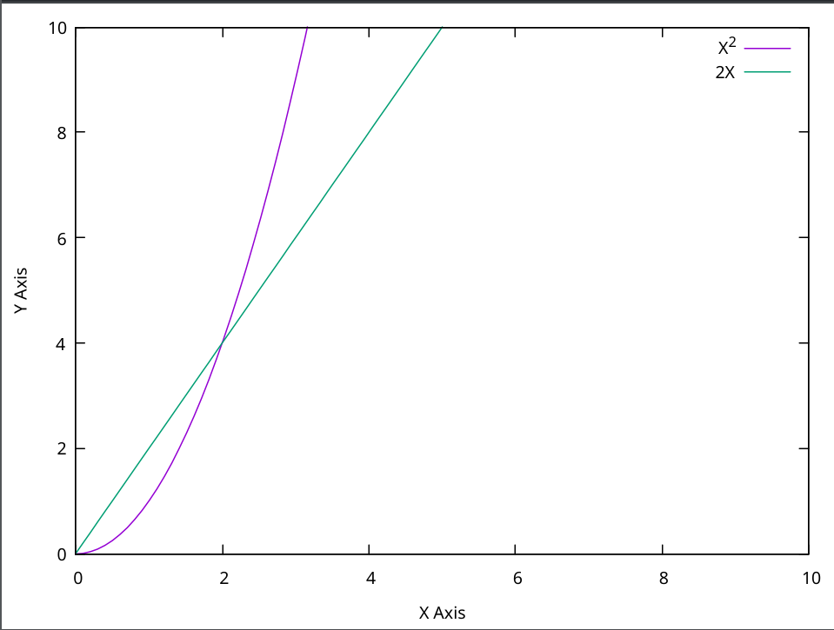
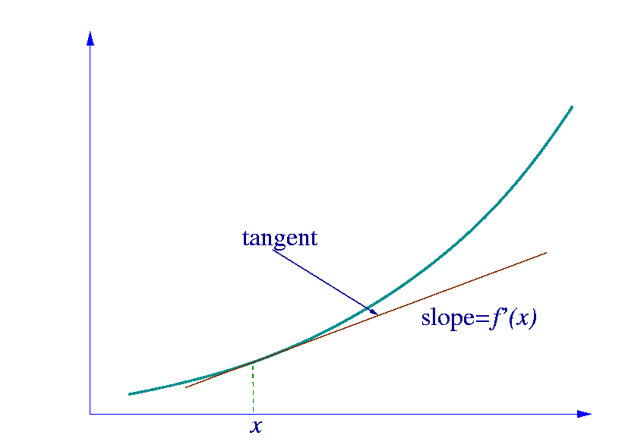
Differential Calculus
Slope of tangent line of graph.

Slide 7
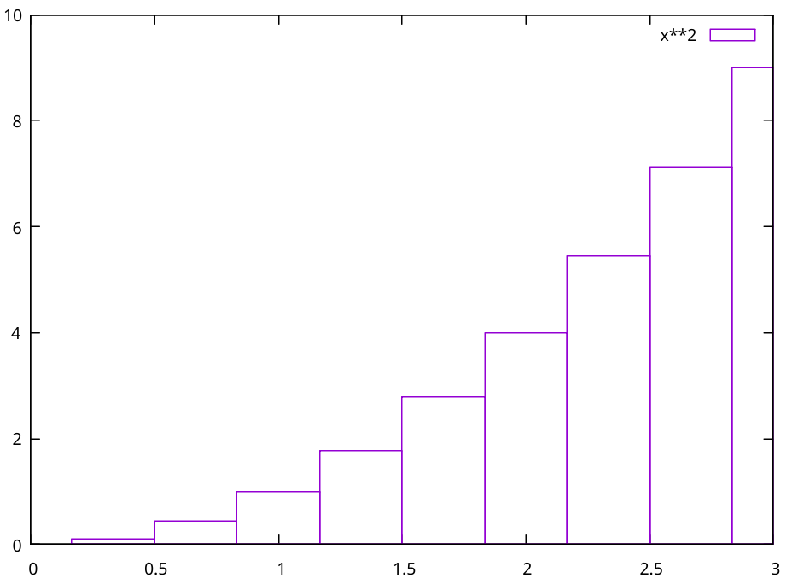
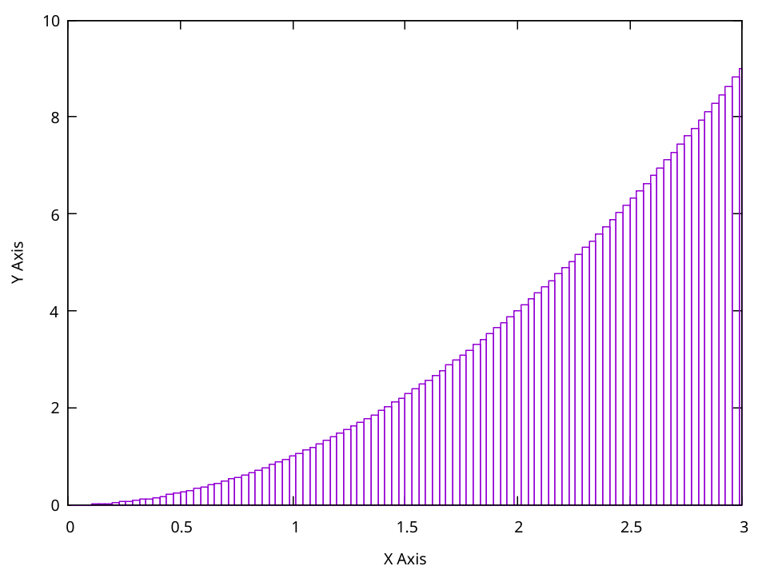
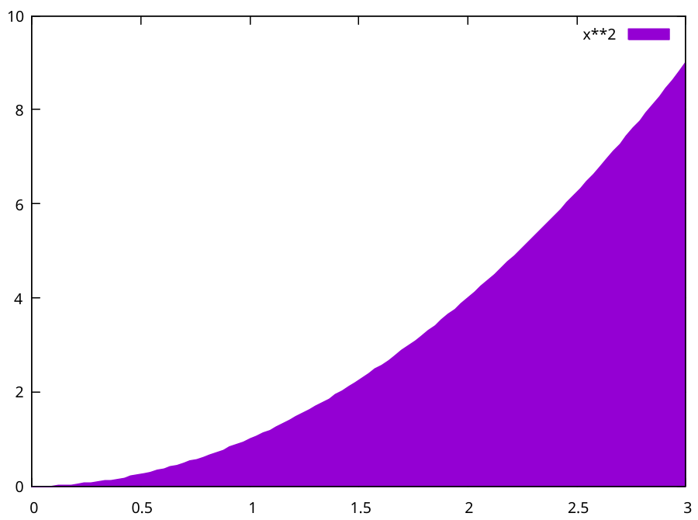
Integral Calculus
Area under the curve
Approximate Exact

Slide 8
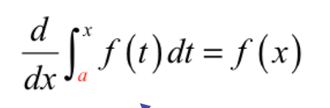
Wait… They’re opposites??
Yes, taking the derivative of an integral yields the original function
Second Fundamental Theorem of Calculus:

