Slide 1
4 Pillars of OOP
Inheritance, Polymorphism, Encapsulation, Abstracton

Slide 2
Inheritance
We’ve gone over encapsulation
Next Pillar is Inheritance
“Is a mechanism within object oriented programming that allows one class to be based on another class. Thus, it receives its properties and behaviors”

Slide 3
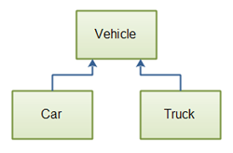
Example
Notes:
We’ve talked about inheritance before. It is one of the pillars of OOP.

Slide 4
Inheritance
Inheritance allows you to access members of the base class in the child class
It enables you to create a child class that can access and use all of the functionality of its base class.
You can keep common variables and functions in the base class and use them as many times as you want to in a child class.

Slide 5

Example
The Cat has a property called Family and a field called family that represents the biological family of all cats
The family field is not directly accessible by HouseCat and can only be accessed by the get accessor of the Family property.
There is no set accessor for Family so the value of the family field may only be changed within Cat.

Slide 6
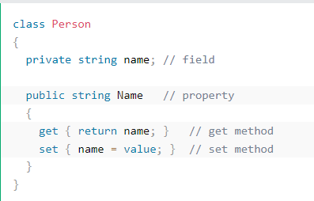
Getter and setter refresh

Slide 7
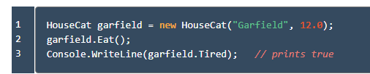
Example
Open up Program.cs
Within the Main method, create an instance of HouseCat and call some of the methods it inherits from Cat.
Notes:
The Eat method was defined in Cat, but may be called on all HouseCat instances as well. We say: “HouseCat inherits the method Eat() from Cat.” We know we have successfully called Eat() on garfield because the printed statement indicates the cat is now tired.

Slide 8
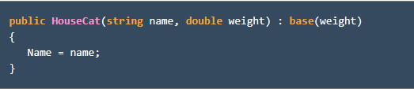
base
A subclass inherits all non-constructor methods from its base class.
We cannot create new instances of our subclass HouseCat using any constructors provided by Cat.
CAT constructors are not inherited by HouseCat. If we want to use a Cat constructor in the subclass, we must provide it.
Look at the constructor provided in HouseCat
Notes:
For this example students will look at file Cats.cs

Slide 9
base
You see the :syntax again with the base keyword on the constructor signature.
This combination allows the constructor to extend the base class constructor that takes a weight parameter.
In this case, the subclass constructor also sets the value of the name field.
The call to the base class constructor must be on the subclass’s constructor signature.
If a base class constructor takes no arguments, then the no-argument constructor is implicitly called for you in the subclass.

Slide 10
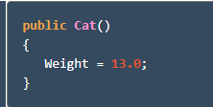
Cat example continued
A no-argument constructor is a constructor that takes no arguments.
Let’s add an additional constructor in Cat:
Notes:
Students will go to their HouseCat.cs file to do this

Slide 11
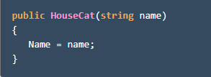
Example continued
Then in HouseCat, we can define another constructor.
Even though we don’t explicitly say we want to call that constructor from Cat, the no-argument constructor will be called.

Slide 12
Example Continued
Then, in HouseCat, we can define another constructor.
Even though we don’t specify that we want to call a constructor from Cat, the no-argument constructor will be called.
Notes:
Students will do this in the Cat.cs file

Slide 13

Example continued
We can initialize a new HouseCat with only a name field and the Cat no-argument constructor will still be applied.
In Program.cs you can confirm that the base class constructor has been called.
This constructor syntax allows us to easily expose any constructor from the base class by providing a subclass constructor that has the same signature, not method body, and calls the base constructor with the : base

