Slide 1
Implementing Database Row Level Security using Haskell LIO

Slide 2
What is LIO?
Library for Information Flow Control.
Provides a framework where security policies are enforced through the use of labels attached to data and even computation.
Used in systems where data security and integrity are critical, such as web servers handling user data, cloud services managing multi-tenant data storage, and any application where data isolation is required, or mutually distrusting parties are involved.

Slide 3
Advantages of LIO
Security guarantees through enforcing policies.
Flexibility to create labels and their components secrecy %% integrity.
Comparing labels using the infix operator “`canFlowTo`”.
Easy Integration into Haskell Code.

Slide 4
DCLabels
Secrecy %% Integrity
Who can read data v/s who can modify data
Have a lattice structure
Data flows from less restrictive to more restrictive

Slide 5
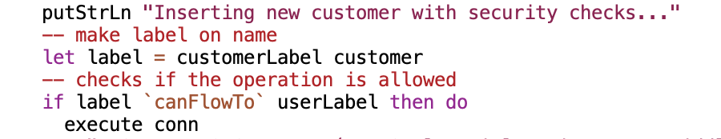
Example
L1 `canFlowTo` L2 iff
Confidentiality of L1 is at least as restrictive as L2
Integrity of L1 is at least as permissive as L2
In this example L1 is label and L2 is userLabel. (SecureDatabaseOperations.hs)

Slide 6
Flow of Data
Data flows from lower Secrecy to higher secrecy.
Data flows from higher integrity to lower integrity.
Modeled like an implication relation in propositional logic.

Slide 7
Importance of Row Level Security
Row Level Security (RLS) is a security mechanism that restricts data access at the row level within a database table based on the users credentials or attributes or permissions granted.
User-Specific Data Access: Applications that manage user-specific data, such as personal information or user-generated content, can leverage RLS to ensure users access only their data.

Slide 8

Implementing RLS using Haskell LIO
Representing
Representing Tables in a DB as data type (as seen in DataTypes.hs)
Interfacing
Interfacing with a database (DatabaseOperations.hs) but without any security policies .
Used as practice before I implemented security policies.
Implementing
Implementing security policies (added security labels by extending DatabaseOperations.hs to SecureDatabaseOperations.hs, SecureDatabaseOperationsV2.hs, SecureDatabaseOperationsV3.hs, SecureDatabaseOperationsV4.hs)
Setting up DB
Uniform encoding for tables
Creating Labels
making DCLabels

Slide 9
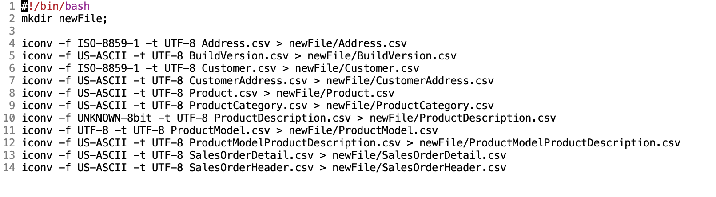
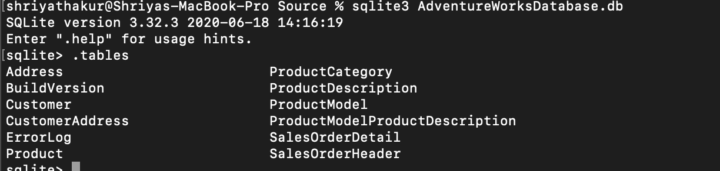
AdventureWorksDatabase.db
Convert to uniform encoding using shell script.
Contains different tables as seen below.
I will limit my scope to the Customer table for this project.

Slide 10
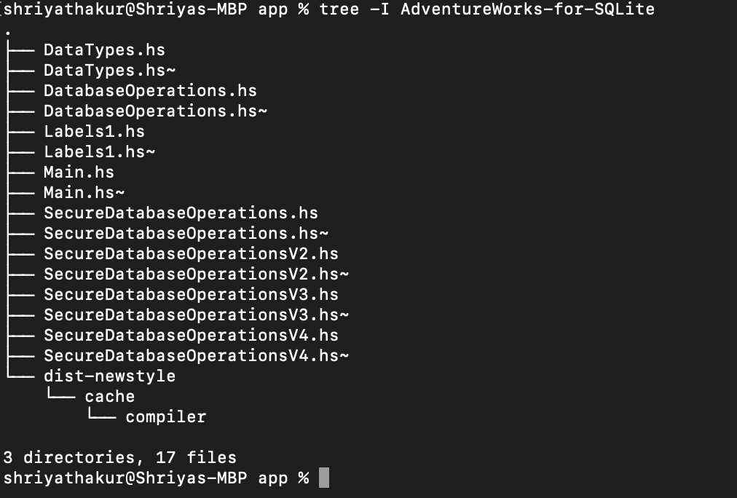
Files
Labels1.hs
DataTypes.hs: Contains tables (eg: Customer) represented as “data” types in Haskell where each column is represented as a constructor.
DatabaseOperations.hs
SecureDatabaseOperations.hs: Extends prev file to define security labels
… V2, V3, V4: Extended versions that play around with labels for inserting and deleting rows.
Database: AdventureWorksDatabase.db

Slide 11
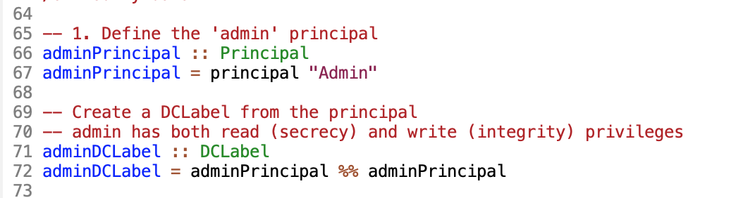
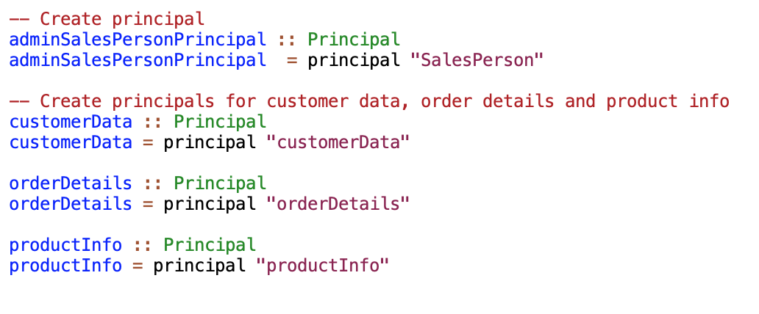
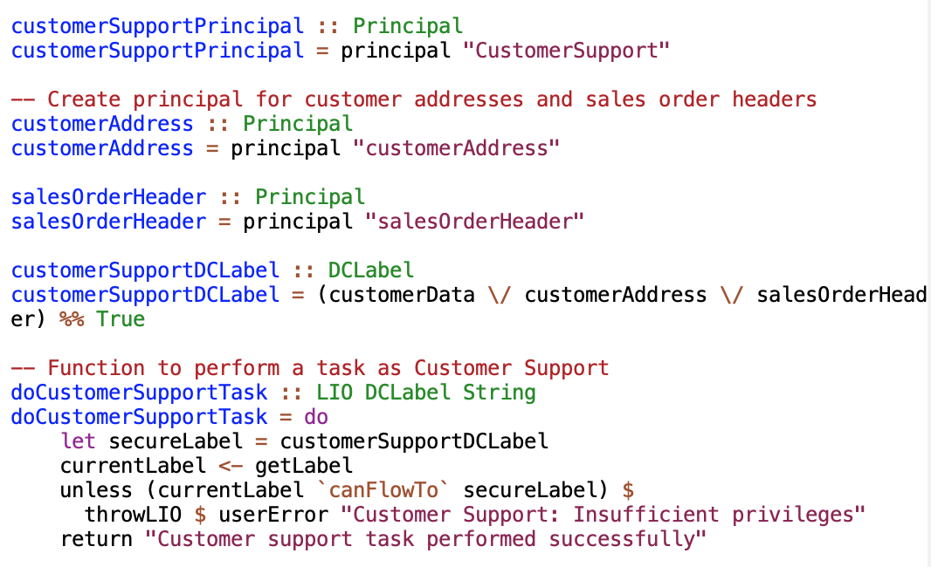
Labels1.hs: Constructing DCLabels
Construct principals and then use these principals to construct DCLabels
Contains DCLabels (that have been tested) to create roles for the given Adventure Works DB.

Slide 12
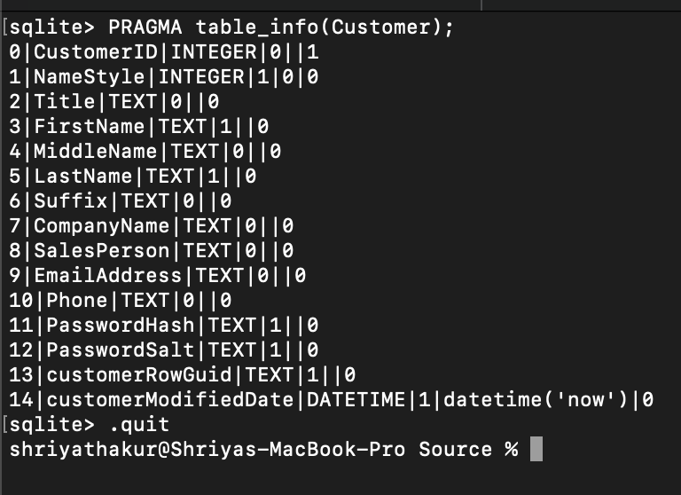
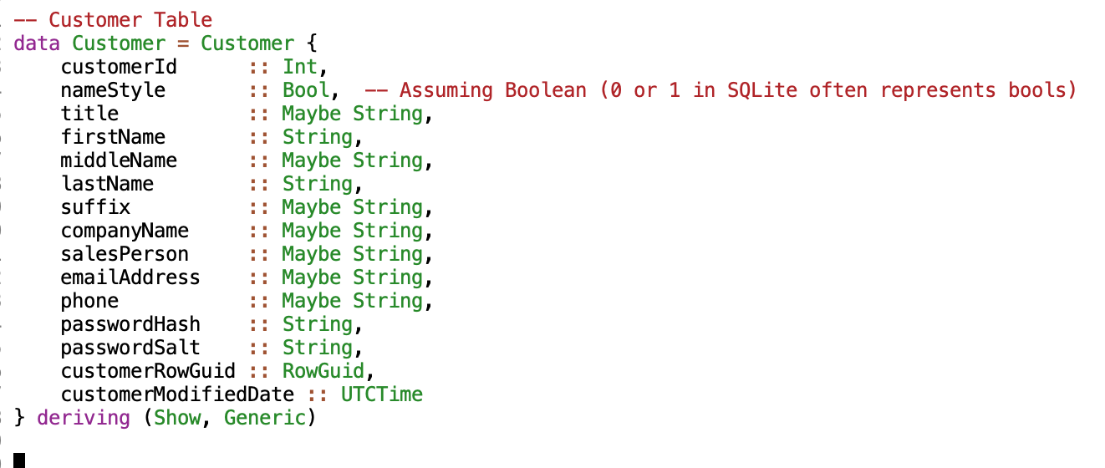

DataTypes.hs: Representing Tables in a DB
Customer table in SQLite represented as data type in Haskell to help us create instances of customer.
Each column in the table is now represented as a constructor.
Contains show and generic instances for each “data” type.
“Generic” allows functions to work on the structure of data.
“Show” lets you print the data on console.
The Maybe type is used in Haskell for columns that are NULL in SQLite.
Newtype is used to create a type wrapper for an existing type (String in this case).

Slide 13
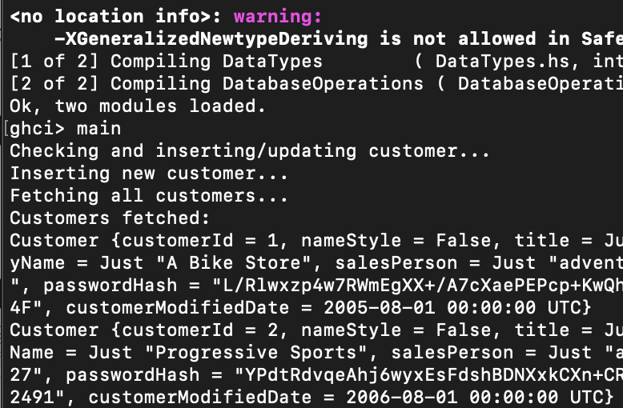
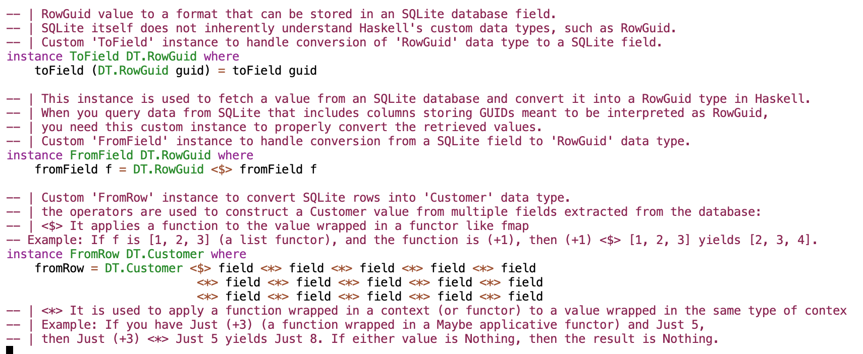
DatabaseOperations.hs: Interfacing with the DB
This defines a module for interacting with DB to manage customer data. It includes functionality to open and manage database connections, convert custom Haskell data types to and from SQL fields, and perform basic database operations such as inserting a customer and fetching or getting all customer records after the insert to print onto screen.
Note: <$> (fmap): This operator is used to apply a function to a value wrapped in a functor. In the case of fromRow, Customer <$> field applies the Customer constructor to the first field of the row. Customer here is a constructor expecting multiple arguments, each corresponding to a field in the database.
Note: <*>: This operator is used to apply a function that is already in a context (like a partially applied constructor) to more values in that context. After Customer <$> field has applied Customer to the first field, each subsequent <*> field applies the constructor to the next field in the database row.

Slide 14
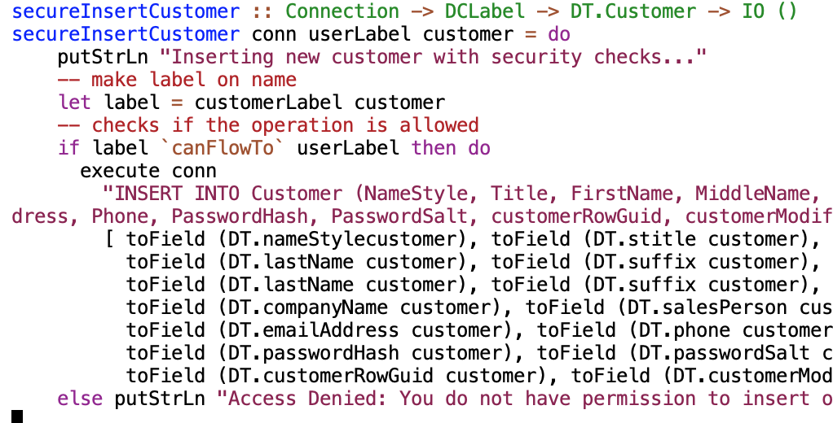
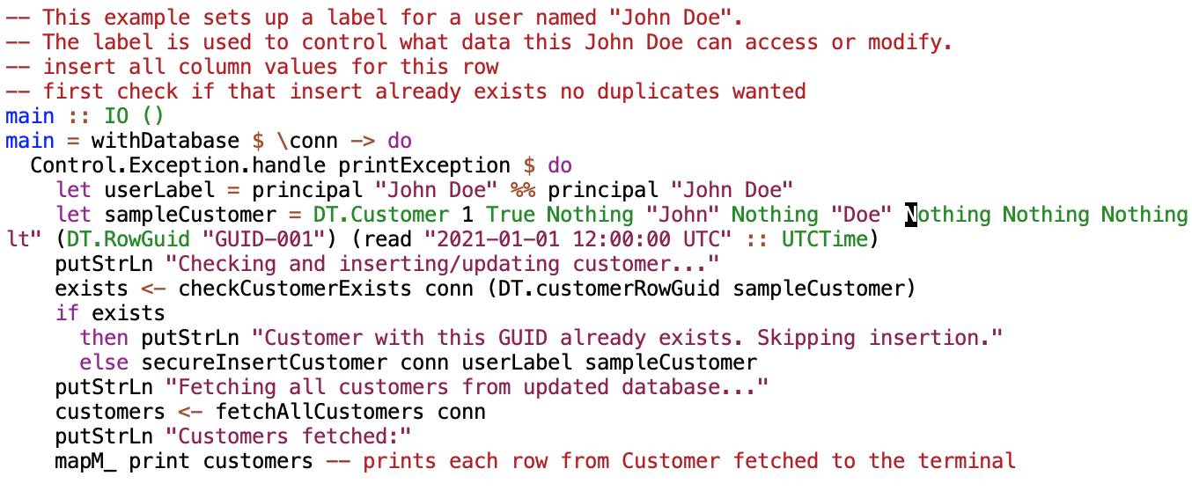
SecureDatabaseOperations.hs: Implementing Security Policies
This file defines functions for securely interacting with DB
Uses the LIO library to enforce security policies during database operations.
Note: Unlike DatabaseOperations.hs, this securely inserts new customer data based on security labels, retrieve all customers, and manage exceptions.
Defines a customerLabel based on firstName and lastName.
The main function demonstrates inserting a customer into the database while enforcing access controls based on security labels. -This example sets up a label for a user named "John Doe". The label is used to control what data this John Doe can access or modify.

Slide 15
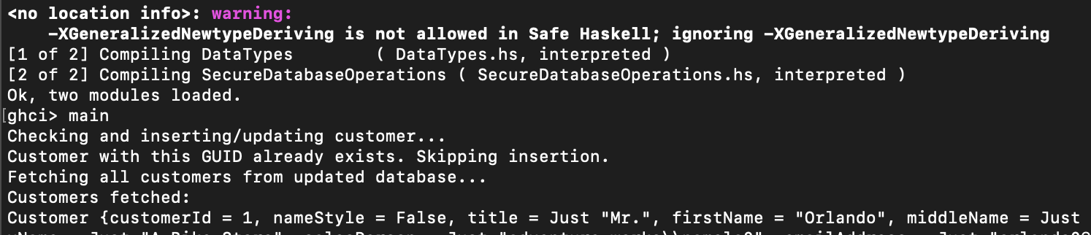
Running SecureDatabaseOperations.hs

Slide 16
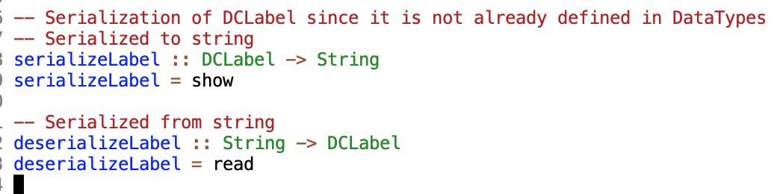

Points to Note in SecureDatabaseOperations.hs
I implemented serialization and deserialization in this file.
Convert DCLabel types to Strings using the show function to allow storage in db.
Convert strings back into DCLabel types using the read function when retrieving.
Use of prepared statements: The “?” here in the query represent placeholders used for substitution.
Each “?” will be replaced with actual customer values using the toField function.

Slide 17
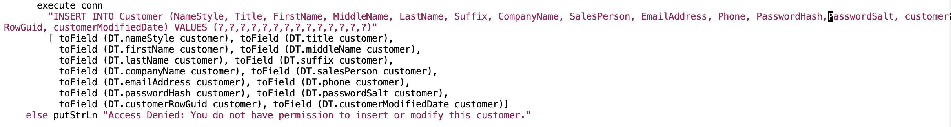
SecuredatabaseOperations.hs
Use of prepared statements: The “?” here in the query represent placeholders used for substitution.
Each “?” will be replaced with actual customer values using the toField function.

Slide 18
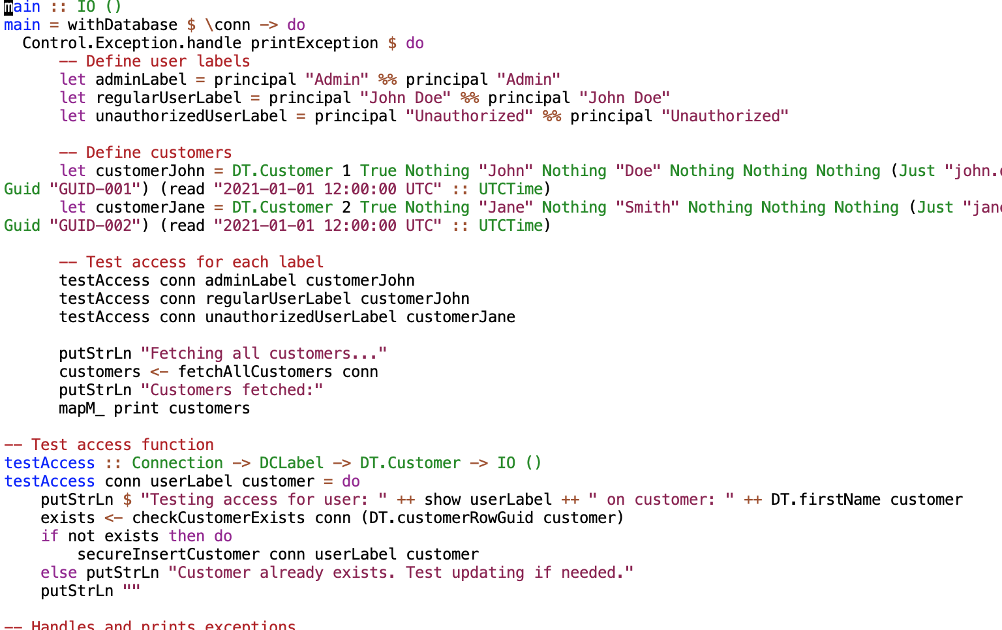
SecureDatabaseOperationV2.hs:
This file extends SecureDatabaseOperations.hs by incorporating specific user roles or labels that dictate access control for different users.
This version tests access rights by defining multiple users with varying security labels (such as Admin, regular user, and unauthorized user) and then attempting to insert customers into the database based on these security permissions.

Slide 19
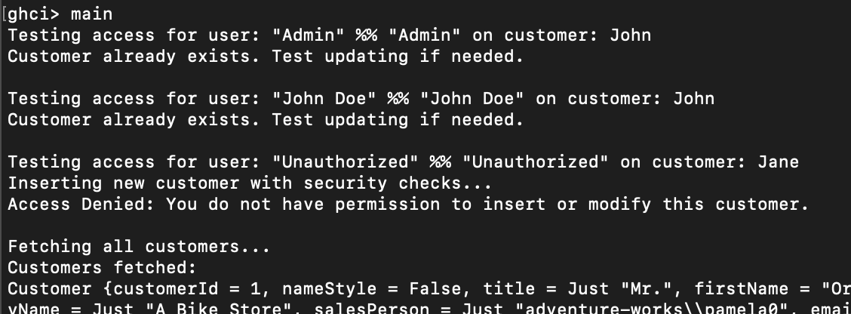
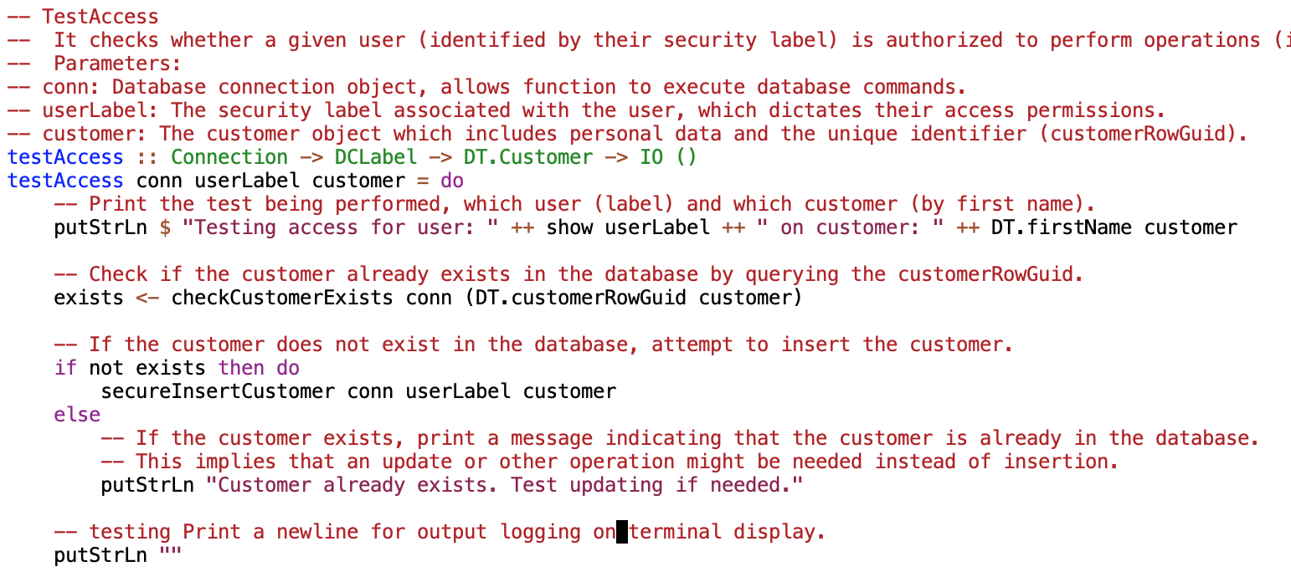
Running SecuredatabaseOperationsV2.hs and TestAccess function.
Message: "Testing access for user: "Admin" %% "Admin" on customer: John"
Action: Since the "Admin" label has the highest privileges, it checks for the existence of the customer "John".
Result: "Customer already exists. Test updating if needed." This implies that the check found an existing customer record for "John", and no insertion was needed.
Note: The testAccess function tests the ability of users with different security labels to perform database operations on customer records

Slide 20
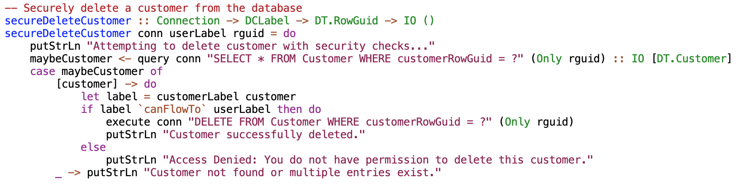
SecureDatabaseOperationsV3.hs
The previous versions focused on inserting/updating and querying customer data while managing access using DClabels.
This extends the prev versions by adding a secureDeleteCustomer function that implements RLS for deleting customer records.
It verifies that the security label associated with the current user allows them to delete the specific customer, ensuring that users can only delete records they are authorized to.

Slide 21
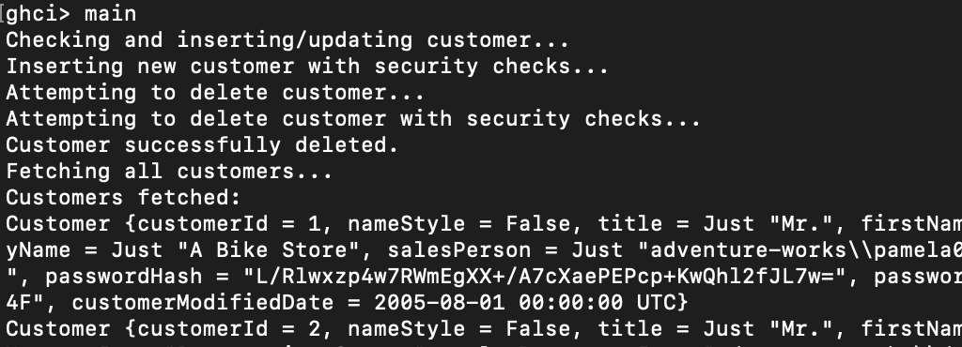
Running SecureDatabaseOperationsV3.hs

Slide 22
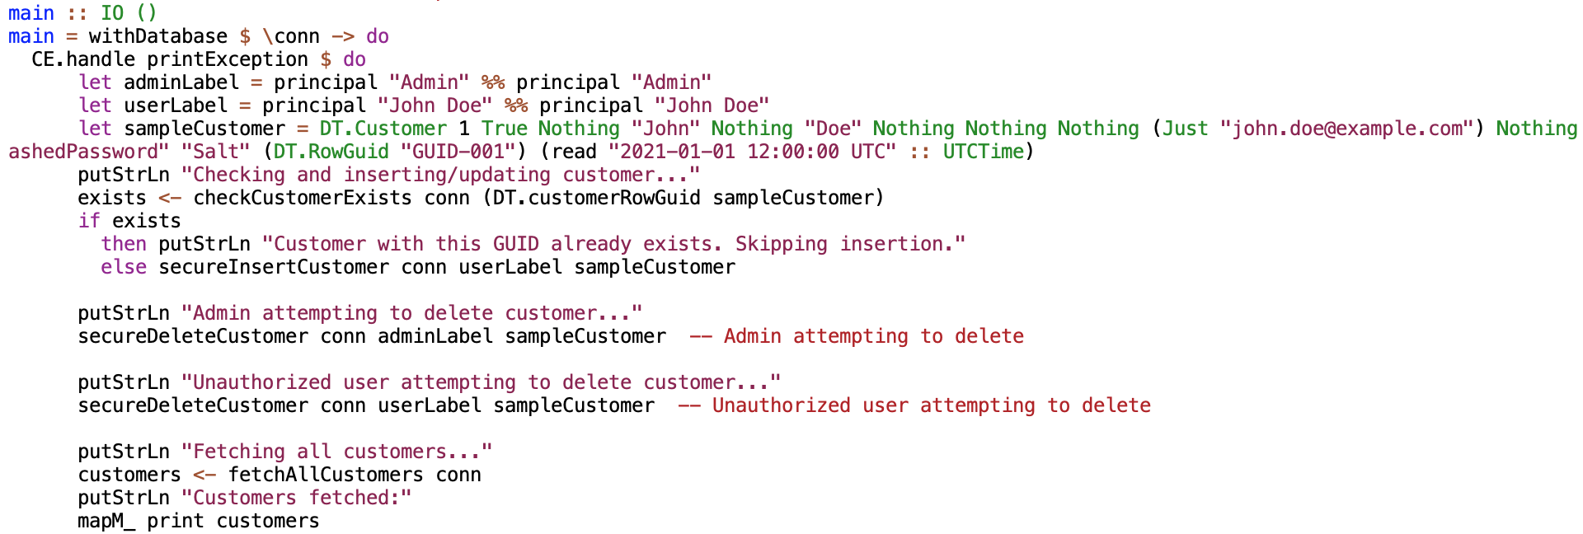
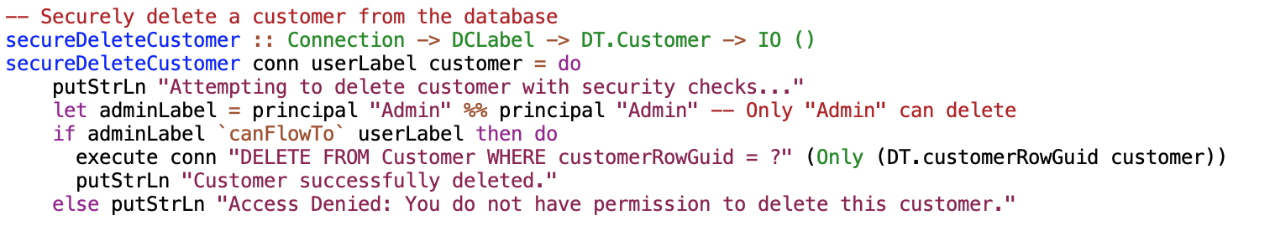
SecureDatabaseOperationsV4.hs
This extends prev version by handling different user roles by explicitly defining and checking against different security labels (adminLabel and userLabel) in the main function.
This example shows how different user roles can interact differently aka an admin being allowed to delete customers while a regular user is not.

Slide 23
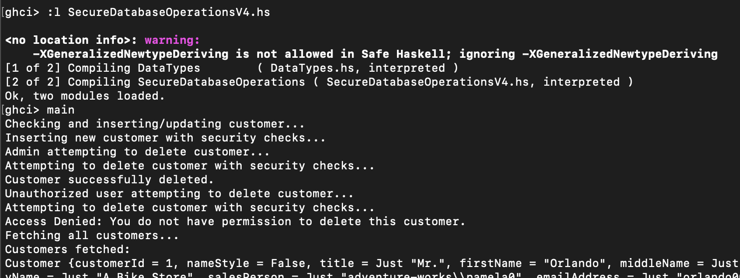
Running SecureDatabaseOperationsV4.hs

Slide 24
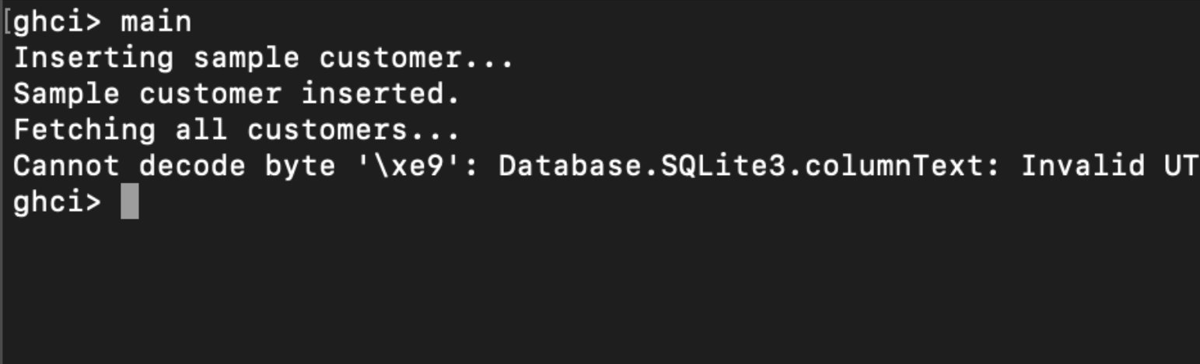
Bugs and Challenges
UTF Encodings
Constructing labels
Interfacing with Sqlite DB

Slide 25
Challenges
Haskell’s LIO library was new to me so implementation bugs were a part of this project.
Interfacing with SQLite introduced me to newer concepts like going from Haskell to SQLite types and vice versa.
If you load and run the files in the Haskell interpreter, it shows a warning saying NewType deriving isn’t allowed in Safe Haskell. This is due to the newtype wrapper for customerRowGuid mentioned in the DataTypes.hs file.
While I am comparing labels, I am not tracking the source of information. I just assume that the database is from a “trusted user”

Slide 26
Future Work
Although RLS is implemented it is done on a minimal scale, particularly only on the Customer table in this database. I would like to use some of the roles aka permit labels I have defined in the Labels1.hs file to incorporate this for the entire DBMS and then generalize this to apply to any DBMS.
I would also like to work on implementing property-based testing using Haskell’s QuickCheck library.

Slide 27
Inspired by
https://www.scs.stanford.edu/~dm/home/papers/stefan:dclabels.pdf
https://cseweb.ucsd.edu/~dstefan/pubs/stefan:2014:building-plas.pdf
https://www.scs.stanford.edu/~dm/home/papers/stefan:lio.pdf
https://dl.acm.org/doi/10.1145/2637113.2637115
Database: https://github.com/nuitsjp/AdventureWorks-for-SQLite/blob/master/Source/instawltdb.sql

Slide 28
Conclusion
LIO provides a great framework to enforce security policies
Haskell’s fine-grained control and expressive type system makes it a great fit, in combination with LIO, to implement RLS for a DBMS.

