Slide 1
RailBeat
Summer School
Alan, Dina, Ravaka, Gabriel

Slide 2
Summary
01
03
02
04
Sound analysis
Showcase
Animation
Contrast with plan

Slide 3
01
Sounds analysis

Slide 4
Sounds analysis
Music file to Midi
Algorithms
STFT = "Where is the energy in the frequency domain?"
CQT = "Which musical notes are present?"
YIN = "What is the pitch of this single sound?"
pYIN = "YIN, but with fewer mistakes."

Slide 5
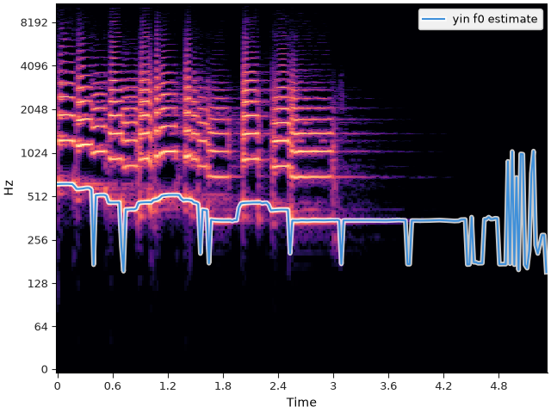
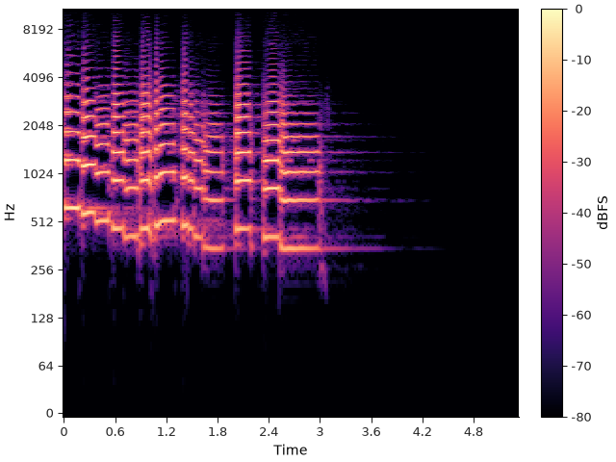
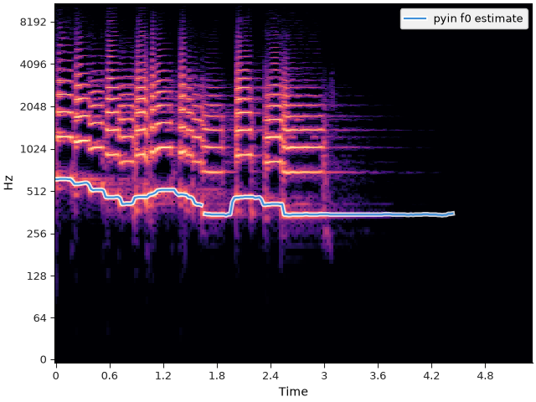
Sounds analysis
YIN
Music file to Midi
Algorithms
CQT
STFT
PYIN

Slide 6
Sounds analysis
Manage Hz ranges from midi
1 bin CQT = 1 halftone = 1 MIDI note if bins_per_octave=12 (Default value)
C2 = 65 Hz (fmin)
B8 = 7,9k Hz (fmax)

Slide 7
Sounds analysis
Translation process
Load the audio → mono waveform
Clean it → Trim silence (-30db)
Separate melody from drums (HPSS)
Find note begining → detect onsets
Estimate pitch
One note → pYIN gives frequency over time
Several notes → CQT gives energy per semitone
Convert frequency → MIDI note
Cut the timeline into segments using the onsets
For each segment, pick the active note(s) and create a MIDI event
Write the .mid file
Done !

Slide 8
Sounds analysis
Detect note and volume
With Librosa
Load MP3
Extract :
Notes
Volume
Onsets

Slide 9
02
Animation

Slide 10
Animation
Train
Syncro
Random trains
Can accelerate
Notes:
The train isn’t draw but described, he can be nuild with a seed
I use a trivial grammar system to build it => a train is only a locomotive with several wagons choose between 5 types of différents probalities
The train can move forward or backward depending of it’s acceleration => I use this when I have more/less notes incoming
A smoke system is used with the train to add more animation (not sync with the music for the moment)

Slide 11
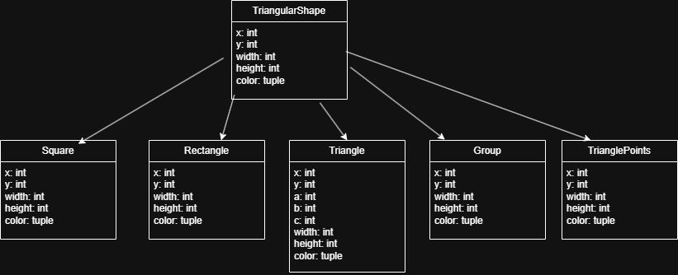
Animation
Shapes
Notes:
- Whole visual is in triangle
Base class TriangularShape => which trangles am I made of ? (list_triangles)
Derived Shapes
Composition to move shapes => Group

Slide 12
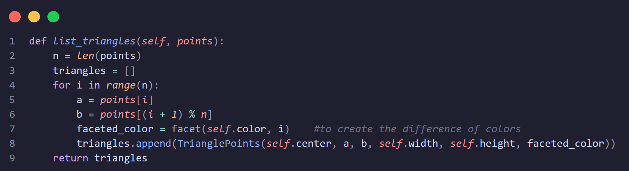
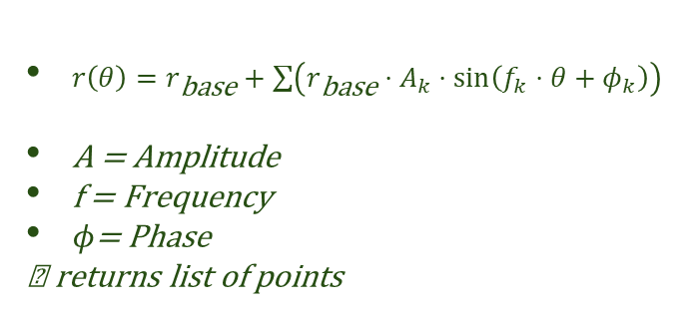
Animation
Clouds moving to the right
Based on a circle
Changes due to additions of sinus
Cloud
$r\left(θ\right)=r_{\text{base}}+\sum{\left(r_{\text{base}}⋅A_{k}⋅\sin\left(f_{k}⋅θ+φ_{k}\right)\right)}$
A = Amplitude
f = Frequency
$φ$= Phase
→ returns list of points
Notes:
The outline starts from a circle deformed by the superposition of sine waves ($r = r_{\text{base}} + \sum \sin$). The amplitude (height of the bumps), frequency (number of waves), and phase (offset) are adjusted to create organic shapes.

Slide 13
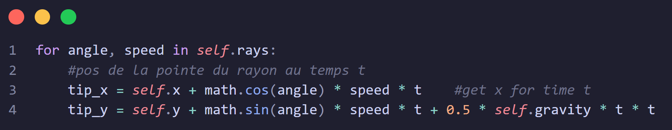
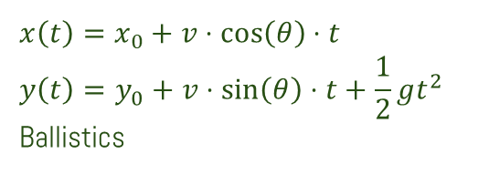
Animation
Groupe of triangles (rays)
Random angle of projection and speed
Fireworks
$$x\left(t\right)=x_{0}+v⋅\cos\left(θ\right)⋅t$$
$$y\left(t\right)=y_{0}+v⋅\sin\left(θ\right)⋅t+\frac{1}{2}gt^{2}$$
Ballistics
Notes:
The outline starts from a circle deformed by the superposition of sine waves ($r = r_{\text{base}} + \sum \sin$). The amplitude (height of the bumps), frequency (number of waves), and phase (offset) are adjusted to create organic shapes.
L’ 'ajout du terme $\frac{1}{2}gt^{2}$courbe la chute vers le bas pour simuler la gravité de manière réaliste.

Slide 14
03
Showcase
Notes:
Alan

Slide 15
04
Contrast with the plan
Notes:
Dina

Slide 16
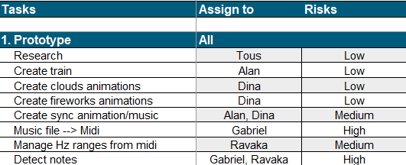
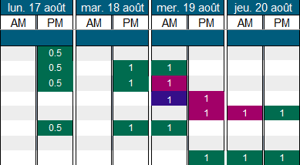
Planification - Prototype

Slide 17
Contrast with plan
What’s next?
Fix some issues Detect instruments Add more animations
Notes:
Alan

Slide 18

Thanks!
Do you have questions?
Please keep this slide for attribution
Notes:
Dina

