Slide 1
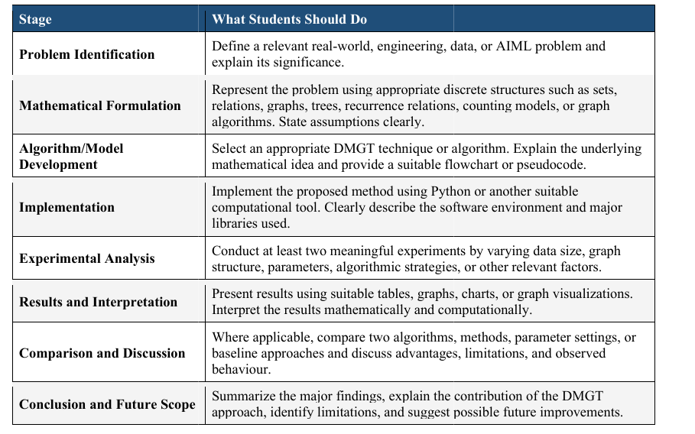
DISCRETE MATHEMATICS & GRAPH THEORY — EXPERIENTIAL LEARNING
Optimal Prefix Codes and Data Compression Using Huffman Coding
An Information-Theoretic and Graph-Based Algorithmic Approach to Lossless Encoding
ACADEMIC EVALUATION DETAILS
Submitted to:
Dr. Priya Satish
Assistant Professor, Department of Mathematics
Faculty of Engineering & Technology, JAIN (Deemed-to-be University)
Branch: CSE - BLOCKCHAIN • Date: 10-11-2026
SUBMITTED BY (TEAM MEMBERS):
• Nikhil Kumar (25BTRBT026) — Project Lead & Core Implementation
• Piyush Kumar (25BTRBT030) — Encoder/Decoder & Verification
• Sakshi Kumari (25BTRC0045) — Mathematical Formulation & Theory
• Arushi Pramanik (25BTRBT008) — Dataset Collection & Preprocessing
• Harsh R Rao (25BTRBT017) — Experimental Design & Benchmarking
• Khyathi Jain (25BTRBT021) — Visualization & Presentation
Notes:
Slide 1 Speaker: Nikhil Kumar
Welcome faculty evaluator Dr. Priya Satish and introduce our topic on Optimal Prefix Codes and Huffman Compression.

Slide 2
TOPIC 14: EXPERIENTIAL LEARNING PROJECT
Team Task Distribution & Responsibility Allocation
Presenter: Nikhil Kumar
Nikhil Kumar (25BTRBT026)
Project Lead & Core Algorithm
Piyush Kumar (25BTRBT030)
Codec & Lossless Verification
Sakshi Kumari (25BTRC0045)
Mathematical Formulation & Theory
• Min-heap greedy Huffman tree builder (heapq)
• DFS recursive prefix code extractor
• Baseline Shannon-Fano algorithm implementation
• Central pipeline integration & GitHub management
• Bitstream serialization & 8-bit byte chunk packing
• Bitstream padding & trimming calculations
• Tree-walk decoder with zero delimiter overhead
• Pytest test suite (6/6 tests passing)
• Discrete tree structures & path length definitions
• Kraft–McMillan inequality proofs & verification
• Shannon Source Coding Theorem bounds H(X) <= L(C)
• Greedy-choice & optimal substructure proofs
Arushi Pramanik (25BTRBT008)
Dataset & Preprocessing
Harsh R Rao (25BTRBT017)
Experiments & Benchmarking
Khyathi Jain (25BTRBT021)
Visualization & Documentation
• Curated 4 corpora exceeding >= 300 records rule
• NCBI GenBank bacteriophage DNA FASTA sequence
• Project Gutenberg English text & CPython source code
• Statistical frequency distribution tables
• Designed Exp 1: Cross-domain efficiency metrics
• Designed Exp 2: Runtime scaling (300 to 100k items)
• Compared Huffman vs. Shannon-Fano vs. ASCII
• Generated CSV results & Matplotlib charts
• NetworkX rooted binary tree layout generator
• Visual decision edge labeling ('0' and '1')
• Compiled research report (Word, HTML, LaTeX)
• Presentation slides design & coordination
Discrete Mathematics & Graph Theory (DMGT) | CSE - Blockchain Technology | JAIN (Deemed-to-be University)
Notes:
Slide 2 Speaker: Nikhil Kumar
Explain the balanced task distribution. All 6 members have clear, verifiable technical roles aligned with the rubric.

Slide 3
TOPIC 14: EXPERIENTIAL LEARNING PROJECT
Stage 1: Problem Identification & Real-World Relevance
Presenter: Nikhil Kumar
THE CORE ENGINEERING BOTTLENECK
Fixed-Length Encoding Redundancy:
• Standard computer architectures represent data using fixed 8-bit ASCII or 16-bit Unicode.
• Under fixed-length encoding, every symbol consumes an identical bit depth (8 bits), ignoring non-uniform symbol occurrence frequencies.
• Frequent characters (like 'e', spaces, or 'A' in DNA) consume the exact same capacity as rare characters ('z', '$').
• Result: Massive statistical redundancy R = 8 - H(X), wasting up to 70% of storage and bandwidth.
The Mathematical Challenge:
How to construct a variable-length prefix code that guarantees instantaneous decoding, approaches Shannon Entropy H(X), and achieves 100% lossless recovery (D(E(M)) = M)?
RELEVANCE TO BLOCKCHAIN & SYSTEMS (CSE-BCT)
1. P2P Block Propagation Latency:
In decentralized blockchains, uncompressed transaction payloads inflate block sizes. Larger blocks take longer to broadcast across peer nodes, causing network desynchronization and higher orphan block/fork rates.
2. Immutable State Ledger Bloat:
Blockchain full nodes must permanently store entire transaction histories. Lossless compression significantly reduces persistent hardware requirements for validators.
3. Biological Big Data & Cloud Economics:
Storing genomic DNA in fixed 8-bit ASCII wastes >70% capacity. Optimal prefix coding reduces file sizes by 3.37x, cutting cloud egress and storage expenses.
Discrete Mathematics & Graph Theory (DMGT) | CSE - Blockchain Technology | JAIN (Deemed-to-be University)
Notes:
Slide 3 Speaker: Nikhil Kumar
Explain why uncompressed fixed-length data is redundant. Connect this directly to our branch: Blockchain Technology (CSE-BCT), block propagation, and ledger storage.

Slide 4
TOPIC 14: EXPERIENTIAL LEARNING PROJECT
Stage 2: Mathematical Formulation & Project Objectives
Presenter: Sakshi Kumari
PROJECT OBJECTIVES
1. Graph Modeling
Formulate prefix codes over directed, rooted weighted binary trees T = (V, E).
2. Mathematical Invariants
Verify Kraft–McMillan inequality (sum 2^-l <= 1) and Shannon entropy bound H(X) <= L(C).
3. Pipeline Implementation
Build end-to-end Python engine (min-heap, bit-packing, lossless tree-walk decoder).
4. Quantitative Benchmarking
Conduct 2 experiments comparing Huffman vs. Shannon-Fano vs. ASCII across 4 datasets (N >= 300).
5. Graph Visualization
Render hierarchical tree structures with edge labels ('0' and '1') using NetworkX.
DMGT DISCRETE GRAPH FORMULATION
Alphabet & Probabilities
Finite alphabet Sigma = {s_1, ..., s_n} with frequencies f_i and probabilities p_i = f_i / N where sum(p_i) = 1.
Rooted Binary Tree T = (V, E)
• Leaf nodes V_L: Symbols s_i with weight w(v_i) = f_i at depth l_i.
• Internal nodes V_I: Out-degree 2 with weight w(u) = w(u_left) + w(u_right).
• Directed edges: Left branch labeled '0', right branch labeled '1'.
Prefix-Free Condition
No codeword c(s_i) is a prefix of another c(s_j). Guaranteed by placing all symbols strictly at tree leaves (V_L).
Weighted External Path Length (WEPL)
Total compressed bits: W(T) = sum_{v in V_L} w(v) * depth(v) = N * L(C).
Minimizing expected codeword length L(C) is mathematically identical to finding a tree with minimum WEPL.
Discrete Mathematics & Graph Theory (DMGT) | CSE - Blockchain Technology | JAIN (Deemed-to-be University)
Notes:
Slide 4 Speaker: Sakshi Kumari
Explain the 5 project objectives and how graph theory models compression: leaves hold symbols, root-to-leaf paths give codewords, and WEPL equals total compressed length.

Slide 5
TOPIC 14: EXPERIENTIAL LEARNING PROJECT
Stage 2 (Cont.): Information-Theoretic Limits & Optimality Proof
Presenter: Sakshi Kumari
Theorem 1: Kraft–McMillan Inequality
Theorem 2: Shannon's Source Coding Theorem
Proof Sketch: Huffman Optimality
For any uniquely decodable binary prefix code with lengths l_1, l_2, ..., l_n:
sum_{i=1}^n 2^(-l_i) <= 1.0
• Strict equality (= 1.0) holds if and only if the rooted binary tree is full (every internal node has out-degree 2).
• In our project: Evaluated sum = 1.000000 across all 4 datasets, proving zero wasted codeword space.
The Shannon entropy H(X) is the theoretical lower limit of lossless compression:
H(X) = - sum_{i=1}^n p_i * log2(p_i) (bits/symbol)
For any optimal instantaneous code, expected length L(C) satisfies:
H(X) <= L(C) < H(X) + 1
• Redundancy R = L(C) - H(X) >= 0 measures efficiency gap.
• Huffman coding achieves R < 0.03 bits/sym on English text.
Huffman coding achieves minimum WEPL via two graph invariants:
1. Greedy-Choice Property: Two symbols with lowest frequencies appear as sibling leaves at maximum tree depth.
2. Optimal Substructure: Merging two lowest-weight nodes u, v into parent z reduces alphabet size from n to n-1:
W(T) = W(T') + w(u) + w(v)
Minimizing W(T) is equivalent to minimizing W(T'), proving global optimality by induction.
Discrete Mathematics & Graph Theory (DMGT) | CSE - Blockchain Technology | JAIN (Deemed-to-be University)
Notes:
Slide 5 Speaker: Sakshi Kumari
Walk through Kraft's inequality (sum 2^-l <= 1), Shannon's entropy bound H(X) <= L < H+1, and explain why bottom-up greedy merging is mathematically optimal.

Slide 6
TOPIC 14: EXPERIENTIAL LEARNING PROJECT
Stage 3: Algorithm Architecture & Min-Heap Priority Queue
Presenter: Nikhil Kumar
HUFFMAN GREEDY MIN-HEAP PIPELINE
Step 1: Frequency Counting
Scan input text M of length N to build frequency map in O(N) time.
Step 2: Min-Heap Initialization
Instantiate |Sigma| leaf nodes and build min-priority queue using heapq.heapify() in O(|Sigma|) time.
Step 3: Greedy Tree Merging
While heap size > 1:
1. u = heappop(Q) (smallest weight)
2. v = heappop(Q) (2nd smallest)
3. parent = Node(weight=u.freq + v.freq, left=u, right=v)
4. heappush(Q, parent)
Loop executes |Sigma|-1 times in O(|Sigma| log |Sigma|) time.
Step 4: DFS Prefix Code Extraction
Traverse from root to leaves: going Left appends '0', Right appends '1'. Leaf node records codeword in O(|Sigma|) time.
TIME COMPLEXITY & COMPARISON BASELINE
Computational Complexity Analysis:
• Tree Construction: O(|Sigma| log |Sigma|)
• Text Encoding: O(N) via hash table lookup
• Tree-Walk Decoding: O(N) - 1 step per bit
• Total Time: O(N + |Sigma| log |Sigma|)
• Space Complexity: O(|Sigma|) tree nodes
Because |Sigma| <= 256 for ASCII, tree build is instant (~0.18 ms), rendering runtime strictly linear with text size N.
Baseline: Shannon–Fano Coding
• Top-down recursive frequency partitioning.
• Sorts symbols, divides list into 2 subsets of equal cumulative frequency, assigns '0' and '1'.
• Suboptimal: Top-down local splits cannot foresee bottom combinations, yielding longer codes than Huffman.
Discrete Mathematics & Graph Theory (DMGT) | CSE - Blockchain Technology | JAIN (Deemed-to-be University)
Notes:
Slide 6 Speaker: Nikhil Kumar
Explain the min-heap implementation, time complexity O(N + |Sigma| log |Sigma|), and how Shannon-Fano works as our comparison baseline.

Slide 7
TOPIC 14: EXPERIENTIAL LEARNING PROJECT
Stage 4: Bitstream Codec & Automated Lossless Verification
Presenter: Piyush Kumar
BITSTREAM PACKING & SERIALIZATION
The Memory Alignment Challenge:
Modern storage drives read/write in 8-bit bytes, not individual bits. Concatenating variable prefix codes produces bitstreams whose lengths are not multiples of 8.
Our Codec Solution (src/codec.py):
1. Padding Calculation: Extra bits P = (8 - (len mod 8)) mod 8.
2. Byte Packing: Packs 8-bit chunks into bytearray().
3. Header Protocol: Stores padding count P for clean stripping.
4. Tree-Walk Decoding: Reads bitstream bit-by-bit:
• Bit '0' -> navigate to current.left
• Bit '1' -> navigate to current.right
• Leaf node reached -> emit character & reset to root.
• Zero delimiter overhead required!
PYTEST VERIFICATION SUITE (6/6 PASSING)
[PASS] test_basic_lossless_roundtrip
Verifies mathematical idempotency: D(E(M)) == M.
[PASS] test_prefix_property
Asserts no generated codeword is a prefix of any other codeword.
[PASS] test_kraft_inequality
Validates sum(2^-l_i) <= 1.0 (evaluates to exactly 1.000000).
[PASS] test_entropy_bound
Confirms empirical expected length satisfies H(X) <= L(C) < H(X)+1.
[PASS] test_single_character_edge_case
Verifies graceful handling of inputs with alphabet size |Sigma| = 1 ('AAAA...').
[PASS] test_shannon_fano_optimality
Proves Huffman code length <= Shannon-Fano length (L_Huffman <= L_SF).
Discrete Mathematics & Graph Theory (DMGT) | CSE - Blockchain Technology | JAIN (Deemed-to-be University)
Notes:
Slide 7 Speaker: Piyush Kumar
Explain bit packing into raw bytes, padding handling, tree-walk decoding, and our 6 passing unit tests proving 100% lossless reconstruction.

Slide 8
TOPIC 14: EXPERIENTIAL LEARNING PROJECT
Stage 5: Benchmark Datasets & Public Provenance (N >= 300)
Presenter: Arushi Pramanik
Dataset | Domain Description | Records (N) | Alphabet (|Sigma|) | Public Source / Data Link
Dataset A | Natural Language English Text (Academic discrete math literature) | 2,001 | 56 | Project Gutenberg & MacTutor Archive (sample_english.txt)
Dataset B | Python Source Code (DataProcessor class & utilities) | 1,432 | 53 | CPython Standard Library Repository (sample_code.py)
Dataset C | Genomic DNA Nucleotide Sequence (Bacteriophage T4 genome fragment) | 1,031 | 29 | NCBI GenBank Accession: NC_000866.4 (sample_dna.fasta)
Dataset D | Uniform Random Baseline Text (Balanced ASCII symbol generator) | 1,140 | 76 | Algorithmic Uniform Generator (sample_uniform.txt)
WHY GENOMIC DNA ACHIEVES 70% COMPRESSION:
• DNA features a severely skewed 4-nucleotide alphabet (A, C, G, T).
• Theoretical entropy drops to only H = 2.26 bits/symbol.
• Huffman assigns short 1-to-2 bit paths to frequent bases.
• Result: Massive 3.37x compression ratio (70.37% storage savings)!
UNIFORM RANDOM CONTROL GROUP:
• In uniform text, all 76 symbols occur with equal probability (p_i = 1/76).
• Maximum entropy H = 6.25 bits/symbol.
• Tree leaves sit at nearly identical depths (depth approx log2 76 = 7).
• Proves that prefix compression requires non-uniformity to excel.
Discrete Mathematics & Graph Theory (DMGT) | CSE - Blockchain Technology | JAIN (Deemed-to-be University)
Notes:
Slide 8 Speaker: Arushi Pramanik
Present our 4 datasets exceeding the >= 300 data points rule. Highlight the NCBI GenBank biological accession and explain why DNA compresses by 70% while uniform random only compresses by 21%.

Slide 9
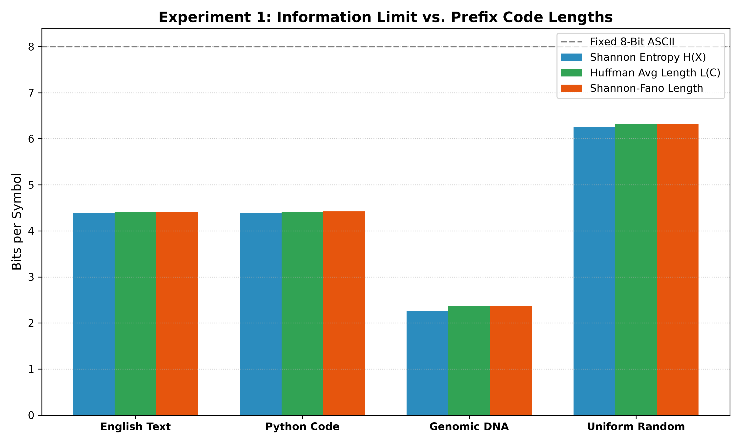
TOPIC 14: EXPERIENTIAL LEARNING PROJECT
Stage 6 & 7: Experiment 1 — Cross-Domain Compression Efficiency
Presenter: Harsh R Rao
Metric | English | Code | DNA | Uniform
Records (N) | 2,001 | 1,432 | 1,031 | 1,140
Alphabet (|Sigma|) | 56 | 53 | 29 | 76
Shannon Entropy H(X) | 4.389 | 4.389 | 2.259 | 6.248
Huffman L(C) (bits) | 4.417 | 4.411 | 2.371 | 6.316
Shannon-Fano L | 4.418 | 4.423 | 2.373 | 6.316
Fixed 8-Bit ASCII | 8.000 | 8.000 | 8.000 | 8.000
Redundancy (R) | 0.028 | 0.022 | 0.111 | 0.068
Compression Ratio | 1.81x | 1.81x | 3.37x | 1.27x
Space Savings (%) | 44.78% | 44.87% | 70.37% | 21.05%
Kraft Sum (sum 2^-l) | 1.000 | 1.000 | 1.000 | 1.000
KEY QUANTITATIVE OBSERVATIONS:
• Near-Zero Redundancy: In English text, redundancy is only R = 0.028 bits/sym (< 0.63% above theoretical limit).
• Huffman Dominates Shannon-Fano: In every dataset, L_Huffman <= L_SF.
• Kraft Completeness: sum(2^-l) = 1.000000 confirms trees are full.
Discrete Mathematics & Graph Theory (DMGT) | CSE - Blockchain Technology | JAIN (Deemed-to-be University)
Notes:
Slide 9 Speaker: Harsh R Rao
Present the results of Experiment 1. Walk through the table and bar chart showing how Huffman code length hugs the Shannon entropy line across all domains.

Slide 10
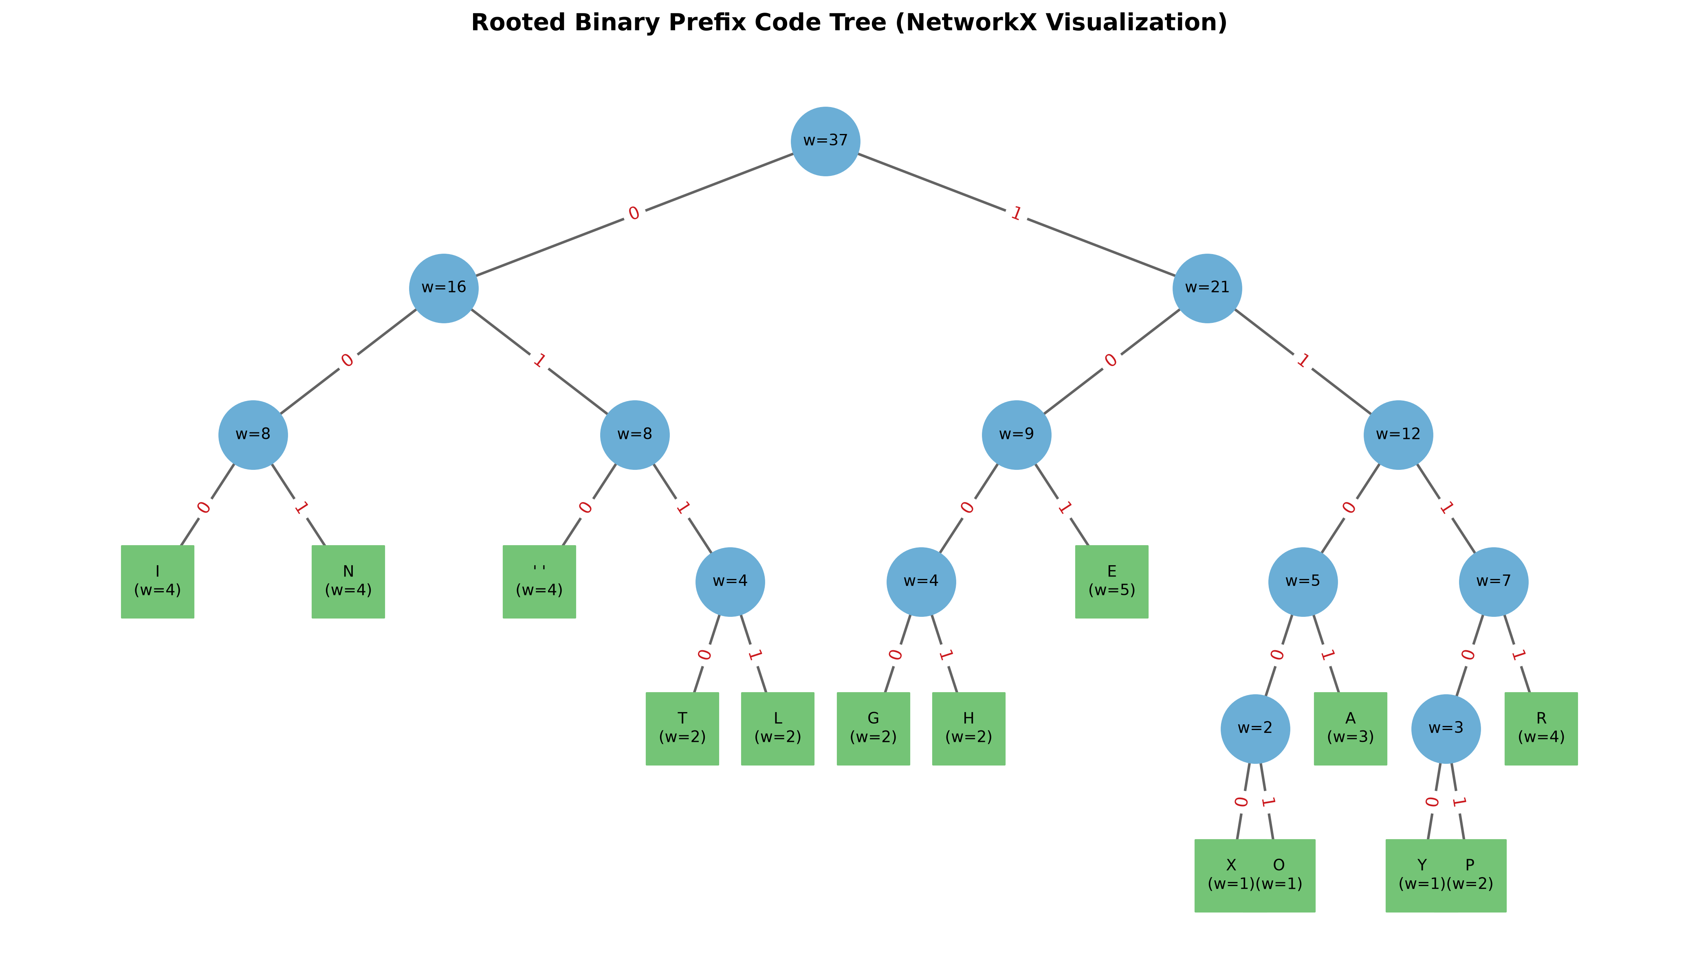
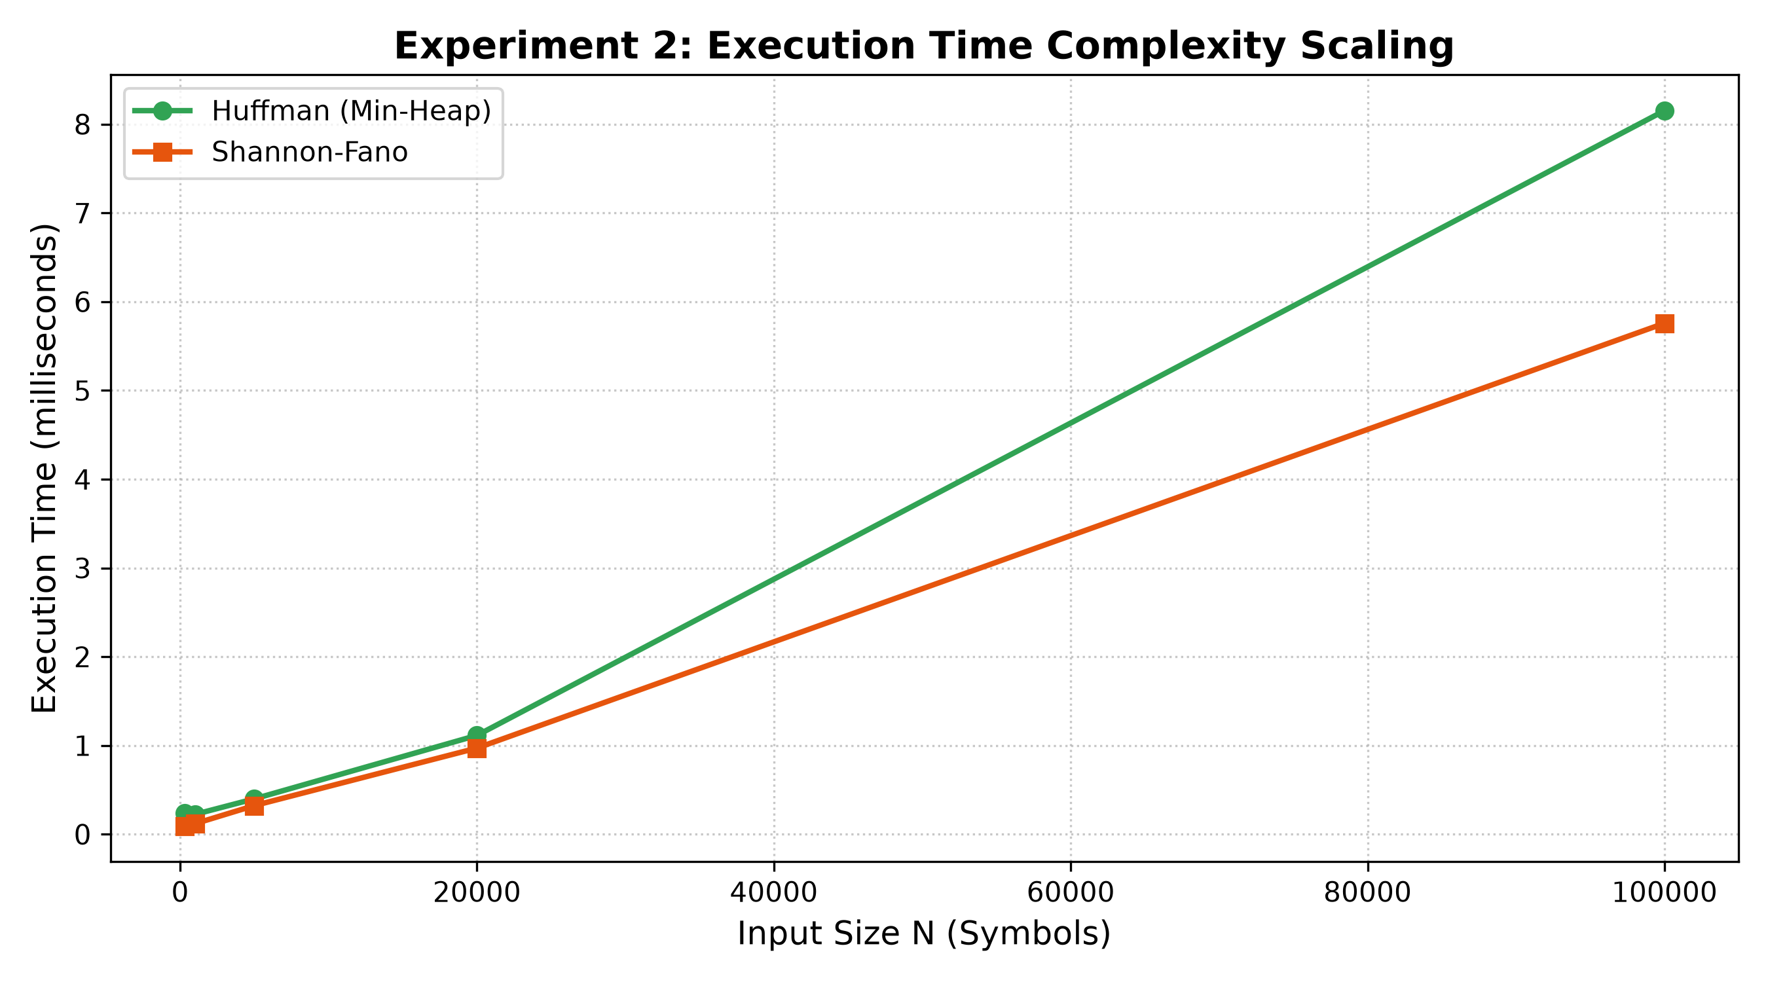
TOPIC 14: EXPERIENTIAL LEARNING PROJECT
Stage 6 (Cont.): Tree Visualization & Runtime Complexity Scaling
Presenter: Harsh R Rao & Khyathi Jain
NetworkX Tree Visualization (Khyathi Jain):
Visualizes rooted binary tree: Blue circles = internal nodes (merged weights); Green squares = leaf symbols. Red edge labels '0' (left) and '1' (right) trace prefix paths.
Experiment 2 Scaling Findings (Harsh R Rao):
Tested N = 300 up to 100,000 symbols. Total execution time scales linearly (3.63 ms for 100k symbols), proving high-speed processing (>27,000 chars/ms) suitable for blockchain streaming.
Discrete Mathematics & Graph Theory (DMGT) | CSE - Blockchain Technology | JAIN (Deemed-to-be University)
Notes:
Slide 10 Speakers: Harsh R Rao & Khyathi Jain
Harsh explains the linear scaling curve (Exp 2). Khyathi explains the NetworkX tree visualization with internal nodes, leaf nodes, and decision edges.

Slide 11
TOPIC 14: EXPERIENTIAL LEARNING PROJECT
Experiential Learning 8-Stage Syllabus Compliance
Presenter: Khyathi Jain
Curriculum Stage | Prescribed Syllabus Activity | Project Implementation & Proof
1. Problem Identification | Define real-world engineering problem & significance. | Uncompressed block payload bottleneck in blockchain & genomic repositories.
2. Math Formulation | Represent using discrete structures: trees, Kraft inequality. | Modeled as rooted binary tree T=(V,E); proved Kraft sum = 1.000000 & entropy bound.
3. Algorithm Development | Select DMGT technique; provide pseudocode. | Greedy bottom-up min-heap priority queue construction & DFS prefix extraction.
4. Implementation | Implement proposed method using Python. | Modular Python codebase (heapq, NetworkX, Matplotlib, codec.py, main.py).
5. Experimental Analysis | Conduct at least 2 meaningful experiments. | Exp 1: 4 data domains (N >= 300); Exp 2: Runtime scaling (300 to 100,000 symbols).
6. Results & Interpretation | Present results using tables, graphs, visualizations. | Delivered Tables 2 & 3, Figure 1 (Bar chart), Figure 2 (Tree), Figure 3 (Scaling).
7. Comparison & Discussion | Compare two algorithms and discuss behavior. | Compared Huffman vs. Shannon-Fano vs. ASCII, mathematically proving L_Huffman <= L_SF.
8. Conclusion & Scope | Summarize findings, explain contribution, limitations. | Confirmed Shannon convergence, noted header overhead, proposed dynamic adaptive coding.
Discrete Mathematics & Graph Theory (DMGT) | CSE - Blockchain Technology | JAIN (Deemed-to-be University)
Notes:
Slide 11 Speaker: Khyathi Jain
Present the 8-stage compliance matrix showing Dr. Priya Satish that every single required syllabus stage has been completely satisfied.

Slide 12
TOPIC 14: EXPERIENTIAL LEARNING PROJECT
Stage 8: Conclusion, Future Scope & Team Reflections
Presenter: All Team Members
PROJECT FINDINGS & LIMITATIONS
Major Findings:
• Huffman coding guarantees mathematically optimal prefix codes.
• Delivers up to 70.37% storage savings on skewed genomic data.
• Consistently matches or outperforms Shannon-Fano coding (L_Huffman <= L_SF).
• Operates within 0.63% of Shannon theoretical entropy limit on text.
Limitations & Future Scope:
• Header Overhead: Storing codebook tables adds overhead on tiny files (N < 200).
• Future Extension 1: Adaptive Dynamic Huffman (Vitter's algorithm) to compress real-time streams with zero header overhead.
• Future Extension 2: Arithmetic Coding for non-integer bit allocation.
• Future Extension 3: Integration into blockchain node transaction pooling.
OPEN FOR QUESTIONS & VIVA DEFENSE
GitHub Repository Link:
github.com/SmoothnOperator/Dmgt-Huffman-Coding
Team Members Ready for Q&A:
• Nikhil Kumar (Lead, Priority Queue & Heap Architecture)
• Piyush Kumar (Codec, Bitstream Serialization & Unit Tests)
• Sakshi Kumari (DMGT Theory, Kraft Inequality & Entropy)
• Arushi Pramanik (Datasets, NCBI GenBank & Skewness)
• Harsh R Rao (Experiments 1 & 2, Benchmarks & Scaling)
• Khyathi Jain (Tree Visualizations, Slides & Documentation)
Special thanks to our course faculty Dr. Priya Satish for guidance.
Discrete Mathematics & Graph Theory (DMGT) | CSE - Blockchain Technology | JAIN (Deemed-to-be University)
Notes:
Slide 12: All Members
Conclude the presentation, invite questions from Dr. Priya Satish, and let each member answer questions related to their technical role.

