Slide 1
SNAKE GAME
WORKED BY:SOUTH.N
KRISTI SAMARA
ENGJELL ABAZAJ
INDRIT FERATI

Slide 2
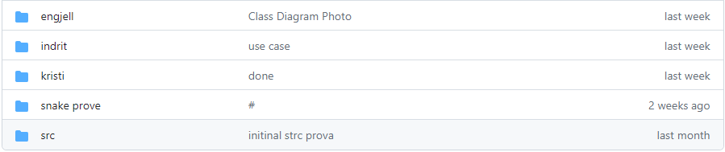
GITHUB

Slide 3
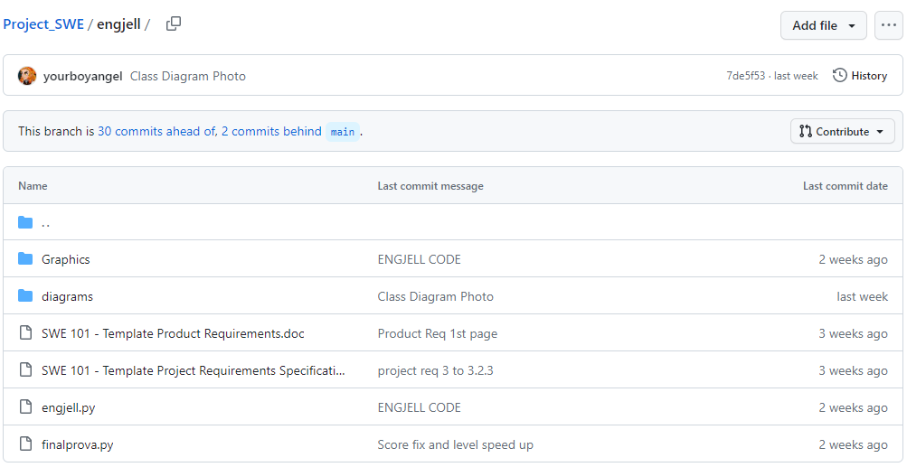
GITHUB(ENGJELL’S PART)

Slide 4
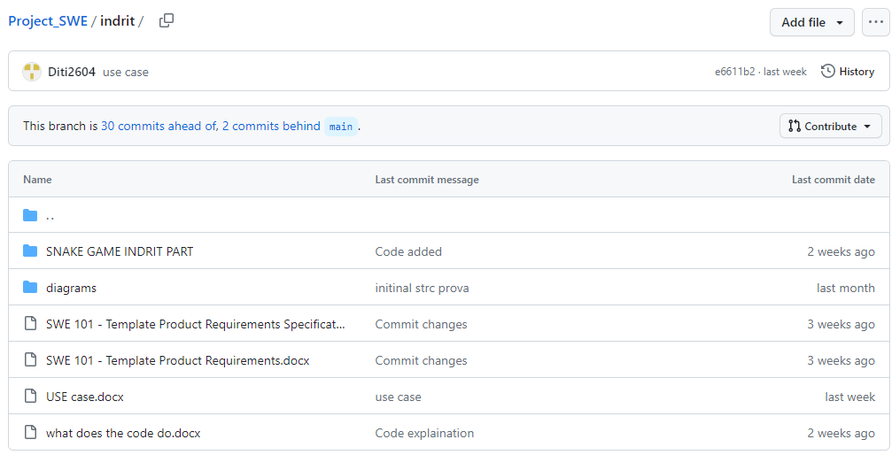
GITHUB(INDRITI’S WORK)

Slide 5
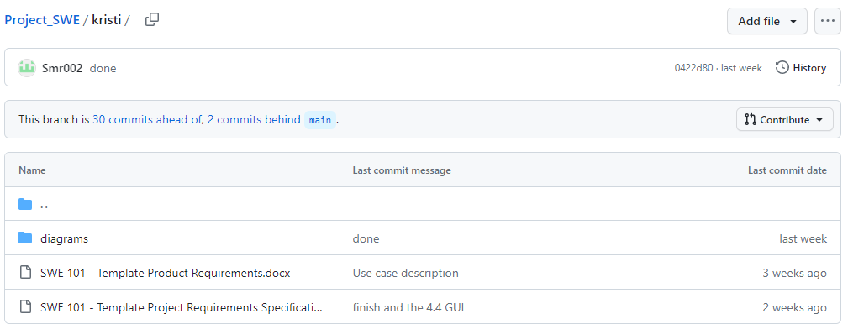
GITHUB(KRISTI’S WORK)

Slide 6
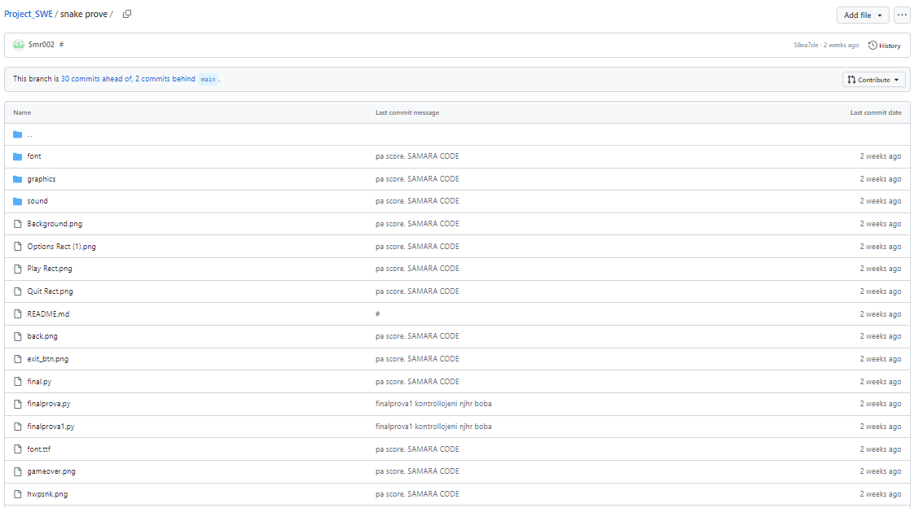
GITHUB(KRISTI’S WORK)

Slide 7
TASK’S
INDRITI’S TASKS
ENGJELL’S TASK
KRISTI’S TASK
1/3 OF THE PROJECT REQUIREMENTS
1/3 OF THE PRODUCT REQUIREMENTS
THE LOGIC OF THE SNAKE
SETTING UP THE BOARD
THE POWERPOINT PRESENTATION
1/3 OF THE PROJECT REQUIREMENTS
1/3 OF THE PRODUCT REQUIREMENTS
CREATING THE SNAKE
MOVING THE SNAKE
ADDING THE SCORE
COMPONENT TESTING
1/3 OF THE CODE
1/3 OF THE PROJECT REQUIREMENTS
1/3 OF THE PRODUCT REQUIREMENTS
CREATING THE FRUIT GRAPHICS
GAME OVER STATES
TASK SPLITTING
COMPONENT TESTING

Slide 8
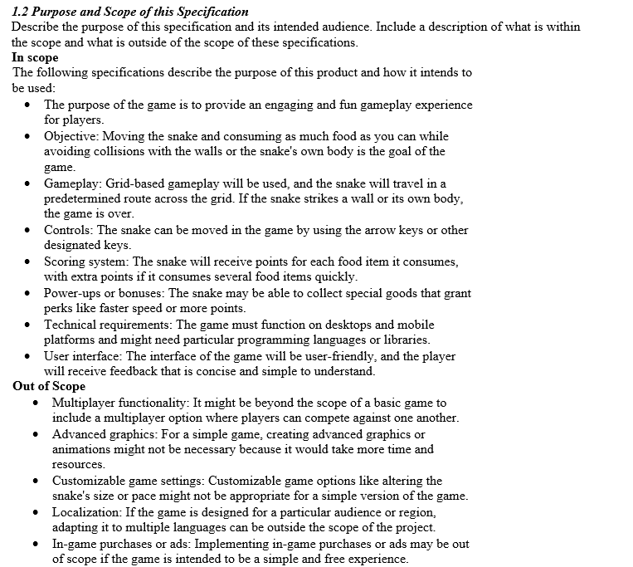
PROJECT REQUIREMENTS
$20K
10%
45K

Slide 9
PROJECT REQUIREMENTS
$20K
10%
45K

Slide 10
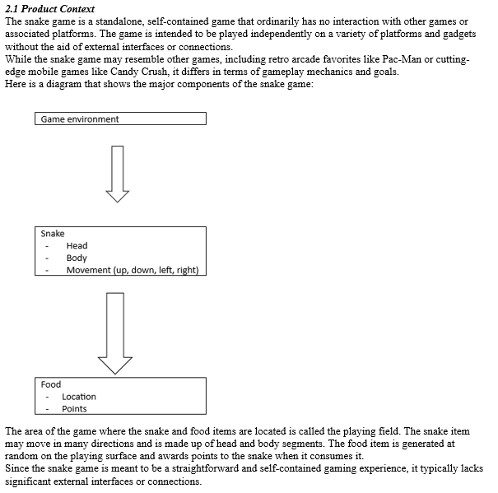
PROJECT REQUIREMENTS
$20K
10%
45K

Slide 11
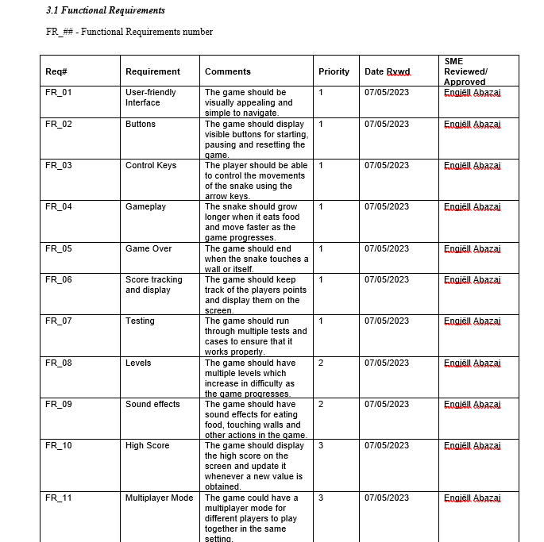
PROJECT REQUIREMENTS
$20K
10%
45K

Slide 12
PROJECT REQUIREMENTS
10%
45K

Slide 13
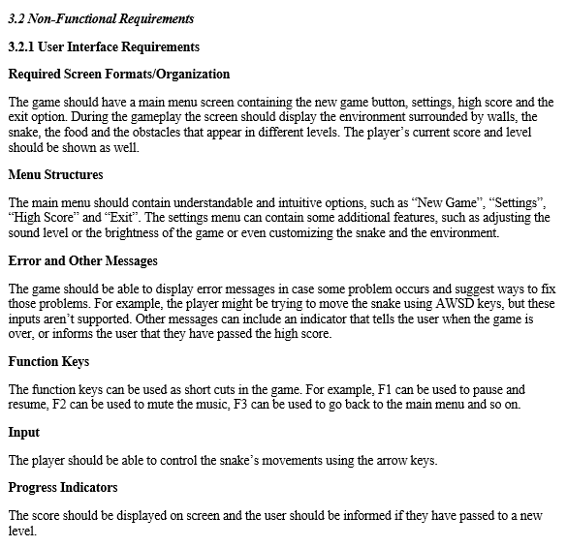
PROJECT REQUIREMENTS
$20K
10%
45K

Slide 14
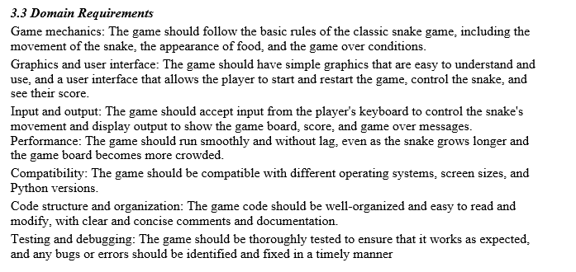
PROJECT REQUIREMENTS
$20K
10%
45K

Slide 15
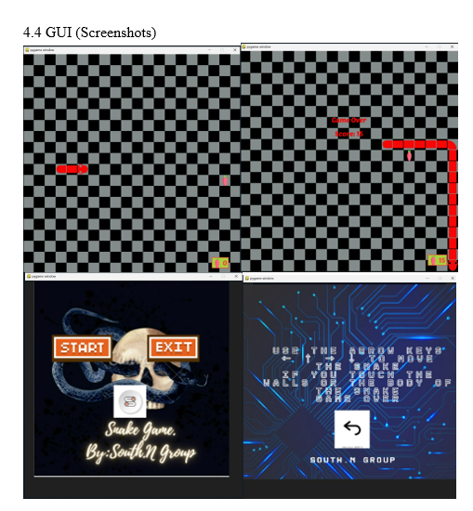
PROJECT REQUIREMENTS
$20K
10%
45K

Slide 16
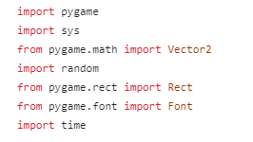
THE IMPLEMENTATION (CODE)
import pygame: This imports the Pygame library, which provides functionality for creating games and multimedia applications.
import sys: This imports the sys module, which provides access to some variables used or maintained by the interpreter and to functions that interact strongly with the interpreter.
from pygame.math import Vector2: This imports the Vector2 class from the pygame.math module. Vector2 represents a 2D vector or point and is commonly used in game development for handling positions, velocities, and other mathematical operations.
import random: This imports the random module, which provides functions for generating random numbers, shuffling sequences, and other randomization tasks.
from pygame.rect import Rect: This imports the Rect class from the pygame.rect module. Rect represents a rectangular area and is commonly used for collision detection and positioning of game objects.
from pygame.font import Font: This imports the Font class from the pygame.font module. Font is used for rendering and manipulating text in Pygame.
import time: This imports the time module, which provides various functions to work with time, such as measuring time intervals.
10%
45K

Slide 17

THE IMPLEMENTATION (CODE)
THE WINDOW DISPLAY IS CREATED
10%
45K

Slide 18
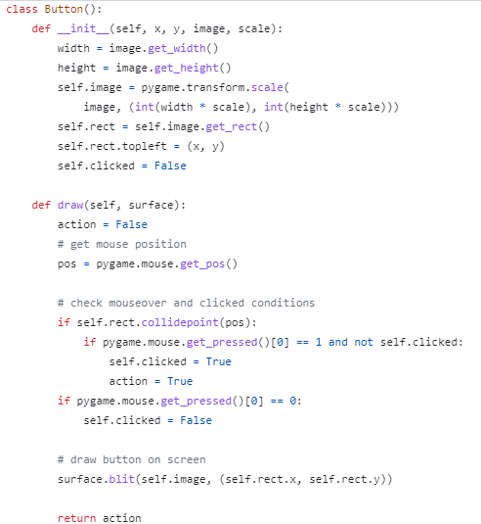
THE IMPLEMENTATION (CODE)
The __init__ method initializes a Button object. It takes the x and y coordinates of the button's top-left corner, an image representing the button's appearance, and a scale factor to resize the image. It resizes the image using pygame.transform.scale to match the desired dimensions based on the provided scale. It also sets up a rectangle (self.rect) to represent the button's position and dimensions, and initializes the clicked attribute as False.
The draw method is responsible for drawing the button on the specified surface (e.g., the game screen). It returns a boolean value (action) indicating whether the button has been clicked.
Inside the draw method, the current mouse position is obtained using pygame.mouse.get_pos().
The code checks if the mouse position is within the boundaries of the button (self.rect.collidepoint(pos)). If the mouse is over the button and the left mouse button is pressed (pygame.mouse.get_pressed()[0] == 1) and the button is not already clicked (not self.clicked), the clicked attribute is set to True and action is set to True as well.
If the left mouse button is released (pygame.mouse.get_pressed()[0] == 0), the clicked attribute is set to False.
Finally, the button image is drawn on the surface using surface.blit(self.image, (self.rect.x, self.rect.y)).
The method returns the action value, indicating whether the button was clicked (True) or not (False).
10%
45K
This code provides a basic implementation for a clickable button in the snake game, allowing you to check if the button is clicked and perform corresponding actions in the game.

Slide 19
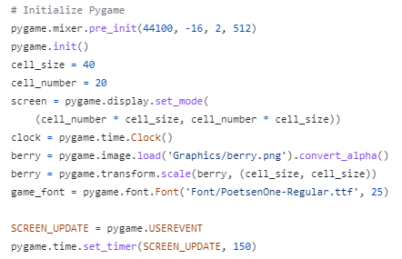
THE IMPLEMENTATION (CODE)
This code initializes Pygame, sets up the game window/screen, loads images and fonts, and sets up a timer for generating custom events to update the game screen.
10%
45K

Slide 20
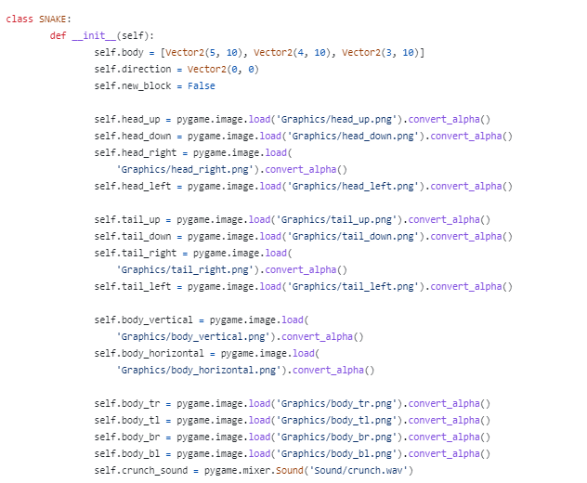
THE IMPLEMENTATION (CODE)
10%
45K
This code sets up the initial state of the snake object, including its body segments, direction, and images representing different parts of the snake's body. It also loads the necessary images and sound for rendering and interacting with the snake in the game.

Slide 21
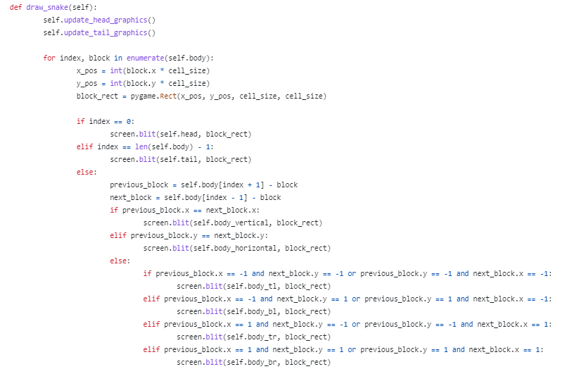
THE IMPLEMENTATION (CODE)
10%
45K
The snake's body will be drawn on the game screen according to its current state, including the head, tail, and body segments with appropriate graphics based on their positions and connections.

Slide 22
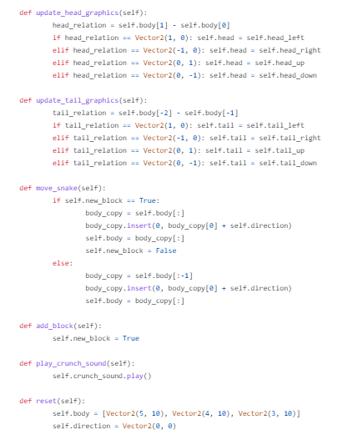
THE IMPLEMENTATION (CODE)
These methods are responsible for updating the graphics and state of the snake, moving it, adding new blocks, playing sound effects, and resetting its state.
10%
45K

Slide 23
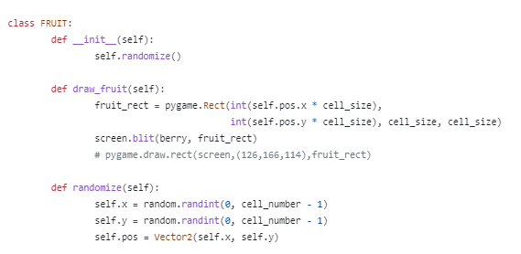
THE IMPLEMENTATION (CODE)
10%
45K
The FRUIT class is responsible for managing the fruit in the game. It initializes the fruit's position, allows for drawing the fruit on the screen, and provides a method to randomize the fruit's position when needed.

Slide 24
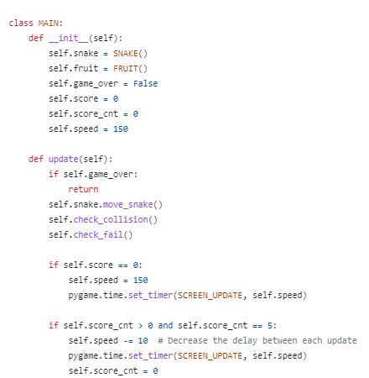
THE IMPLEMENTATION (CODE)
The MAIN class manages the game state and updates the game on each frame. It handles the movement of the snake, checks for collisions and failures, updates the game speed based on the score, and adjusts the score counter.
10%
45K

Slide 25
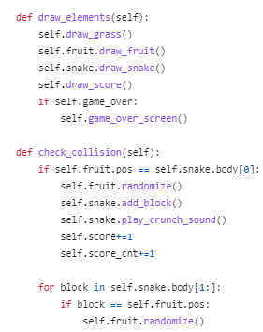
THE IMPLEMENTATION (CODE)
These methods are part of the MAIN class and contribute to the game logic. They handle the drawing of game elements, check for collisions between the snake and fruit, and perform the necessary actions when a collision occurs (e.g., updating score, repositioning the fruit, adding a block to the snake).
10%
45K

Slide 26
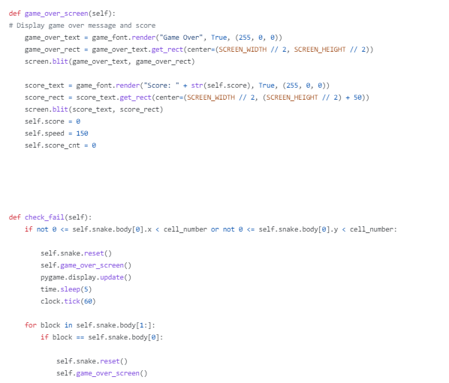
THE IMPLEMENTATION (CODE)
These methods handle the game over scenario and the checks for failure conditions in the game. They are responsible for displaying the game over screen, resetting the game state, and controlling the flow of the game after failure.
10%
45K

Slide 27
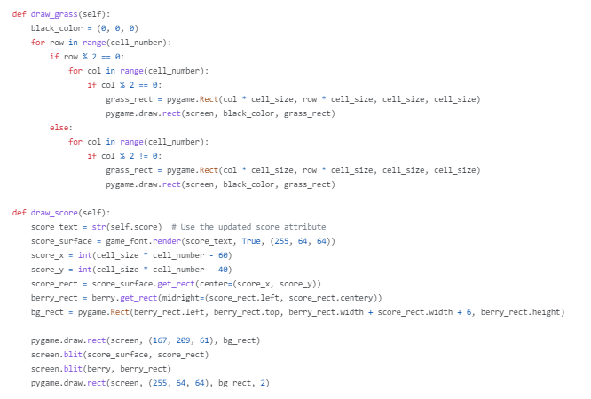
THE IMPLEMENTATION (CODE)
These methods handle the drawing of the grass background pattern and the rendering and display of the score on the game screen.
10%
45K

Slide 28
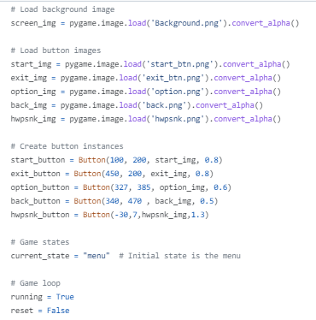
THE IMPLEMENTATION (CODE)
This code segment sets up the main menu interface, loads the necessary images, creates button instances, and initializes the game loop and game state.
10%
45K

Slide 29
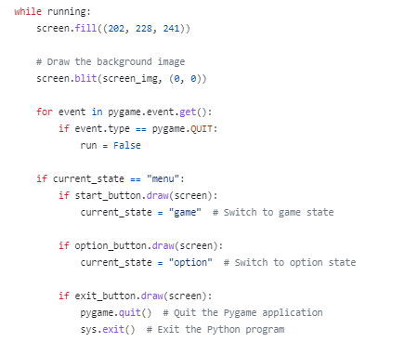
THE IMPLEMENTATION (CODE)
This code segment handles the main menu functionality, including drawing the menu screen, checking for button clicks, and transitioning between different game states based on user input.
10%
45K

Slide 30
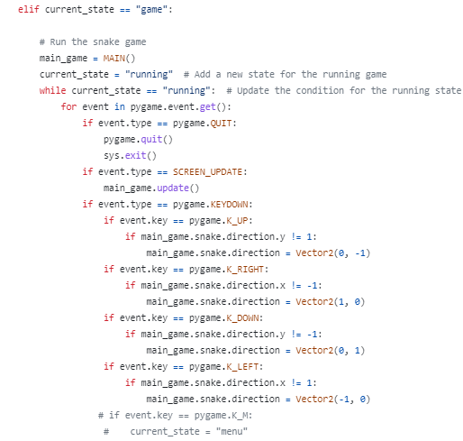
THE IMPLEMENTATION (CODE)
This code segment handles the game state, including the game loop, event handling, and input processing for controlling the snake's movement.
10%
45K

Slide 31
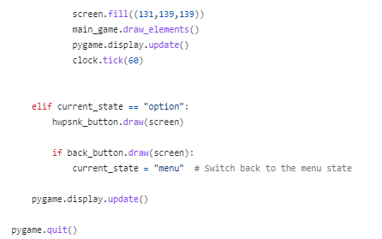
THE IMPLEMENTATION (CODE)
After the game loop ends (i.e., running is set to False), the pygame.quit() function is called to quit the Pygame application. This ensures that the program exits gracefully and cleans up any resources used by Pygame.
10%
45K

Slide 32
Code testing
Ensure that you have all the required images (such as background, buttons, etc.) and sound files referenced in the code. Make sure they are present in the correct directory.
Initialize Pygame by importing the necessary modules and calling pygame.init().
Create the game window by calling pygame.display.set_mode() with the appropriate screen dimensions.
Set up the game clock by creating an instance of pygame.time.Clock().
Create an instance of the MAIN class to represent the game.
Start the main game loop by setting the running variable to True.
Inside the game loop, handle events using pygame.event.get(). Check for events such as quitting the game, button clicks, and keyboard inputs.
Based on the current game state (current_state), perform the necessary actions. This includes updating the game, drawing game elements on the screen, and handling state transitions.
Update the display using pygame.display.update() to show any changes made to the screen.
Control the frame rate using clock.tick() to limit the game's refresh rate.
Once the game loop ends (when running is set to False), call pygame.quit() to exit the Pygame application.
10%
45K

Slide 33
Future features
# In the main game loop:
while running:
# ...
if current_state == "game":
# ...
while current_state == "running":
# ...
if event.type == SCREEN_UPDATE:
main_game.update()
# Check if the snake ate a fruit
if main_game.score % 10 == 0 and main_game.score != 0:
main_game.speed -= 10 # Increase the speed of the snake
pygame.time.set_timer(SCREEN_UPDATE, main_game.speed)
# Check if the snake ate enough fruits to create a wall
if main_game.score % 20 == 0 and main_game.score != 0:
main_game.create_random_wall()
# ...
# ...
# ...
def create_random_wall():
# Generate random coordinates for the wall
wall_x = random.randint(0, cell_number - 1)
wall_y = random.randint(0, cell_number - 1)
# Add the wall to the game
main_game.add_wall(Vector2(wall_x, wall_y))
Speed increased after every 10 points and a random wall generated after 20 points
10%
45K

Slide 34
Thanks for watching! SOUTH.N
Please keep this slide for attribution

