Slide 1





Final Project
-BY SMRIDHI GUPTA

Slide 2
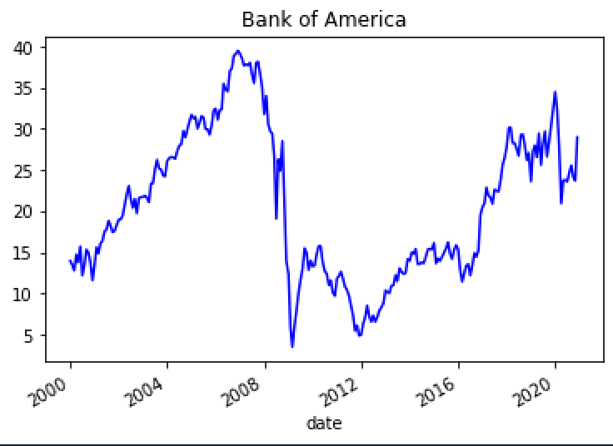
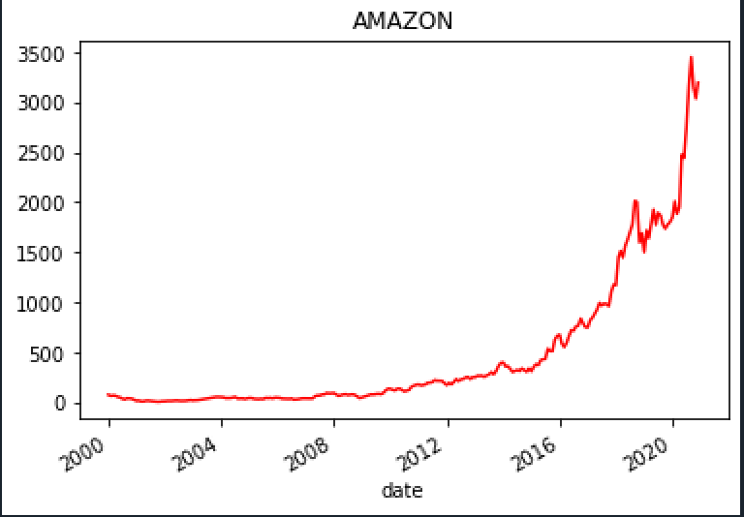
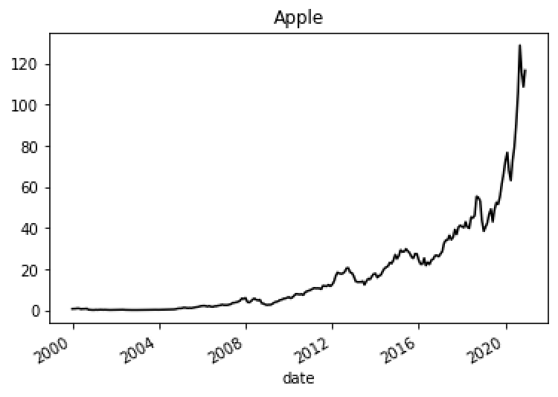
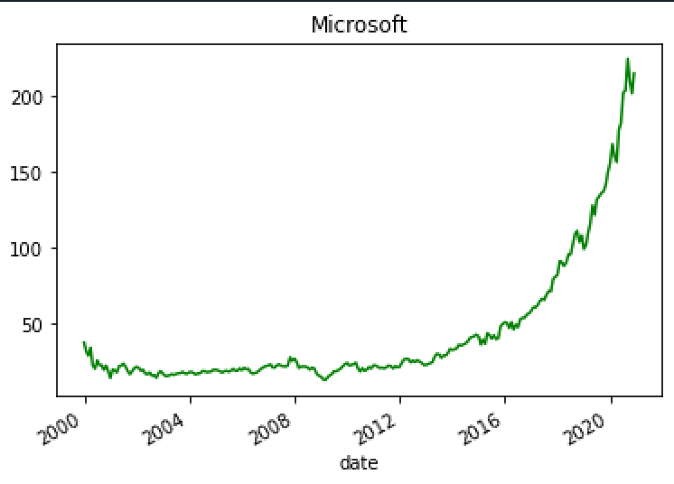
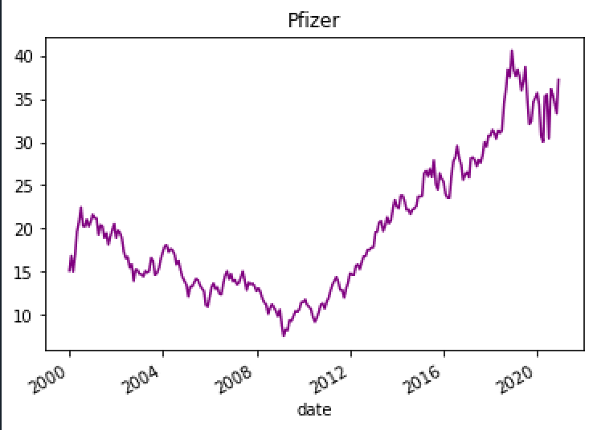
Objective
Build Optimal portfolios for 5 companies. Then, Compare the predictions with Actuals.
5 Companies :
Bank of America, Amazon, Apple, Pfizer, Microsoft
Images : Adjusted closing prices

Slide 3
Steps followed
Selected those companies which have at least 10 years of data
Import adjusted monthly closing prices from Alpha Vantage for 5 companies
Run a regression (Regress Data on Book-to-Market ratios)on Training sample from ‘1999-12’ to ‘2019-12’
Predict/Forecast 5 companies on Testing Sample from ‘2020-01’ to ‘2020-08’
Calculate Sigma epsilon then covariance matrix to find out the weights for the optimal portfolio
Compare Actual returns vs Forecast returns from ‘2020-01’ to ‘2020-08’
Evaluate the performance of optimal portfolio

Slide 4
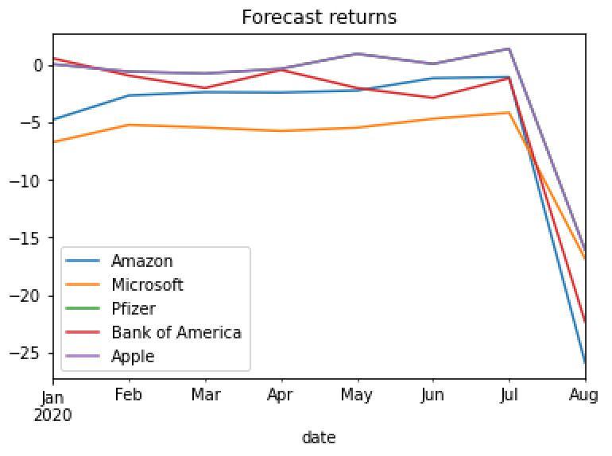
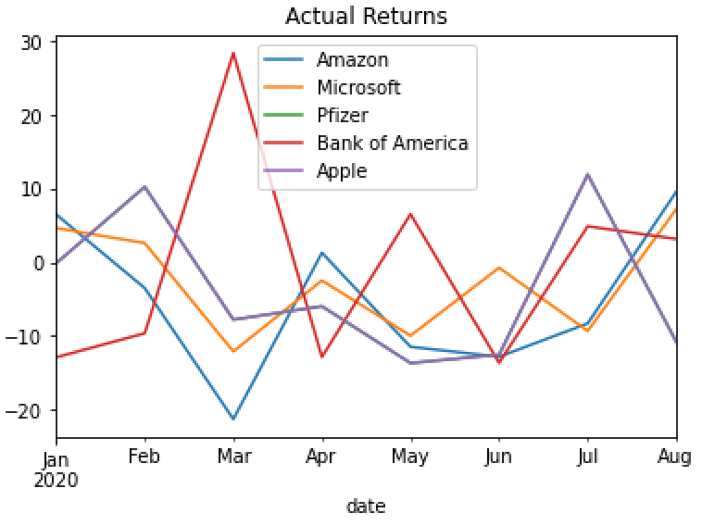
Forecast vs Actual

Slide 5
Differences in Returns
Not testing based on 100% sample data
OLS overfits the data and doesn’t predict accurately
Due to COVID and other events, returns fluctuated
Actual returns can vary since it’s not possible to predict 100% correctly

Slide 6
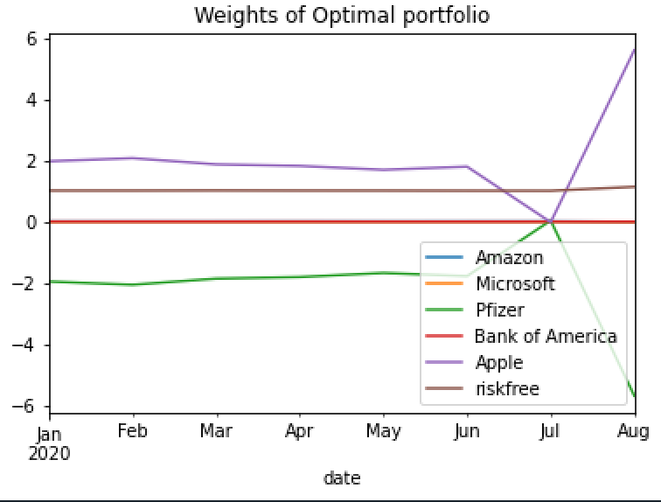
Portfolio performance
Minimum portfolio return = -0.026%
Mean (annualized) = 2.13%
Maximum portfolio return = 0.85%
Sharpe Ratio = 1.47
Minimum portfolio weight = -5.7
Maximum portfolio weight = 5.6

Slide 7
Implementation Drawbacks
Weights are ranging from 2 to -2 till the month of June. Afterwards, changing severely from 5 to -5
To go short 200% investment for Pfizer company is unfeasible as the position is too high in magnitude and too risky to take
These positions will require the investor to maintain very high margin balance in account ,which is an additional idle money left in account
Trading costs such as Brokerage fee, Tax and Transaction cost will also be high because of such high range and during the change from 2 to 5 in weights

