Slide 1
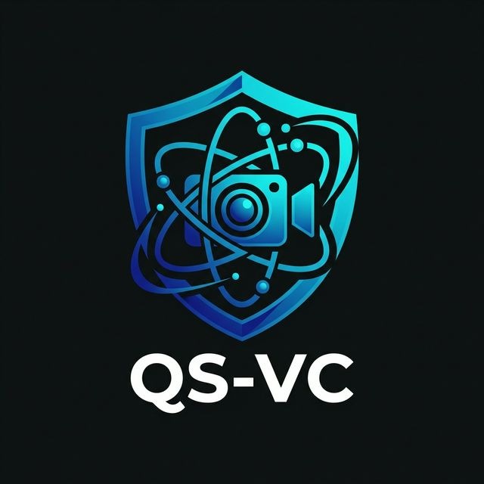
Quantum-Safe Video Conferencing
Secure HD/4K video calls with NIST-approved post-quantum
cryptography, real-time AI captions & translation.
PQC L5
10K+
99+
99.995%
NIST Security Level
Participants/Call
Languages STT
Uptime SLA
E2E Encrypted
Zero-Knowledge SFU
AI Captions
Air-Gap Ready
HSM Keys
1 / 8

Slide 2
QS-VC
The Quantum Threat to Video Calls
Adversaries harvest encrypted call traffic today, waiting for quantum computers to break it.
The Risk
QS-VC Solution
RSA-2048 & ECC vulnerable to Shor's algorithm
Quantum computers expected by 2030
Nation-states harvesting encrypted call traffic
Video calls contain the most sensitive discussions
Once broken, all recorded calls exposed forever
Hybrid Kyber-1024 + X25519 for every call
Dilithium-5 + Ed25519 for all signaling
E2EE media — SFU never sees plaintext
Crypto-agility: dual-layer protection
60-second media key rotation
2 / 8

Slide 3
QS-VC
Video Conferencing Features
HD/4K Video
Crystal Audio
Screen Sharing
VP9/AV1, Simulcast+SVC, up to 4K@30fps
Opus 48kHz stereo, AI noise suppression
Full-screen, annotation, remote control
Whiteboard
Recording
Live Streaming
CRDT collaborative canvas, real-time sync
Cloud/on-prem, MP4, encrypted at rest
RTMP→HLS/DASH, 100K+ broadcast
Smart Camera
Meeting Tools
SIP/H.323 Interop
Multi-Platform
Auto-framing, person tracking
Breakout rooms, polls, lobby
Legacy rooms, PSTN dial-in
Web, Desktop, iOS, Android
3 / 8

Slide 4
QS-VC
AI-Powered Meeting Intelligence
Real-Time Pipeline (<300ms)
Capture
Denoise
Transcribe
Translate
Display
Opus 48kHz
→
RNNoise+U-Net
→
Whisper 99+ langs
→
NLLB-200
→
Live captions
Post-Meeting AI (Async)
Clean
Segment
Summarize
Actions
Report
Speaker diarization
→
Topic identification
→
LLaMA 3
→
Tasks+Deadlines
→
Engagement
Voice Cloning
22 Indian Langs
Smart Search
Voice-preserving translation
All scheduled languages
Search across transcripts
4 / 8

Slide 5
QS-VC
Quantum-Safe Security Architecture
Every layer of the media pipeline is protected with PQC.
1
Signaling (Quantum-TLS)
Kyber-1024+X25519, Dilithium-5+Ed25519, TLS 1.3+PQC
2
Media E2EE
SFrame via Insertable Streams, per-participant Kyber keys, AES-256-GCM
3
Key Management
HSM-backed (Shamir 5-of-8), 60s media key rotation, hourly TURN rotation
4
Recording Encryption
Kyber-wrapped DEK, encrypted MinIO/S3, tamper-proof metadata
5
Audit Trail
Merkle-tree hash chains, Dilithium-signed entries, configurable retention
NIST PQC Level 5
HSM-Backed
60s Key Rotation
Zero-Knowledge SFU
5 / 8

Slide 6
QS-VC
Deployment & Scalability
SaaS Cloud
On-Premise (Air-Gapped)
Hybrid
Multi-tenant Kubernetes
Auto-scaling SFU pools
Region-selectable residency
Zero-downtime updates
100% on-site, zero internet
HSM key management
Local AI (NVIDIA A10)
4-8 hour automated install
Edge media+cloud control
Media stays local
72hr offline grace
Auto state sync
99.995%
<3s
<150ms
<2s
Platform SLA
Join Time
Audio Latency
Failover
1-49: Single SFU
50-500: SFU Cascade
500-10K: Webinar
10K-100K: Broadcast
6 / 8

Slide 7
QS-VC
Choose Your Plan
Business
Enterprise
Sovereign
SaaS | Per-user/month
SaaS/Hybrid | Custom
On-Premise | Perpetual+AMC
Up to 300 participants
HD 1080p video & audio
Screen sharing & recording
AI captions (English)
Basic noise suppression
SSO (SAML 2.0 / OIDC)
Email support
Up to 10,000 participants
4K video + live streaming
99+ language STT & translation
Quantum-safe E2EE (PQC)
Summarization & actions
SIP/H.323 gateway
24/7 support + CSM
Air-gapped deployment
HSM key management
All AI (local GPU)
Full data sovereignty
Custom branding
LDAP/Active Directory
On-site deployment
7 / 8

Slide 8
QS-VC
Secure Calls Today. Quantum-Safe Tomorrow.
Schedule a demo and experience quantum-safe video
conferencing — HD/4K with post-quantum encryption.
Get Started
www.qsvc.io
sales@qsvc.io
+91-XXXX-XXXXXX
Bengaluru, India
© 2025 QS-VC Technologies Pvt. Ltd. — All Rights Reserved
8 / 8

