Slide 1

1M1B AI for Sustainability Virtual Internship Project Presentation
MULTIMODAL MEDICAL ASSISTANT
A multimodal AI medical assistant that accepts text, speech, and medical images, uses RAG and LLMs to generate context-aware responses, and provides answers in both text and speech.
RAG + LLM
Image + Voice
Text + Audio
Smrithi Pillai

Slide 2

Problem Statement
Access to understandable and reliable medical information can be challenging, especially when users have difficulty interpreting complex medical terminology or communicating their concerns through text alone.
Traditional healthcare support may also be less accessible to people who prefer voice-based interaction or need assistance understanding information from medical images.
The Multimodal Medical Assistant addresses this problem by providing a single AI-powered platform where users can type or speak their medical queries and upload medical images. The system combines speech processing, multimodal AI, RAG, and LLMs to retrieve relevant information and generate understandable responses in text and speech.
The system is designed as an informational support tool, not a replacement for professional medical diagnosis or treatment.
UN SDG Alignment
SDG 3 – Good Health & Well-Being: Improves access to understandable medical information through text, speech, and image-based AI assistance.
SDG 10 – Reduced Inequalities: Makes health information more accessible through multimodal and voice-based interaction.
SDG 9 – Industry, Innovation & Infrastructure: Applies LLMs, RAG, multimodal AI, and speech technology to healthcare.
Multimodal Medical Assistant
2

Slide 3

Two Core Workflows
One platform, two complementary ways to interact with the assistant
General Medical Chat
Multimodal Medical Assistant
RAG-based knowledge retrieval
Image + voice analysis
1
User asks a medical question (e.g. "What is jaundice?")
1
Patient provides a voice note and/or a medical image
2
Question embedded via Sentence Transformers
2
Speech-to-text transcribes audio; vision-language model reads the image
3
FAISS vector search finds top-k relevant documents
3
Combined text + image context sent to the LLM
4
LLM generates a grounded, sourced answer
4
Doctor's response returned as text and synthesized speech
Multimodal Medical Assistant
2

Slide 4
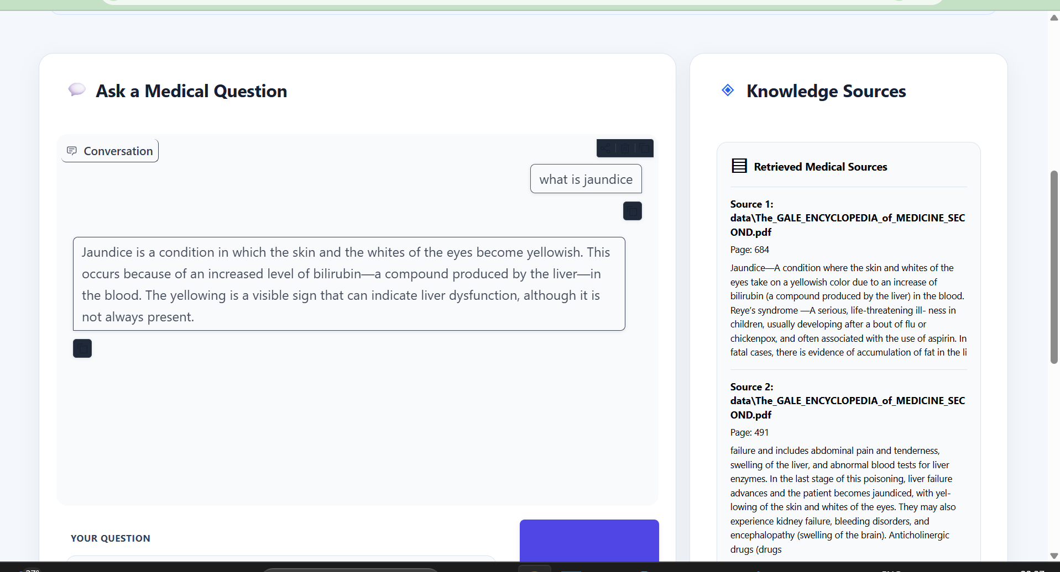
General Medical Chat Interface
RAG-based knowledge retrieval
General Mdical Chat
Multimodal Medical Assistant
RAG-based knowledge retrieval
1
User asks a medical question (e.g. "What is jaundice?")
Patient provides a voice note and/or a medical image
2
Question embedded via Sentence Transformers
Speech-to-text transcibes audio; vision-language model reads the image
3
FAISS vector search finds top-k relevant documents
Combined text + image context sent to the LLM
4
LLM generates a grounded, sourced answer
4
Doctor's response returned as text and synthesized speech
Multimodal Medical Assistant
2

Slide 5
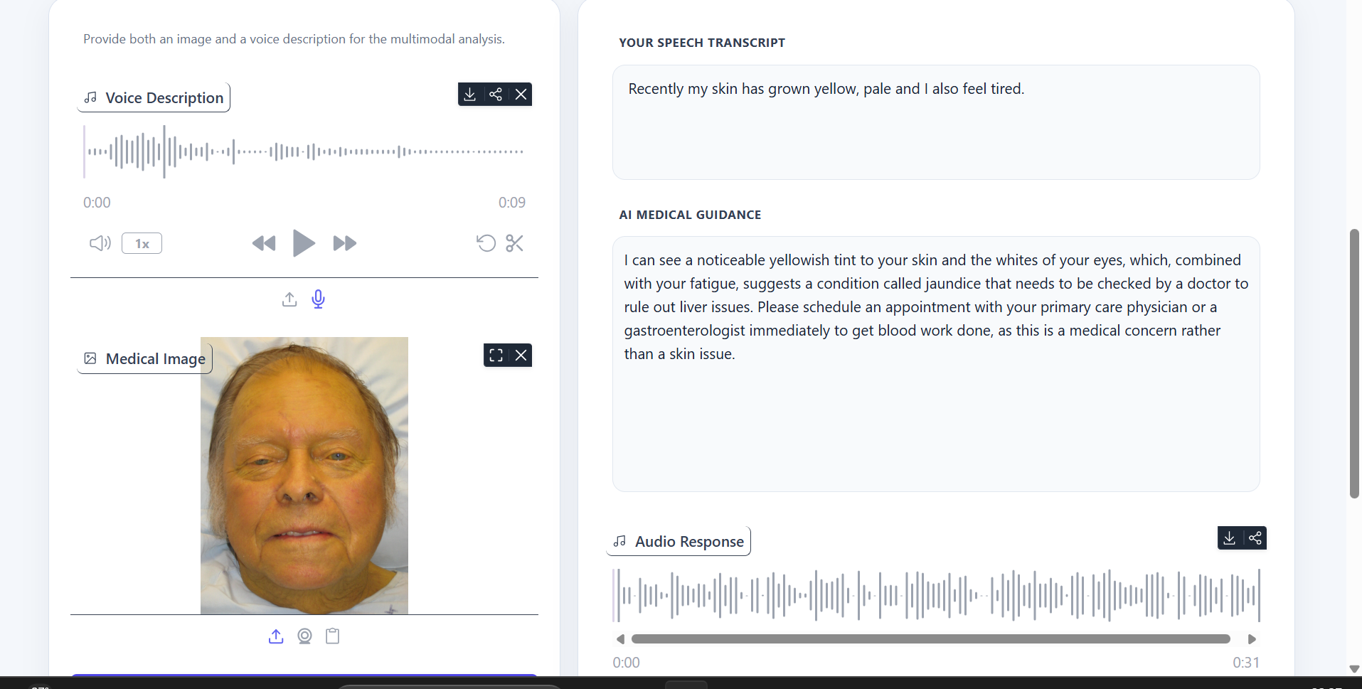
Multimodal Medical Assistant Interface
Image + voice analysis
General Mdical Chat
Multimodal Medical Assistant
RAG-based knowledge retrieval
1
User asks a medical question (e.g. "What is jaundice?")
Patient provides a voice note and/or a medical image
2
Question embedded via Sentence Transformers
Speech-to-text transcibes audio; vision-language model reads the image
3
FAISS vector search finds top-k relevant documents
Combined text + image context sent to the LLM
4
LLM generates a grounded, sourced answer
4
Doctor's response returned as text and synthesized speech
Multimodal Medical Assistant
2

Slide 6





Workflow 1 — General Medical Chat
RAG pipeline: from a plain-language question to a grounded answer
User Question
01
"What is jaundice?" — a natural-language medical query
Text Embedding
02
Sentence Transformers (all-MiniLM-L6-v2) encodes the query
FAISS Vector Database
03
Semantic search retrieves top-k relevant medical documents
Retrieved Documents
04
Top 3 sources returned with metadata (source, page)
Multimodal Medical Assistant
3

Slide 7



Backend — RAG Pipeline
The engine that powers grounded, safe medical responses
Environment Configuration
ChatGroq LLM
Loads .env with a dedicated RAG_GROQ_API_KEY, separate from the main API key
Model: openai/gpt-oss-20b · temperature 0.5 · max_tokens 512
Prompt Template
Retrieval Chain
Injects medical guidance with retrieved context and safety instructions
create_retrieval_chain combines the retriever with the document chain
Multimodal Medical Assistant
4

Slide 8
Final Output
What the user sees after the RAG pipeline completes
Chat Response
Sources Display
Grounded in retrieved medical knowledge
Source document name
Clear, plain-language explanations
Exact page number
Includes inline source references
Short preview of the retrieved content
Both cards are generated together for every user query, keeping answers transparent and traceable.
Multimodal Medical Assistant
5

Slide 9




Workflow 2 — Multimodal Assistant
From patient voice + image to a spoken doctor's response
Voice Description (Audio)
Medical Image
Speech-to-text transcribes the patient's spoken symptoms
Vision-language model analyzes the image — the "brain of the doctor"
Processed Input: Patient transcript text + image analysis result, combined into one context
Doctor's Response — generated by the LLM (Groq) from the combined patient context
Text-to-Speech
Outputs: patient transcript (text) · AI medical guidance (text) · audio response (doctor voice)
Converts reply to doctor audio
Multimodal Medical Assistant
6

Slide 10


Tech Stack
The tools and frameworks behind the assistant
Python
LangChain
Groq
FAISS
Core application language
Retrieval-chain orchestration
High-speed LLM inference
Vector similarity search
Hugging Face
Gradio
Speech / Vision APIs
Embedding & model hosting
User-friendly interface
Speech-to-text, TTS & image analysis
Multimodal Medical Assistant
7

Slide 11


Key Features & Important Notes
Key Features
Important Notes
RAG with FAISS for accurate, grounded responses
Uses a dedicated RAG_GROQ_API_KEY, keeping the main GROQ_API_KEY isolated for other modules
Multimodal input support (image + voice)
Speech-to-text and text-to-speech built in
Not a medical diagnosis — provides educational information based on the knowledge base only
Retrieved source display for transparency
Designed with privacy-conscious principles and clear safety disclaimers throughout
Separate workflows for chat vs. multimodal assistant
User-friendly Gradio interface
Multimodal Medical Assistant
8

Slide 12

Grounded knowledge. Multimodal input.
Human-centered design.
Multimodal Medical Assistant — RAG + LLM · Image + Voice · Text + Audio

