Slide 1

Sant Longowal Institute Of Engineering and Technology Punjab Project Synopsis :Bank Automation System
Under the guidance of: Name:
Mrs. Ashu Anjali Bhardwaj : SL/15/0294
Dikshita Garg : SL/15/0271
Smriti Rani : SL/15/0274

Slide 2
Introduction
A bank is an organization used to deal with money.
Bank draws surplus money from the people who are using at the time and lend to those who are in a position to use it for productive purpose. Banks are extremely useful.
Banks play a vital role in economics developments of under developed economics. In an era of economics development, Banks create credit more liberally and thus make a valuable contribution to speed up the level of economic development in the country.
The bank is also useful for the people who are unable to built their house.
Bank provide some of the facilities such as:
Receiving Deposit
Advancing loans
Deposit schemes

Slide 3
Objective
The project is developed to increase the performance of the Bank without much attempt which does the job of Money Transaction and play a vital role in economics development of under developed economic.
The proposals are to analysis the exiting performance of the employee and make the organization automated to get the employees performance without doing any paper work.

Slide 4
This project has following objectives:
Reduce the paper works in office.
Less management problem
Accurate information
Easy to manage
Reduce time
Easy modification, addition and deletion of records.
The Project Starts with a menu which tells the user to choose which area he or she want to work in .In this menu
options are:
New Account
Close Account
Modify
Transaction

Slide 5
Draw backs of the Existing System
It is very time consuming - In the Manual system, the performance measuring of an employee is a tiresome job to do and also time consuming.
Less Data security is there.
Lot of the paper work - The existing system involves a lot of repetitive paper work including different records of the poles.
More paper works are to be done
No alarming facility. In the Manual system it doesn’t checks for the performance of an employee, hence this causes irregularity in the matter of promotion.

Slide 6
Advantage of the Proposed System
It fully user friendly - The system is fully user friendly since it is developed in windows based with c++ , which is having very easy understandable facilities.
It does not require expert hand - The data entry can be done by any body. Since it handles. Any error may be handle by a readable message.
Paper work is reduced - Since there is no unnecessary printing, Photo coping of the Document for the individual customer.
Timely alerting - The system alerts the user about the customer that when the period of deposit is over and the customer closes his account or continue his account.
Faster access of information - The system will accessed the data fastly .
Query can be done easily - Query will make easy to get the information about a particular customer.
Report generation can be done easily - As after the automation of the system report about an customer can be done easily.

Slide 7
Data Flow diagram
KEYBOARD
DATA INPUT
BANKING
DATABASE
STORAGE
WITHDRAW
CLOSE ACC

Slide 10
New Acc- In the New Acc module user enters the name, address, Name of verifying person, Initial deposit for creating a new account.
List of Acc- In the List of Acc module it displays Date, Acc no, Name, Address, Balance, Total balance in bank.
Ind Acc-In this module it displays Acc no. , Name, Add, Date, Date of transaction, Particular, Deposit, Withdraw, Balance, Total Balance etc.
Daily Transaction-In this module firstly user enter Acc No. then its gives the prompt for deposit or withdraw and also display last balance of account.
Monthly Report-In this module user enter the date of a month then it display all the transaction of this particular month.
Edit Account-In this module there are sub module containing Modify Account, Close Account, Quit
Modify Account
Within this module user enter acc no. then it gives a prompt for modify name and address of account holder.
Close Account
In this module user enter the acc no. for delete from account list.
Quit
It is use for return to main menu.
Exit-It is use to quit from program.

Slide 11
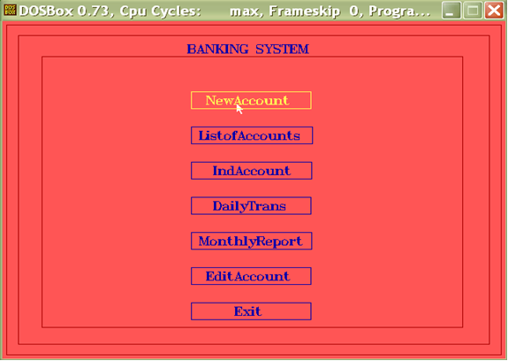

Slide 12
Tools/Platforms , language to be used
Software Requirement :
Operating System : Ms - Dos, Microsoft Windows 95,98,ME
Tools : Turboc3 (version 3.0)
Front End : OOPS concept (C++)
Back End : Text file of C++
Hardware Requirement :
Primary Memory : 16 MB SDRAM and more
Microprocessor :Intel Pentium Processor (100 MHZ)
Secondary Memory :10 GB Hard disk
Monitor :Plug and Play Monitor

Slide 13
Thanku

