Slide 1
Project Presentation
on
Complete website with backend using
PHP, MYSQL and PDO
In the partial fulfillment for the award of
BACHELOR OF ENGINEERING
In
COMPUTER SCIENCE & ENGINEERING
Submitted by
Smriti Rani GCS 1830033
Aakriti Raj GCS 1830040
Dikshita Garg GCS 1830041
Under the Guidance of
Dr Utkarsh Sir
Assistant Professor
(CSE Department)
Sant Longowal Institute of Engineering & Technology, Longowal – 148106
District – Sangrur, Punjab

Slide 2
Introduction This project is all about a complete web development project. Our goal of this project report is to build a complete website with backend using PHP, MYSQL and PDO. We are using PHP in our project as we all know PHP is a widely used, open source scripting language and it is powerful enough to be at the core of the biggest blogging system on the web. It is deep enough to run the largest social network (Facebook). PHP can generate dynamic page content and can create, open, read, write, collect form data, send and receive cookies, can also add, delete, modify data in our database. Since we wanted to create a dynamic website that makes use of PHP code so we needed Apache server to compile our PHP code. Also, we wanted to perform some operations related to a database such as storing data into a database or fetching data from database, so for this we needed to have MySql , MariaDB database functionality. This is why we overall needed to use XAMPP to fulfill the requirements to run our PHP project.

Slide 3
XAMPP offers the run environment or executes codes and tasks of our PHP language programming. It is open source and free to use .XAMPP is one of the best Apache distribution that help web developers to create a local webserver for testing and deployment purpose. It was designed to be one of the easiest way to install, run a development server and it is the most complete package. (X-Cross-platform , A-Apache, M-Maria DB, P-PHP, P-Perl)
wide range of relational database management systems such as MYSQL, SQLite , and PostgreSQL can be used by the PHP. PDO(PHP data objects) is basically a new database connection abstraction library that has been offered by the PHP 5.1 version. PDO works by providing a standard set of functions for common database operations such as connecting, querying, result set processing and error handling, and internally translating these functions to native API calls understood by the database in use.

Slide 4
Problem Definition
Building a complete web development project using PHP, MYSQL and PDO. This project is to develop a working website having dynamic pages and all the other features which the websites have right from the post section to the comment section.
PHP is the language which we have used in our project as it has remained one of the most versatile and pragmatic web development languages in the world today .It’s range of functionalities, amazing array of add-ins to extend functionalities, its open source nature, and tremendous online community support has made PHP a perennial favorite amongst newbies as well as established development agencies worldwide.

Slide 5
Proposed Work
The proposed work of this project is to create a dynamic website that contains dynamic pages such as templates, contents scripts etc. The dynamic website displays various content types every time it is browsed.
Nowadays sites have to change constantly and provide up to date news, information, stock , prices, and customized pages. PHP and SQL are two ways to make our site dynamic.
PHP is a robust, server side, open source scripting language that is extremely flexible and fun to learn and MYSQL is the standard query language for interacting with databases. MYSQL is an open source, SQL database server that is more or less free and extremely fast. MYSQL is also cross platform as PHP .Both of these helps in providing interactive, user friendly website and also facilitates visitors to openly interact while producing a genuinely dynamic and flexible content.
The feature of dynamic website are Page Management, File Collection, Guestbook, Search Opportunity, Menus in management, Color and front management, photo Album. In dynamic websites there is complete control over the content and search engine optimization can be improved. There are options to record user information and to monitor user’s navigation over the website. They are easy to add, change and control all the content.

Slide 6
Objectives
Some of the benefits of dynamic website are:
Easy Updating: The biggest advantage of a dynamic website is that it can be easily updated as per the needs of the owner of the website. No expert computer knowledge is required in changing the dynamic website and a single change in the template file would bring the design change in all the pages with that particular file. It can be quickly updated to become responsive to various screen sizes that were impossible with a static one.
User friendly: Dynamic websites are very user friendly. It is extremely important to showcase your clients that you are serious about business and hence to get them back on to our website numerous times, one should opt for dynamic websites. Users can easily make changes to the website as per their requirements.
Interactive: User can leave a reply or comment on the sites based on their real-time experience and this helps the owner of the website to know how the customers feel about their business, products, or their website. User can also ask questions which would be reverted by the owner of the website. This makes a Dynamic website interactive.

Slide 7
Professional look: The dynamic website looks more professional than static websites. Static websites often look unprofessional. Simply showcasing your products on the website and asking the user to call and book order is a caveman style now. So dynamic websites is preferred more because of its look.
Easily manageable: Dynamic sites use languages like PHP, MVC to interact with information stored in databases. These websites can be built with an admin panel which can help the website owner to make changes in the website in a blink without any knowledge of coding.

Slide 8
Methodology/Technology
This website has involvement of PHP, PDO and MYSQL.
For all of this to be used we need to install XAMPP
XAMPP is the title used for a compilation of free software. The name is an acronym, with each letter representing one of the five key components. The software packet contains the web server Apache, the relational database management system MYSQL and the scripting languages Perl and PHP. The initial X represents operating system that it works with Linux, Windows, and Mac OS X.
Apache: The open source web server Apache is the most widely used server worldwide for delivery of web content. The server application is made available as a free software by the apache software foundation.
MYSQL/Maria DB: It contains one of the most popular relational database management system in the world.in combination with the web server Apache and the scripting language PHP, MYSQL offers data storage for web services.

Slide 9
PHP: The server side programming language PHP enables users to create dynamic websites or applications .PHP can be installed on all platforms and supports a number of diverse database systems.
Perl: The scripting language Perl is used in system administration, web development, and network programming. Like PHP, Perl also enables users to program dynamic web applications.

Slide 10
Hardware requirements
Operating system
X86 64 –bit CPU
4GB RAM
5 GB free disk space
Software requirements
A PHP engine – version 5.Included in XAMPP Windows.
A Web server – Apache HTTP Server 2.2 is recommended. Included in XAMPP Windows.
A Database server – MYSQL Server 5.0 is recommended. Included in XAMPP Windows.
A PHP debugger – Xdebug 2.0 or later(Optional)

Slide 11
Components of XAMPP
As defined earlier, XAMPP is used to symbolize the classification of solutions for different technologies. It provides a base for testing of projects based on different technologies through a personal server. XAMPP is an abbreviated form of each alphabet representing each of its major components. This collection of software contains a web server named Apache, a database management system named MariaDB and scripting/ programming languages such as PHP and Perl.
Many other components are also part of this collection of software and are explained below.
Cross-Platform: Different local systems have different configurations of operating systems installed in them. The component of cross-platform has been included to increase the utility and audience for this package of Apache distributions. It supports various platforms such as packages of Windows, Linus, and MAC OS.
Apache: It is an HTTP cross-platform web server. It is used worldwide for delivering web content. The server application has been made free for installation and used for the community of developers under the aegis of Apache Software Foundation. The remote server of Apache delivers the requested files, images, and other documents to the user.

Slide 12
MariaDB: Originally, MySQL DBMS was a part of XAMPP, but now it has been replaced by MariaDB. It is one of the most widely used relational DBMS, developed by MySQL. It offers online services of data storage, manipulation, retrieval, arrangement, and deletion.
PHP: It is the backend scripting language primarily used for web development. PHP allows users to create dynamic websites and applications. It can be installed on every platform and supports a variety of database management systems. It was implemented using C language. PHP stands for Hypertext Processor. It is said to be derived from Personal Home Page Tools, which explains its simplicity and functionality.
Perl: It is a combination of two high-level dynamic languages, namely Perl 5 and Perl 6. Perl can be applied for finding solutions for problems based on system administration, web development, and networking. Perl allows its users to program dynamic web applications. It is very flexible and robust.
phpMyAdmin: It is a tool used for dealing with MariaDB. Its version 4.0.4 is currently being used in XAMPP. Administration of DBMS is its main role.

Slide 13
OpenSSL: It is the open-source implementation of the Secure Socket Layer Protocol and Transport Layer Protocol. Presently version 0.9.8 is a part of XAMPP.
XAMPP Control Panel: It is a panel that helps to operate and regulate other components of the XAMPP. Version 3.2.1 is the most recent update.
Webalizer: It is a Web Analytics software solution used for User logs and prodetails about the usage.
Mercury: It is a mail transport system, and its latest version is 4.62.It is a mail server, which helps to manage the mails across the web.
Tomcat: Version 7.0.42 is currently being used in XAMPP. It is a servlet based on JAVA to provide JAVA functionalities.
Filezilla: It is a File Transfer Protocol Server, which supports and eases the transfer operations performed on files. Its recently updated version is 0.9.41.

Slide 14
XAMPP Format Support
XAMPP is supported in three file formats:
.EXE- It is an extension used to denote executable files making it accessible to install because an executable file can run on a computer as any normal program.
.7z - 7zip file- This extension is used to denote compressed files that support multiple data compression and encryption algorithms. It is more favored by a formalist, although it requires working with more complex files.
.ZIP- This extension supports lossless compression of files. A Zipped file may contain multiple compressed files. The Deflate algorithm is mainly used for compression of files supported by this format. The .ZIP files are quite tricky to install as compared to .EXE
Thus .EXE is the most straightforward format to install, while the other two formats are quite complicated and complex to install.

Slide 15
How Our Website is different from other Websites?
HTML (Hypertext Markup Language) is the language used to develop webpages. It is not an actual programming language but a markup language. Hypertext is a text that has a link embedded into it that points to a different page or website. Mainly HTML is used for structuring a webpage and making a foundation. Basically, Html is the backbone of webpages.
HTML, CSS and JavaScript work together to form the front-end design of a website by applying information that affects content, style and interactivity of a site.
There are some disadvantages of using HTML:
Complexity– A lot of code can be complex to handle
Security– It is not secure by its own
Limitations– Alone HTML do not have many capabilities
Write Code– You have to write code for the simplest webpages
Not Centralized– Each page should be programmed separately
Dynamic Pages– Creating dynamic pages are hard

Slide 16
Role of MYSQL
There’s quite a bit more that we can do with MySQL than just simple INSERT and SELECT commands. For example, you can join multiple tables according to various criteria, ask for results in a variety of different orders, make partial matches when you know only part of the string that you are searching for, return only the nth result, and a lot more.
Using PHP, you can make all these calls directly to MySQL without having to run the MySQL program yourself or use its command-line interface. This means you can save the results in arrays for processing and perform multiple lookups, each dependent on the results returned from earlier ones, to drill right down to the item of data you need.

Slide 17
The number of internet users is increasing tremendously. The websites have become an essential part for businesses across the world. For developing any dynamic website, or any web application the most preferred tool is PHP MYSQL. Both PHP and MySQL are open source projects.
In any open source technology and projects, programmers have complete access to the source code. This empowers the individual or group analysis to identify the substantially problematic code and also offer additions changes to that code. One of the important reasons for the developer to choose PHP, MYSQL in dynamic website development is its simplicity, reliability, and ease of use.
MySQL is a free-to-use, open-source database that facilitates effective management of databases by connecting them to the software. It is a stable, reliable and powerful solution with advanced features including: Data Security, On-Demand Scalability, High Performance, Round-the-Clock Uptime, Comprehensive Transactional Support, Complete Workflow Control, Reduced Total Cost of Ownership, The Flexibility of Open Source

Slide 18
Our website is using PHP combined with Html, CSS and Javascript and that is the reason it is different from normal websites. PHP is an open-source general-purpose scripting language, which is widely used for creating dynamic and interactive web pages. PHP can access a large range of relational database management systems such as MYSQL, SQLite, and PostgreSQL.
PHP is used for backend coding that is making a connection between our website and the database. So even if we use PHP we need Html and CSS to design our webpage before we can link it using PHP. With PHP, it’s a simple matter to embed dynamic activity in web pages. When we give pages the .php extension, they have instant access to the scripting language.

Slide 19
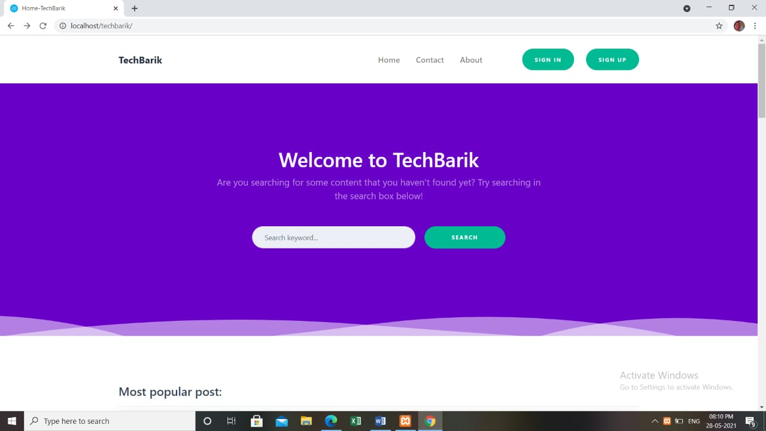
This is the interface of our website. We accessed our website by simply typing localhost/filename.
The first page of our website show options like sign in and sign out. Other than this, there are options like Home, Contact, and About.

Slide 20
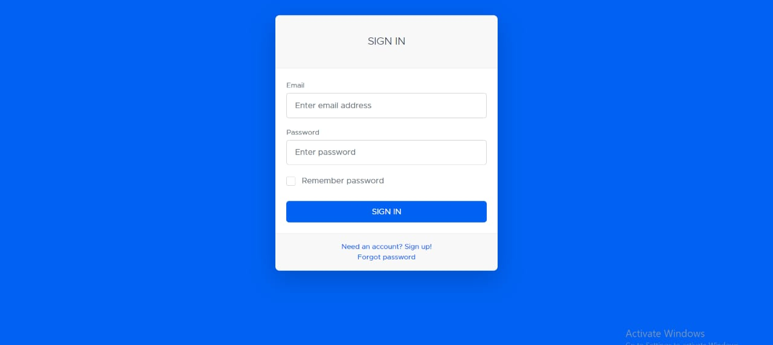
After signing in, a message is displayed which says that you have signed in successfully. Without signing in one can access the website . Sign in gives more accessibility to a user.
We also have Password Recovery option here which is available when someone has created an account.(incase they forget the password)
It takes some of the details and provides the feature to recover our password.

Slide 21
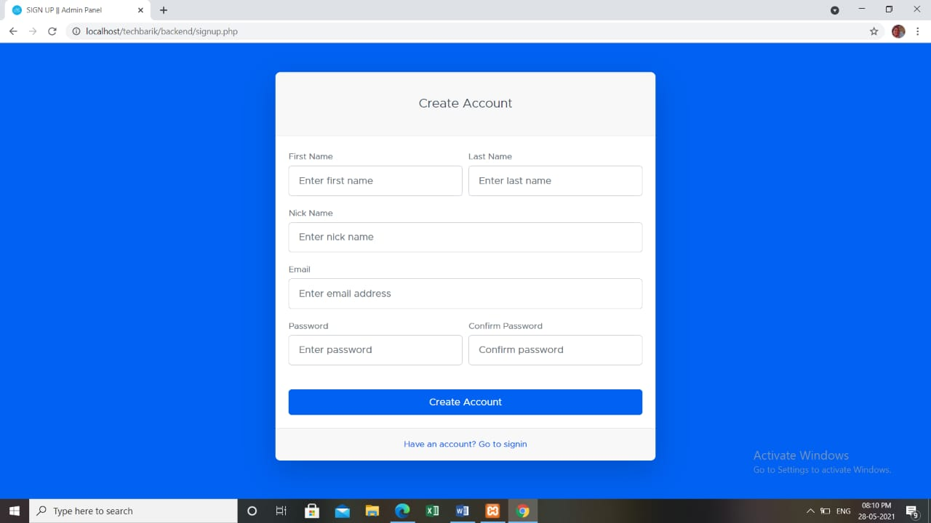
If someone is new to the website they can sign up i.e create an account. To make an account on the website details like first name, last name, nickname, email address password, and confirm password is asked . After account creation, a message gets displayed which says that our account has successfully created. Now, one can easily access the content of the website.

Slide 22
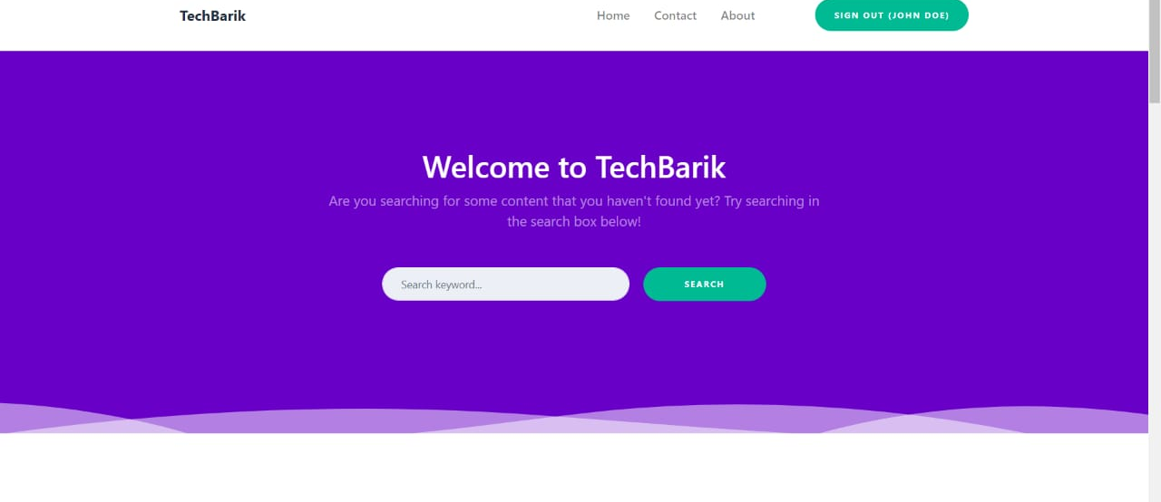
As we sign in to the website after accessing localhost/Techbarik , this interface is shown and on the left, it shows the username of the person who has signed in to the website.
There is a message displayed on the interface which says Welcome to Techbarik and then there is a feature when you can search the keyword on what you want to see in this website.
It is along with the Signout option. So when someone wants to sign out from the website they can click here.

Slide 23
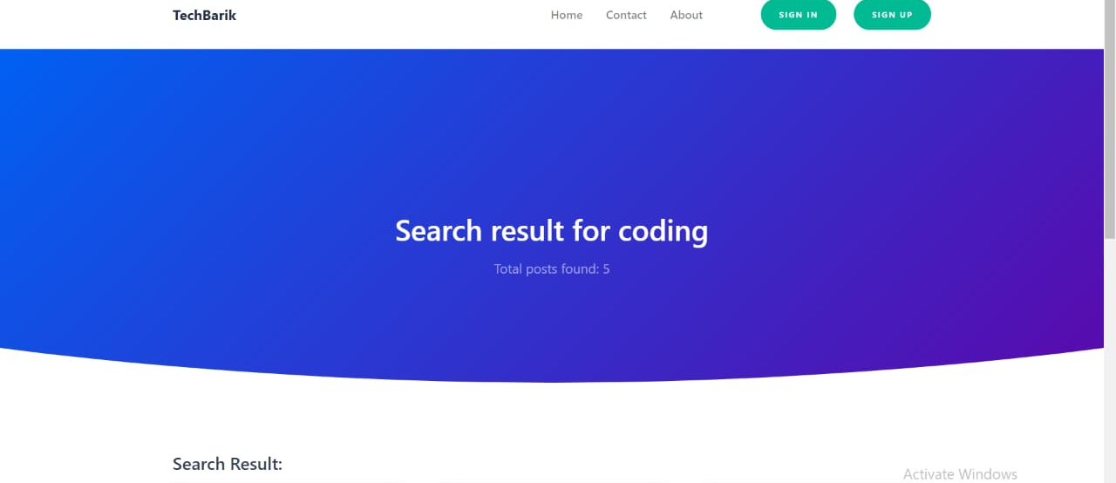
If the keyword matches with the existing posts then it shows results based on search criteria.

Slide 24
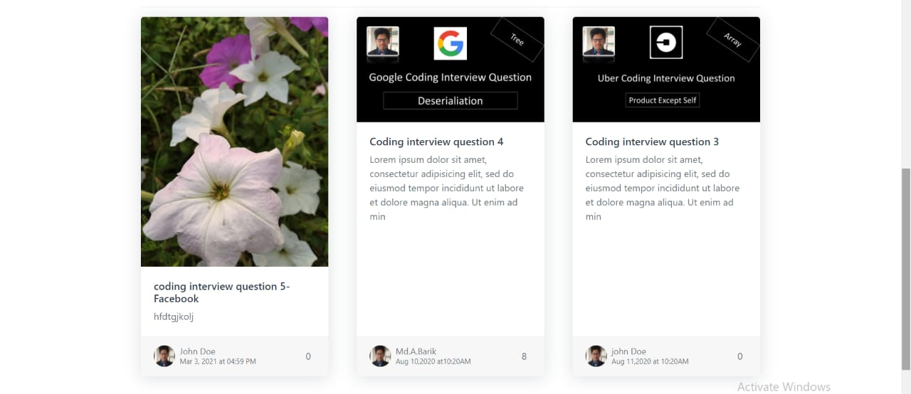
So, This is the pattern how our search result appears. We can navigate through the results by switching between the pages shown at the bottom .

Slide 25
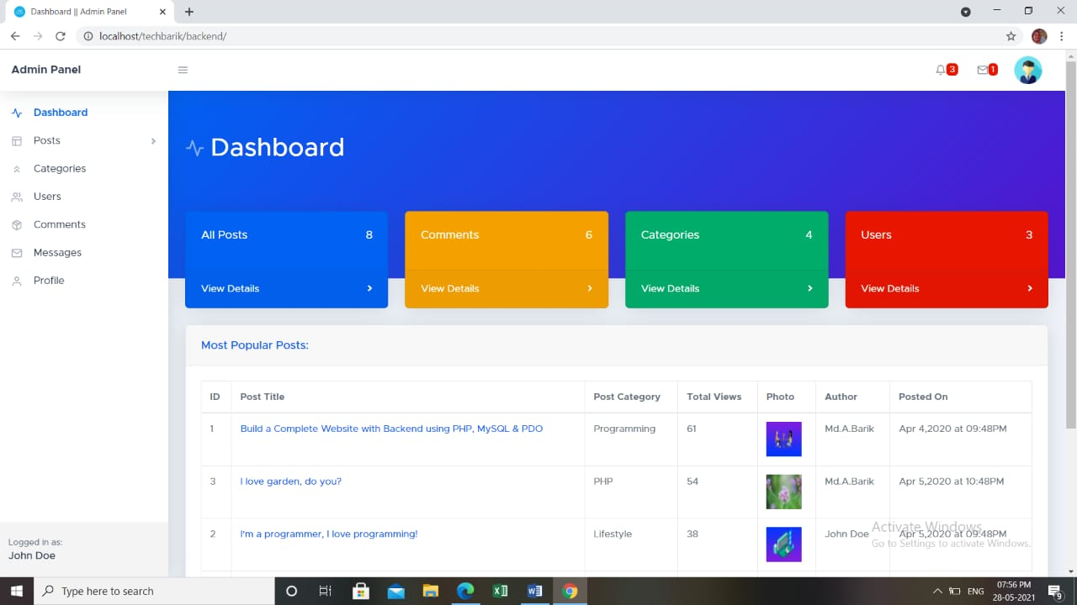
In the Backend of Website , Dashboard contains all the information including all posts , comments , categories and users . From backend admin can delete and update the information present on the website.

Slide 26
The user who has been given the permission of admin from database can access the backend of the website and to access it the user should be logged to the website. In the dashboard, all the details are there including Posts, Categories, Users, Comments, Messages, and Profiles.
The admin can access backend by typing localhost/filename/backend. After accessing it, admin can modify posts or category and can also send response to the messages of visitor.
Under the Post option, there are two sub-options.
The first one is All Posts and the second one is Create New Post. In the All posts section all the posts regardless of any category are shown with the post details. The post details are Title, status, Category Author, Image, Date, Details, Tags, Comments, Views, Edit and delete.
Then inside the create new post, we can create a new post of any particular category from backend. And for that we need to fill in the details like Post title, post status etc
In the category section, all the categories that we have created on the database are shown with the details like total posts inside that category, created by, status edit and delete.
In the category section ,all the categories that we have created on the database are shown with the details like total posts inside that category, created by, status edit and delete. Inside comment, all the comments will be displayed which we have till now with the user email, user name, comment, date, status, approve, disapprove and delete.

Slide 27
Thank You

