Slide 1

Currency Recognition
using Image Processing
Created by
Aanchal Chugh (111510001)
Smriti Singh (111508068)
Ameya Tammewar (111508069)
Under Guidance of
Mr. S. P. Gosavi

Slide 2

Problem Statement

Slide 3
Aim
The project provides a platform for recognition of currency of different countries using which a user can easily find exchanged rates.

Slide 4
Intended Audience
Banks
Financial Institutions
Currency Exchanges
Small shops and Departmental stores
Shopping malls

Slide 5
Literature Survey

Slide 6
Features
• Receiving webcam input from a user system
• Processing the input image to identify the country and denomination of the currency
• Required denomination exchange rate is determined using Forex rates at the instant

Slide 7
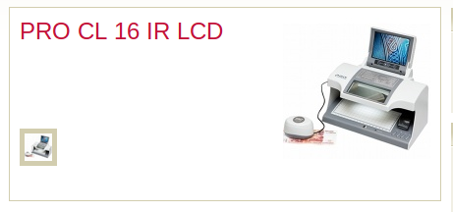
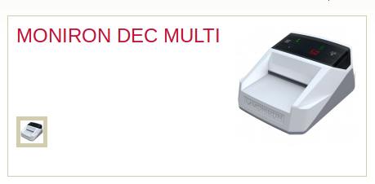
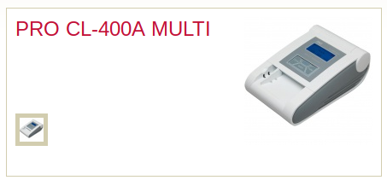
Problems with Existing Systems
portability
varying environments
not efficient and costly
Rs. 16,000
Rs. 13,000
Rs. 35,000

Slide 8
Solutions we provide
Input from webcam, portable
Increases usability
Invariant to different environments
Cheaper
User friendly

Slide 9
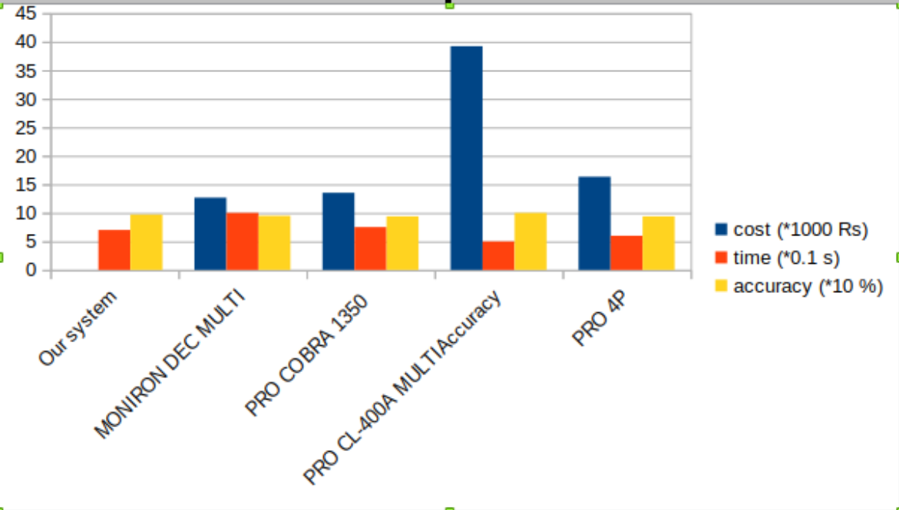
Comparison

Slide 10
Design Decisions

Slide 11
Forex-python
• Get historical rates for any day since 1999
• List of all currency rates
• Convert amount (10 USD to INR)
Tkinter
It is a python library used to create standard GUI.
Creating a GUI with Tkinter is very fast, easy and efficient

Slide 12
SIFT algorithm
For feature extraction, Scale Invariant Feature Transform (SIFT) is used.
It robustly identify objects
SIFT feature descriptor is invariant to uniform scaling, orientation, illumination changes, and partially invariant to affine distortion.

Slide 13
FLANN algorithm
Fast Library For Approximate Nearest Neighbour (FLANN) is used as matching algorithm for approximate nearest neighbor search.
FLANN found to be about one order of magnitude faster on many datasets (in query time), than previously available approximate nearest neighbor search software.

Slide 14
Implementation details

Slide 15
Steps
Step1 :Image Acquisition
Capturing the image of currency note using web-camera of a computer as a input for currency detection
Step2 :Feature Extraction
SIFT algorithm is used for keypoint detection and descriptor creation
1.keypoint
2.descriptor

Slide 16
Steps
Step3 :Matching Algorithm
FLANN is used as matching algorithm. Features extracted from input image is matched with database images.

Slide 17
Future Scope

Slide 18
Future Scope
To automate the dataset as countries print new notes
Fake currency detection
Android application to improve usability of this system
Link the system to cloud to store the data and for faster computation

Slide 19
Thank You

