Slide 1

ENPM 809B
BUILDING A MANUFACTURING ROBOT SOFTWARE SYSTEM
Final Project - Group 1
Abhiram Dapke Prasanna Balasubramanian
Smriti Gupta Piyushkumar Bhuva
Niket Shah
ENPM - 809B

Slide 2
Objective
The Main Objective was to read and complete the orders and partly build the manufacturing unit and kit in Gazebo simulated environment.
Based on the instructions set we had to provide parts to the system to implement the operation within the stipulated time and meet criteria.
The flow of information was chosen using the architecture built in our case hybrid architecture.
Parts including Gasket, Piston rod, Gear, Pulley and Disk were used for kit building and the count and pose/orientation for these parts are obtained from the order configuration file.
ENPM - 809B

Slide 3
Tasks
Sensor and camera setup
Pick and place operation
Kit building
In-order process update
Part handling:
Faulty Parts
Dropped Parts
Flip Parts
ENPM - 809B

Slide 4
Approach
For the final project, we followed a simple strategy of divide and conquer.
Enhancing efficiency by means of task decomposition.
For an instance, we first implemented how to get sensors reading(Like detecting parts and their positions in relatives frames and world frame using logical camera)
Then we implemented pick and place operation where we have picked up required parts from conveyer belt and putting into AGV.
Then we implemented a solution to detect faulty parts and how to deal with them followed by drop part and flip part handling process.
Thus, we have followed and implemented few simple tasks in order to create bigger picture.
ENPM - 809B

Slide 5
What we learnt from this course and the project?
ROS Core Concepts:
- Interface, messages, topics, launching files
Ariac implementation:
- Configure the environment, sensors and cameras
Real time industrial manufacturing
Motion/Configuration Planning - RRTs,PDDL methodologies
OOPS based code development :
- Abstraction, Encapsulation, Classes, Objects, Polymorphism
ENPM - 809B

Slide 6
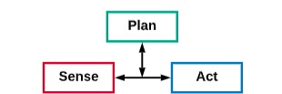
Architecture and why this architecture?
It's super important to chose the information flow types in robotics systems and for such complicated tasks.
So, among multiple choices we chose hybrid architecture to build our systems.
To make this decisions we have considered multiple factors which ease up the process of building kits.
Reactive architecture essentially lack the planning step for any task and since we are continuously dealing with planning for various parts and that is why it does not offer intelligent decision making.
And on the other hand, hierarchical planning is difficult to deal with because it does not break the flow of information which is not suitable for application.
For an instance hierarchical planning fails when we have to make decisions in process update part of the project.
Hybrid structure in fact offers co-ordination of all essential steps like sense, plan and act.
ENPM - 809B

Slide 7
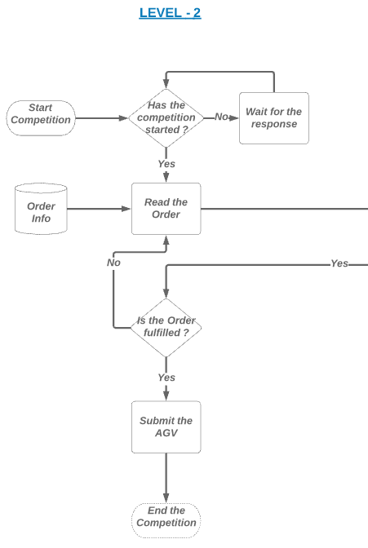
Architecture Upper Level - (Level 2)
Hybrid architecture is divided into 3 levels based on their interaction with hardware and overall process.
This is called upper most level because of its minimal level of interaction unto system.
The competition starts and ends in this level and final check whether order is fulfilled or not is also checked.
ENPM - 809B

Slide 8
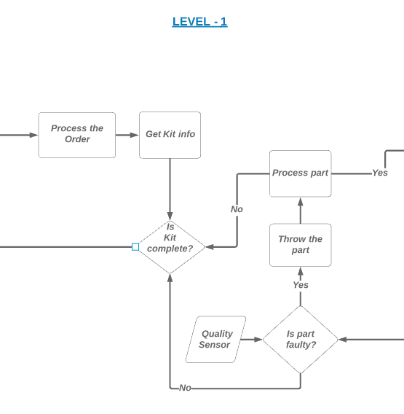
Intermediate Level - (Level 1)
This level is called dissociative level because order is disintegrated into small parts and we verify whether the part is faulty or not and again check for kit completion.
Also, this is the only level which interacts with both the levels of architectures and the disintegrated information is fed to lowermost level(level 0) and if the kit is built the signal is sent to upper level.
ENPM - 809B

Slide 9
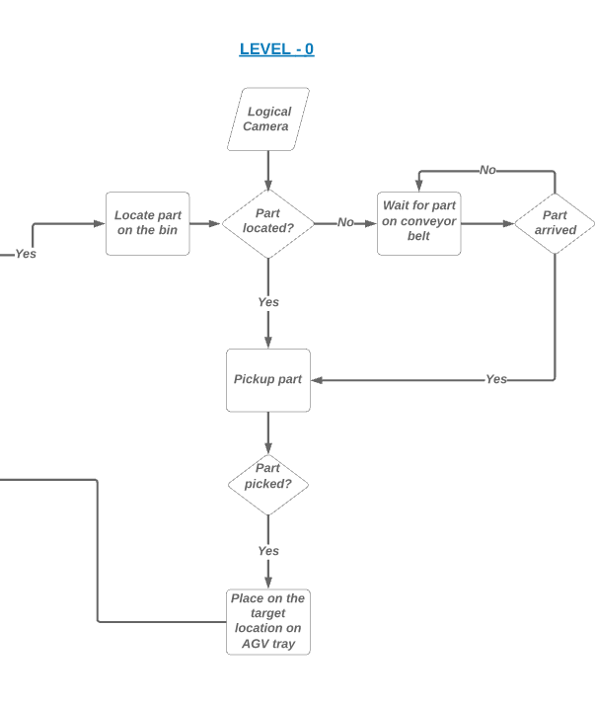
Lower Level - (Level 0 )
This is the architecture where most of the hardware interaction takes place and this is relatively difficult part to execute and hard to achieve perfection.
Here, we read which parts are required and we detect them using logical sensors and then perform pick and place operation and check health of parts using logical sensors.
ENPM - 809B

Slide 10
Technical Implementation
Sensor setup (Logical and Quality):
There are totally nine Logical cameras that we used in this project to identify and locate the parts in the order. Each storage bin is mounted with a Logical Camera at the top and totally there are six cameras over the bins.
There is one camera mounted above the Conveyor Belt to detect the presence of the type of the part on the moving conveyor belt.
Two more logical cameras are mounted with a skew angle on the top of the AGV tray to detect the type and position of parts that are dropped by the robot arms on the tray during Part drop function.
ENPM - 809B

Slide 11
Order handling :
The Order list is read and checked for the parts that are not available on the bin and whichever part is not available on the bin will be picked first from the conveyor using both the arms based on the number of shipments.
The parts that are picked from the conveyor are dropped exactly on the correct drop pose at the AGV tray and it is followed by picking and dropping of other parts in the order list in sequence.
Robot Control :
The robot’s home position is initially set to face the conveyor to pick up the parts from the conveyor first.
After the pick and place of belt parts, robots are set to a new home position facing the bin. The robot arms will pick and place the parts according to the order sequence.
The robots movements are programmed to coordinate in such a way that it won’t clash against each other.
The mid-point on the rail is chosen for exchanging the parts picked by each arm to drop in the opposite AGV tray.
ENPM - 809B

Slide 12
Project Demo:
The kit was built on both the AGV trays using the parts mentioned in the shipment Order list. The AGVs were submitted for delivery once the order was completed.
The video of the project execution can be found in the below mentioned drive link.
Group1_Final_Project_Demo
ENPM - 809B

Slide 13
Building a whole kit
The aim of this project was to build a whole kit using an order having two shipments, each consisting of 5 products. There were two AGVs involved in this task.
We had a sensor blackout of 50 seconds but it didn’t affect our operation since the pose and orientation of all the parts are obtained at the beginning of the competition.
The shipments consisted of the following parts that were fulfilled:
gasket_part
piston_rod_part
gear_part
pulley_part
Disk_part
There were two faulty parts namely, a gasket_part_3 and a gear_part_3. We were successfully able to pick up the parts from the conveyor, handle them by using both the robot arms and deliver the products on the respective AGV.
ENPM - 809B

Slide 14
PART HANDLING
Part Flipping
In order to meet order requirements, we also have to consider orientation of the different parts and in order to do so we have to flip the parts as mentioned in the order update.
To flip a part, let's assume a disk part, we first pick the part from the bin and place it vertically on the bin.
The next step is to slightly push the disk from the opposite side of the disk so that when it falls on the ground, it is flipped.
Now, as the task of flipping is accomplished, we can simply pick up the part by using the robot arm and place it wherever desired.
ENPM - 809B

Slide 15
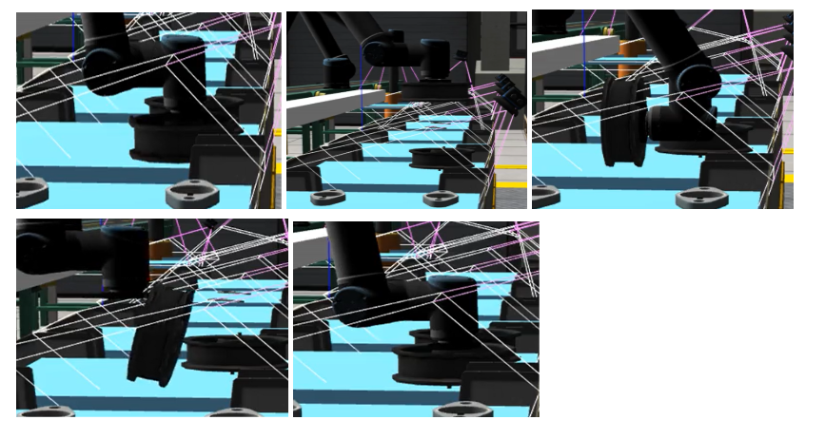
PART HANDLING
Part Flipping
ENPM - 809B

Slide 16
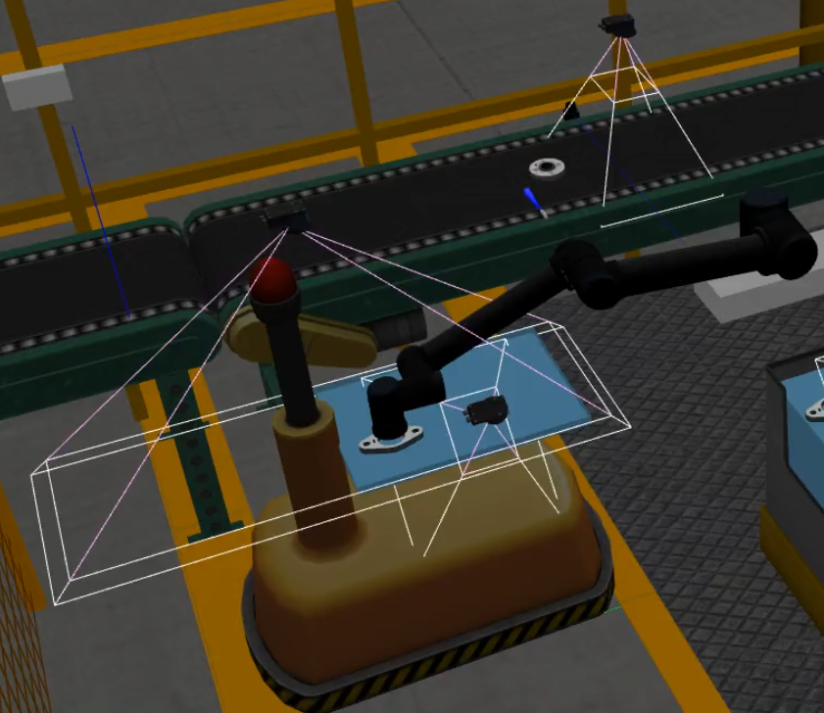
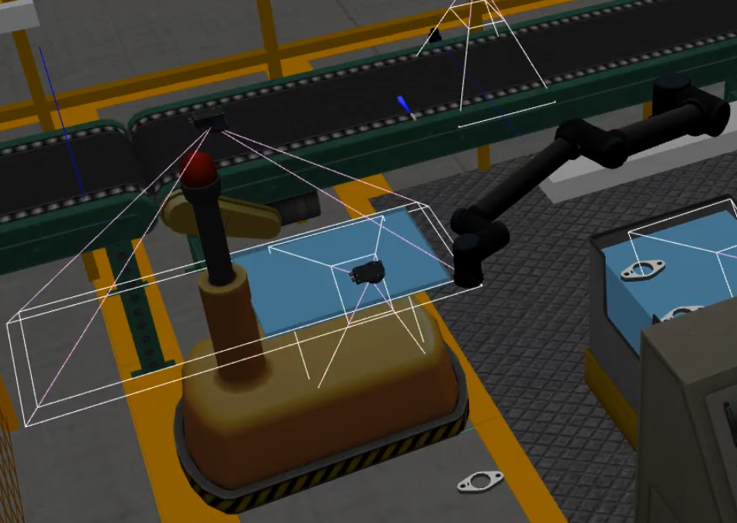
Faulty Part Handling
Few of the parts in the environment were tagged faulty and our task was to make sure none of them ended up on the AGV tray.
Once the pick and place operation is complete, the part in the AGV is checked by a quality sensor which is mounted on the top of the AGV to detect faulty parts.
If the part turns out to be faulty, then the robot arm picks up the faulty part from the AGV discards it.
ENPM - 809B

Slide 17
In-Process Update
In this, we would receive an order update and we need to modify the parts on the AGV tray accordingly.
We maintained a list of products(part type+part pose) we already fulfilled and placed a logical camera overlooking the AGV tray.
We compared the list of products the camera sees against the fulfilled products and act according to the steps below:
We first put all the existing parts and their positions in a queue.
We pop one product and check if it is required or not. If not, we discard it.
If it is required, we check the new pose of the product, if unchanged we move on.
If it is changed, we check if the new pose is occupied or not. If not, we pick up the part from that location and place.
If occupied, we place the part at a temporary pose and push that to the queue. And move on to the next product and repeat the above.
Once the queue is empty, we fulfill the products that were not present in the previous order.
ENPM - 809B

Slide 18
Drop part Handling
This challenge would force the arm drop the part on the wrong pose in the AGV tray.
We check the gripper state just before placing the part on the tray and if the part was accidently dropped earlier than desired, we invoke a function to determine the position of the dropped part.
We compare the list of fulfilled products with the list of products seen by the camera over the tray and determine the position of the dropped part.
Later the arm will simply pick up the part from the dropped position and place is at the desired pose.
ENPM - 809B

Slide 19
Challenges faced
In our initial approach, the arm moved around a lot and hit a lot of objects and always followed a random trajectory. To avoid this, we started giving joint states as goal position to the arm.
When handling the shipment order parts, we processed the conveyor belt parts first in order to not miss the moving parts in the belt as we can’t pick them up once they all ran off in the belt.
While performing part exchange there were chances for both the robots to collide with each other, hence we chose an exchange pose and followed steps of dropping the part by one arm on the exchange pose position and picking up by the other arm from the same exchange pose position.
ENPM - 809B

Slide 20
When dropping the parts on the AGV tray, there are some parts that drop beforehand. We were not able to drop them in their expected droppose in the first attempt. Hence we picked them again and dropped them in their respective poses in the tray with the help of the position value obtained from the logical camera mounted on the tray.
The in-order process update was difficult to implement since we had to efficiently take care of the already processed parts and the newer order. If the part on the tray has to be placed on a new position, and that position is already occupied, we have to devise our algorithm in such a way that it is taken care of without a lot of time-delay.
We could not tackle the challenge if Sensor Blackout is triggered along with in-process order update or Drop part because we need to determine the pose of the products real-time.
ENPM - 809B

Slide 21
Conclusion
We successfully accomplished the following:
Placing sensors and cameras on the bins and reading their values.
Pick and place parts in the order from the moving conveyor belt into the AGV.
Building the whole kit.
Anticipating and updating an order.
Detect and discard the faulty products using the quality sensors.
Flip a disk part by using a single robot arm in the bin.
In this project, our aim was to control the robot arms in the Ariac environment in such a way that we will be able to accomplish the tasks to fulfill the orders and build the kits with the help of these two robot arms and we were able to accomplish it and successfully deliver the products.
ENPM - 809B

Slide 22
Future Improvements
The system performed slower than expected, so changes can be made there. First one
would be to try and implement different planners instead of just RRTConnect.
Implement multi-threading on the arms so that they both work simultaneously.
Use a higher level planner to dictate and prioritize tasks to the two arms.
Waiting time can be utilized by optimizing the process of conveyor belt pickup and completing the rest of the order while waiting for the parts on the belt.
ENPM - 809B

Slide 23
Individual Contributions:
Abhiram: Worked on streamlining the code for pick and place operation, contributed in building the architecture and
created major part of the report and the presentation.
Piyush: Worked on building architecture, placing sensors and bins to detect pose of the parts and edited sensors yaml
files which will allow sensors function work properly and helped streamlining and debugging C++ code.
Prasanna: Worked on implementing the program for order handling and pick and place of parts from the conveyor belt.
Generalized the code for unexpected part changes in the test config file and also contributed towards the
building of the architecture of the project.
Niket: Worked on the implementation of pick and place operation, part exchange between the arms, part flipping,
faulty part detection, drop part detection, in-order process update implementation and designing of the
architecture.
Smriti: Worked on building architecture and the system flow, building pipelines for each task and implementing them in code and
documented the process simultaneously .
ENPM - 809B

Slide 24
References
ROS Concepts - A Gentle Introduction to ROS
C++ Programming book - https://books.goalkicker.com/CPlusPlusBook/
Ariac Tutorials - http://wiki.ros.org/ariac/Tutorials/SystemSetup
ROS & Ariac - Lecture Slides
Object Oriented Programming concepts-https://beginnersbook.com/2017/08/cpp-oops-concepts/
ENPM - 809B

Slide 25

Thank You
Group Members:
Piyushkumar Bhuva
Abhiram Dapke
Prasanna Balasubramanian
Smriti Gupta
Niket Shah
Instructors:
Zeid Kootbally
Craig Schlenoff
ENPM - 809B

